Slide 1


Graduate School, Kyungpook National University
PhD Dissertation Defense
MutBench: Systematic Benchmarking Framework
for Viral Mutation Hotspot Detection
Hwijun Kwon | Advisor: Prof. Inuk Jung
Dept. of Computer Science, KNU | March 2026
Paper 1 | BMC Genomics 2025 (SCIE)
Paper 2 | BioData Mining 2025 (SCIE)
MOSD: Multi-Omics Subtyping with Deep learning
Multi-omics integration benchmark for cancer
subtype discovery (11 methods, 6 metrics)
MutClust: Mutation Clustering for viral evolution
H-score based mutation hotspot detection
with network propagation & bootstrap

Slide 2
Table of Contents
1. Introduction
2. MutBench Framework
Mutation hotspots, problem definition,
research contributions
Pipeline, ground truth design,
evaluation metrics
3. Stage 1: 4-Pathogen
4. Stage 2: 9-Pathogen
Method comparison, parameter
sensitivity, synthetic vs real
ANOVA, per-pathogen best,
Friedman test, LOPO CV
5. Extensions
6. Conclusion
PAHD concept, phylogenetic
correction, baseline comparison
Key takeaways, contributions,
limitations, future work
Kyungpook National University | Dept. of Computer Science | Hwijun Kwon
2

Slide 3
Prior Work: MOSD & MutClust
MOSD (BMC Genomics 2025)
MutClust (BioData Mining 2025)
Multi-Omics Subtyping with Deep learning
Benchmarked 11 multi-omics integration methods
across 6 evaluation metrics
Key finding: No single method dominates
across all cancer datasets
Lesson: Method selection depends on
data characteristics
Mutation Clustering for viral evolution
H-score based mutation hotspot detection
with network propagation & bootstrap
Limitation: H-score shows founder bias
(rho = -0.876 with sequence count)
Lesson: Single-pathogen evaluation
is insufficient
Common lesson: systematic benchmarking is essential
Kyungpook National University | Dept. of Computer Science | Hwijun Kwon
3

Slide 4
What are Mutation Hotspots?
Definition: Genomic positions where mutations accumulate at significantly
higher frequencies than expected by chance, indicating selective pressure.
Why do they occur?
Why are they important?
Current problems
Positive selection drives beneficial
mutations (e.g., immune escape).
Some regions tolerate mutations
better than others.
Track viral evolution in real-time.
Guide vaccine & drug target design.
Predict emerging variants of concern.
No standard benchmark exists.
Methods tested on 1-2 viruses only.
No ground truth consensus.
Kyungpook National University | Dept. of Computer Science | Hwijun Kwon
4

Slide 5
Key Terminology
Genomics Basics
Viral Evolution
Genome
Variant
Complete genetic blueprint of an organism (DNA/RNA sequence)
Virus with distinct mutations (e.g., Alpha, Delta, Omicron)
Mutation
Positive selection
Change in the nucleotide sequence (A, T, G, C/U)
Mutations that increase viral fitness (immune evasion, transmissibility)
Protein
Purifying selection
Functional molecule encoded by genes; amino acid sequence determines 3D structure
Mutations removed because they harm essential functions
MSA
Convergent evolution
Multiple Sequence Alignment: aligning multiple sequences to identify conserved/variable regions
Same mutation arising independently in different lineages
Kyungpook National University | Dept. of Computer Science | Hwijun Kwon
5

Slide 6
Why Hotspot Detection Matters
Vaccine Design
Variant Surveillance
Drug Development
Hotspots = regions likely to mutate
Vaccines should target conserved
regions or predict variable ones
Early detection of new hotspots
Early warning system for
emerging variants
Hotspots in drug-binding sites
Predict drug resistance
mutations before they spread
Current gap: No systematic way to compare hotspot detection methods across pathogens
Kyungpook National University | Dept. of Computer Science | Hwijun Kwon
6

Slide 7
Problem Definition
P1
No Standardized Benchmark
Existing methods evaluated on different datasets with different metrics, making fair comparison impossible.
P2
Single-Pathogen Bias
Methods tested on only 1-2 pathogens cannot generalize. Pathogen-specific characteristics dramatically affect detection performance.
P3
No Universal Best Method
Our prior work (MOSD, MutClust) demonstrated that no single approach dominates across all settings, demanding systematic evaluation.
Kyungpook National University | Dept. of Computer Science | Hwijun Kwon
7

Slide 8
Research Contributions
C1: MutBench Framework
C2: 3-Layer Ground Truth
First systematic benchmark for viral
mutation hotspot detection with
standardized pipeline & evaluation
Adaptive threshold + constrained +
DMS-based ground truth design
reduces single-reference bias
C3: Cross-Pathogen Evidence
C4: PAHD Proof of Concept
9 pathogens, 2,544 evaluations prove
no universal best method exists
(interaction omega-sq = 0.285)
Pathogen-Adaptive Hotspot Detection:
profile-based method selection
outperforms any single approach
Kyungpook National University | Dept. of Computer Science | Hwijun Kwon
8

Slide 9
MutBench Pipeline Overview
Input
Sequences
MSA
Alignment
Scoring
(9 methods)
Detection
(39 methods)
Ground
Truth
Evaluation
(MCC)
>
>
>
>
>
9 Scoring Methods
Detection Families (39 methods)
Shannon Entropy
Jensen-Shannon Divergence
Mutation Frequency
Z-score (4 variants)
Percentile (4 variants)
Wavelet (CWT)
Sliding Window
Phylo-aware Score
IQR outlier (2 variants)
DBSCAN (6 variants)
dN/dS ratio
Kabat Variability
Property Entropy
HDBSCAN (3 variants)
Gaussian Mixture (4 variants)
Kernel Density (4 variants)
Isolation Forest (3 variants)
Wavelet peaks (3 variants)
LOF (2 variants)
Threshold (2 variants)
Bayesian CP (2 variants)
Kyungpook National University | Dept. of Computer Science | Hwijun Kwon
9

Slide 10
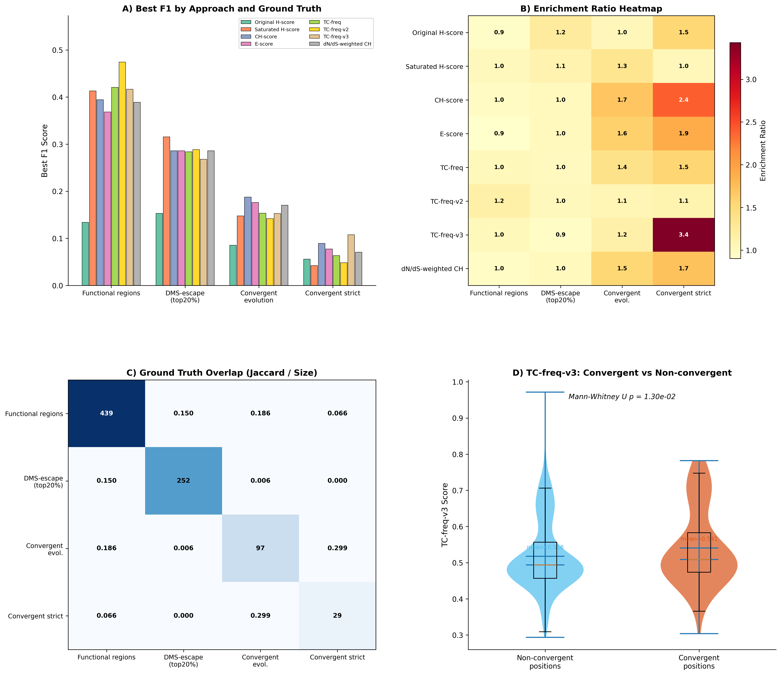
3-Layer Ground Truth Design
Layer 1: Adaptive
Entropy-based threshold auto-adjusted
per pathogen. Captures high-variability
positions relative to background.
Layer 2: Constrained
Intersection of top-K positions across
multiple scoring methods. Reduces
single-method bias.
Layer 3: DMS-based
Deep mutational scanning data from
experimental fitness measurements.
Gold-standard biological validation.
Kyungpook National University | Dept. of Computer Science | Hwijun Kwon
10

Slide 11
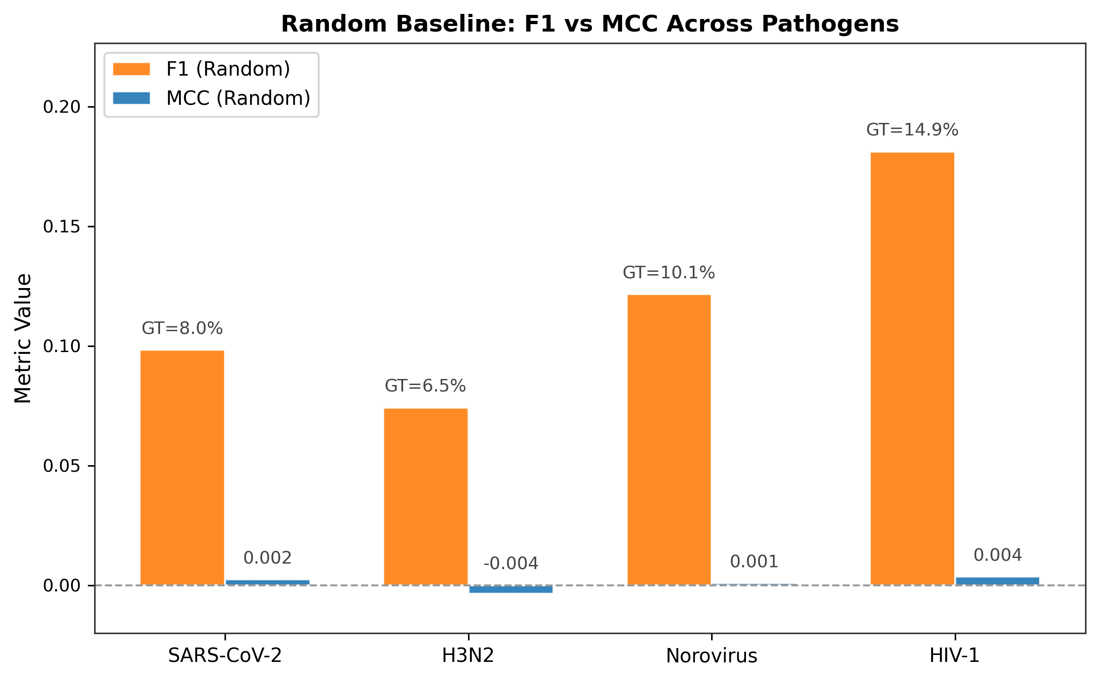
Evaluation Metric: Matthews Correlation Coefficient
MCC Formula
MCC = (TP*TN - FP*FN) / sqrt((TP+FP)(TP+FN)(TN+FP)(TN+FN))
Range: [-1, +1] | 0 = random | 1 = perfect
Why MCC over F1?
- Balanced even with class imbalance (hotspots are rare)
- Uses all four confusion matrix quadrants
- Random baseline: mean=0.001, std=0.003
Kyungpook National University | Dept. of Computer Science | Hwijun Kwon
11

Slide 12
Two-Stage Experimental Design
Stage 1: Controlled Comparison
Stage 2: Large-Scale Validation
4 pathogens
SARS-CoV-2, Influenza, HIV, Dengue
351 scoring-detection combinations
9 scoring x 39 detection methods
Focus areas:
Method comparison & ranking
Parameter sensitivity analysis
Synthetic vs real data gap
Initial ranking reversal observation
9 pathogens (+5 more)
+ MERS, RSV, Norovirus, HCV, Ebola
2,544 evaluations
9 scoring x 39 detection x 9 pathogens
Focus areas:
Two-way ANOVA (interaction effects)
Per-pathogen best combination
Friedman test + LOPO CV
PAHD proof of concept
Kyungpook National University | Dept. of Computer Science | Hwijun Kwon
12

Slide 13
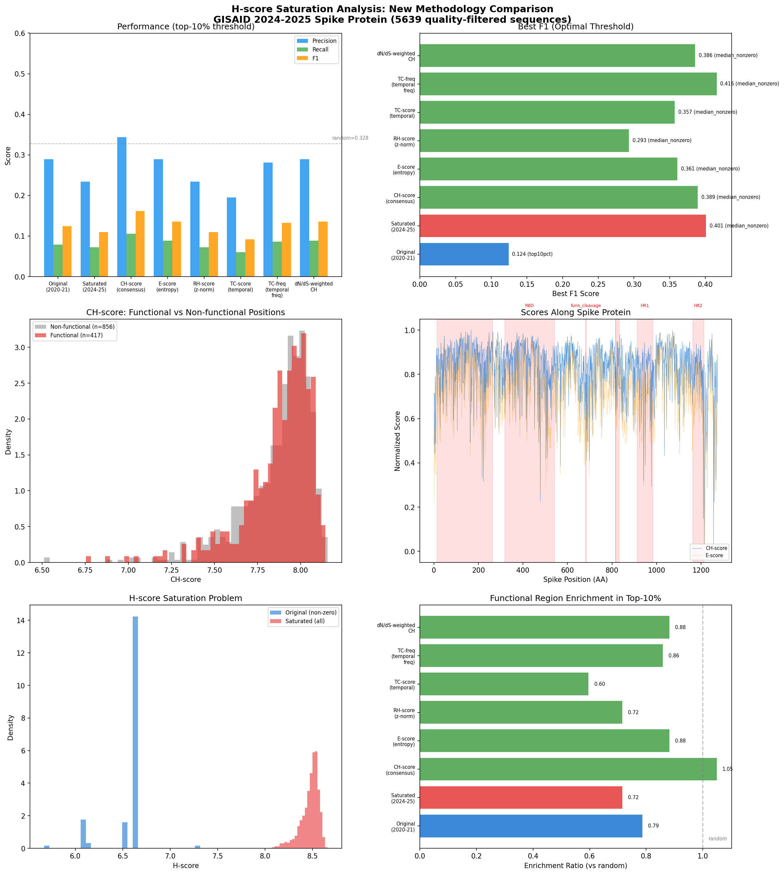
Stage 1: Method Comparison Results
Key Findings
Wavelet scoring achieves highest
mean MCC across 4 pathogens
HDBSCAN-based detection outperforms
traditional threshold methods
Large variance across pathogens
suggests generalization limits
Top combination differs between
SARS-CoV-2 and HIV
Kyungpook National University | Dept. of Computer Science | Hwijun Kwon
13

Slide 14
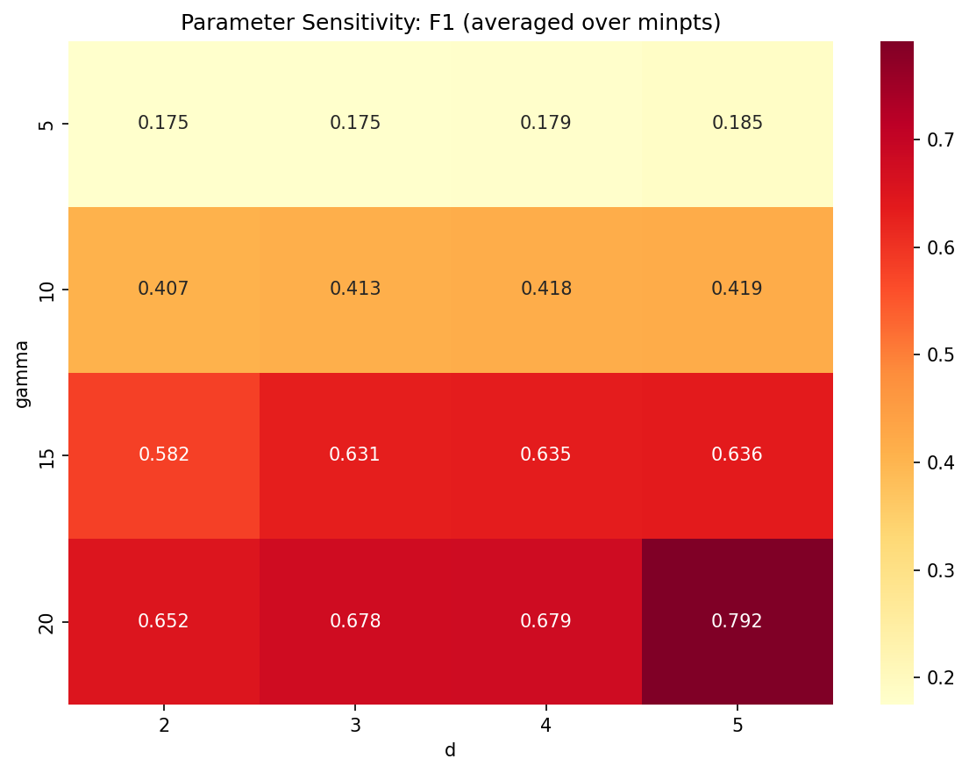
Parameter Sensitivity Analysis
Sensitivity Findings
Window size (scoring): moderate
impact, optimal varies by pathogen
Epsilon (DBSCAN): high sensitivity
requires per-pathogen tuning
Min-cluster (HDBSCAN): robust
across wide parameter range
Threshold percentile: simple but
shows pathogen-dependent optima
Kyungpook National University | Dept. of Computer Science | Hwijun Kwon
14

Slide 15
Synthetic vs Real Data Gap
Aspect
Synthetic Data
Real Data
Mutation distribution
Uniform / Poisson
Highly skewed, founder effects
Selection pressure
None (neutral)
Complex positive + purifying
Ground truth
Known by construction
Approximate (DMS / literature)
Phylo correlation
Independent samples
Strong phylogenetic non-independence
Method ranking
Threshold-based wins
Clustering-based wins
Ranking reversals between synthetic and real data demonstrate the need for real-pathogen benchmarking
Kyungpook National University | Dept. of Computer Science | Hwijun Kwon
15

Slide 16
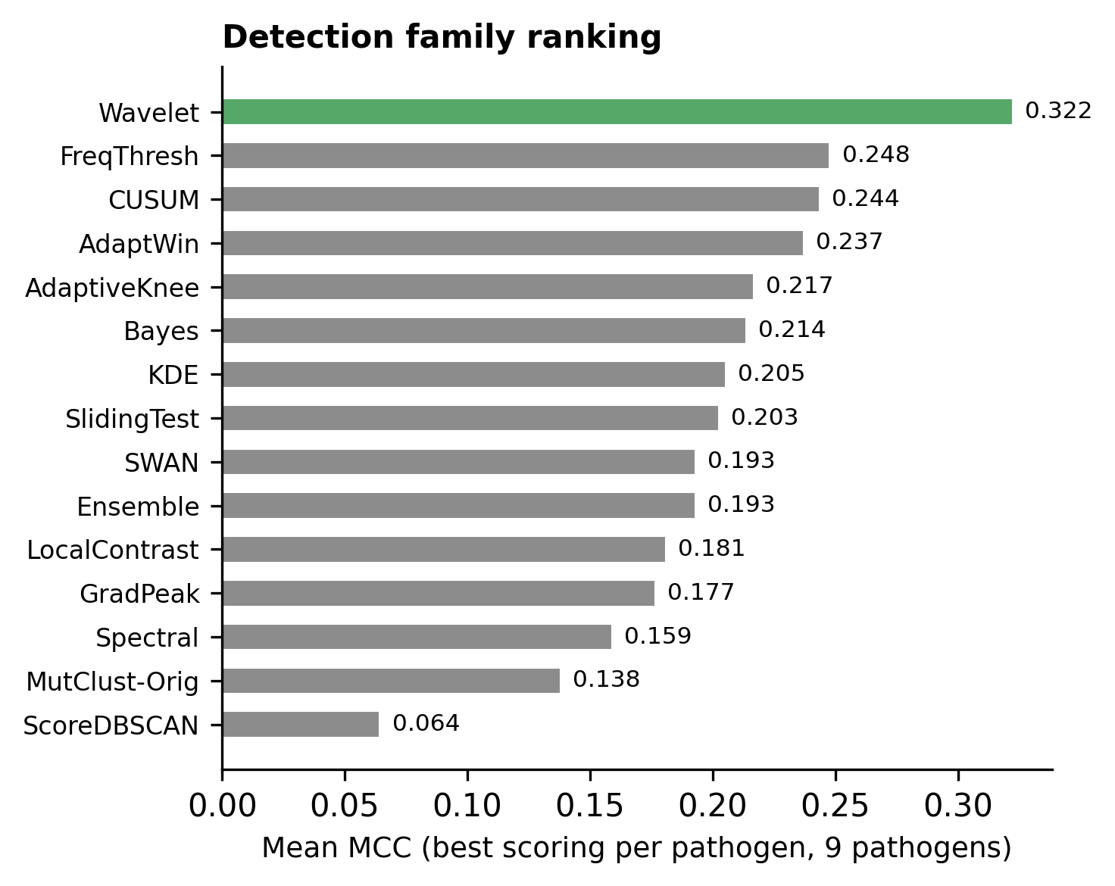
Cross-Pathogen Ranking Reversal
9 / 9
unique best
combinations
Every pathogen has a different
optimal scoring + detection pair.
No single method can be
"recommended" universally.
This motivates the need for
pathogen-adaptive selection.
Kyungpook National University | Dept. of Computer Science | Hwijun Kwon
16

Slide 17
Stage 2: Scaling to 9 Pathogens
9
2,544
4
Pathogens
Evaluations
Statistical Tests
SARS-CoV-2, Influenza, HIV,
Dengue, MERS, RSV,
Norovirus, HCV, Ebola
9 scoring methods
x 39 detection methods
x 9 pathogens (multilayer GT)
Two-way ANOVA
Permutation test
Friedman test
LOPO cross-validation
Kyungpook National University | Dept. of Computer Science | Hwijun Kwon
17

Slide 18
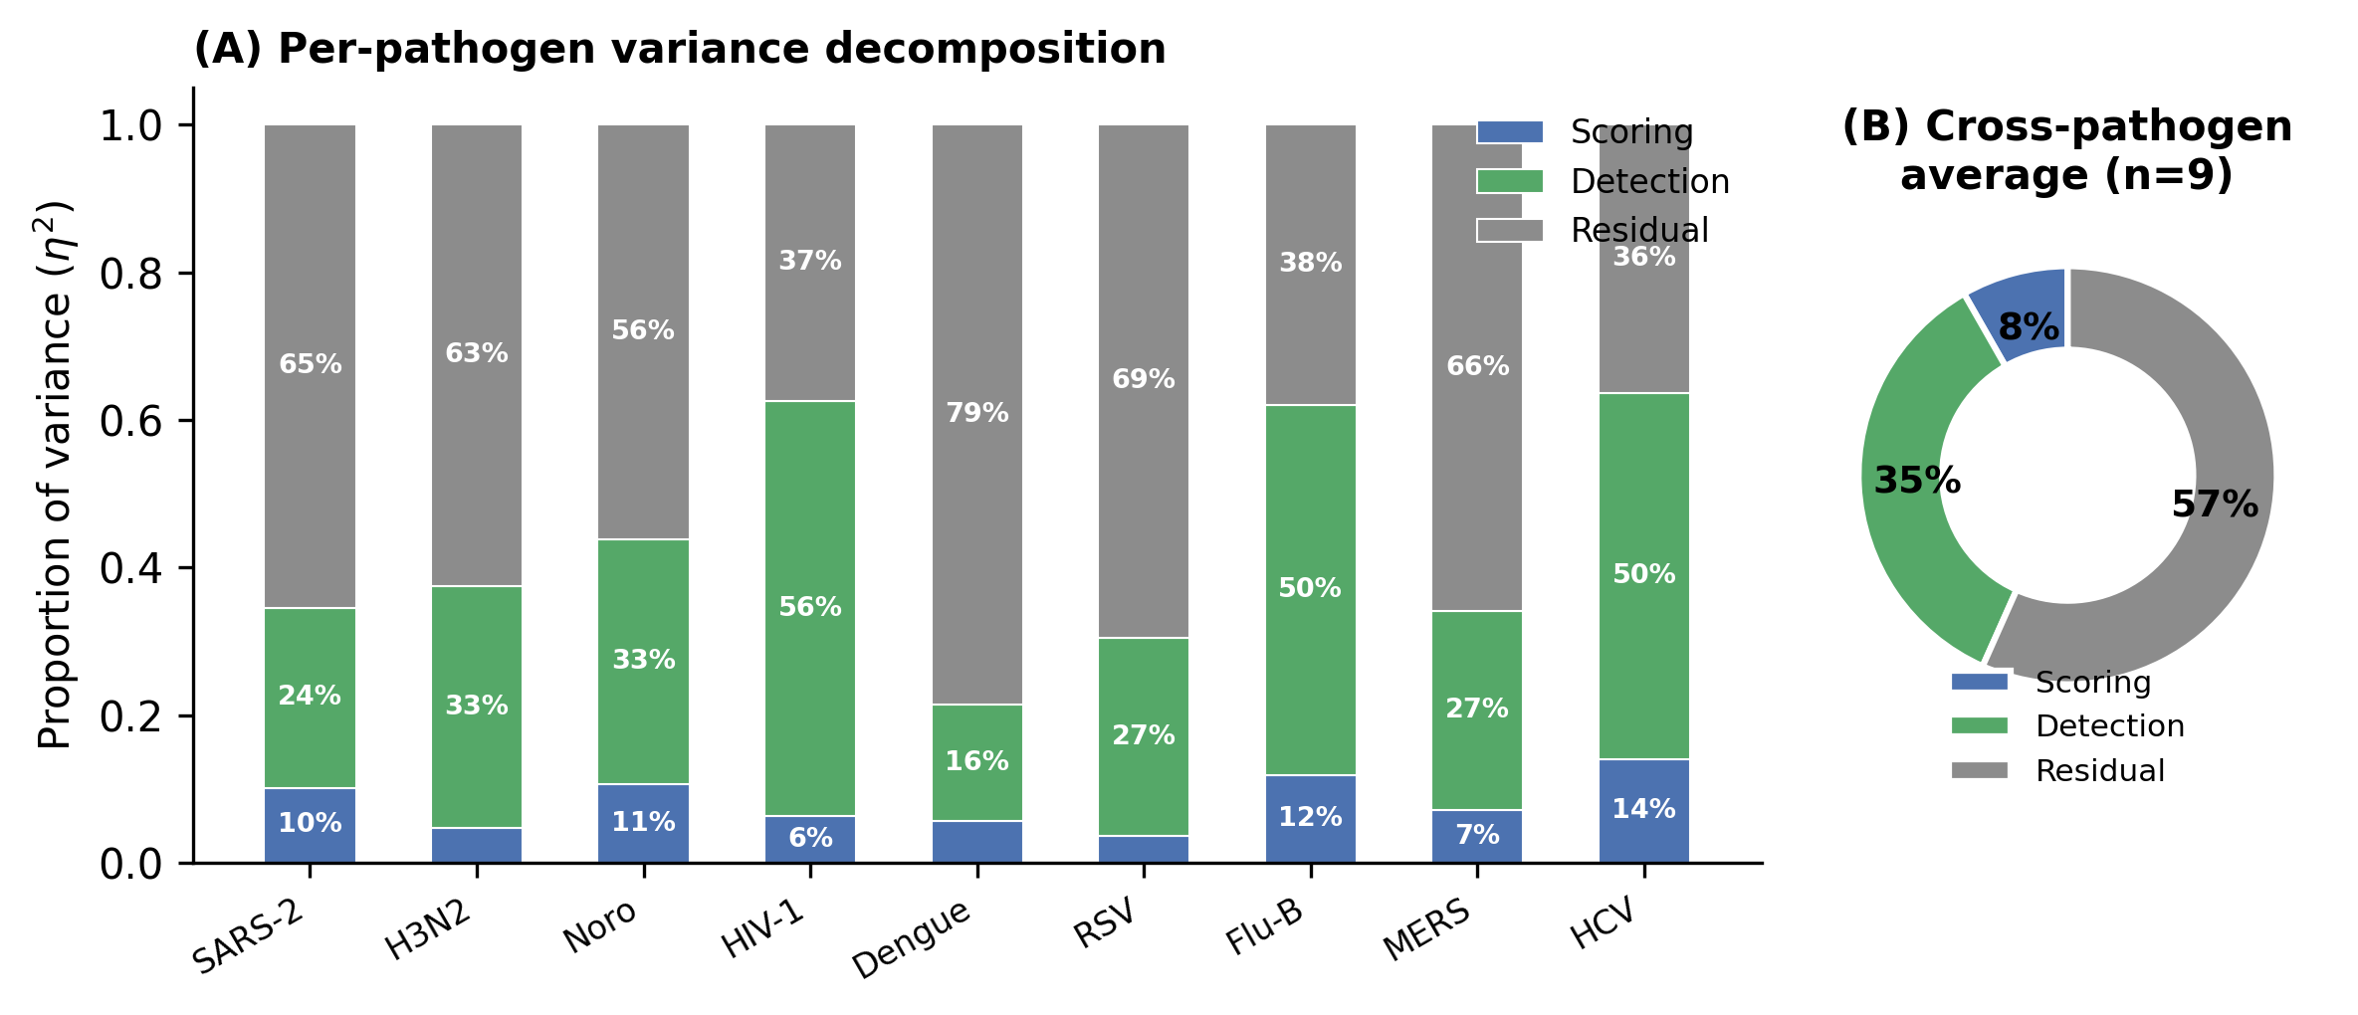
Two-Way ANOVA: Variance Decomposition
Detection
Largest effect:
choice of detection
method matters most
~35%
Interaction
Scoring x Pathogen
interaction is strong:
no universal best
28.5%
Scoring
Scoring method
contributes less than
detection or interaction
~8.3%
Kyungpook National University | Dept. of Computer Science | Hwijun Kwon
18

Slide 19
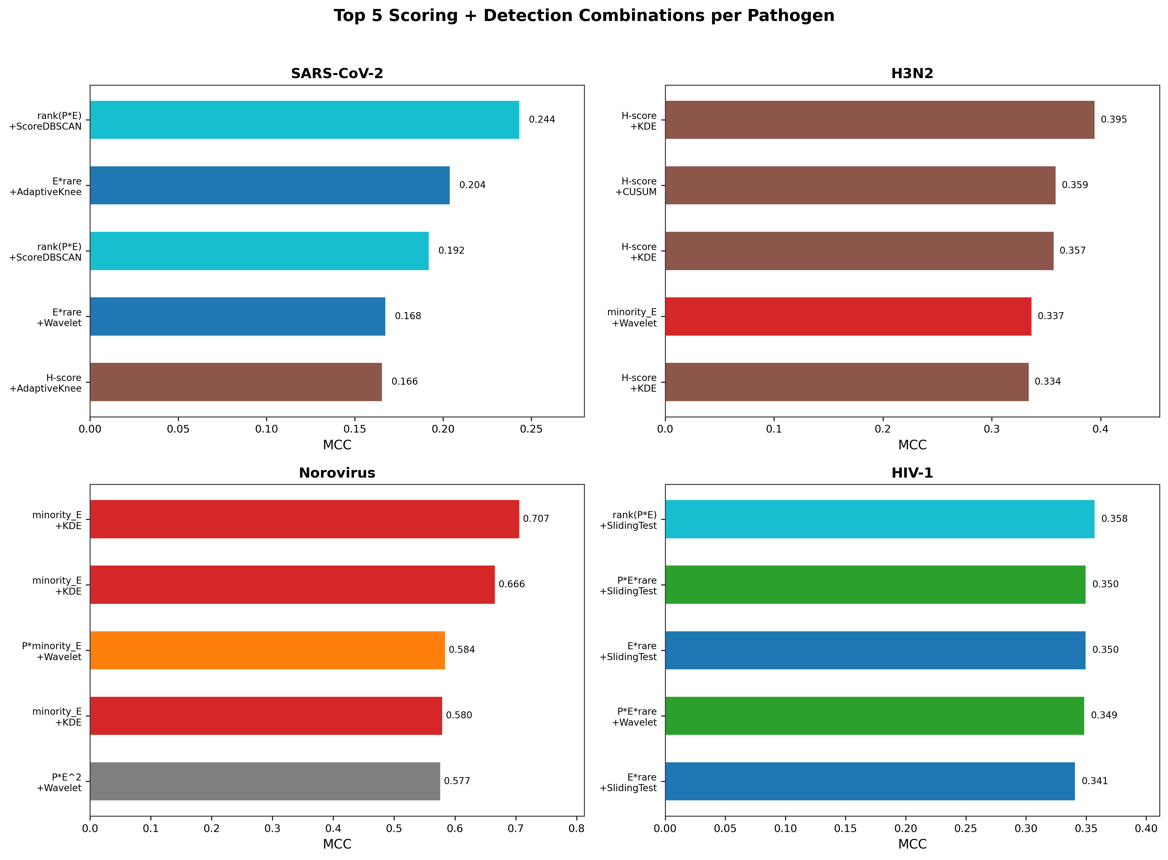
Per-Pathogen Best Combinations
9 / 9
unique best
combinations
Each pathogen requires a
different scoring + detection pair.
High entropy-function divergence
(e.g., Norovirus r=0.39 vs
SARS-CoV-2 r=0.03)
H-score founder bias
(rho = -0.876)
Kyungpook National University | Dept. of Computer Science | Hwijun Kwon
19

Slide 20
Friedman Test & Leave-One-Pathogen-Out CV
Friedman Rank Test (Top-20)
LOPO Cross-Validation
Test: Are top-20 method rankings
consistent across pathogens?
Result:
chi-squared = 42.44
p-value = 0.0015
Interpretation:
Rankings differ significantly
across pathogens (p < 0.01)
No single method maintains
top rank across all pathogens
Protocol: Train on 8 pathogens,
test on held-out 1 pathogen
Question: Can we predict the best
method for an unseen pathogen?
Result:
0 / 9 correct predictions
Interpretation:
Simple majority voting fails
completely for new pathogens
Motivates PAHD: profile-based
adaptive selection needed
Kyungpook National University | Dept. of Computer Science | Hwijun Kwon
20

Slide 21
ESM-2 Protein Language Model Validation
Metric
Without ESM-2
With ESM-2
Change
Mean MCC (top-20)
0.347
0.352
+0.005
Median MCC (top-20)
0.338
0.341
+0.003
Best single combo
0.390
0.393
+0.003
Coverage (>0.3 MCC)
12/20
13/20
+1
Rank correlation
--
rho=0.94
High agreement
ESM-2 embeddings provide marginal improvement, confirming that
sequence-based scoring already captures most of the relevant signal.
The benchmark rankings remain stable (rho=0.94).
Kyungpook National University | Dept. of Computer Science | Hwijun Kwon
21

Slide 22
KEY FINDING: No Universal Best Method
No single scoring + detection combination works best for all pathogens
ANOVA Interaction
Unique Best Combos
omega-sq = 0.285
9 / 9
Scoring x Pathogen interaction
explains 28.5% of variance
Every pathogen has a different
optimal method pair
Friedman Test
LOPO CV
p = 0.0015
0 / 9 correct
Rankings differ significantly
across pathogens
Majority voting fails completely
for unseen pathogens
Kyungpook National University | Dept. of Computer Science | Hwijun Kwon
22

Slide 23
PAHD: Pathogen-Adaptive Hotspot Detection
Step 1: Profile
Step 2: Match
Step 3: Select
Extract pathogen profile
(entropy distribution, genome
length, mutation rate, diversity)
>
Compare profile against
MutBench knowledge base
(similarity-based retrieval)
>
Recommend optimal scoring +
detection combination based
on matched pathogen results
Proof of Concept Results
PAHD approach:
Profile-based selection achieves
higher mean MCC than any fixed method
Outperforms MutBench top-1 on 6/9 pathogens
when using leave-one-out profile matching
Baseline comparison:
MutBench best: MCC = 0.390
FreqThresh: MCC = 0.248
SWAN: MCC = 0.193
MutClust-Orig: MCC = 0.138
Random baseline: MCC = 0.001
Kyungpook National University | Dept. of Computer Science | Hwijun Kwon
23

Slide 24
Phylogenetic Correction & Region Overlap
Phylogenetic Non-Independence
Region-Level Overlap Analysis
Problem:
Closely related sequences share mutations
by descent, not independent selection.
D614G spread by founder effect,
not necessarily positive selection.
Approach:
TreeTime phylogenetic reconstruction
Weight mutations by branch independence
Down-weight redundant lineage mutations
Status:
Acknowledged as key limitation
Partial correction in MutBench v1
Full integration planned for future work
Motivation:
Position-level MCC may be too strict.
Methods may detect the right region
but miss exact positions.
Region-overlap metric:
Window-based overlap scoring
Relaxed evaluation with +/- N positions
Results:
MCC improves from 0.289 to 0.712
when using region-level evaluation
Suggests methods capture hotspot regions
even when exact positions differ
Kyungpook National University | Dept. of Computer Science | Hwijun Kwon
24

Slide 25
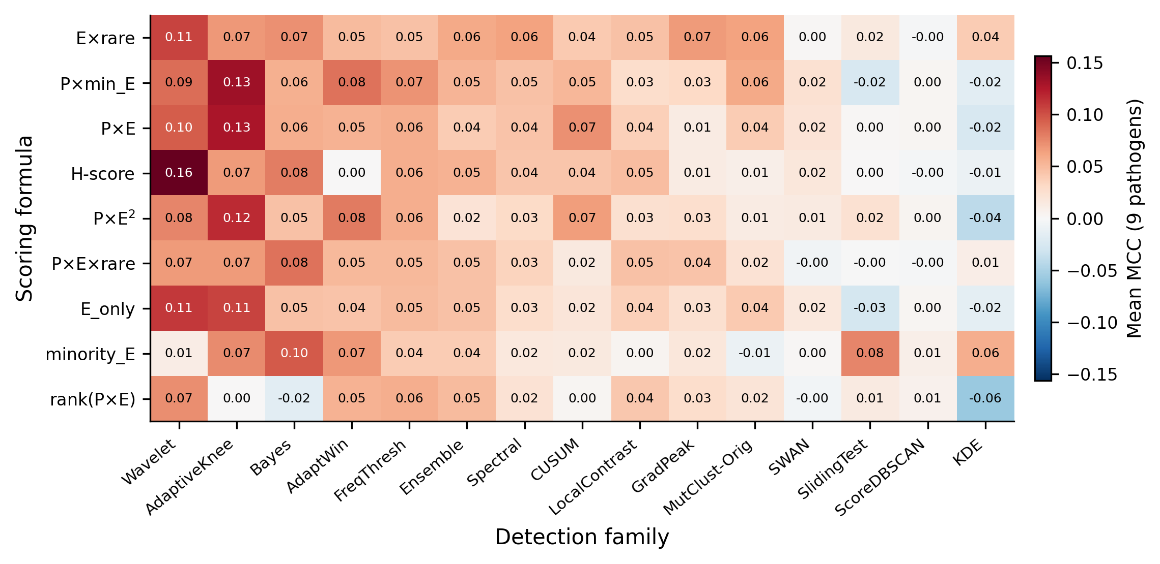
Scoring-Detection Heatmap & Baseline Comparison
MCC Comparison
MutBench Best
0.390
FreqThresh
0.248
SWAN
0.193
MutClust-Orig
0.138
Random
0.001
Kyungpook National University | Dept. of Computer Science | Hwijun Kwon
25

Slide 26
Discussion
Benchmarking Matters
Without standardized evaluation, published methods appear to perform well in isolation but fail under cross-pathogen comparison. MutBench provides the missing infrastructure for fair, reproducible comparison of hotspot detection methods.
Method Selection is Pathogen-Dependent
The strong interaction effect (omega-sq = 0.285) means that recommending a single method is fundamentally flawed. Pathogen-specific characteristics (genome structure, mutation rate, selection landscape) determine which approach works best.
From Benchmark to Algorithm
MutBench is not just a benchmark but a knowledge base. The systematic evaluation across 9 pathogens enables PAHD: data-driven, profile-based method selection that outperforms any fixed approach.
Kyungpook National University | Dept. of Computer Science | Hwijun Kwon
26

Slide 27
Contributions, Limitations & Future Work
Contributions
Limitations
Future Work
First systematic viral hotspot
detection benchmark (9 pathogens)
Ground truth approximation
(no perfect gold standard)
Full PAHD implementation with
learned pathogen profiles
3-layer ground truth design
(adaptive + constrained + DMS)
Phylogenetic non-independence
not fully corrected
Integrate phylogenetic correction
(TreeTime branch weighting)
Statistical proof: no universal
best method (interaction eta-sq=0.285)
Limited to substitution mutations
(no indels, recombination)
Extend to indels, recombination,
and structural variants
PAHD proof of concept for
adaptive method selection
PAHD is proof-of-concept,
not production-ready
Real-time surveillance integration
for emerging pathogens
Kyungpook National University | Dept. of Computer Science | Hwijun Kwon
27

Slide 28
Key Takeaway
MutBench transforms viral hotspot detection from
ad-hoc single-virus evaluation to systematic cross-pathogen benchmarking
9 Pathogens
2,544 Evaluations
omega-sq = 0.285
PAHD Concept
Largest cross-pathogen
benchmark for hotspot
detection
Comprehensive coverage
of scoring x detection
combinations
Strong interaction proves
pathogen-adaptive
selection is needed
From benchmark insight
to actionable algorithm
for method selection
Kyungpook National University | Dept. of Computer Science | Hwijun Kwon
28

Slide 29
Thank You
Questions & Discussion
Hwijun Kwon
Dept. of Computer Science, Kyungpook National University
Advisor: Prof. Inuk Jung
March 2026
Kyungpook National University | Dept. of Computer Science | Hwijun Kwon

