Slide 1
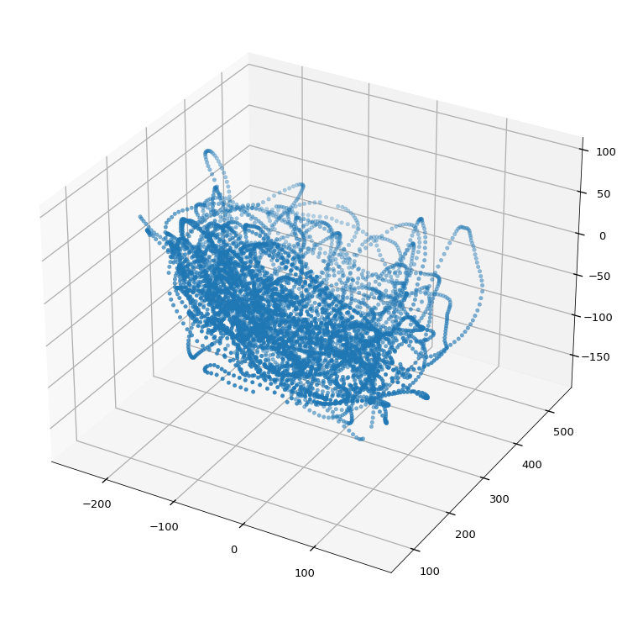
2020 Fall
HFE74201: Special Topics in HFE 3
(Machine Learning Methods)
Homework 1
Hwiyeon Kim
20195073

Slide 2
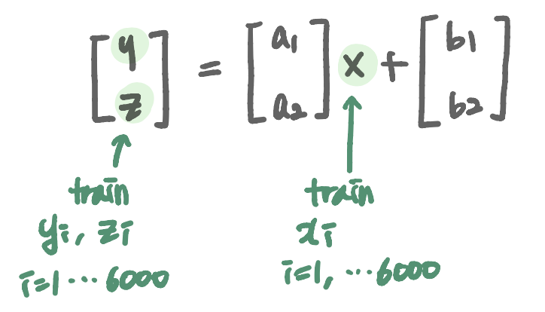
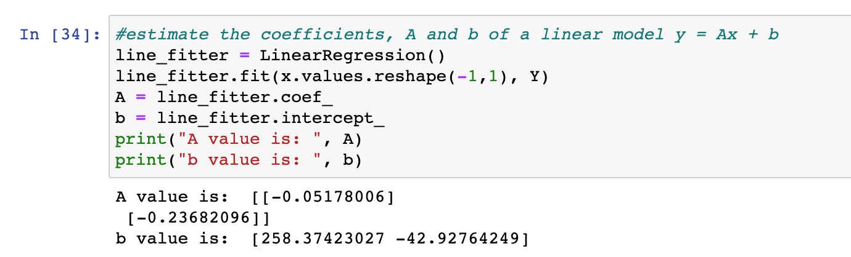
1) Select one of the three coordinates as a hidden variable (say x, here) and the other two as observed vectors (say y = [y z]T). Using the training set, Xtrain, estimate the coefficients, A and b, of a linear model, y = Ax + b. Note that A and b are a 2x1 vector.

Slide 3


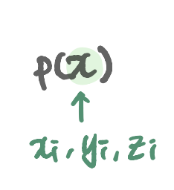
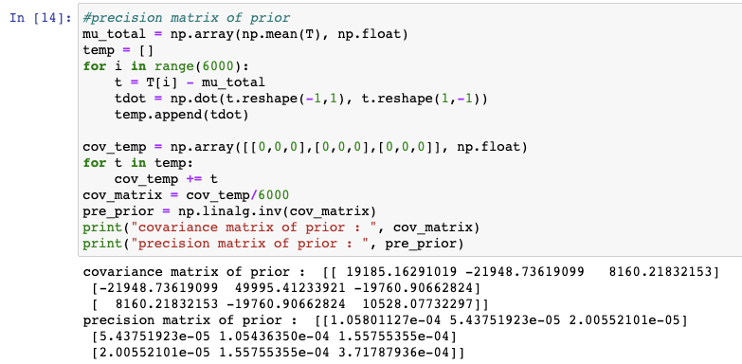
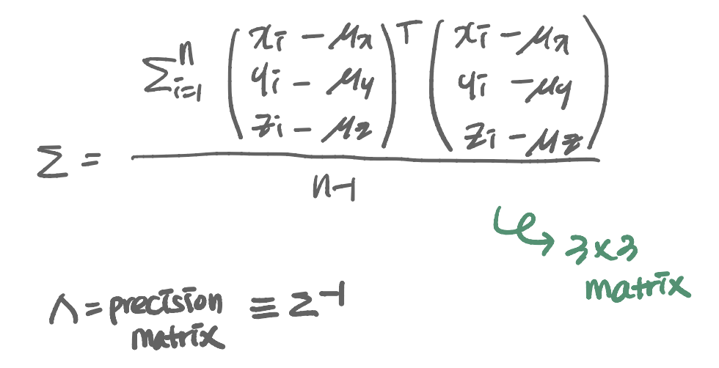
2) Also from the training set, estimate the mean and precision of the prior, namely, p(x) with an assumption that p(x) is Gaussian.

Slide 4
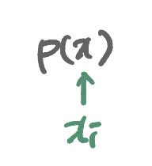
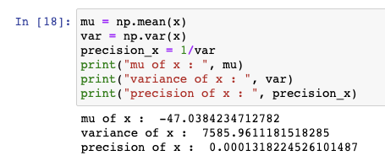
2) Also from the training set, estimate the mean and precision of the prior, namely, p(x) with an assumption that p(x) is Gaussian.

Slide 5
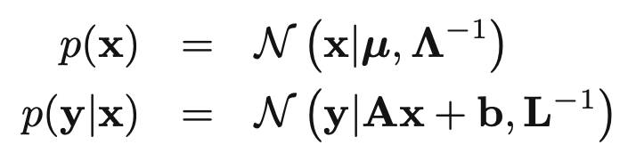
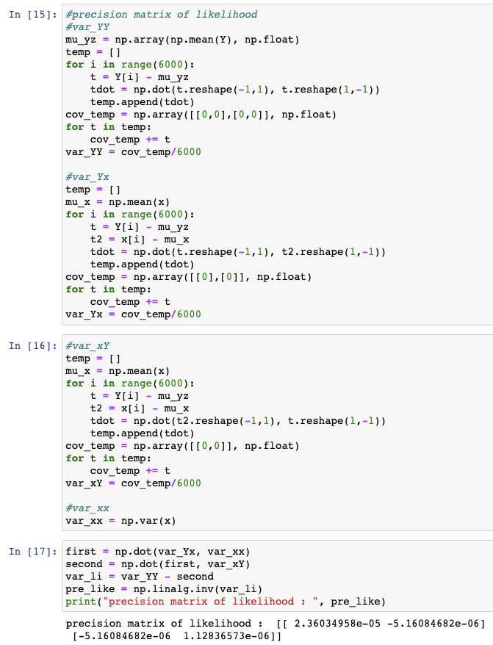
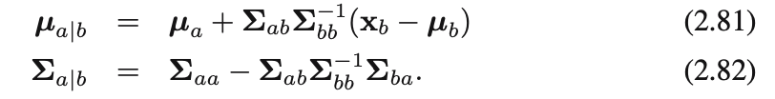
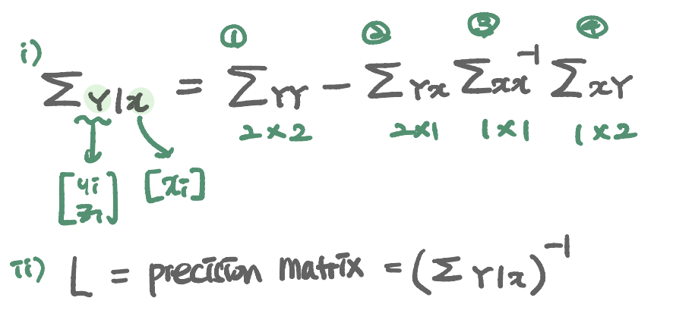
3) Estimate the precision matrix of the likelihood function, namely, the conditional distribution of p(y|x), which is also a Gaussian distribution according to the linear Gaussian model. Note that finding the precision matrix here involves finding errors between y and Ax + b.

Slide 6
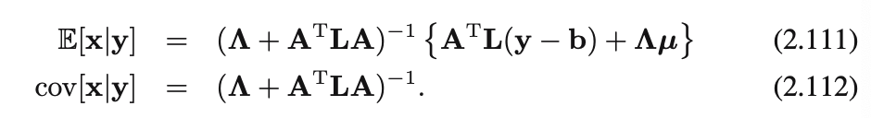
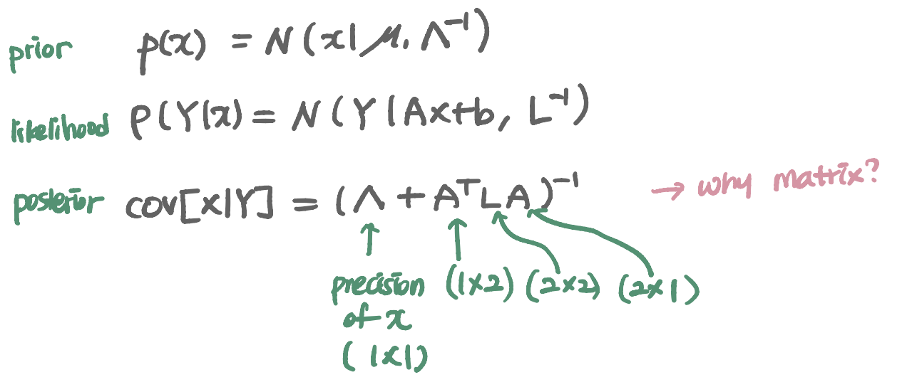
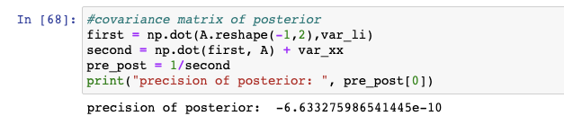
4) Using the Bayes’ theorem and the linear Gaussian model, infer the covariance matrix of the posterior of x given y, p(x|y). Note that this covariance matrix is independent of the observation of y according to the linear Gaussian model.

Slide 7
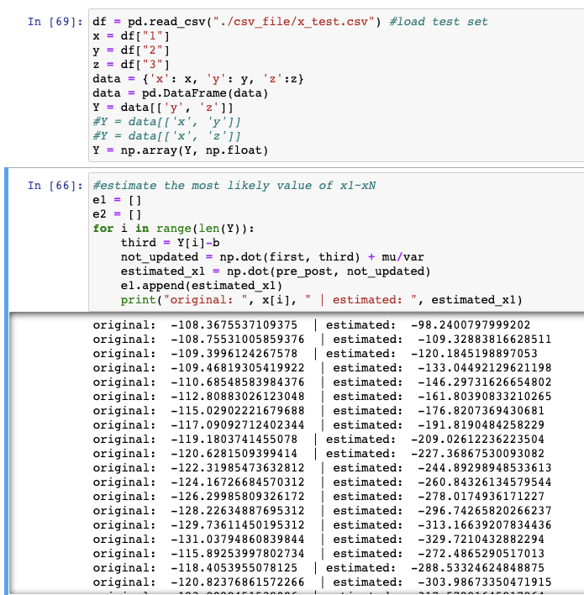
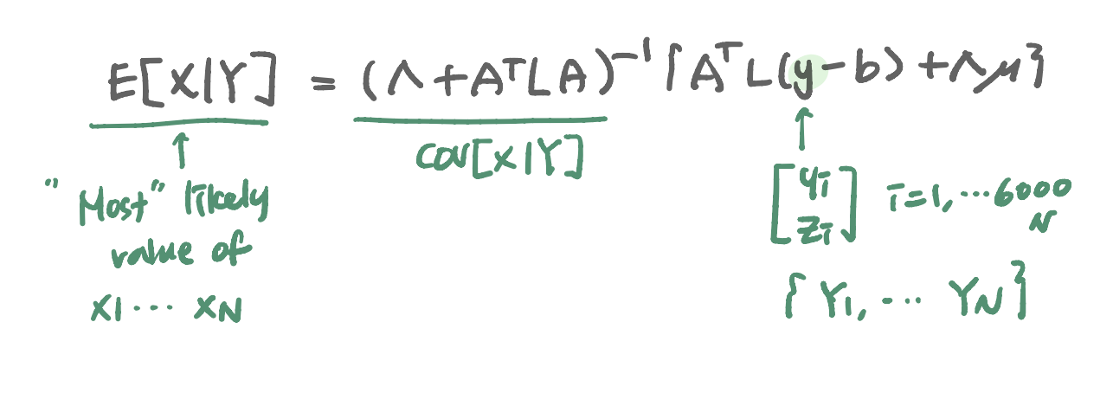
5) Now, we want to infer the hidden variable x from the observation of y in the test set. Utilizing the fact that p(x|y) is Gaussian, infer the most likely value of x1, ..., xN, corresponding to the test data in Xtest, {y1, ..., yN}, where N is the number of test samples. When you estimate the mean of p(x|y), consider whether you will update the mean of the prior using the newly estimated mean, or you will just keep using the original mean of the prior without update. Compare the results between these two cases.

Slide 8
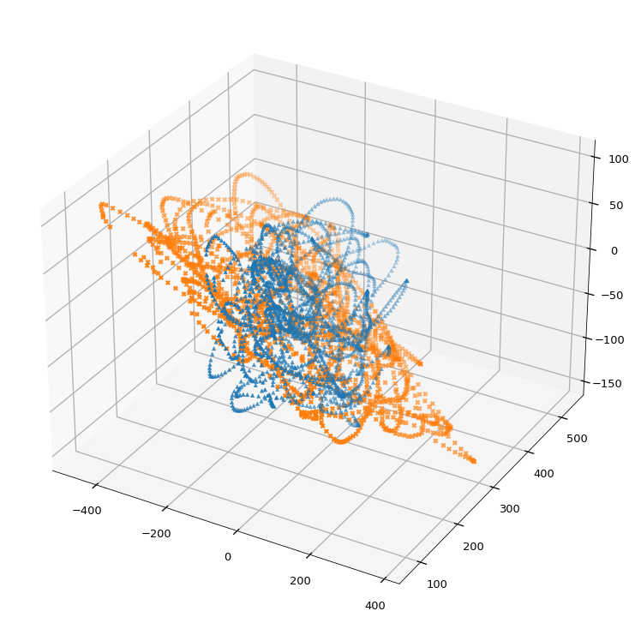
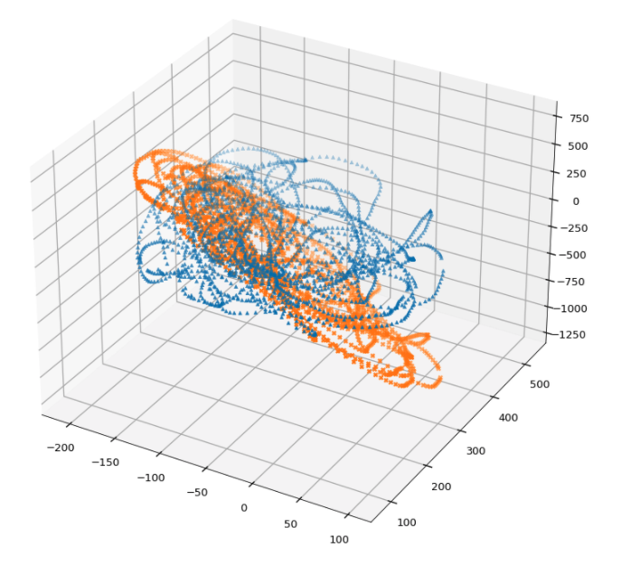
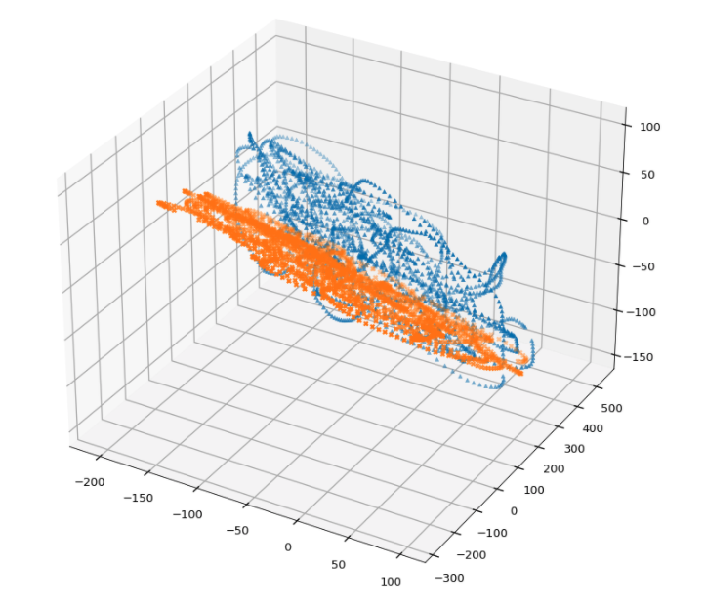
6) Change the coordinates for x and y and repeat 1)-5). Since there are three coordinates, there will be three different cases for {x, y} combinations. Show the plots of your estimates of x along with true x for each coordinate.
x=x, y = [y z]
x=z, y = [x y]
x=y, y = [x z]

