Slide 1
2020 Fall
HFE74201: Special Topics in HFE 3
(Machine Learning Methods)
Homework 2
Hwiyeon Kim
20195073

Slide 2
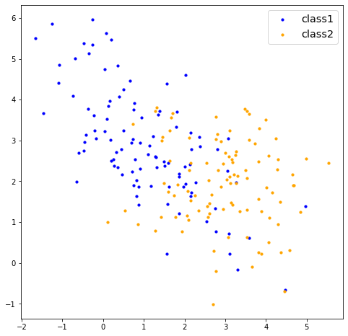
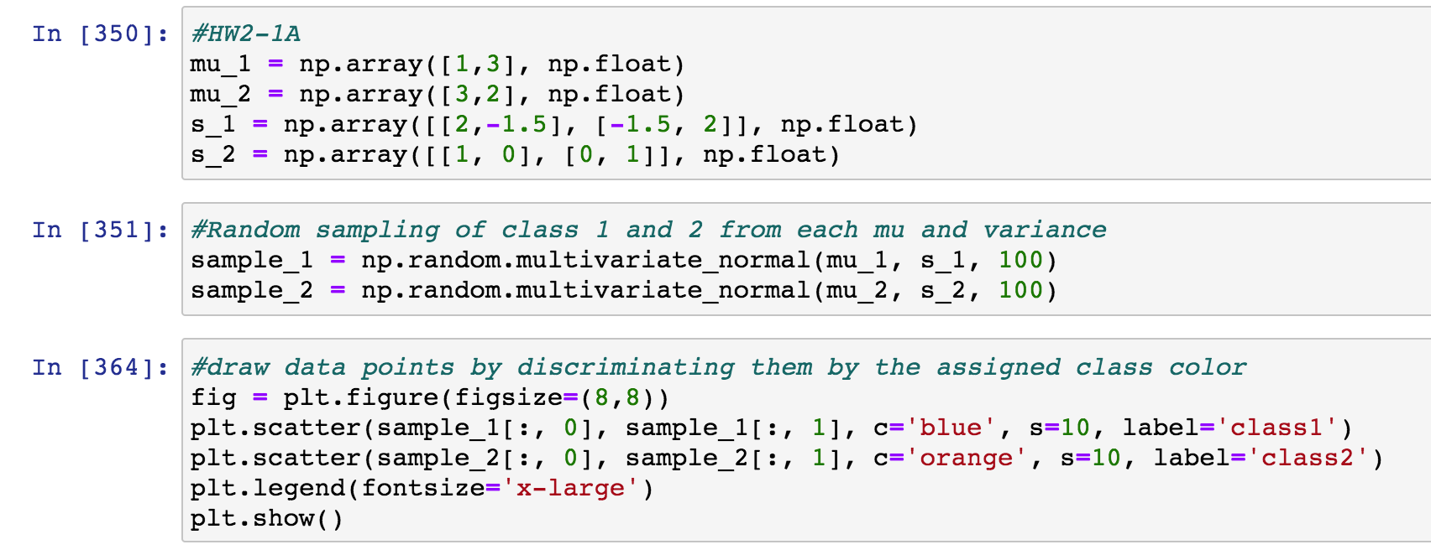
1A. Generate two 100-sample datasets from each of the following 2D normal distributions: µ1 = [1, 3]^{T}, S1 = [2, -1.5; -1.5, 2]; and µ2 = [3, 2]^{T}, S2 = [1, 0; 0, 1].
Assign the class 1 to the first set and 2 to second set. Then, build a linear Fisher discriminant classifier using these data.
Draw all the data points from each class together. Discriminate classes by colors.
Notes:
For the first question, I simply create random 100 samples for class 1 and 2.
Blue points here refer to class 1 and yellow points refer to class 2.

Slide 3
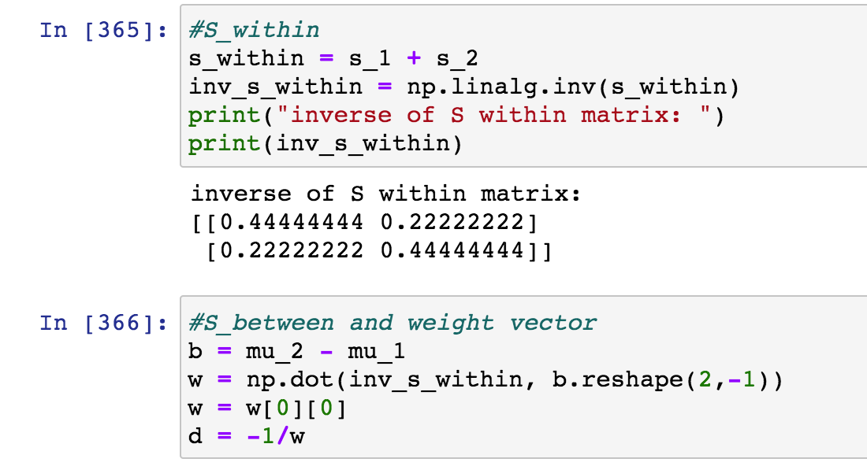
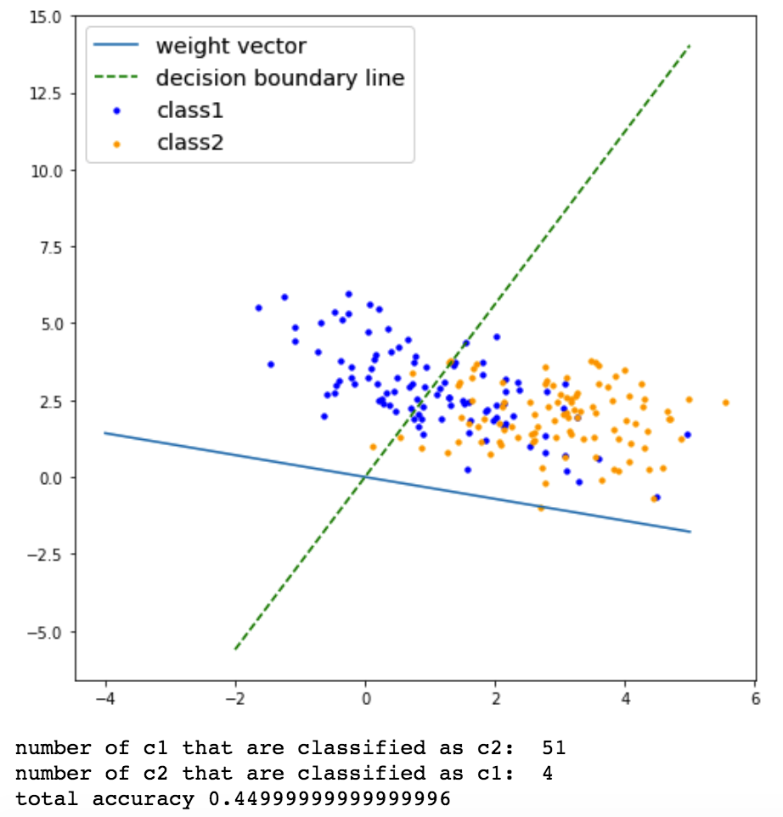
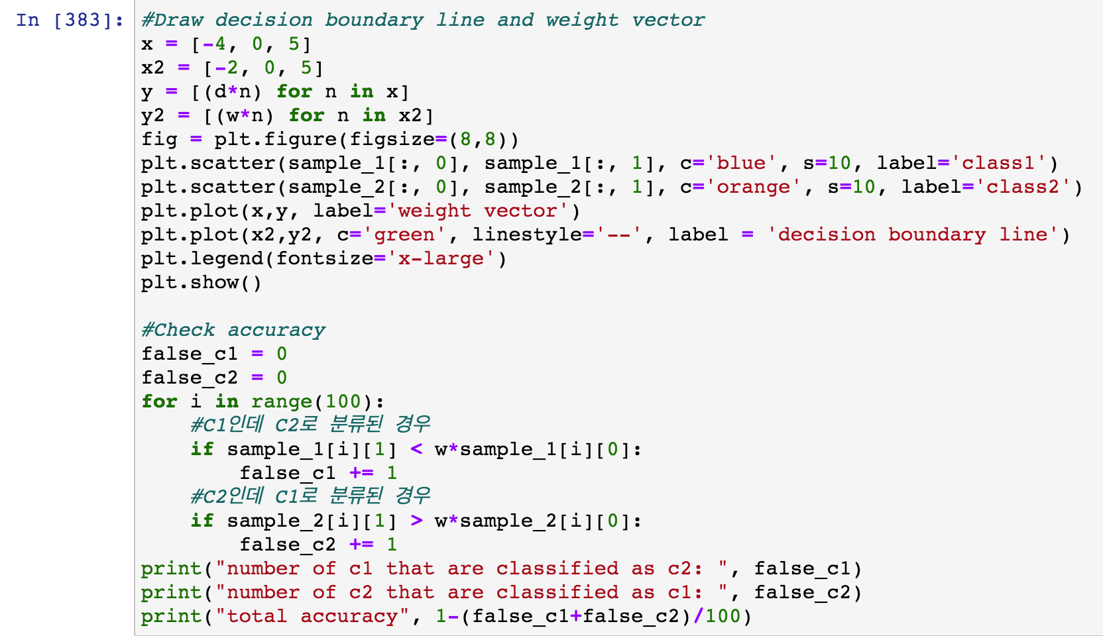
1A (Continue)
On top of this plot, draw your decision boundary line.
Also, on top of that, draw your classifier weight vector (excluding w0).
How many points are misclassified for each class? Report it.
Notes:
With the samples of each class, I calculated S within and S between according to the equations of Fishers’ Linear discriminate.
I draw decision boundary line using that the line would be orthogonal to the weight vector.
Then I got some misclassified points for each class. If class 1 point is less than decision boundary line, I counted it as a misclassified one of class 1.
So the number of class 1 points that are classified as c2 is 51 and the other side is 4.

Slide 4

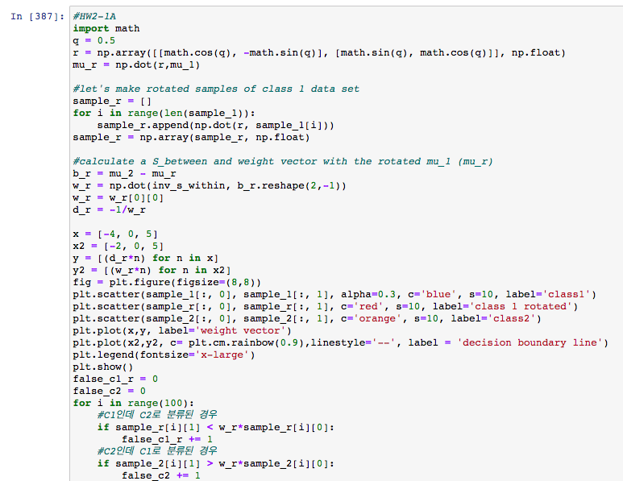
1B. Sometimes we can improve classification performance by a transformation of original variables. Here, we will exercise it with a simple transformation: rotation. The rotation matrix in the 2D data can be given as follows:
which rotates a 2D vector by an angle q counterclockwise. Using this, rotate the first data set by an angle q with respect to its mean vector, μ1 = [1, 3]T. Find the angle q* at which the maximum classification performance is achieved. Discuss your result during the class.
Change q from 0 ~ 2.5
Calculate each accuracy based on changed q
Notes:
For the question 1B, it was about calculate arbitrary q angle that maximizes classification performance by rotation.
Since I don’t know how to calculate the best q for the just one time, I decide to increase q, which is radian in my code, from 0. Also I calculated radian to angle and will show q as an angle.

Slide 5
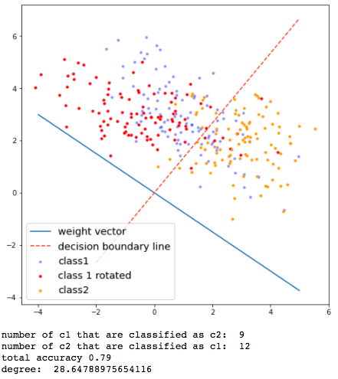
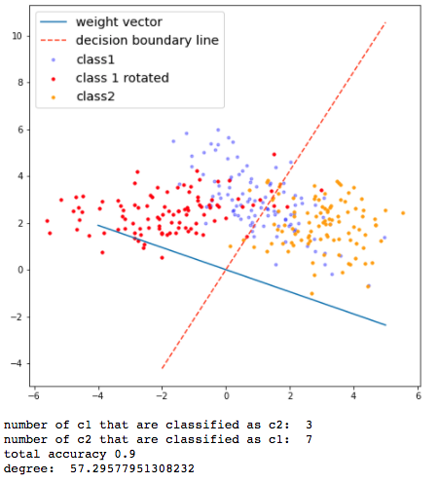
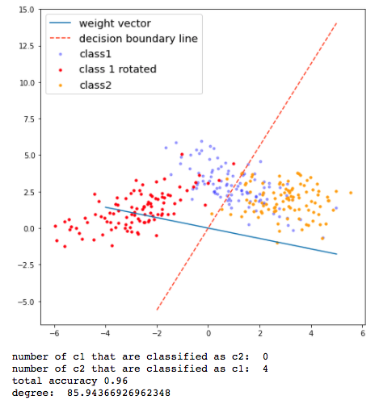
Find the angle q* at which the maximum classification performance is achieved. Discuss your result during the class.
q = 0.5 (radian)
q = 1 (radian)
q = 1.5 (radian)
Notes:
So, this is my result of rotation by increasing q. The blue transparent points refers to the original points of class 1, and red points refers to newly rotated points of class 1. So you can see they are gradually rotating counterclockwise.
From 0.5 to 1.5 radian, I observe that the total accuracy goes high from 0.79 to 0.96.

Slide 6
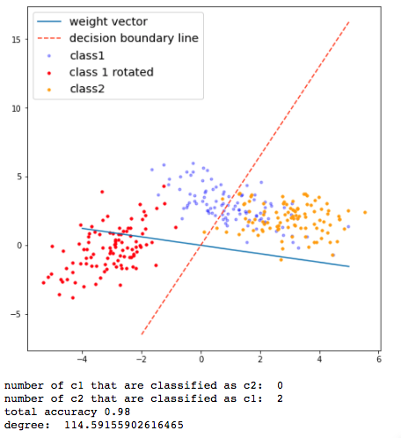
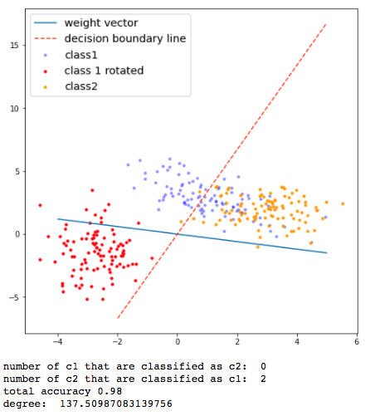
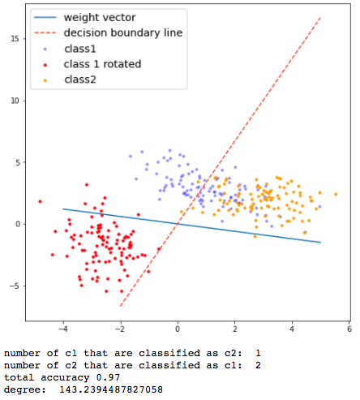
Find the angle q* at which the maximum classification performance is achieved. Discuss your result during the class.
q = 2 (radian)
q = 2.4 (radian)
q = 2.5 (radian)
My result
Radian: 1.5~2.4 / Degree: 85.94 ~ 137.51 → (0.98 accuracy)
still 2 from class 2 remained misclassified
From q=2.5, accuracy starts to decrease
Questions left
How to search for the best performing q?
Doesn't this rotation cause bias in the data?
Which data case is best for this method?
Notes:
In result, I can see that the accuracy maximizes for 85 to 137 degree. It seems the result maximized up to the perfect case, but still, 2 points from class 2 remained misclassified.
Also, I noticed that from q = 2.5, the accuracy starts to decrease. Maybe it is because of this one dot from class 1 that goes over the boundary line.
After this, I got some questions like, how to efficiently search for the best performing q? Also, I have one concern that when it comes to apply this rotation method to the data, whether some biases would be caused or not.
Lastly, I am curious about the best case of data for this method.

Slide 7
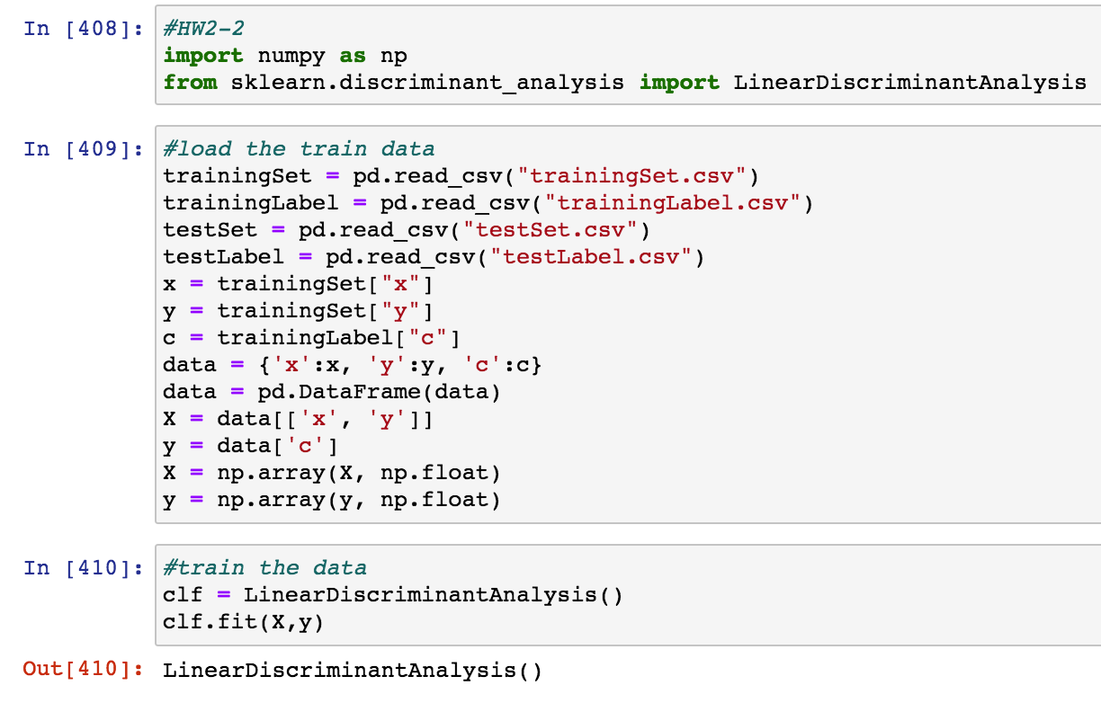
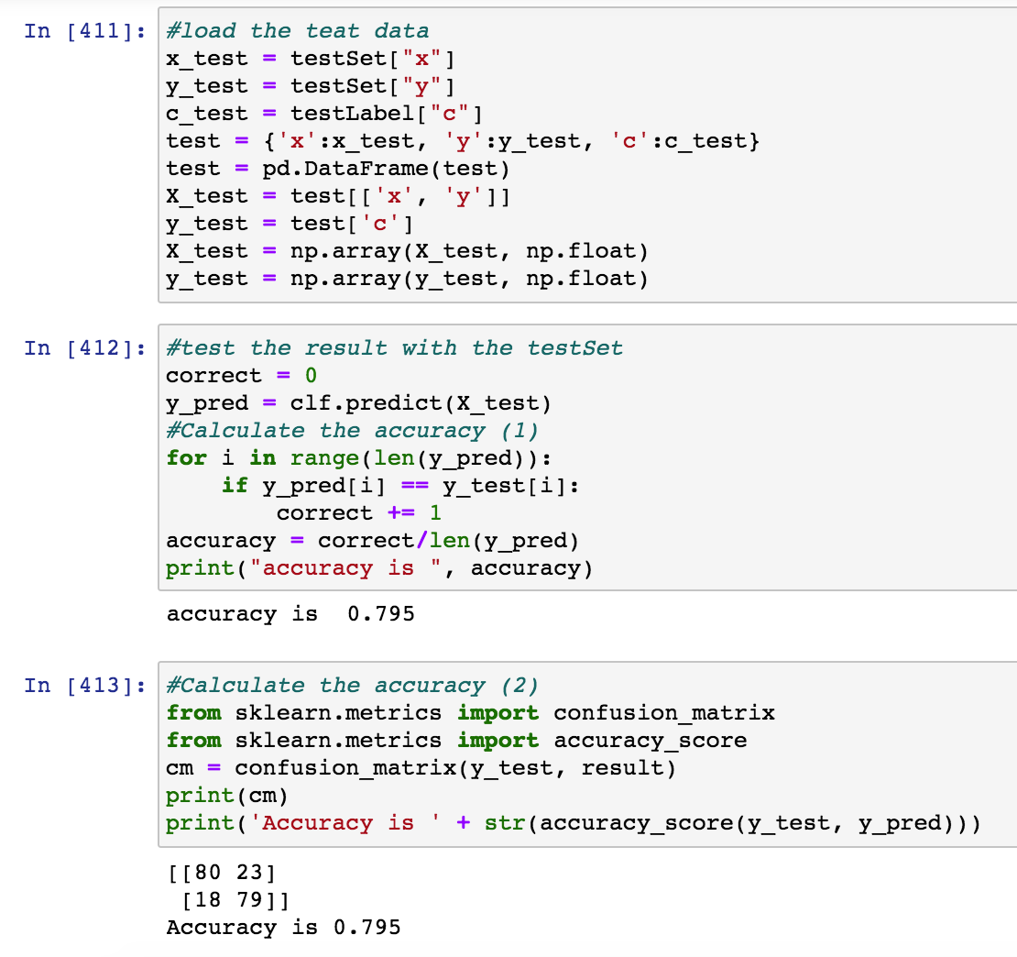
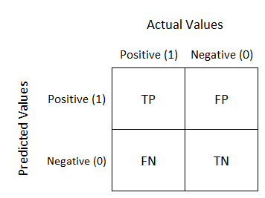
2. Load classification_data.mat. In this data, you will find 2-class neural data. The data were generated from the spiking activities of two motor cortical neurons of a monkey before and after the movement onset. As such, we divided neuronal activities into two classes: rest (class label = -1) vs. movement (class label = 1). There are four types of the data, including trainingSet, trainingLabel, testSet and testLabel. trainingSet and testSet contain the 2D neural spiking activity data for training and testing, respectively. trainingLabel and testLabel contain the corresponding class information, either +1 or -1.
Train the linear Fisher discriminant classifier using {trainingSet, trainingLabel} and test it using {testSet}. Then, compare the estimated classes with the true classes, testLabel, to assess accuracy. Discuss your results during the class.
Notes:
For the second question, simply train the data with linear discriminant analysis and test it with true value.
To calculate the accuracy, I used two way. One is directly counting the correct value and divide it by total number.
Second one is using a library. I found that this also provides a confusion matrix. The accuracy results of both way were same.
Plus, I didn’t plot for this second data but I will draw it after class and see how it would be look like.
Thank you.

