Slide 1
2020 Fall
HFE74201: Special Topics in HFE 3
(Machine Learning Methods)
Homework 3
Hwiyeon Kim
20195073

Slide 2
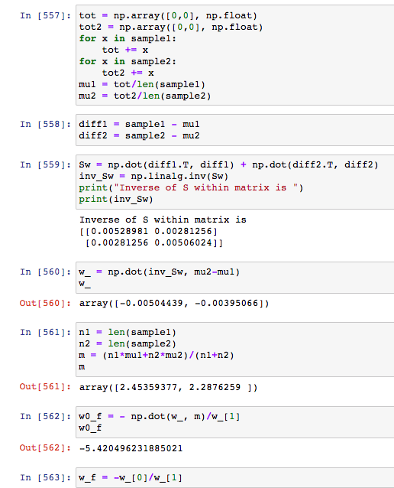
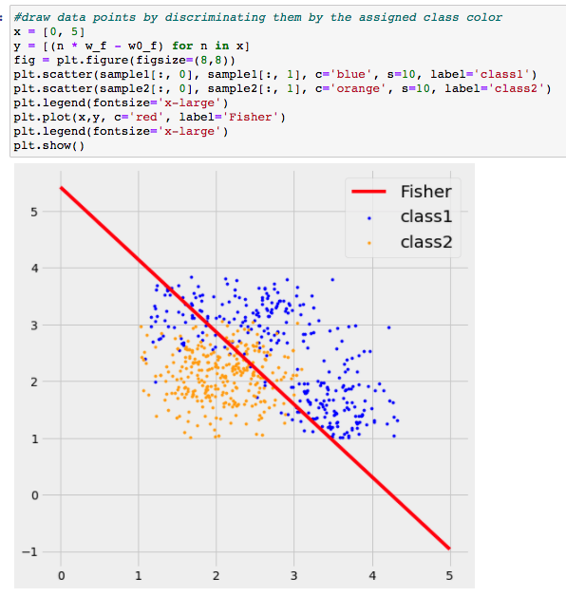
A. Revisit classification accuracy from HW#2 where you have classified these data using the Fisher linear discriminant classifier. If you have updated your Fisher linear discriminant classifier, please use it.
Notes:
Used Fisher discriminant classifier that I calculated for HW2. Last time I used a library and didn't even visualize it, so I calculated and visualized it all this time.

Slide 3
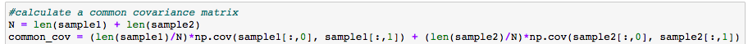
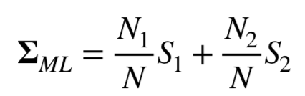
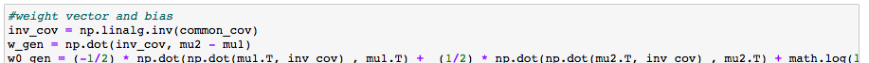
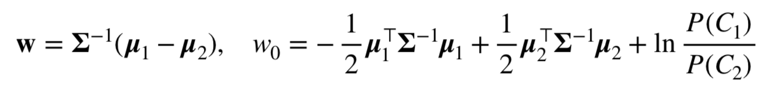
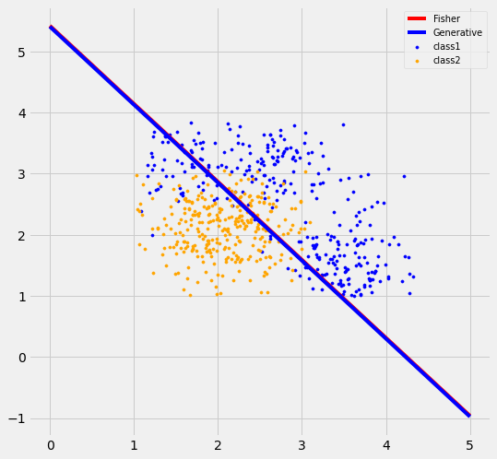
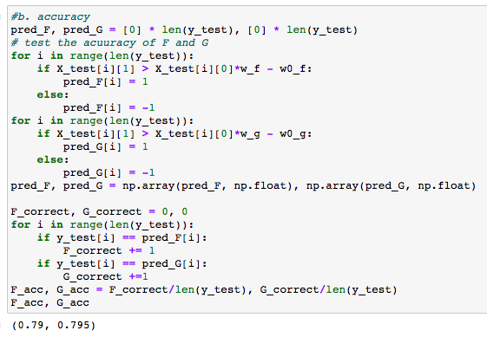
B. Classify the neural data using the generative model with the assumption of Gaussian likelihoods.
Draw the decision surface on the input space with the assumption of a common covariance matrix. Compare it with the decision surface drawn by the Fisher linear discriminant analysis.
Compare the resulting classification accuracy with that of A.
Notes:
B was a problem of classifying the given data using the generative model. Initially, w and w0 were calculated using the common covariance matrix using the given equation, and the accuracy was 0.795.

Slide 4
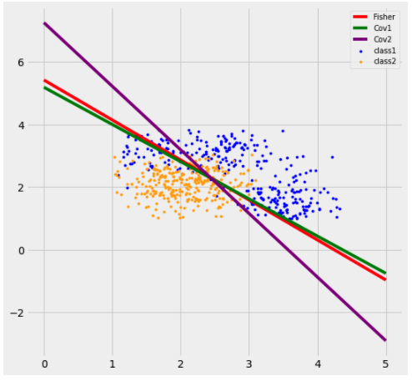
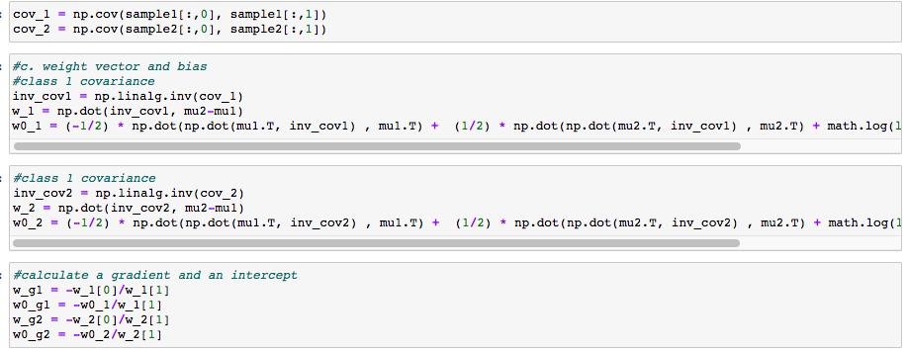
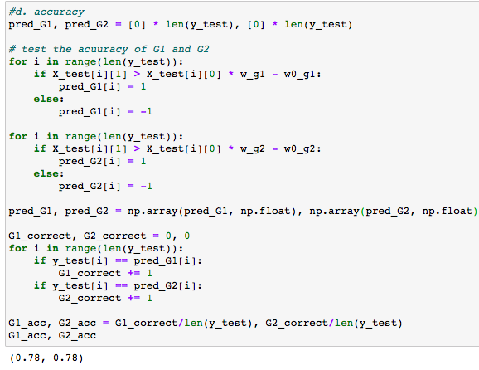
B. Classify the neural data using the generative model with the assumption of Gaussian likelihoods.
c. Draw again the decision surface on the input space with the assumption of individual covariance matrices for each class. Compare it with the decision surface drawn by the Fisher linear discriminant analysis.
d. Discuss whether loosening the assumption on the covariance matrices improve classification accuracy.
Fisher: 0.79
Generative (shared S): 0.795
Generative (S1, S2): 0.78
Notes:
In problems c and d, I thought that individual covariance was about covariance of class 1 and 2.
In the visualization, the decision boundary for each covariance was skewed to either side compared to the shared, and the accuracy was 0.78.
However, I can see my solution is not right and there’s some equations for the individual covariance so will update after the class.

Slide 5
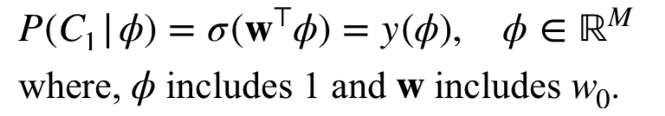

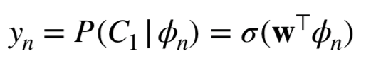
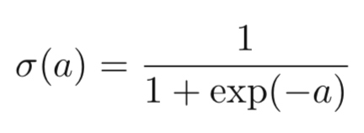
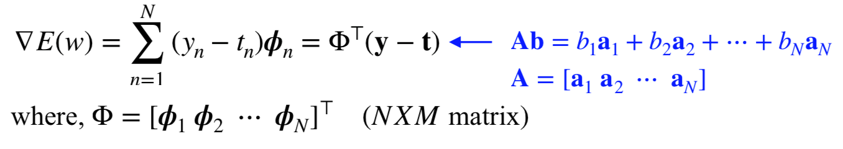
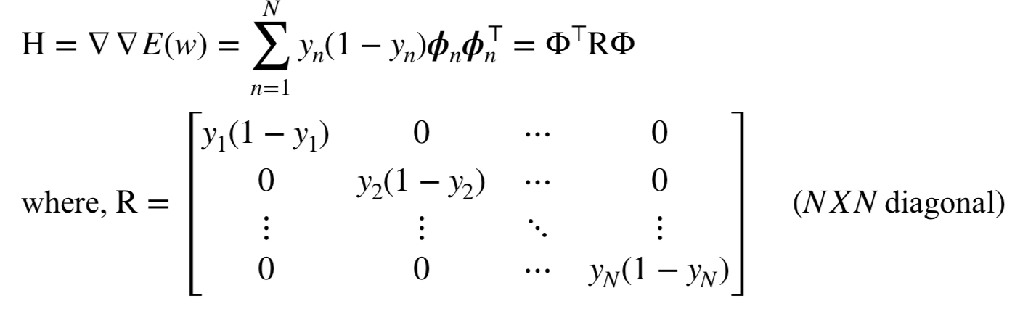
D. Classify the data again using the logistic regression model. Report and compare the resulting classification accuracy with those of A, B-b, B-d and C.
* To-do: get w by logistic regression model
pi = [x, y, 1] (3*1)
w = [w w0] (3*1)
Notes:
Problem C was about classify the data using the generative model without assumption of Gaussian likelihoods. Unfortunately, I don't know how to approach the solution, so I'll learn from others’ solution.
D was a problem of classifying data through a logistic regression model.
pi will be the x y coordinate of the train data containing 1, and w will be the vector containing the bias w0.
From this equations, I started to build some functions.

Slide 6
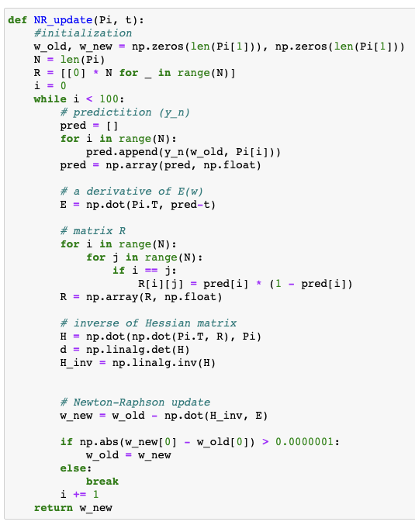
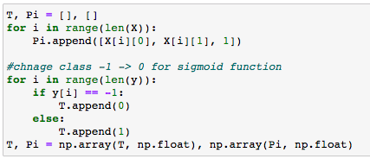


D. Classify the data again using the logistic regression model. Report and compare the resulting classification accuracy with those of A, B-b, B-d and C.
Data preprocessing
w
w0
Notes:
Before that, the given labels were 1 and -1, so I changed them as 1 and 0, just for convenience of using sigmoid function.
What I made is one sigmoid function and one Newton-Raphson update containing the equation on the right side.
This function returns updated w through iterations.

Slide 7
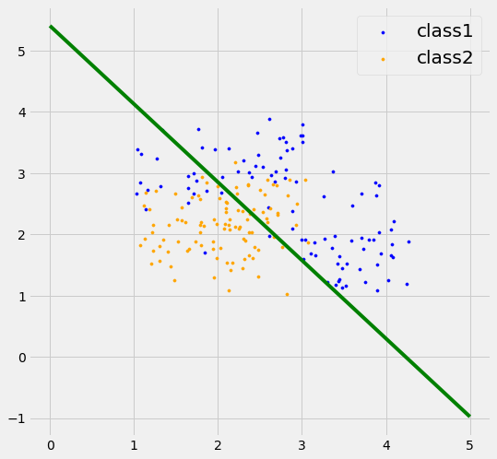
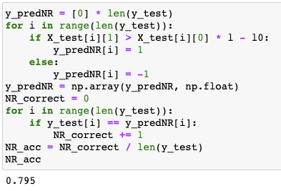
D. Classify the data again using the logistic regression model. Report and compare the resulting classification accuracy with those of A, B-b, B-d and C.
Fisher: 0.79
Generative (shared S): 0.795
Generative (S1, S2): 0.78
Logistic regression: 0.795
Notes:
The accuracy was 0.795. Also I can see difference from previous classification results.

Slide 8
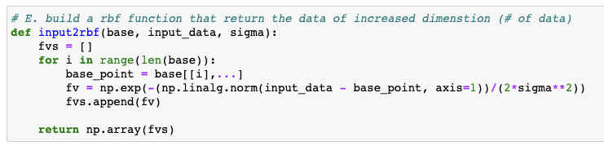
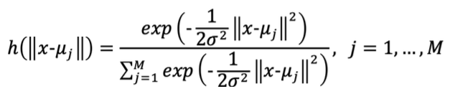
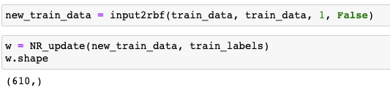


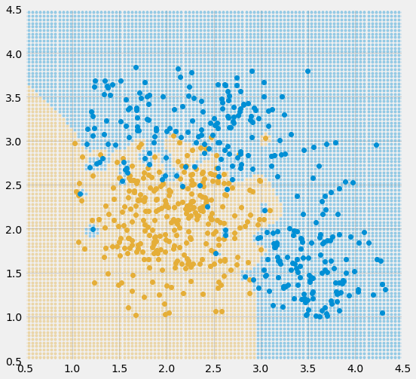
E. (Optional) Classify the data using the logistic regression model. But in this case, use a set of the basis functions instead of the input data directly. Please choose any basis functions you want to apply. Here is an example of the basis function that has been widely used: a radial basis function (RBF).
where μj is the M different centers in the input space. In doing so, there are M basis functional outputs from a given input vector x. You can also determine the value for variance s2 at your own way. Report and compare the classification accuracy resulted from the application of basis functions with those of A, B-b, B-d, C and D.
Euclidean distance from given x
Train data
input2rbf
New train data
NR_update
Input vector
RBF Function
Weighted sum
Logistic regression
610*2
610*610
→ w (610*1)
x is close to μj : close to 1 (weight)
x is far from μj : close to 0 (weight)
Notes:
For problem E, I’m not really sure about my solution.. But I nearly get the concept of Radial Basis Function kernel.
I understand that this concept includes Euclidean distance from given x. and it’s about giving different weights using the distance.
What I’ve done is implementing the RBF with the given equation. So it turns new train data that are projected in 610 dimensions, and I put the new data into logistic regression, which returns 610 by 1 matix.
It seems like it was overfitted since I put sigma just as 1.

