Slide 1
2020 Fall
HFE74201: Special Topics in HFE 3
(Machine Learning Methods)
Homework 5
Hwiyeon Kim
20195073

Slide 2
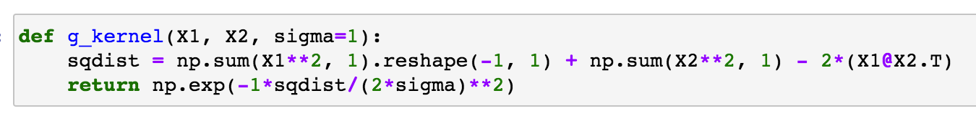

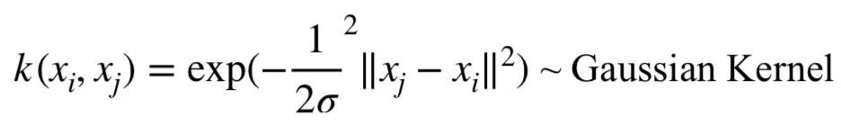
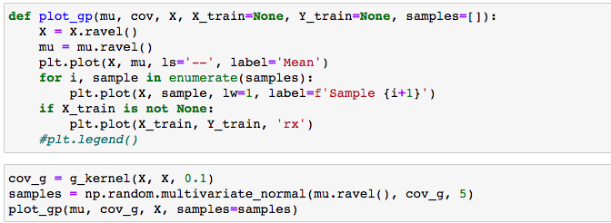
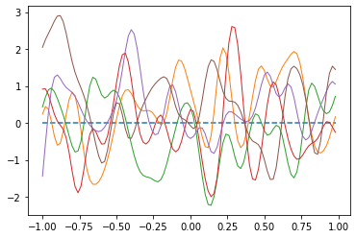
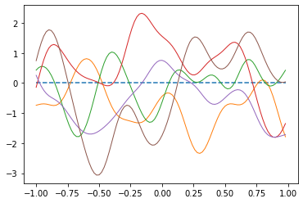
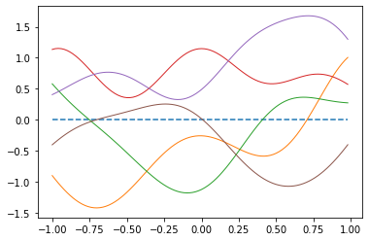
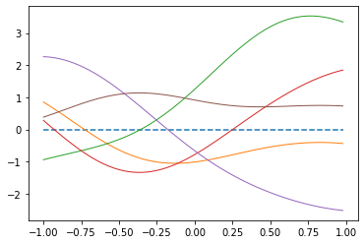
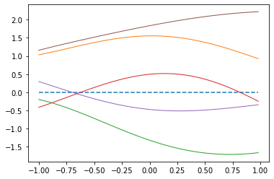
1A. Use the Gaussian kernel for the Gaussian process. Set the variance of the Gaussian kernel, σ2 at your own choice. Generate 5 samples of functions from this Gaussian process. Play with a wide range of the variance, σ2, for the Gaussian kernel. Explain the effect of σ2 on the Gaussian process output.
Generate five samples from $σ=0.05$ to $σ=1$ → when $σ$ goes high, the graph shows low complexity
0.05
0.1
0.3
0.5
1

Slide 3
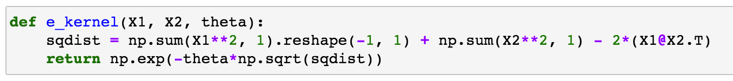
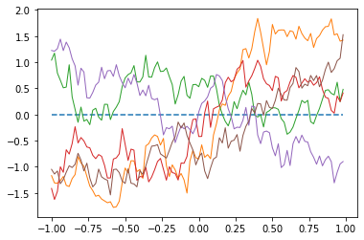
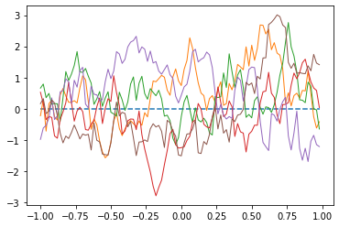
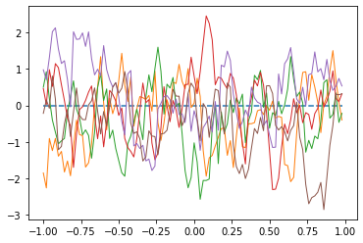
1B. Use the exponential kernel for the Gaussian process. Set the parameter of the exponential kernel, θ, at your own choice. Generate 5 samples of functions from this Gaussian process. Play with a wide range of θ for the exponential kernel. Explain the effect of θ on the Gaussian process output.
Generate five samples from $θ =1$ to $θ =10$ → when$θ$ goes high, the graph shows high complexity
1
5
10

Slide 4
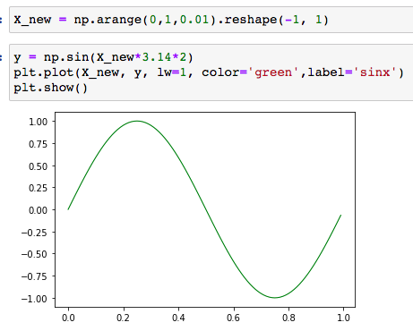
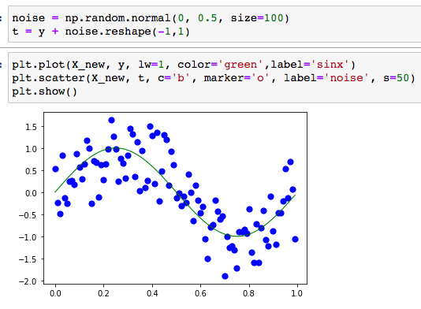
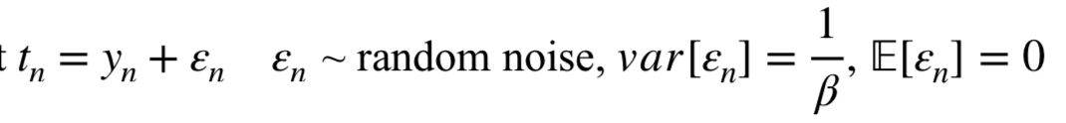
2. Repeat the prediction example shown in Figure 6.8 in the textbook. To draw the mean of the Gaussian process predictive distribution (red line in Figure 6.8), generate 100 new input data equally distributed from 0 to 1.
1. Draw a sin graph from x=0 to x=1
2. Generate random noises that follows normal distribution (sigma = 0.5)

Slide 5

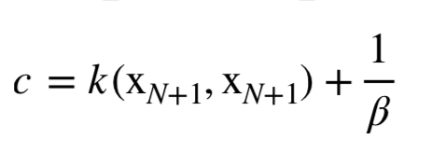
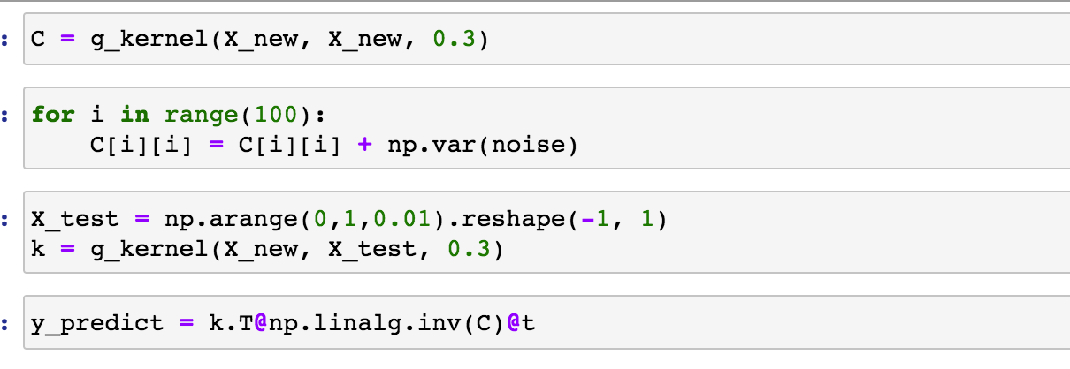

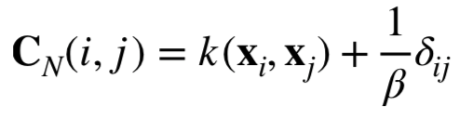
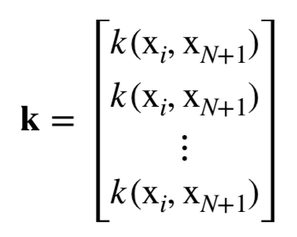
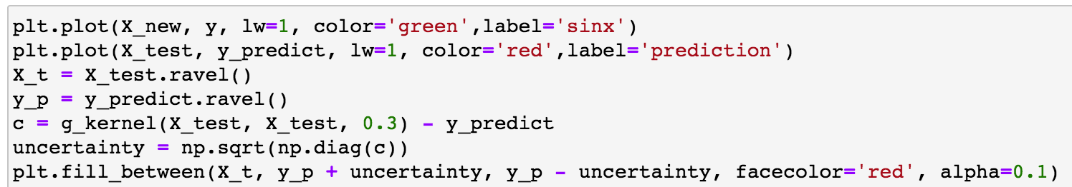

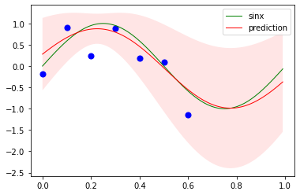
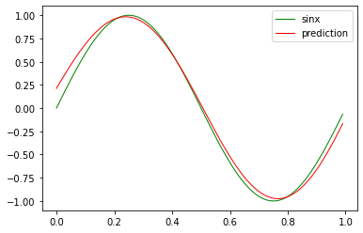
2. Repeat the prediction example shown in Figure 6.8 in the textbook. To draw the mean of the Gaussian process predictive distribution (red line in Figure 6.8), generate 100 new input data equally distributed from 0 to 1.
3. Draw mean of the GP predictive distribution (red line)
4. Draw uncertainty with variance
100 * 100

Slide 6
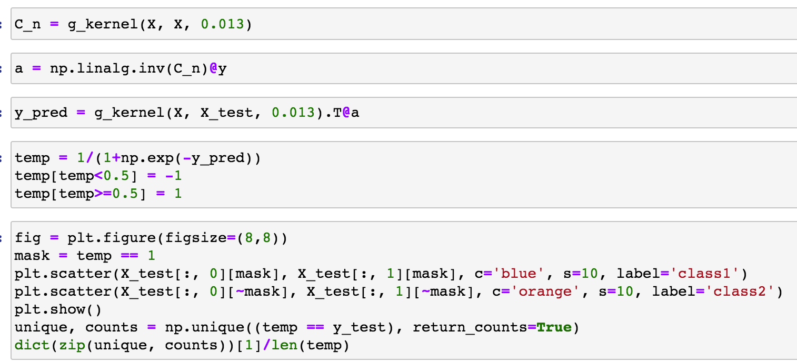
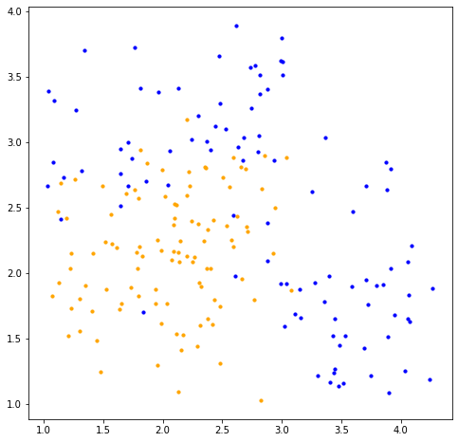
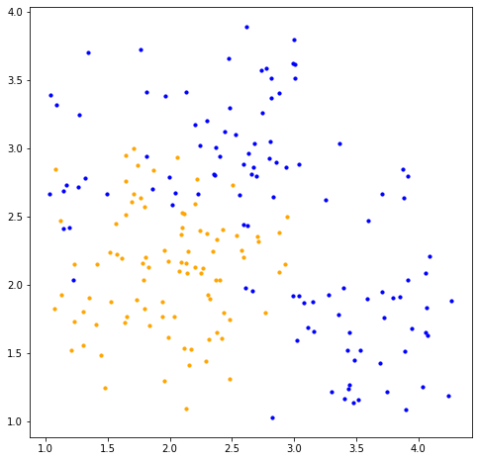

3. Load classification_data.mat. Classify the data using Gaussian processes. Refer to classification using Gaussian processes described in the section 6.4.5 and 6.4.6 of the textbook. Make your own choice for a kernel (e.g. the one in (6.63)). Compare the classification result using Gaussian process with your previous classification results.
Test data
GP classification (sigma=0.013)
Fisher: 0.79
Generative (shared S): 0.795
Generative (S1, S2): 0.78
Logistic regression: 0.795

