Slide 1
2020 Fall
HFE74201: Special Topics in HFE 3
(Machine Learning Methods)
Homework 6
Hwiyeon Kim
20195073

Slide 2
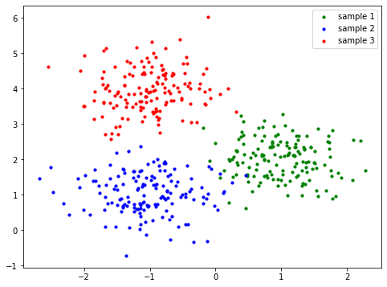
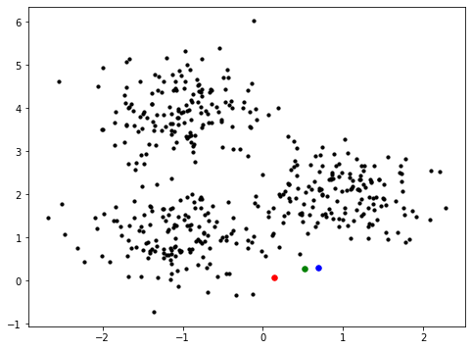
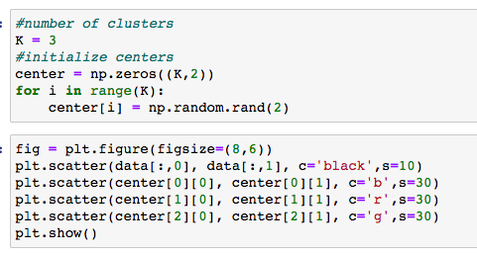
1. Generate 50 samples from each of the three 2D multivariate normal distributions whose mean vectors are: [1 2]T, [-1 1]T, and [-1 4]T, respectively.
The covariance matrix of all these normal distributions are equal, given by:
We want to cluster these 150 samples into K = 3 clusters using the k-means algorithm.
Initialize K centers randomly.
Run the k-means algorithm and show how the E-step and M-step work at each iteration (refer to Fig. 9.1 in the text). Determine by yourself how many iterations to go over.
Original data
Initialized centers

Slide 3
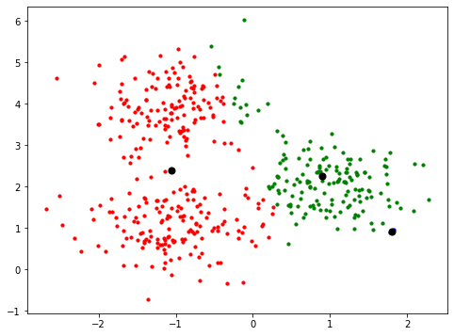
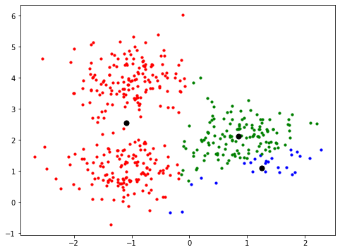
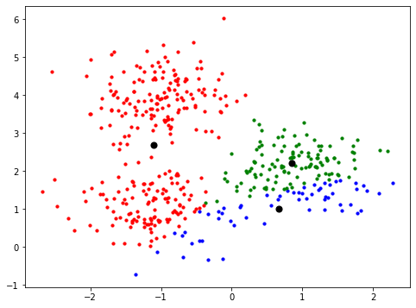
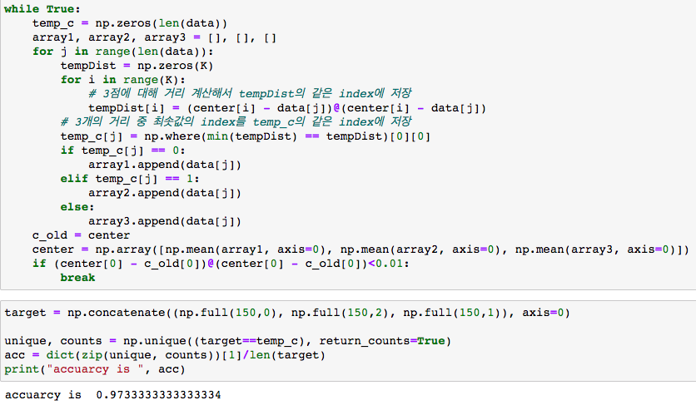
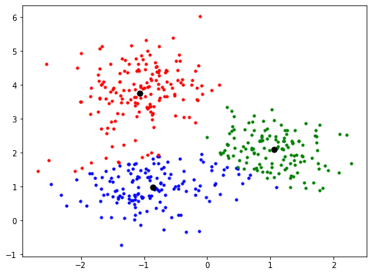
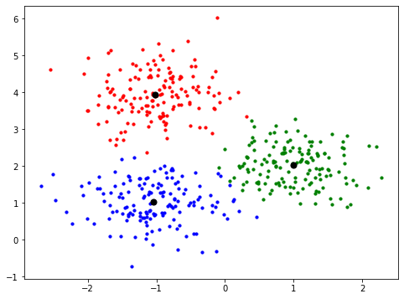

Show the change of the distortion measure over iterations. (refer to Fig. 9.2 in the text)
Find how many samples are assigned to a wrong cluster, different from their original distributions.
Initialized centers
Iterations

Slide 4
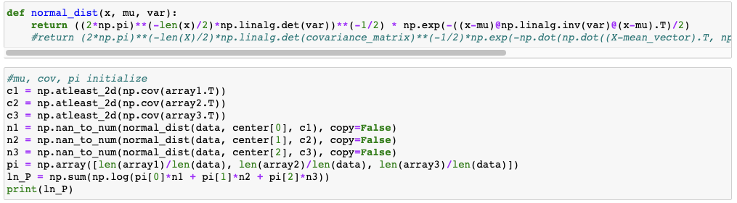
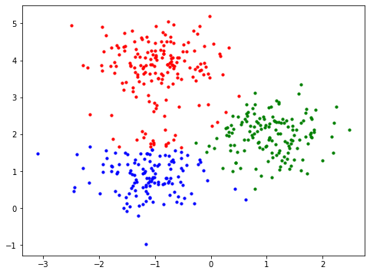
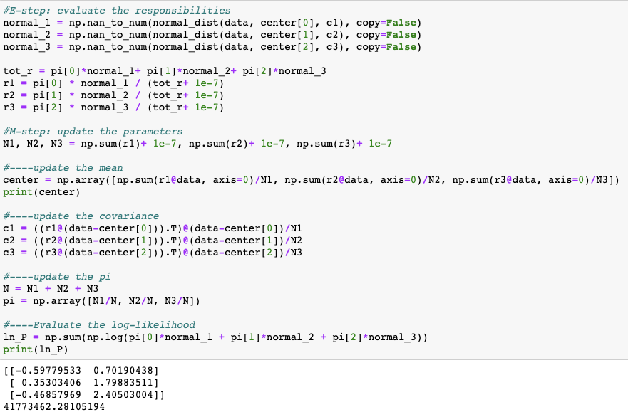
2. From the data you generated in the problem 1 above, now we want to estimate the density of the data using a mixture of Gaussians with K = 3. - Run the EM algorithm and show how the E-step and M-step work at each iteration (refer to Fig. 9.8 in the text). Determine by yourself how many iterations to go over. Compare it with the case of the k-means algorithm. - Show the change of the log-likelihood over iterations. - Find how many samples are assigned to a wrong cluster, different from their original distributions. Compare it with the case of the k-means algorithm. - Repeat the EM algorithm above with random initialization. Discuss how different initialization affects the resulting mixture of Gaussians.

Slide 5
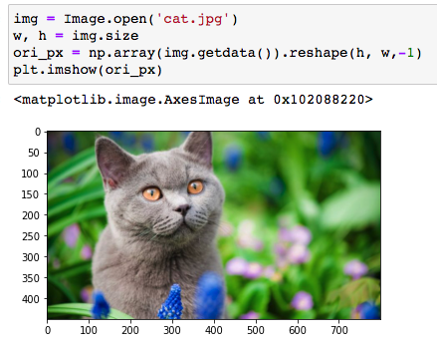
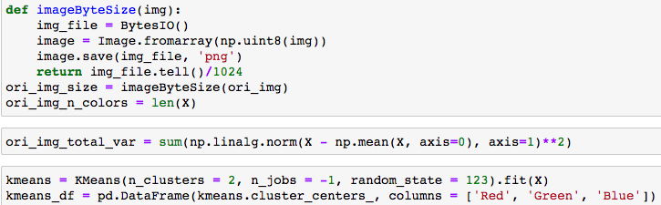
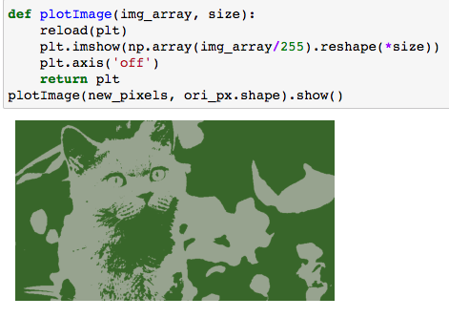
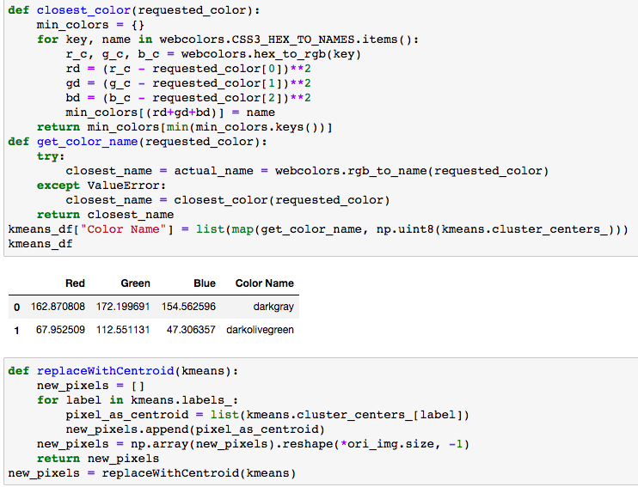
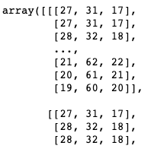
3. Pick any picture file as you want. Load that file using imread( ), which will read the RGB values of the image. For instance, if the image has p x q pixels, the reading will generate p x q x 3 data, where the last dimension contains the RGB values of each pixel. In general, a RGB value ranges from 0 to 255 in integer. Then, we want to apply the k-means clustering to the image such that we can segment the image into K clusters based on colors.
- Cluster each pixel into one of the K clusters using the k-means algorithm. Show how the image segmentation changes over iterations. Also, show the change of the distortion measure over iterations.
1. Import an image
2. K-means clustering
5. Plot the image
3. Check clusters’ color names
4. Replace a cluster’s each pixel value with a centroid
Reference: https://ichi.pro/ko/python-eseo-k-pyeong-gyun-keulleoseuteoling-mich-juseongbun-bunseog-eul-sayonghan-imiji-abchug-150907224231445

Slide 6
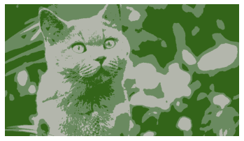
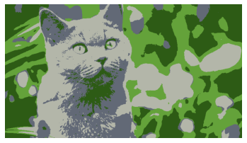
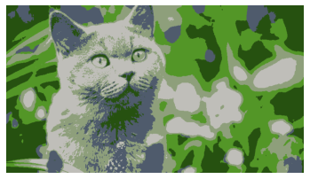
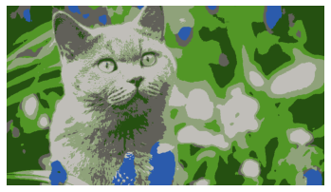
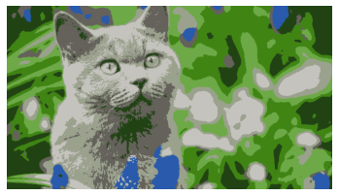
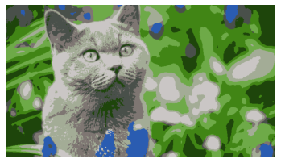
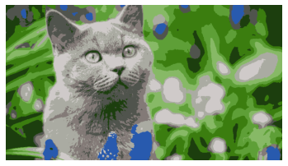
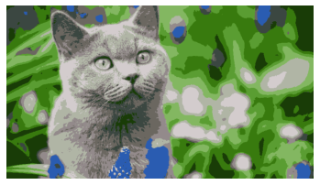
- Vary K from 2 to 10 and observe how image segmentation changes. Compare your results along with the original image. (refer to Fig. 9.3 in the text)
3
4
5
6
7
8
9
10

