Slide 1
Machine Learning Method Final Project Presentation
2020 Fall
HFE74201: Special Topics in HFE 3
Hwiyeon Kim, 20195073

Slide 2
Overview
Data to be used
Description, Reason of selection
Result & Analysis
Fisher Discriminant Analysis
Generative model (with Gaussian likelihoods)
Logistic Regression
Support Vector Machine
Gaussian Process
K-means Clustering (EM algorithm)
Summary
Notes:
Firstly, I will describe the dataset that I used for this project.
Secondly, I will briefly review the method that we have learn and report some results.
Then, I will compare all the results.

Slide 3
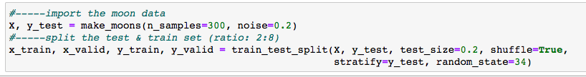
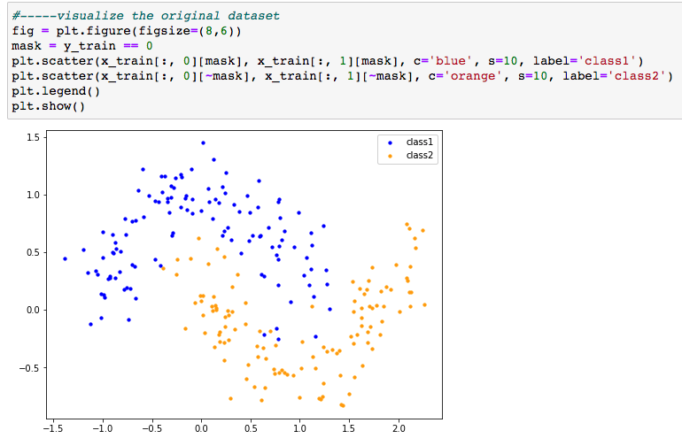
Data to be used
Moon dataset
Two interleaving half circles
A simple toy dataset to visualize clustering and classification algorithms
Due to its shape & popularity
Seems hard to classify with linear classification
For this project..
Number of samples = 300
each 150 samples
Noise = 0.2
Split the train data & test data
Train : Test = 8 : 2
<Without any noise>
Notes:
Since my research is mainly about qualitative analysis with texts, I could not utilize my research data for this project.
Through the whole class, I can try basic machine learning methods almost without any libraries but there are some errors in my code.
Therefore, I decided to review & revise my codes and make some sparse codes as functions that people can utilize it.
I choose he moon dataset. This dataset is famous for classification and clustering problem, which consists of two interleaving half circles.
I firstly thought that this data would be hard for linear classification, instead, using some kernel would be efficient.
For this project, I generated the 300 data with some noise and split it into the train and test dataset.

Slide 4
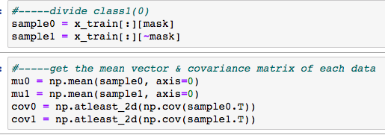
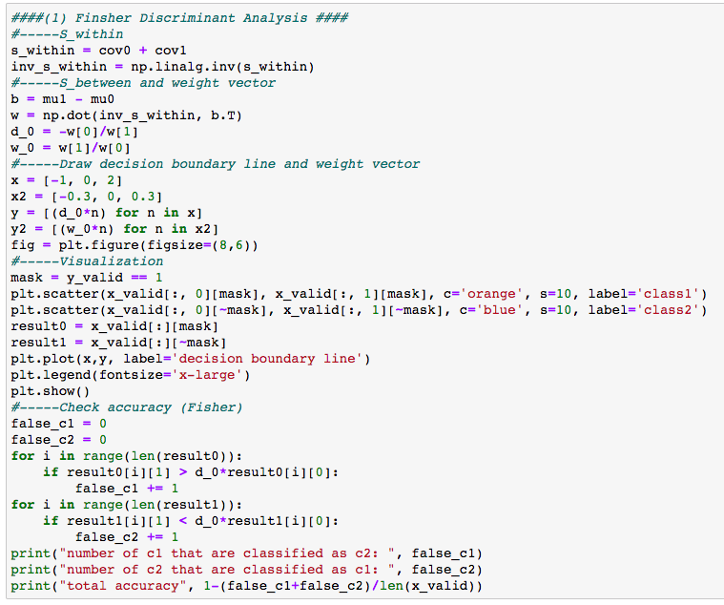
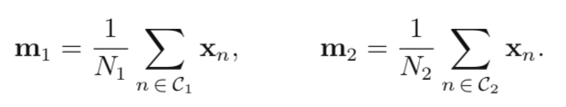


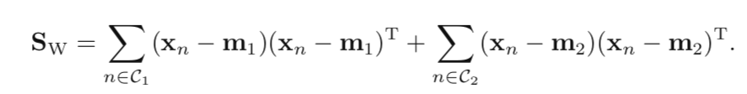
Fisher Discriminant Analysis
Method
1. Mean vector & Covariance matrix of each class
3. Draw the decision boundary & Calculate the accuracy
2. Calculate S_{W}
Notes:
Fisher Discriminant Analysis is a method of finding an axis where elements within the same class (within class) are grouped, and the distance between the groups (between class) is further apart.
To get the weight vector, I calculated Fisher criterion, especially S within.

Slide 5
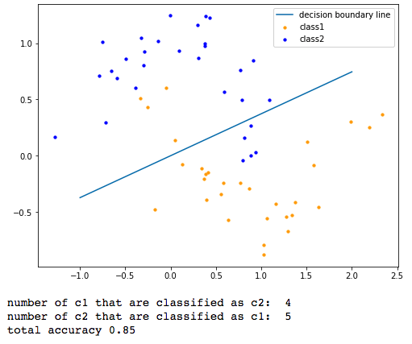
Fisher Discriminant Analysis
Results
Accuracy = 0.85
Misclassified points:
# of c1 misclassified as c2: 4
# of c2 misclassified as c1: 5
Notes:
Since the data set was composed of two semicircles, I found that there are several misclassified points.
The accuracy of FDA is 0.85.

Slide 6
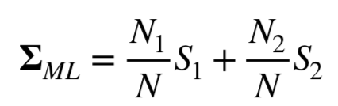
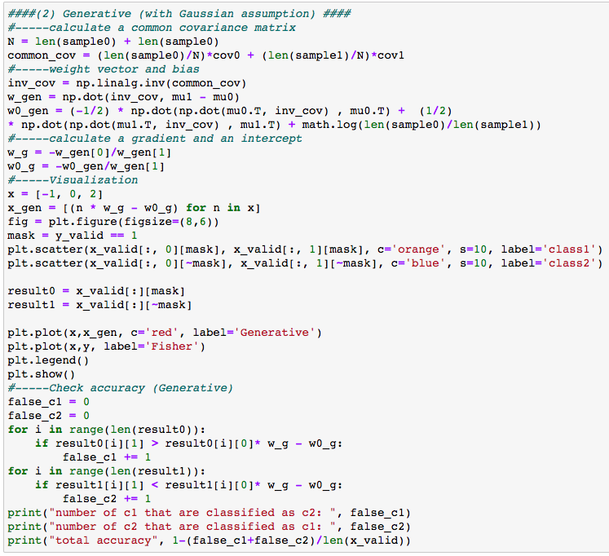
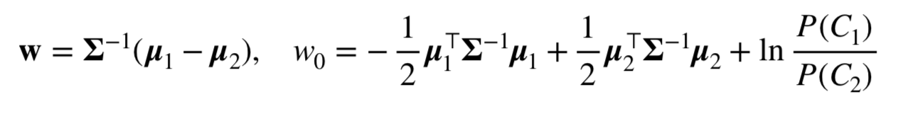
Generative model With Gaussian assumption
Method
1. Calculate a common covariance matrix
3. Draw the decision boundary & Calculate the accuracy
2. Calculate the weight vector & bias
Notes:
Secondly, I applied a generative model with gaussian assumption to the dataset.
To draw the decision boundary, I calculated a common covariance matrix with the equation.
For this time, I calculated the weight vector and bias with these equations.

Slide 7
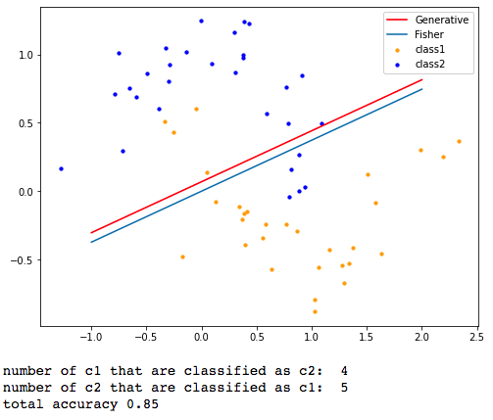
Generative model
Results
Accuracy = 0.85
Misclassified points:
# of c1 misclassified as c2: 4
# of c2 misclassified as c1: 5
No big changes compared to Fisher Discriminant Analysis
Notes:
In result, the accuracy is 0.85, no big changes compared with Fisher Discriminant Analysis.
The decision boundary slightly moved since I added some bias for this time. However, the misclassified points still remained.

Slide 8
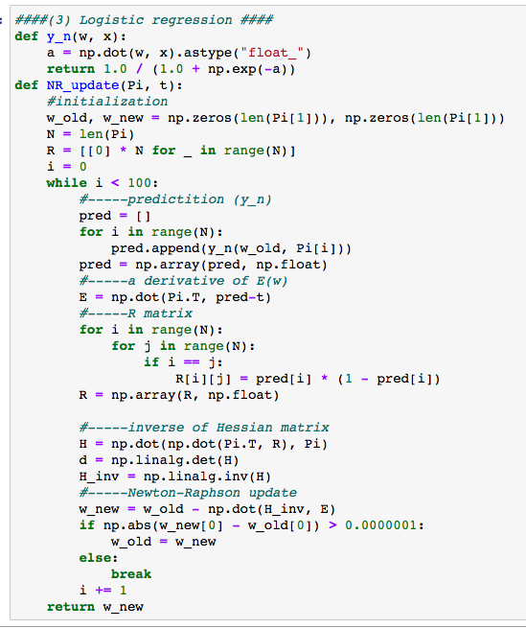
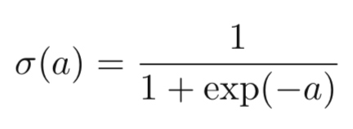
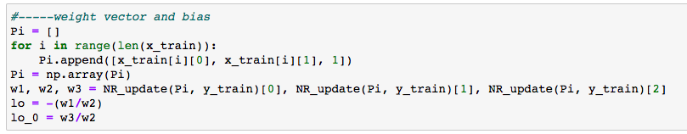
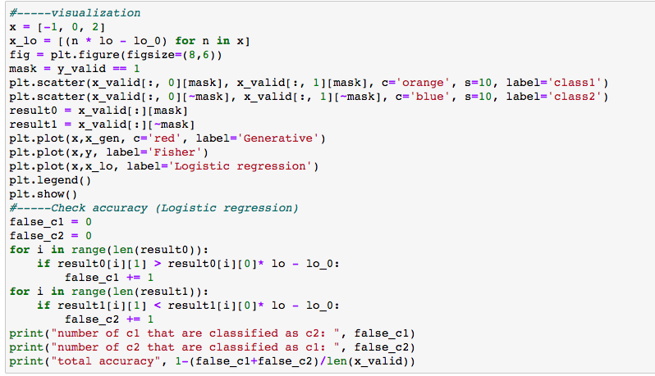
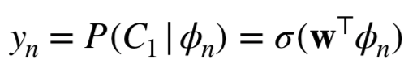
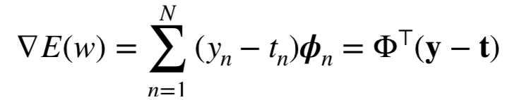
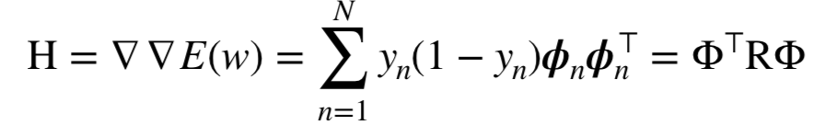
Logistic Regression
Method
1. Build a sigmoid function
3. Calculate a weight vector and bias
2. Build a Newton-Raphson update function
4. Draw the decision boundary & Calculate the accuracy
a. y_{n} with sigmoid function
b. A derivative of E(w)
c. R & Hessian matrix
d. Update w
Notes:
The third method that I utilized was Logistic Regression.
For this time, I build a sigmoid function and a function that updates weight with Newton-Raphson method.
This function consists of yn, A derivative of E(w), R and Hessian matrix. At the end of this function, the weight is updated. When the updated weight is not much different from the previous one, the loop stops.
With the updated weight vector and bias, I plot the decision boundary and checked the accuracy with misclassified points.

Slide 9
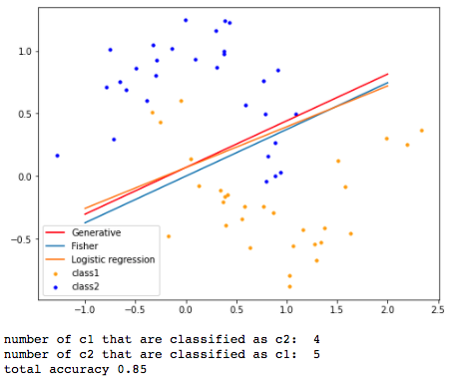
Logistic Regression
Results
Accuracy = 0.85
Misclassified points:
# of c1 misclassified as c2: 4
# of c2 misclassified as c1: 5
Slightly different changes in slope compared to Generative model & Fisher Discriminant Analysis
Same accuracy
Hard to classify with linear models
Notes:
The accuracy of logistic regression was same with the previous ones. The slope was slightly changed compared to generative model and fisher discriminant analysis.
However, as same as previous methods, linear discriminant analysis seems to be hard to successfully classify the data.

Slide 10
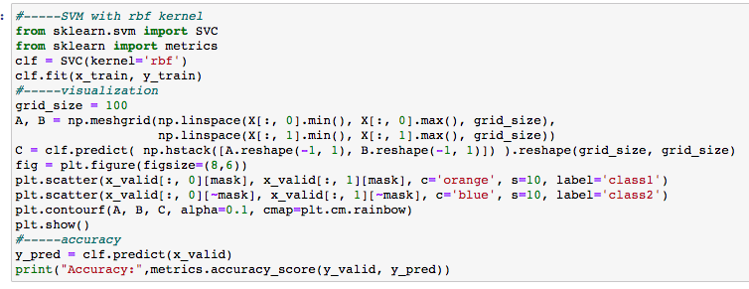



Support Vector Machine
Method
Maximize the ‘margins’
Skicit-learn package with three different kernel (linear, polynomial, and RBF)
Linear
Polynomial
Radial-Basis Function
Notes:
The main idea of support vector machine is maximizing the margins of the decision boundary.
I couldn't implement SVM by directly using math expressions, so I used the Scikit-learn package. Instead, I tried applying three different kernels to see how the results were different.

Slide 11
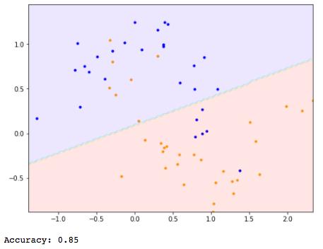
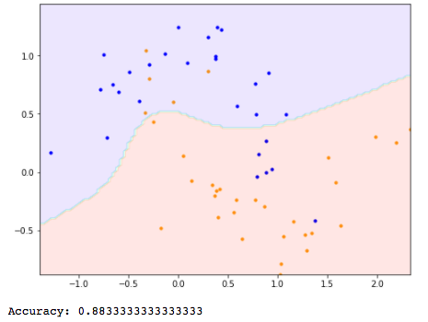
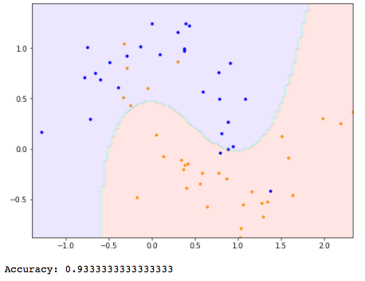
Support Vector Machine
Results
Linear kernel
(accuracy = 0.85)
Polynomial kernel
(accuracy = 0.88)
RBF kernel
(accuracy = 0.93)
Notes:
Compared to the one without any kernels, polynomial and RBF kernel show high accuracy.
Especially, I found that decision boundary using RBF kernel fit to the shape of the original data.

Slide 12
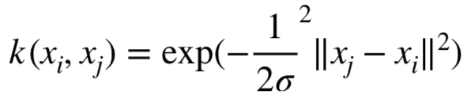
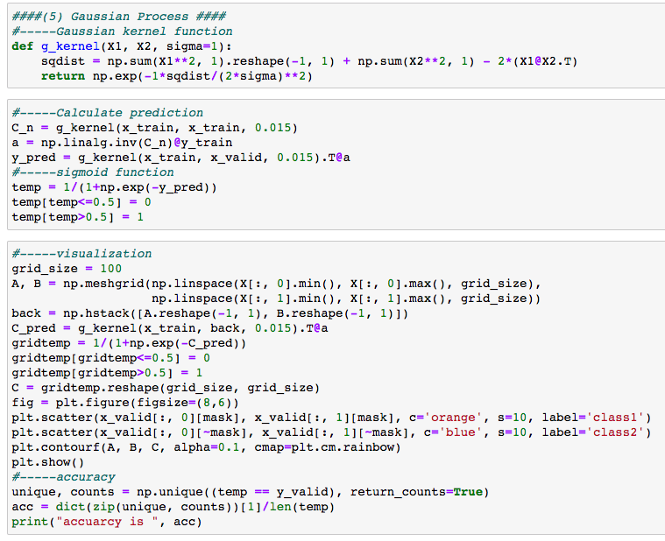
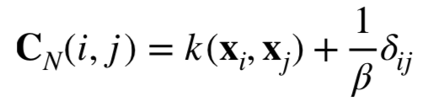
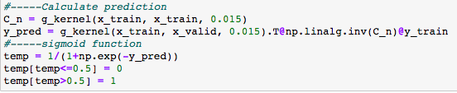
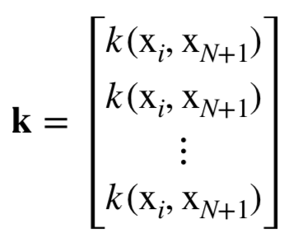


Gaussian Process
Method
1. Build a Gaussian kernel function
4. Draw the decision boundary & Calculate the accuracy
2. Calculate C_{N,} K, and t
C_{N}⁻¹
t
X_{i} = x_train
X_{N+1} = x_valid
3. Calculate p(t|a) and get prediction
Predict classification
Notes:
Next, I classified the data with the Gaussian Process.
As I did in the last homework, I build a gaussian kernel function. Then I calculate the formula one by one. Here, I calculated CN with putting the train data to the kernel, calculated k with train and test data, and product km CN and t.
Then I got the prediction that predict labels of the test data by putting the previous result in the sigmoid function

Slide 13
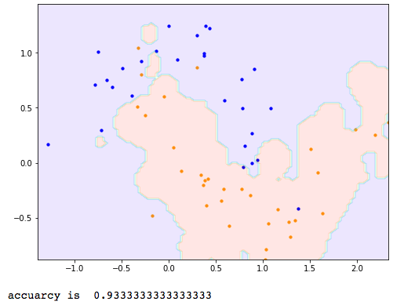
Gaussian Process
Results
Accuracy = 0.93
Fitted shape with the moon dataset (two interleaving circles)
Shows the best result, same with support vector machine result & RBF kernel
Notes:
It's a pity that I'm not sure if the current accuracy is really the best since I found the sigma by putting in numbers by my hand.
In addition, I could see some boundary that classified without any points or misclassified points.
Nevertheless, it is the method showing the highest accuracy so far.

Slide 14
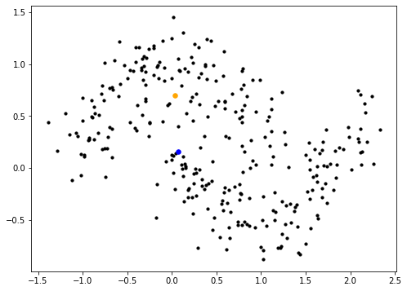
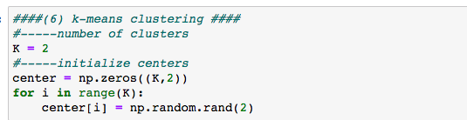
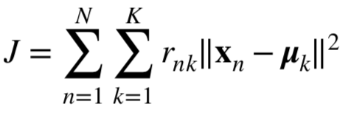
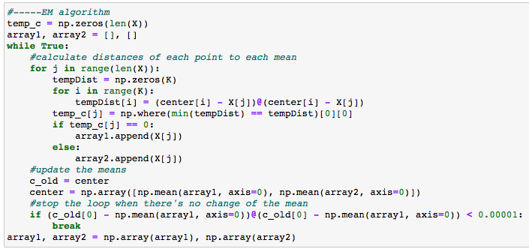
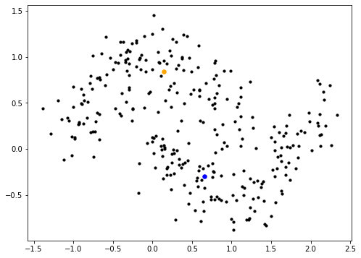
K-means Clustering
Initialized Centers (yellow & blue dots)
Method
1. Initialize a center of each cluster (randomly)
2. E-step: fix m_{k}, minimize J w.r.t r_{nk}
Updated Centers (yellow & blue dots)
3. M-step: fix r_{nk}, minimize J w.r.t m_{k}
4. Stop the loop at the convergence
Notes:
Final method was k-means clustering. This is one of the unsupervised learning method.
I used EM algorithm for optimizing centroids of two clusters. For e step, the code calculate the shortest distance among the fixed centroids.
For m step, the code update the centroids with the fixed points. I stopped the loop with comparison of the prior centroids of the first cluster for convinience
As you can see, the top figure shows initialized random centroids, and the bottom one shows updated centroids after the EM algorithm,

Slide 15
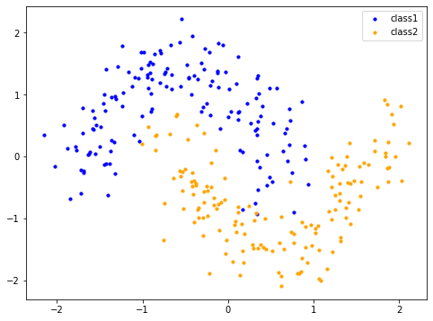
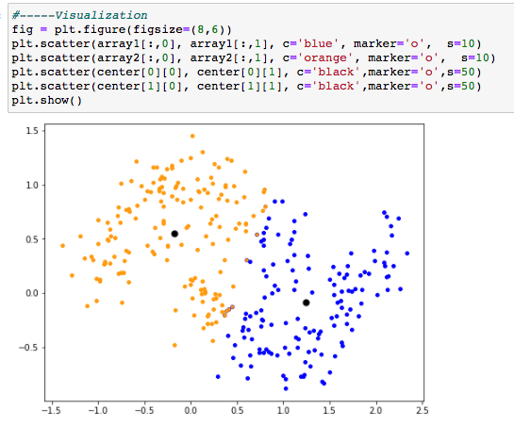
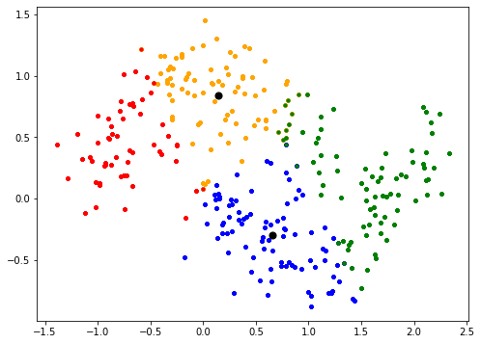
K-means Clustering
Results
Original Data
K = 2
K = 4
Misclassified points
Seems not fitted to the half-circle shapes (Gaussian)
Confusing intersection exists
Notes:
Compared to the original data, I could see the K-means clustering was not that right method for classify my data. There are many misclassified points and it seems like assuming gaussian distribution.
After I run the code with 2 clusters, I thought that it might be better with the number of four clusters, but the result seems worse.

Slide 16
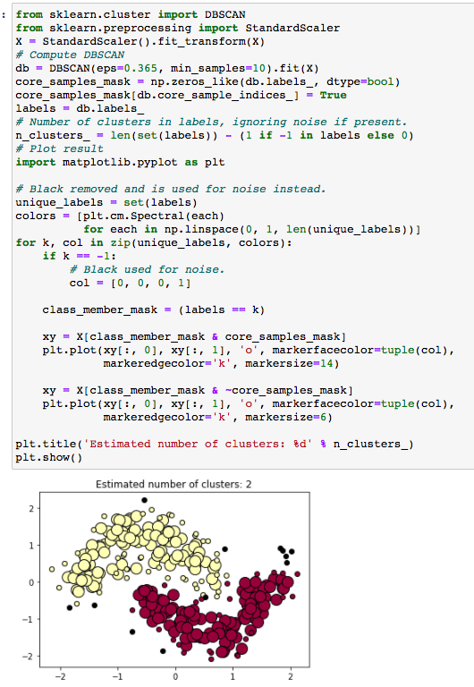
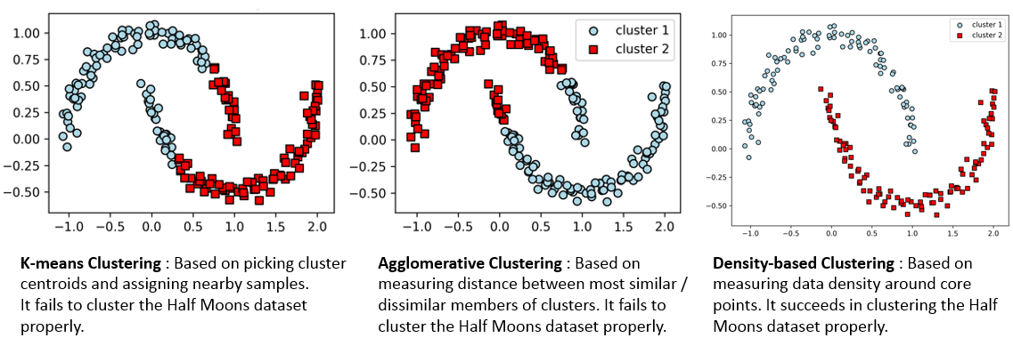
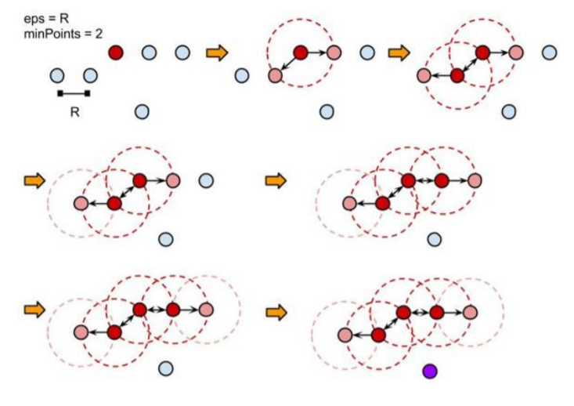
Density-based Spatial Clustering of Applications with noise (DBSCAN)
Unsupervised density-based clustering algorithm
Density-based means that the algorithm focuses on the distance between each point and it’s neighbors instead of the distance to a centroid like K-Means.
https://www.cellstrat.com/2018/08/20/clustering-for-half-moons-dataset/
Notes:
To get better clustering result, I searched some new method called Density-based Spatial clustering of applications with noise.
According to the reference site that I found, the moon dataset are not successfully classified with K-means clustering and Agglomerative Clustering. So my previous classification was some expected result.
So the method is unsupervised density-based clustering algorithm, and this algorithm focuses on each point. That is to say, it calculates the distances between each point and neighbors.
Interesting thing is that you don’t have to set the number of clusters, rather, it determines estimated number of clusters.
Luckily, I found some references to utilize this new clustering method, and the bottom figure shows the clustering result which is more successful than previous ones. There are still misclassified black points, but it seems that the method best fits for the dataset.

Slide 17
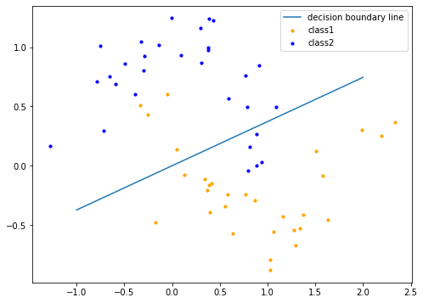
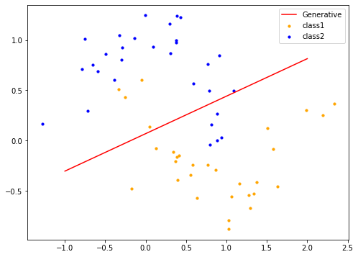
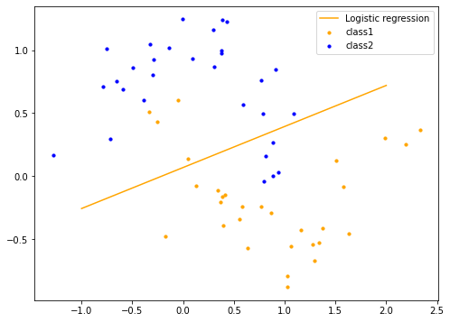
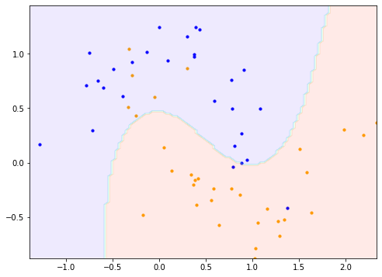
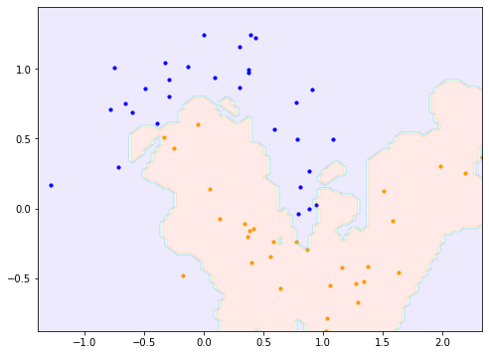
Summary
FDA
(accuracy = 0.85)
Generative
(accuracy = 0.85)
Logistic Regression
(accuracy = 0.85)
Best result (0.93)
Gaussian process
SVM with RBF kernel
Second best (0.88)
SVM with polynomial kernel
Worst (0.85)
FDA
Generative model (Gaussian assumption)
Logistic Regression
SVM with RBF kernel
(accuracy = 0.93)
Gaussian Process
(accuracy = 0.93)
K-means
Clustering
Notes:
In summary, SVM with RBF kernel and Gaussian Process showed the best performance, with the highest accuracy 0.93.
SVM with polynomial kernel was the second best.
As expected, linear models including FDA, Generative and Logistic regression showed the worst performance among the method that I tested.
I think for this dataset, SVM, Gaussian process, and density based clustering that I tried previously would be the best approach.
I think the reason for this result is that linear classification is difficult due to the nature of the data shape, and a technique to classify data into different dimensions using a Gaussian kernel was used.
Thorough the class, I think I have good chances to build my own functions.
After this class, my final goal is updating my code and building my own library, and finally, publishing as github codes.
Thank you for listening.

