Slide 1

YOUR
DEVELOPMENT ENVIRONMENT

Slide 2
LEARNING OBJECTIVES
Using the Command Line
Create folders and files using the command line (mkdir, touch)
Change directories and list directory content (cd, ls)
Check the current working directory (pwd)
Introduction to Git
Use and explain common Git commands, including init, add, commit, push, pull and clone.
Distinguish between local and remote repositories.
Create, copy and delete repositories locally or on Github
Clone remote repositories

Slide 3
Pre-Work
Mac
Install Git (type git into terminal and it will walk though the install).
Windows
Install Git Bash

Slide 4
Using the Command Line

Slide 5
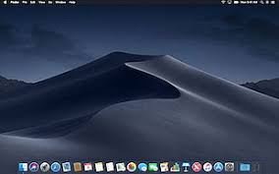
WHAT IS A GUI?
A graphical user interface (GUI), pronounced “goo-ee”, allows users to interact with a computer beyond just typing.

Slide 6
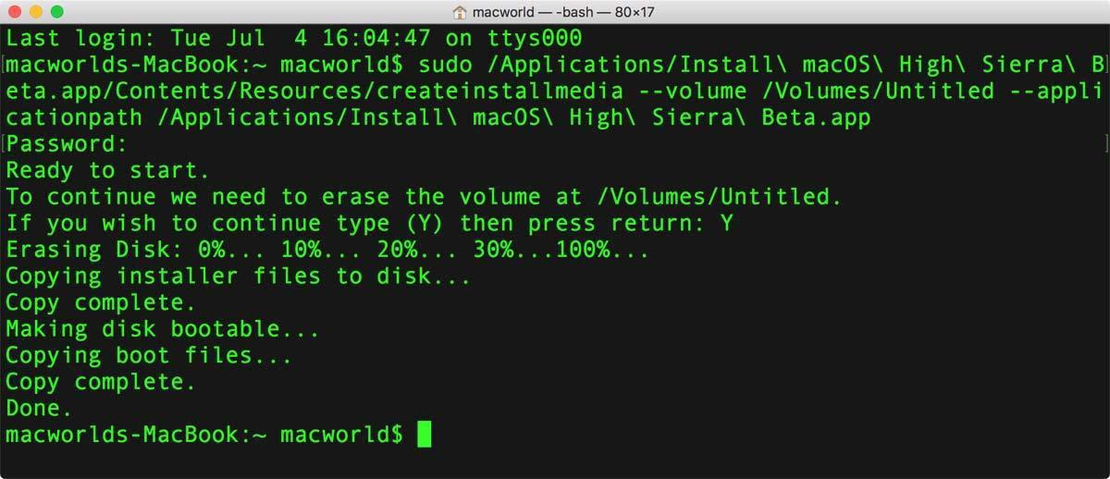
WHAT IS A CLI?
A command-line interface (CLI) is a way to interact with a computer where the client (user) issues commands using text, or command lines.

Slide 7
WHY COMMAND LINE?
This CLI is the gateway to your operating system and can perform many of the same actions without a graphical interface.
Terminal commands can assist you with:
Running processes
Finding files
Substring match of file contents
Assessing performance
Remote operations
Web browsing
Installing packages
Managing your development environment

Slide 8
BASH
In this class, we will use a popular UNIX shell called bash.
For Mac:
Terminal allows users to input command lines for the OS as well as git.
If using for first time, type git and return in the Terminal and the system will install git.
For Windows:
Git Bash provides a set of executables that emulate bash commands in the Windows shells.

Slide 9
Understanding Paths

Slide 10
TERMINOLOGY
Every file or folder in a file system can be read, written, and deleted by referencing its position inside that system. The position is called a path.
Directories are used interchangeably with folder.

Slide 11
TERMINOLOGY
Absolute Path is the specific location of a file or folder as accessed from the root directory, shown as /.
The Root directory is the starting point from which all other folders are defined, which is not typically the same as the home directory, typically found at /Users/[Your Username]
Relative Path is a reference to a file or folder relative to your current position, or the present working directory (pwd).
If you are in the folder /Users/me/C:/Documents/my_stuff and want to open the file with absolute path /Users/me/C:/Documents/my_stuff/file.txt the relative path is file.txt or ./file.txt. In a CLI, you can open it with open file.txt or open ./file.txt.

Slide 12
NAVIGATION
Changing Directories
The tilde (~) character is an alias for your home directory. Use it to quickly return home: cd ~
To navigate to your desktop you can type cd ~/Desktop
If you are already in your home directory, you can simply use the relative path: cd Desktop
Navigating to a folder with spaces in the name requires quotations, like cd “/c/My Folder”

Slide 13
NAVIGATION
The dot . means ”right here”. The double dot .. means one directory up.
To navigate to your desktop you can type cd ~/Desktop
To navigate back to your home directory from there, use cd ..
To return home from ~/Desktop/my_folder, you must execute cd .. twice.
To go back to a previous location, use cd -

Slide 14
UNDERSTANDING YOUR CONTENTS
pwd informs you of the directory you are in.
ls lists contents of current directory
ls –d */ shows subdirectories within the current directory.
ls –1 lists the contents of the directory, one item per line.
ls –a shows everything, including hidden items
ls –al will list everything vertically, in long form.
View contents of a specific directory, for example on the Desktop, use ls –a ~/Desktop

Slide 15
CREATING NEW DIRECTORIES
mkdir NewFolder will create a folder in the current directory.
To create a folder in a specific directory path, specify the directory, such as mkdir /c/Documents/NewFolder
To create a parent folder to house a new directory, use mkdir –p /c/NewParentFolder/NewFolder

Slide 16
CREATING NEW FILES
touch myFile.txt will create a text file in the new directory.
touch myFile.md will create a markdown file in the current directory.
To create multiple files at once, you can list the files: touch myFile1.txt myFile2.txt…myFile_n

Slide 17
REMOVING DIRECTORIES AND FILES
rmdir –p FolderName will remove an empty folder.
rm –rf FolderName will remove the folder and all contents.
rm FileName will remove the file in the current directory.
rm –i FileName will prompt you for confirmation before removing the file.

Slide 18
EDITING A FILE
open myFile.txt opens the file in a default editor.
open -a ”Microsoft Word" ~/Desktop/myFile.txt allows you to open file with the program specified in the quotes.
From the CLI you can also edit text.
To append text to a file, echo “This text is added to the end of the file” >> myFile.txt. If the files does not exist, it is created.
To overwrite text, echo “This text replaces existing text in the file” > myFile.txt

Slide 19
VIEWING A FILE
cat myFile.txt will display short files.
head myFile.txt will show the first few lines.
head -n myFile.txt will show the first n lines.
tail myFile.txt will show the last few lines.
tail –n myFile.txt will show the last n lines.

Slide 20
THE ESSENTIALS
If nothing else, remember these essentials:
pwd – present working directory. This is where you are in the system.
ls – list items in directory.
cd – change directories
mkdir – create a new directory (folder)
touch – create a new file
rm – remove files/folders

Slide 21
EXERCISE 1: Interacting with the Command Line

Slide 22
Common Data Science Environments

Slide 23

JUPYTER NOTEBOOKS
Open-source software for interactive computing across dozens of programming languages.
https://www.dataquest.io/blog/jupyter-notebook-tips-tricks-shortcuts/
https://github.com/adam-p/markdown-here/wiki/Markdown-Here-Cheatsheet

Slide 24
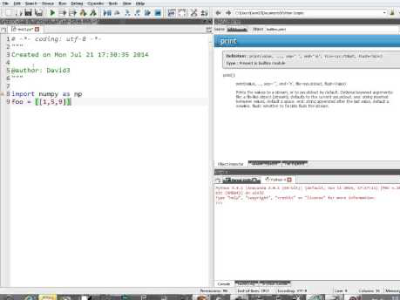
SPYDER INTERACTIVE DEVELOPMENT ENVIRONMENT (IDE)

Slide 25
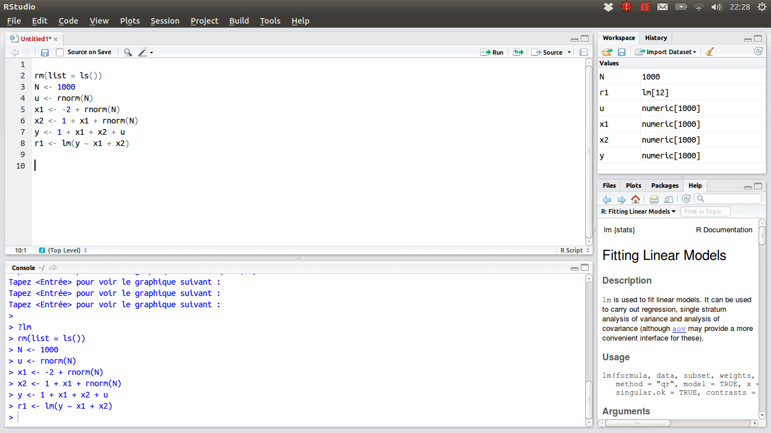
RSTUDIO
An IDE used for the R language, which is outside the scope of this class.
Available to install in Anaconda distribution.

Slide 26
TEXT EDITORS
In addition to IDEs, developers also use text editors to create or edit code and files.
Text editors are more commonly used for files that are executed via the command line, as well as for software and website development.
Common text editors:
Notepad++
Atom
Visual Studio Code

Slide 27
EXERCISE 2: Get Familiar with Jupyter Notebooks

Slide 28
Git and Github

Slide 29
WHAT IS GIT?
Created by Linus Torvalds, the creator of the Linux kernel
Program you run from the command line
Distributed version control system
Programmers use Git to keep a history of all changes made to their code. This means they can roll back changes as far back as when they started using Git in their project.
A code base in Git is referred to as a repository, or repo.

Slide 30
WHAT IS GITHUB?
Hosting service for Git repositories
Web interface to explore Git repositories
Social network for programmers
You can follow users, star your favorite projects and fork projects to be on your account.
Developers frequently use GitHub to share and collaborate on open-source code.
Git is software. GitHub is a company that happens to use Git software. Therefore, you can use Git without GitHub.

Slide 31
WHAT IS GITHUB ENTERPRISE?
Professional application of GitHub
Where GitHub is the public, 'Social Network' for programming and programmers, Github Enterprise is the private, professional application of GitHub.
Because, GitHub and GitHub Enterprise have a similar structure and are based off the git language, interacting with the two is is almost identical.

Slide 32
EXERCISE 3: Configure and Clone Git Resources

Slide 33
EXERCISE 4: Learning More Git Commands

Slide 34
Appendix

Slide 35
EXERCISE 1: INTERACTING WITH COMMAND LINE
Open the cmd prompt (or terminal)
Make sure you are in your home directory (cd if necessary)
List all items in the home directory
Change to your Documents or My Documents folder
Create a new directory called data_science
Change into that directory
Confirm whether that is your present working directory
Move back to your Documents
Remove the data_science directory
Create a new directory called DataScience
Change into that directory
Create a text file called dog.txt
Create two more text files called cat.txt and horse.txt
List all items in the directory, 1 item per line
Open dog.txt in Notepad or Word
Type the sentence “The dog jumped over the fence.” and save the file
Back in the CLI, view the contents of the file
Without opening a text editor, insert ”The cat jumped over the fence.” to cat.txt
Append another line to cat.txt that says “The fence was tall.”
Remove horse.txt, having the CLI confirm whether you want to delete it or not
List everything in the directory to confirm you have deleted the file
Remove the folder DataScience and all of its contents
Confirm you have removed the folder

Slide 36
EXERCISE 2: GET FAMILIAR WITH JUPYTER NOTEBOOKS
Open Anaconda Navigator
Launch Jupyter Notebook
In Documents, create a New Python 3 Notebook
In the notebook, where it reads “Untitled”, double click it and rename the notebook to “My First Notebook”.
Assign x=2 and print(x). Shift+Enter will execute the cell and create a new cell below.
Convert this cell to a markdown cell by toggling where it says Code below Help.
In this cell create a header, typing # My Title and hitting shift enter.
After moving to the new cell, Insert Cell Below. Insert another cell below that.
Go back to the cell with the markdown, double click to edit the cell and add a second level header using ##.
Select Cell -> All Output -> Clear
Rerun everything by selecting Cell -> Run All
In a new cell at the bottom, assign y=3 and print(y).
Clear all output again.
With your cursor in the cell with y=3, select Cell -> Run All Above.
Insert a new cell above this cell, switch it to Markdown and type “The cell below assigns 3 to y.”
Copy the cell with x=2 and paste it at the bottom.
Create a new markdown cell and type “My conclusion is the analysis demonstrates confounding evidence of definite principles.” Make the font bold. In the same cell, add a header above that saying “Conclusion”.
Save your work.
Select Kernel -> Shutdown

Slide 37
CONFIGURE GIT (This is only done once)
Open your git bash terminal
Confirm version: git --version
git config --global user.name "Your Name"
git config --global user.email your.name@example.com (Use the email address you registered with at https://git.generalassemb.ly
To see the current values, type git config --global user.name and git config --global user.email, respectively.

Slide 38
GETTING CLASS RESOURCES
In bash - navigate to where you want to keep all your DataScience materials for this class (e.g. Desktop, Documents etc)
Create a new directory to hold your data science materials
Change directory so you are in that repository
From today's lesson in slack or the course-info page - go to the url for today's lesson "Your Development Environment"
Note: You will need to be signed into git.generalassemb.ly for this next part
In the upper right of the screen click on the word that says "Fork". This will create your own private online copy of the day's lesson. In the upper left you'll see the name has changed to YourUserName/your-development-environment
Click on the green button titled "Clone or Download" on the right hand side of the screen & copy the url (clicking on the button to the right of the url will copy it for you as well)
Return to bash terminal & confirm you are in your data science directory by running pwd
The next step will likely ask you to enter your username and password. Have these ready. If you have an issue with your password please let us know on slack and an IA will assist (remote class) or just shout out (in person class)
Enter the command git clone https://git.generalassemb.ly/username/your-development-environment, replacing the URL with the one shown in your GitHuband
Hit enter
You've now copied today's lesson materials directly to your machine! Confirm they are there using the ls command

Slide 39
OPERATIONS AND COMMANDS
There are several basic operations:
Initialize
Add
Commit
Push
Pull
Clone
Some advanced operations:
Branching
Merging

Slide 40
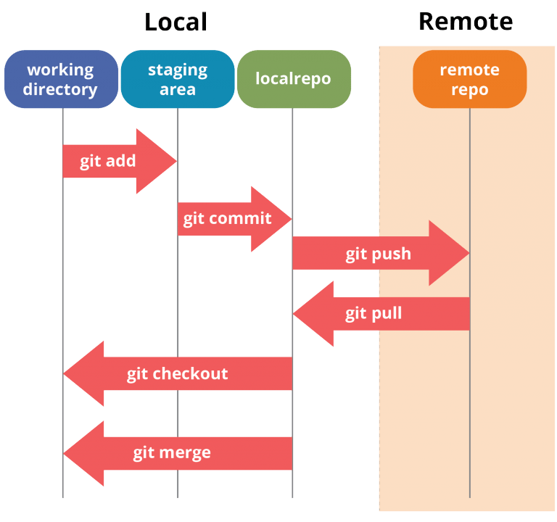
GIT ARCHITECTURE
When using Git, GitHub and GHE it is common to have your repositories in several locations. Typically, there are two repository locations, Remote and Local.
Remote: Repositories that are not stored in our current location/machine. Usually where we store the repo.
Local: Repositories that are stored on our current machine. Usually where we work on the repo.
Notes:
Local repo is

Slide 41
INITIALIZE
git init will initialize a repository on your local computer to begin tracking changes.
To begin, in git bash, create a new directory on your Desktop called myrepo.
cd ~/Desktop
mkdir myrepo
cd myrepo
Now initialize the repository with git init. Git will reply: Initialized empty Git repository in <location>. This is the working directory in which git changes will be tracked.
ls –A will show there is a hidden file called .git. This is where all information about the repo is stored.

Slide 42
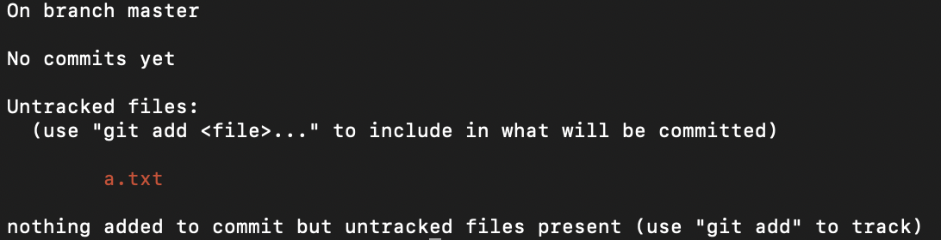
ADD
Create a new file called a.txt using touch a.txt
Run git status, we should get:
This means that there is a new, untracked file. Next, tell Git to take a snapshot of the contents of all files under the current directory.
git add a.txt will store the file in a temporary staging area, which Git calls the "index." To confirm the files are staged and ready to be committed, again run git status.
You can alternatively add all new and modified files at once using git add .

Slide 43

COMMIT
To permanently store the contents of the index in the repository, (i.e., commit these changes to the "HEAD"), you need to run the following command:
git commit -m ”Your comment”
The comment should be informative, so perhaps “Created a.txt”
The output should be something like:
git log will allow you to view the commit history.

Slide 44
CREATING A NEW REMOTE REPO
On your GitHub account, on the right hand side, select the + button for New repository.
Name your repository myrepo, just like the one on your local computer. (Do not initialize with a README).
Notice the instructions to push an existing repository. To send files from our local machine to our remote repository on GitHub, we need to use the command git push. However, you also need to add the name of the remote repo — in this case, we called it origin — and the name of the branch, in this case master.
In git bash, while in the local myrepo directory, type git remote add origin https://git.generalassemb.ly/kevmccullough/myrepo.git, replacing the URL with the one shown in your GitHub.
Hit return and then type git push –u origin master.
Refresh your GitHub and the files from your computer should appear.
Now every time you want to push files, you just need to use git push

Slide 45
PUSH
Add a new file called b.txt in your local my repo.
Once you add and commit this file to git, you can then use git push to add the file to your remote repo.

Slide 46
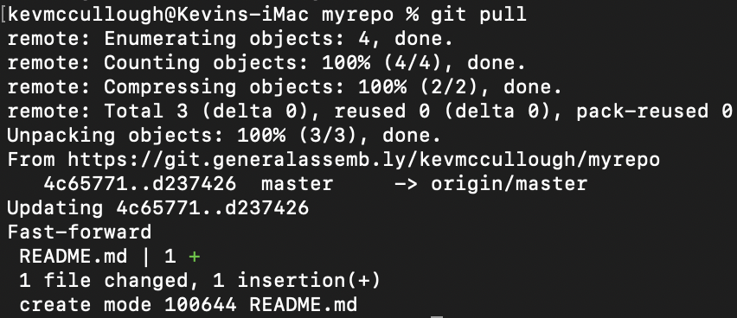
PULL
Pull is the opposite of push, meaning you are bringing changes made from a remote repo down to your local repo.
In GitHub in myrepo, select the button Add A README. You can edit the file and near the bottom you can commit the file.
Notice this change does not show up in your local copy. To do so, make sure that in git bash you are in the local directory and type git pull.

Slide 47
CREATE A PULL REQUEST ON GITHUB
When working on a project with other collaborators, we all can’t work on same repo at same time, so we use branches.
With branches, we can create branch off of the main repo, or “master” branch. There, additions or alterations can be made, and then merge changes back into the master.
Rather than a branch merging automatically, your request goes through an administrator who can review your changes and additions and approve or deny the request.

Slide 48
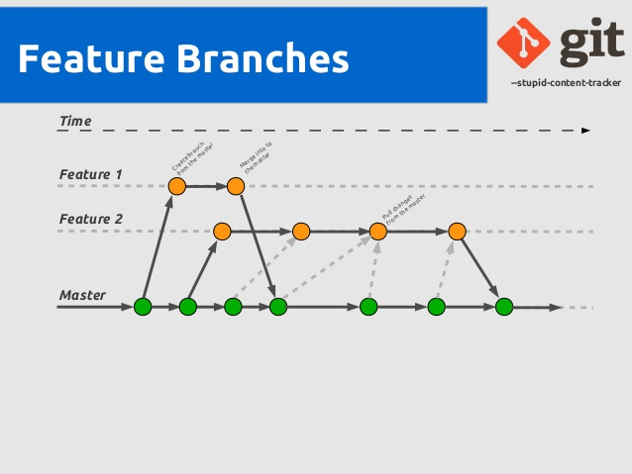
CREATE A PULL REQUEST ON GITHUB
Even though we are trying to push information into master, it is called a pull request because we are making a request to the administrator to pull our branch into master.

Slide 49
PULL REQUEST
Online, in Github, Create a new repository called test.
Initialize the repository with a README.
Click "Branch:master" on the left-hand side and create a branch called 'branch-edits' by typing in the box and hitting enter. This should put you on your new branches page.
Make sure you're on your new branch and in GitHub create a new '.md' or '.txt' file using the “Create new file” button. Call it what you like and place some text in it.
Edit the readme by clicking on the pencil logo on the top right of the readme. Add a sentence saying “This is a new sentence.”
Select “Compare” on the branch-edits branch. Review the changes.
Select “Create pull request.” Add a message and select “Create pull request again.”
Select ”Merge pull request” and “Confirm merge” to merge the changes into master. You can ”Delete the branch.” If you were to reject the changes, you can leave a comment and select “Close pull request.”
The end of today's lesson is to delete your local myrepo then go online and delete your online repo
Local Repo
Either navigate to the the folder in the UI and delete it or complete it from the command line
Note consider deleting the ".git" folder first, navigate to the folder in bash and notice there is no longer a master branch tag anymore
Online Repo
Navigate to the online repo folder
Select Settings in the upper right
Navigate to the bottom of the page and click on Delete this repository
Enter the repo name then click on I understand the consequences, delete this repo

Slide 50
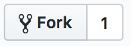
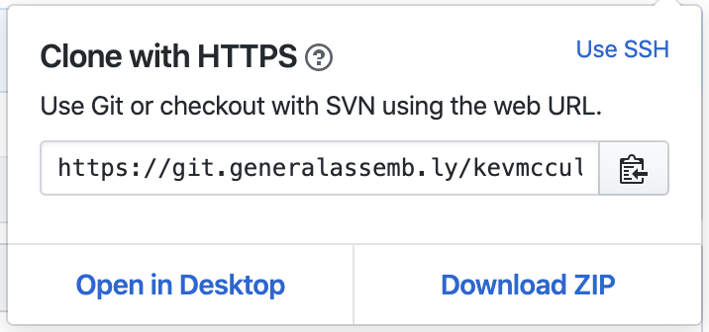

CLONE
Cloning is most useful when there is a repo that exists remotely that we want on our local machines.
Fork the main repo for this lesson to your account. Forked repos are personal copies of others’ repositories.
Once the repo is forked, you can clone it to your local machine by first copying the URL.
In your git bash, go to the directory in which you want to clone this repo and type clone <URL>, pasting the URL in the clone command.

Slide 51
GIT WORKFLOW
Change directories into your Documents.
Create a new directory called gitpractice.
Change into that directory.
Initialize the repo for git.
Add a file called hello-world.txt.
Open the file from the command line in a text editor and add “Hello World” and save.
In the command line, view the contents of the file.
Check the git status.
Add the file to the git index.
Commit the file.
Create another file called hello-planet.txt. Add ”Hello Planet” without opening a text editor.
Check the git status.
Create another file called hello-mars.txt. Add ”Hello Mars” without opening a text editor.
Check the git status.
Now add both files to the index at once.
Commit the files.
Create a new repo on GitHub called gitpractice.
Push the local repo to the remote repo.
Add a readme on the remote repo.
Pull those changes to your local repo.
Check the git log.
Bonus: revert back to a previous commit: git revert <commit hash>

Slide 52
HOW WE WILL USE GITHUB IN THIS CLASS
Our use of GitHub will be very linear.
There is the central class repository where all of the lesson materials are housed. You will create a forked version of the master repo which will be yours to do as you please.
Forked repos are personal copies of others’ repositories.
If the original is updated, you can pull those changes to your copy via git pull upstream master.

Slide 53
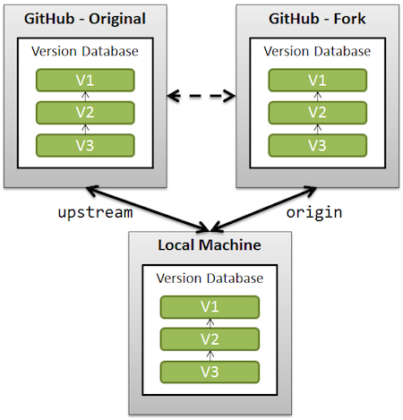
HOW WE WILL USE GITHUB IN THIS CLASS
Once we have a forked copy, we will clone the fork to our machines to make a local copy.
Most of your git commands will be pulling updates from the main class repo to your local and pushing changes make on your local to your remote version.

Slide 54
CONCLUSION
You should now know how to use the Command Line and Git, both separately and in conjunction with each other.
You should also have an initial understanding of Jupyter Notebooks.

