Slide 1
进化算法 evoluntionary algorithms,EAs
In artificial intelligence, an evolutionary algorithm (EA) is a subset of evolutionary computation, a generic population-based metaheuristic optimization algorithm. An EA uses mechanisms inspired by biological evolution, such as reproduction,mutation,recombination,and selection. Candidate solutions to the optimization problem play the role of individuals in a population, and the fitness function determines the quality of the solutions (see also loss function). Evolution of the population then takes place after the repeated application of the above operators.它不是一个具体的算法，而是一个“算法簇”。

Slide 2
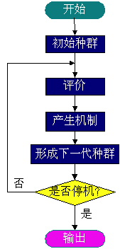
进化算法包括遗传算法、进化程序设计、进化规划和进化策略等等，进化算法的基本框架还是简单遗传算法所描述的框架，但在进化的方式上有较大的差异，选择、交叉、变异、种群控制等有很多变化，进化算法的大致框图可描述如右图所示。

Slide 3
Genetic algorithm （GA）
借鉴生物界自然选择和自然遗传机制的随机化搜索算法。模拟自然选择和自然遗传过程中发生的繁殖、交叉和基因突变现象。遗传算法通常实现方式为一种计算机模拟。对于一个最优化问题，一定数量的候选解（称为个体）的抽象表示（称为染色体）的种群向更好的解进化。传统上，解用二进制表示（即0和1的串），但也可以用其他表示方法
在每次迭代中都保留一组候选解，并按某种指标从解群中选取较优的个体，利用遗传算子(选择、交叉和变异)对这些个体进行组合，产生新一代的候选解群，重复此过程，直到满足某种收敛指标为止。

Slide 4
遗传算法中每一条染色体，对应着遗传算法的一个 解决方案,使用适应度函数（fitness function）衡量该解决方案的优劣。可以把遗传算法的过程看作一个在多元函数里面求最优解的过程。
模拟物竞天择的生物进化过程，通过维护一个潜在解的群体执行了多方向的搜索，并支持这些方向上的信息构成和交换。以面为单位的搜索，比以点为单位的搜索，更能发现全局最优解。

Slide 5
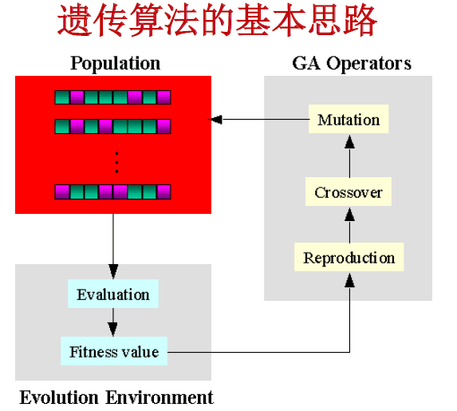

Slide 6
遗传算法的实现过程
首先寻找一种对问题潜在解进行“数字化”编码的方案。
————建立表现型和基因型的映射关系
用随机数初始化一个种群（那么第一批袋鼠就被随机化的分散到了山脉上），种群里面的个体就是这些数字化的编码。
通过适当的解码过程（得到袋鼠的位置坐标）之后，用适应性函数对每一个基因个体进行适应度评估。（袋鼠爬的越高，其适应度越高）
用选择函数按照某种规定进行择优选择（我们要每隔一段时间，在山上射杀一些所在海拔较低的袋鼠，以保证袋鼠总体数目持平。）
使个体基因交叉变异（让袋鼠随机跳一跳）然后产生子代（希望存活下来的袋鼠是多产的，并在那里生儿育女）
遗传算法并不保证你能获得问题的最优解，但是使用遗传算法的最大优点在于不必去了解和操心如何 去“找”最优解。（不必去指导袋鼠向哪边跳，跳多远。）而只要简单的“否定”一些表现不好的个体就行了。（把那些总是爱走下坡路的袋鼠射杀。）

Slide 7
一般步骤
1.评估每条染色体所对应个体的适应度。
2.遵照适应度越高，选择概率越大的原则，从种群中选择两个个体作为父方和母方。
3.抽取父母双方的染色体，进行交叉，产生子代。
4.对子代的染色体进行变异。
5.重复2，3，4步骤，直到新种群的产生。
结束循环。

Slide 8
基本遗传算法的组成
（1）编码（产生初始种群）
（2）适应度函数（它的设计应结合求解问题本身的要求而定）
（3）遗传算子（选择（轮盘赌选择方法）、交叉、变异）
（4）运行参数

Slide 9
编码
采用二进制编码（表现个体特征）
010010011011011110111110
采用浮点数编码（当个体特征比较复杂时）
1.2 – 3.3 – 2.0 –5.4 – 2.7 – 4.3
编码的目的是建立基因型到表现型之间的映射关系

Slide 10
轮盘赌（Roulette Wheel Selection）选择法
轮盘赌选择方法的实现步骤: （1）计算群体中所有个体的适应度值； （2）计算每个个体的选择概率； （3）计算积累概率； （4）采用模拟赌盘操作（即生成0到1之间的随机数与每个个体遗传到下一代群体的概率进行匹配） 来确定各个个体是否遗传到下一代群体中。

Slide 11
假设有4条染色体，他们所对应的适应度评分分别为：s1= 13 (01101) ，s2= 24 (11000)， s3= 8 (01000)，s4= 19(10011)
f(s)=s^2 ，则 f (s1) = f(13) = 13^2 = 169 f (s2) = f(24) = 24^2 = 576 f (s3) = f(8) = 8^2 = 64 f (s4) = f(19) = 19^2 = 361
累计总适应度为：F=169+576+64+361=1170
各个个体被选中的概率分别为：

Slide 12
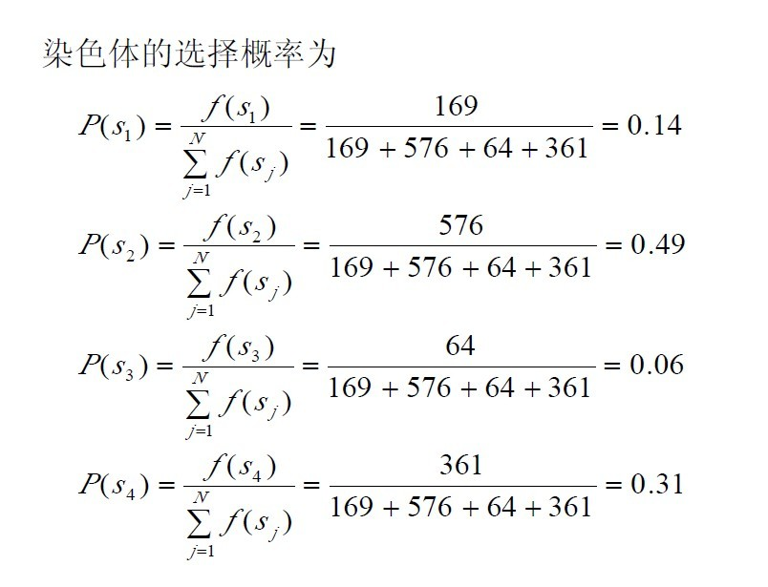

Slide 13
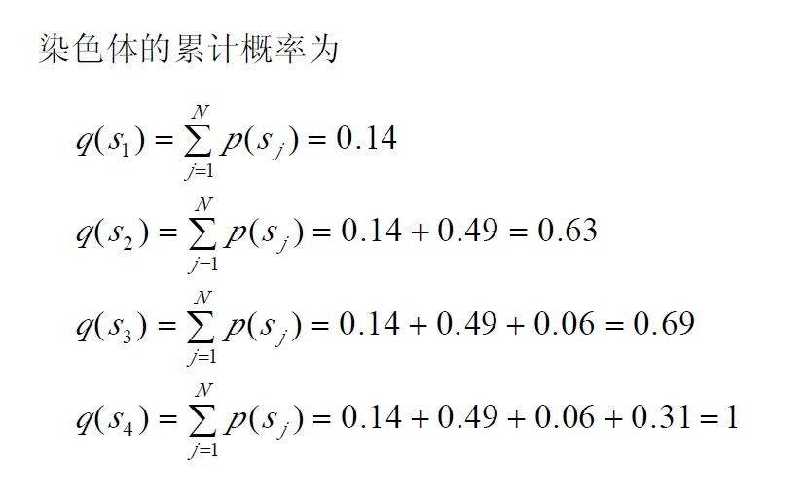

Slide 14
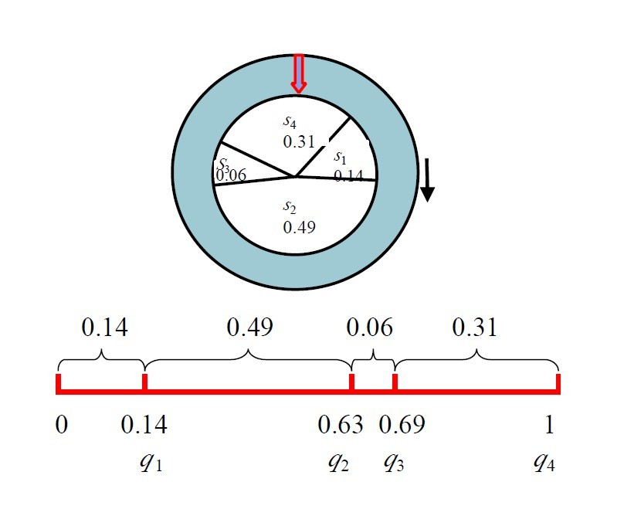

Slide 15
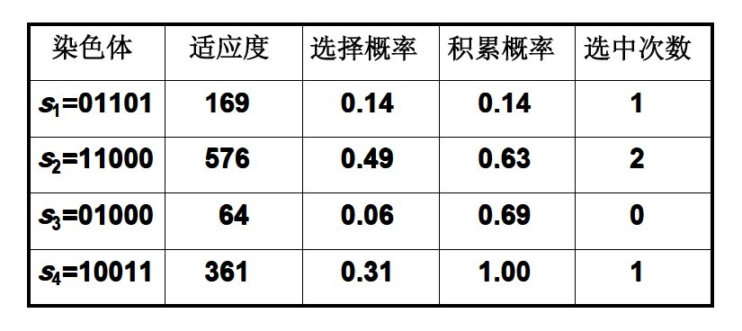
例如设从区间［0, 1］中产生4个随机数:
r1 = 0.450126, r2 = 0.110347
r3 = 0.572496, r4 = 0.98503

Slide 16
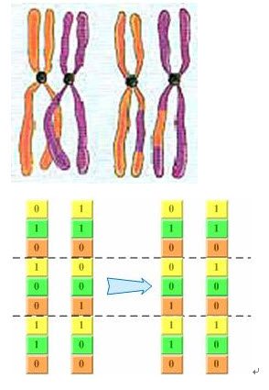
基因重组/交叉

Slide 17
基因突变
基因串上的“ 0”或“ 1”有一定几率变成与之相反的“ 1”或“ 0”。
例如 00000100011110
10000000011110
浮点型编码的基因突变过程一般是对原来的浮点数增加或者减少一个小随机数（步长）。

Slide 18
一些参数的设置
目标函数的左右区间，目前的设置是[-1,2]
遗传算法相关参数：
每条染色体的编码个数
进化的代数
种群的人口数目
基因交叉概率，基因突变的概率 ，基因变异的步长（针对浮点数编码）

Slide 19
1） 初始化 t←0进化代数计数器；T是最大进化代数；随机生成M个个体作为初始群体 P（t）；
2） 个体评价 计算P（t）中各个个体的适应度值；
3） 选择运算 将选择算子作用于群体；
4） 交叉运算 将交叉算子作用于群体；
5） 变异运算 将变异算子作用于群体，并通过以上运算得到下一代群体P（t + 1）;
6） 终止条件判断 t≦T：t← t+1 转到步骤2；
t>T：终止 输出解。

Slide 20
优势与不足
优势：1. 与问题领域无关切快速随机的搜索能力。 2. 搜索从群体出发，具有潜在的并行性，可以进行多个个体的同时比较，robust. 3. 搜索使用评价函数启发，过程简单 4. 使用概率机制进行迭代，具有随机性。 5. 具有可扩展性，容易与其他算法结合。
不足：1、遗传算法的编程实现比较复杂,首先需要对问题进行编码,找到最优解之后还需要对问题进行解码,
2、另外三个算子的实现也有许多参数,如交叉率和变异率,并且这些参数的选择严重影响解的品质,而目前这些参数的选择大部分是依靠经验.
3、没有能够及时利用网络的反馈信息,故算法的搜索速度比较慢，要得要较精确的解需要较多的训练时间。
4、算法对初始种群的选择有一定的依赖性，能够结合一些启发算法进行改进。

Slide 21
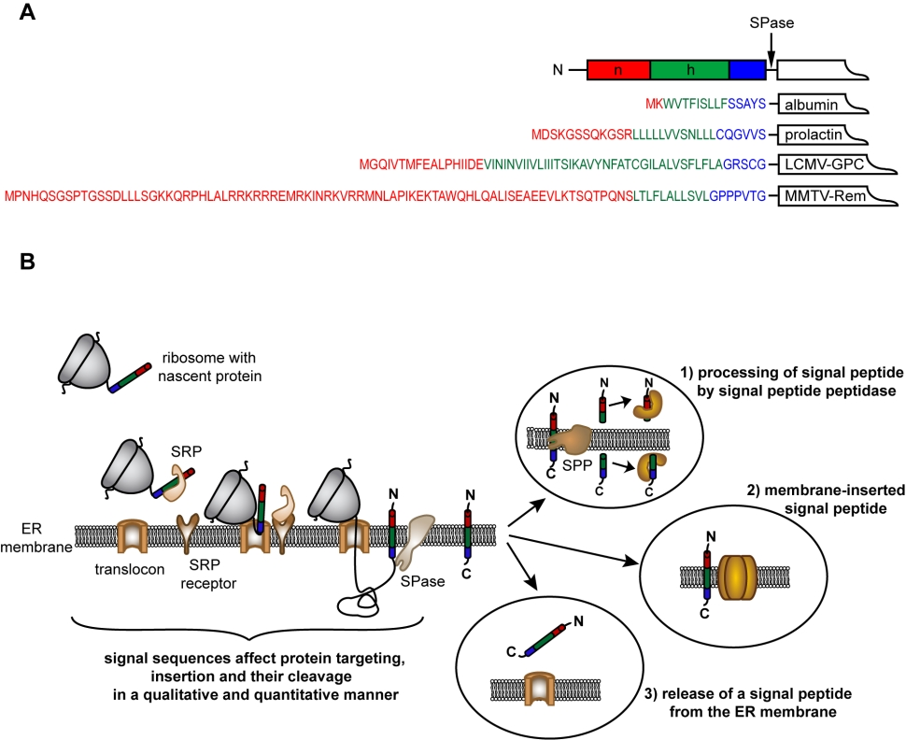
Analysis of cleavage-site patterns in protein precursor sequences with a perceptron-type neural network

Slide 22
背景介绍
Many nuclear encoded proteins destined for organelles like mitochondria and chloroplasts are synthesized as precursor proteins in the cytoplasm of the cell. Proteins targeted to the organelles are processed inside of them by special proteases which cleave off N-terminal targeting sequences .
The cleavage-site region of precursor proteins consists of amino acid sequences showing no or only little homology（无专一性）
among other functional important sequences the classification of targeting peptides and their cleavage-sites of nuclear encoded organelle proteins will be helpful for understanding genome organization.

Slide 23
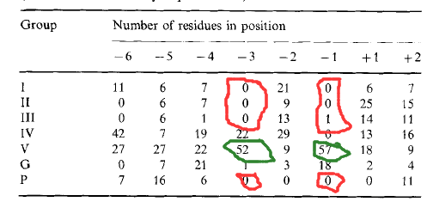
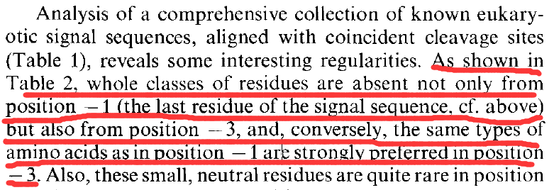
研究现状
Alignment procedures and statistical approaches led to the discovery of several rules describing cleavage-site regions already, e.g. the well known “-3, -1 rule” for eubacterial and eukaryotic secretory targeting signals。

Slide 24
Using these rules for prediction leads to accuracies less than 100% which still is not sufficient for an accurate analysis of chromosome organization。
For an identification of locally encoded sequence patterns improved results for sequence classification and prediction can already be obtained with a Perceptron-type neural network although it still has limitations due to its architecture。
a Perceptron-type neural network to the identification of cleavage-site features which allows a property-based analysis of protein sequence data combined with a neural network feature extraction。 contrast to most earlier approaches to this problem, the cleavage-site sequences are described in terms of four physico-chemical amino acid properties which have been identified to be useful for cleavage-site analysis : Hydrophobicity, hydrophilicity , polarity , and side-chain volume

Slide 25
An evolutionary computing algorithm, the simple Evolution Strategy , was used for network training instead of the commonly used generalizing delta rule。
Although these multilayer networks appear to be well suited for the development of prediction systems they lack the possibility to explicitely show what the important sequence features are. non-symbolic technique itself, many investigations using neural networks are based on a sequence representation in terms of binary numbers representing characters rather than physico-chemical property values.
The obtained optimized networks have been analyzed using Hinton-diagrams which offers the possibilty to interprete a network's weight values wjj

Slide 26
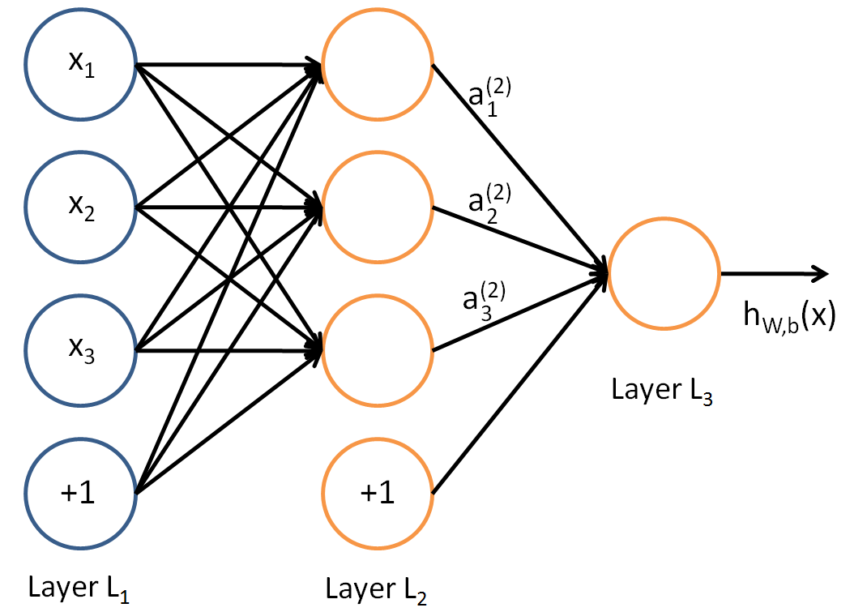

Slide 27
methods
Data selection and preparation
24 E.coli periplasmic protein precursors, 27 chloroplast precursor sequences from spinach, and 39 human mitochondrial precursor proteins with experimentally confirmed cleavage-sites were selected from the SwissProt database.
Training seq vs test set(7:3)
17 vs 7 (E.coli)
19 vs 8 (chloroplast)
27 vs 12 (mitochondrial )
The training data(positions -10 to +2)--- 12-residue windows served as positive examples,(positive examples:negative examples=1:3)

Slide 28
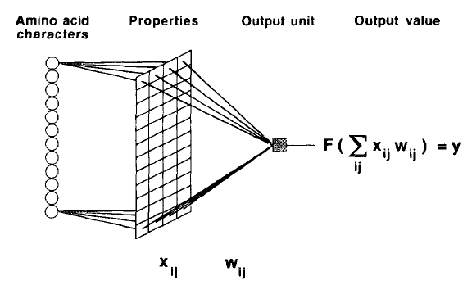
methods
Network architecture and training technique
感知机神经网络模型示意图

Slide 29
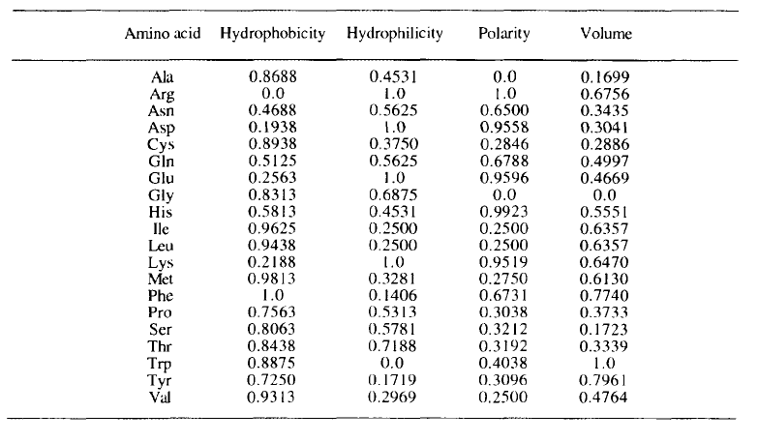
method
The normalized property scales

Slide 30

The single output unit calculates the network's output value (0.0 <y < 1.0)for a given sequence window using a sigmoid function F(x) = 1 / (1 + exp(-x)) as transfer function (In contrast to the classical Perceptron) Therefore, the separation of positive and negative examples of a training set is not restricted to linear separation

Slide 31
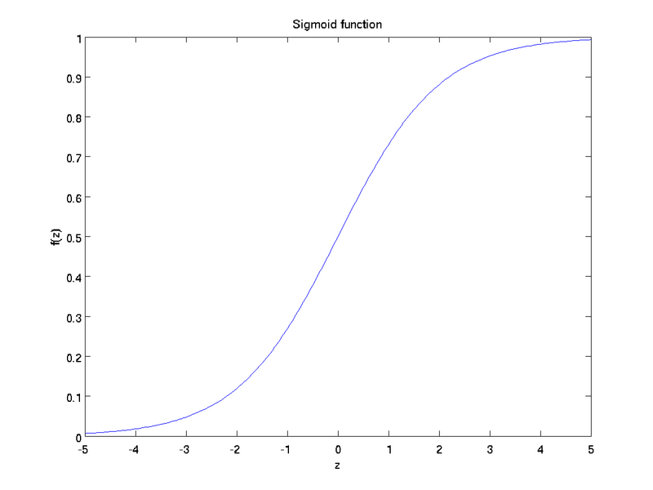
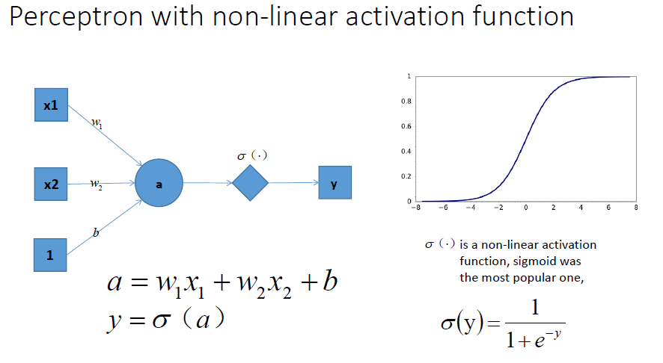
做sigmoid变换的目的是把（-inf，+inf）取值范围的信号（用x表示）映射到（0，1）范围内（用y表示）

Slide 32

The task was to find the correct weight values wu. which allow an optimal separation between positive and negative examples.For this, a -evolution strategy with a daptive stepsize control was used
This optimization method employs a systematic top down search in the feature space imitating the natural process of repeated mutation and selection
The best weight values of a learning cycle are selected following an external quality function. We used the minimization of the square error A2 for supervision of the learning process:

Slide 33

n is the number of sequence windows in the training set, tp is the desired output value (1.0 for a positive example, 0.0 for a negative example), and yp is the actual network output for the training sequence p.
To reduce the effect of overlearning, a second simple statistical quality function Q was used to determine the termination time of the learning process. Q calculates the prediction accuracy of the network:
P is the positive correct prediction, N is the negative correct prediction, and tot is the total number of investigated residues
If Q=1 terminate.

Slide 34
learning cycles<=200
a high Q value and a low absolute square error 0² of its output value.

Slide 35
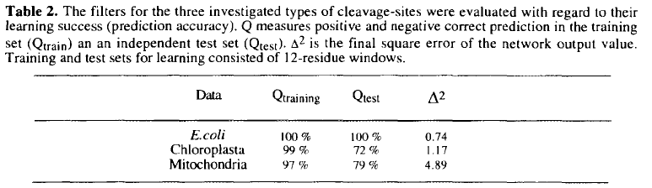
结果分析
indicating that no generalizing feature could be found

Slide 36
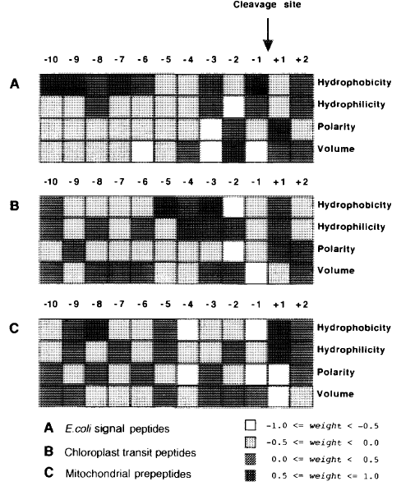
结果分析

Slide 37
Description of E.coli signal peptide cleavage-site patterns
In general, there are two predominant sections around the signal peptidase cleavage-site：A mainly hydrophobic part starting at -6 and the positions -3 to -1； Polar residues at the N-terminus of the mature protein (+1) appear to contribute to the cleavage-site signal

Slide 38
Description of chloroplast transit peptide cleavage-site patterns
A cluster of extreme values at the positions -5 to -1
Description of mitochondrial prepeptide cleavage-site patterns
Position -8 is found to be occupied by strong
hydrophobic residues which is confirmed by experiments

