Slide 1

Cutlery: Comprehensive Analysis Pipeline for CUT&RUN Data
2020/07/31
Hee-Woong Lim

Slide 2
Goal:
Development of comprehensive analytic pipeline
Level 1: analogous to ChIP-seq data analysis
  Peak calling
  Motif search & TF prediction
  Visualization
Level 2: high-resolution chromatin landscape, i.e. footprint
  Primary TF binding
  Secondary TF binding
  Co-binding
  Bias correction
What about histone CUT&RUN?
+ Packaging & publication

Slide 3
Technical Challenges Ahead
Peak centering
  Currently, peak is centered at the signal summit
  Slight offset from the primary motif is observed unlike ChIP-seq peak
  EChO method?
Statistical model for robust footprint analysis
  Joint model incorporating motif & footprint
  Benchmarking of analogous methods such as DNase footprint data
Performance evaluation platform
  A few methods developed for CUT&RUN footprint (e.g. CUT&RUNtools)
  Comprehensive benchmarking is yet to be done
  How to evaluate the footprint performance
Packaging and publication
  How to share our tool effectively with others?
  Conda? Docker? Or porting to different unified programming language?
Any further information we can learn from CUT&RUN?
  Other than histone modification from histone CUT&RUN?

Slide 4
Current status of Cutlery
Bunch of bash and R scripts
Snakemake-based automatic parallel processing
Fastq
Processed sample
Adapter trimming
Fragment groups
NFR/NUC/all
Alignment
Nucleotide base frequency at frag. ends
Fragment length distribution
Filtering
K-mer frequency
Deduplication (optional)
Homer tag directories
Homer peak calling
Motif search
Processed BAM
BigWig files from fragments
Peak visualization
BigWig files from 5’ 1bp
Footprint analysis
FCL file (fcl.bed.gz)

Slide 5
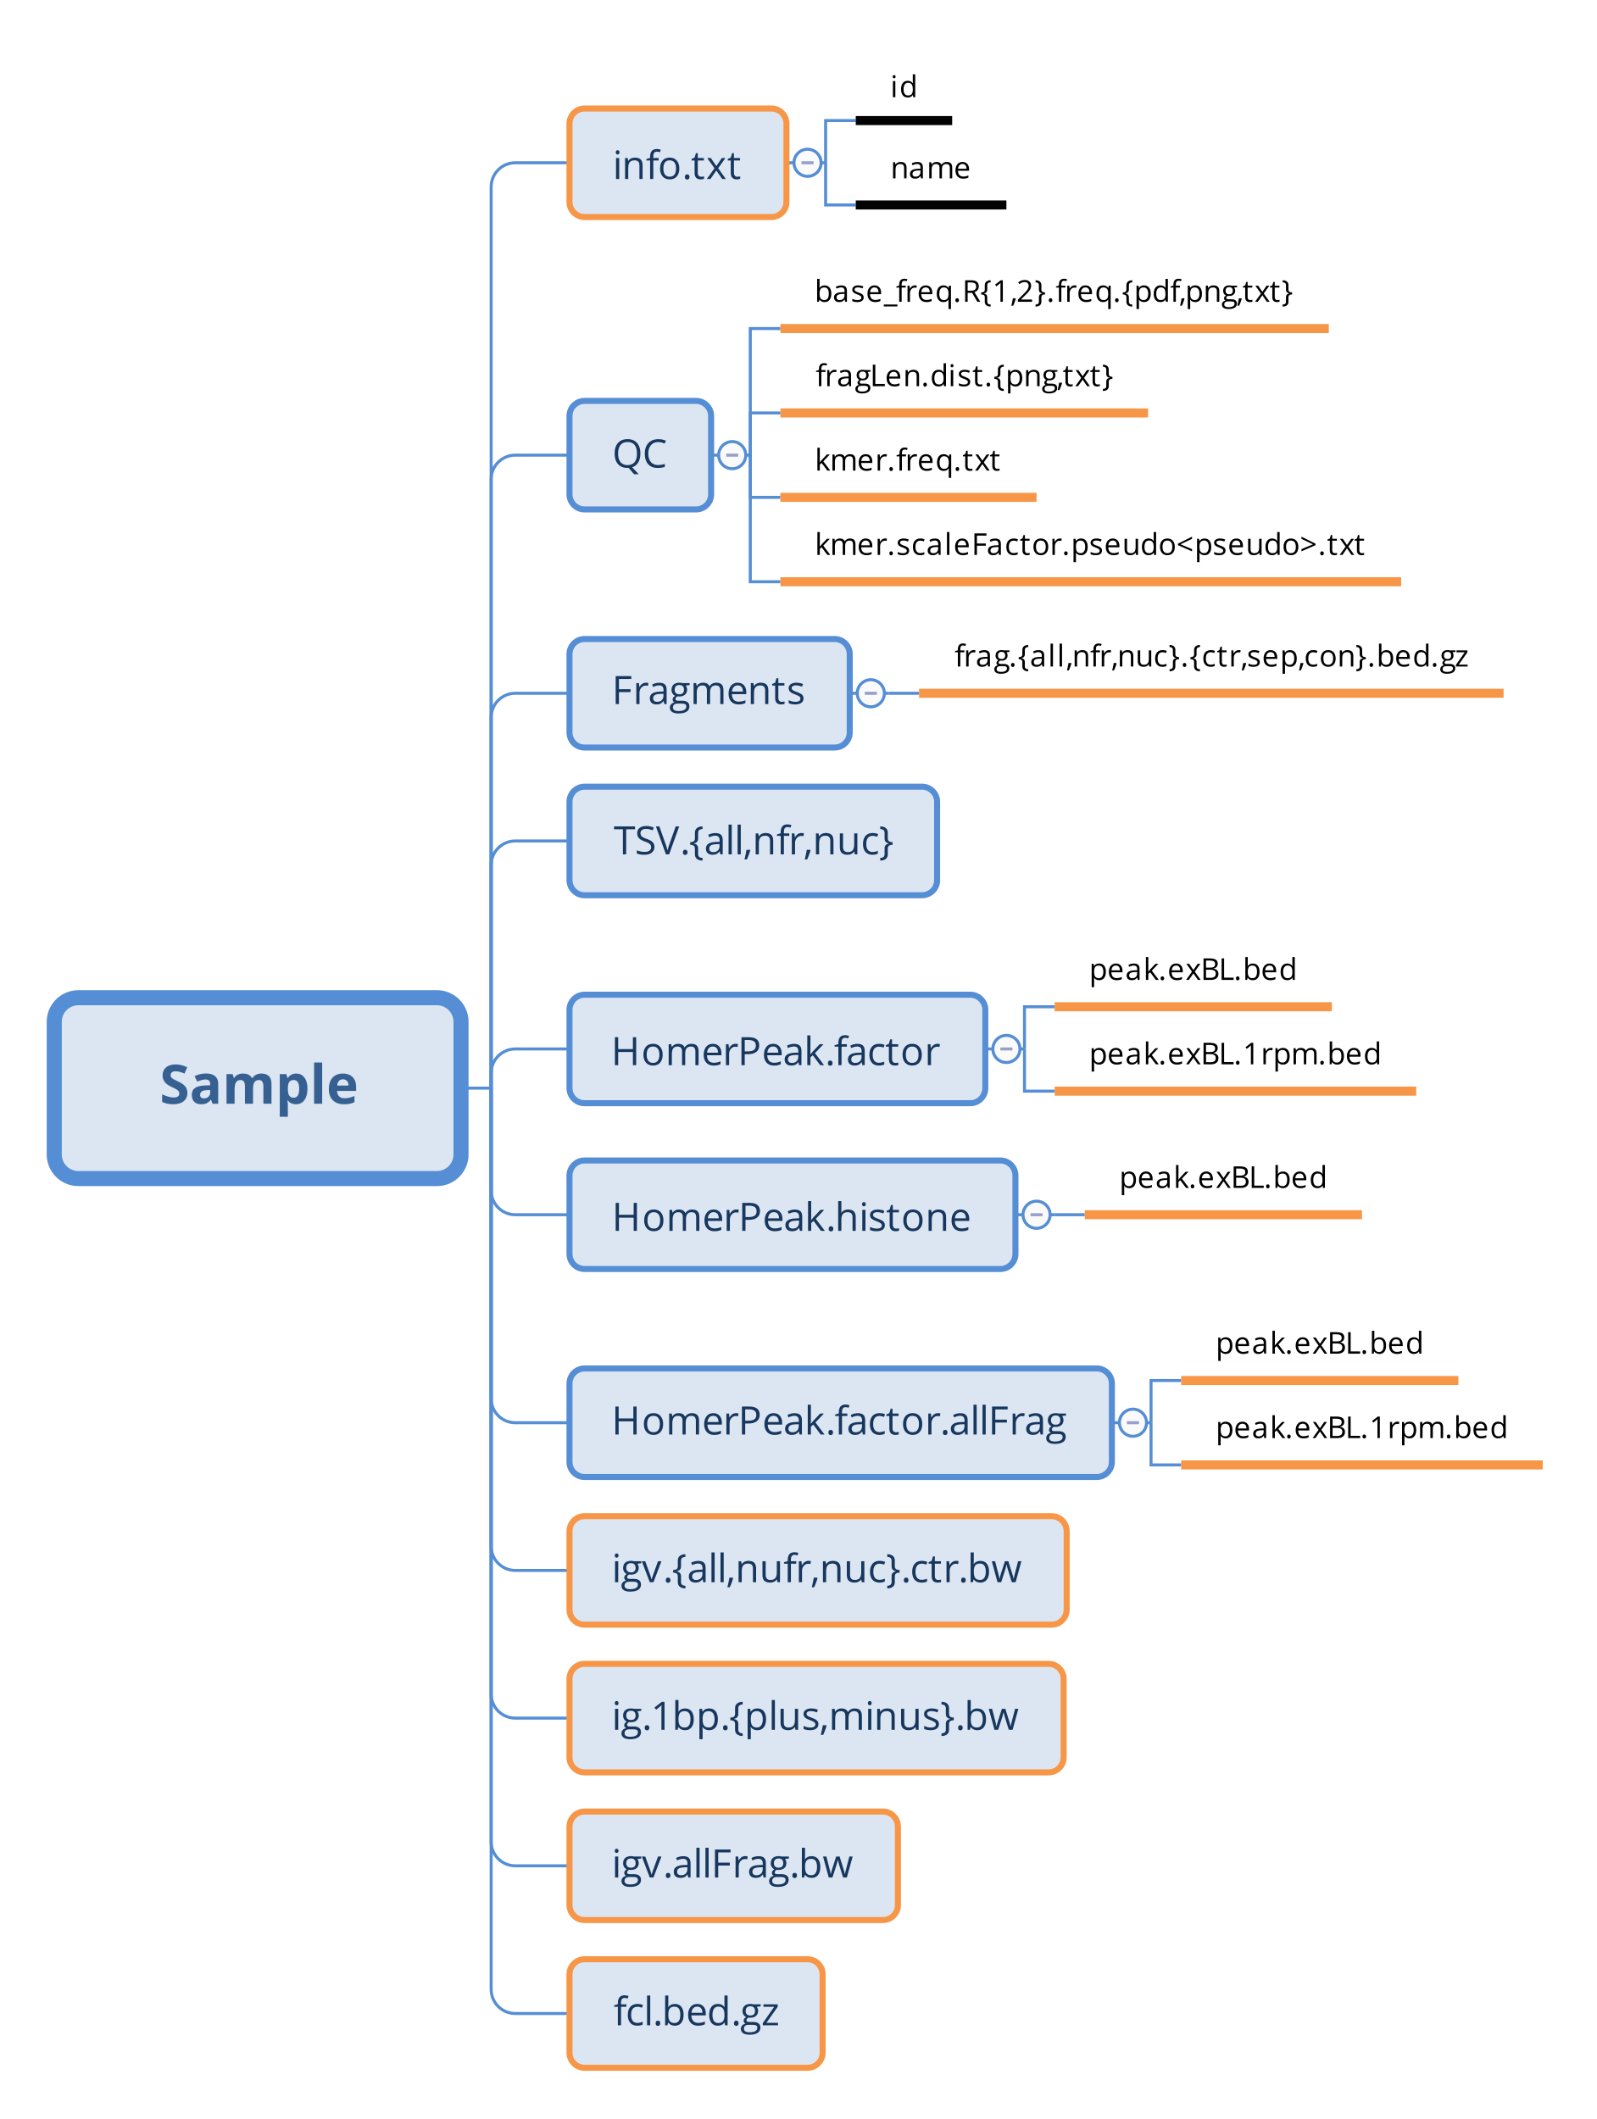
Processed Sample Directory
Sample information
Folder
File
Quality control
& k-mer bias
Text field
Fragment groups
Homer tag directory
TF peak calling using NFR fragments
Histone peak calling
TF peak calling using all fragments
bigwig file (resized) using
distinct groups of fragments
Still exploring phase for best analysis
Overlap & redundancy
Can be more concise
bigwig file (5’-ends 1bp)
bigwig file using all original fragments
fragment center x length file

Slide 6
previous version

Slide 7
Current status of Cutlery
Bunch of bash and R scripts
Snakemake-based automatic parallel processing
Fastq
Processed sample
Adapter trimming
*Nucleotide base frequency
at 5’-ends of reads
*planned to move downstream below fragment generation
Alignment
Fragment groups
NFR/NUC/all
Fragment length distribution
Filtering
K-mer frequency
Deduplication (optional)
Homer tag directories
Homer peak calling
Motif search
Processed BAM
BigWig files from fragments
Peak visualization
BigWig files from 5’ 1bp
Footprint analysis
FCL file (fcl.bed.gz)

