Slide 1
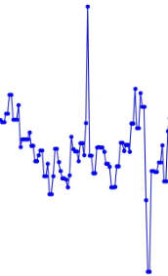

Sim data
Content encoder
Latent vector
1 or 0
(up down)
Freeze
Sim data
Content encoder
Latent vector
Sim data
Style encoder
Latent vector
Decoder
Sim data
Real data
Content vector
: Concat
Content encoder
Fixed vector
Style encoder
Sim style vector
Decoder
Real2Sim

