Slide 1


Demonstration of sorting algorithms on an array
bubble sort, heap sort, and shell sort

Slide 2
Requirement
Sorting algorithm is an algorithm that puts elements of a list in a certain order. Efficient sorting is important for optimizing the efficiency of many other algorithms. A lots of sorting algorithm have been developed so far, making it difficult to understanding and remembering all of them. This project purpose is to help people get a better understanding 3 basic sorting algorithms: bubble sort, heap sort, and shell sort through a visualizing application showing each step of the algorithms. The application is built in Java with the GUI created using JavaFX.

Slide 3

Member and Assignment
Nguyễn Huy Hoàng 20210373
Nguyễn Xuân Hưng 20194585
Nguyễn Huy Hoàng 20215056
HeapSort Class
CreateArray Class
Main Class
Report
MainMenu.fxml, About.fxml, MainScreen Controller
BubbleSort Class
Demo video
Slide
BubbleSort.fxml, SortController
ShellSort Class
GeneralSort Class
HeapSort.fxml, ShellSort.fxml

Slide 4
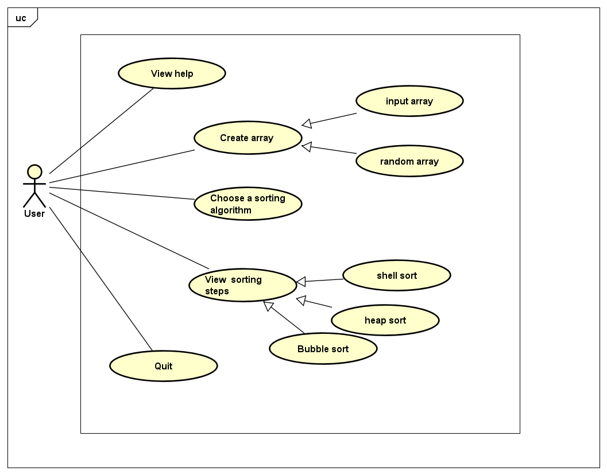
Use-case Diagram

Slide 5
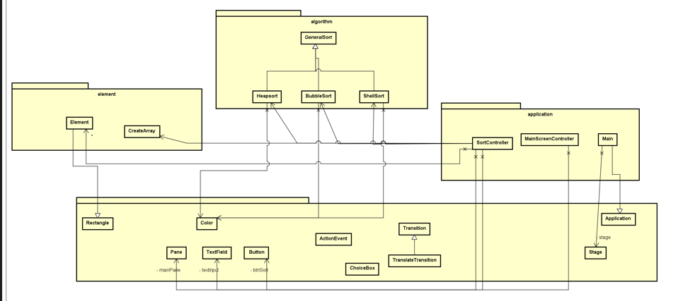
General Class Diagram

Slide 6

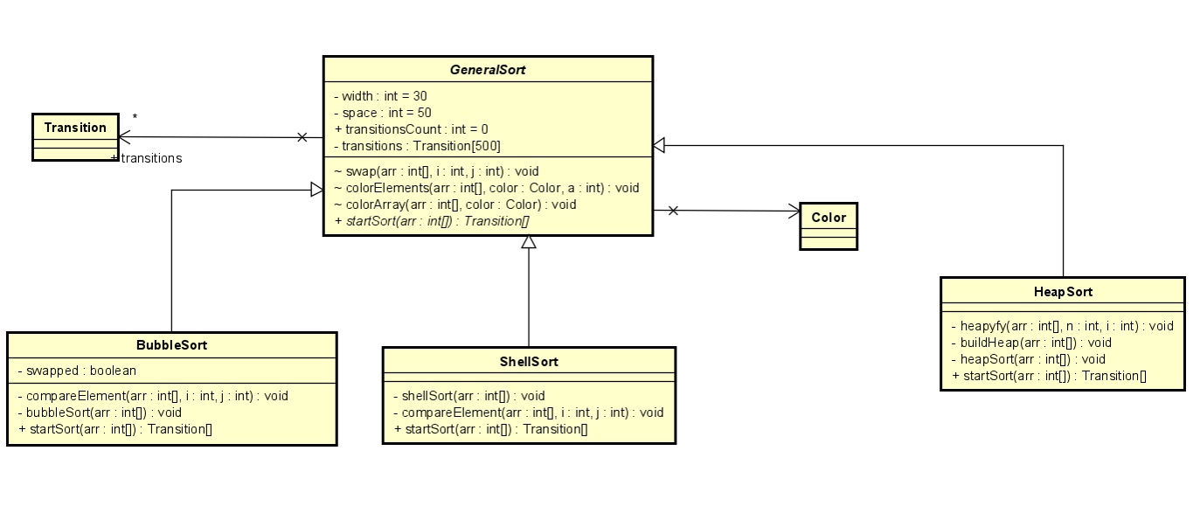
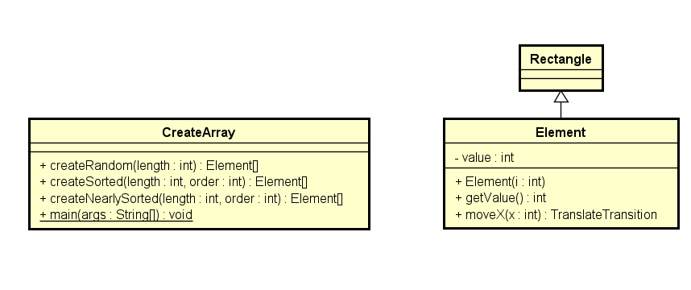
Detail Class Diagram
Package Element
Package Algorithm

Slide 7
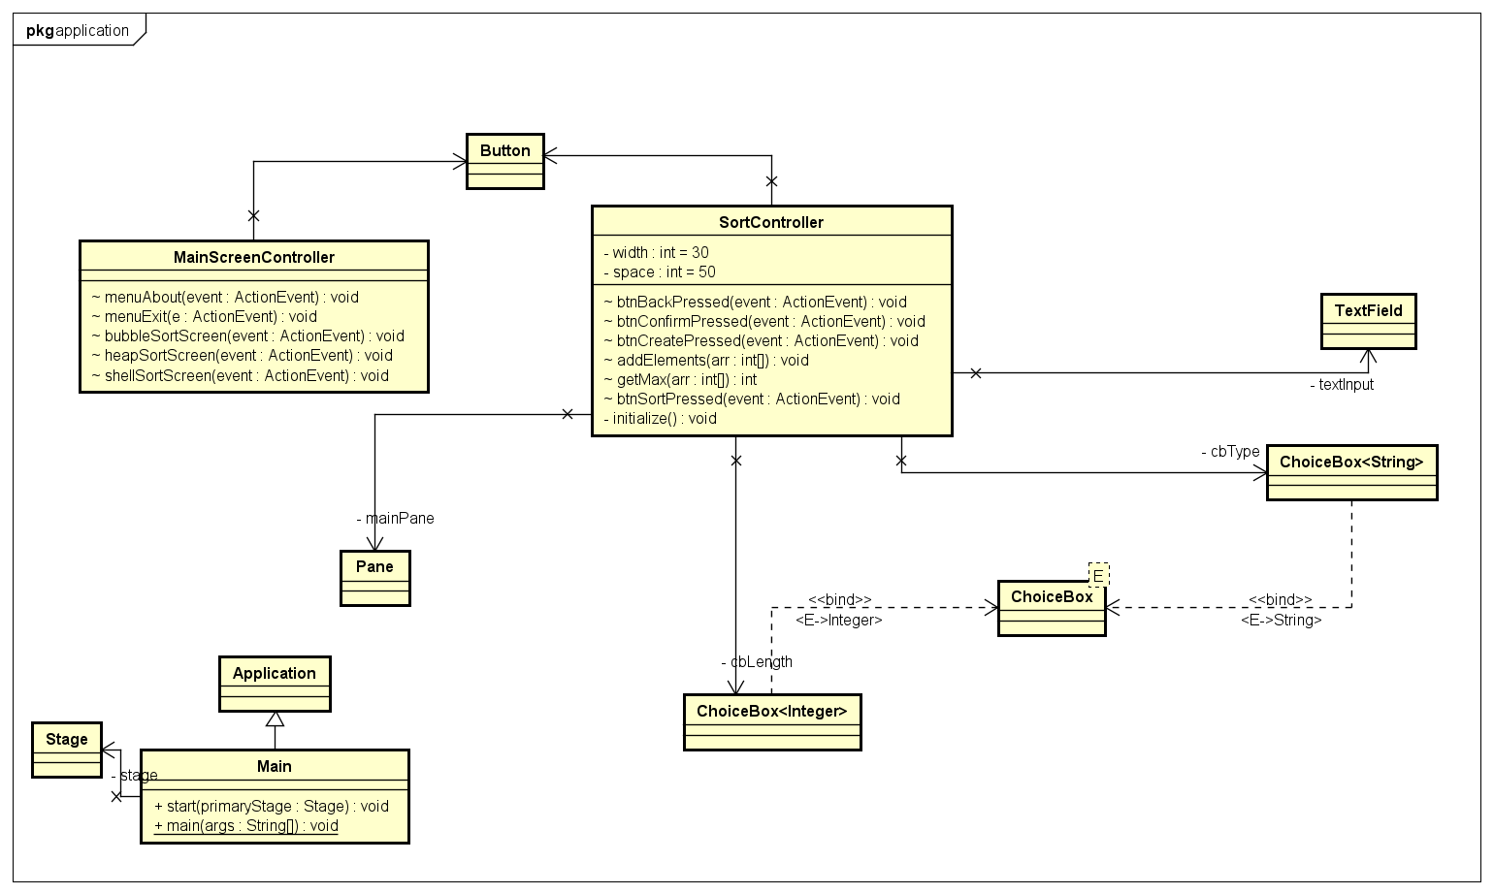
Detail Class Diagram
Package Application
Package Algorithm

Slide 8
OOP Techniques
Abstraction:
Abstract method startSort(Element[]) is defined in GeneralSort class and implemented in bubble sort, heap sort, and shell sort class
Association:
SortController class associates with CreateArray class, bubble sort, heap sort, and shell sort class
Main class associate with Stage class.
SortController and MainScreenController associate with many elements from JavaFX to create the GUI.
Inheritance:
Element class inherits from Rectangle class
bubble sort, heap sort, and shell sort inherit from the class GeneralSort
Main class inherits from the Application class

Slide 9
Link Video Demo
New channel meeting-20240106_211709-Meeting Recording.mp4 (sharepoint.com)

