Slide 1
Enhancing Diagnostic Accuracy in Rare and Common Fundus Diseases with a Knowledge-Rich Vision Language Model
动机：来源实际 许多地区眼科资源不足+现有模型基本上都只针对特定疾病
Task I: Zero-shot fundus disease recognition
Task II: Fundus disease identification by image-to-image retrieval
Task III: AI-assisted clinical diagnosis
Task IV: Internal domain retinal disease identification
Task V: Few-shot fine-tuning
Task VI: Cross-domain fundus disease identification

Slide 2
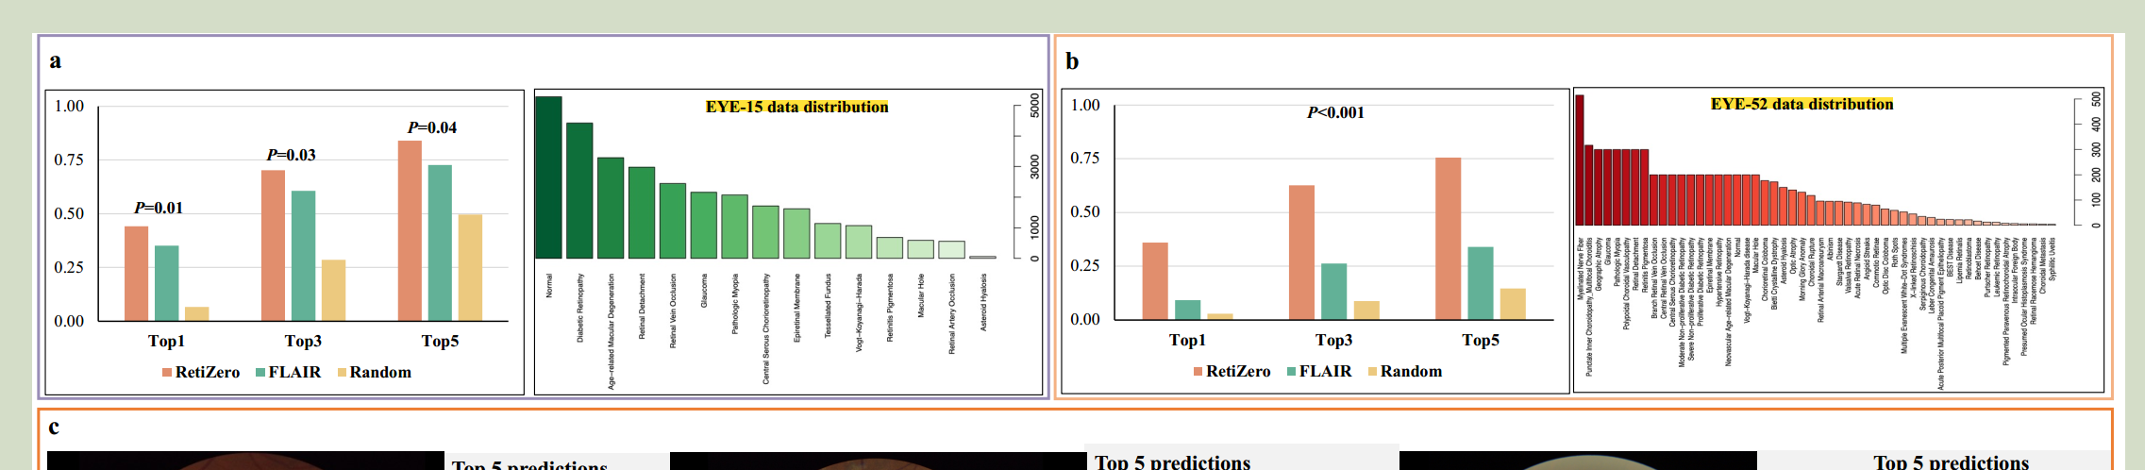
数据来源
pretraining：MAE-based backbone(RETFound) +CLIP+uncertainty-based feature calibration
publicly available dataset with category information
ophthalmic literature (with disease-related keywords descriptions)
image-text pairs from online resources
Data for the tasks of zero-shot and image-to-image retrieval
EYE-15（H1,H2,H3)-来自三家医院，没有给出链接
ETE-52 （JSIEC&另外四家医院） 没找到o(╥﹏╥)o （只给了很多预训练库的链接

Slide 3
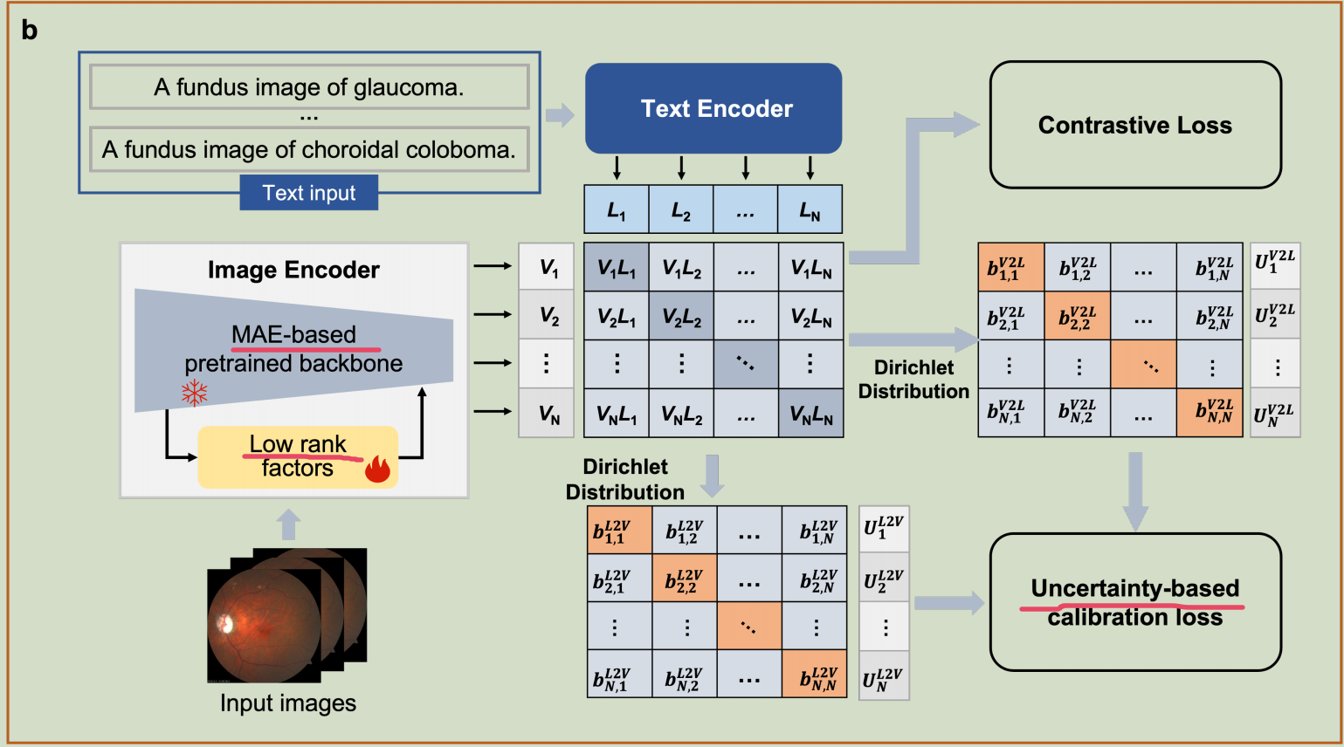
原理

Slide 4
./zeroshot/modeling/model.py Main FLAIR modeling function
CLIP-style Contrastive Framework
MAE-based Backbone
Uncertainty-based Feature Calibration
Low-rank Training Methods / LoRA

Slide 5
Boosting Pathology Foundation Models via Few-shot Prompt-tuning for Rare Cancer Subtyping
目的
罕见癌症诊断困难且容易恶性肿瘤,尤其儿科的
pathology vision-language (VL) foundation models临床效果有限
现有MIL方法忽略了多模态特征+稀释了可解释性
PathPT
few-shot
癌症区域定位
spatial-aware visual aggregation
task-adaptive prompt tuning--不改变现有模型经验
tile-level supervision from slide-level labels

Slide 6
dataset
8 rare cancer datasets (4 adult, 4 pediatric)
adults ：EBRAINS，TCGA（-UCS，-THYM，-SARC） 只提供了ucs的csv文件
pediatric：nephroblastoma (5 subtypes), hepatoblastoma(4 subtypes), medulloblastoma (3 subtypes), and neuroblastoma (3 subtypes)
有huggingface链接，需要申请
3 common cancer datasets：UBC-OCEAN, TCGA-BRCA , TCGA-BRAIN
baseline
base VL models PILP MUSK CONCH KEEP
few-shot learning method zero-shot+MIL frameworks(ABMIL CLAM TransMIL DGRMIL)+PathPT
3 region segmentation：CAMELYON16、PANDA、AGGC22

Slide 7
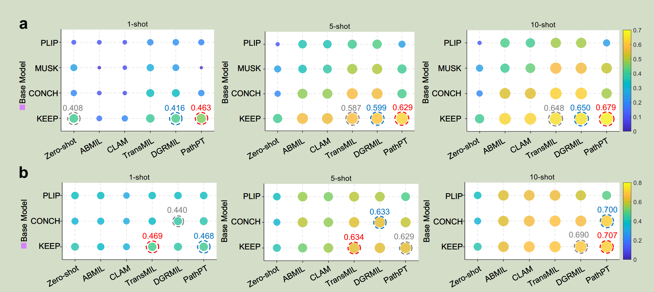
Benchmark on Rare Adult Cancer Subtyping
Benchmark on Rare Pediatric Cancer Subtyping
Extending to Common Cancer Subtyping
PathPT Enhances Cancerous Region Segmentation

Slide 8
主要源文件
train.py
params.py 参数配置文件，只有TCGA-UCS的示例
evaluation.py 获得bacc,wf1,auc,dice
subtyping/main_wsi_subtyping_{model}.py 加载数据+初始化模型+执行具体的少样本训练循环
PathPT_model_{model}.py 实现promptlearning

Slide 9
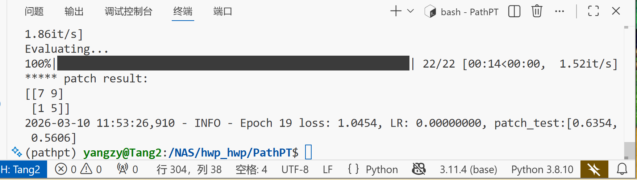
结果
TCGA-UCS + KEEP
loss: 1.0454 patch_test:[0.6354, 0.5606]
patch_bacc (Balanced Accuracy)：图像块层面的平衡准确率0.6534
patch_wf1 (Weighted F1-score)：图像块层面的加权 F1 分数0.5606

Slide 10
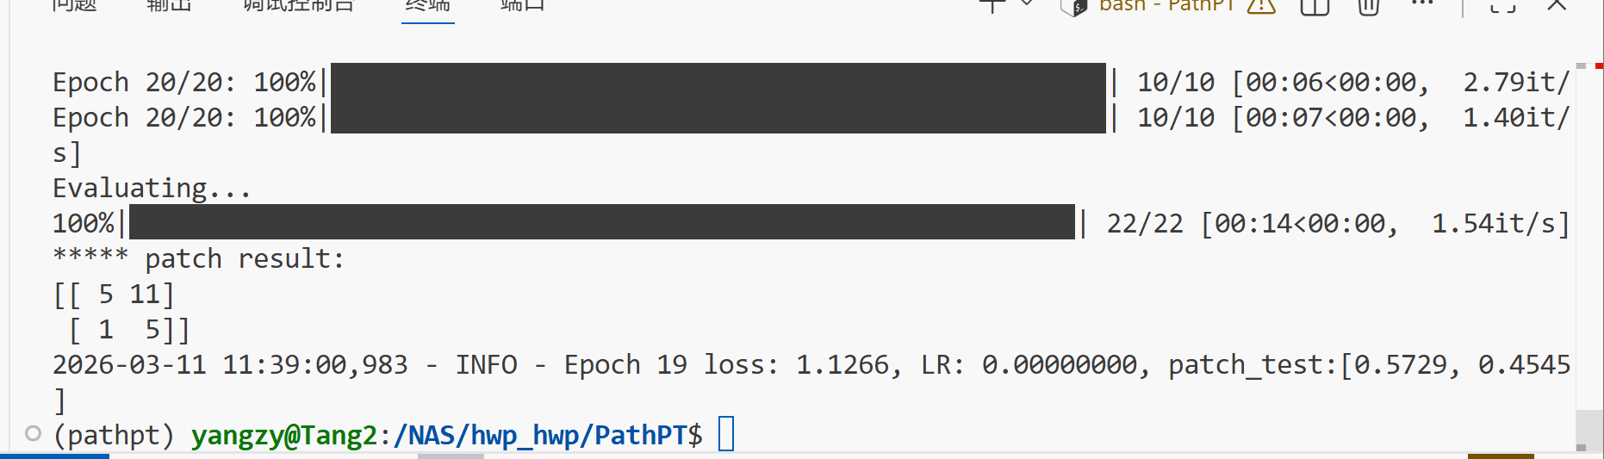
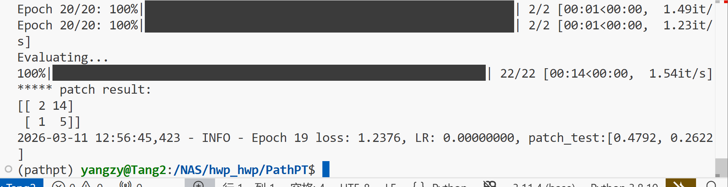
5shot--0.5729 1shot-0.4792

Slide 11
多个baseline论文复现的标准？
大研课题

