Slide 1
Domain Adaptation of Sound Source Localization Neural Networks
Weipeng He, Petr Motlicek, Jean-Marc Odobez
(submitted to icassp 2019)

Slide 2
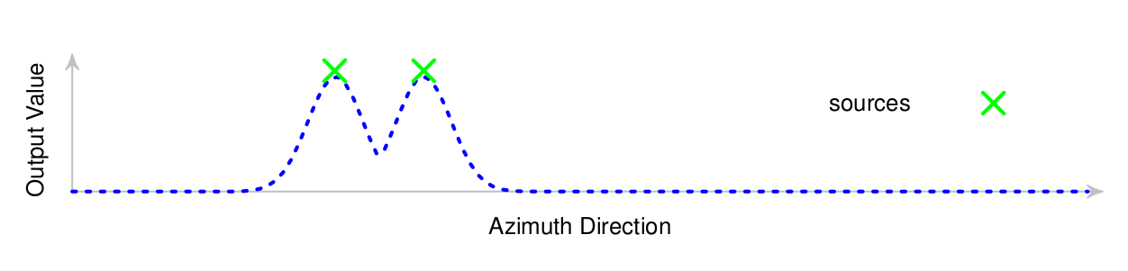
Learning to Localize Sound
Input:
Cross-correlation
Raw STFT
...
Output:
Spatial spectrum
Neural
Network
Decode
Multi-channel audio
Directions of arrival (DOA)
or locations
of multiple sources

Slide 3
Learning to Localize Sound
Output: Spatial spectrum

Slide 4
Learning to Localize Sound

Slide 5
Current Issue
Learning-based methods require a large amount of training data:
  Diversity in source signal, power, positions, noise, etc.
  Data are device-specific.
Data collection and annotation is costly.

Slide 6
Idea
Train with simulated data.
Mismatch between simulation and reality:
  Device physical body
  Microphone response pattern
  Room acoustic features
We need: domain adaptation.

Slide 7
Problem
Source Domain
Target Domain
Simulated Data
(labelled)
Real Data
(weakly labelled)
Training Set
Adaptation Set
Weak labels: number of sources
Provides relevant information
Easy to annotate
Real Data
(labelled)
Target: best performance on the target domain test set
Test Set

Slide 8
Approach
Combination of:
  Weak supervision (output).
  Domain-adversarial training (feature).

Slide 9
Weak Supervision
Weak label reduces space of possible correct network output.
Adjust network model so that the distance between the output and the reduced space is minimized.

Slide 10

Weak Supervision
Output space:
Space of ideal outputs
Actual output
Desired output
Space of outputs consistent with the weak label

Slide 11
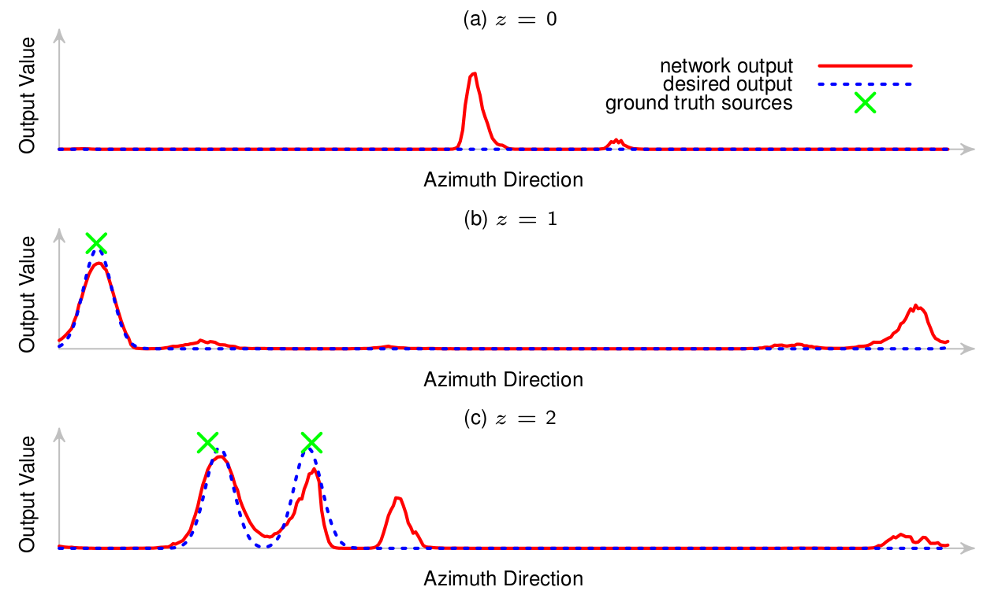
Weak Supervision

Slide 12
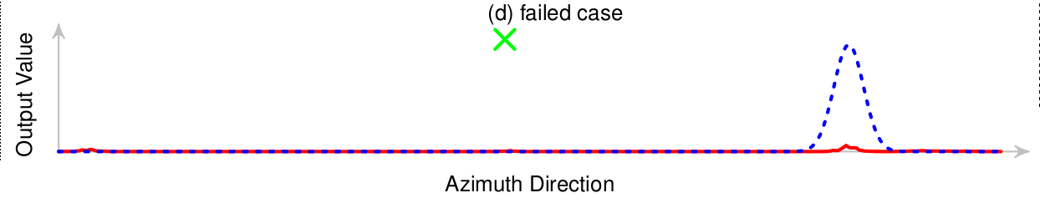
Weak Supervision

Slide 13
Domain-adversarial Training
Ganin et al. “Domain-adversarial training of neural networks,” Journal of Machine Learning Research, 2016.
Goal:
  Domain-independent features

Slide 14
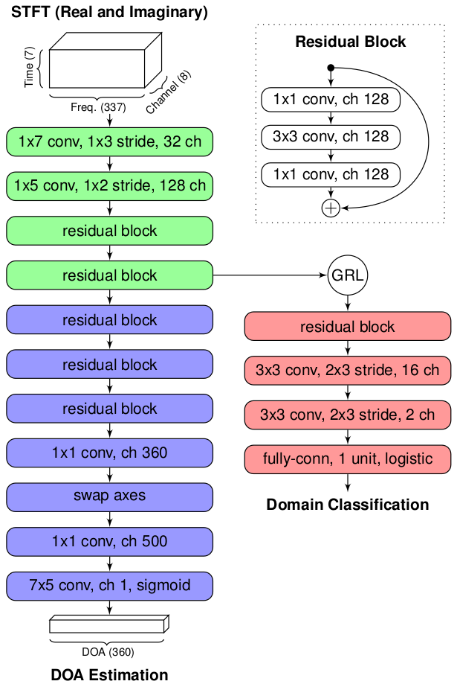
Network
Feature extractor
(green)
DOA estimator
(blue)
Domain classifier
(red)

Slide 15
Training
Extract feature
that can fool the
domain classifier.

Slide 16
Experiment
Data
  Source domain: simulation RIR generator.
  Target domain: play with loudspeakers, record by a robot.
  Source signals: clean segments from AMI corpus.
Evaluation
  Frames of 170 ms, maximum 2 sources
  Detection is correct if error < 5 degrees

Slide 17
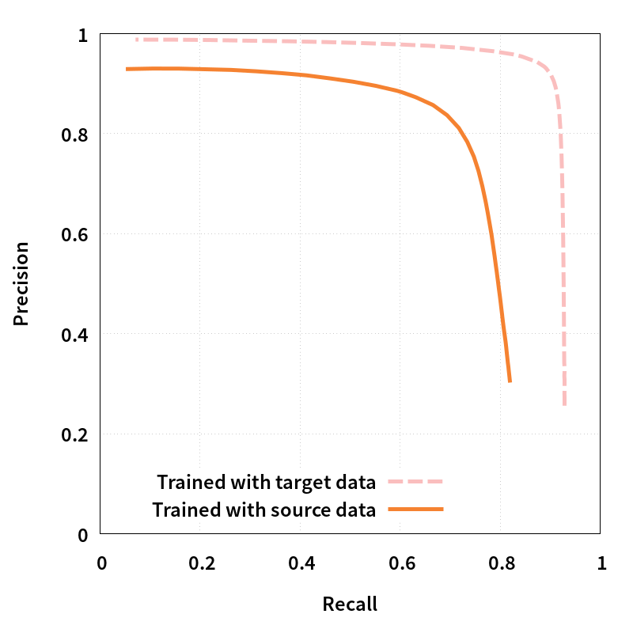
Results: Supervised Training

Slide 18
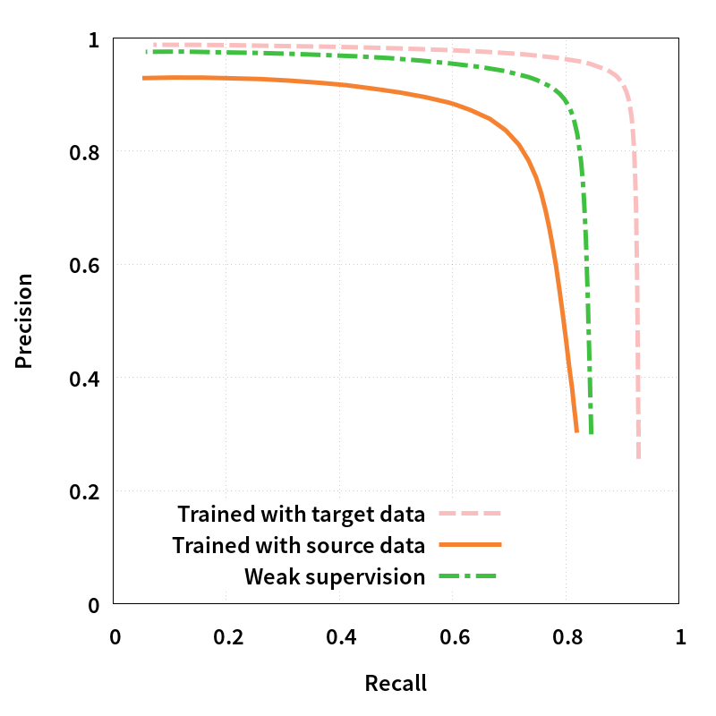
Results: Weak Supervision

Slide 19
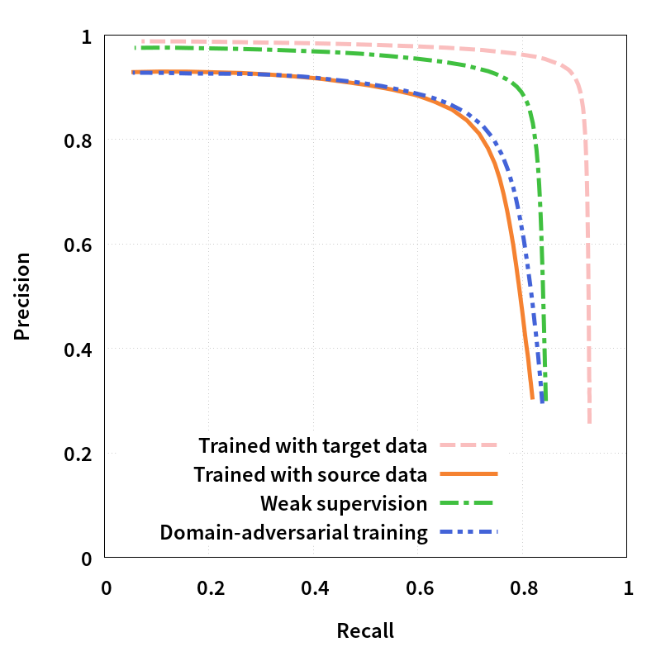
Results: Domain-adversarial

Slide 20
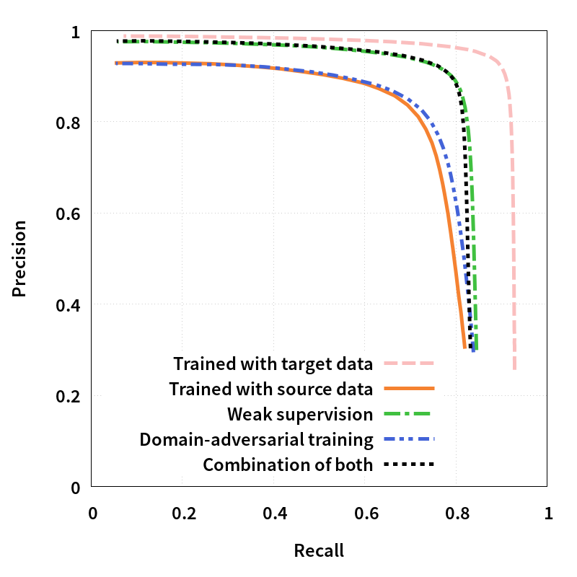
Results: Combined

Slide 21
Conclusion
Weak supervision with known number of sources on the target data significantly improves an unadapted model.
Domain-adversarial training fails to yield significant results.
  Difficult to find the trade-off between domain-invariance and discriminative power.

