Slide 1


Deep Learning Approaches for
Auditory Perception in Robotics
Ph.D. Thesis
Weipeng He
23.03.2021
Idiap Research Institute
École polytechnique fédérale de lausanne
Supervisors: Jean-Marc Odobez, Petr Motlicek

Slide 2

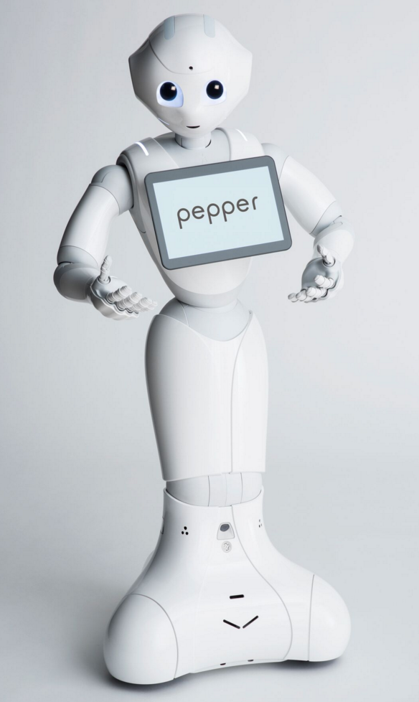
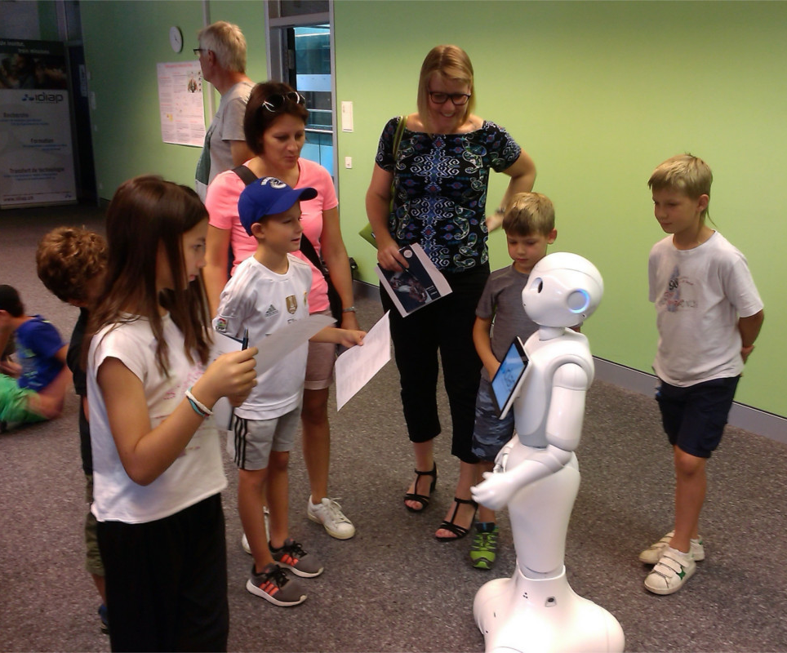
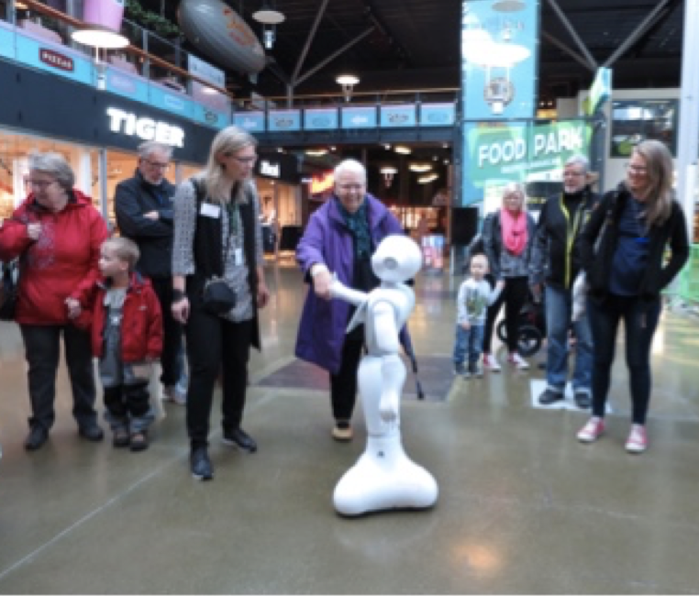
Robots for Social Interactions
Project: Multi-Modal Mall Entertainment Robot
Human Robot Interaction (HRI)
Perception
Reasoning
Action

Slide 3
Auditory Perception is Important for HRI
Where is the speaker?
Voice or noise?
Have I talked with them before?

Slide 4
Auditory Perception is Challenging for HRI
Environment:
  Overlapping sound sources (speech and noises)
  Reverberation
  Robot ego noise
Signal:
  Short utterances
Real-time:
  Quick response

Slide 5
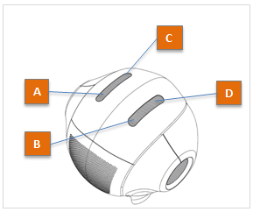
Robot Pepper
Microphone array: four co-planar microphones
Ego noise: cooling fans near the microphones

Slide 6
Thesis Overview
Sound Localization/
DOA Estimation
Sound Separation
Speech Recognition
Speaker Recognition
Sound Classification
Perception
Functions:
Traditional Approaches:
Ideas of this
Thesis:
Solutions based on explicit
models of sound propagation
Independent single-channel
sound analysis
Learn from data
Joint solution
Explored by using Deep Neural Networks (DNNs)
DOA: Direction-of-Arrival

Slide 7
Thesis Overview
Sound Localization/
DOA Estimation
Sound Separation
Speech Recognition
Speaker Recognition
Sound Classification
Perception
Functions:
Ideas:
Research
Topics:
Learn from data
Joint solution
Topic 1
DNN for multi-speaker
DOA estimation
Topic 3
Multi-task networks for
multiple perception functions
Topic 2
Domain adaptation of
DOA estimation models

Slide 8
Outline
Topic 1
DNN for multi-speaker
DOA estimation
Topic 3
Multi-task networks for
multiple perception functions
Topic 2
Domain adaptation of
DOA estimation models

Slide 9
Outline
Topic 1
DNN for multi-speaker
DOA estimation
Topic 3
Multi-task networks for
multiple perception functions
Topic 2
Domain adaptation of
DOA estimation models

Slide 10
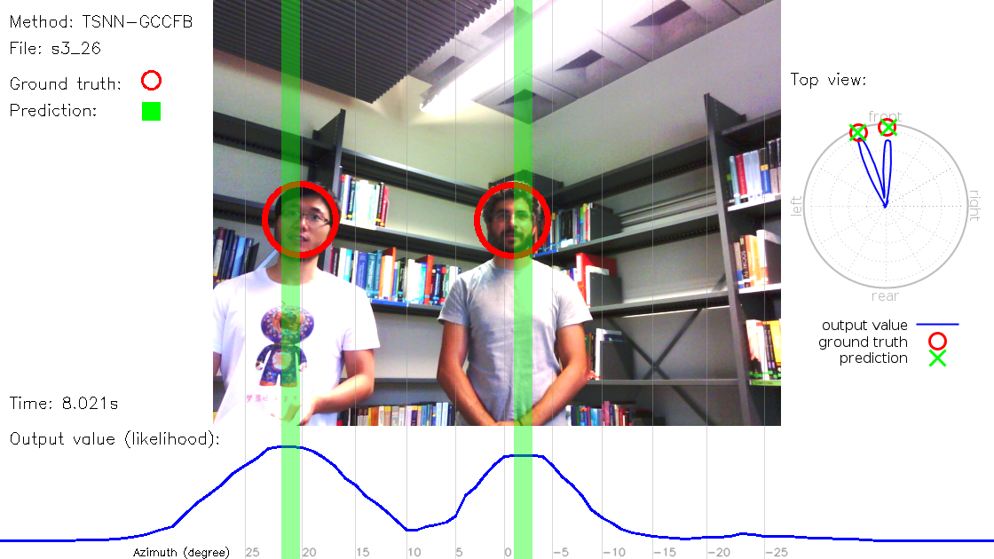
Multi-speaker DOA Estimation
How can we train neural networks to estimate DOAs of multiple overlapping sound sources in noisy environments?
Deep Neural Networks for Multiple Speaker Detection and Localization, He et al., in ICRA 2018

Slide 11
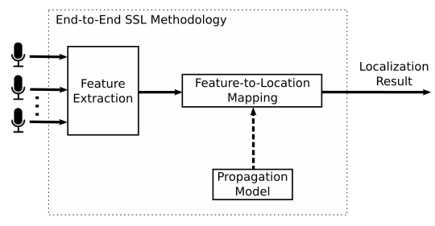
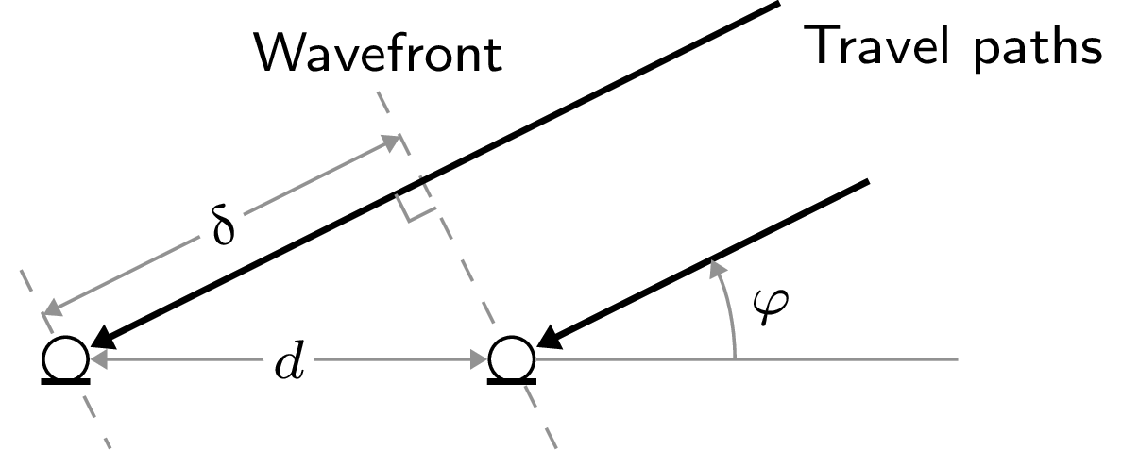
Traditional DOA Estimation Methods
Analytical solutions based on sound propagation: SRP-PHAT[1], MUSIC[2], …
Requires: propagation model
  Far-field OR near-field
  Free-field OR reverberant OR obstacles
In general, rely on simplifying assumptions.
Difficult to apply to complex environments.
[1] DiBiase et. al., ‘Robust Localization in Reverberant Rooms’, in Microphone Arrays: Signal Processing Techniques and Applications, 2001
[2] Schmidt, ‘Multiple emitter location and signal parameter estimation’, IEEE Trans. Antennas and Propagation, 1986

Slide 12
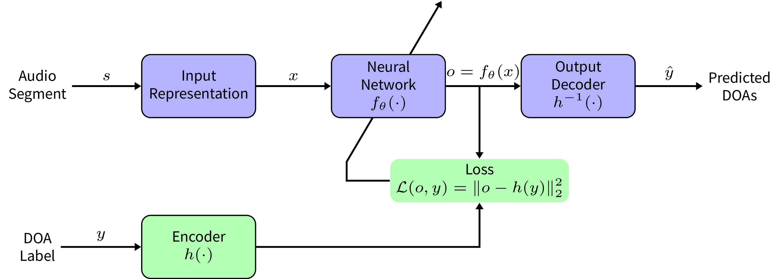
Our Approach
Input?
Architecture?
Output?

Slide 13
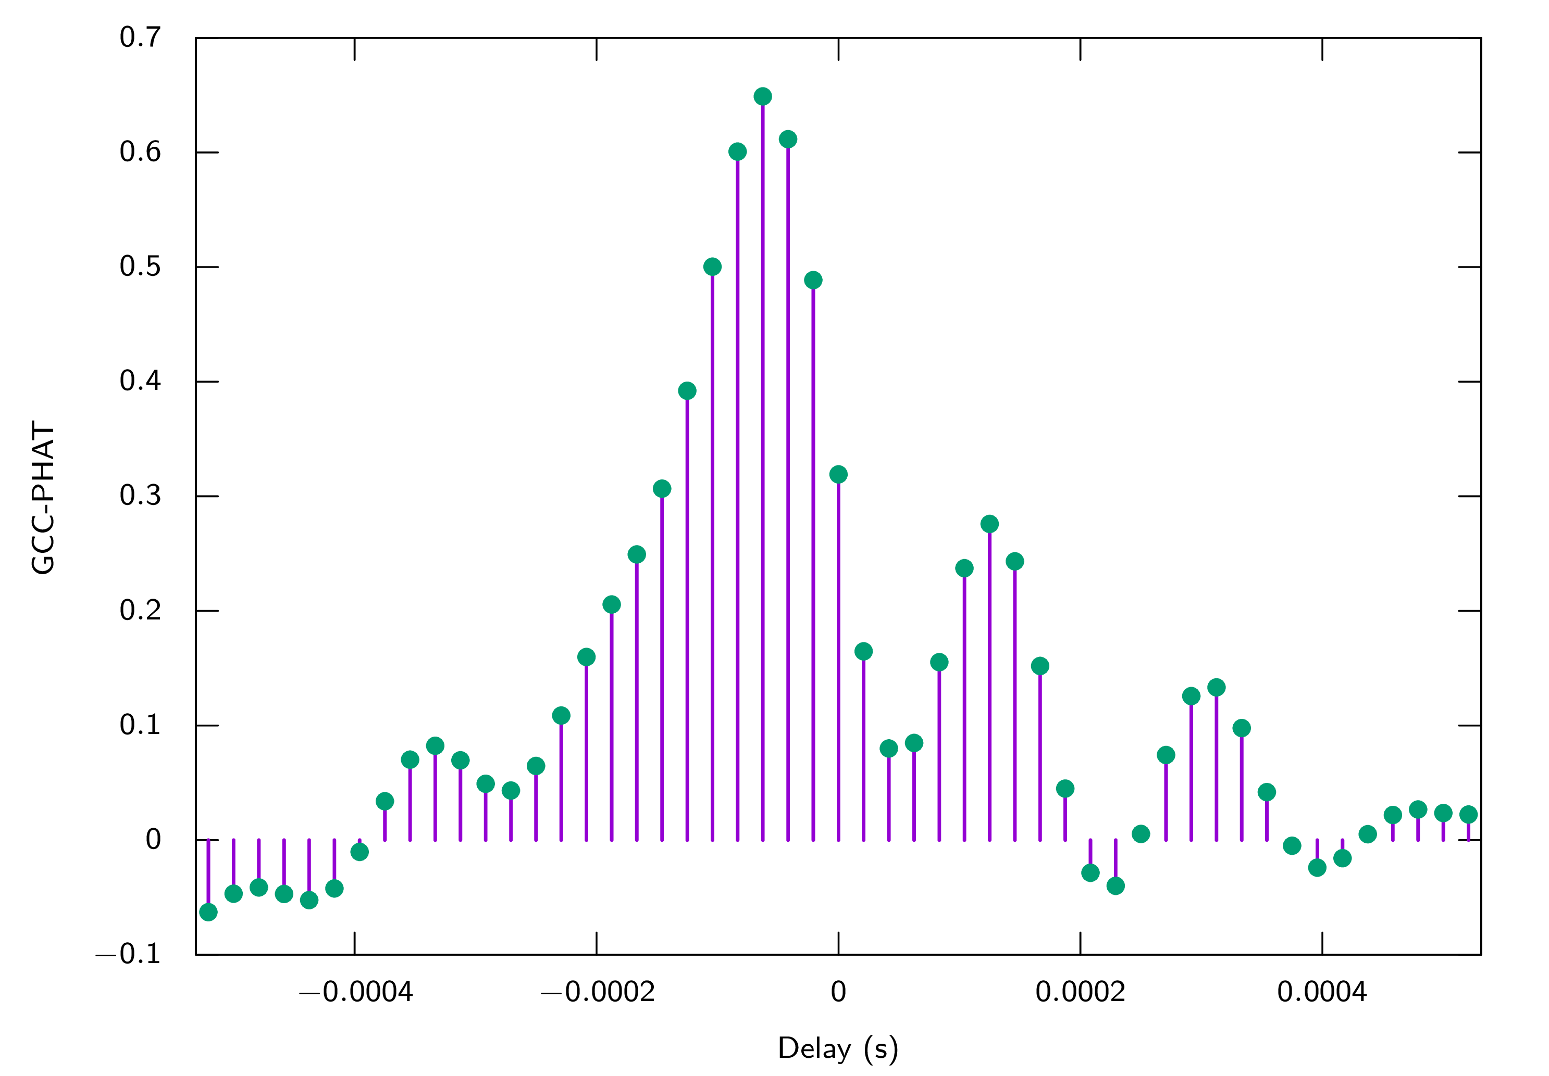
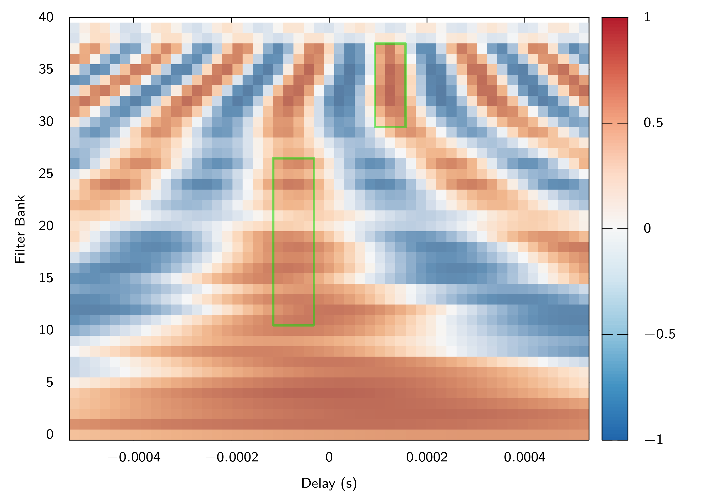
Three Input Representations
Cross-correlation: delay between channels
  GCC-PHAT coefficients
  GCC-PHAT on filter bank
Raw signal: Short-time Fourier Transform (STFT)
  Real and imaginary parts as individual channels
  No information loss due to feature extraction
× each pair of microphones
GCC-PHAT : Generalized Cross-Correlation with PHAse Transform

Slide 14
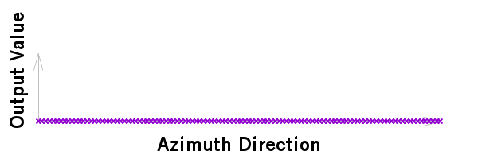







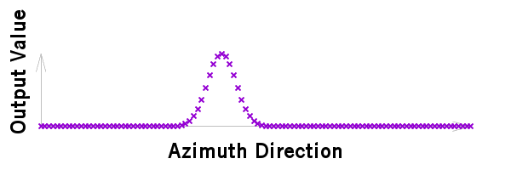
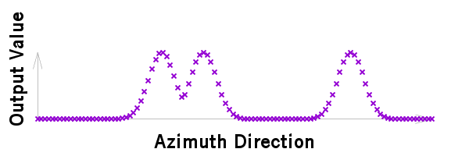
Output : Spatial Spectrum
Likelihood score for each azimuth direction (360):
  Encode: Gaussian functions
  Decode: peak finding with threshold
Loss function: Mean Squared Error (MSE)
No active sound source
Can handle an arbitrary
number of sources
Three sound sources
One sound source

Slide 15
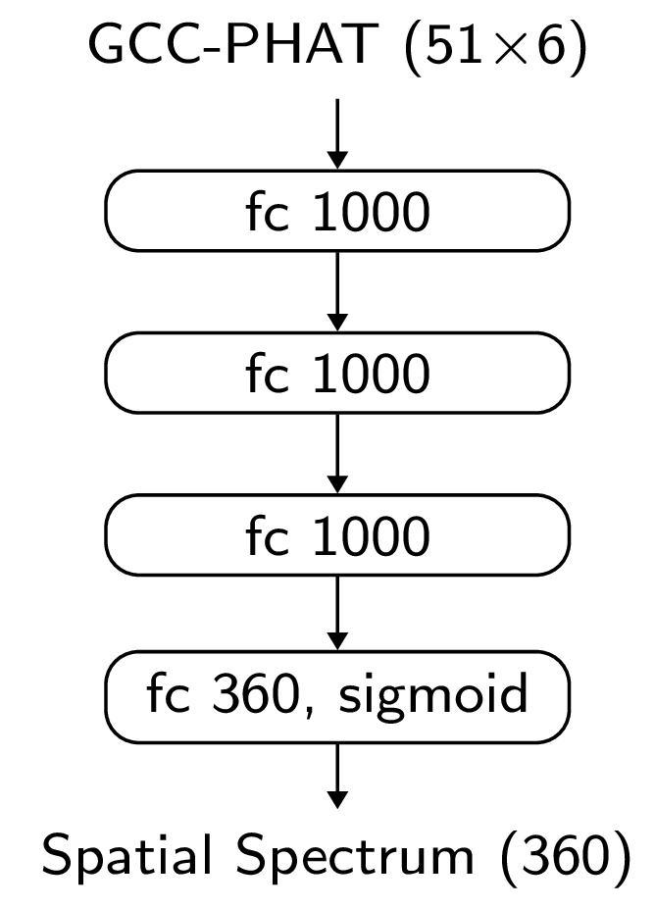
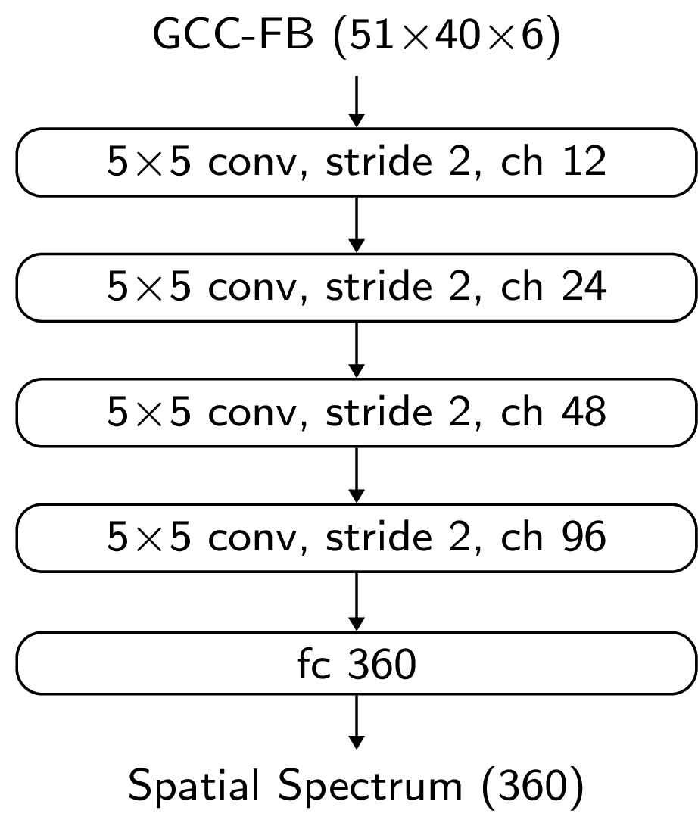
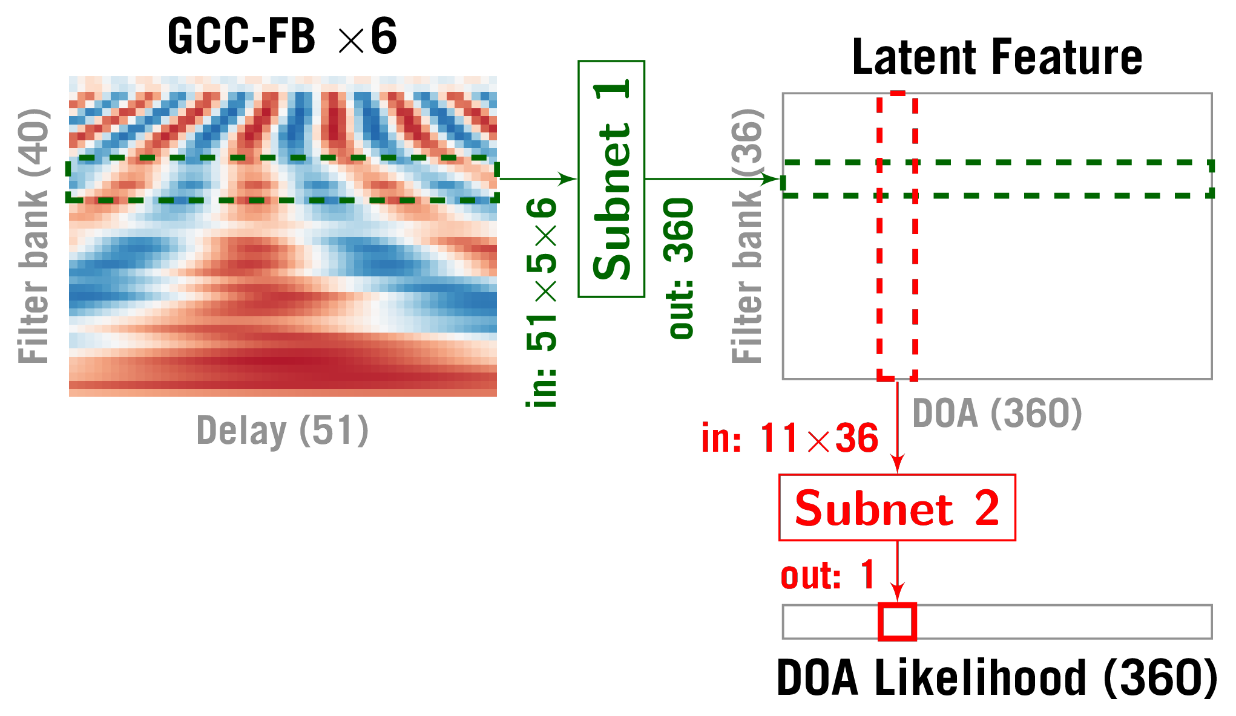
Architectures for Cross-correlation Inputs
Multi-layer perception : MLP-GCC
Convolutional neural network: CNN-GCCFB
Two-stage network: TSNN-GCCFB

Slide 16
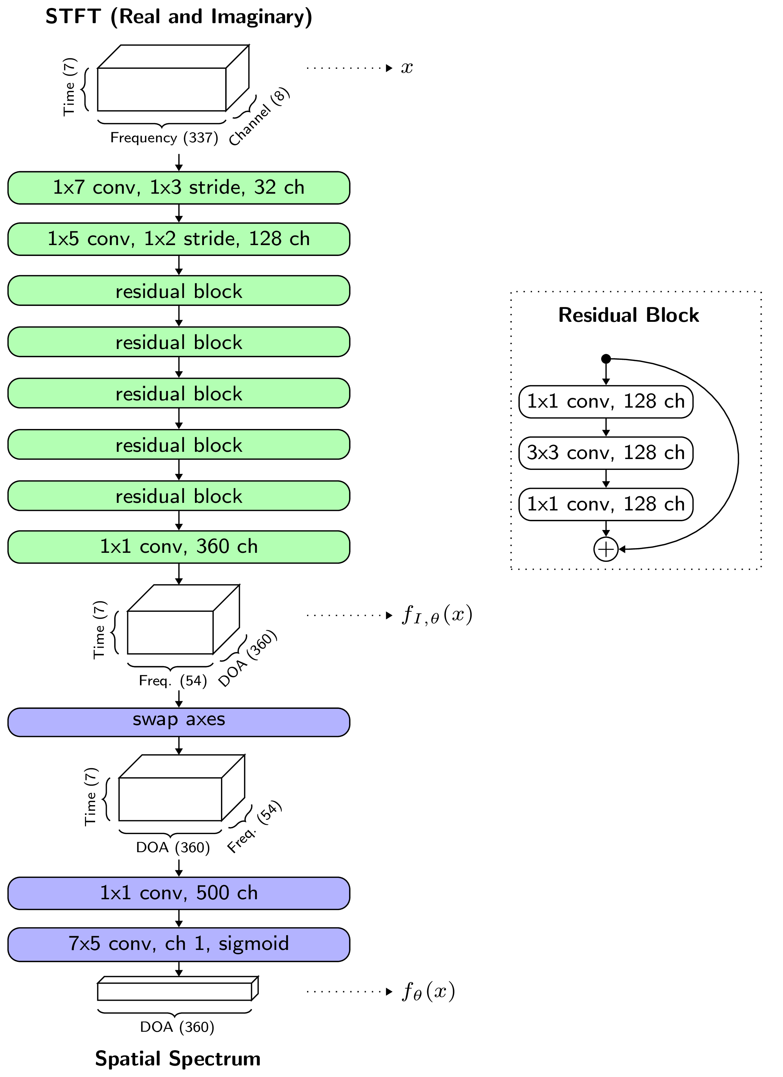
Architecture for low-level input
Residual Network for STFT input:
ResNet-STFT
Deep structure allows network to extract high level features by itself

Slide 17
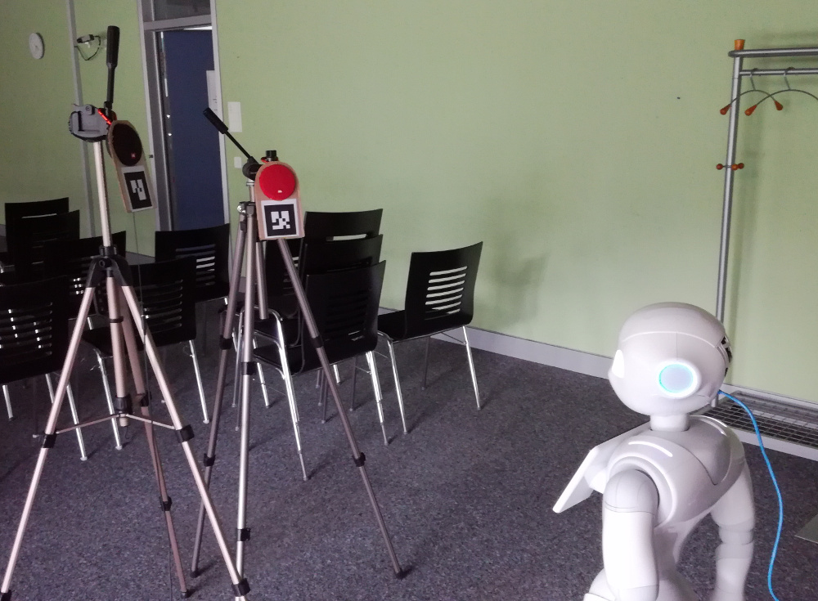
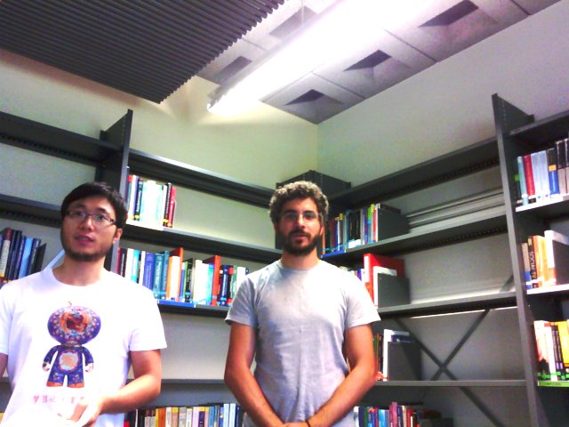
Robot Recordings
with loudspeakers
16h train, 8h test
with human talkers
4 min
Up to 2 overlapping sources;
In 3 different rooms
Large variety of sound locations
by moving robot head

Slide 18
Demo

Slide 19
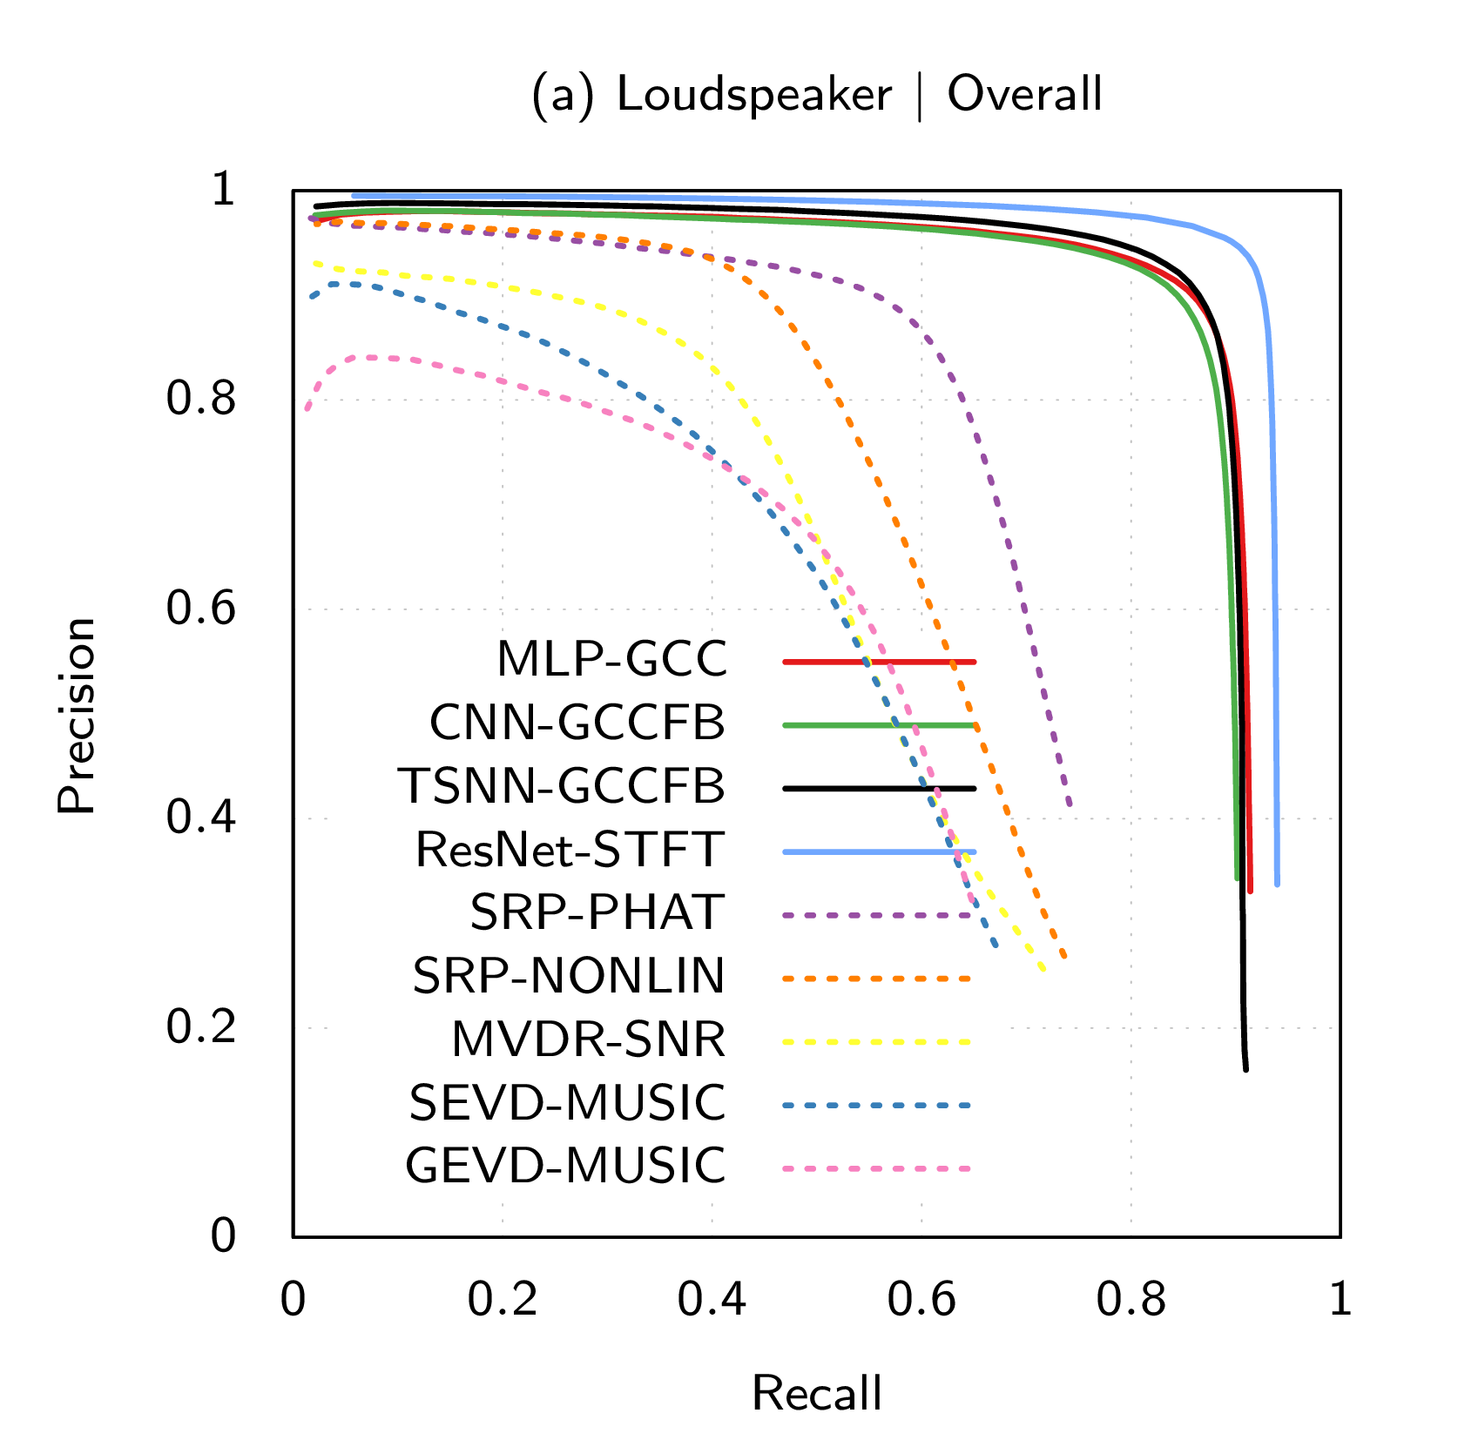
Evaluation (Loudspeaker Recordings)
Proposed
Detection
  Unknown number of sources
Correct: <5° error
Variate decoding threshold:
  Precision vs recall curve
Baselines

Slide 20
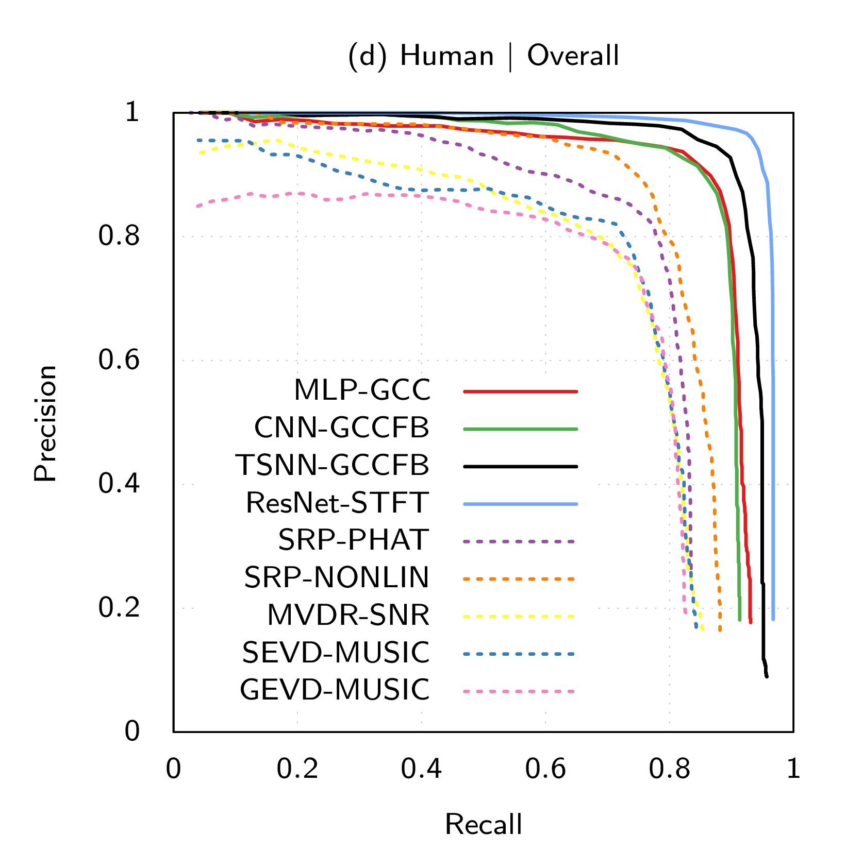
Evaluation (Human Recordings)
ResNet-STFT:
>95% Precision & Recall

Slide 21
Summary
Proposed Gaussian spatial spectrum output coding
  Scales to an arbitrary number of sound sources
Outperforms traditional approaches in noisy conditions
  Learn propagation and signal models
High-level feature vs low-level representation
  DNN can learn by itself to extract suitable features
Publication:
  Deep Neural Networks for Multiple Speaker Detection and Localization, He et al., in ICRA 2018

Slide 22
Outline
Topic 1
DNN for multi-speaker
DOA estimation
Topic 3
Multi-task networks for
multiple perception functions
Topic 2
Domain adaptation of
DOA estimation models

Slide 23
Issue: DNN-based Methods Require Data
Neural networks only learn what is provided
For better generalization, training data should include:
  Diversity in source signals, locations, noise, etc.
Data collection and annotation is costly
  External devices required for annotation
Data are device-specific
Limited application to new microphone arrays

Slide 24
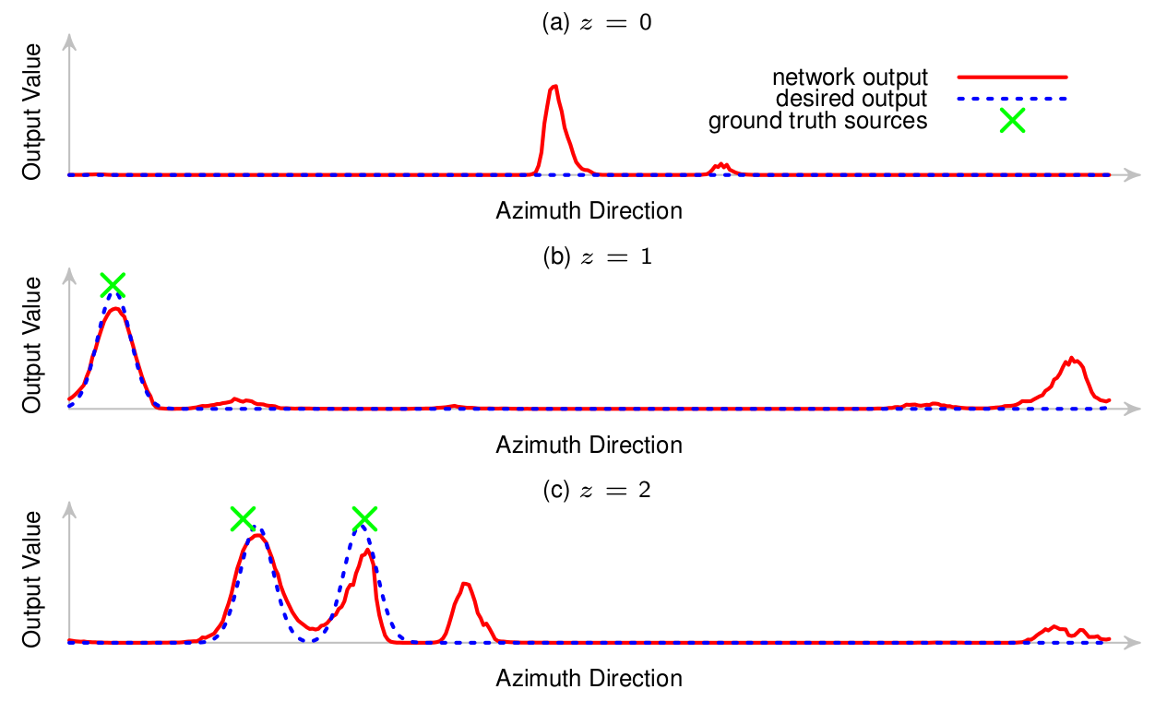
Domain Adaptation
How can we train the DOA estimation models with minimal effort for data collection and annotation?
Adaptation of Multiple Sound Source Localization Neural Networks with Weak Supervision and Domain-Adversarial Training
He et al., in ICASSP 2019

Slide 25
Idea
Generate training data by simulation
Mismatch between simulation and reality:
  Physical body of the robot
  Microphone response pattern
  Room acoustic features
We need: domain adaptation
  Source domain: simulation
  Target domain: real

Slide 26
Weakly-Supervised Adaptation
Weak label: number of sources
Provides relevant information
Easy to annotate (no external devices required)
Simulated Data
(labeled)
Real Data
(weakly-labeled)
Supervised Loss
+
Weakly-supervised
Loss
=
Target Loss

Slide 27
Weak Supervision
Minimum Distance Criterion
  Minimize distance between network output and all ideal spatial spectra that are consistent with the weak label
Favors models that
• generate curves that are close to ideal spatial spectra
• make correct detection of the number of sources
Issue: Rely on good initial prediction, otherwise lead to wrong supervision

Slide 28
Modification with Data Augmentation
Localization of multiple sources is more difficult than a single source
Generate multi-source segments by mixing single source recording
Simulated Data
(labeled)
Real Data
(weakly-labeled)
Augmented Data
(weakly-labeled)
Supervised Loss
+
Weakly-supervised
Loss
+
Modified
W-S Loss
=
Target Loss
Apply weak supervision on easier single-source components instead of multi-source mixtures, and then merge weak supervisions

Slide 29
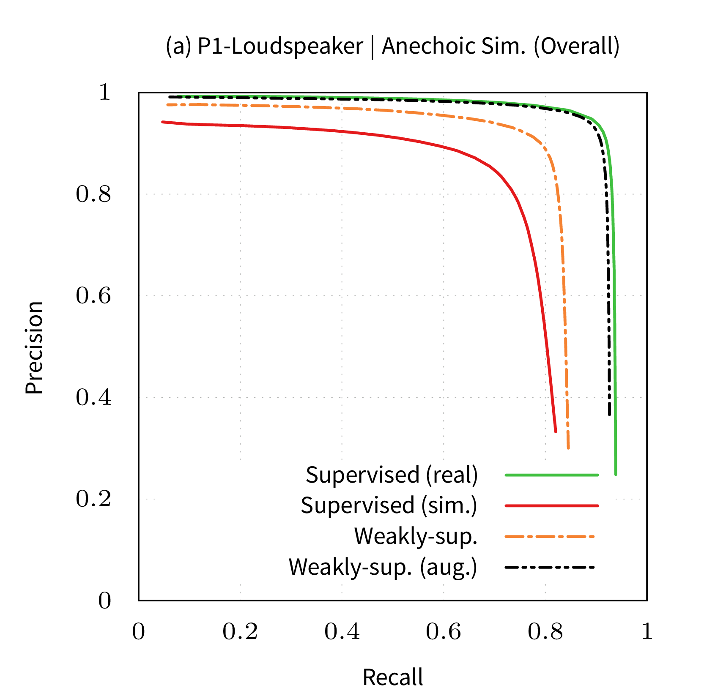
Performance
Weak-supervision improves significantly the model trained with simulated data
Adding data augmentation achieves similar performance as methods using fully-labeled real data

Slide 30
Summary
We proposed a practical framework for deploying DOA estimation models to new microphone arrays
  Requires only number of sources labeled
  Data collection workload is reduced
Publications:
  Adaptation of Multiple Sound Source Localization Neural Networks with Weak Supervision and Domain-Adversarial Training, He et al., in ICASSP 2019
  Neural Network Adaptation and Data Augmentation for Multi-Speaker Direction-of-Arrival Estimation, He et al., TASLP 2020

Slide 31
Outline
Topic 1
DNN for multi-speaker
DOA estimation
Topic 3
Multi-task networks for
multiple perception functions
Sub-topics:
Joint localization and classification
Speaker embedding using DOA
estimation as an auxiliary task
Topic 2
Domain adaptation of
DOA estimation models

Slide 32
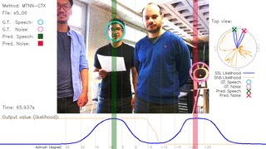
Joint localization and classification
How can the network to detect the sound sources and at the same time classify whether they are speech or noise?
Joint localization and classification of multiple sound sources using a multi-task neural network
He et al., Interspeech 2018

Slide 33
Problems: Localization and Classification
Real HRI environments:
  Robot ego noise
  Simultaneous sound sources
  Speech and non-speech sources
Robots need to distinguish speech and noise

Slide 34
Sequential vs Joint Approaches
Previous studies: sequential approach [1,2]
Our approach: joint solution
Localization
Beamformer/
Separation
Classification
Issue: Error propagates through the pipeline
Localization
Spatial information
Classification
Spectral information
Multi-task Learning (MTL) networks
[1] May et al., “Binaural detection of speech sources in complex acoustic scenes,” in WASPAA, 2011.
[2] Crocco et al., “Audio Tracking in Noisy Environments by Acoustic Map and Spectral Signature,” IEEE Trans. on Cybernetics, 2017.

Slide 35
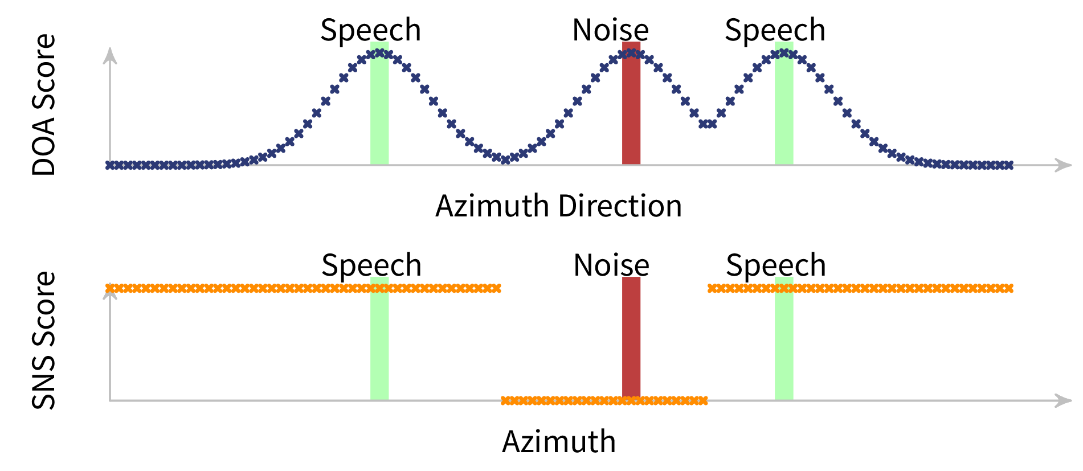

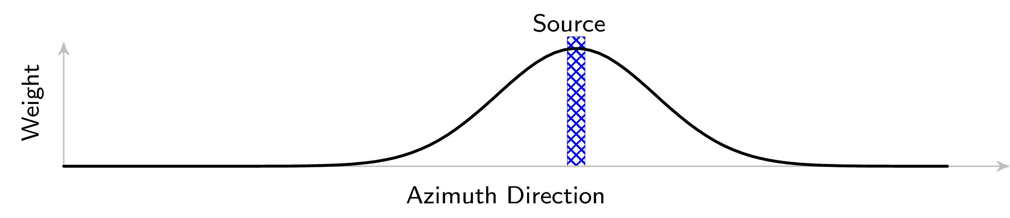
Network Output and Loss Function
SSL and SNS scores for each direction
Loss: weighted mean squared error
emphasis on directions next to active sources
SSL: sound source localization
SNS: speech/non-speech

Slide 36
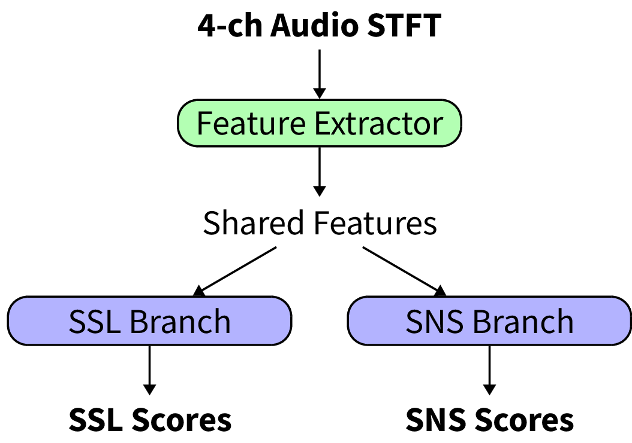
Shared-feature MTL Network
Regularization:
Better generalization

Slide 37
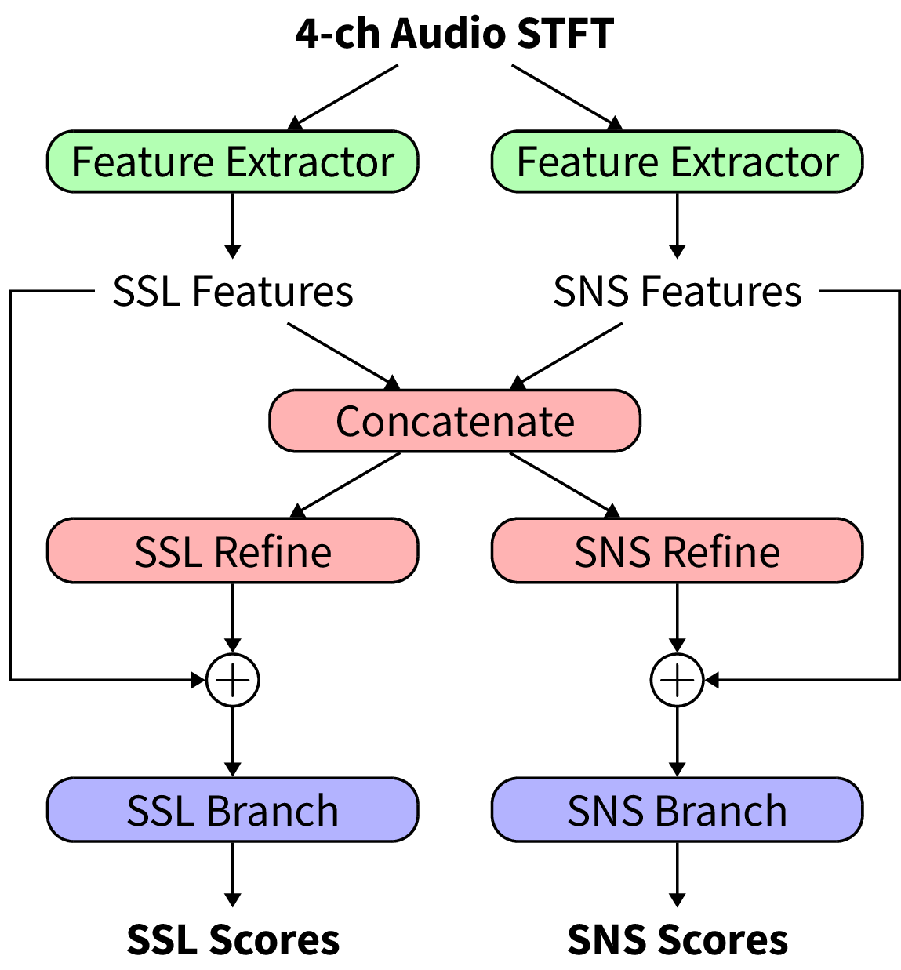
Re-estimation MTL Network
Independent feature extraction/
Initial TF-local prediction
Re-estimation module:
Refine TF-local prediction based on information from both tasks

Slide 38
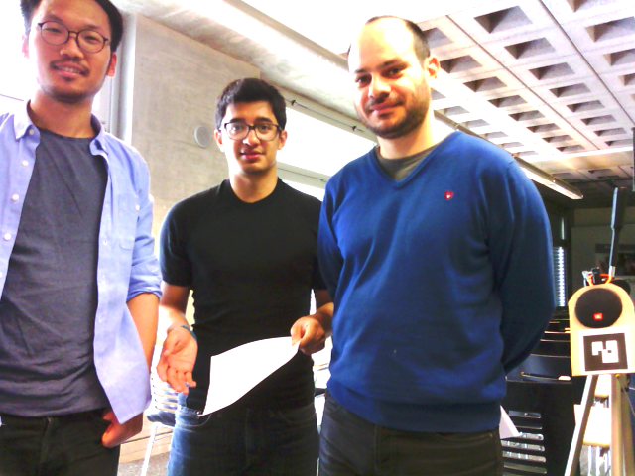
Data
Training:
  Loudspeakers: 32 hours, 148 speakers
  Speech: AMI Corpus, up to 2 sources
  Non-speech: Google AudioSet, up to 1 source
Test:
  Loudspeaker: 17 hours, 16 speakers
  Human talkers: 8 minutes, 7 speakers

Slide 39
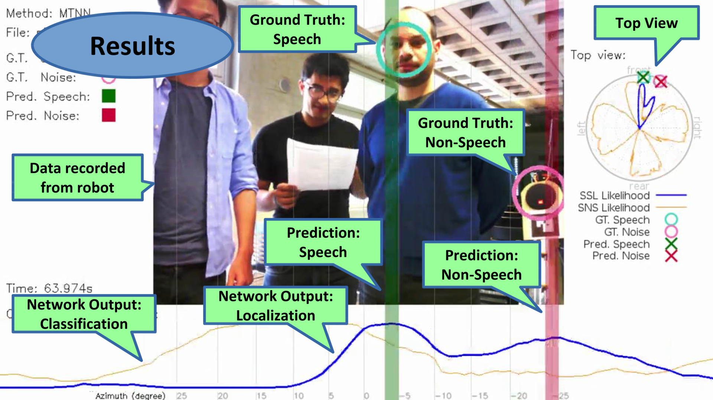
Demo

Slide 40
Evaluation
Three tasks:
  Sound Localization
  Speech/Non-speech Classification
  Speech Localization (combination of sound localization and classification, ignore non-speech sources)
Methods:
  Sequential: Localization + MVDR + Classification
  Single-task networks
  Proposed method
MVDR: Minimum Variance Distortionless Response beamformer

Slide 41
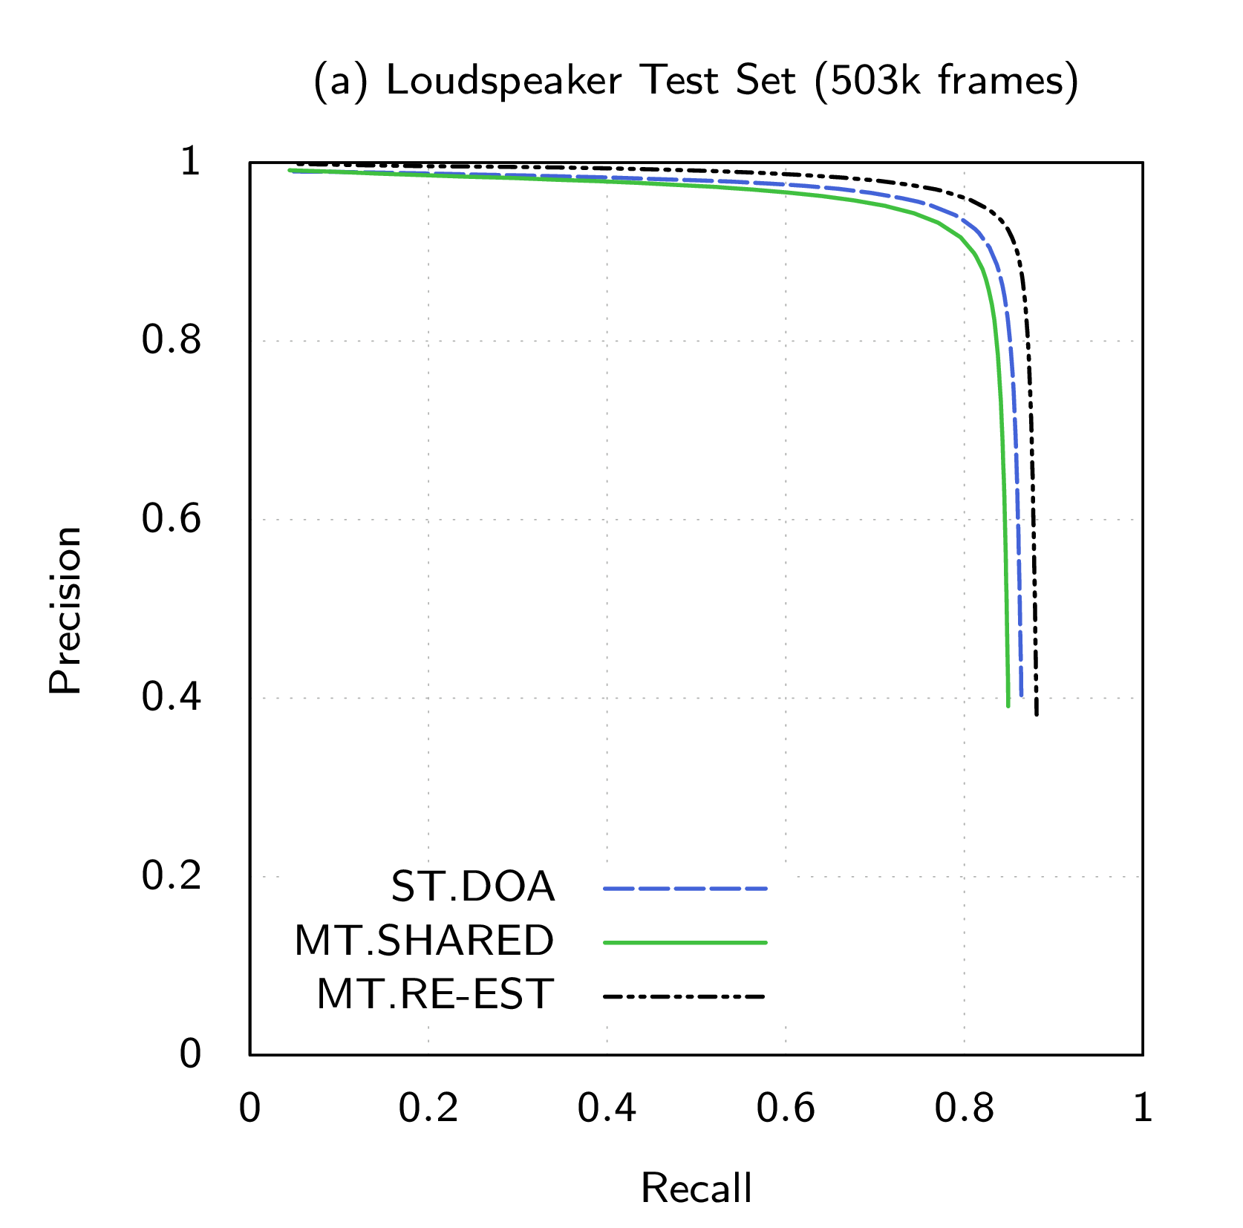
Sound Source Localization
Re-estimation
MTL network
Shared-feature
MTL network
Single-task network for DOA estimation

Slide 42
Speech/Non-speech Classification
Classification accuracy
  Assuming sound direction is known
Approaches | Loudspeaker | Human
Sequential | 0.80 | 0.68
Separate Single-Task Networks | 0.94 | 0.81
Shared-feature MTL Network | 0.95 | 0.85
Re-estimation MTL Network | 0.95 | 0.85

Slide 43
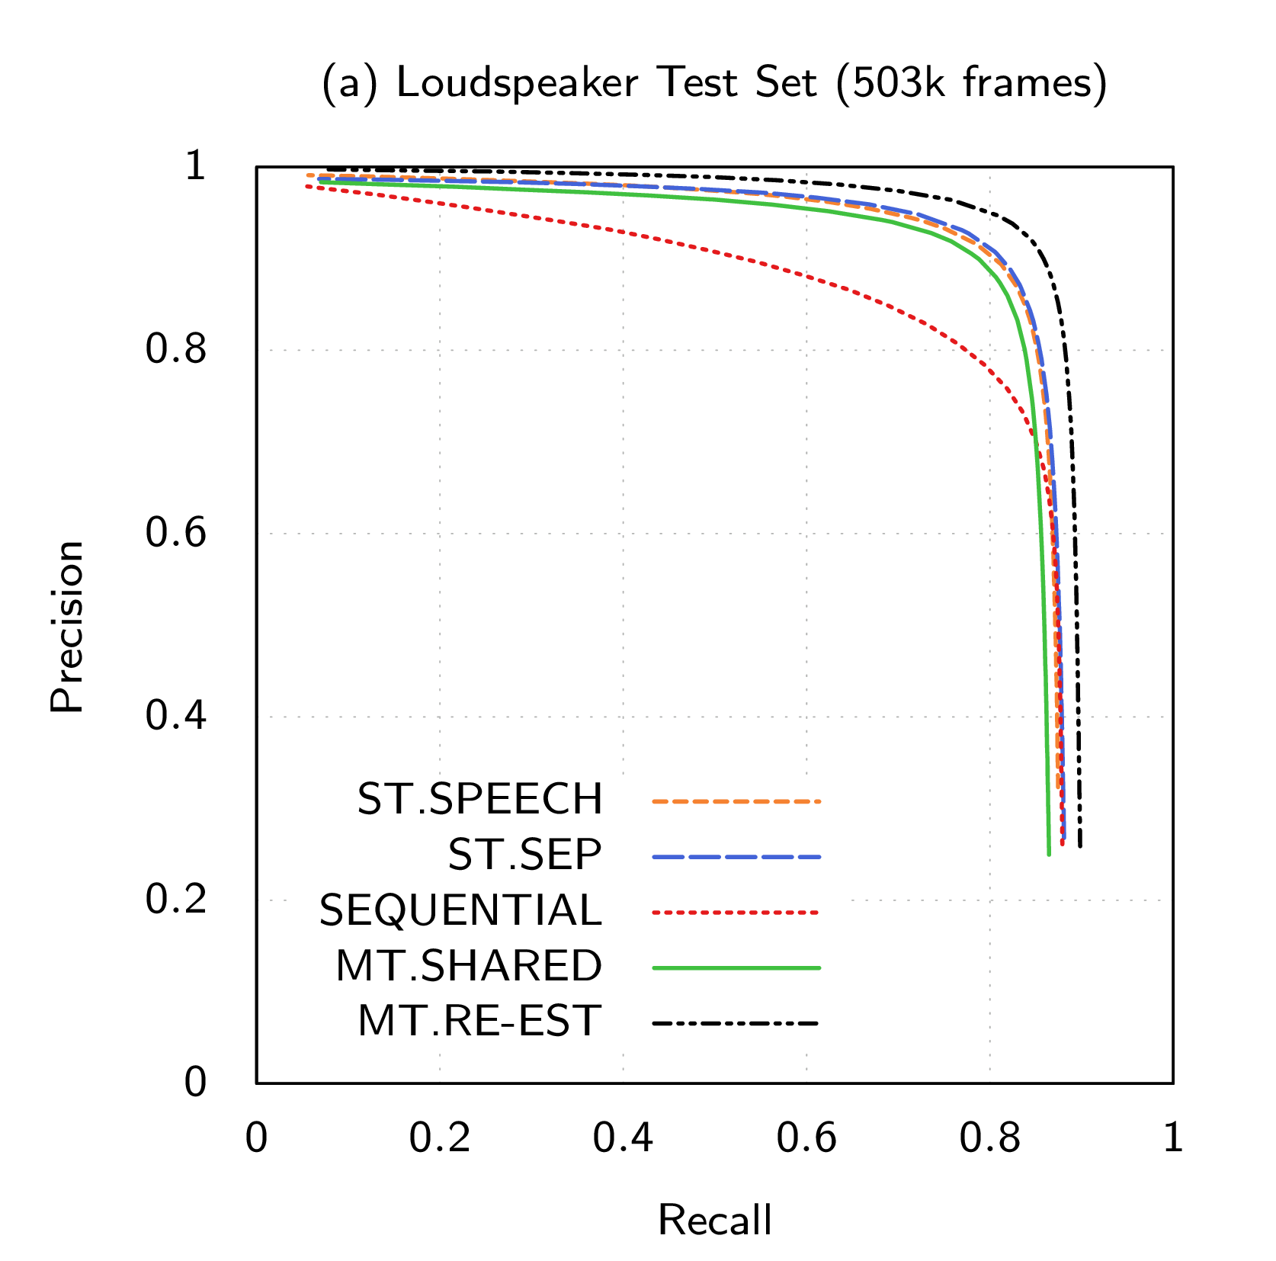
Speech Source Localization
Re-estimation
MTL network
Shared-feature
MTL network
Sequential approach
Single-task network for speech localization

Slide 44
Summary
Proposed two MTL networks for joint localization and classification of multiple sound sources
  Both outperform the sequential approach
Using shared feature may compromise one task to improve the other
Re-estimation allow refinement on top of independent estimation, achieves best performance
Publications:
  Joint localization and classification of multiple sound sources using a multi-task neural network, He et al., in Interspeech 2018
  Multi-Task Neural Network with Re-Estimation for Joint DOA estimation and Speech/Non-Speech Classification, He et al., submission under preparation, 2021

Slide 45
Conclusions
We have shown that we can train DNNs for auditory perception in robotics:
  Proposed DOA estimation neural notworks with Gaussian spatial spectrum output coding that allows detection of an arbitrary number of sound sources
  Proposed weakly-supervised domain adaptation framework to reduce data collection workload
  Proposed multi-task networks for jointly solving multiple perception functions
It works for real robotic applications:

Slide 46
Acknowledgment
My supervisors:
  Jean-Marc and Petr
People participated in our data collection
Jury committee members
All colleagues and friends from Idiap

Slide 48
Future Work
More challenging conditions:
  More overlapping sound sources
  Other type of noise: motor noise, babble noise
Audio-visual fusion
  Fusion with visual voice activity detection
  Co-learning (learn from more reliable modality)
Explicit modeling of signal prior

Slide 49
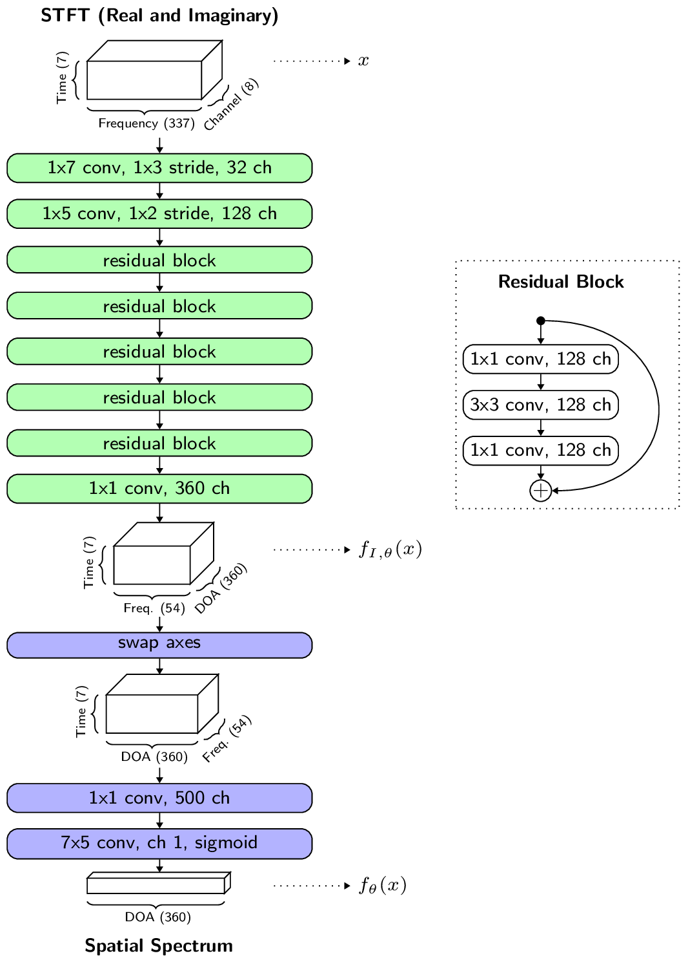
Multi-speaker DOA Estimation
Use DNN to predict spatial spectra
Investigated different input representations and network structures
Outperforms traditional approaches
  Implicitly learn propagation and signal models
Deep Neural Networks for Multiple Speaker Detection and Localization, He et al., ICRA 2018

Slide 50
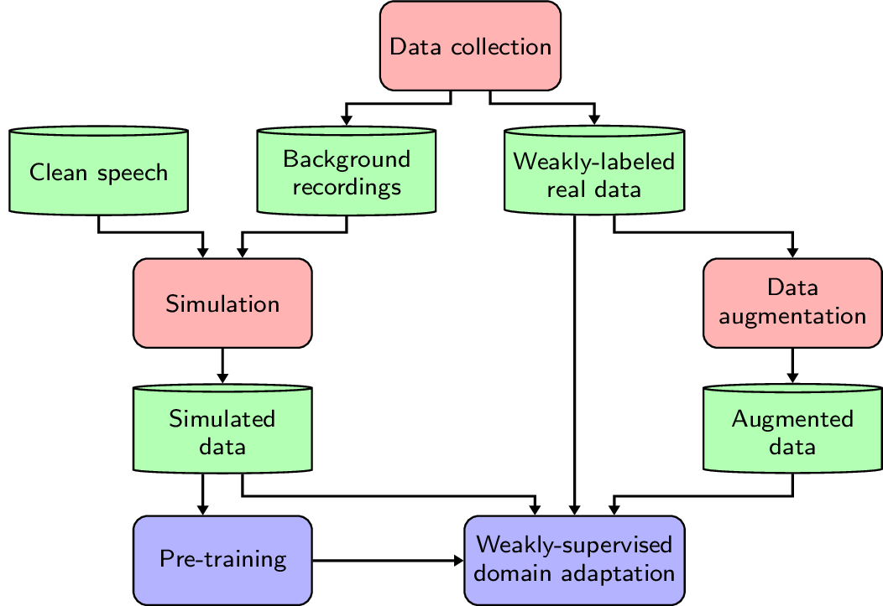
Domain Adaptation for
DOA Estimation Models
Real training data are costly
  Each microphone array is distinct
  Annotation requires external devices
Simulation data are biased
Domain Adaptation
  Weakly-supervised with number of sources as labels
  Improved by data augmentation
  Unsupervised domain-adversarial training
Adaptation of Multiple Sound Source Localization Neural Networks with Weak Supervision and Domain-adversarial Training
He et al., ICASSP 2019

Slide 51
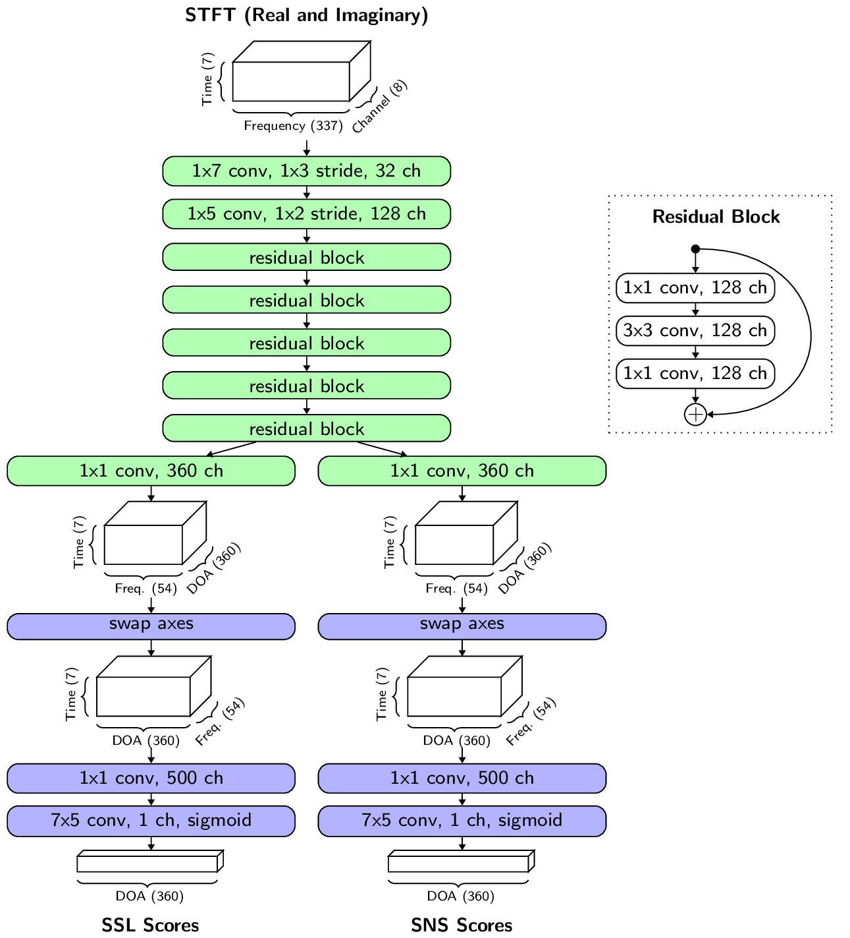
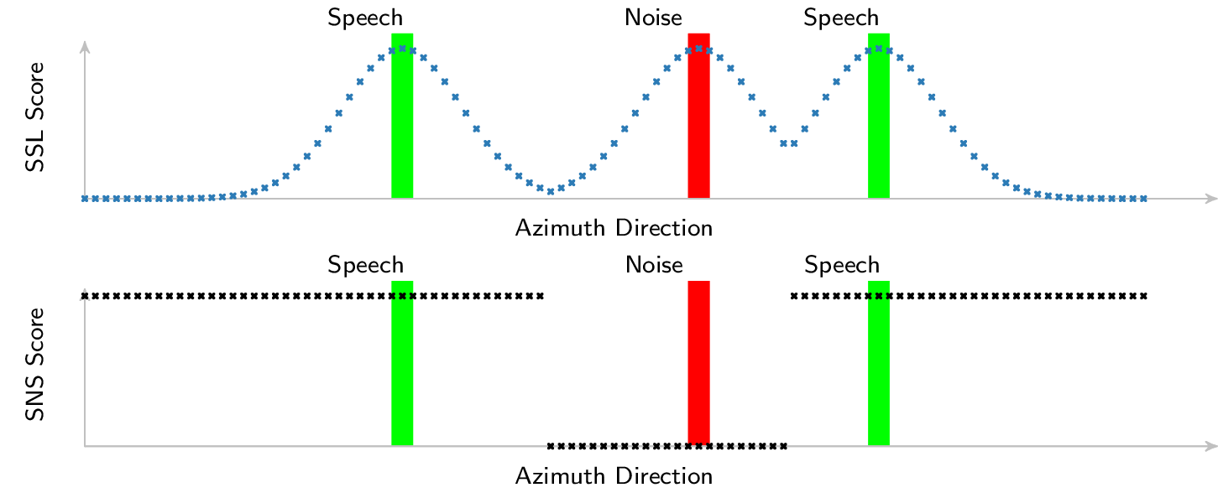
Joint Localization and Classification
Localization
Spatial information
Classification
Spectral information
DNN generates two outputs:
Network structures
  shared feature
  re-estimation
Outperforms sequential approach
(SSL + Beamforming + Classification)
Joint localization and classification of multiple sound sources using a multi-task neural network
He et al., Interspeech 2018

Slide 52
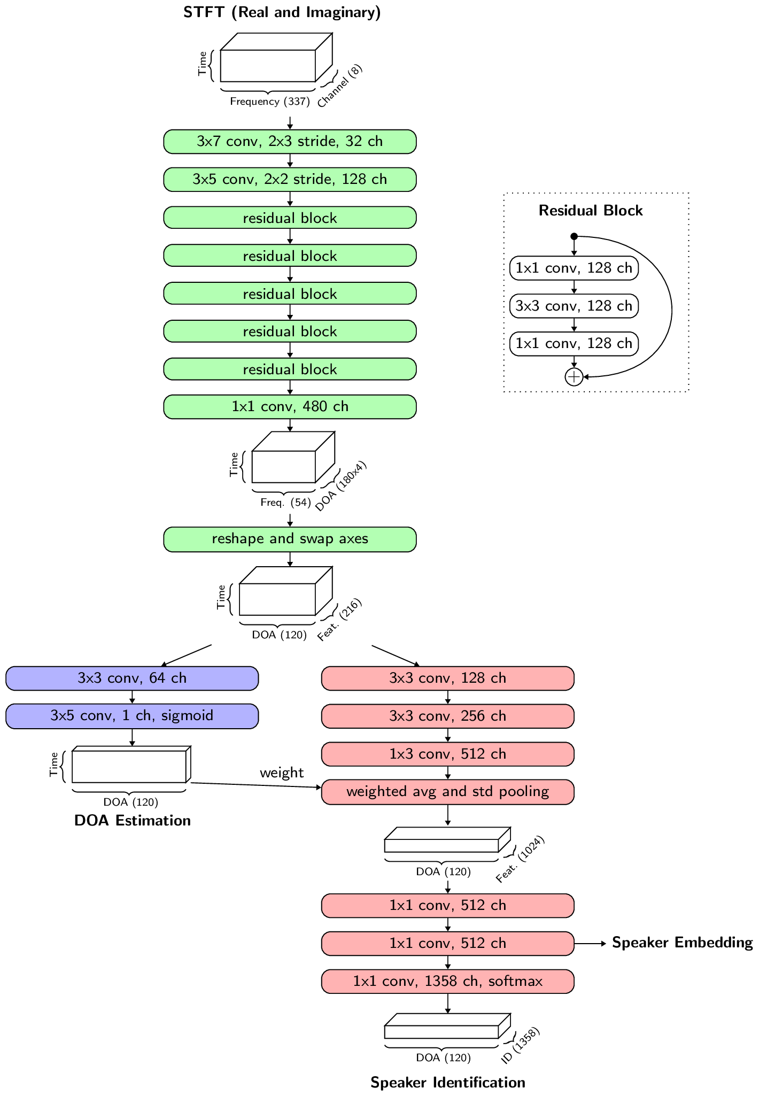
Speaker Embedding in
Multi-Speaker Environments
Shared feature multi-task network:
  DOA estimation as an auxiliary task
  Speaker embeddings at all DOAs
DOA estimation as attention
Compared to a sequential approach
  Better performance in
  multi-speaker segments
  Not as good in single-speaker segments

Slide 53
DEMO
Joint Localization and Classification

Slide 54
Conclusion
Explored the deep learning approaches for auditory perception in robotics
  Network architectures, input/output representations for multi-speaker DOA estimation
  Framework for practical application with minimal data collection effort
  Multi-task learning networks for jointly solving multiple perception functions
It works for the robot!

Slide 55
Thank you!

Slide 56
Topics
Multi-speaker Direction-of-Arrival (DOA) estimation
Domain adaptation for DOA estimation models
Multi-task learning
  Joint DOA estimation and speech/non-speech classification
  Speaker embedding in multi-speaker environments

Slide 57
Idea
Extract speaker embeddings at each direction
Use DOA estimation as an auxiliary task

Slide 58

MTL Network
Extract features for each direction
Frame-wise speaker features per direction
DOA estimation
Temporal pooling:
Get sequence-wise speaker features
Speaker Embedding
Speaker Identification

Slide 59
Performance
Compared to sequential approach:
  Better performance in multi-speaker segments
  Not as good in single-speaker segments
Extracting embeddings per direction:
  Very complex network structure
  Prone to local optima as well as overfitting

Slide 60
Traditional Approach
Spatial (angular) spectrum:
  SRP-PHAT, MUSIC, MVDR…
Sound Sources
DOA

Slide 61
Limitations
Assumptions about environments
  High SNR
  Known steering vector
  Noise are spatially uncorrelated
Separate estimation of number of sources

Slide 62
Learning-based Approach
Single source localization
  Classification of DOA (or silent)
Studies in multiple sound sources
  Require long input
  Does not scale easily to more sources

Slide 63
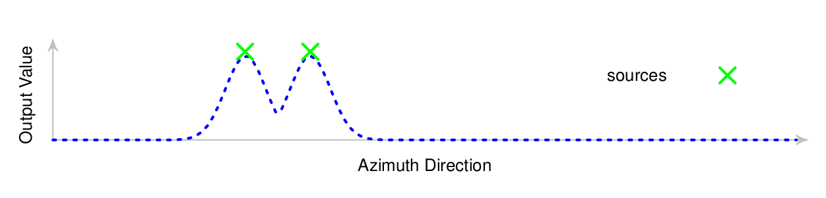
DNN predicts spatial spectrum
Input:
Cross-correlation
Raw STFT
...
Output:
Spatial spectrum
Neural
Network
Decode
Multi-channel audio
Directions of arrival (DOA)
of multiple sources

Slide 64
Output : Spatial Spectrum
Encode: Gaussian functions
Decode: peak finding with threshold
silent
one source
three sources

Slide 65
Output : Spatial Spectrum
Encode: Gaussian functions
Decode: peak finding with threshold
Topologically correlated multi-label classification
Arbitrary number of sources

Slide 66
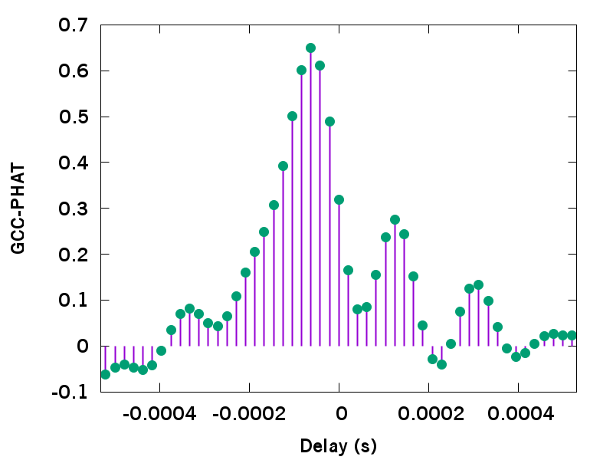
Input : cross-correlation features
GCC-PHAT coefficients
×each pair of microphones
GCC-PHAT (generalized cross-correlation with phase transform)

Slide 67
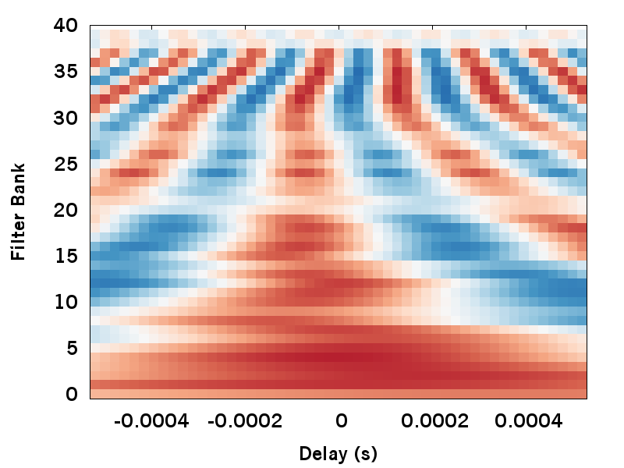
Input : cross-correlation features
GCC-PHAT on filter banks (GCC-FB)
Speech sources are time-frequency sparse
×each pair of microphones

Slide 68
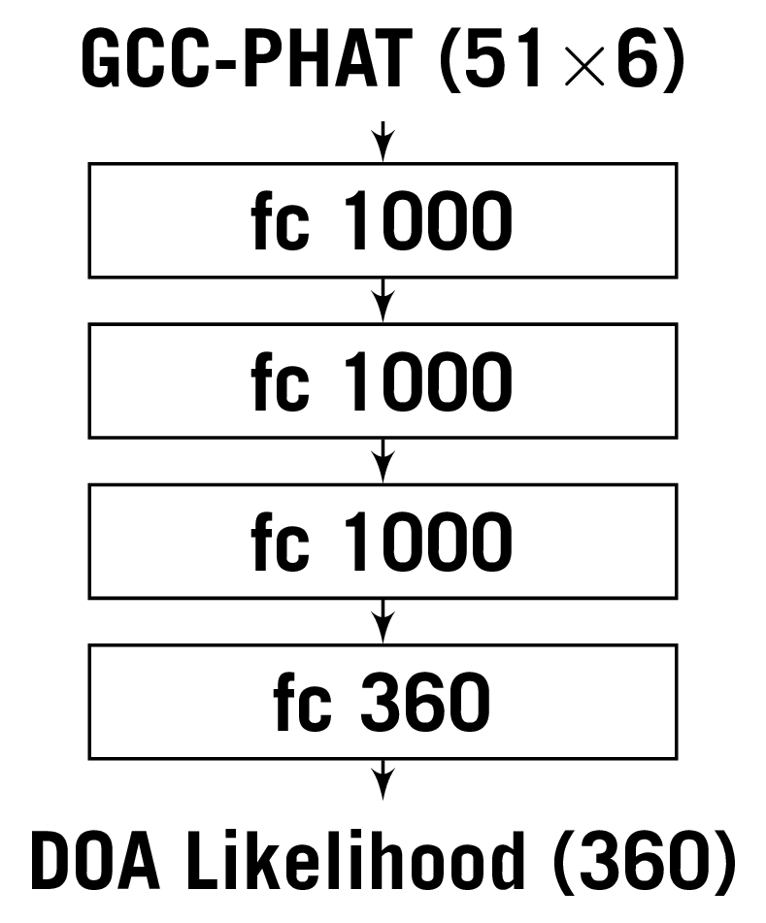
Network Architectures
Multi-layer perceptron (MLP)

Slide 69
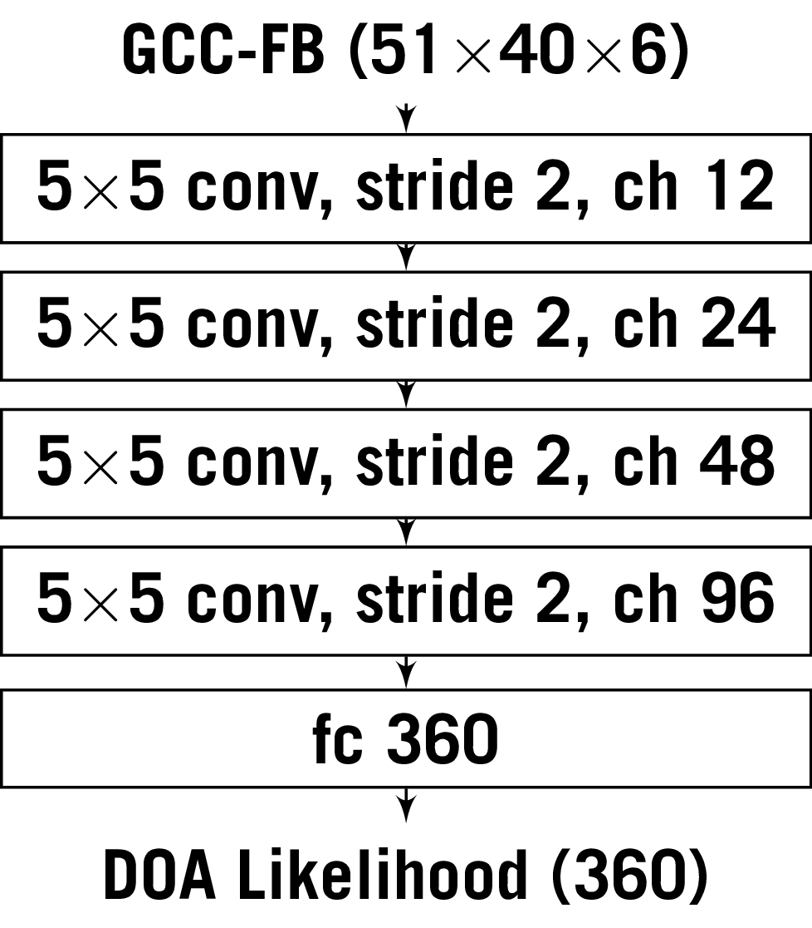
Network Architectures
Convolutional neural network (CNN)

Slide 70
Network Architectures
Two-stage network

Slide 71
Robot Recordings (24 hours)
with Loudspeakers
with Human Talkers

Slide 72
Demo

Slide 73
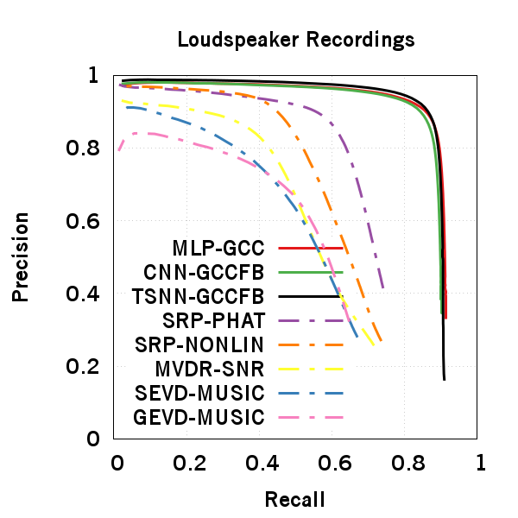
Evaluation
Proposed

Slide 74
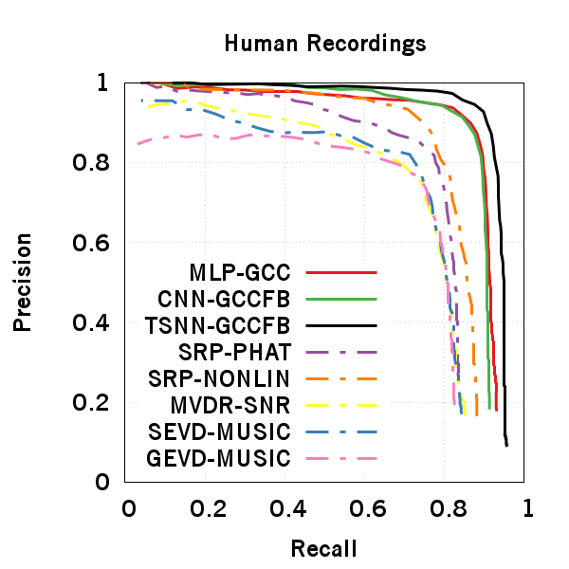
Evaluation
Proposed:
>90% Precision & Recall

Slide 75
Summary
Learning to predict spatial spectrum
Scales to arbitrary number of sources
Exploits speech sparsity in TF domain
Achieves >90% frame-wise precision and recall

Slide 76
Joint localization and classification
How can the network detect the sound sources and at the same time classify whether the sounds source is speech or noise?
Joint localization and classification of multiple sound sources using a multi-task neural network
He et al., Interspeech 2018 (best student paper finalist)

Slide 77
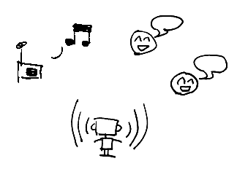
Problems:
Localization and Classification
Wild Environment:
Robot ego noise
Simultaneous sound sources
Speech and non-speech sources
Localize sound sources and classify them into speech or non-speech sources.

Slide 78
Previous Studies
Problems are solved sequentially:
Localization
Beamformer/
Separation
Classification
Examples:
May et al. “A Binaural Scene Analyzer for Joint Localization and Recognition of Speakers in the Presence of Interfering Noise Sources and Reverberation,” 2012.
Crocco et al. “Audio Tracking in Noisy Environments by Acoustic Map and Spectral Signature,” 2017.
Notes:
citation

Slide 79
Jointly Solving Both Problems
Sound localization and classification can help each other:
We propose:
Jointly solving both problems
Multi-task neural network
Localization
Spatial information
Classification
Spectral information

Slide 80
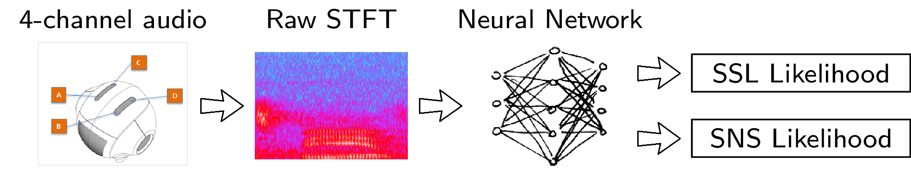
Overview
SSL : sound source localization
SNS : speech/non-speech

Slide 81
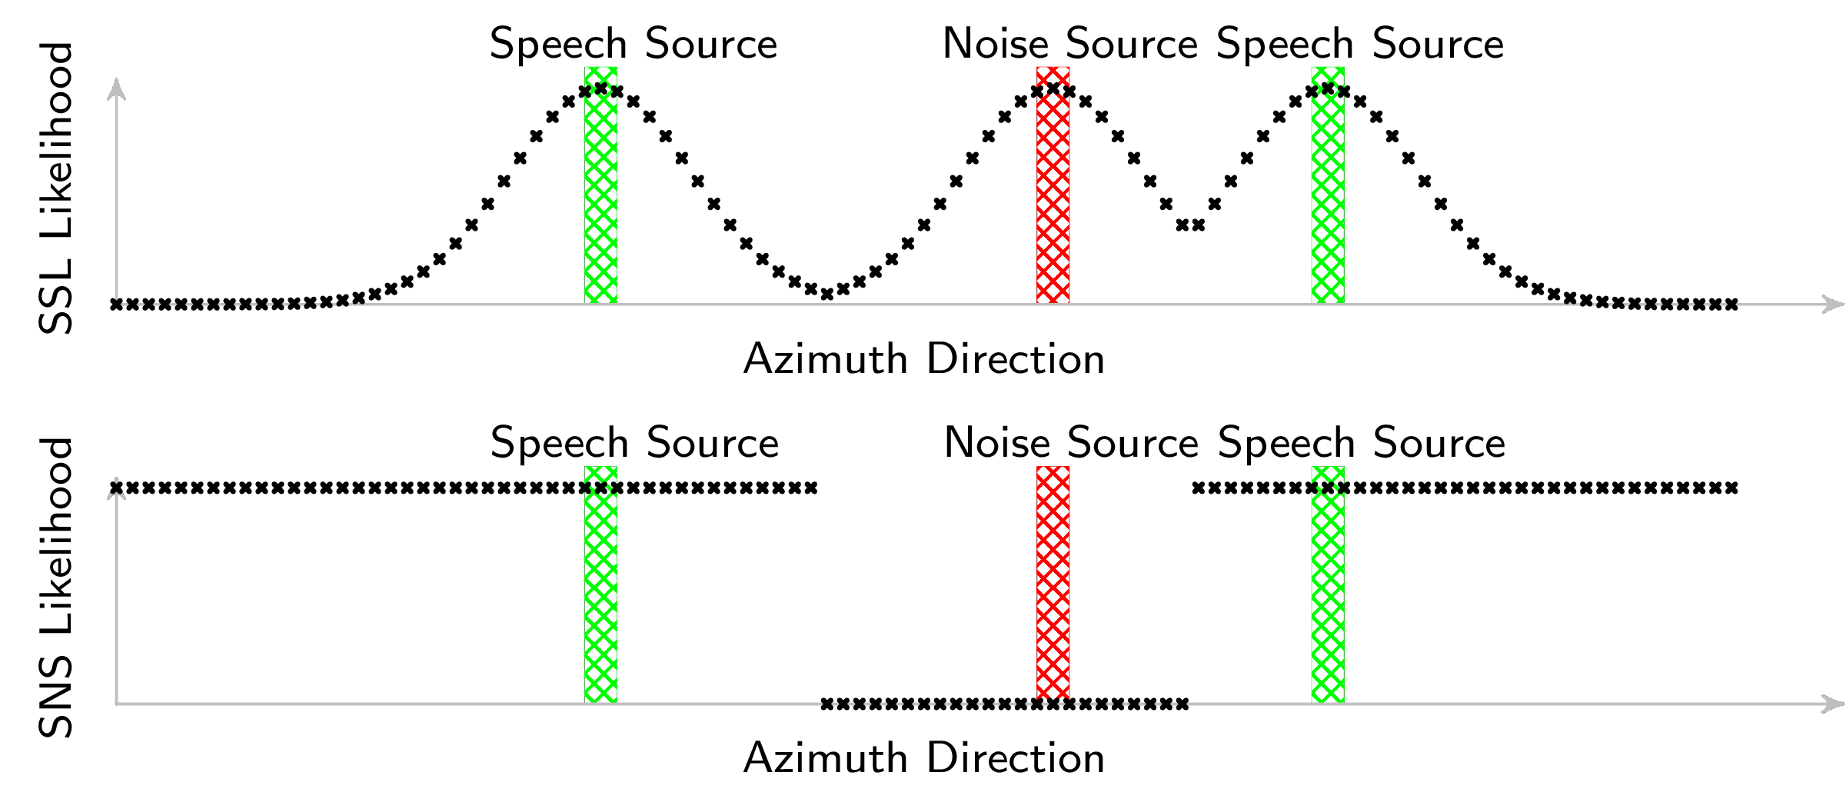
Output and Loss Function
Likelihood score on each direction
emphasis on directions next to active sources
Notes:
P and Q

Slide 82
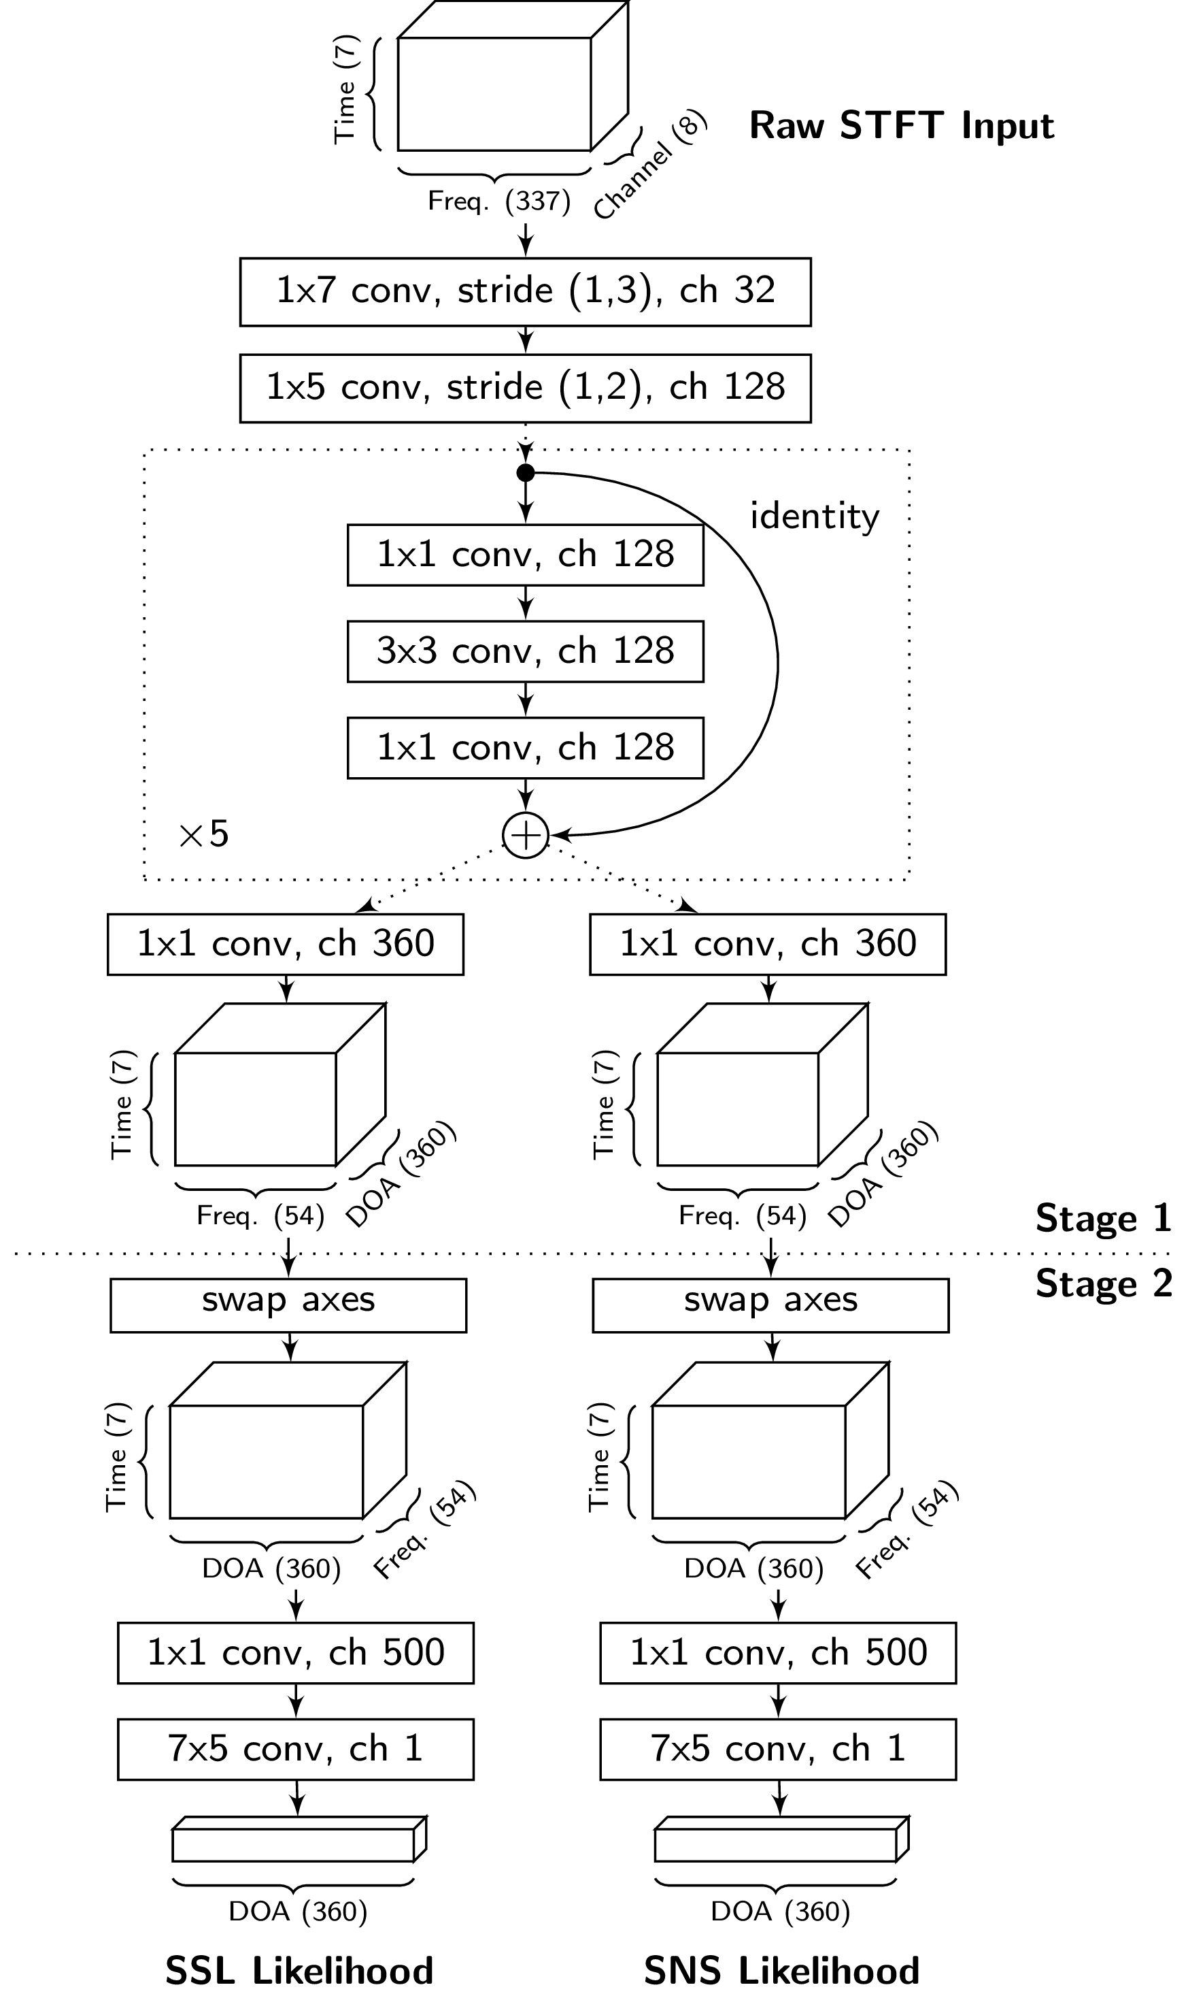
Network Structure
Fully Convolutional:

Slide 83
Network Structure
Fully Convolutional:
Residual network trunk
Notes:
T-f filtering

Slide 84
Network Structure
Fully Convolutional:
Residual network trunk
Two task-specific branches

Slide 85
Two-Stage Training
Train network end-to-end

Slide 86
Two-Stage Training
Stage 1:
Convolution in time-frequency (TF) domain:
the output is TF-local.
Notes:
Indicate in the axes

Slide 87
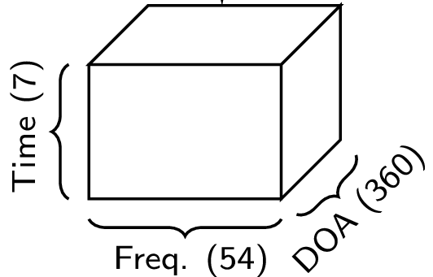
Two-Stage Training
Stage 1:
Convolution in time-frequency (TF) domain:
the output is TF-local.
Output 360 channels:
can be interpreted as early prediction for each TF point.
Notes:
Indicate in the axes

Slide 88
Two-Stage Training
(1) Supervision on output of Stage 1
(2) Train whole network end-to-end

Slide 89
Data
Training:
Loudspeakers: 32 hours, 148 speakers
Speech: AMI Corpus
Non-speech: Google AudioSet
Test:
Loudspeaker: 17 hours, 16 speakers
Human talkers: 8 minutes, 7 speakers
AMI Corpus: http://groups.inf.ed.ac.uk/ami/corpus/
AudioSet: https://research.google.com/audioset/
Notes:
url

Slide 90
Demo
Notes:
Mention pepper camera

Slide 91
Evaluation
Sound Localization
Speech/Non-speech Classification
Speech Localization
Methods
Baseline: Localization + MVDR + Classification
Proposed method

Slide 92
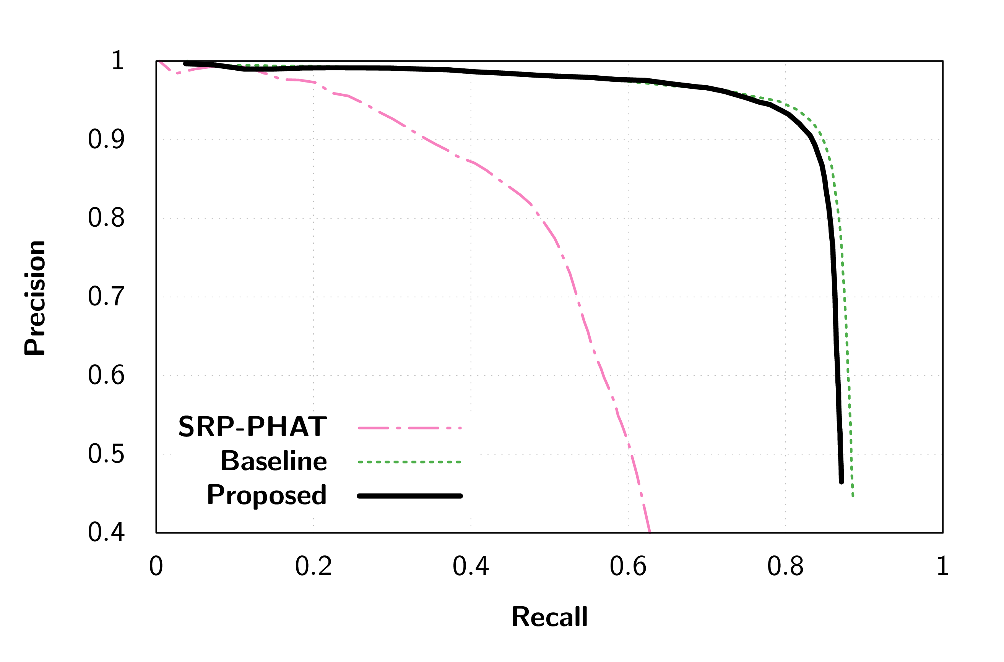
Result: Sound Localization
Human Recordings
Proposed Method
>90% precision
>80% recall
(Similar conclusion can be drawn for loudspeaker recordings)

Slide 93
Result:
Speech/Non-speech Classification
(Assuming sound direction is known)
Accuracy | Loudspeaker | Human
Baseline | 0.80 | 0.68
Proposed Method | 0.95 | 0.85

Slide 94

Result: Speech Localization
Human Recordings
Proposed Method
>80% precision
>70% recall
(Similar conclusion can be drawn for loudspeaker recordings)
Notes:
Display observation in bullet points

Slide 95

Result: Speech Localization
Human Recordings
Without 2-stage Training
(Similar conclusion can be drawn for loudspeaker recordings)
Notes:
Display observation in bullet points

Slide 96

Result: Speech Localization
Human Recordings
Extension:
Add Temporal Context to Input
(600ms instead of 170ms)
(Similar conclusion can be drawn for loudspeaker recordings)
Notes:
Display observation in bullet points

Slide 97
Summary
We proposed deep learning-based methods for jointly solving sound localization and classification:
Significant better performance compared to baseline in speech/non-speech classification and speech localization.
Two-stage training allows better model to be trained.
Further improvement by adding temporal context.
Notes:
implemented in robots

Slide 98
Learning with low resources
How can we train the sound source localization models with minimal workload for data collection and annotation?
Adaptation of Multiple Sound Source Localization Neural Networks with Weak Supervision and Domain-adversarial Training
He et al., ICASSP 2019

Slide 99
Current Issue
Learning-based methods require a large amount of training data:
  Diversity in source signal, power, positions, noise, etc.
  Data are device-specific.
Data collection and annotation is costly.

Slide 100
Current Issue
Learning-based methods require a large amount of training data:
  Diversity in source signal, power, positions, noise, etc.
  Data are device-specific.
Data collection and annotation is costly.

Slide 101
Idea
Train with simulated data.
Mismatch between simulation and reality:
  Device physical body
  Microphone response pattern
  Room acoustic features
We need: domain adaptation.

Slide 102
Problem
Target Domain
Source Domain
Simulated Data
(labelled)
Real Data
(weakly labelled)
Training Set
Adaptation Set
Weak labels: number of sources
Provides relevant information
Easy to annotate
Real Data
(labelled)
Target: best performance on the target domain test set
Test Set

Slide 103
Approach
Combination of:
  Weak supervision (output).
  Domain-adversarial training (feature).

Slide 104
Weak Supervision
Weak label reduces space of possible correct network output.
Adjust network model so that the distance between the output and the reduced space is minimized.

Slide 105

Weak Supervision
Output space:
Space of ideal outputs
Actual output
Desired output
Space of outputs consistent with the weak label

Slide 106
Weak Supervision

Slide 107

Weak Supervision

Slide 108
Domain-adversarial Training
Ganin et al. “Domain-adversarial training of neural networks,” Journal of Machine Learning Research, 2016.
Goal:
  Domain-independent features

Slide 109

Network
Feature extractor
(green)
DOA estimator
(blue)
Domain classifier
(red)

Slide 110
Training
Extract feature
that can fool the
domain classifier.

Slide 111
Experiment
Data
  Source domain: simulation RIR generator.
  Target domain: play with loudspeakers, record by a robot.
  Source signals: clean segments from AMI corpus.
Evaluation
  Frames of 170 ms, maximum 2 sources
  Detection is correct if error < 5 degrees

Slide 112

Results: Supervised Training

Slide 113

Results: Weak Supervision

Slide 114

Results: Domain-adversarial

Slide 115

Results: Combined

Slide 116
Summary
Weak supervision with known number of sources on the target data significantly improves an unadapted model.
Domain-adversarial training fails to yield significant results.
  Difficult to find the trade-off between domain-invariance and discriminative power.

Slide 117
Conclusion
Explored the deep learning approaches for audio perception in robots
  Sound source localization
  Localization and classification
  Learning with low resource
It works for the robot!
It applies to other devices as well

Slide 118
Architecture 1: MLP-GCC
Input: GCC-PHAT Coefficients
Output: Spatial Spectrum
Architecture: MLP
× each pair of microphones
GCC-PHAT : Generalized Cross-Correlation with PHAse Transform

Slide 119
Output : Spatial Spectrum
Likelihood score for each azimuth direction (360):
  Encode: Gaussian functions
  Decode: peak finding with threshold
Loss function: Mean Squared Error (MSE)
No active sound source
Can handle an arbitrary
number of sources
Three sound sources
One sound source

Slide 120
Architecture 2: CNN-GCCFB
Input: GCC-PHAT on Filter Bank
Output: Spatial Spectrum
Architecture: CNN
× each pair of microphones

Slide 121
Architecture 4: ResNet-STFT
Input: Short-time Fourier Transform
  Real and imaginary channels
  No information loss
Output: Spatial Spectrum
Architecture: Residual Network
Deep structure to
extract high level features

Slide 122
Weak Supervision
pseudo-label

Slide 123

Problem
Rely on initial performance
  Multi-source segments

Slide 124
Data Augmentation
Mix single-source segments
  Generate multi-source segments
  Knowledge of its components
Apply pseudo-labeling on individual components instead of mixture

Slide 125

Pseudo-labeling on Components

Slide 126
Pseudo-labeling on Components

