Slide 1
Mert Gör

Slide 2

Mert Gör
I want to lead to The Free Software Movement

Slide 3

PSD GNU/Linux
Userspace is fully free with network services
Kernelspace is modified with minor commits

Slide 4

Programming
Training for The Internet

Slide 5
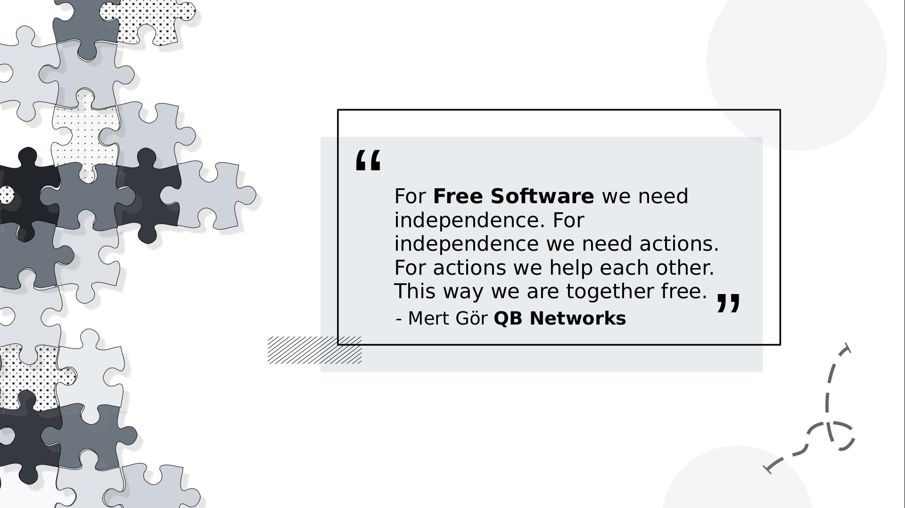
Together we are free

Slide 6


Contribute back
Foundations
Companies
Individuals

Slide 7

Why Software
Software as a strategy
To make theories happen

Slide 8

Convergents
Converging the teams’ roles
Converging tools, software, with a deep consiousness of hardware

Slide 9
Science
HPC
Culture
Ai

Slide 10

To lead means carry on
We QB Networks and Masscollabs Services are leading to Software, Hardware and Science for the Internet Cyberspace with our own consciousness. We have our own roadmap and which is why we say we are a Free Software project. This is an open way to software and open infrastructures ...

Slide 11


happy hacking
irc.libera.chat server’s #qbnetworks channel
Q&A
mertgor@qbnetworks.xyz
GPG Key ID 0xD200B456637BC4F3

Slide 12
Presentation Licensing
This presentation is licensed under the terms of CC BY-SA 4.0 or later license

Slide 13

Template Licensing
This slide template, and any artwork contained within was made by me, Natalie Chmura and is published via the Creative Commons BY License

