Slide 1
Num of POIs for New Categories

Slide 2
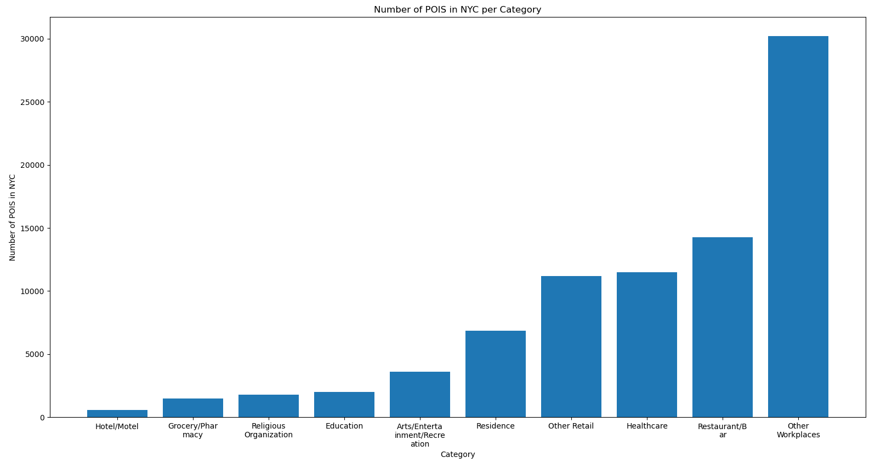

Slide 3
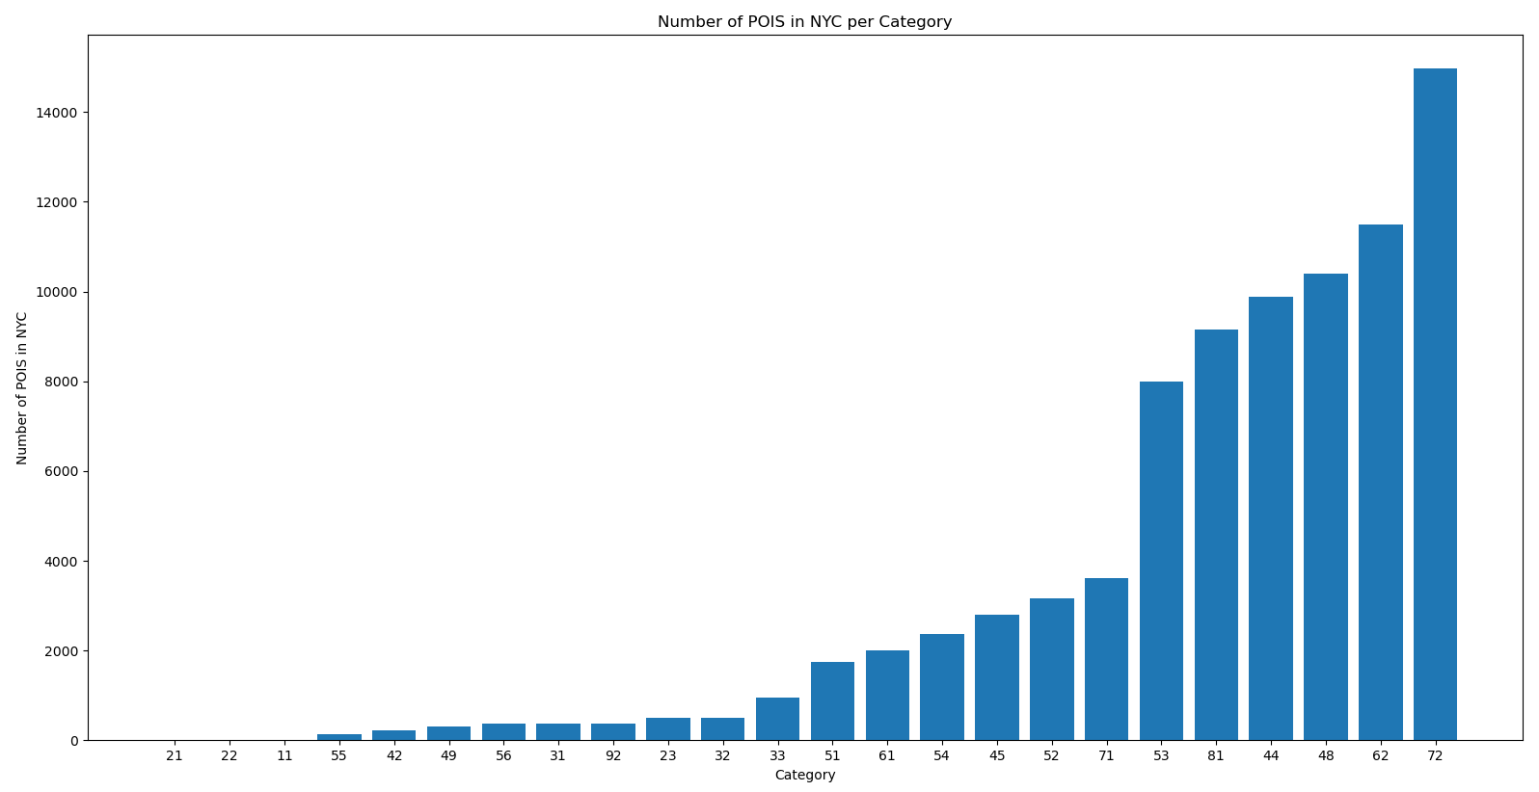

Slide 4
New Plots

Slide 5
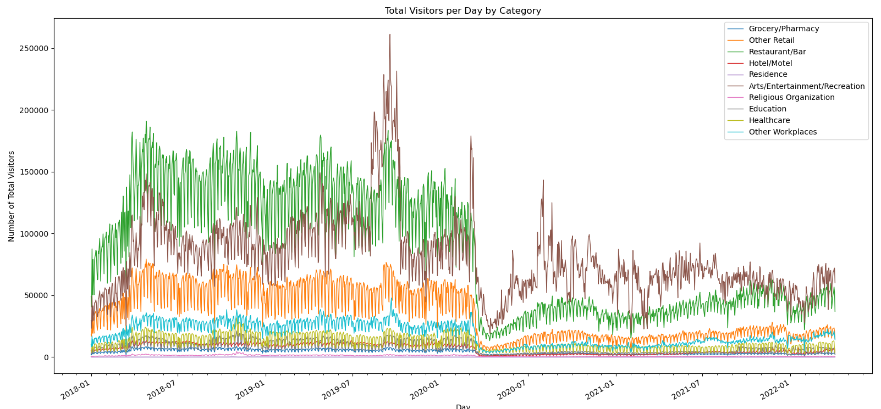

Slide 6
Weekly Average Plot

Slide 7
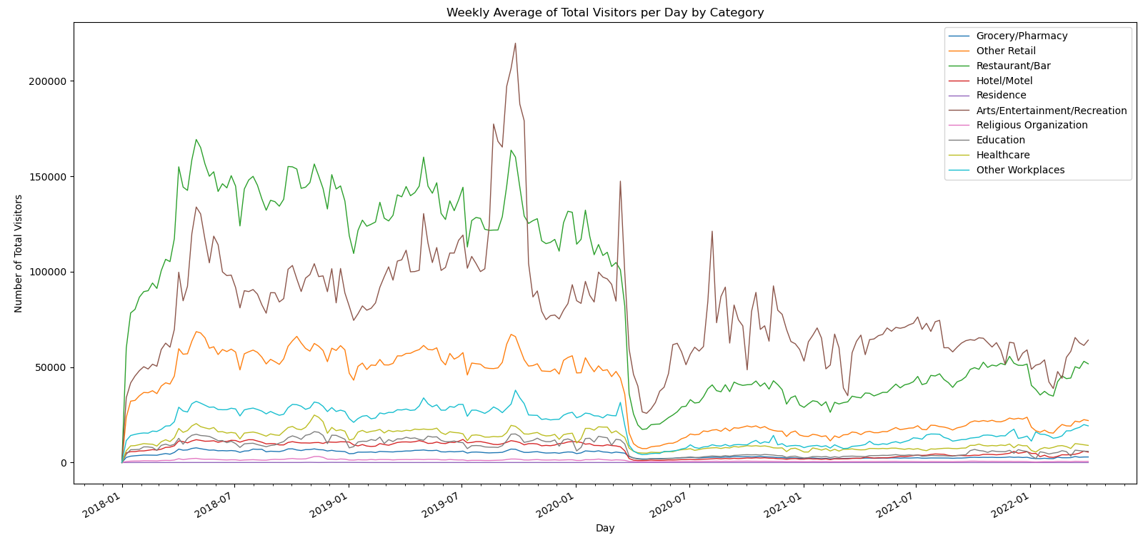

Slide 8
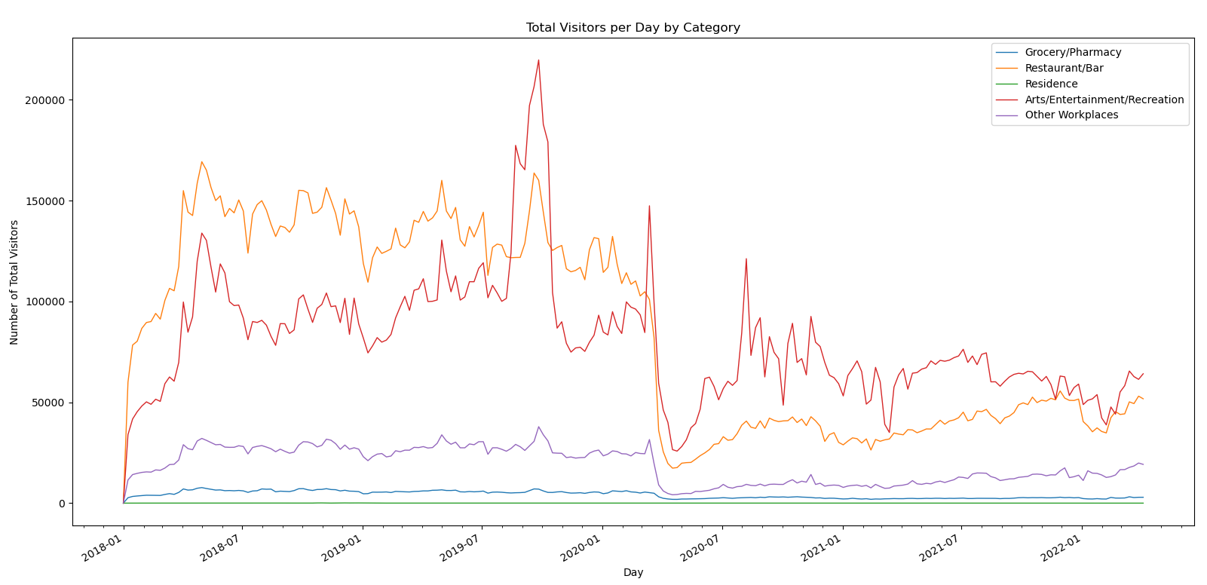

Slide 9
