Slide 1
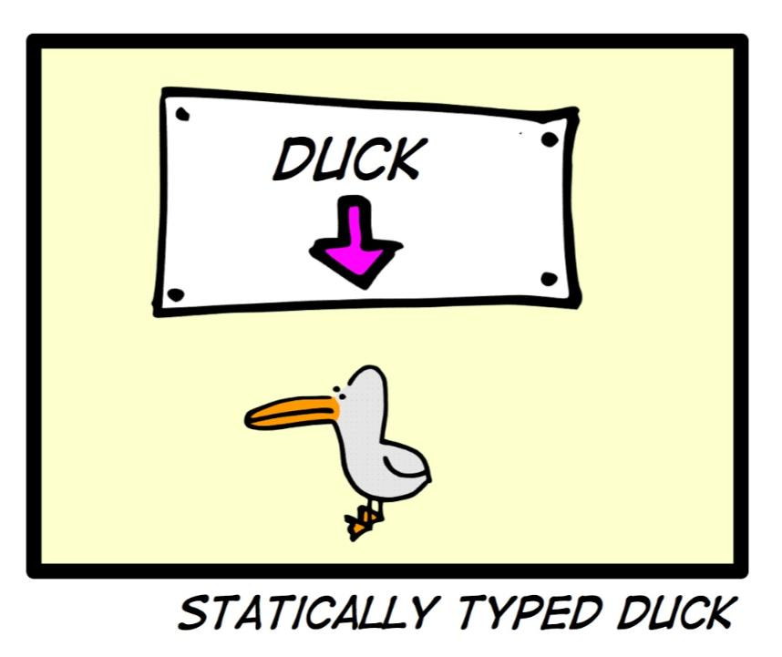

Notes:
Waiting for people to arrive

Slide 2
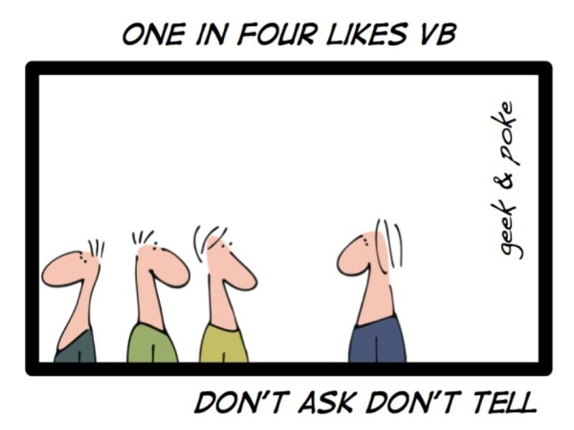
Notes:
Waiting for people to arrive

Slide 3
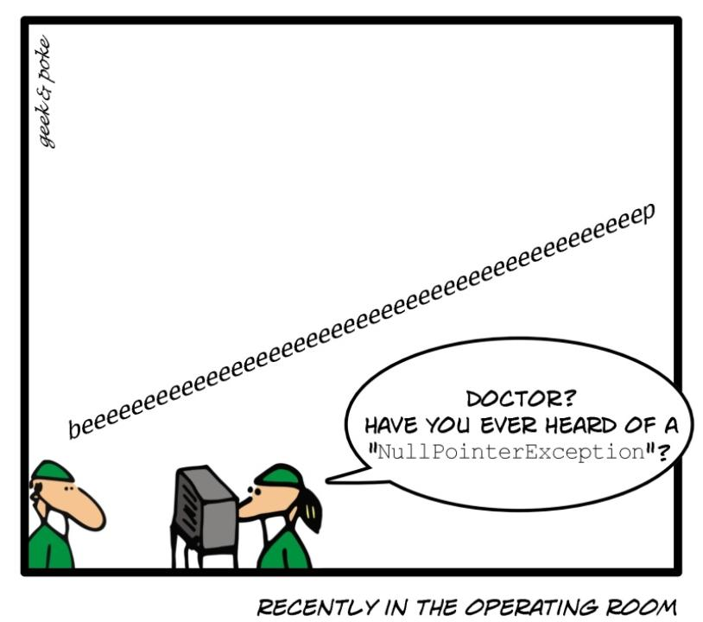
Notes:
Waiting for people to arrive

Slide 4
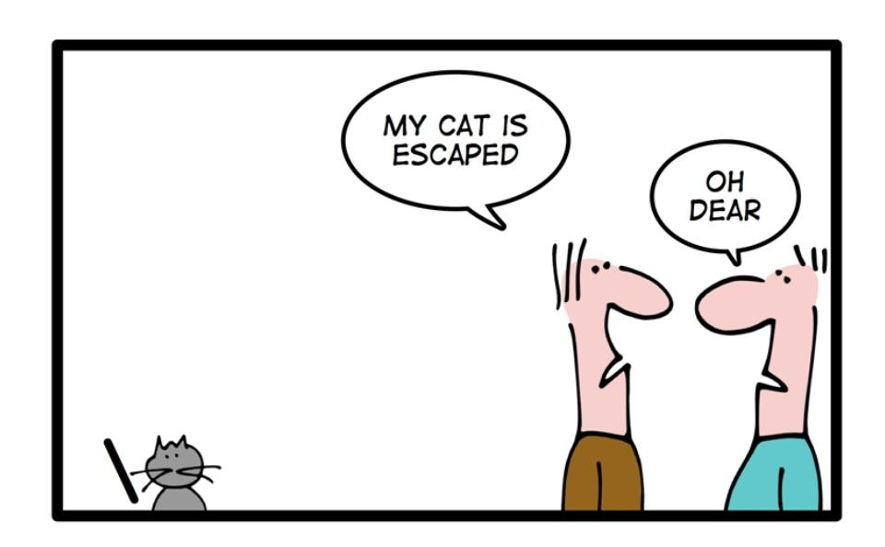
geek & poke
Notes:
Waiting for people to arrive

Slide 5





A Dynamic Component Architecture for High Performance Gameplay
Terrance Cohen
Lead Systems Engineer
Insomniac Games
Notes:
Visit me on the Web
http://www.TerranceCohen.com
Follow me on Twitter:
http://twitter.com/terrance_cohen
Connect with me on LinkedIn:
http://www.linkedin.com/in/terrancecohen
Ask me a question:
http://www.formspring.me/terrancecohen

Slide 6
Please View Speaker Notes by clicking the icon
or selecting Actions -> Show Speaker Notes.
Notes:
Thank you.

Slide 7

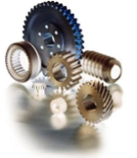

A Dynamic Component Architecture for High Performance Gameplay
Purpose
The Dynamic Component System
Implementation by Example
Questions (note slide #)
Notes:
At a high level, I have three sections to this discussion
First, we'll talk about, "Why are we here?"
Not, "Why are we here on this earth," that's outside the scope of this presentation. I mean, "What do I hope you'll conclude from this."
We'll discuss the problem we're trying to solve, and my approach to a solution
Second, we'll talk about details of my solution, which I call the Dynamic Component System.
We'll discuss features of the system, and why it's a good solution
And third, we'll dig into implementation details of the system,
Using a few systems of dynamic components for illustration purposes

Slide 8
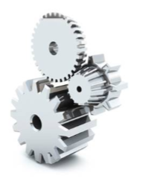
A Dynamic Component Architecture for High Performance Gameplay
Purpose
Statement of Problem
Proposed Solution
The Dynamic Component System
Implementation by Example
Notes:
First we'll talk about the problem we're trying to solve.

Slide 9
Purpose : Statement of Problem
Monolithic / deep Game Object hierarchy
Memory: binds data @ compile time
Allocated throughout lifetime
Notes:
This is the traditional OO game object based gameplay model
Member data allocated throughout lifetime, even when not in use
Some designs will allocate some data separately from the game object, e.g. a physics instance
But this is counter to the architecture, rather than central to the architecture,
And each system is likely to roll it’s own solution, since the unifying architecture doesn’t support it

Slide 10
Purpose : Statement of Problem
Monolithic / deep Game Object hierarchy:
Memory: binds data @ compile time
Performance: poor cache coherence
Arrays of non-homogeneous objects
Virtual dispatch
Fragmented instance data
Notes:
Encourages iteration over arrays of non-homogeneous objects
Encourages virtual dispatch in the most unpredictable patterns
Instance data fragmented by unused elements
These are general issues with performance under OO

Slide 11
Purpose : Statement of Problem
Monolithic / deep Game Object hierarchy:
Memory: binds data @ compile time
Performance: poor cache coherence
Architecture: capability <=> inheritance
Fixed at compile time
Fully determined by class
Change capabilities -> change hierarchy
Notes:
Capabilities of an object are fixed at compile time, fully determined by class
Changing capabilities means changing hierarchy
often impossible without code duplication or multiple inheritance of implementation
both have serious drawbacks
Changing capabilities through multiple inheritance:
Some will argue that there are no serious drawbacks to MI
Beyond the scope of this discussion
Even for strong proponents of such architecture, should agree that it's not a good solution to this problem
Messy unification of disparate hierarchies

Slide 12
Purpose : Statement of Problem
Monolithic / deep Game Object hierarchy:
Memory: binds data @ compile time
Performance: poor cache coherence
Architecture: capability <=> inheritance
"What we're used to"
But select the best tool for the job.
Notes:
"What we're used to," so easy to overlook flaws
Step back. Select the best tool for the job.

Slide 13

Purpose : Statement of Problem
Monolithic / deep Game Object hierarchy:
Memory: binds data @ compile time
Performance: poor cache coherence
Architecture: capability <=> inheritance
"What we're used to"
But select the best tool for the job.
There's a better way!

Slide 14
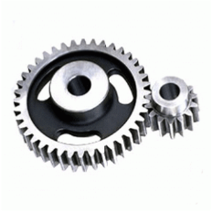
A Dynamic Component Architecture for High Performance Gameplay
Purpose
Statement of Problem
Proposed Solution
The Dynamic Component System
Implementation by Example
Notes:
So here's my attempt at a solution. It's worked well for us. I hope it'll work well for you.

Slide 15
Purpose : Proposed Solution
Construction of Game Object through composition of components at runtime

Slide 16
Purpose : Proposed Solution
Construction of Game Object through composition of components at runtime
Simple!
Thank you for coming!

Slide 17
Purpose : Proposed Solution
Construction of Game Object through composition of components at runtime
Simple!
Thank you for coming!
Oh, you want details !?!

Slide 18
Purpose : Proposed Solution
Construction of Game Object through composition of components at runtime
Small chunks
Represent a data transformation
Notes:
Everything that the Game Object represents can be broken-down into small chunks
Each component represents a data transformation
Ultimately, that's all the game is doing
e.g. state machine + states
e.g.
model
animation
physics
ai/logic
sensing
send/receive messaging
causing damage

Slide 19
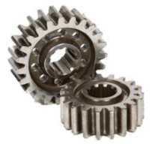
A Dynamic Component Architecture for High Performance Gameplay
Purpose
The Dynamic Component System
Features
Implementation by Example
Notes:
So now we'll talk about my solution which I call the Dynamic Component System.
First we'll talk at a high level about what is the system

Slide 20
The Dynamic Component System
Evolution
Resistance 1 - Proof of Concept (1 type)
Resistance 2 - "Early Adopters" (32 types)
Ongoing (295 types as of May 1st 2010)
Majority of new gameplay code
Large portions of old gameplay refactored

Slide 21
The Dynamic Component System
Evolution
Resistance 1 - Proof of Concept (1 type)
Resistance 2 - "Early Adopters" (32 types)
Ongoing (295 types as of May 1st 2010)
Majority of new gameplay code
Large portions of old gameplay refactored
So it’s mature.

Slide 22
The Dynamic Component System
Evolution
Resistance 1 - Proof of Concept (1 type)
Resistance 2 - "Early Adopters" (32 types)
Ongoing (295 types as of May 1st 2010)
Majority of new gameplay code
Large portions of old gameplay refactored
So it’s mature. (No, not that way.)
Notes:
Not in the “adults only” sense. It’s been exercised.

Slide 23
The Dynamic Component System
Side-by-side implementation
Not necessary to refactor existing code
Coexist with components
General solution
Notes:
Side-by-side implementation
Not necessary to refactor existing code
Game objects in the traditional (or "legacy") monolithic model can coexist and interoperate with components
The solution is general - doesn't require a particular game architecture.
Some environment-specific implementation details

Slide 24

The Dynamic Component System
Does not address matters of
Reflection
Serialization
Data building
Instance versioning
... those things are handled separately
outside the scope of this discussion
Notes:
sorry if you were looking for tips on those things
if you're interested in my thoughts on those subjects, please contact me afterward

Slide 25
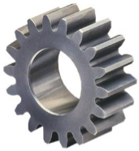
A Dynamic Component Architecture for High Performance Gameplay
Purpose
The Dynamic Component System
Features
Implementation by Example
Notes:
Now we'll discuss features of the system, a.k.a. why I think it's a good solution.

Slide 26
Dynamic Component System : Features
Components
High-performance
Dynamic
System

Slide 27
Dynamic Component System : Features
Components
Originally Aspects
Base Component class
8 bytes of administrative data
Allocated from pools
One pool per concrete type
"Roster" indexes instances
"Partition" separates allocated/free instances
Notes:
Components
Originally called Aspects from AOP
Derived from base Component class
12 bytes of administrative data
"Payload" can be detached & treated as POD for processing in separate memory spaces
Allocated from pools
One pool per concrete type
Homogeneous type instances per pool
Each pool is indexed with a "partition" value separating free from allocated instances
Called the "Roster"

Slide 28
Dynamic Component System : Features
Components
High-performance
Small, constant-time operations
Allocate/free
Resolve handle
Get type
Type implements (derived from)
No instance copying
Notes:
High-performance
All operations, except for "search", are small constant-time
Allocate/free
Resolve handle
Get type
Type implements (derived from)
No instance copying
manipulations are done on the Roster rather than the instance pool

Slide 29
Dynamic Component System : Features
Components
High-performance
Updates per-type (per-pool)
Cache friendly
Encourage async update
e.g. on SPU
Roster: contiguous list of alloc'd instances
Roster up to partition is DMA list
Notes:
High-performance
Updates are performed per-type (per-pool)
Cache friendly
Designed to encourage & simplify async update
e.g. on SPU
Roster contains contiguous list of pool indices of allocated instances
Roster up to partition is DMA list

Slide 30
Dynamic Component System : Features
Components
High-performance
Resolving handle
Small, constant-time operation:
Index into Pool
Compare generation
Return Component*
Notes:
High-performance:
References between components normally handled by holding/resolving handles

Slide 31
Dynamic Component System : Features
Components
High-performance
Dynamic
Runtime composition of game objects
Dynamically alter behavior without baggage
Component allocated == in use
Pool sizes == max concurrent allocations
Notes:
Dynamic:
Runtime composition of game objects
Objects can substantially alter any aspect without carrying around any "baggage" from other states
Recommended idiom: component is allocated IFF actively in use
Pool sizes need only accommodate max concurrent allocations

Slide 32
Dynamic Component System : Features
Components
High-performance
Dynamic
High-frequency alloc() & free()
alloc():
test for availability
make handle from index & generation
increment Roster Partition
Component::Init()
Notes:
Dynamic:
Results:
High-frequency alloc() & free()
Small constant-time operations:
alloc():
test for availability
make handle from index & generation
increment roster partition
call Init on allocated component

Slide 33
Dynamic Component System : Features
Components
High-performance
Dynamic
High-frequency alloc() & free()
alloc():
free():
Component::Deinit()
swap Roster index with Partition-adjacent index
decrement Partition
increment generation
Notes:
Dynamic
Results:
High-frequency alloc() & free()
Small constant-time operations:
free():
call Deinit
swap index in roster with partition-adjacent index
decrement partition
increment generation
So let's take an example to put some of these pieces together.
We'll look at an example of freeing a dynamic component instance.

Slide 34
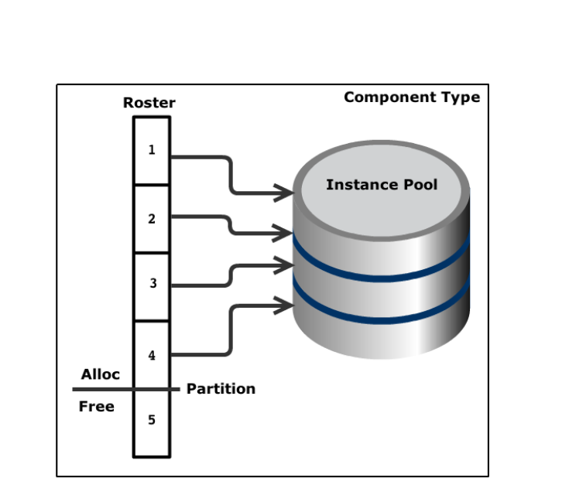
Demo : DynamicComponent::Free()
//free the component from host's component chain
void DynamicComponent::Free( Type type, HostHandle host_handle, Chain& chain,
ComponentHandle& component_handle );
Notes:
Here's the prototype for DynamicComponent::Free(). It takes...
So here's an example.
We have a pool of instances of some given component type.
We have a roster, which is an array of indices into the instance pool. (Note that all of the instances in the pool are of the same type, so they are of equal size. So the value at a roster index is itself just an index into the pool.
You can see that we have a partition value, which separates roster indices representing allocated vs. free instances.

Slide 35
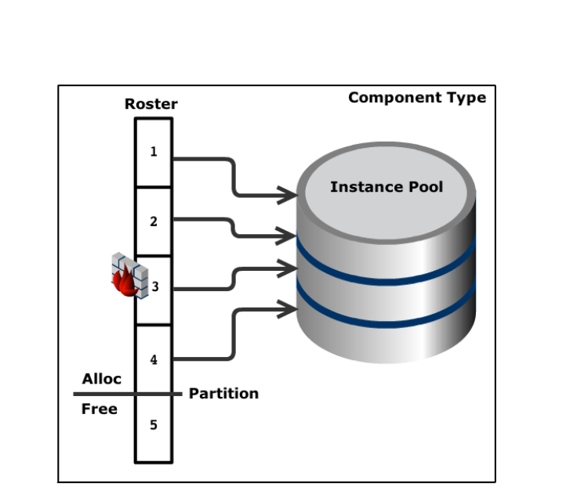
Demo : DynamicComponent::Free()
//free the component from host's component chain
void DynamicComponent::Free( Type type, HostHandle host_handle, Chain& chain,
ComponentHandle& component_handle );
Notes:
Alright. Now we're going to free the component represented by the 3rd roster element, which is currently index 3 in the pool.

Slide 36
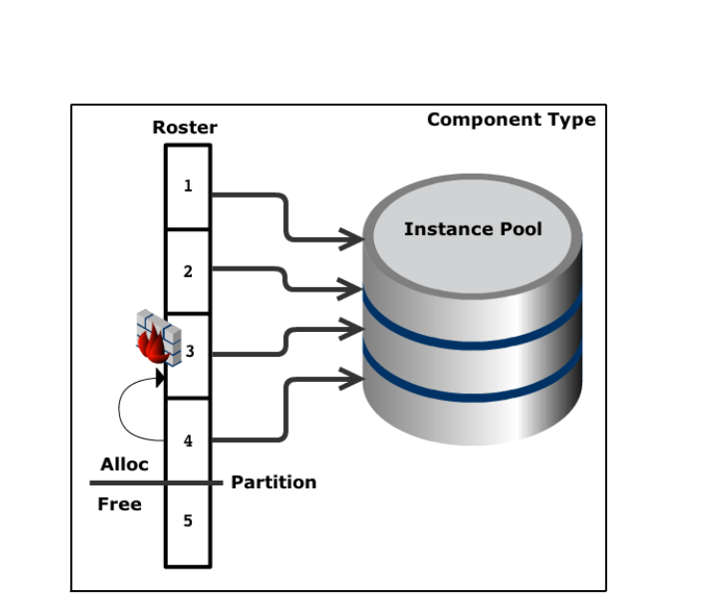
Demo : DynamicComponent::Free()
//free the component from host's component chain
void DynamicComponent::Free( Type type, HostHandle host_handle, Chain& chain,
ComponentHandle& component_handle );
Notes:
So what we'll do is swap the 3rd and 4th roster elements.

Slide 37
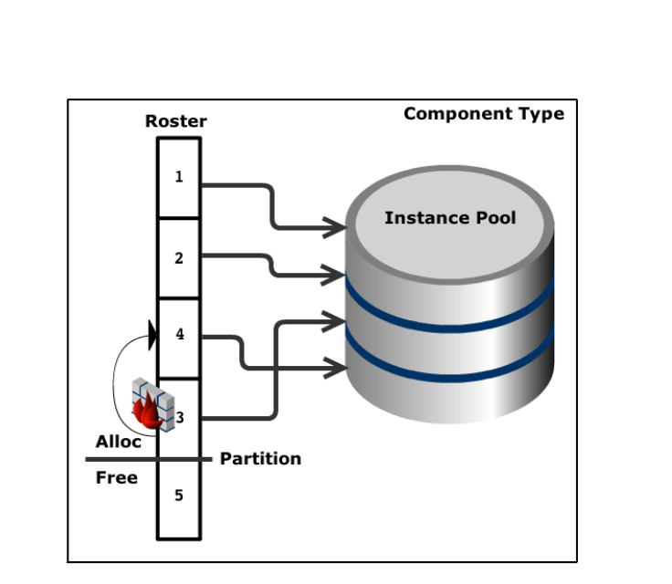
Demo : DynamicComponent::Free()
//free the component from host's component chain
void DynamicComponent::Free( Type type, HostHandle host_handle, Chain& chain,
ComponentHandle& component_handle );
Notes:
Now we're freeing the 4th roster element, which represents the 3rd instance in the pool.
Since we swapped the roster entry for the element to be freed into the partition-adjacent roster entry, all we have to do to free that instance is...

Slide 38
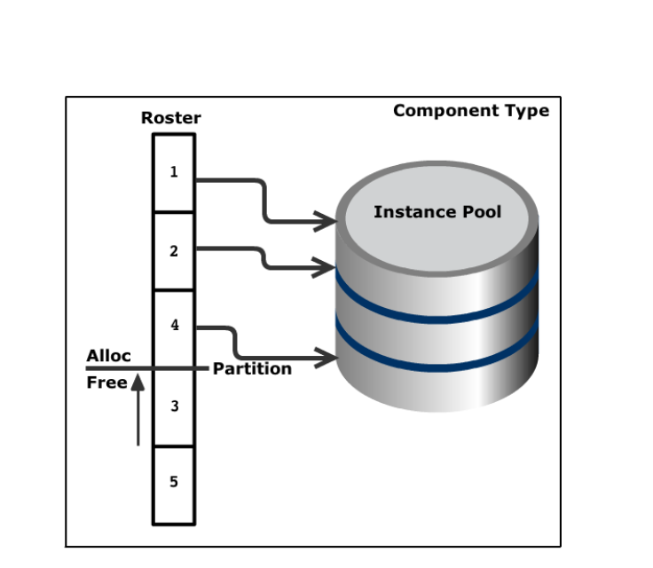
Demo : DynamicComponent::Free()
//free the component from host's component chain
void DynamicComponent::Free( Type type, HostHandle host_handle, Chain& chain,
ComponentHandle& component_handle );
Notes:
... decrement the partition.
And voila, we've free'd a component instance with a few very small constant-time operations, and we didn't touch the instance data, only indices.

Slide 39
Dynamic Component System : Features
Components
High-performance
Dynamic
System
Not all-or-nothing!
Examples:
Conversation
Script Events
Shots: no game object
Notes:
System
Doesn't need to completely replace a standard game object model
Can completely replace standard game object model
Other systems host components
Conversation
Script Events
Shots
No game object

Slide 40
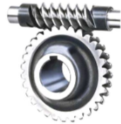
A Dynamic Component Architecture for High Performance Gameplay
Purpose
The Dynamic Component System
Implementation by Example
API
Script Events: Type Registration
Navigation: Allocation & Init
Shots: Asynchronous Update
Notes:
At a high level, I have three sections to this discussion
So now we're digging into implementation details of the system
APIs always a good place to start

Slide 41

namespace DynamicComponent
{
//
// Hosts' API
//
// Call these from GameObjects (or other objects) that host Dynamic Components
//
___________________________________________________________________________________________________
.
//allocate a component of type, add it to host's component chain,
// and optionally park a prius in the component
// returns null if no space is available for allocation
Component* Allocate ( Type type, HostHandle host_handle,
Chain* chain, void* prius = NULL );

Slide 42
namespace DynamicComponent
{
//
// Hosts' API
//
// Call these from GameObjects (or other objects) that host Dynamic Components
//
Component* Allocate ( Type type, HostHandle host_handle,
Chain* chain, void* prius = NULL );
___________________________________________________________________________________________________
.
//resolve a ComponentHandle to a Component
// returns NULL if component_handle is null or is a stale handle
// (i.e. component instance has been reused)
Component* ResolveHandle ( Type type, ComponentHandle component_handle );

Slide 43
namespace DynamicComponent
{
//
// Hosts' API
//
// Call these from GameObjects (or other objects) that host Dynamic Components
//
Component* Allocate ( Type type, HostHandle host_handle,
Chain* chain, void* prius = NULL );
Component* ResolveHandle ( Type type, ComponentHandle component_handle );
_______________________________________________________________________________________________________
.
//get one component of type that belongs to host
Component* Get ( Type type, HostHandle host_handle, Chain chain );

Slide 44
namespace DynamicComponent
{
//
// Hosts' API
//
// Call these from GameObjects (or other objects) that host Dynamic Components
//
Component* Allocate ( Type type, HostHandle host_handle,
Chain* chain, void* prius = NULL );
Component* ResolveHandle ( Type type, ComponentHandle component_handle );
Component* Get ( Type type, HostHandle host_handle, Chain chain );
_______________________________________________________________________________________________________
.
//get the first Component in host's chain that implements the type interface
Component* GetComponentThatImplements( Type type, HostHandle host_handle, Chain chain );

Slide 45
namespace DynamicComponent
{
//
// Hosts' API
//
// Call these from GameObjects (or other objects) that host Dynamic Components
//
Component* Allocate ( Type type, HostHandle host_handle,
Chain* chain, void* prius = NULL );
Component* ResolveHandle ( Type type, ComponentHandle component_handle );
Component* Get ( Type type, HostHandle host_handle, Chain chain );
Component* GetComponentThatImplements( Type type, HostHandle host_handle, Chain chain );
_______________________________________________________________________________________________________
.
//get all Components of type in host's chain, up to a max of count instances.
// count should be passed with the size of the component array.
// on return, count will contain the number of matching components, up to the specified limit.
Component** GetComponents ( Type type, HostHandle host_handle,
Chain chain, u32& count );

Slide 46
namespace DynamicComponent
{
//
// Hosts' API
//
// Call these from GameObjects (or other objects) that host Dynamic Components
//
Component* Allocate ( Type type, HostHandle host_handle,
Chain* chain, void* prius = NULL );
Component* ResolveHandle ( Type type, ComponentHandle component_handle );
Component* Get ( Type type, HostHandle host_handle, Chain chain );
Component* GetComponentThatImplements( Type type, HostHandle host_handle, Chain chain );
Component** GetComponents ( Type type, HostHandle host_handle,
Chain chain, u32& count );
_______________________________________________________________________________________________________
.
//get all Components in host's chain that implement type's interface.
// count should be passed with the size of the component array.
// on return, count will contain the number of matching components, up to the specified limit.
Component** GetComponentsThatImplement( Type type, HostHandle host_handle,
Chain chain, u32& count );

Slide 47
namespace DynamicComponent
{
//
// Hosts' API
//
// Call these from GameObjects (or other objects) that host Dynamic Components
//
Component* Allocate ( Type type, HostHandle host_handle,
Chain* chain, void* prius = NULL );
Component* ResolveHandle ( Type type, ComponentHandle component_handle );
Component* Get ( Type type, HostHandle host_handle, Chain chain );
Component* GetComponentThatImplements( Type type, HostHandle host_handle, Chain chain );
Component** GetComponents ( Type type, HostHandle host_handle,
Chain chain, u32& count );
Component** GetComponentsThatImplement( Type type, HostHandle host_handle,
Chain chain, u32& count );
_______________________________________________________________________________________________________
.
//free the component from host's component chain
void Free ( Type type, HostHandle host_handle, Chain& chain,
ComponentHandle& component_handle );

Slide 48
namespace DynamicComponent
{
//
// Hosts' API
//
// Call these from GameObjects (or other objects) that host Dynamic Components
//
Component* Allocate ( Type type, HostHandle host_handle,
Chain* chain, void* prius = NULL );
Component* ResolveHandle ( Type type, ComponentHandle component_handle );
Component* Get ( Type type, HostHandle host_handle, Chain chain );
Component* GetComponentThatImplements( Type type, HostHandle host_handle, Chain chain );
Component** GetComponents ( Type type, HostHandle host_handle,
Chain chain, u32& count );
Component** GetComponentsThatImplement( Type type, HostHandle host_handle,
Chain chain, u32& count );
void Free ( Type type, HostHandle host_handle, Chain& chain,
ComponentHandle& component_handle );
_______________________________________________________________________________________________________
.
//free all of the components in host's component chain
// (GameObjects automatically free their component chain when they are destroyed)
void FreeChain ( HostHandle host_handle, Chain& chain );

Slide 49
namespace DynamicComponent
{
//
// Hosts' API
//
// Call these from GameObjects (or other objects) that host Dynamic Components
//
Component* Allocate ( Type type, HostHandle host_handle,
Chain* chain, void* prius = NULL );
Component* ResolveHandle ( Type type, ComponentHandle component_handle );
Component* Get ( Type type, HostHandle host_handle, Chain chain );
Component* GetComponentThatImplements( Type type, HostHandle host_handle, Chain chain );
Component** GetComponents ( Type type, HostHandle host_handle,
Chain chain, u32& count );
Component** GetComponentsThatImplement( Type type, HostHandle host_handle,
Chain chain, u32& count );
void Free ( Type type, HostHandle host_handle, Chain& chain,
ComponentHandle& component_handle );
void FreeChain ( HostHandle host_handle, Chain& chain );
_______________________________________________________________________________________________________
.
//downcast a Component* to one of its subclasses.
// please use this instead of the c-style '(Type*)object' so that casts are checked in debug
//Example:
// HeadComponent* my_head = COMPONENT_CAST(component_ptr, Head);
//
#define COMPONENT_CAST(component, type) \
((type##Component*)ValidCast(component, DynamicComponent::type))
inline Component* ValidCast ( Component* component, Type type );

Slide 50
namespace DynamicComponent
{
// Hosts' API
Component* Allocate ( Type type, HostHandle host_handle,
Chain* chain, void* prius = NULL );
Component* ResolveHandle ( Type type, ComponentHandle component_handle );
Component* Get ( Type type, HostHandle host_handle, Chain chain );
Component* GetComponentThatImplements( Type type, HostHandle host_handle, Chain chain );
Component** GetComponents ( Type type, HostHandle host_handle,
Chain chain, u32& count );
Component** GetComponentsThatImplement( Type type, HostHandle host_handle,
Chain chain, u32& count );
void Free ( Type type, HostHandle host_handle, Chain& chain,
ComponentHandle& component_handle );
void FreeChain ( HostHandle host_handle, Chain& chain );
.
#define COMPONENT_CAST(component, type) \
((type##Component*)ValidCast(component, DynamicComponent::type))
inline Component* ValidCast ( Component* component, Type type );
_______________________________________________________________________________________________________
.
//
// Systems' API
//
// Call these from systems that use the DCS
//
.
//get a list of component types that implement the interface of the given component type
// count should be passed with the size of the types array.
// on return, count will contain the number of matching component types,
// up to the specified limit.
Type* GetTypesThatImplement ( Type type, u32& count );

Slide 51
namespace DynamicComponent
{
// Hosts' API
Component* Allocate ( Type type, HostHandle host_handle,
Chain* chain, void* prius = NULL );
Component* ResolveHandle ( Type type, ComponentHandle component_handle );
Component* Get ( Type type, HostHandle host_handle, Chain chain );
Component* GetComponentThatImplements( Type type, HostHandle host_handle, Chain chain );
Component** GetComponents ( Type type, HostHandle host_handle,
Chain chain, u32& count );
Component** GetComponentsThatImplement( Type type, HostHandle host_handle,
Chain chain, u32& count );
void Free ( Type type, HostHandle host_handle, Chain& chain,
ComponentHandle& component_handle );
void FreeChain ( HostHandle host_handle, Chain& chain );
#define COMPONENT_CAST(component, type) \
((type##Component*)ValidCast(component, DynamicComponent::type))
inline Component* ValidCast ( Component* component, Type type );
//
// Systems' API
//
// Call these from systems that use the DCS
//
Type* GetTypesThatImplement ( Type type, u32& count );
_______________________________________________________________________________________________________
.
//returns whether component type implements interface
bool TypeImplements ( Type type, Type interface );

Slide 52
namespace DynamicComponent
{
// Hosts' API
Component* Allocate ( Type type, HostHandle host_handle,
Chain* chain, void* prius = NULL );
Component* ResolveHandle ( Type type, ComponentHandle component_handle );
Component* Get ( Type type, HostHandle host_handle, Chain chain );
Component* GetComponentThatImplements( Type type, HostHandle host_handle, Chain chain );
Component** GetComponents ( Type type, HostHandle host_handle,
Chain chain, u32& count );
Component** GetComponentsThatImplement( Type type, HostHandle host_handle,
Chain chain, u32& count );
void Free ( Type type, HostHandle host_handle, Chain& chain,
ComponentHandle& component_handle );
void FreeChain ( HostHandle host_handle, Chain& chain );
#define COMPONENT_CAST(component, type) \
((type##Component*)ValidCast(component, DynamicComponent::type))
inline Component* ValidCast ( Component* component, Type type );
//
// Systems' API
//
// Call these from systems that use the DCS
//
Type* GetTypesThatImplement ( Type type, u32& count );
bool TypeImplements ( Type type, Type interface );
_______________________________________________________________________________________________________
.
//returns the number of components of type that are currently allocated
u32 GetNumAllocated ( Type type );

Slide 53

namespace DynamicComponent
{
// Hosts' API
Component* Allocate ( Type type, HostHandle host_handle,
Chain* chain, void* prius = NULL );
Component* ResolveHandle ( Type type, ComponentHandle component_handle );
Component* Get ( Type type, HostHandle host_handle, Chain chain );
Component* GetComponentThatImplements( Type type, HostHandle host_handle, Chain chain );
Component** GetComponents ( Type type, HostHandle host_handle,
Chain chain, u32& count );
Component** GetComponentsThatImplement( Type type, HostHandle host_handle,
Chain chain, u32& count );
void Free ( Type type, HostHandle host_handle, Chain& chain,
ComponentHandle& component_handle );
void FreeChain ( HostHandle host_handle, Chain& chain );
#define COMPONENT_CAST(component, type) \
((type##Component*)ValidCast(component, DynamicComponent::type))
inline Component* ValidCast ( Component* component, Type type );
//
// Systems' API
//
// Call these from systems that use the DCS
//
Type* GetTypesThatImplement ( Type type, u32& count );
bool TypeImplements ( Type type, Type interface );
u32 GetNumAllocated ( Type type );
_______________________________________________________________________________________________________
.
//returns an array of pointers to all allocated components of type, their count,
// and their size
Component** GetComponents ( Type type, u32& count );
//returns an array of all components of type (including unallocated instances!),
// an array of the indices of allocated components within that array,
// and the count of indices
Component* GetComponentsIndexed ( Type type, u16*& indices, u32& count );
Notes:
Get familiar with GetComponentsIndexed()

Slide 54
namespace DynamicComponent
{
// Hosts' API
Component* Allocate ( Type type, HostHandle host_handle,
Chain* chain, void* prius = NULL );
Component* ResolveHandle ( Type type, ComponentHandle component_handle );
Component* Get ( Type type, HostHandle host_handle, Chain chain );
Component* GetComponentThatImplements( Type type, HostHandle host_handle, Chain chain );
Component** GetComponents ( Type type, HostHandle host_handle,
Chain chain, u32& count );
Component** GetComponentsThatImplement( Type type, HostHandle host_handle,
Chain chain, u32& count );
void Free ( Type type, HostHandle host_handle, Chain& chain,
ComponentHandle& component_handle );
void FreeChain ( HostHandle host_handle, Chain& chain );
#define COMPONENT_CAST(component, type) \
((type##Component*)ValidCast(component, DynamicComponent::type))
inline Component* ValidCast ( Component* component, Type type );
//
// Systems' API
//
// Call these from systems that use the DCS
//
Type* GetTypesThatImplement ( Type type, u32& count );
bool TypeImplements ( Type type, Type interface );
u32 GetNumAllocated ( Type type );
Component** GetComponents ( Type type, u32& count );
Component* GetComponentsIndexed ( Type type, u16*& indices, u32& count );
_______________________________________________________________________________________________________
.
//updates all components of those types that want to be updated in the given UpdateStage
void UpdateComponents ( UpdateStage::Enum stage );

Slide 55
namespace DynamicComponent
{
// Hosts' API
Component* Allocate ( Type type, HostHandle host_handle,
Chain* chain, void* prius = NULL );
Component* ResolveHandle ( Type type, ComponentHandle component_handle );
Component* Get ( Type type, HostHandle host_handle, Chain chain );
Component* GetComponentThatImplements( Type type, HostHandle host_handle, Chain chain );
Component** GetComponents ( Type type, HostHandle host_handle,
Chain chain, u32& count );
Component** GetComponentsThatImplement( Type type, HostHandle host_handle,
Chain chain, u32& count );
void Free ( Type type, HostHandle host_handle, Chain& chain,
ComponentHandle& component_handle );
void FreeChain ( HostHandle host_handle, Chain& chain );
#define COMPONENT_CAST(component, type) \
((type##Component*)ValidCast(component, DynamicComponent::type))
inline Component* ValidCast ( Component* component, Type type );
//
// Systems' API
//
// Call these from systems that use the DCS
//
Type* GetTypesThatImplement ( Type type, u32& count );
bool TypeImplements ( Type type, Type interface );
u32 GetNumAllocated ( Type type );
Component** GetComponents ( Type type, u32& count );
Component* GetComponentsIndexed ( Type type, u16*& indices, u32& count );
void UpdateComponents ( UpdateStage::Enum stage );
_______________________________________________________________________________________________________
//frees a component that was allocated without a host, and is not in any chain
void Free ( Type type, ComponentHandle& component_handle );

Slide 56
namespace DynamicComponent
{
// Hosts' API
Component* Allocate ( Type type, HostHandle host_handle,
Chain* chain, void* prius = NULL );
Component* ResolveHandle ( Type type, ComponentHandle component_handle );
Component* Get ( Type type, HostHandle host_handle, Chain chain );
Component* GetComponentThatImplements( Type type, HostHandle host_handle, Chain chain );
Component** GetComponents ( Type type, HostHandle host_handle,
Chain chain, u32& count );
Component** GetComponentsThatImplement( Type type, HostHandle host_handle,
Chain chain, u32& count );
void Free ( Type type, HostHandle host_handle, Chain& chain,
ComponentHandle& component_handle );
void FreeChain ( HostHandle host_handle, Chain& chain );
#define COMPONENT_CAST(component, type) \
((type##Component*)ValidCast(component, DynamicComponent::type))
inline Component* ValidCast ( Component* component, Type type );
//
// Systems' API
//
// Call these from systems that use the DCS
//
Type* GetTypesThatImplement ( Type type, u32& count );
bool TypeImplements ( Type type, Type interface );
u32 GetNumAllocated ( Type type );
Component** GetComponents ( Type type, u32& count );
Component* GetComponentsIndexed ( Type type, u16*& indices, u32& count );
void UpdateComponents ( UpdateStage::Enum stage );
void Free ( Type type, ComponentHandle& component_handle );
_______________________________________________________________________________________________________
//returns the current PPU UpdateStage::Enum.
// will be UpdateStage::None unless UpdateComponents() is on the stack.
UpdateStage::Enum GetCurrentUpdateStage ( );

Slide 57

namespace DynamicComponent
{
// Hosts' API
Component* Allocate ( Type type, HostHandle host_handle,
Chain* chain, void* prius = NULL );
Component* ResolveHandle ( Type type, ComponentHandle component_handle );
Component* Get ( Type type, HostHandle host_handle, Chain chain );
Component* GetComponentThatImplements( Type type, HostHandle host_handle, Chain chain );
Component** GetComponents ( Type type, HostHandle host_handle,
Chain chain, u32& count );
Component** GetComponentsThatImplement( Type type, HostHandle host_handle,
Chain chain, u32& count );
void Free ( Type type, HostHandle host_handle, Chain& chain,
ComponentHandle& component_handle );
void FreeChain ( HostHandle host_handle, Chain& chain );
#define COMPONENT_CAST(component, type) \
((type##Component*)ValidCast(component, DynamicComponent::type))
inline Component* ValidCast ( Component* component, Type type );
//
// Systems' API
//
// Call these from systems that use the DCS
//
Type* GetTypesThatImplement ( Type type, u32& count );
bool TypeImplements ( Type type, Type interface );
u32 GetNumAllocated ( Type type );
Component** GetComponents ( Type type, u32& count );
Component* GetComponentsIndexed ( Type type, u16*& indices, u32& count );
void UpdateComponents ( UpdateStage::Enum stage );
void Free ( Type type, ComponentHandle& component_handle );
UpdateStage::Enum GetCurrentUpdateStage ( );
_______________________________________________________________________________________________________
//returns true iff type updates in stage
u8 GetTypeUpdateStages ( Type type );
}
Notes:
IFF if and only if

Slide 58

namespace DynamicComponent
{
// Hosts' API
Component* Allocate ( Type type, HostHandle host_handle,
Chain* chain, void* prius = NULL );
Component* ResolveHandle ( Type type, ComponentHandle component_handle );
Component* Get ( Type type, HostHandle host_handle, Chain chain );
Component* GetComponentThatImplements( Type type, HostHandle host_handle, Chain chain );
Component** GetComponents ( Type type, HostHandle host_handle,
Chain chain, u32& count );
Component** GetComponentsThatImplement( Type type, HostHandle host_handle,
Chain chain, u32& count );
void Free ( Type type, HostHandle host_handle, Chain& chain,
ComponentHandle& component_handle );
void FreeChain ( HostHandle host_handle, Chain& chain );
#define COMPONENT_CAST(component, type) \
((type##Component*)ValidCast(component, DynamicComponent::type))
inline Component* ValidCast ( Component* component, Type type );
// Systems' API
Type* GetTypesThatImplement ( Type type, u32& count );
bool TypeImplements ( Type type, Type interface );
u32 GetNumAllocated ( Type type );
Component** GetComponents ( Type type, u32& count );
Component* GetComponentsIndexed ( Type type, u16*& indices, u32& count );
void UpdateComponents ( UpdateStage::Enum stage );
void Free ( Type type, ComponentHandle& component_handle );
UpdateStage::Enum GetCurrentUpdateStage ( );
u8 GetTypeUpdateStages ( Type type );
}

Slide 59
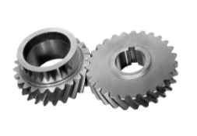
A Dynamic Component Architecture for High Performance Gameplay
Purpose
The Dynamic Component System
Implementation by Example
API
Script Events: Type Registration
Navigation: Allocation & Init
Shots: Asynchronous Update
Notes:
At a high level, I have three sections to this discussion
First, we'll talk about our purpose here.
We'll discuss the problem we're trying to solve, and my approach to a solution
Second, we'll talk about details of my solution, which I call the Dynamic Component System.
We'll discuss features of the system, and why it's a good solution
And third, we'll dig into implementation details of the system,
Using a few systems of dynamic components for illustration purposes

Slide 60
Script Events : Type Registration
Script Events are Components
Hosted by the System
Possibly related to a Game Object
Registered (allocated) from Lua
When conditions are met, call back
Satisfaction:
Updated: poll their conditions
Notified by gameplay
Notes:
x
Script Events are Components
Possibly related to a Game Object, but
Hosted by the Script Event System
Allocated on-demand from Lua scripts
When specified conditions are met, callback to script
Two modes of testing for satisfaction:
Some event types are updated automatically by the Dynamic Component System, and poll their conditions
Other event types are notified of occasions during gameplay that may cause them to become satisfied

Slide 61
Script Events : Type Registration
Notified
Checkpoint
Damage
Death
NumAlive
Active
Custom
Reload
Zoom
Grapple
SeatEnter
Updated
Location
Timer
Visible

Slide 62


Script Events: Type Registration
namespace DynamicComponent
{
typedef u16 Type;
Type unregistered_type = 0xFFFF;
Type TypeRegistrar::RegisterType(
const char* name,
Type base_type = unregistered_type,
UpdateStage::Enum update_stages = UpdateStage::None,
AsyncUpdateStage::Enum async_update_stages = AsyncUpdateStage::None);
}
Notes:
Types are registered through the DynamicComponent::TypeRegistrar.
The registrar is responsible for keeping track of
the types registered with the system,
Their base classes for testing which types implement which interfaces
And during which update stages each type wants to be updated by the DCS

Slide 63


Script Events: Type Registration
namespace DynamicComponent
{
typedef u16 Type;
Type unregistered_type = 0xFFFF;
Type TypeRegistrar::RegisterType(
const char* name,
Type base_type = unregistered_type,
UpdateStage::Enum update_stages = UpdateStage::None,
AsyncUpdateStage::Enum async_update_stages = AsyncUpdateStage::None);
}
using namespace DynamicComponent;
void ScriptEventSystem::Init()
{
m_event_type = TypeRegistrar::RegisterType("ScriptEvent");
m_checkpoint_type = TypeRegistrar::RegisterType("CheckpointEvent", m_event_type);
m_location_type = TypeRegistrar::RegisterType(
"LocationEvent",
m_event_type, //base class is ScriptEvent
UpdateStage::PostUpdate, //automatically updated on PPU during PostUpdate
AsyncUpdateStage::PreUpdate); //and on the SPU during the PreUpdate stage
}
Notes:
e.g. Say the ScriptEventSystem just has a base type and two concrete event types.
The base class is a component type named ScriptEvent. We'll register two component type that are subclass of ScriptEvent
To illustrate type registration, one will be notified, and one will be an event that updates both on PPU and asynchronously, e.g. on an SPU. So we'll use LocationEvent for example.
Upon system initialization, it registers both types
LocationEvents update on the SPU during PreUpdate to poll various conditions for satisfaction. It'll stash the results back in the component
LocationEvents also update on the PPU during PostUpdate for an opportunity to invoke script callbacks if they're satisfied
Note, for even better performance, polling components don't need to update on PPU at all. If SPU job determines that an event is satisfied, it can add the component to a shared "invoke list" to be processed after all ScriptEvents are updated.
That way, only satisfied events will touch the PPU on any given frame.

Slide 64
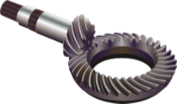
A Dynamic Component Architecture for High Performance Gameplay
Purpose
The Dynamic Component System
Implementation by Example
API
Script Events: Type Registration
Navigation: Allocation & Init
Shots: Asynchronous Update
Notes:
At a high level, I have three sections to this discussion
First, we'll talk about our purpose here.
We'll discuss the problem we're trying to solve, and my approach to a solution
Second, we'll talk about details of my solution, which I call the Dynamic Component System.
We'll discuss features of the system, and why it's a good solution
And third, we'll dig into implementation details of the system,
Using a few systems of dynamic components for illustration purposes

Slide 65
Navigation : Allocation & Initialization
NavComponents are hosted by Game Objects
Updated by the Navigation system
Notes:
NavComponents are hosted by Game Objects (usually Bots) to query the navigation database (mesh + dynamic obstructors)
Updated by the Navigation system, not automatically by the Dynamic Component System
For navigation-specific load balancing
Interesting initialization idiom

Slide 66

Navigation : Allocation & Initialization
Remember the API call to allocate a component:
WTF is a prius?
//allocate a component of type, add it to host's component chain,
// and optionally park a prius in the component
// returns null if no space is available for allocation
Component* DynamicComponent::Allocate( Type type, HostHandle host_handle,
Chain* chain, void* prius = NULL );
Notes:
WTF is a prius?
In Dynamic Component parlance, a prius is, "A lightweight vehicle for transporting initialization data."
Opportunity to pass runtime or design-time data to a component instance.
Pirus is simply passed to the initialization method of a component instance upon allocation.
But is that safe!?!
Component must cast to an assumed type!

Slide 67
Navigation : Allocation & Initialization
Remember the API call to allocate a component:
WTF is a prius?
initialization data
Runtime or design-time data
void* But is that safe!?
//allocate a component of type, add it to host's component chain,
// and optionally park a prius in the component
// returns null if no space is available for allocation
Component* DynamicComponent::Allocate( Type type, HostHandle host_handle,
Chain* chain, void* prius = NULL );
Notes:
WTF is a prius?
In Dynamic Component parlance, a prius is, "A lightweight vehicle for transporting initialization data."
Opportunity to pass runtime or design-time data to a component instance.
Pirus is simply passed to the initialization method of a component instance upon allocation.
But is that safe!?!
Component must cast to an assumed type!

Slide 68


Navigation : Allocation & Initialization
Initialization
NavQuery is the Prius for a NavComponent
NavQuery::Submit() allocates a NavComponent, and passes itself as the prius.
host->AllocateComponent()? Helper in GameObject:
NavComponent* NavQuery::Submit(GameObject* host)
{
DynamicComponent::Type type = GetComponentType(); //virtual member of NavQuery
DynamicComponent::Component* component = host->AllocateComponent(type, this);
NavComponent* nav = COMPONENT_CAST(component, Nav);
return nav;
}
DynamicComponentComponent*
GameObject::AllocateComponent(DynamicComponent::Type type, void* prius)
{
return DynamicComponent::Allocate(type, m_handle, &m_component_chain, prius);
}
Notes:
Interesting initialization idiom
A NavQuery is the Prius for a NavComponent
NavQuery::Submit() allocates a NavComponent, and passes itself as the prius.

Slide 69

Navigation : Allocation & Initialization
Gameplay code example
When navigation components are updated, endpoints and path are dynamically recomputed on SPU
void FollowerBot::Initialize(GameObject* target)
{
Nav::GameObjectQuery source_query (this); //query closest point to game object
Nav::GameObjectQuery target_query (target);
Nav::PathQuery path_query (source_query, target_query);
Nav::PathComponent* m_path = path_query.Submit();
}
Notes:
Obviously highly simplified, but meant to convey the point that that a Nav::Query is a prius, whose Submit() method returns the result of DynamicComponent::Allocate(),passing itself as void* prius.

Slide 70

A Dynamic Component Architecture for High Performance Gameplay
Purpose
The Dynamic Component System
Implementation by Example
API
Script Events: Type Registration
Navigation: Allocation & Init
Shots: Asynchronous Update
Notes:
At a high level, I have three sections to this discussion
First, we'll talk about our purpose here.
We'll discuss the problem we're trying to solve, and my approach to a solution
Second, we'll talk about details of my solution, which I call the Dynamic Component System.
We'll discuss features of the system, and why it's a good solution
And third, we'll dig into implementation details of the system,
Using a few systems of dynamic components for illustration purposes

Slide 71
Shots : Asynchronous Update
Hosted by Game Object
Replaces Projectile GameObjects
Two DynamicComponent Type hierarchies:
Shot represents a state machine
Notified
ShotAction represents the state of a Shot
Updated
Shared
Notes:
x
Hosted by Game Object that fired the Shot
Completely replace the Projectile type of GameObject
Two DynamicComponent Type hierarchies:
Shot represents a state machine
Don't update
They are notified of events by their current ShotAction(s)
ShotActions represent the states of a Shot
Shared among different Shot types
Automatically & asynchronously updated by the Dynamic Component System

Slide 72

Shots : Asynchronous Update
#ifndef SPU //PPU only
class ShotMoveForward : public ShotAction
{
DERIVED_COMPONENT(ShotMoveForward, ShotAction)
public:
virtual void ParkPrius (void* prius);
virtual void Update (UpdateStage::Enum stage);
#else //SPU only
struct ShotMoveForward
{
puspu_vec4 m_location ALIGNED(16); //shadows ShotAction::m_next_location on PPU
#endif //PPU & SPU shared
puspu_vec4 m_direction;
f32 m_speed;
} __attribute__((aligned(16)));
ShotAction::m_next_location on PPU and ShotMoveForward::m_location on SPU share the same address
Notes:
The ShotMoveForward component type has different declarations on the PPU and on an SPU
On the PPU, it is a polymorphic type, derived from ShotAction
On the SPU, however, it is a POD type
This allows us to operate on instances in an object-oriented way on the PPU, without a need to fix-up vtables in a different address space
Note that m_location is the first member of ShotMoveForward on SPU, whereas m_next_location is a member of the base class ShotAction on the PPU.

Slide 73

Shots : Asynchronous Update
How? "Sentinel"
// async components must indicate where their async data begins
#define BEGIN_ASYNC_COMPONENT_DATA \
u32 m_async_data[0] __attribute__((aligned(16))); \
class ShotAction : public DynamicComponent::Component
{
COMPONENT(ShotAction);
// ...
DynamicComponent::Handle m_shot;
DynamicComponent::Type m_shot_type;
BEGIN_ASYNC_COMPONENT_DATA
vec4f m_next_location;
};
Notes:
"Sentinel" data member identifies start of SPU instance
This is achieved by placing a "sentinel" in the base class declaration identifying where an instance of the class begins when being DMA'd to an SPU.
The sentinel is a zero-sized array member

Slide 74

A Dynamic Component Architecture for High Performance Gameplay
Purpose
The Dynamic Component System
Implementation by Example
Notes:
What we've discussed
First, we talked about our purpose here.
We discussed the problem we wre trying to solve, and my approach to a solution
Second, we talked about details of my solution, which I call the Dynamic Component System.
We discussed features of the system, and why it's a good solution
And third, we dug into implementation details of the system,
Using a few systems of dynamic components for illustration purposes

Slide 75
A Dynamic Component Architecture for High Performance Gameplay
Purpose
The Dynamic Component System
Implementation by Example
Thank You!
Questions
Notes:
What we've discussed
First, we talked about our purpose here.
We discussed the problem we wre trying to solve, and my approach to a solution
Second, we talked about details of my solution, which I call the Dynamic Component System.
We discussed features of the system, and why it's a good solution
And third, we dug into implementation details of the system,
Using a few systems of dynamic components for illustration purposes

Slide 76
A Dynamic Component Architecture for High Performance Gameplay
Visit me on the Web:
http://www.TerranceCohen.com
Follow me on Twitter:
http://twitter.com/terrance_cohen
Connect with me on LinkedIn:
http://www.linkedin.com/in/terrancecohen
Ask me anything:
http://www.formspring.me/terrancecohen
Notes:
What we've discussed
First, we talked about our purpose here.
We discussed the problem we wre trying to solve, and my approach to a solution
Second, we talked about details of my solution, which I call the Dynamic Component System.
We discussed features of the system, and why it's a good solution
And third, we dug into implementation details of the system,
Using a few systems of dynamic components for illustration purposes

Slide 77



A Dynamic Component Architecture for High Performance Gameplay
Terrance Cohen
Lead Systems Engineer
Insomniac Games
www.TerranceCohen.com
Twitter: @terrance_cohen
Notes:
Closing thoughts.
Tricky aspect: components that share data or otherwise communicate
2 options:
Select one to own the data, other references through owner by resolving handle
E.g. ShotActions call into Shot to notify of events
Scatter-gather idiom
PU update stages gather inputs for & scatter outputs from SPU processes
Involves copying
Better for async processing

