Slide 1
Monetary Poverty Measurement Training Workshop for ESS and MoPD Staff (cont.)
Aug 25 – Aug 29 2025

Slide 2
Objectives of the Training
Recap the welfare aggregation process from the last training to strengthen familiarity with constructing welfare aggregates.
Review the ETH2021 (HoW2021 + WMS2022) welfare aggregation steps and identify possible improvements.
Preview the upcoming NISH 2024 survey and prepare for the key steps in welfare aggregate construction.

Slide 3
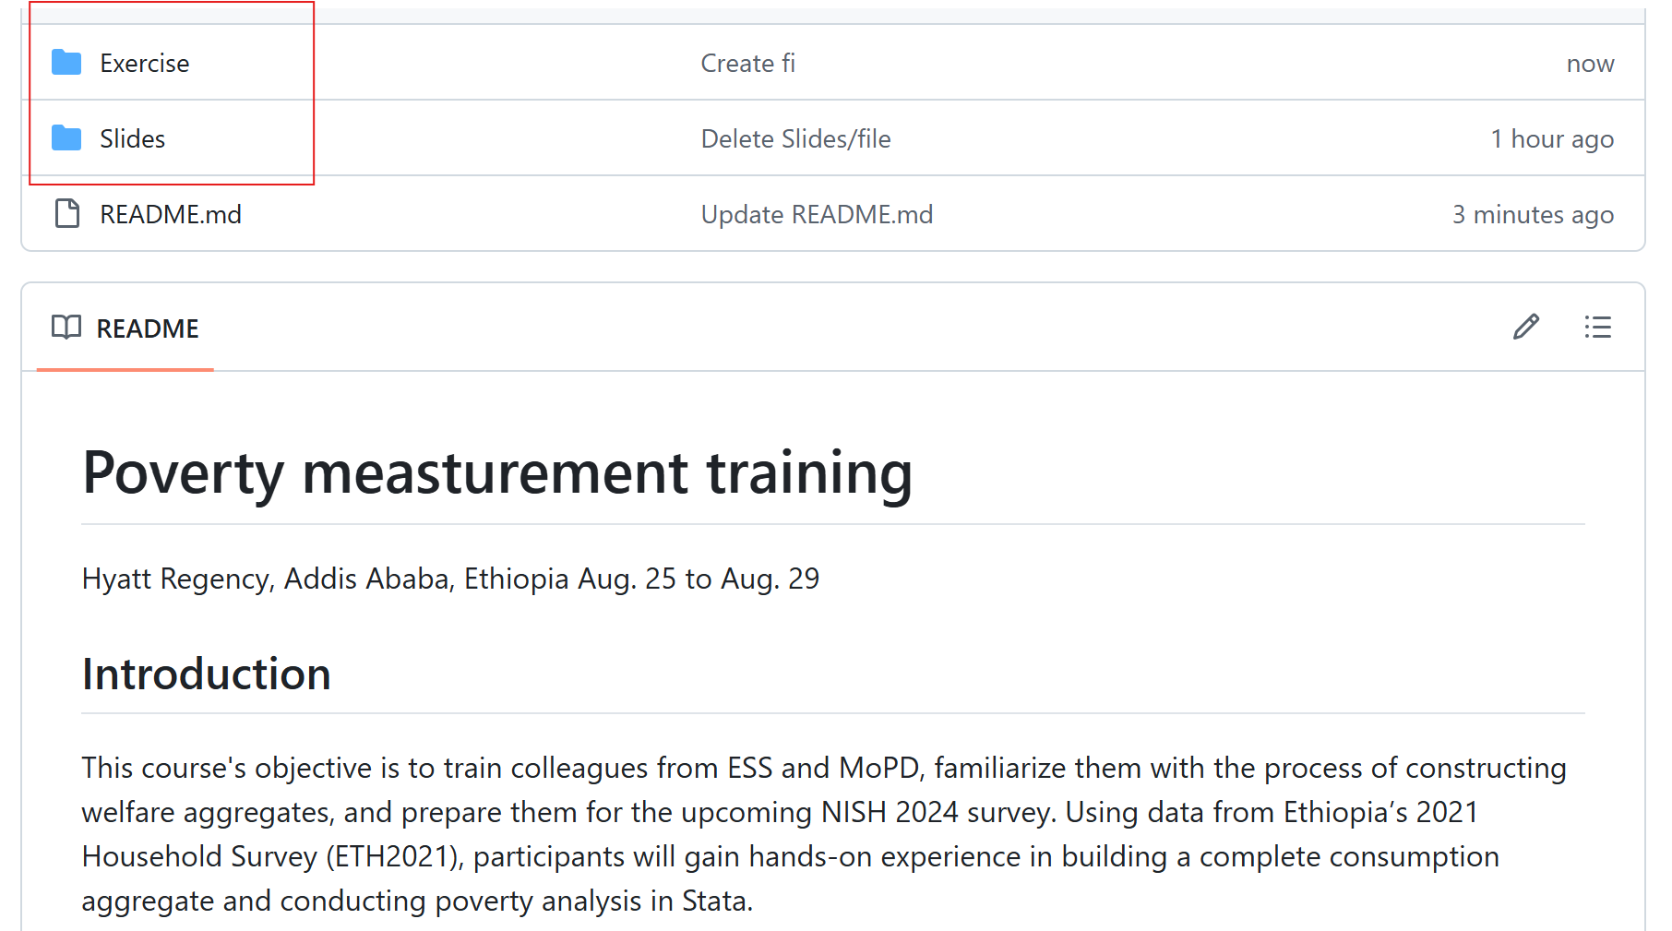
Course Materials Folder
All the materials will be published on Github:
https://github.com/hwwbg/ETH_poverty_measurement_training_2025

Slide 4
Data used in training
Main data set:
1. HCES 2021:
2. WMS2022:

Slide 5
Course Outline
Monday | Tuesday | Wednesday | Thursday | Friday
Recap from last training and refresher on key poverty measurement concepts | Data cleaning principles and restructuring survey microdata ETH2021 survey review and comparison | Constructing food consumption aggregates Unit values, consistency checks, treatment of missing values, and outliers | Nonfood – nondurable goods consumption aggregates Nonfood – nondurable goods consumption aggregates Durable goods: consumption flow estimation | Poverty Line Construction National and International Poverty Measures Organizing work and data quality control process

