Slide 1
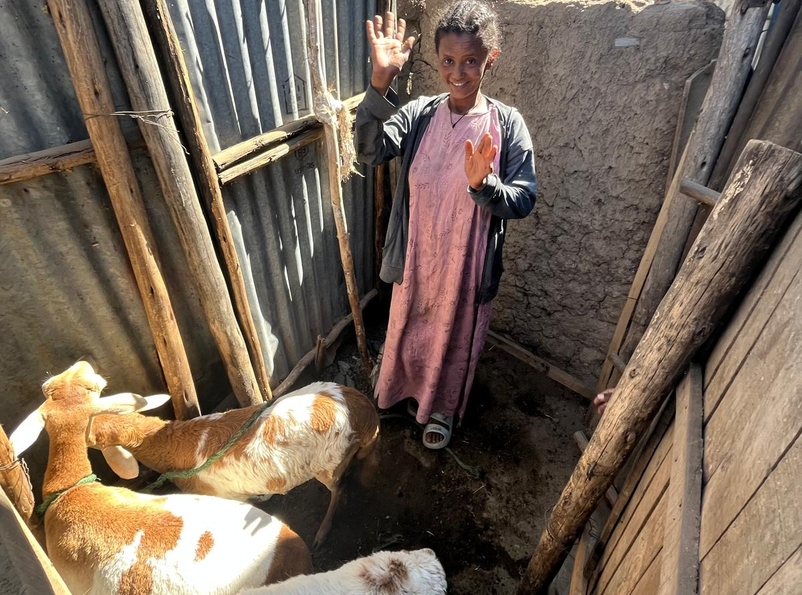
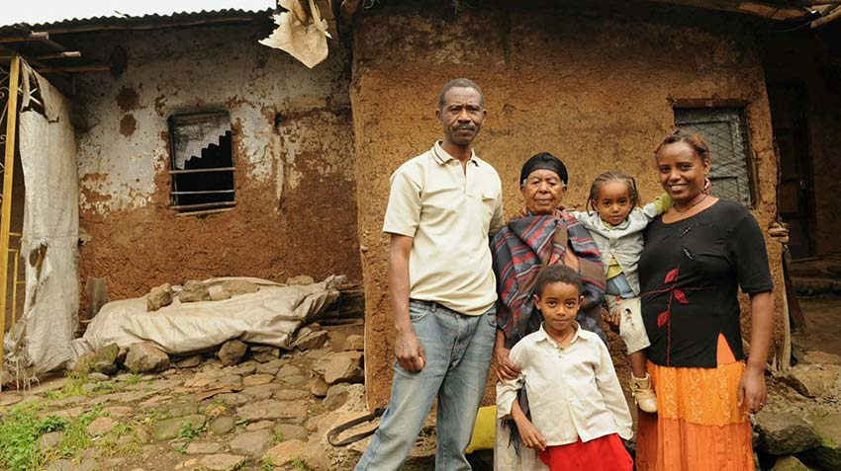
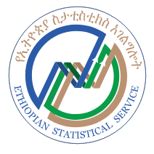


Monetary Welfare and Poverty Measurement Training Workshop
Aug 25th – Aug 29th, 2025
Addis Ababa, Ethiopia

