Slide 1
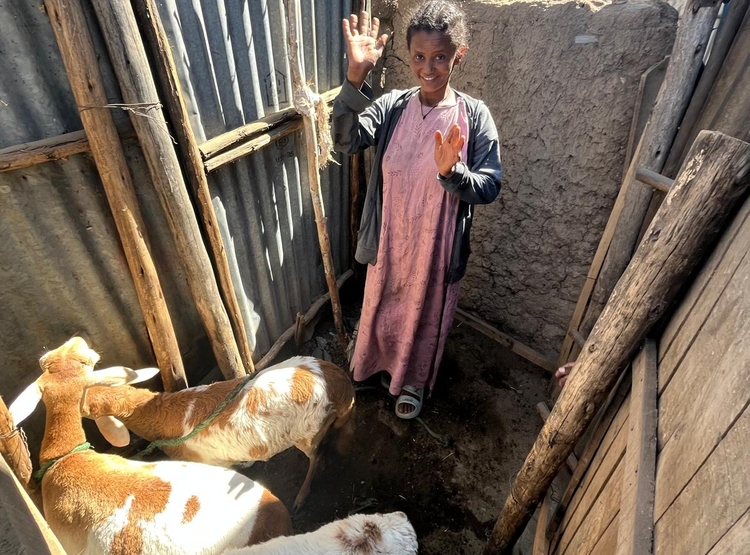

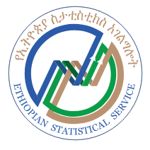


Monetary Welfare and Poverty Measurement Training Workshop
August 25th – 29th, 2025
Addis Ababa, Ethiopia

