Slide 1
Data Communications and Networking
第十二单元 数据网拥塞控制
12 Congestion in Data Networks
拥塞与网络性能 拥塞控制技术 通信量管理
分组网拥塞控制 ATM通信量管理 帧中继拥塞控制

Slide 2
拥塞?
拥塞产生于通过网络传输的分组数量接近网络的最大分组处理能力之时
拥塞控制旨在保持分组数量不超越致使性能急剧下降的水平
数据网本质上是一个由队列组成的网络
一般而言，达到80%利用率是一条警戒线
队列的有限长度意味着数据可能因溢出而丢失

Slide 3
What is Congestion?
Congestion occurs when the number of packets being transmitted through the network approaches the packet handling capacity of the network
Congestion control aims to keep number of packets below level at which performance falls off dramatically
Data network is a network of queues
Generally 80% utilization is critical
Finite queues mean data may be lost

Slide 4
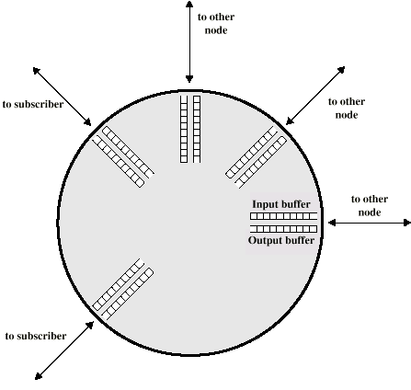
Queues at a Node
Any given node has a number of I/O ports:
One or more to other nodes
Zero or more to end systems
Why?

Slide 5
12.1 拥塞对网络性能的影响
到达的分组存放在输入缓存中
考察每个分组并作出路由选择判决
将分组移至输出缓存
排队输出的分组尽快地发出
  统计时分复用
若分组到达过快以至来不及选路, 或者说输入快于输出, 缓冲会溢满
两种通用策略
  丢弃分组
  使用流量控制

Slide 6
12.1 Effects of Congestion
Packets arriving are stored at input buffers
Examines each packet and makes routing decision
Packet moves to output buffer
Packets queued for output are transmitted as fast as possible
  Statistical time division multiplexing
If packets arrive too fast to be routed, or to be output, buffers will fill
Two general strategies
  Can discard packets
  Can use flow control

Slide 7
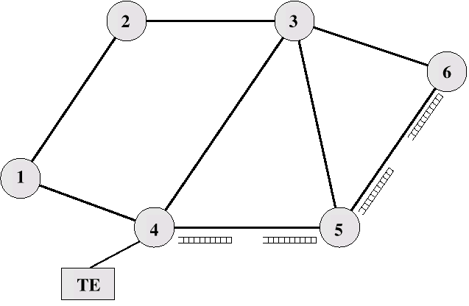
Interaction of Queues
Can propagate congestion through network

Slide 8
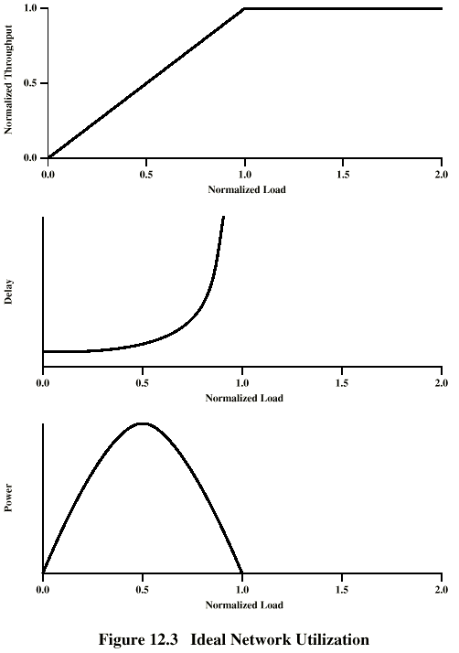
12.1.1 Ideal
Performance
理想性能
1
0.8
0.5
网络传播时延+节点处理时延+节点排队时延
Throughput
Power＝——————
Delay

Slide 9
12.1.2 实际性能
理想情况是假定缓存空间无限且无额外开销
实际应用中缓存是有限的
在交换拥塞控制报文时产生额外开销

Slide 10
12.1.2 Practical Performance
Ideal assumes infinite buffers and no overhead
Buffers are finite
Overheads occur in exchanging congestion control messages

Slide 11
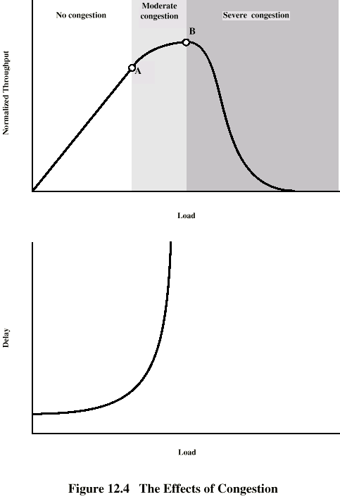
Effects of
Congestion -
No Control
负荷较轻时
  随负荷增长，网络吞吐率及网络利用率增加
进入中度拥塞（A点）
  随负荷增长，网络吞吐率增长减慢
  负载不均匀导致部分节点丢弃分组
  平衡负载的选路分组增加开销，降低数据通信量
进入严重拥塞（B点）
  随负荷增长，网络吞吐率反而下降
  有限缓存丢弃分组导致重传
  应答延滞使已交付分组重传

Slide 12
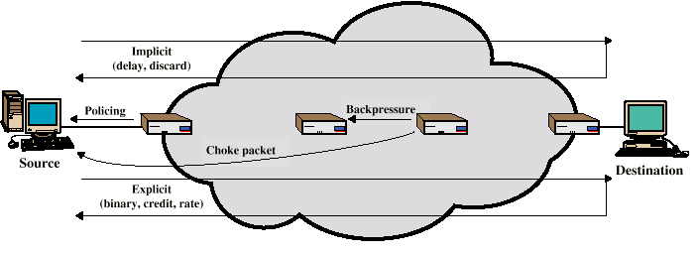
12.2 Congestion Control 拥塞控制
Mechanisms for Congestion Control

Slide 13
12.2.1 反压
倘若节点拥塞，可能减缓或阻停来自其它节点的分组流量
可能引起其它节点不得不对分组进入速率施加控制
流量限制传播回源节点
可以对产生大部分通信量的逻辑连接给予限制
用于允许逐跳拥塞控制的面向连接网络 (如 X. 25)
ATM和帧中继中不采用
  因其无逐跳限制流量的功能
近年仅为IP开发出基于流量的机制
  IPv6分组中的逐跳选项首部（15.4.5），所携信息必须被沿途每个路由器检查

Slide 14
12.2.1 Backpressure
If node becomes congested it can slow down or halt flow of packets from other nodes
May mean that other nodes have to apply control on incoming packet rates
Propagates back to source
Can restrict to logical connections generating most traffic
Used in connection oriented that allow hop by hop congestion control (e.g. X.25)
Not used in ATM nor frame relay
Only recently developed for IP

Slide 15
12.2.2 阻流分组
控制分组
  由发生拥塞的节点生成
  送至源节点
  例如， ICMP 源站抑制
    来自路由器或目的站
    源站削减流量直至再无源站抑制报文
    为每个丢弃的分组或预见的拥塞发送抑制报文
相当粗糙的机制
  预测拥塞发送的抑制报文所指的数据报可能正确交付

Slide 16
12.2.2 Choke Packet
Control packet
  Generated at congested node
  Sent to source node
  e.g. ICMP source quench
    From router or destination
    Source cuts back until no more source quench message
    Sent for every discarded packet, or anticipated
Rather crude mechanism

Slide 17
12.2.3 隐式拥塞信令
传输时延会随拥塞而增加
分组可能被丢弃
随着拥塞的隐含指示，源站能够检测到这些
在无连接（数据报）网络中是有用的
  例如，基于 IP的因特网
    (TCP 包含拥塞控制和流量控制 – 见第 17章)
用于帧中继 LAPF控制协议

Slide 18
12.2.3 Implicit Congestion Signaling
Transmission delay may increase with congestion
Packet may be discarded
Source can detect these as implicit indications of congestion
Useful on connectionless (datagram) networks
  e.g. IP based
    (TCP includes congestion and flow control - see chapter 17)
Used in frame relay LAPF

Slide 19
12.2.4 显式拥塞信令
网络会对渐增的拥塞向端系统告警
端系统采取步骤减轻供给网络的负载
反向
  在所需分组的相反方向上采取拥塞避免措施
前向
  在所需分组的相同方向上采取拥塞避免措施

Slide 20
12.2.4 Explicit Congestion Signaling
Network alerts end systems of increasing congestion
End systems take steps to reduce offered load
Backwards
  Congestion avoidance in opposite direction to packet required
Forwards
  Congestion avoidance in same direction as packet required

Slide 21
显式信令种类
二进制
  在分组中置位一个比特来指示拥塞
基于信用值
  指示源站可以发送多少分组
  常见于端到端流量控制
基于速率
  提供明确的数据率上限
  例如， ATM

Slide 22
Categories of Explicit Signaling
Binary
  A bit set in a packet indicates congestion
Credit based
  Indicates how many packets source may send
  Common for end to end flow control
Rate based
  Supply explicit data rate limit
  e.g. ATM

Slide 23
12.3 通信量管理
公平性
  最后到达最先丢弃策略并不保证对不同流量体现公平
  为每个逻辑连接或每对源-目的站维持缓存大小相同的一个队列，通信量负荷最大的队列应更频繁丢弃分组
服务质量(QoS)
  不同的连接可以希望不同的对待
  ISA和DS – 见16.2和16.4
预约
  例如， ATM
  用户与网络之间的通信量合约
  RSVP协议 – 见16.3

Slide 24
12.3 Traffic Management
Fairness
Quality of service
  May want different treatment for different connections
Reservations
  e.g. ATM
  Traffic contract between user and network
  RSVP protocol - see Chapter 16

Slide 25
12.4 分组交换网中的拥塞控制
发送控制分组到某些或全部源节点
  在拥塞期间需要额外的通信量
依赖路由选择信息
  可能会反应过快
端到端探测分组
  增加网络开销
当分组穿越节点时向其添加拥塞信息
  或者反向或者前向

Slide 26
12.4 Congestion Control in Packet Switched Networks
Send control packet to some or all source nodes
  Requires additional traffic during congestion
Rely on routing information
  May react too quickly
End to end probe packets
  Adds to overhead
Add congestion info to packets as they cross nodes
  Either backwards or forwards

Slide 27
虚电路或帧中继连接上的通信量
通信量本质上是突发性的
接收系统期望以突发方式接收从各条连接上进入的通信量
网络不必在出口节点复制进入通信量完全相同的时序模式
可使用简单的STDM在一个物理UNI之上容纳多条逻辑连接

Slide 28
Traffic on Virtual Circuits or Frame Realy Connections
Traffic is bursty in nature
Receiving system expects to receive incoming traffic on each connection in a bursty fashion
Network does not need to replicate the exact timing pattern of incoming traffic at exit node
Simple STDM can be used to accommodate multiple logical connections over physical UNI

Slide 29
12.5 ATM通信量管理
ATM通信量特点
  速度高、信元长度小、额外开销比特有限
  仍在演变
主要论题
  通信量及拥塞控制需求
  反应迟滞 / 速度影响
  信元时延偏差
  通信量与拥塞控制框架
  通信量管理和拥塞控制技巧

Slide 30
12.5 ATM Traffic Management
High speed, small cell size, limited overhead bits
Still evolving
Key Topics
  Requirements
  Latency / Speed Effects
  Cell Delay Variation
  Traffic and Congestion Control Framework
  Traffic Management & Congestion Control Techniques

Slide 31
12.5.1 ATM通信量及拥塞控制的需求
多数通信量并不服从流量控制
因信元传输时间比之传播时延大幅减小显得反馈迟缓
广泛的应用要求
差异很大的通信量模式
不同的网络服务
高速交换与传输增加了易变性

Slide 32
12.5.1 Requirements for ATM Traffic and Congestion Control
Majority of traffic not amenable to flow control
Feedback slow due to reduced transmission time compared with propagation delay
Wide range of application demands
Different traffic patterns
Different network services
High speed switching and transmission increases volatility

Slide 33
12.5.2 反应迟滞 / 速度影响
ATM 150Mbps
插入单个信元大约需2.8x10⁻⁶秒
跑完网络全程的时间取决于传播时延和交换时延
假定以2/3光速传播
倘若源站和目的站处于美国东西两端, 传播时间约 48x10⁻³ 秒
采用隐式拥塞控制, 在丢弃信元通知报文到达源站之时为止, 已经传输了7.2x10⁶比特
  参见教材第313页倒数第4行的计算（英文版p.396）
因此这对ATM不是一个好策略
  当源站对拥塞指示反应过来时，网络拥塞得一塌糊涂

Slide 34
12.5.2 Latency/Speed Effects
ATM 150Mbps
~2.8x10⁻⁶ seconds to insert single cell
Time to traverse network depends on propagation delay, switching delay
Assume propagation at two-thirds speed of light
If source and destination on opposite sides of USA, propagation time ~ 48x10⁻³ seconds
Given implicit congestion control, by the time dropped cell notification has reached source, 7.2x10⁶ bits have been transmitted
So, this is not a good strategy for ATM

Slide 35
12.5.3 信元时延偏差
对于ATM话音/视频, 数据是一信元流
穿越网络的时延必须短小
交付速率必须恒定
运送中总是存在一些偏差
信元交付给应用之前增加一点可调时延，使之能够为应用维持恒定的比特率

Slide 36
12.5.3 Cell Delay Variation
For ATM voice/video, data is a stream of cells
Delay across network must be short
Rate of delivery must be constant
There will always be some variation in transit
Delay cell delivery to application so that constant bit rate can be maintained to application

Slide 37
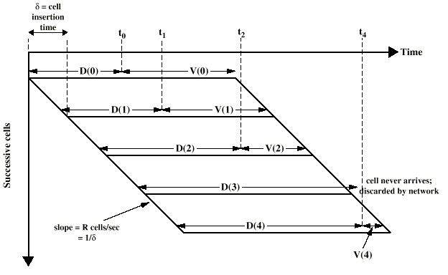
Time Re-assembly of CBR Cells
V(i)=V(i-1)-[t_{i}-(t_{i-1}+δ)]

Slide 38
网络对信元时延偏差的影响
分组交换的网络
  排队时延
  路由选择判决时间
帧中继
  同上，但程度较轻
ATM
  比帧中继还小
  ATM协议就是为使交换节点处理开销最小化而设计的
  ATM交换机有着极高的吞吐率
  唯一值得注意的时延偏差来自拥塞
  必须不接受引起拥塞的负荷
    丢弃引起网络拥塞的信元

Slide 39
Network Contribution to
Cell Delay Variation
Packet switched networks
  Queuing delays
  Routing decision time
Frame relay
  As above but to lesser extent
ATM
  Less than frame relay
  ATM protocol designed to minimize processing overheads at switches
  ATM switches have very high throughput
  Only noticeable delay is from congestion
  Must not accept load that causes congestion

Slide 40
UNI上的信元时延偏差
应用程序产生固定速率的数据
ATM的三层处理仍会引起时延偏差
  交织的信元来自不同连接
  运行维护管理（OAM）信元也必须与用户信元相交织
  若使用SDH帧, 这些帧的额外开销比特插入物理层
  无法预测这些时延

Slide 41
Cell Delay Variation At The UNI
Application produces data at fixed rate
Processing at three layers of ATM causes delay
  Interleaving cells from different connections
  Operation and maintenance cell interleaving
  If using synchronous digital hierarchy frames, these are inserted at physical layer
  Can not predict these delays

Slide 42
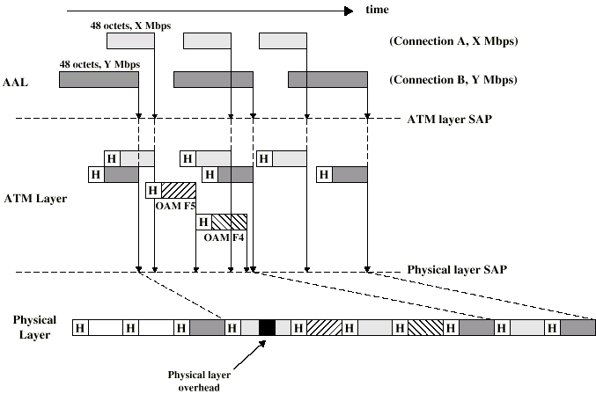
Origins of Cell Delay Variation

Slide 43
12.5.4 通信量与拥塞控制框架
ATM层通信量控制与拥塞控制应该为所有可预见的网络服务支持QoS类别
应该不依赖于与具体网络相关的 AAL协议，也不依赖于高层的具体应用协议
应该使网络以及端到端系统的复杂性最小化

Slide 44
12.5.4 Traffic and Congestion
Control Framework
ATM layer traffic and congestion control should support QoS classes for all foreseeable network services
Should not rely on AAL protocols that are network specific, nor higher level application specific protocols
Should minimize network and end to end system complexity

Slide 45
通信量控制策略本质
确定是否可以容纳一条给定的新连接
与用户设备协商需要支持性能参数
  实际上用户与网络达成一份通信量合约
    网络答应在该连接上以某种性能级别支持通信量
    用户承诺不超越通信量参数限制

Slide 46
Nature of Strategy
Determine whether a given new connection can be accommodated
Agree performance parameters with subscriber
  In effect, subscriber and network enter into a traffic contract
    Network agrees to support traffic at a certain level of performance on this connection
    Subscriber agrees not exceed traffic parameter limits

Slide 47
考虑的时序
信元插入时间
往返传播时间
连接持续时间
长期

Slide 48
Timings Considered
Cell insertion time
Round trip propagation time
Connection duration
Long term

Slide 49
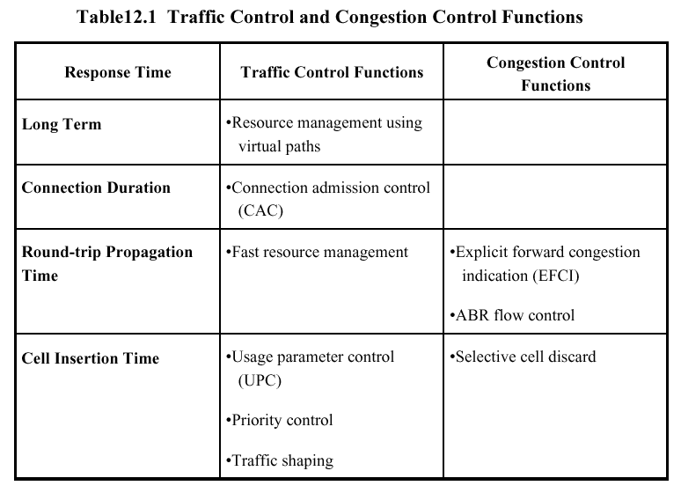

Slide 50
12.5.5 通信量管理与拥塞控制技巧
使用VP管理资源
连接许可控制
使用参数控制
选择性信元丢弃
通信量整形

Slide 51
12.5.5 Traffic Management and Congestion Control Techniques
Resource management using virtual paths
Connection admission control
Usage parameter control
Selective cell discard
Traffic shaping

Slide 52
利用VP进行资源管理
根据服务特性区别不同的通信流量
  用户到用户应用
  用户到网络应用
  网络到网络应用
网络资源管理涉及的QoS参数
  信元丢失率
  信元传送时延
  信元时延偏差

Slide 53
Resource Management Using Virtual Paths
Separate traffic flow according to service characteristics
  User to user application
  User to network application
  Network to network application
Concern with:
  Cell loss ratio
  Cell transfer delay
  Cell delay variation

Slide 54
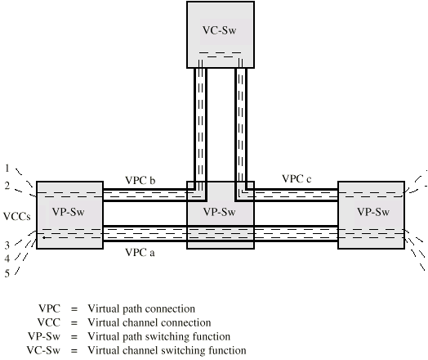
Configuration of VCCs and VPCs

Slide 55
在VPC内部分配VCC
VPC内的所有VCC应该体验类似的网络性能
分配容量的选项
  聚集峰值需求
  统计复用

Slide 56
Allocating VCCs within VPC
All VCCs within VPC should experience similar network performance
Options for allocation:
  Aggregate peak demand
  Statistical multiplexing

Slide 57
连接许可控制
防止网络过载的第一道防线
用户通过选择一种QoS为新连接(VCC或VPC)规定通信量
仅当网络能够满足该需求时才认可该连接
通信量合约
  最大信元速率
  信元时延偏差
  持续信元速率
  突发容限

Slide 58
Connection Admission Control
First line of defence
User specifies traffic characteristics for new connection (VCC or VPC) by selecting a QoS
Network accepts connection only if it can meet the demand
Traffic contract
  Peak cell rate
  Cell delay variation
  Sustainable cell rate
  Burst tolerance

Slide 59
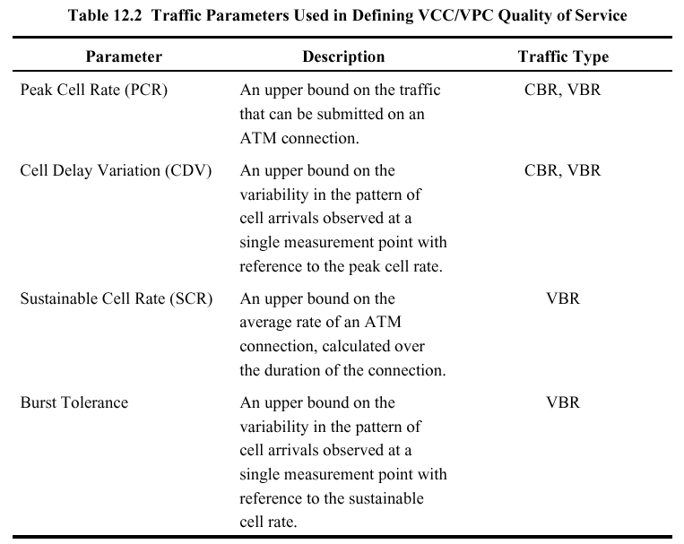

Slide 60
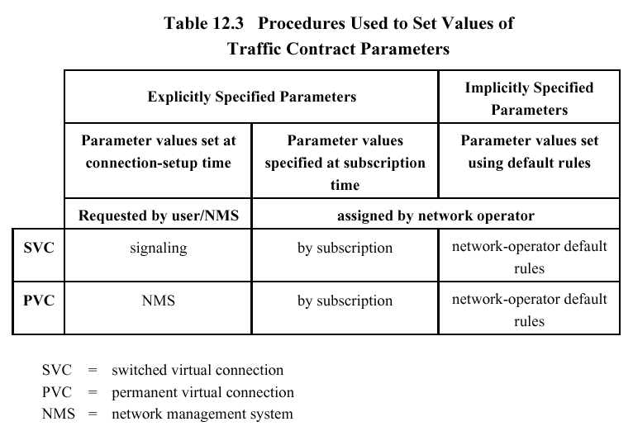

Slide 61
使用参数控制
监控连接确保通信量遵从合约
防止网络资源因某条连接而超载
在 VCC和 VPC两级上实现
包含两个独立的功能
  最大信元速率及相关的信元时延偏差的控制
  持续信元速率及相关的突发容限
丢弃不遵从通信量合约的信元
被称为通信量管制

Slide 62
Usage Parameter Control
Monitor connection to ensure traffic conforms to contract
Protection of network resources from overload by one connection
Done on VCC and VPC
Peak cell rate and cell delay variation
Sustainable cell rate and burst tolerance
Discard cells that do not conform to traffic contract
Called traffic policing

Slide 63
信元丢弃策略
加标签方法及相关的通信量合约
选择性信元丢弃
CLP的应用
作为课后作业，仔细研读教材第321页

Slide 64
通信量整形
通信量管制的辅助策略
使通信量平稳并减少信元堆积
令牌桶

Slide 65
Traffic Shaping
Smooth out traffic flow and reduce cell clumping
Token bucket

Slide 66
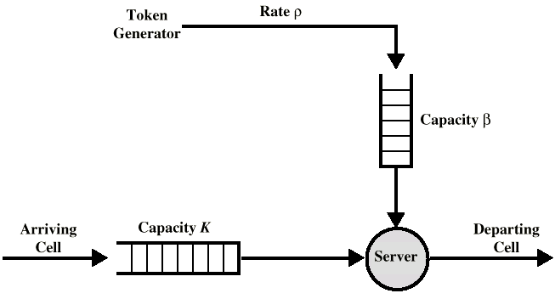
Token Bucket

Slide 67
令牌桶计算题
例 一个ATM网络使用令牌桶方案的通信量管制。每5μs放入桶内的一个新的令牌。试问最大的可持续的净数据率（不包含信元首部）是多少？
解答
已知每5μs放入信令桶的一个新的令牌，
则1秒钟可放入2×10⁵个令牌，即每秒可传送2×10⁵个信元。
每个信元不包括首部有48个八比特组，即 8×48＝384个比特。
因此，最大的可持续的净数据率
R ＝ 384×2×10⁵ ＝ 768×10⁵ ＝ 76.8Mbps

Slide 68
12.6 ATM-ABR通信量管理
应用于CBR、VBR的上述方法称为开环控制
某些应用未很好定义通信量特性
  Web, FTP, RPC, NFS
尽最大努力
  允许这些应用分享未用容量
    如果拥塞构成，信元被丢弃
闭环控制
  多个ABR连接共享可用容量
  该共享容量在最小信元速率(MCR)与最大信元速率(PCR) 之间变化
  因为反馈使ARB流量受到可用容量的限制
    在反馈时延期间缓冲吸收超出的通信量
  信元丢失率低
阅读ABR服务
主要特性
P.323

Slide 69
12.6 ATM-ABR Traffic Management
Some applications (Web, file transfer) do not have well defined traffic characteristics
Best efforts
  Allow these applications to share unused capacity
    If congestion builds, cells are dropped
Closed loop control
  ABR connections share available capacity
  Share varies between minimum cell rate (MCR) and peak cell rate (PCR)
  ARB flow limited to available capacity by feedback
    Buffers absorb excess traffic during feedback delay
  Low cell loss

Slide 70
12.6.1 反馈机制
传输速率特性
  允许的信元速率 ACR
  最小的信元速率 MCR
  最大信元速率 PCR
  初始信元速率 ICR
以ACR=ICR开始
根据来自网络的反馈调整ACR
  资源管理信元
    拥塞指示比特 CI
    不增加比特 NI
    显式信元速率字段 ER

Slide 71
12.6.1 Feedback Mechanisms
Transmission rate characteristics:
  Allowed cell rate
  Minimum cell rate
  Peak cell rate
  Initial cell rate
Start with ACR=ICR
Adjust ACR based on feedback from network
  Resource management cells
    Congestion indication bit
    No increase bit
    Explicit cell rate field

Slide 72
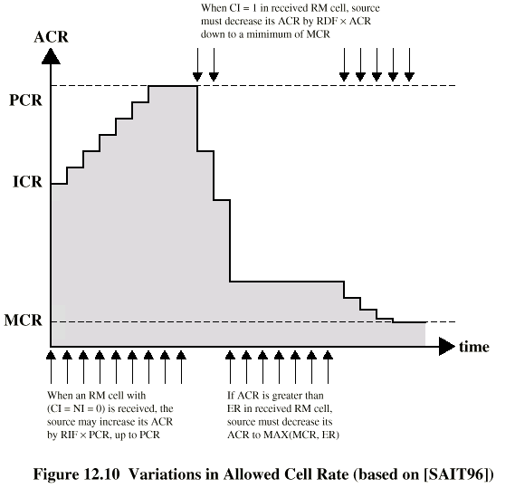
Variations in Allowed Cell Rate

Slide 73
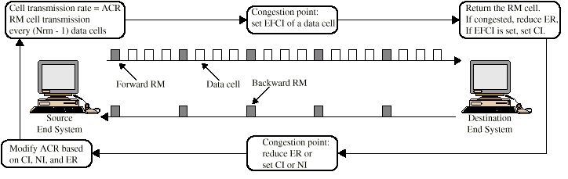
12.6.2 Cell Flow

Slide 74
速率控制反馈
EFCI (Explicit forward congestion indication 显式前向拥塞指示) 标记设置
相对速率标记设置
显式速率标记设置

Slide 75
Rate Control Feedback
EFCI (Explicit forward congestion indication) marking
Relative rate marking
Explicit rate marking

Slide 76
12.7 帧中继拥塞控制
目标
  丢弃的帧最少
  维持约定的 QoS
  一个端用户独占网络的可能性最小
  实现简单
    网络或端用户上额外开销小
  产生最小的额外通信量
  公平地分配资源
  限制拥塞的扩散
  无论通信流量大小都能高效运作
  对其它系统影响最小
  QoS变化最小

Slide 77
12.7 Frame Relay Congestion Control
Minimize discards
Miantain agreed QoS
Minimize probability of one end user monoply
Simple to implement
  Little overhead on network or user
Create minimal additional traffic
Distribute resources fairly
Limit spread of congestion
Operate effectively regardless of traffic flow
Minimum impact on other systems
Minimize variance in QoS

Slide 78
技巧
丢弃策略
拥塞避免
显式信令
拥塞恢复
隐式信令机制

Slide 79
Techniques
Discard strategy
Congestion avoidance
Explicit signaling
Congestion recovery
Implicit signaling mechanism

Slide 80
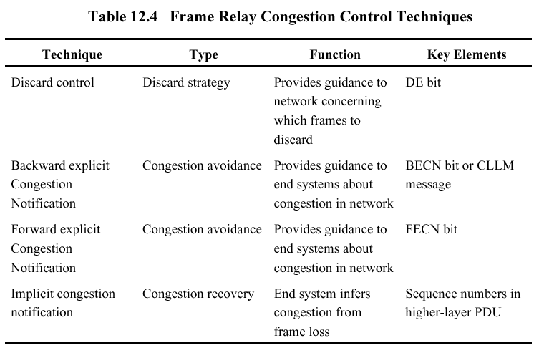

Slide 81
12.7.1 通信量速率管理
必须丢弃帧来应付拥塞
  随意丢弃, 不管来源
  对流量限制无回报，因此端系统尽可能快地传输
  许诺的信息速率 (CIR)
    丢弃超出该速率的数据
    不能担保
    各CIR的总和不应超出实际数据率
参数
  许诺的突发数据长度
  过量的突发数据长度

Slide 82
12.7.1 Traffic Rate Management
Must discard frames to cope with congestion
  Arbitrarily, no regard for source
  No reward for restraint so end systems transmit as fast as possible
  Committed information rate (CIR)
    Data in excess of this liable to discard
    Not guaranteed
    Aggregate CIR should not exceed physical data rate
Committed burst size
Excess burst size

Slide 83
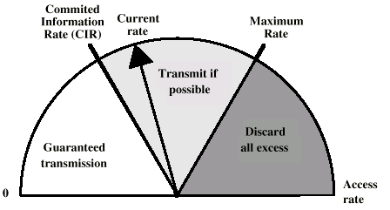
Operation of CIR

Slide 84
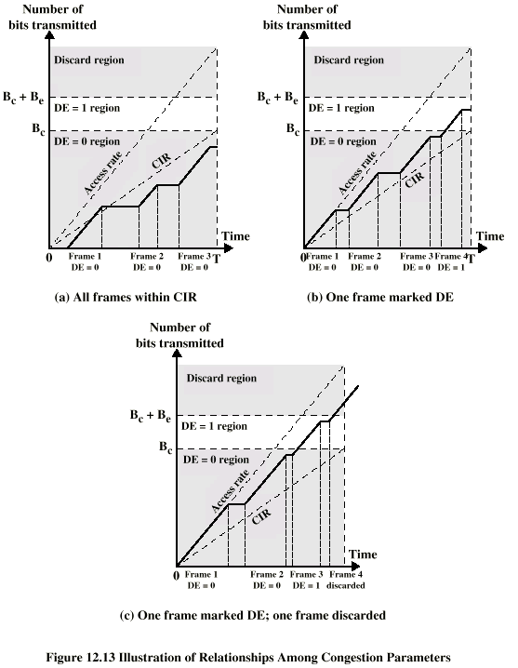
Relationship
Among
Congestion
Parameters

Slide 85
12.7.2 显式信令
网络向端系统警告拥塞增长的情况
帧的地址字段提供两个信令比特
  反向显式拥塞通知
  前向显式拥塞通知
每个帧处理器监控它的队列
可以通知一些或所有的逻辑连接
用户响应
  降低速率

Slide 86
12.7.2 Explicit Signaling
Network alerts end systems of growing congestion
Backward explicit congestion notification
Forward explicit congestion notification
Frame handler monitors its queues
May notify some or all logical connections
User response
  Reduce rate

Slide 87
Assignments
Required Reading
  Stallings chapter 12
Exercises
  Essential: 12.3
  Optional: 12.1
  Additional:
欲对网络中某个站点实现令牌桶通信量整形控制。假定令牌桶初始容量8Mbit，令牌装填速率为1M bps，那么，站点能够以6Mbps数据率发送多少时间？设令牌长8bit，每取1个令牌发送1个八比特组数据。

