Slide 1

Data Communications and Networking
Textbook
William Stallings, Data and Computer Communications, 6e
Chapter 15 Internetwork Protocols
Yang Xianchun
Department of Computer Science and Technology
Nanjing University

Slide 2
Internetworking Terms (1)
Communications Network
  Facility that provides data transfer service
An internet
  Collection of communications networks interconnected by bridges and/or routers
The Internet - note upper case I
  The global collection of thousands of individual machines and networks
Intranet
  Corporate internet operating within the organization
  Uses Internet (TCP/IP and http)technology to deliver documents and resources

Slide 3
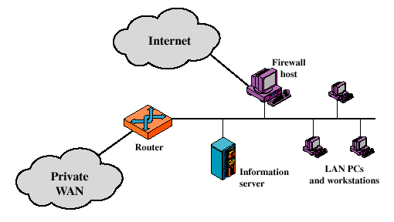
Intranet

Slide 4
Internetworking Terms (2)
Extranet
  Allows some external users or companies to access intranet
  An extranet VPN is usually created between a corporation and its customers or suppliers
End System (ES)
  Device attached to one of the networks of an internet
  Supports end-user applications or services
Intermediate System (IS)
  Device used to connect two networks
  Permits communication between end systems attached to different networks

Slide 5
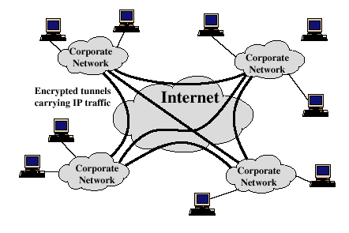
VPN - Virtual Private Network
Intranet VPN or Extranet VPN

Slide 6
Internetworking Terms (3)
Two types of ISs of particular interest are:
Bridge
  IS used to connect two LANs using similar LAN protocols
  Address filter passing on packets to the required network only
  OSI layer 2 (Data Link)
Router
  Connects two (possibly dissimilar) networks
  Uses internet protocol present in each router and end system
  OSI Layer 3 (Network)

Slide 7
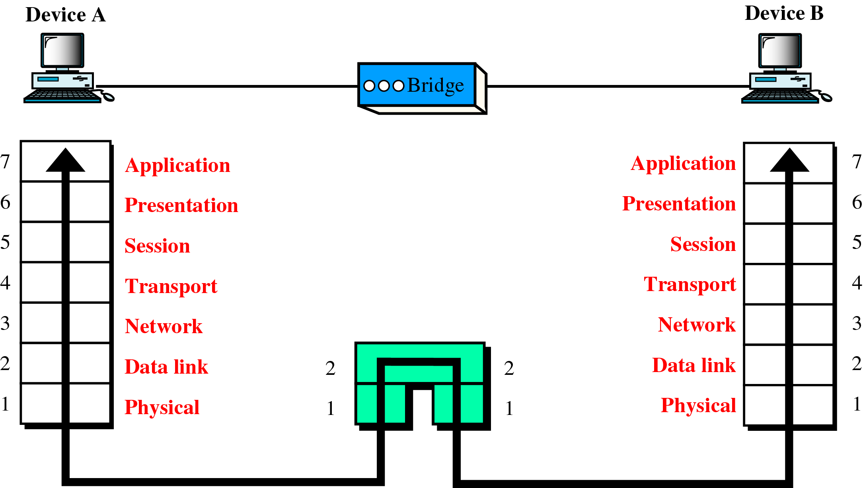
A Bridge in the OSI Model
Acts as a relay of frames among similar networks

Slide 8
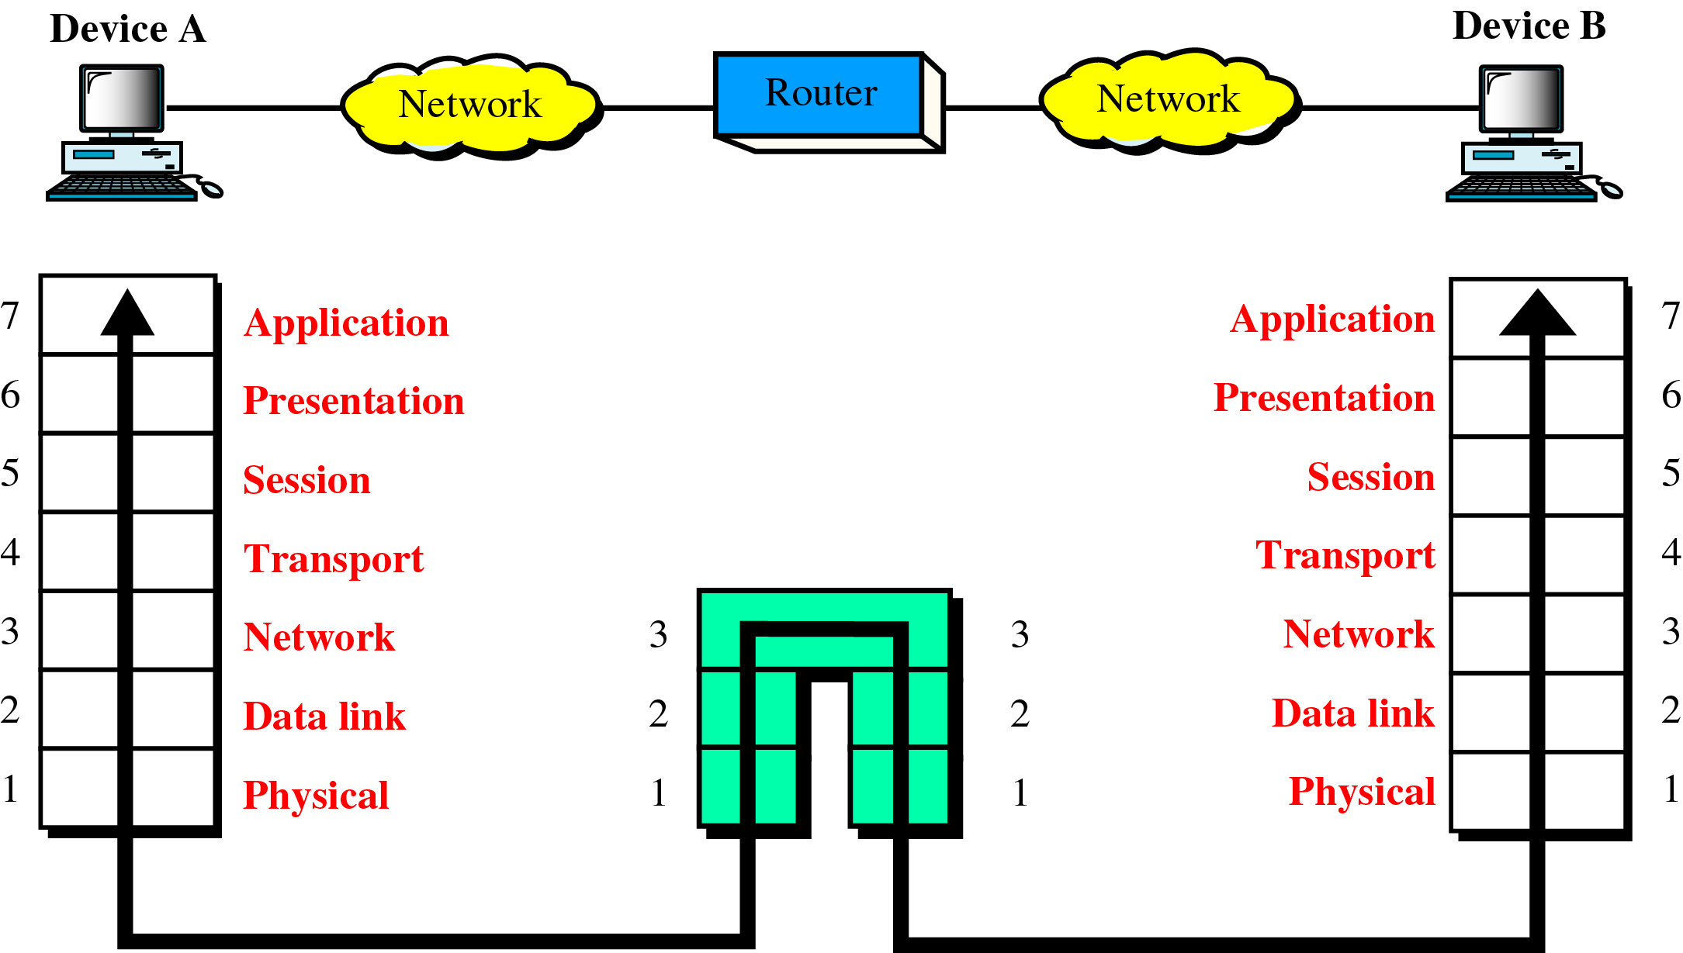
A Router in the OSI Model
Routes packets among potentially different networks

Slide 9
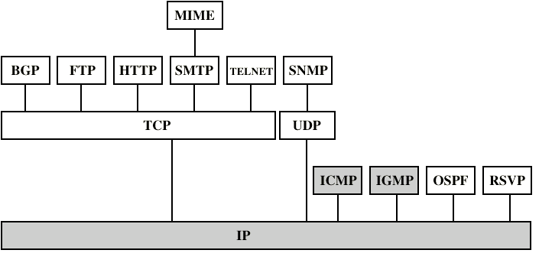
Internetworking Protocols
Routing Protocols

Slide 10
15.1 Principles of Internetworking
Requirements
  Overall requirements for an internetworking facility
  Differences between networks in architecture features
Architectural Approaches
  Connection-oriented operations
  Connectionless operations

Slide 11
Requirements of Internetworking
Link between networks
  At minimum, a physical and link layer is needed
Routing and delivery of data between processes on different networks
Accounting services and status information
Independent of network architectures

Slide 12
Network Architecture Features
Addressing
Packet size
Access mechanism
Timeouts
Error recovery
Status reporting
Routing
User access control
Connection based or connectionless

Slide 13
Architectural Approaches
Connection-Oriented Operation
  Corresponds to virtual circuit mechanism in packet switched network
Connectionless Operation
  Corresponds to datagram mechanism in packet switched network

Slide 14
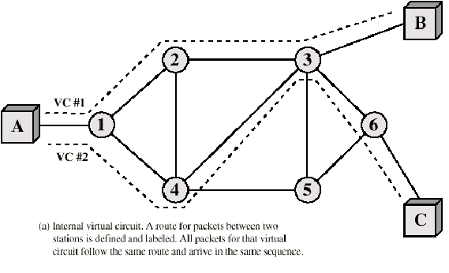
Virtual Circuit Mechanism

Slide 15
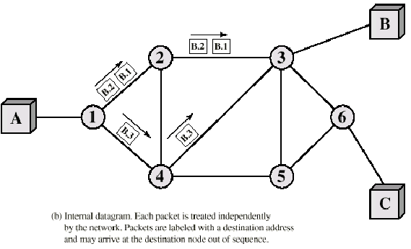
Datagram Mechanism

Slide 16
Connection Oriented
Assume that each network is connection oriented
IS connect two or more networks
  IS appear as DTE to each network
  Logical connection set up between DTEs
    Concatenation of logical connections across networks
  Individual network virtual circuits joined by IS
May require enhancement of local network services
  802, FDDI are datagram services

Slide 17
Connection Oriented IS Functions
Relaying
Routing
e.g. X.75 used to interconnect X.25 packet switched networks
Connection oriented not often used
  (IP dominant)

Slide 18
Connectionless Operation
Each NPDU treated separately
Network layer protocol common to all DTEs and routers
  Known generically as the internet protocol
Internet Protocol
  One such internet protocol developed for ARPANET
  RFC 791 (Get it and study it)
Lower layer protocol needed to access particular network

Slide 19
15.2 Connectionless Internetworking
Operations of a scheme
Design Issues
  Routing
  Datagram lifetime
  Fragmentation and reassembly
  Error control
  Flow control

Slide 20
Connectionless Internetworking
Advantages
  Flexibility
  Robust
  No unnecessary overhead
Unreliable
  Not guaranteed delivery
  Not guaranteed order of delivery
    Packets can take different routes
  Reliability is responsibility of next layer up (e.g. TCP)

Slide 21
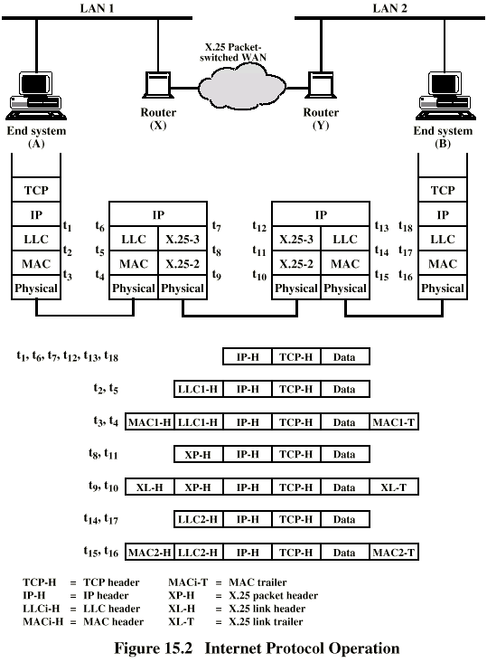
IP Operation

Slide 22
Design Issues
Routing
Datagram lifetime
Fragmentation and re-assembly
Error control
Flow control

Slide 23
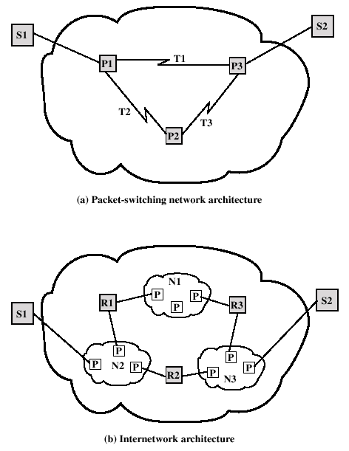
Internetwork Architecture vs
Packet-switching network
Architecture

Slide 24
Routing
End systems and routers maintain routing tables
  Indicate next router to which datagram should be sent
  Static
    May contain alternative routes
  Dynamic
    Flexible response to congestion and errors
Source routing
  Source specifies route as sequential list of routers to be followed
  Security
  Priority
Route recording

Slide 25
Datagram Lifetime
Datagrams could loop indefinitely
  Consumes resources
  Transport protocol may need upper bound on datagram life
Datagram marked with lifetime
  Time To Live field in IP
  Once lifetime expires, datagram discarded (not forwarded)
  Hop count
    Decrement time to live on passing through a each router
  Time count
    Need to know how long since last router
(Aside: compare with Logan’s Run)

Slide 26
Fragmentation and Reassembly
Different packet sizes
When to re-assemble
  At destination
    Results in packets getting smaller as data traverses internet
  Intermediate re-assembly
    Need large buffers at routers
    Buffers may fill with fragments
    All fragments must go through same router
      Inhibits dynamic routing

Slide 27
IP Fragmentation (1)
IP re-assembles at destination only
Uses fields in header
  Data Unit Identifier (ID)
    Identifies end system originated datagram
      Source and destination address
      Protocol layer generating data (e.g. TCP)
      Identification supplied by that layer
  Data length
    Length of user data in octets

Slide 28
IP Fragmentation (2)
  Offset
    Position of fragment of user data in original datagram
    In multiples of 64 bits (8 octets)
  More flag
    Indicates that this is not the last fragment

Slide 29
An Example of Fragmentation
To fragment a long datagram into two pieces, an IP module in a router performs follwing tasks
  Create two new datagram and copy the header fields of the coming datagram into both
  Divide the incoming user data field into two approximately equal portions along a 64-bit boundary, placing one portion in each new datagram. The first portion must be a multiple of 64 bits (8 octets)
  Set the Data Length of first new datagram to the length of the inserted data, and set More Flag to 1 (true). The Offset field is unchanged
  Set the Data Length of the second new datagram to the length of the inserted data, and add the length of first data portion divided by 8 to the Offset field. The More Flag remains the same

Slide 30
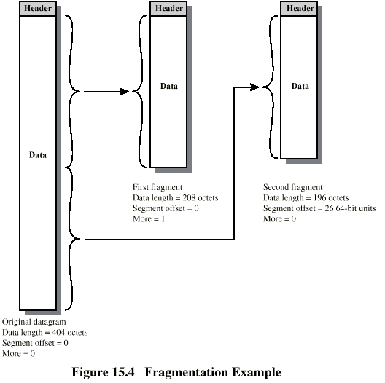
Fragmentation Example

Slide 31
Datagram Re-assembly
Must have enough buffer space at reassembly point
As fragments with the same ID arrive, their data fields are inserted in proper position in the buffer
Until entire data field is reassembled
  a contiguous set of data exists starting with an Offset of zero and ending with data from a fragment with a false More Flag

Slide 32
Dealing with Failure
Re-assembly may fail if some fragments get lost
Need to detect failure
Approach 1: Re-assembly lifetime
  Assigned to first fragment to arrive
  If timeout expires before all fragments arrive, discard partial data
Approach 2: Datagram Lifetime
  Use packet lifetime (time to live in IP)
  If time to live runs out, kill partial data

Slide 33
Error Control
Not guaranteed delivery
Router should attempt to inform source if packet discarded
  e.g. for time to live expiring
Source may modify transmission strategy
May inform high layer protocol
Datagram identification needed
(Look up ICMP)

Slide 34
Flow Control
Allows routers and/or stations to limit rate of incoming data
Limited in connectionless systems
Send flow control packets
  Requesting reduced flow
e.g. ICMP (source-quench message)

Slide 35
15.3 Internet Protocols
IP Services
IP Protocol
IP Addresses
  Network classes
  Subnets and subnet masks
ICMP Protocol

Slide 36
Internet Protocol (IP)
Part of TCP/IP
  Used by the Internet
Specifies interface with higher layer
  e.g. TCP
Specifies protocol format and mechanisms

Slide 37
15.3.1 IP Services
Service Primitives
  Functions to be performed
  Form of primitive implementation dependent
    e.g. subroutine call
  Send
    Request transmission of data unit
  Deliver
    Notify user of arrival of data unit
Parameters
  Used to pass data and control info

Slide 38
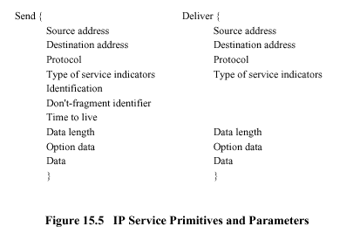
Send and Deliver Primitives

Slide 39
Parameters (1)
Source address
Destination address
Protocol
  Recipient e.g. TCP
Type of Service
  Specify treatment of data unit during transmission through networks
Identification
  Source, destination address and user protocol
  Uniquely identifies PDU
  Needed for re-assembly and error reporting
  Send only

Slide 40
Parameters (2)
Don’t fragment indicator
  Can IP fragment data
  If not, may not be possible to deliver
  Send only
Time to live
  Send onl
Data length
Option data
User data

Slide 41
Type of Service
Precedence
  8 levels
Reliability
  Normal or high
Delay
  Normal or low
Throughput
  Normal or high

Slide 42
Options
Security
Source routing
Route recording
Stream identification
Time stamping

Slide 43
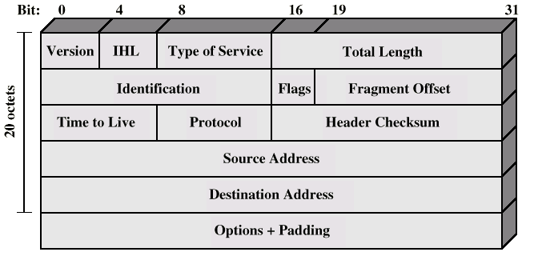
15.3.2 IP Protocol

Slide 44
Header Fields (1)
Version (4 bits)
  Currently 4
  IP v6 - see later
IHL - Internet header length (4 bits)
  In 32 bit words
  Minimum value 5 for the length of 20 octets
  Including options
Type of service (8 bits) Note an error in textbook
Total length (16 bits)
  Of datagram, in octets

Slide 45
Header Fields (2)
Identification (16 bits)
  Sequence number
  Used with addresses and user protocol to identify datagram uniquely
Flags (3 bits)
  More bit
  Don’t fragment
Fragmentation offset (13 bits)
Time to live (8 bits)
Protocol (8 bits)
  Next higher layer to receive data field at destination

Slide 46
Header Fields (3)
Header checksum (16 bits)
  Reverified and recomputed at each router
  16 bit ones complement sum of all 16 bit words in header
  Set to zero during calculation
Source address (32 bits)
Destination address (32 bits)
Options (variable)
Padding (variable)
  To fill to multiple of 32 bits long

Slide 47
Data Field
Carries user data from next layer up
Integer multiple of 8 bits long (octet)
Max length of datagram (header plus data) 65,535 octets

Slide 48
15.3.3 IP Addresses
32 bit global internet address
Network part and host part
  Class A - Few networks, each with many hosts
  Class B - Medium number of networks, each with a medium number of hosts
  Class C - Many networks, each with a few hosts

Slide 49
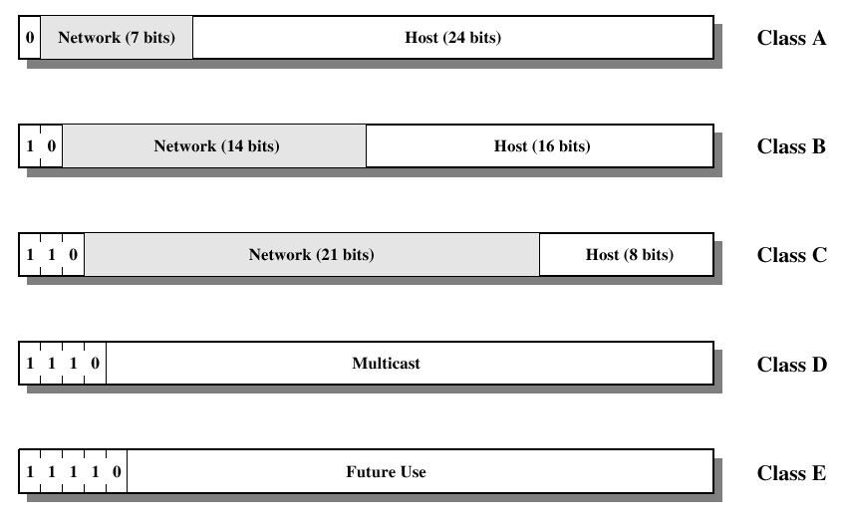
IP Address Formats

Slide 50
IP Addresses - Class A
Start with binary 0
All 0 reserved
01111111 (127) reserved for loopback
Range 1.x.x.x to 126.x.x.x
All allocated

Slide 51
IP Addresses - Class B
Start 10
Range 128.x.x.x to 191.x.x.x
Second Octet also included in network address
2¹⁴ = 16,384 class B addresses
All allocated

Slide 52
IP Addresses - Class C
Start 110
Range 192.x.x.x to 223.x.x.x
Second and third octet also part of network address
2²¹ = 2,097,152 addresses
Nearly all allocated
  See IPv6

Slide 53
Subnets and Subnet Masks
Allow arbitrary complexity of internetworked LANs within organization
Insulate overall internet from growth of network numbers and routing complexity
Site looks to rest of internet like single network
  Site cannot be put into “站点” here
Each LAN assigned subnet number
Host portion of address partitioned into subnet number and host number
Local routers route within subnetted network
Subnet mask indicates which bits are subnet number and which are host number

Slide 54
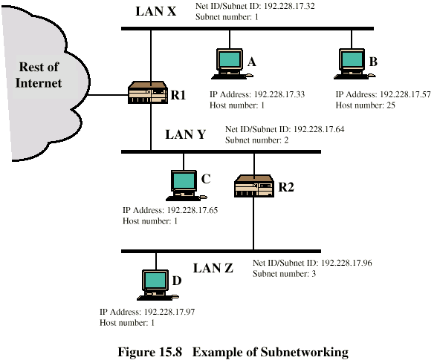
Routing Using Subnets

Slide 55
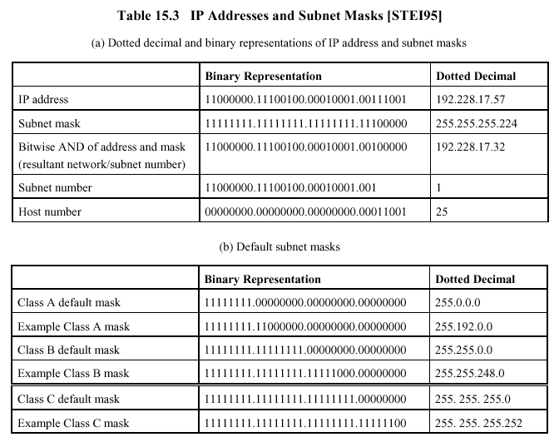

Slide 56
ICMP
Internet Control Message Protocol
RFC 792 (get it and study it)
Transfer of (control) messages from routers and hosts to hosts
Feedback about problems
  e.g. time to live expired
Encapsulated in IP datagram
  Not reliable

Slide 57
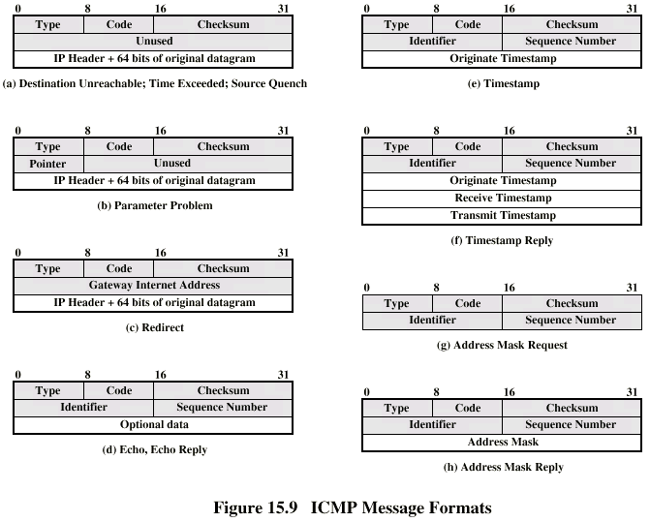
ICMP Message Formats

Slide 58
ICMP Message Header (1)
Message Types (8 bits)
  0 Echo Reply
  3 Destination Unreachable
  4 Source Quench
  5 Redirect
  8 Echo
  11 Time Exceeded
  12 Parameter Problem
  13 Timestamp
  14 Timestamp Reply
  15 Address Mask Request (Information Request)
  16 Address Mask Reply (Information Reply)

Slide 59
ICMP Message Header (2)
Code (8 bits)
Checksum (16 bits)
Parameters (32 bits)
  Pointer
  Gateway (router) internet address
  Identifier
  Sequence number

Slide 60
Destination Unreachable Message
Type: 3
Code:
  0 = net unreachable;
  1 = host unreachable;
  2 = protocol unreachable;
  3 = port unreachable;
  4 = fragmentation needed and DF set;
  5 = source route failed.
Codes 0, 1, 4, and 5 may be received from a router. Codes 2 and 3 may be received from a host.

Slide 61
Time Exceeded Message
Type: 11
Code:
  0 = time to live exceeded in transit;
  1 = fragment reassembly time exceeded.
Code 0 may be received from a router
Code 1 may be received from a host.

Slide 62
Parameter Problem Message
Type: 12
Code:
  0 = pointer indicates the error
Pointer
  If code = 0, identifies the octet where an error was detected.

Slide 63
Source Quench Message
Type: 4
Code: 0
Code 0 may be received from a router or a host.
A router may discard internet datagrams if it does not have the buffer space needed to queue the datagrams for output to the next network on the route to the destination network.
The gateway or host may send the source quench message when it approaches its capacity limit rather than waiting until the capacity is exceeded.

Slide 64
Redirect Message (1)
Type: 5
Code:
  0 = Redirect datagrams for the Network.
  1 = Redirect datagrams for the Host.
  2 = Redirect datagrams for the Type of Service and Network.
  3 = Redirect datagrams for the Type of Service and Host.
Codes 0, 1, 2, and 3 may be received from a gateway.

Slide 65
Redirect Message (2)
The router sends a redirect message to a host in the following situation (see the figure on Silde 54)
  A Router, R1, receives an internet datagram from host C on network Y to which the router is attached.
  The router, R1, checks its routing table and obtains the address of the next router, R2, on the route to the datagram's internet destination network, Z.
  If R2 and the host identified by the internet source address of the datagram are on the same network, a redirect message is sent to host C.
  The redirect message advises the host to send its traffic for network Z directly to router R2 as this is a shorter path to the destination.
  The router forwards the original datagram's data to its internet destination.

Slide 66
Echo or Echo Reply Message
Type:
  8 for echo message;
  0 for echo reply message
Code: 0
  Code 0 may be received from a router or a host
Identifier
  If code = 0, an identifier to aid in matching echos and replies, may be zero.
Sequence Number
  If code = 0, a sequence number to aid in matching echos and replies, may be zero.

Slide 67
Timestamp or Timestamp Reply Message
Type:
  13 for timestamp message;
  14 for timestamp reply message
Code: 0
  Code 0 may be received from a router or a host
Identifier
  If code = 0, an identifier to aid in matching timestamp and replies, may be zero.
Sequence Number
  If code = 0, a sequence number to aid in matching timestamp and replies, may be zero.

Slide 68
Address Mask Request or Address Mask Reply Message (1)
Type:
  15 for address mask request message;
  16 for address mask reply message.
Code: 0
  Code 0 may be received from a router or a host
Identifier
  If code = 0, an identifier to aid in matching request and replies, may be zero.
Sequence Number
  If code = 0, a sequence number to aid in matching request and replies, may be zero.

Slide 69
Address Mask Request or Address Mask Reply Message (2)
This message may be sent with the source network in the IP header source and destination address fields zero (which means "this" network).
  The replying IP module should send the reply with the addresses fully specified.
  This message is a way for a host to find out the number of the network it is on.
The identifier and sequence number may be used by the echo sender to aid in matching the replies with the requests.
  For example, the identifier might be used like a port in TCP or UDP to identify a session, and the sequence number might be incremented on each request sent.
  The destination returns these same values in the reply.

Slide 70
15.4 IPv6
IP Next Generation
IPv6 Structure
IPv6 Header
  Traffic class
  Flow label
IPv6 Addresses
Hop-by-Hop Options Header
Fragment Header
Routing Header
Destination Options Header

Slide 71
15.4.1 IP Next Generation
IP v6 - Version Number
  IP v 1-3 defined and replaced
  IP v4 - current version
  IP v5 - streams protocol
  IP v6 - replacement for IP v4
    During development it was called IPng
    Next Generation

Slide 72
Why Change IP?
Address space exhaustion
  Two level addressing (network and host) wastes space
  Network addresses used even if not connected to Internet
  Growth of networks and the Internet
  Extended use of TCP/IP
  From single address to multiple addresses per host
Requirements for new types of service

Slide 73
IPv6 RFCs
1752 - Recommendations for the IP Next Generation Protocol
2460 - Overall specification
2373 - addressing architecture
Others (find them)
  1550 - IP: Next Generation (IPng) White Paper Solicitation
  1726 - Technical Criteria for Choosing IP: The Next Generation (IPng)
  1888 - OSI NSAPs and IPv6
  1933 - Transition Mechanisms for IPv6 Hosts and Routers
  1981 - Path MTU Discovery for IP version 6
  2401 - Security Architecture for the Internet Protocol
  2402 - IP Authentication Header
  2406 - IP Encapsulating Security Protocol (ESP)
  2463 - ICMP for the Internet Protocol Version 6 (IPv6)

Slide 74
IPv6 Enhancements over IPv4 (1)
Expanded address space
  128 bit
Improved option mechanism
  Separate optional headers between IPv6 header and transport layer header
  Most are not examined by intermediate routes
    Improved speed and simplified router processing
    Easier to extend options
Address autoconfiguration
  Dynamic assignment of addresses
  Provide information such as that provided by DHCP in IPv4

Slide 75
IPv6 Enhancements (2)
Increased addressing flexibility
  Anycast - delivered to one of a set of nodes
  Improved scalability of multicast addresses
Support for resource allocation
  Replaces Type of Service field in IPv4
  Labeling of packets to particular traffic flow
  Allows special handling
  e.g. real time video

Slide 76
15.4.2 IPv6 Structure
IPv6 PDU known as a packet
General form
  IPv6 Head
    Mandatory, must always appear first
  Extension Headers
    Hop-by-hop options
    Destination option (note 1)
    Routing
    Fragment
    Authentication (note 2)
    Encapsulating security payload (note 2)
    Destination option (note 3)
  Upper layer PDU
    Such as TCP header
    Application data

Slide 77
Notes
Note 1
  for options to be processed by the first destination that appears in the IPv6 Destination Address field plus subsequent destinations listed in the Routing header.
Note 2
  additional recommendations regarding the relative order of the Authentication and Encapsulating Security Payload headers are given in [RFC-2402 and RFC-2406].
Note 3
  for options to be processed only by the final destination of the packet.

Slide 78
Extension Headers
Hop-by-Hop Options
  Require processing at each router
Routing
  Similar to IPv4 source routing
Fragment
  For fragmentation and reassmbly
Authentication
  Provide packet integrity and authentication
Encapsulating security payload
  Privacy
Destination options
  For destination node

Slide 79
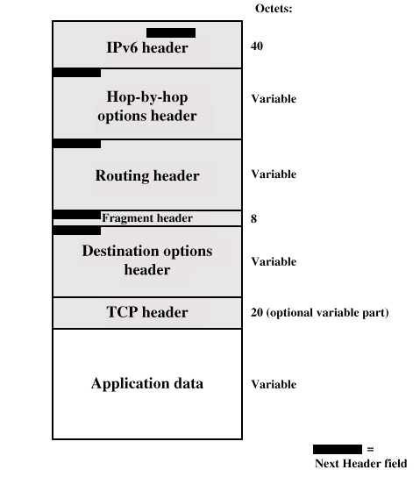
Example Packet Structure

Slide 80
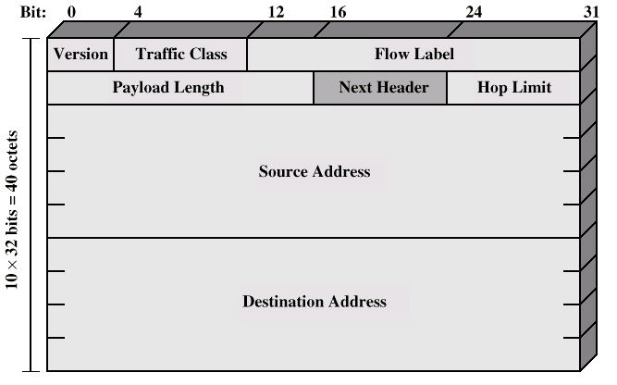
15.4.3 IPv6 Header

Slide 81
IP v6 Header Fields (1)
Version (4 bits)
  6
Traffic Class (8 bits)
  Classes or priorities of packet
  Still under development
  See RFC 2460
Flow Label (20 bits)
  Used by hosts requesting special handling
  Rules apply to flow label (see later)
Payload length (16 bits)
  Includes all extension headers plus user data

Slide 82
Guidelines for Traffic Class
Service interface to IPv6
  must enable upper-layer protocols to supply the value of the traffic class field
Nodes supporting use of traffic class field
  are permitted to change the value of those bits in packets that they originate, forward or receive, as required for that specific use
Upper-layer protocol
  must not assume that the value of the traffic class bits in a received packet is the same as the value sent by the packet’s source

Slide 83
Flow
IPv6 standard defines a flow as a sequence of packets
  sent from a particular source to a particular (unicast or multicast) destination for which the source desires special handling by the intervening routers
From source’s point of view
  generated from a single application at the source and have a the same transfer service requirements
  A flow may comprise a single TCP connection or even multiple TCP connections
  A single application may generate a single flow or multiple flows
From router’s point of view
  share attributes (path, accounting, resource allocation, discard requirements, and security) that affect how these packets are handled by the router

Slide 84
Flow Label
Two approaches of flow handling
  All of a user’s requirements for a particular flow could be defined in an extension header and included with each packet
  Flow label adopted for IPv6, in which the flow require-ments are defined prior to flow commencement and a unique flow label is assigned to the flow
A flow is uniquely identified by the combination of a source address, destination address, and a non-zero 20-bit flow label
No special significance to any particular flow label
Special handling to be provided for a packet flow must be declared in some other way

Slide 85
Flow Handling
Request Way of Flow Handling
  A source might negotiate or request special handling ahead of time from routers by means of a control protocol
  Negotiate or request special handling at transmission time by information in one of the extension header
    such as Hop-by-Hop Option header
Examples of special handling
  Some sort of non-default quality of service
  Some form of real-time service

Slide 86
Rules Apply to Flow Label
Hosts or routers that do not support Flow Label
  Set the field to zero when originating a packet
  Ignore the field when receiving a packet
Router
  Can decide how to route and process the packet by simply looking up the Flow Label in a table and without examining the rest of the header
  ( All packets originating from a given source with the same nonzero Flow Label must have the same Source Address, Destination Address, Hop-by-Hop Options and Routing header contents )
Source
  Assigns a Flow Label to a flow
  New Flow Label must be chosen randomly and uniformly
  Zero Flow Label indicates that no flow label is being used

Slide 87
IP v6 Header Fields (2)
Next Header (8 bits)
  Identifies type of header
    Extension or next layer up
Hop Limit (8 bits)
Source Address (128 bits)
Destination address (128 bits)

Slide 88
15.4.4 IPv6 Addresses
128 bits long
Assigned to interface
Single interface may have multiple unicast addresses
Combination of long addresses and multiple addresses per interface (see RFC-2373)
  Enables improved routing efficiency over IPv4
Three types of address
FEDC : BA98 : 7654 : 3210 : FEDC : BA98 : 7654 : 3210
1080 : 0 : 0 : 0 : 8 : 800 : 200C : 417A

Slide 89
Types of address
Unicast
  Single interface
Anycast
  Set of interfaces (typically different nodes)
  Delivered to any one interface
  the “nearest”
Multicast
  Set of interfaces
  Delivered to all interfaces identified

Slide 90
Example Addresses
1080:0:0:0:8:800:200C:417A a unicast address
FF01:0:0:0:0:0:0:101 a multicast address
0:0:0:0:0:0:0:1 the loopback address
0:0:0:0:0:0:0:0 the unspecified addresses
may be represented as:
1080::8:800:200C:417A a unicast address
FF01::101 a multicast address
::1 the loopback address
:: the unspecified addresses

Slide 91
Mixed Environment of IPv4 and IPv6
A mixed environment of IPv4 and IPv6 nodes is
  x:x:x:x:x:x:d.d.d.d
  'x's are the hexadecimal values of the six high-order 16-bit pieces of the address,
  'd's are the decimal values of the four low-order 8-bit pieces of the address (standard IPv4 representation)
Examples:
  0:0:0:0:0:0:13.1.68.3
  0:0:0:0:0:FFFF:129.144.52.38
or in compressed form:
  ::13.1.68.3
  ::FFFF:129.144.52.38

Slide 92
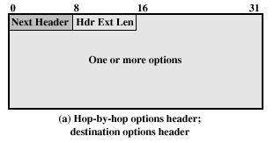
15.4.5 Hop-by-Hop Options
Next header
Header extension length
Options (Three subfields)
  Option Type (8 bits)
  Length (8 bits)
  Option Data (variable)

Slide 93
Option Type (1)
High-order 2 bits
  00 - skip over this option and continue processing the header
  01 - discard the packet
  10 - discard the packet and send an ICMP parameter Problem message to the packet’s Source Address, pointing to the unrecognized Option Type
  11 - the same as 10, only if the packet’s Destination Address is not a multicast address
The third highest-order bit
  Option Data field does not change(0) or may change (1) en route from source to destination

Slide 94
Option Type (2)
Lower 5 bits - Two hop-by-hop options
  Jumbo payload
    Over 2¹⁶ = 65,535 octets
    2³² = 4 billion octets (4GB)
    Facilitates the transmission of large video packets
  Router alert
    Tells the router that the contents of this packet is of interest to the router
    Provides support for RSPV (chapter 16)
These Conventions for the Option Type field also apply to the Destination Options header

Slide 95
15.4.6 Fragmentation Header
Fragmentation only allowed at source
No fragmentation at intermediate routers
Node must perform path discovery to find smallest MTU of intermediate networks
Source fragments to match MTU
Otherwise limit to 1280 octets

Slide 96

Fragmentation Header Fields
Next Header
Reserved
Fragmentation offset
Reserved
More flag
Identification

Slide 97
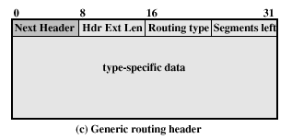
15.4.7 Routing Header
List of one or more intermediate nodes to be visited
Next Header
Header extension
length
Routing type
Segments left
  i.e. number of nodes still to be visited

Slide 98
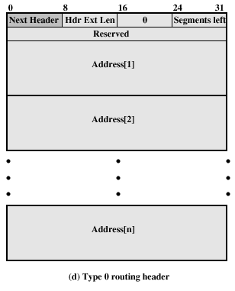
Type 0 Routing Header

Slide 99
As the packet travels from S to I1:
Source Address = S Hdr Ext Len = 6
Destination Address = I1 Segments Left = 3
Address[1] = I2
Address[2] = I3
Address[3] = D
As the packet travels from I1 to I2:
Source Address = S Hdr Ext Len = 6
Destination Address = I2 Segments Left = 2
Address[1] = I1
Address[2] = I3
Address[3] = D
As the packet travels from I2 to I3:
Source Address = S Hdr Ext Len = 6
Destination Address = I3 Segments Left = 1
Address[1] = I1
Address[2] = I2
Address[3] = D
As the packet travels from I3 to D:
Source Address = S Hdr Ext Len = 6
Destination Address = D Segments Left = 0
Address[1] = I1
Address[2] = I2
Address[3] = I3

Slide 100
15.4.8 Destination Options
Same format as Hop-by-Hop options header

Slide 101
15.5 Multicasting
Particular Applications
Comparison of Strategies
  Broadcast
  Multiple unicast
  Multicast
Requirements for multicast
IGMP Protocol
  IGMP Message Format
  IGMP operation
  Group membership with IPv6

Slide 102
Particular Applications
Multicast
  Addresses that refer to group of hosts on one or more networks
Uses
  Multimedia “broadcast”
  Teleconferencing
  Database
  Distributed computing
  Real time workgroups

Slide 103
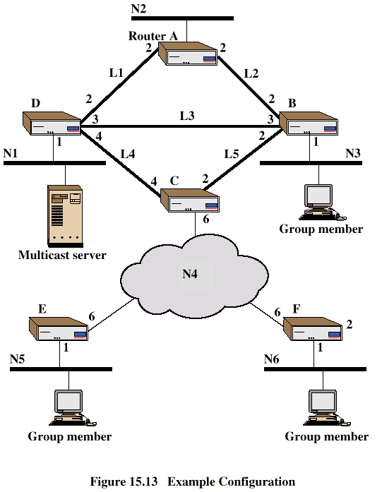
Example
Configuration

Slide 104
Broadcast and Multiple Unicast
Broadcast a copy of packet to each network
  Requires 13 copies of packet
Multiple Unicast
  Send packet only to networks that have hosts in group
  11 packets

Slide 105
True Multicast
Determine least cost path to each network that has host in group
  Gives spanning tree configuration containing networks with group members
Transmit single packet along spanning tree
Routers replicate packets at branch points of spanning tree
8 packets required

Slide 106
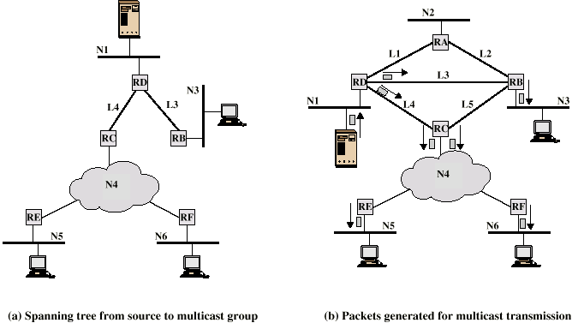
Multicast Example
If N4 is a LAN, RC only need to transmit one packet for RE and RF to read

Slide 107
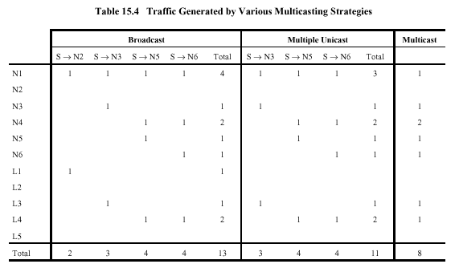

Slide 108
Requirements for
Multicasting (1)
Router may have to forward more than one copy of packet
Convention needed to identify multicast addresses
  IPv4 - Class D - start 1110
  IPv6 - 8 bit prefix, all 1, 4 bit flags field, 4 bit scope field, 112 bit group identifier
Nodes must translate between IP multicast addresses and list of networks containing group members
Router must translate between IP multicast address and network multicast address

Slide 109
Multicast Addresses Format
| 8 | 4 | 4 | 112 |
11111111
flgs
scop
group ID
The high-order 3 flags are reserved, and must be initialized to 0.
Lowest flag bit
  0 = indicates a permanently-assigned ("well-known") address, assigned by the global internet numbering authority.
  1 = indicates a non-permanently-assigned ("transient") multicast address.
scop is a 4-bit multicast scope value used to limit the scope the multicast group. The values are:
  0 reserved 1 node-local scope 2 link-local scope 3 (unassigned)
  4 (unassigned) 5 site-local scope 6 (unassigned)
  7 (unassigned) 8 organization-local scope 9 (unassigned)
  A (unassigned) B (unassigned) C (unassigned)
  D (unassigned) E global scope F reserved
group ID identifies the multicast group, either permanent or transient, within the given scope.

Slide 110
Requirements for
Multicasting (2)
Mechanism required for hosts to join and leave multicast group
Routers must exchange info
  Which networks include members of given group
  Sufficient info to work out shortest path to each network
Routing algorithm to work out shortest path
Routers must determine routing paths based on source and destination addresses

Slide 111
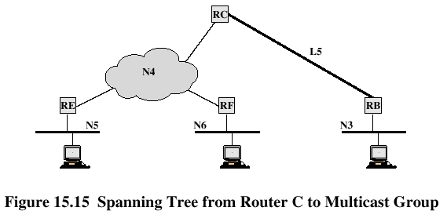
A Simple-minded Approach

Slide 112
IGMP
Internet Group Management Protocol
RFC 1112
Host and router exchange of multicast group info
Use broadcast LAN to transfer info among multiple hosts and routers

Slide 113
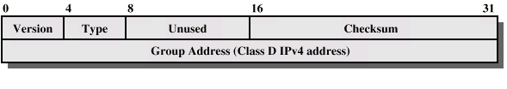
IGMP Fields
Version
  1
Type
  1 - query sent by router
  O - report sent by host
Checksum
Group address
  Zero in request message
  Valid group address in report message

Slide 114
IGMP Operation
To join a group, hosts sends report message
  Group address of group to join
  In IP datagram to same multicast destination address
  All hosts in group receive message
  Routers listen to all multicast addresses to hear all reports
Routers periodically issue request message
  Sent to all-hosts multicast address
  Host that want to stay in groups must read all-hosts messages and respond with report for each group it is in

Slide 115
Group Membership in IPv6
Function of IGMP included in ICMP v6
New group membership termination message to allow host to leave group

Slide 116
Required Reading
Stallings chapter 15
Comer, D. Internetworking with TCP/IP,
volume 1, 3e, Prentice-Hall (A textbook in next semester)
Huitema, C. IPv6: The New Internet Protocol, 2e, Prentice-Hall
All RFCs mentioned plus any others connected with these topics
Loads of Web sites on TCP/IP and IP version 6.

Slide 117
Problems
Essential
  15.6
  15.9
  15.19
Optional
  15.18 (see Section 4.4 in RFC-2460)

