Slide 1
Analyzing the Effect of Noise Injection on Gradient Boosting Machine Regression Models
Hamza Bachnak
Thesis Supervisor Dr. Jeremy Blum
The Pennsylvania State University
School of Science, Engineering, and Technology

Slide 2
Introduction
Relevance of machine learning and AI
Improving on accuracy, speed, and memory

Slide 3
Background
What are decision trees?
What are Gradient Boosting Machine models?

Slide 4
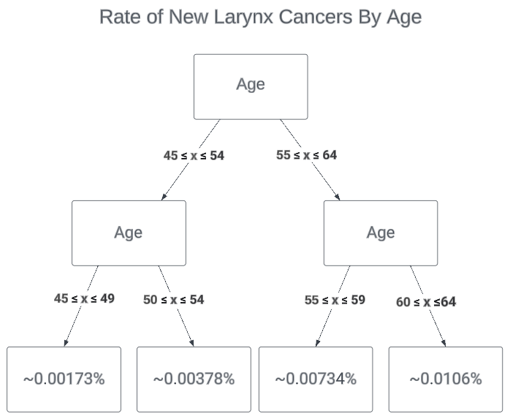
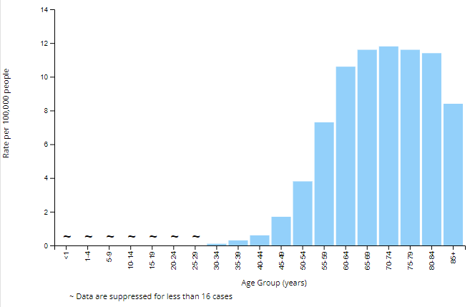
Decision Trees
Figure 1: Rates of New Larynx Cancers By Age Reported By NDC Presented as Bar Graph [1].
Figure 2: Rates of New Larynx Cancers By Age Reported By NDC Presented as Decision Tree [1].

Slide 5
Research Question
One reason for the large number of trees in GBM models is the discontinuous nature of tree-based predictions, and therefore, if other means were used to smooth out GBM predictions, smaller models could produce similar results.

Slide 6
Methods
GBM Models for Testing
Baseline model
Noise injected model
Synthetic dataset
Real-world dataset
Evaluated using RMSE

Slide 7
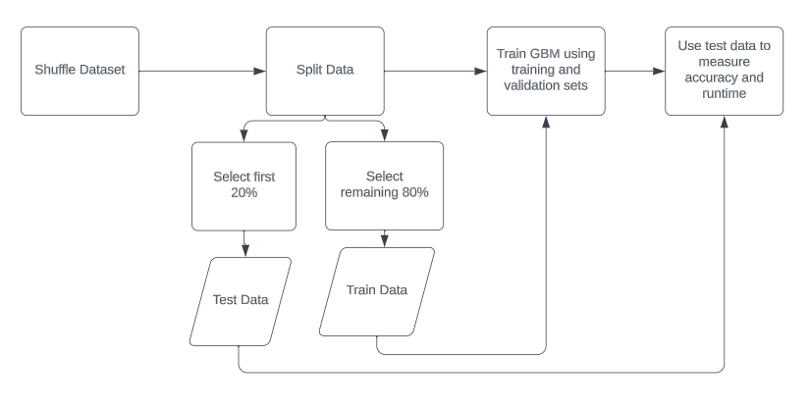
Baseline GBM
Figure 3: Flowchart representation for construction of baseline GBM

Slide 8
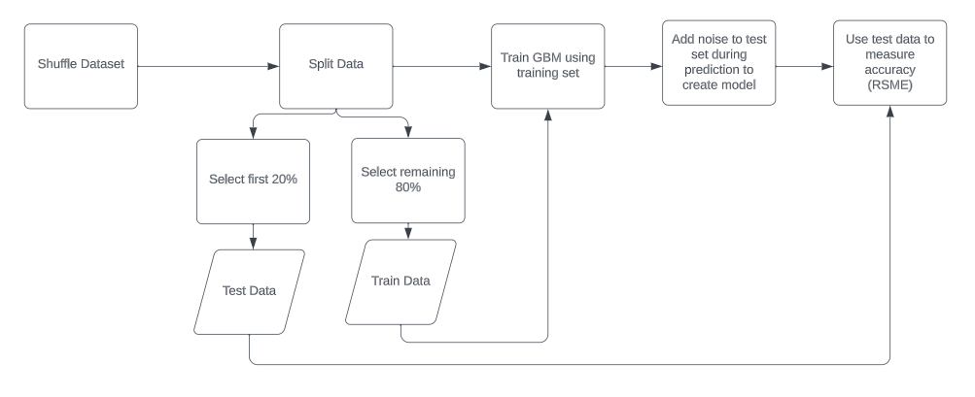
Noise Injected Model
Figure 4: Flowchart representation for construction of noise injected GBM model

Slide 9
Results
Trees | 0.1 | 0.01 | 0.001 | 0.0001
1 | -0.075% | -0.022% | -0.003% | 0%
2 | -0.119% | -0.033% | -0.004% | 0%
4 | -0.145% | -0.03% | 0.002% | 0%
8 | -0.189% | -0.001% | 0.004% | -0.001%
16 | -0.119% | 0.103% | 0.01% | -0.003%
32 | 1.945% | 0.707% | 0.131% | 0.004%
64 | 9.773% | 2.826% | 0.436% | 0.02%
128 | 12.565% | 3.572% | 0.535% | 0.019%
256 | 12.762% | 3.843% | 0.563% | 0.019%
512 | 13.028% | 3.989% | 0.606% | 0.015%
Trees | 0.1 | 0.01 | 0.001 | 0.0001
1 | -0.255% | -0.04% | -0.005% | 0.001%
2 | -0.599% | -0.08% | -0.011% | 0.003%
4 | -1.041% | -0.108% | -0.015% | 0.002%
8 | -2.369% | -0.163% | -0.026% | 0.004%
16 | -5.124% | -0.437% | -0.081% | -0.023%
32 | -8.121% | -0.818% | -0.164% | -0.033%
64 | -10.728% | -1.695% | -0.43% | -0.109%
128 | -14.449% | -2.45% | -0.596% | -0.153%
256 | -18.015% | -3.001% | -0.686% | -0.21%
512 | -22.202% | -3.218% | -0.624% | -0.169%
Table 1: Percentage Improvement in the RSME in relation to baseline for synthetic dataset
Table 2: Percentage Improvement in the RSME in relation to baseline for the real-world dataset

Slide 10
Limitations
Compatibility of noise addition with GBM
Handling of Categorical Attributes
Noise addition to training data
Complexity constraints on individual trees

Slide 11
Conclusion
Importance of machine learning
Baseline compared to noise injected model
Synthetic data results show increase in accuracy
Real-world data results show decrease in accuracy
Limitations on handling real-world data and GBM

Slide 12
References
[1] Center of Disease Control and Prevention, "cdc.gov," Center of Disease Control and Prevention, 2023. [Online]. Available: https://gis.cdc.gov/Cancer/USCS/#/Demographics/. [Accessed 26 June 2023].
[2] "US Used cars dataset," Kaggle, 2020. [Online]. Available: https://www.kaggle.com/datasets/ananaymital/us-used-cars-dataset. [Accessed 11 June 2023].

Slide 13
Acknowledgements
Thesis Supervisor: Dr. Blum
Thesis Reader: Dr. Kabir
Honors Staff and Faculty:
Dr. Shirley Clark
Dr. Gina Brelsford
Stephanie Ponnett
Family

Slide 14
Questions?

