Slide 2
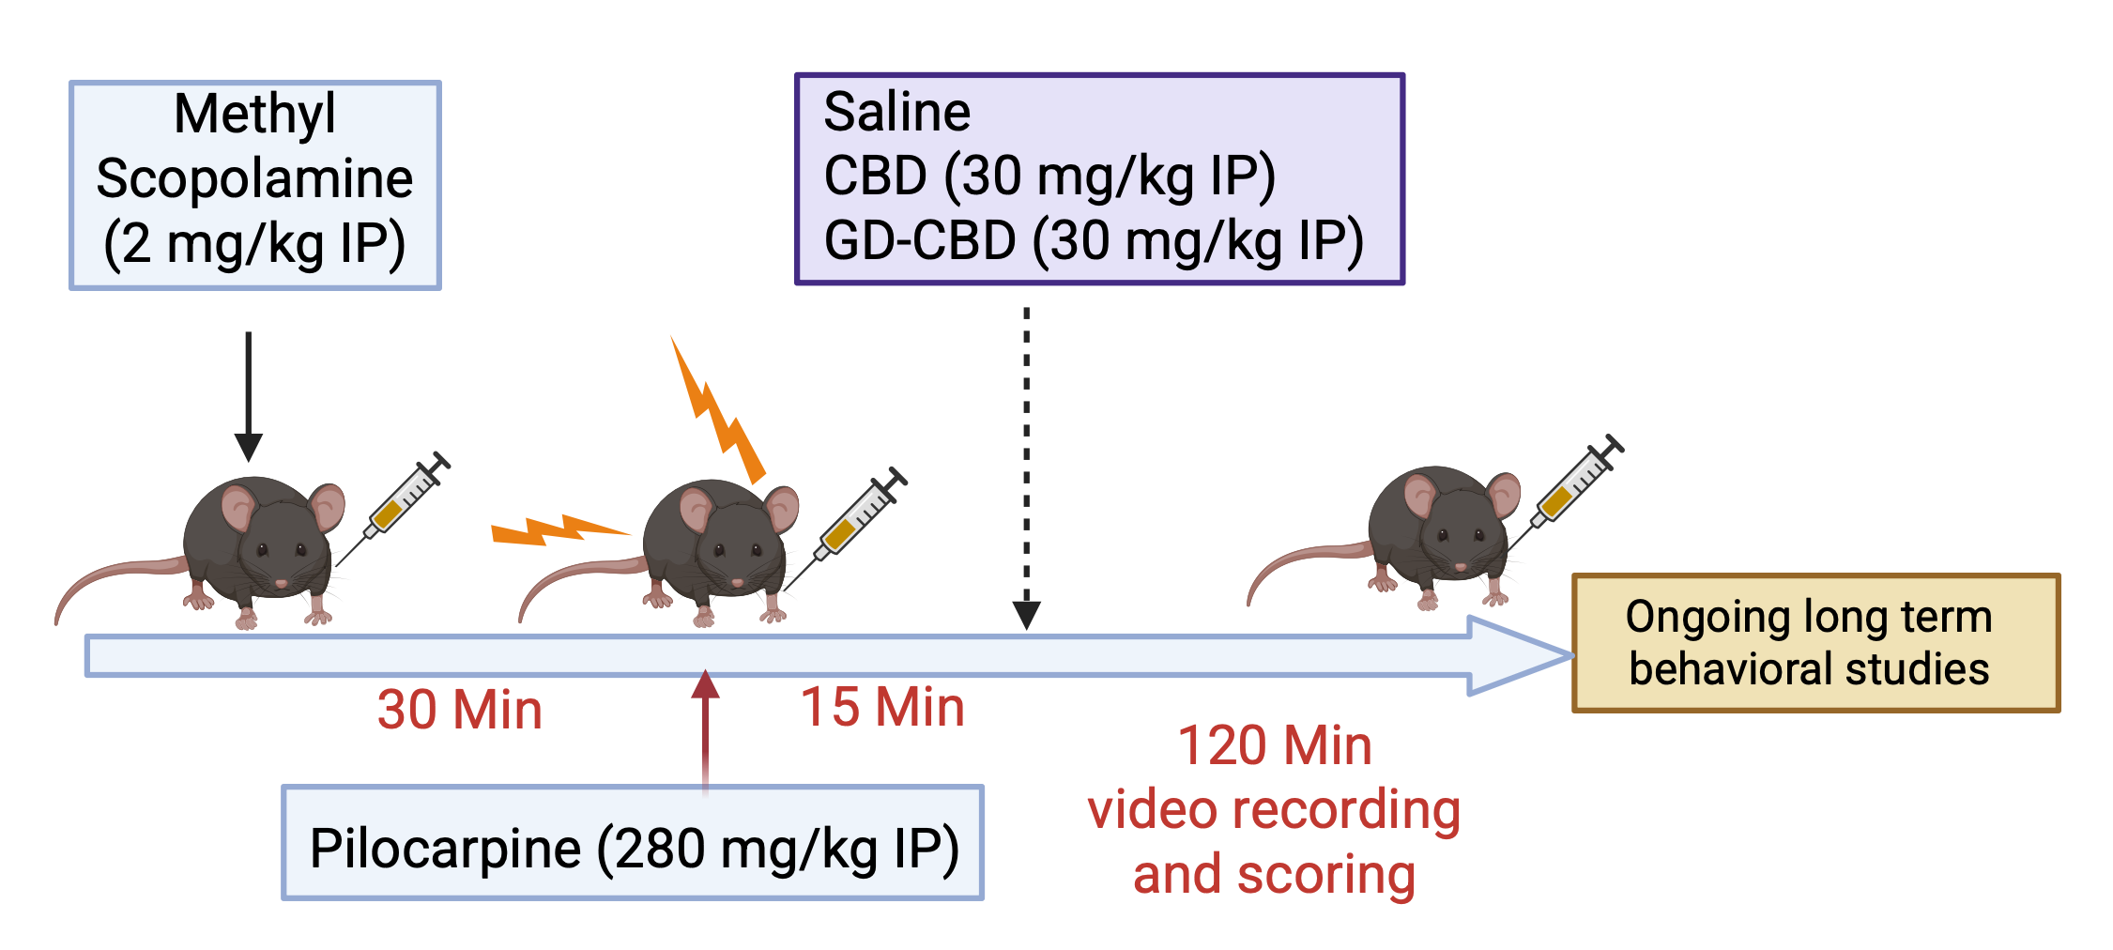
Pilocarpine model of refractory status epilepticus
Notes:
This the mecp2 bird model that we are using!
We have KO and Het model

Slide 3
Acute GD-CBD administration reduces seizure duration and severity
% total duration seizing
% Duration of
Generalized seizures
% Duration of Generalized seizures over time​
Seizure duration
Duration and episodes of generalized seizures
Recovery from SE

Slide 4
GD-CBD improves survival and reduce seizure severity post-SE
% Survival 48 hours post-SE
Survival proportions
% Duration of seizure stages (stacked)
% Duration stage 6
Survival post-SE
Seizure severity

