Slide 1
Consumer Credit Analytics
Probability of Default Modeling | Lending Club 2007–2020
Are we lending to the right borrowers?
Hongxu Dong

Slide 2
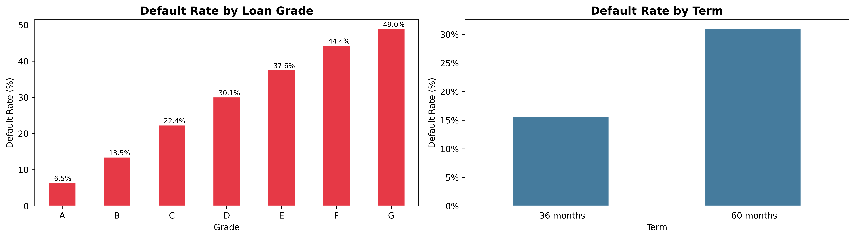
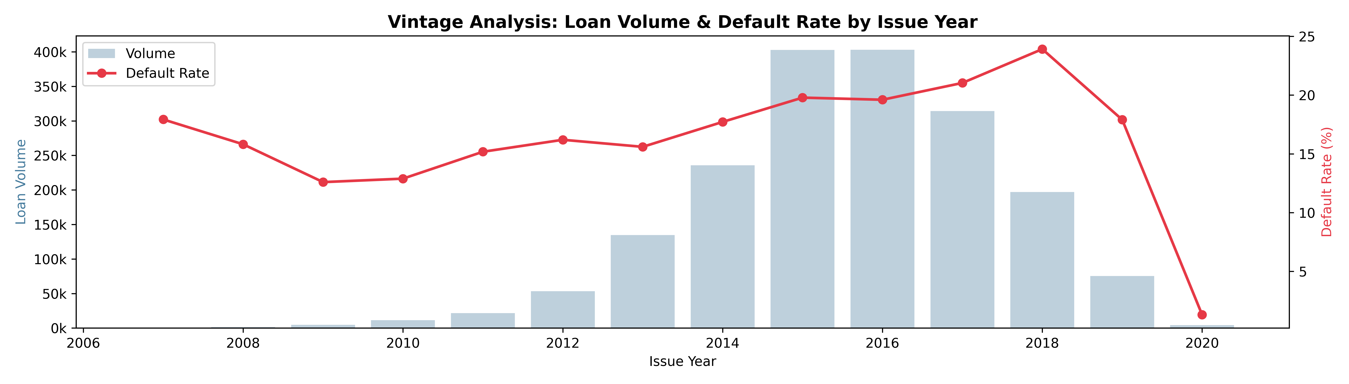
Key EDA Findings – Few Examples

Slide 3
Methodology
01
02
03
04
05
Scope Filter
Feature Eng.
Preprocessing
Modeling
Evaluation
Completed loans only
(Fully Paid / Charged Off)
Excluded: Current, Late, In Grace Period, etc.
80+ origination-time features
Derived: log(income), PTI ratio
FIFO avg, vintage year
Median imputation for missing.
Fine & Coarse classing
Standard scaling (LR)
OHE for categorical variables
Multicollinearity check
Feature Selection based on Information Value
8 final features
Logistic Regression class_weight=balanced
AUC-ROC
KS Statistic
Gini Coefficient
No data leakage: only origination-time features used. Post-origination fields (payments, recovery, balance) were excluded.

Slide 4
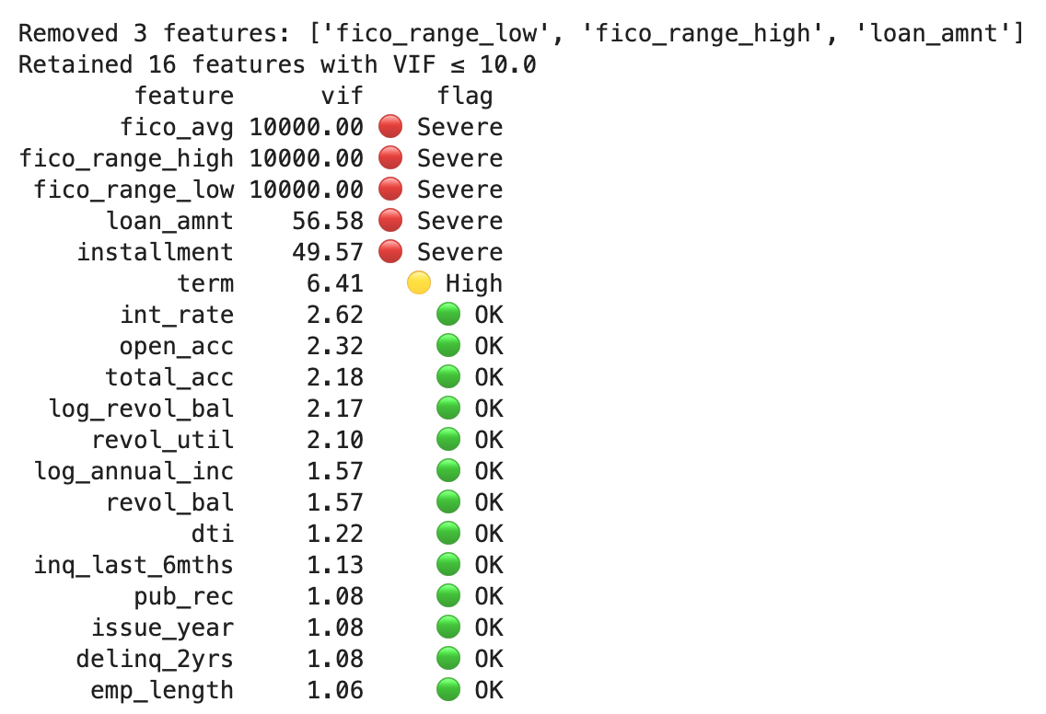
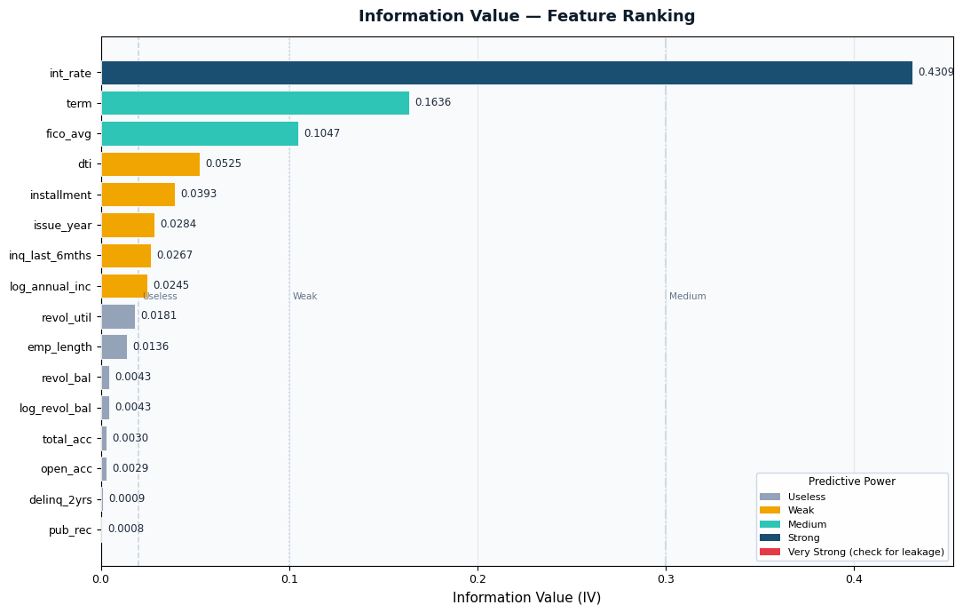
Methodology – Feature Selection based on VIF and IV
Information Value (IV) measures how strongly a variable predicts whether a customer will default (bad) or pay back (good), with higher IV indicating a stronger, more useful predictor for risk.
Variance Inflation Factor (VIF) detects multicollinearity in features. Removing highly correlated features (VIF >= 10) help to reduce model complexity and improve stability and interpretability.

Slide 5
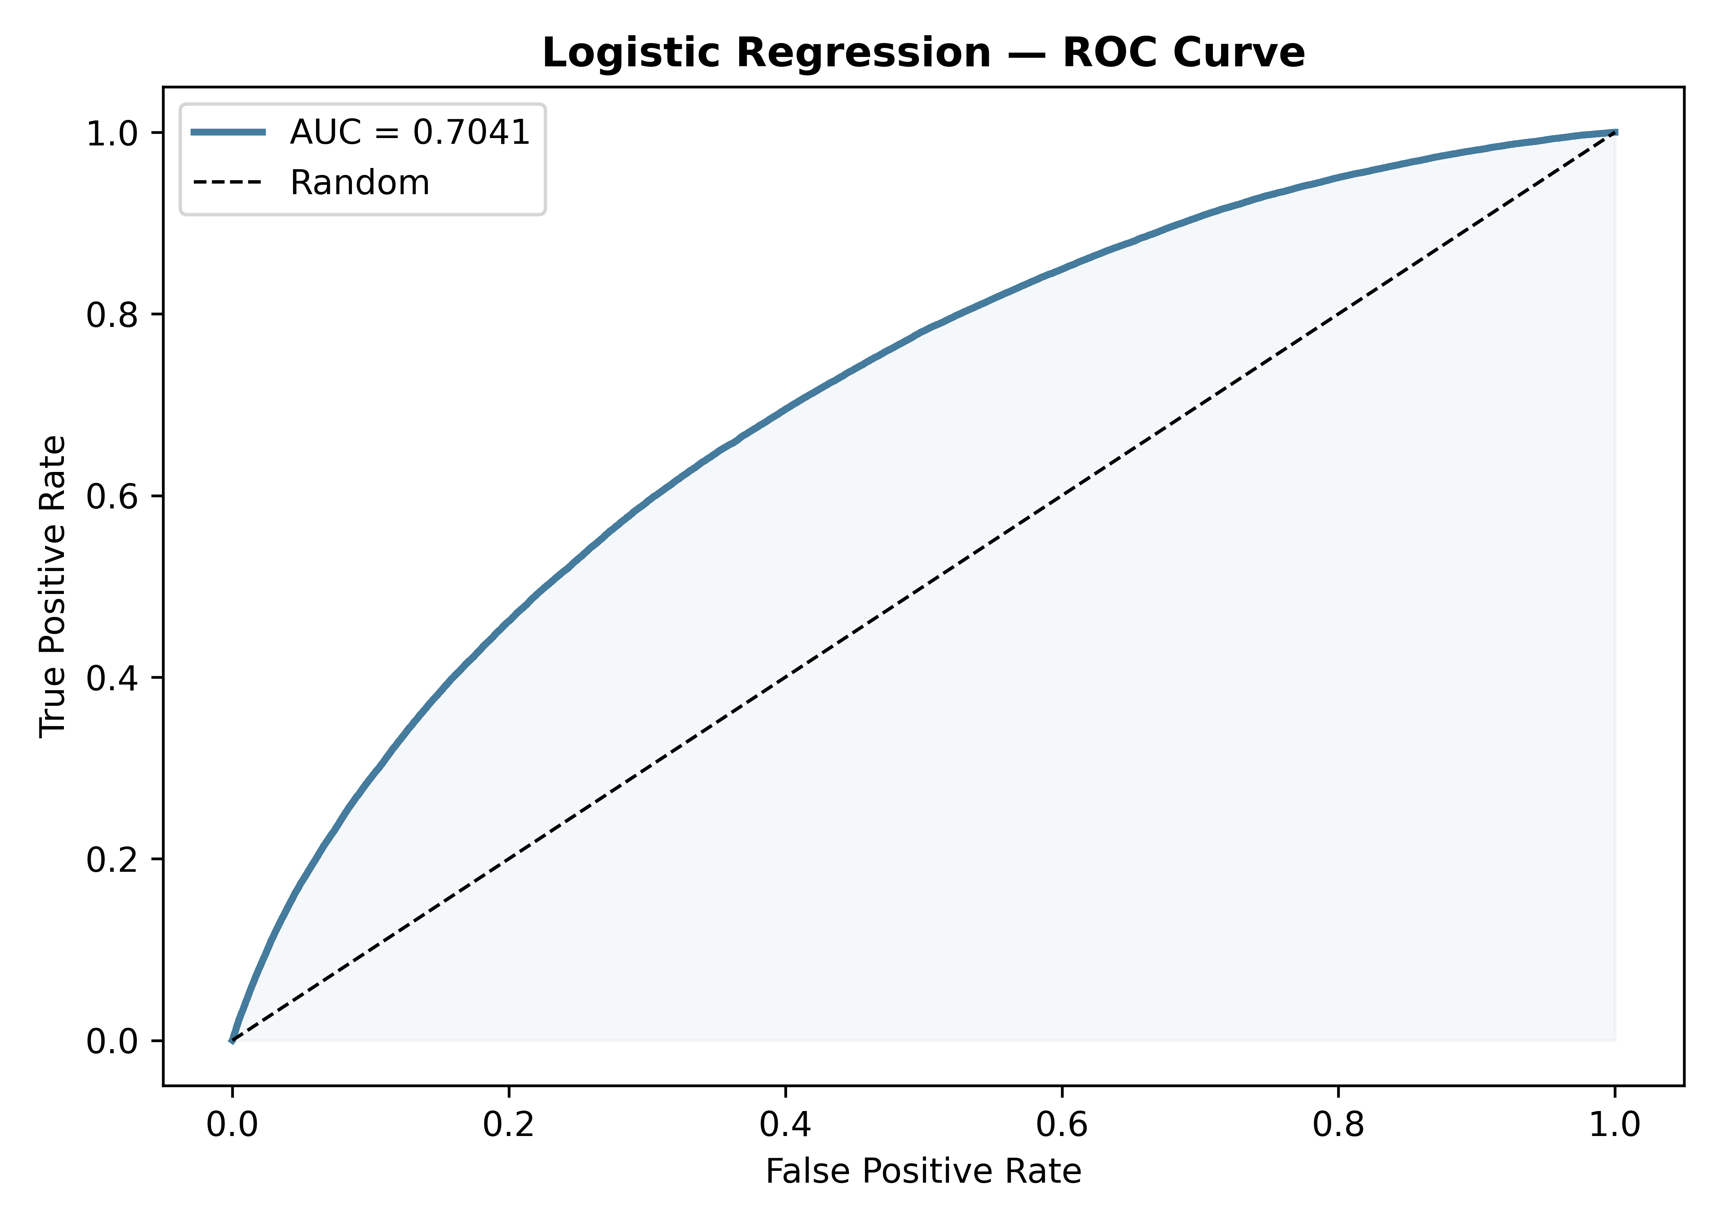
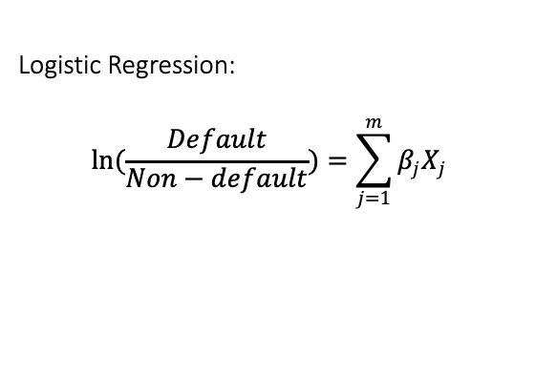
Model Performance
Logistic Regression:
$$ln(\frac{Default}{Non−default})=\sum_{j=1}^{m}{β_{j}X_{j}}$$
Metric | Logistic Regression | Industry Benchmark
AUC-ROC | 0.70 | > 0.70 = Good
KS Statistic | 0.30 | > 0.30 = Acceptable
Gini Coefficient | 0.40 | > 0.40 = Good

Slide 6
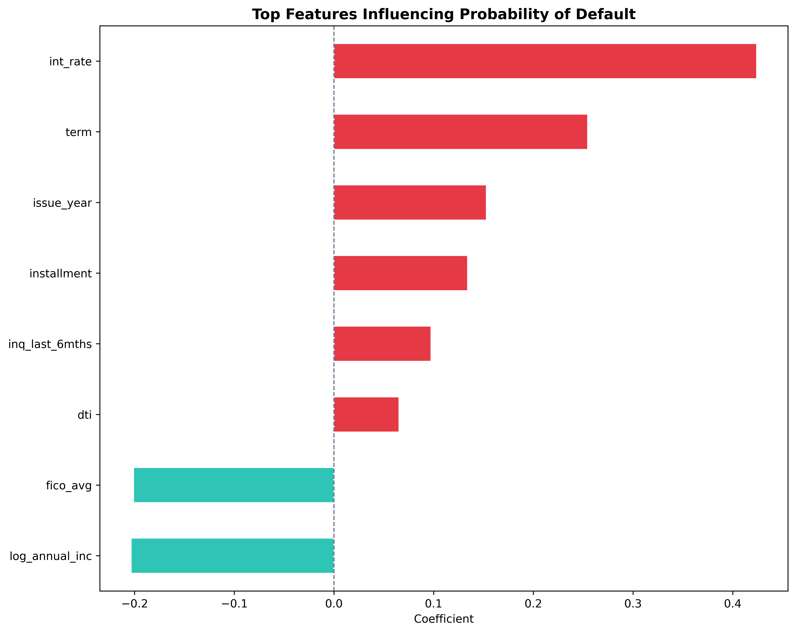
Model Performance
Interpretation of coefficients
Positive coefficient: higher value indicates higher probability of default
Negative coefficient: smaller value indicates lower probability of default

Slide 7
Key Risk Drivers
Interest Rate
↑ Risk
Term (60 months)
↑ Risk
High-rate loans price in risk — and it materialises.
Longer exposure window → more default opportunities.
Installments
↑ Risk
DTI
↑ Risk
Stretched borrowers lack capacity to absorb shocks.
High DTI → more default opportunities.
FICO Score
↓ Risk
Annual Income (log)
↓ Risk
Strongest single predictor of repayment.
Higher income = stronger repayment capacity.

Slide 8
Business Implications & Recommendations
1
Underwriting Threshold
2
Risk-Based Repricing
Decline or manually review applications scoring in the top PD decile.
Grade D/E/F/G (a correlated feature with FICO) loans may be under-priced relative to actual default rates. Review spread adequacy for high-DTI + low-FICO segments.
3
DTI / Income Caps
4
Vintage Monitoring
Introduce hard DTI caps (e.g. 40%) for 60-month loans and require income verification for applicants with FICO < 650.
Monitor annual cohort performance. 2007–2009 vintages showed 40%+ charge-off rates. But this is due to macroeconomic event (financial crisis in 2009).
Set portfolio-level vintage limits.

