Slide 1
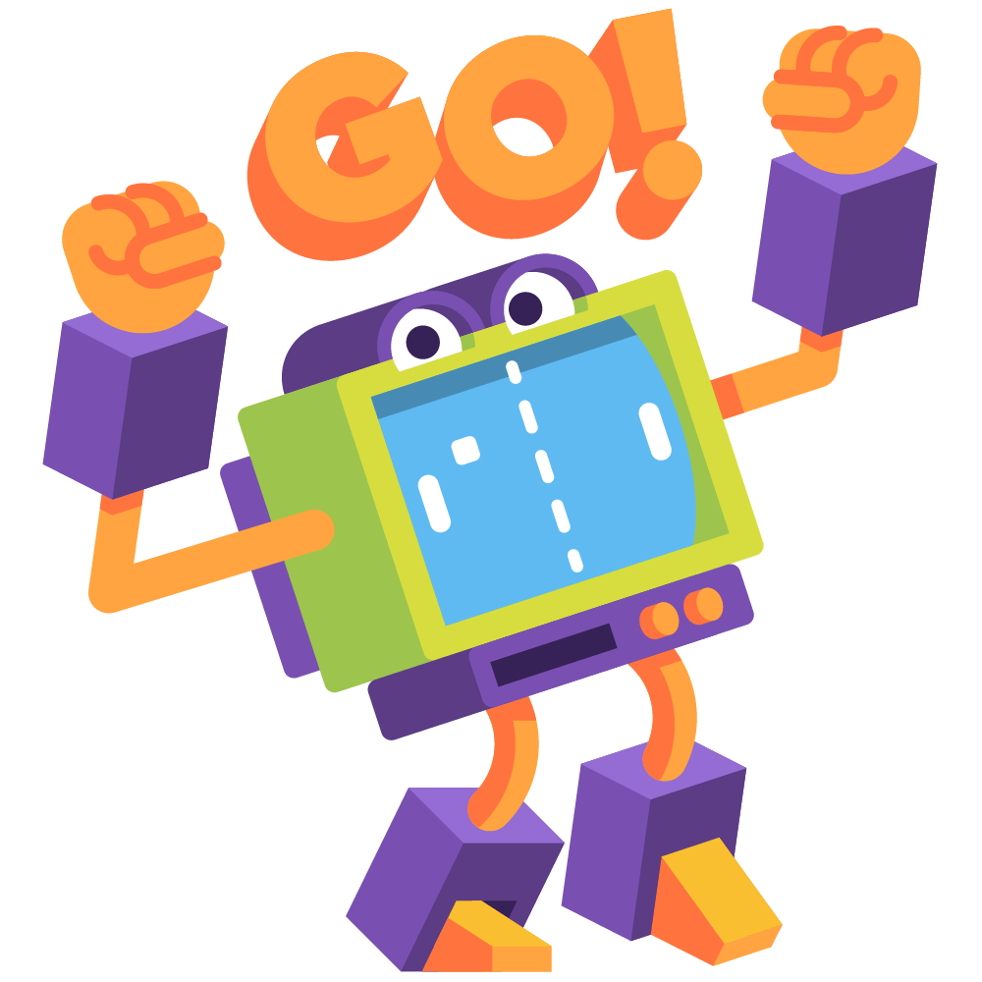

ConvAI2 Competition The task
Organizers: Mikhail Burtsev, Varvara Logacheva, Valentin Malykh, Ryan Lowe, Iulian Serban, Shrimai Prabhumoye, Emily Dinan, Douwe Kiela, Alexander Miller, Kurt Shuster, Arthur Szlam, Jack Urbanek and Jason Weston.
Advisory board: Yoshua Bengio, Alan W. Black, Joelle Pineau, Alexander Rudnicky, Jason Williams.
Speaker:
Jason Weston, Facebook AI Research

Slide 2

COMPETItiON AIM: SHARED TASK TO FIND BETTER Chitchat DIALOGUE MODELS
Few available datasets for non-goal-oriented dialogue (chit-chat).
Currently no standard evaluation procedure.
ConvAI2 Goals:
A concrete scenario for testing chatbots
A standard evaluation tool
datasets are open source
baselines and evaluation code (automatic + MTurk) are open source
encourage all competitors to open source code, winner must be

Slide 3


Convai2 : conversational AI challenge
This is the second ConvAI Challenge.
Last year focused on dialogue based on a news/Wikipedia article.
This year we aim to improve over last year:
Providing a dataset from the beginning, PersonaChat
Making the conversations more engaging for humans
Clearer evaluation process (automatic evaluation, followed by human eval)

Slide 4

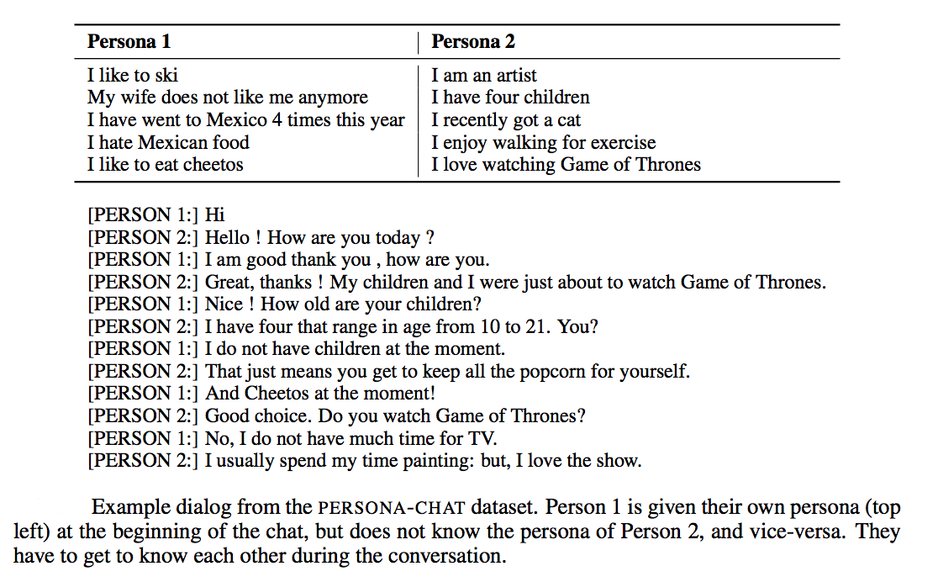

Personachat dataset
(Zhang et al., 2018)
http://parl.ai/
The dataset consists of
164,356 utterances
in 11k dialogs,
over 1155 personas

Slide 5

COMPETItiON AIM: SHARED TASK TO FIND BETTER Chitchat DIALOGUE MODELS
Common issues with chit-chat models include:
(i) no consistent personality (Li et al., 2016)
(ii) no long-term memory; in seq2seq last lines of dialogue are input (Vinyals et al., 2015)
(iii) tendency for generic responses, e.g. ``I don’t know’’ (Li et al., 2015).
ConvAI2 aims to find models that address those issues.

Slide 6



Prize
The winning entry will receive $20,000 in Mechanical Turk funding – in order to encourage further data collection for dialogue research.

Slide 7


schedule
Competitors submit models until Sep 30th
Evaluated on hidden test set via automated metrics (PPL, hits@1, F1).
Leaderboard visible to all competitors.
`Wild’ live evaluation on Messenger/Telegram can be used to tune models.
Sep 30th: system locked
Best 7 performing systems make it to the next round
Evaluated using Mechanical Turk and the `wild’ evaluation
Winners announced at NeurIPS 2018.

Slide 8

rules
Competitors must indicate which training sources are used
Can augment training with other data as long as publicly released (and hence, reproducible)
Competitors must provide their source code
so hidden test set evaluation can be computed
so that the competition has further impact in the future
Code can be in any language but a thin python wrapper must be provided in order to work with our evaluation code via ParlAI’s interface.

Slide 9
