Slide 1


ConvAI2 Competition: FUTURE WORK
Speaker: Jason Weston
Facebook AI Research

Slide 2

Lessons?
Pre-trained generative transformers work well!
But not just about perplexity -- search strategy important too!

Slide 3
Lessons?
Pre-trained transformers + good search works well!
Retrieval models fared worse in the competition, but no method with hits@1 > 0.7 was tried.
To our eyes, when they work, they are still more exciting to read..

Slide 4
Lessons?
Pre-trained transformers + good search works well!
Retrieval models fared worse in the competition, but no method with hits@1 > 0.7 was tried.
To our eyes, when they work, they are still more exciting to read..
New representations are coming all the time,… e.g., BERT.. we expect further improvements
BUT.. dialogue is certainly not yet solved…

Slide 5
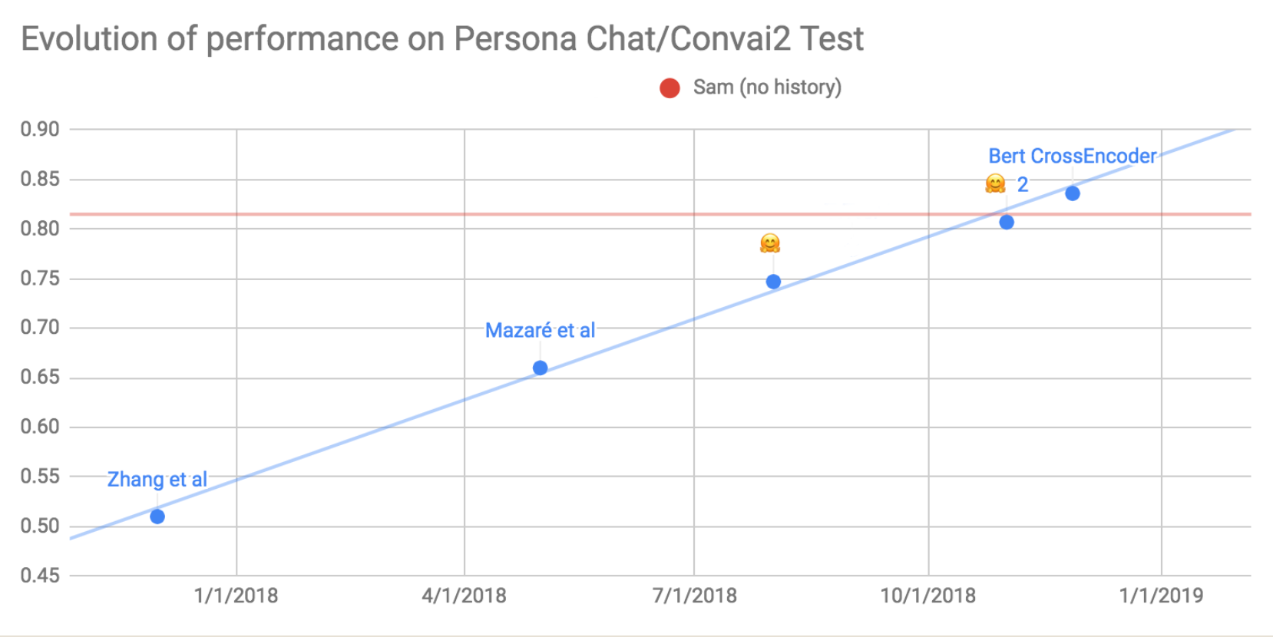
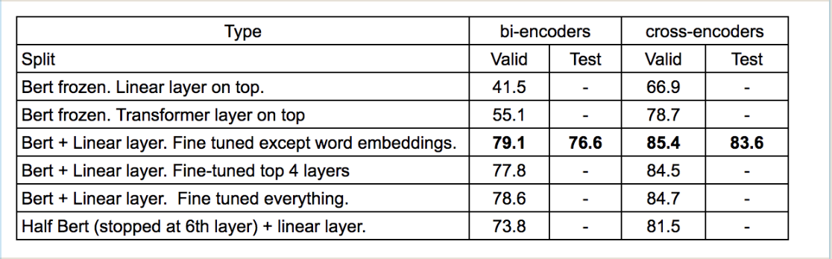
BERT on convai2 (Samuel humeau @ FAIR)
Human (Sam) with no history

Slide 6

Lessons?
How good are the automated metrics?
There was some correlation between PPL and hits@1and human evaluation

Slide 7
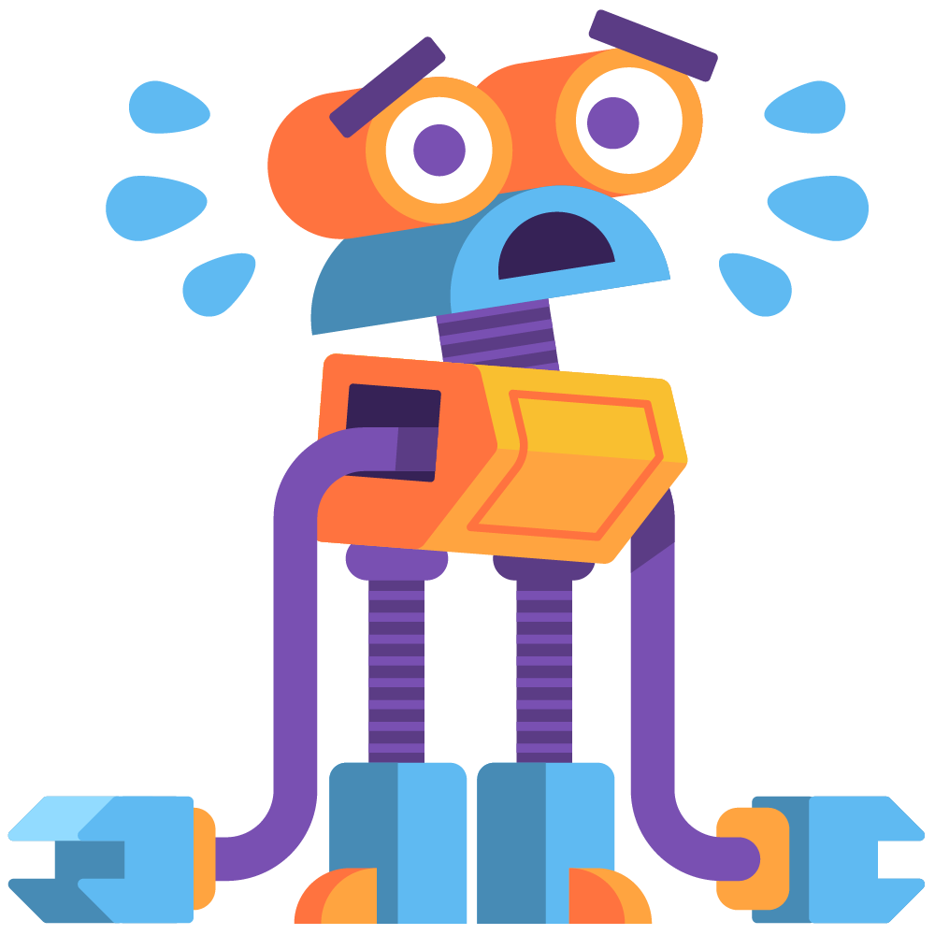

Lessons?
How good are these automated metrics?
There was some correlation between PPL and hits@1and human evaluation
However, Major ISSUE with F1:
Mega-dumb baseline pick a combination of frequent words:
“i am you to do the a, and your is like!?”
each turn would give the best F1 score in the competition
(19.6 on the test set and 20.5 on the valid set compared to Hugging Face’s 19.5 and 19.1)
In any case, shown not be correlated well with human metrics (Liu et al, 2016)

Slide 8
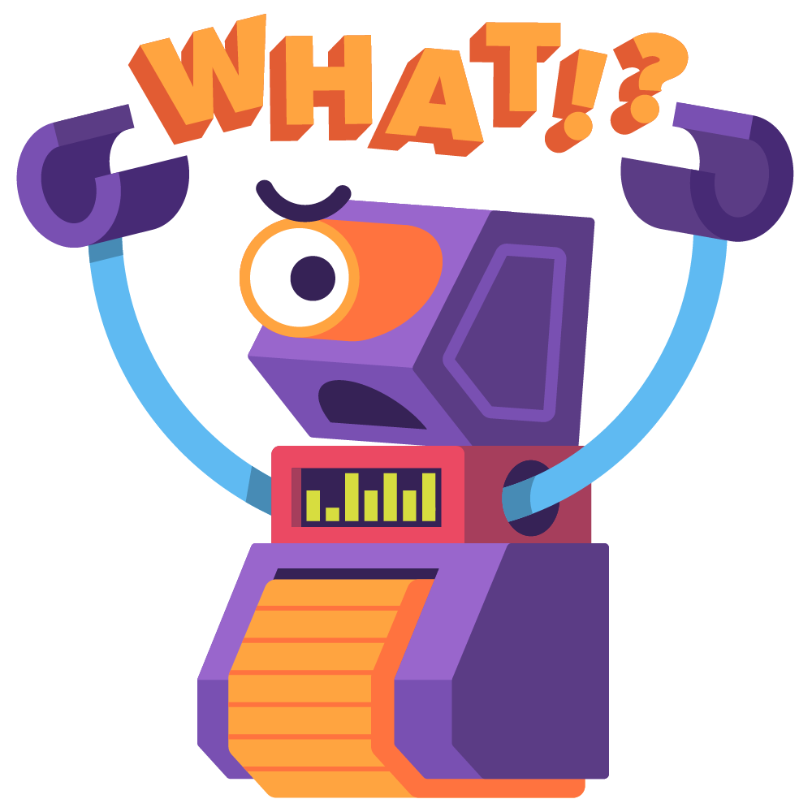
Lessons?
How good are these automated metrics?
Even PPL and hits@1 do not evaluate some aspects of multi-turn dialogue well, e.g. repetition, consistency
PPL does not evaluate the search component (e.g. beam search)
Hard to compare retrieval and generation models (hits@1 vs. PPL)

Slide 9
Lessons?
How good are these automated metrics?
Even PPL and hits@1 do not evaluate some aspects of multi-turn dialogue well, e.g. repetition, consistency
PPL does not evaluate the search component (e.g. beam search)
Hard to compare retrieval and generation models (hits@1 vs. PPL)
How can we better automatically evaluate multi-turn performance?
Repetition, question-asking, consistency, memory

Slide 10
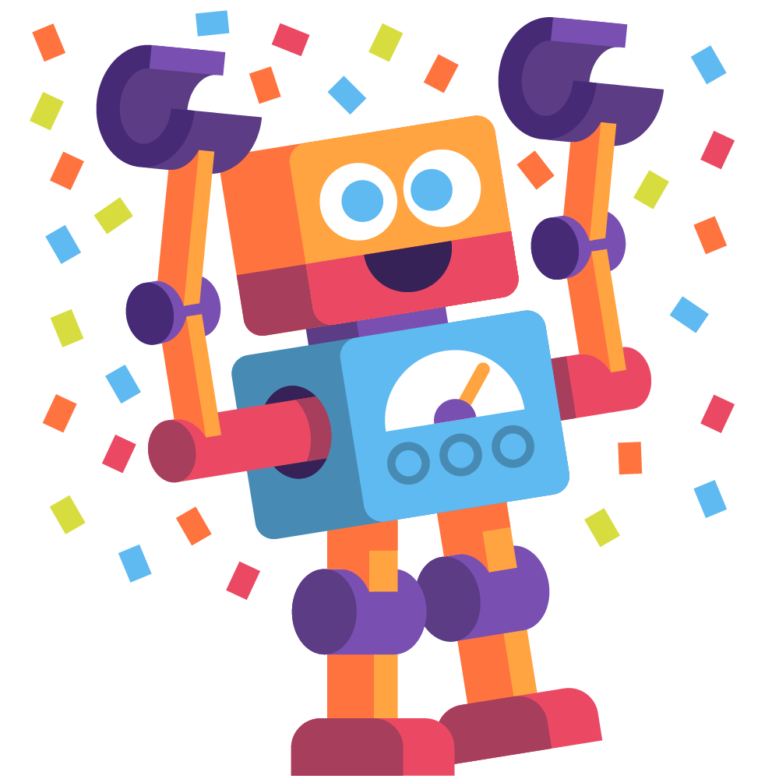
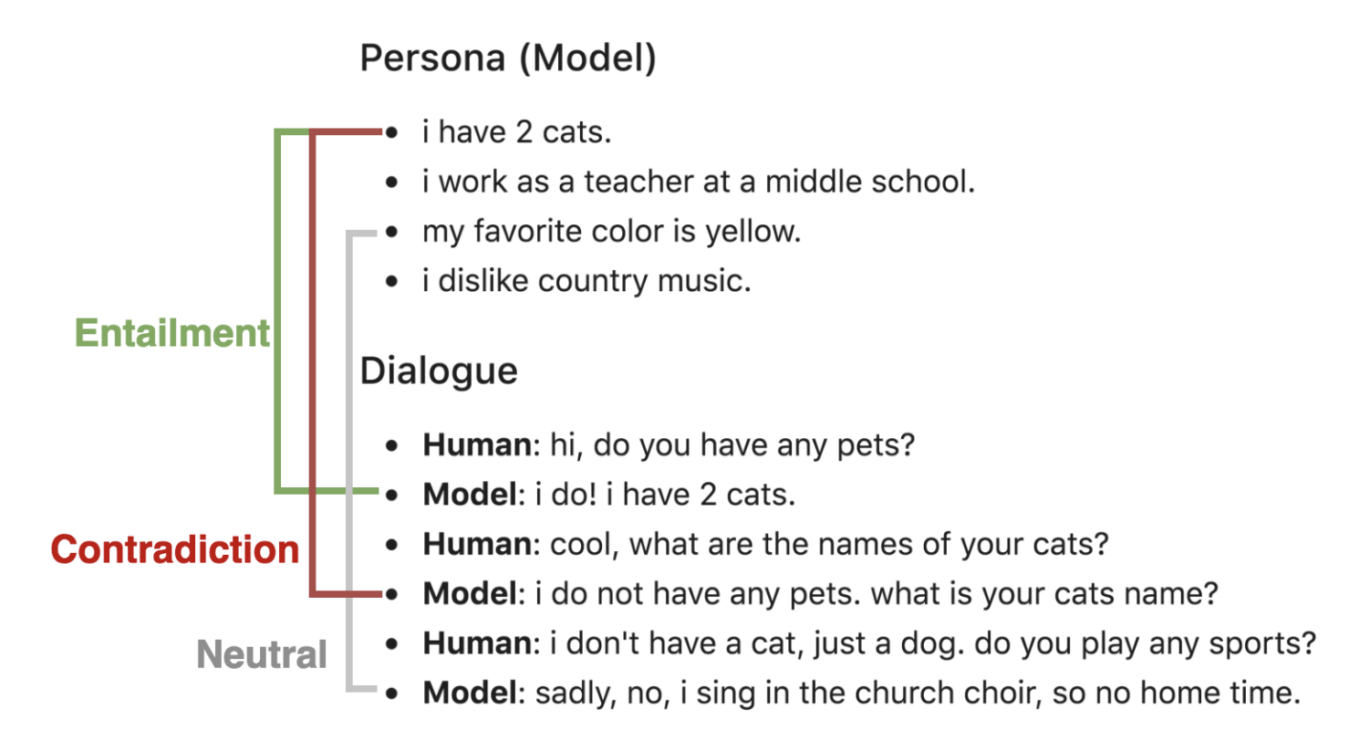
Lessons?
Models are not consistent / we do not measure consistency:
Recent solution: Dialogue NLI (Welleck et al., 2018)

Slide 11
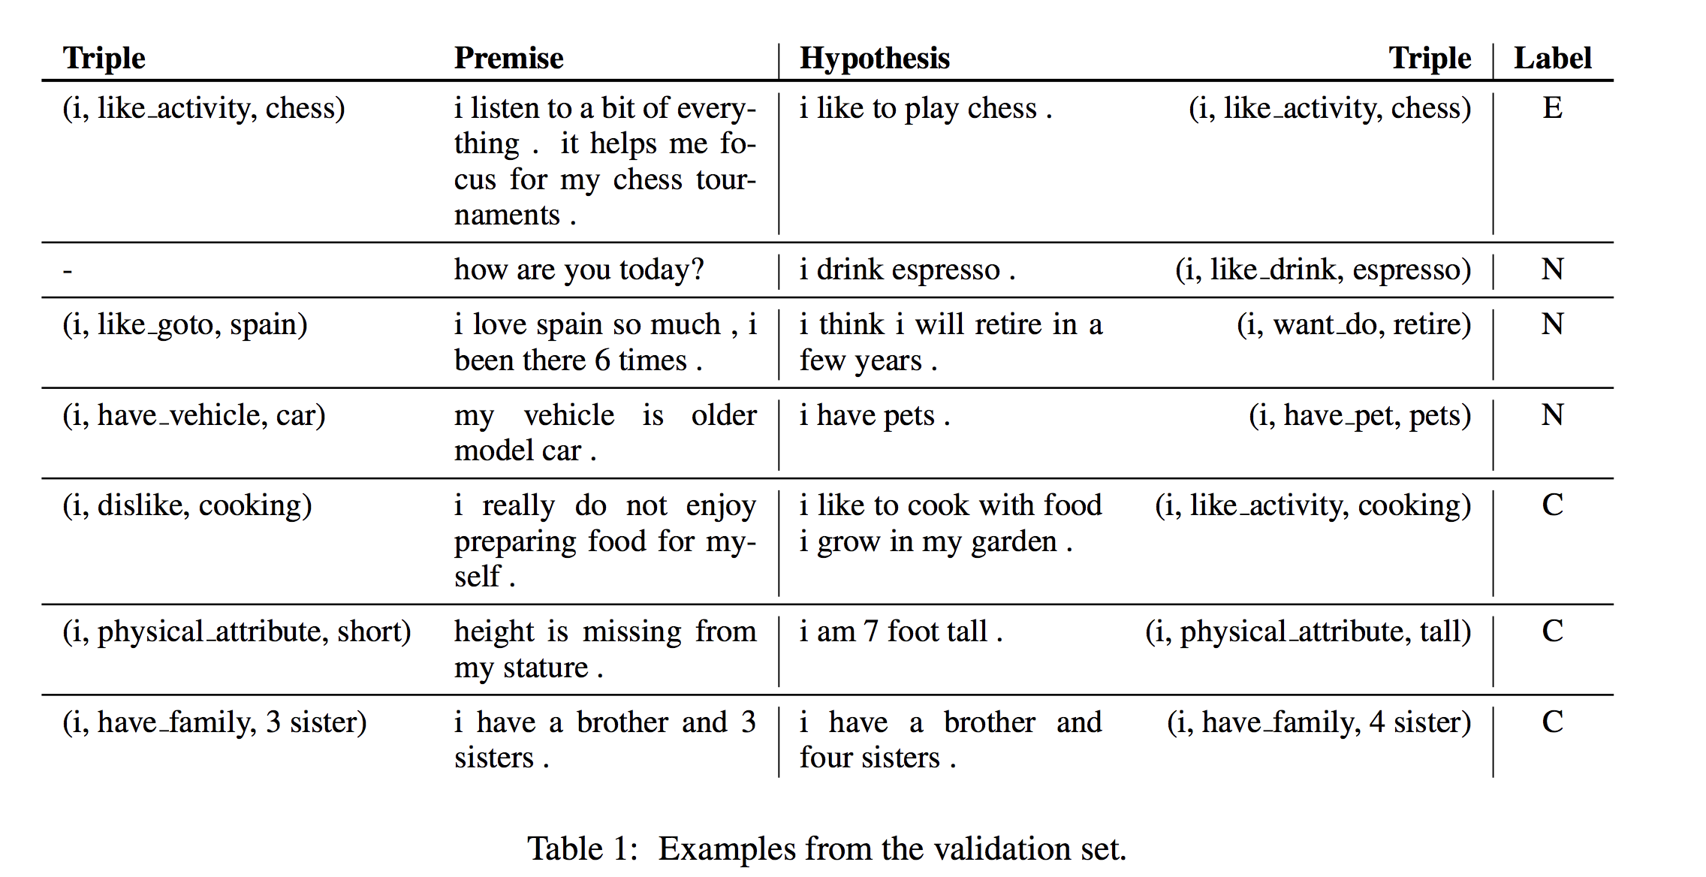
Dialogue NLI for consistency (Welleck et al., 2018)

Slide 12
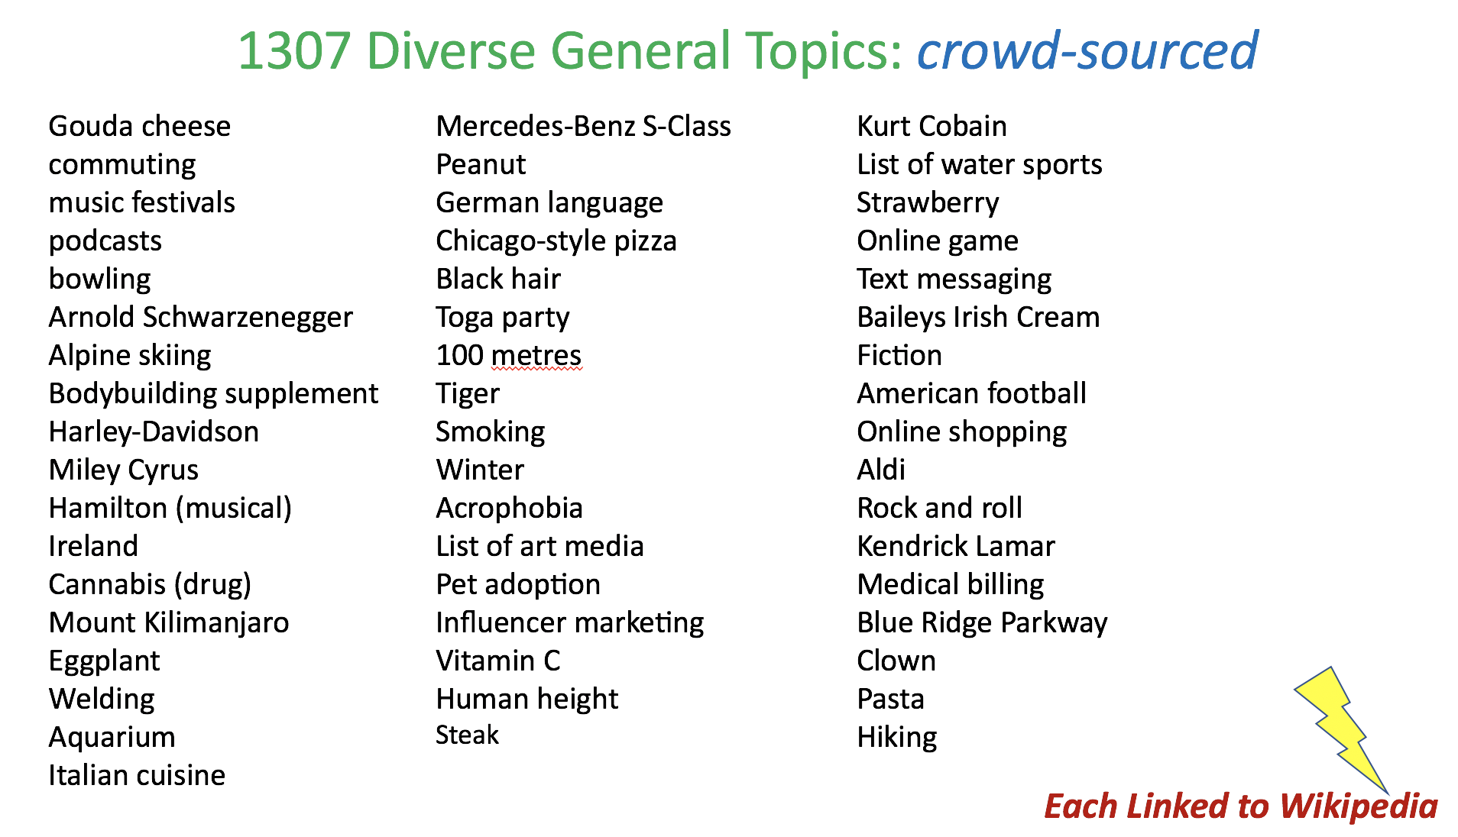

NEXT STEPS?
PersonaChat is only a meet-and-greet task, doesn’t have topic depth
More sophisticated task: chat about topics
http://parl.ai/

Slide 13

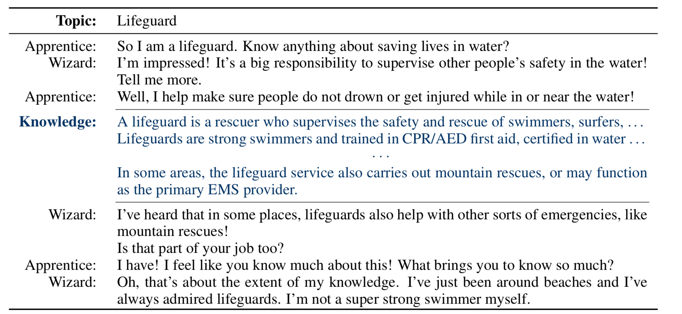
Dataset Examples
Wizard of Wikipedia (Dinan et al., 2018)

Slide 14
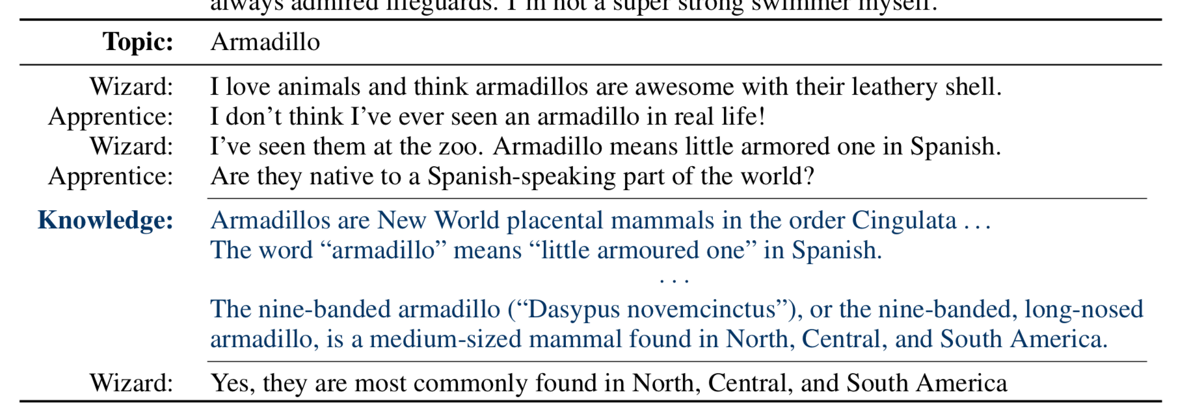
Dataset Examples
Wizard of Wikipedia (Dinan et al., 2018)

Slide 15
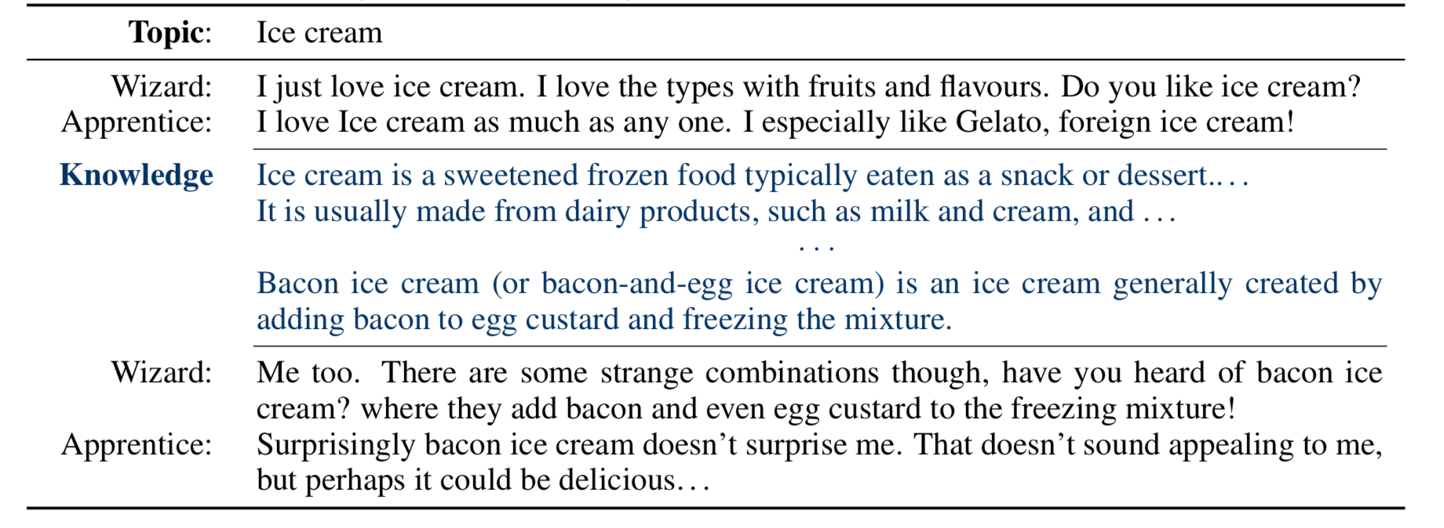
Dataset Examples
Wizard of Wikipedia (Dinan et al., 2018)

Slide 16
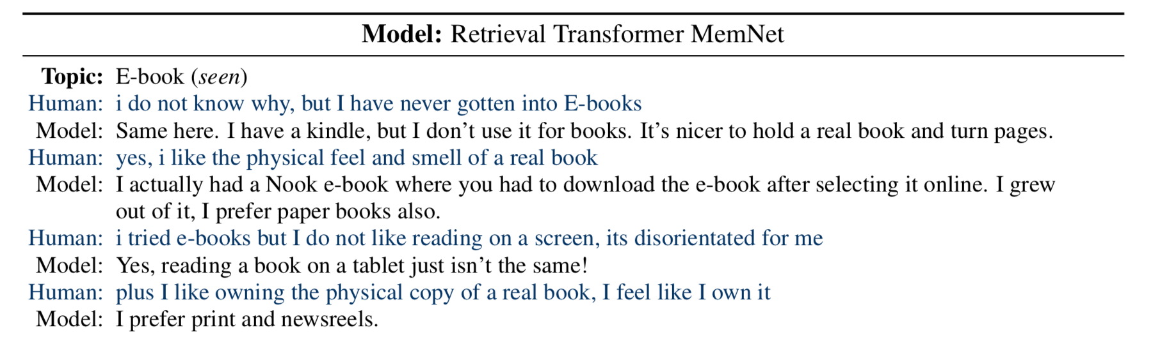
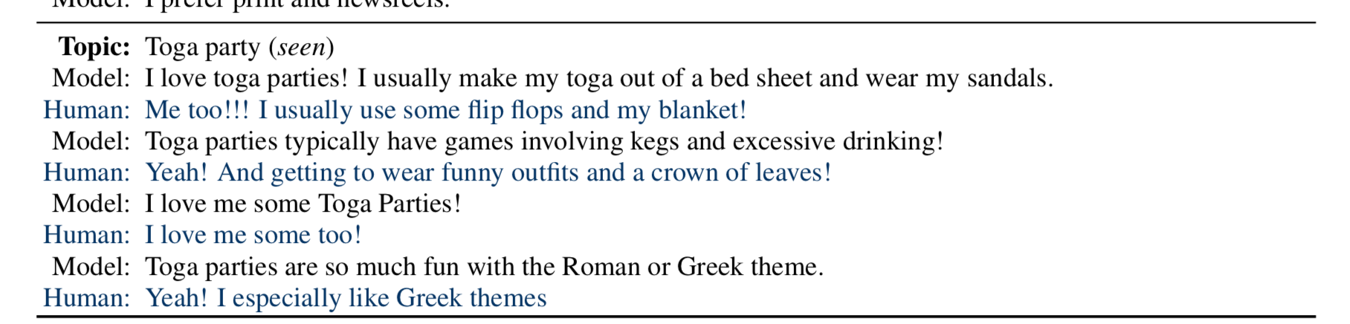
BASELINE MODELS
Wizard of Wikipedia (Dinan et al., 2018)

Slide 17
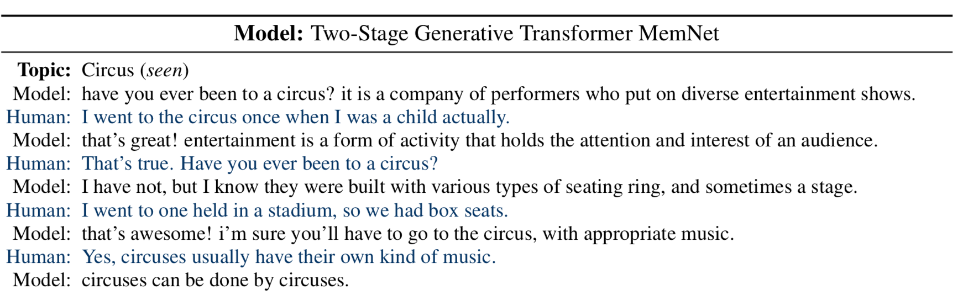
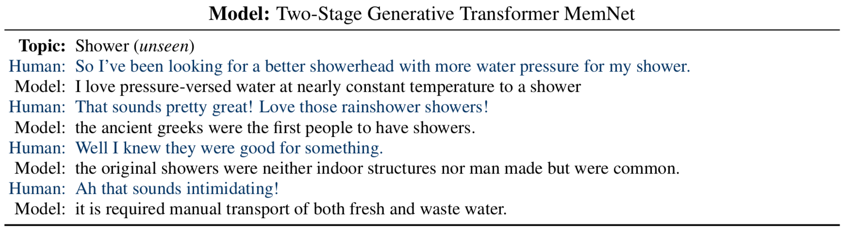
BASELINE MODELS
Wizard of Wikipedia (Dinan et al., 2018)

Slide 18
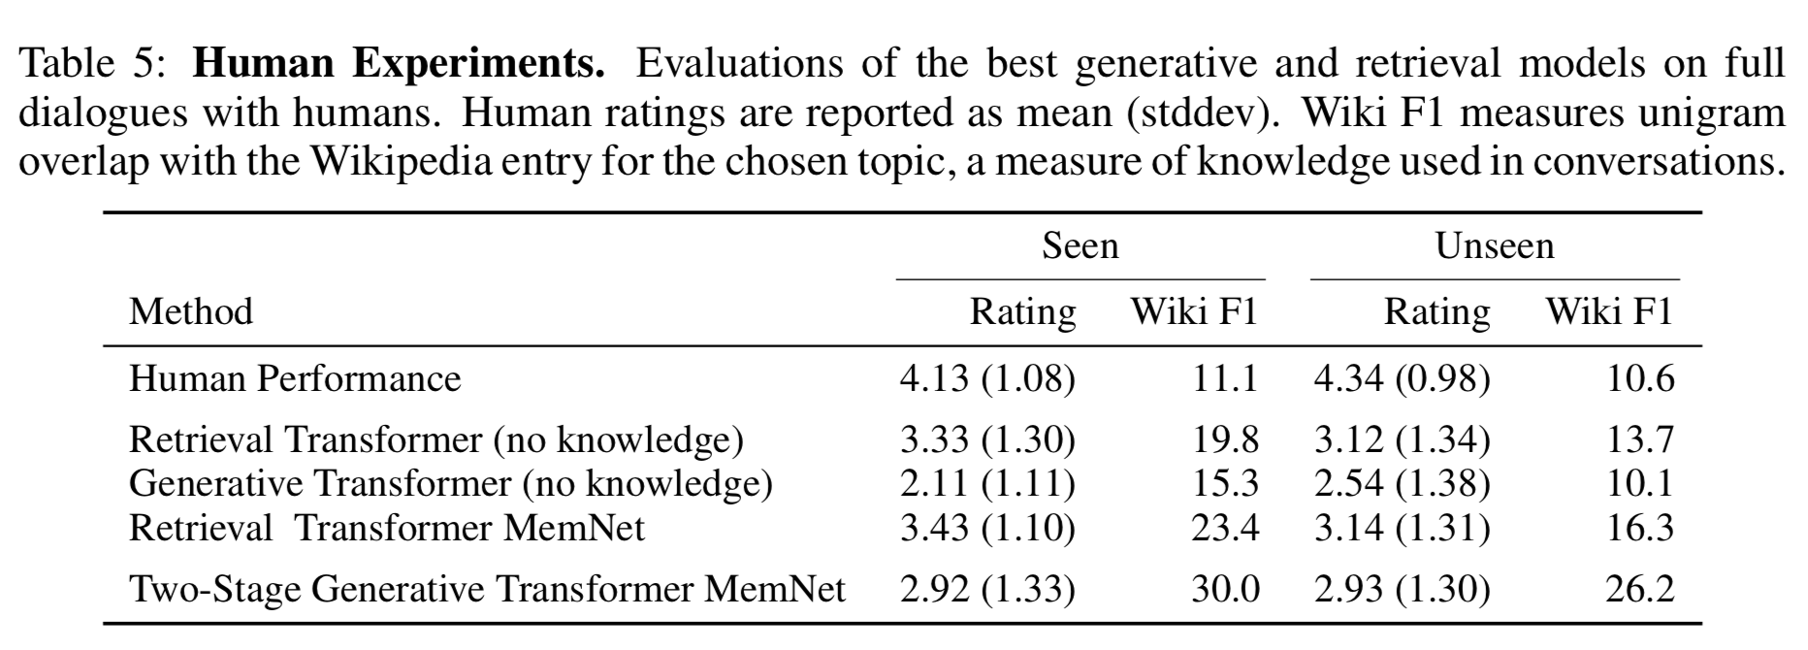
BASELINES
Generative models aren’t as engaging on seen, but can generalize to unseen.
Future competition: find improved models?

