Slide 1
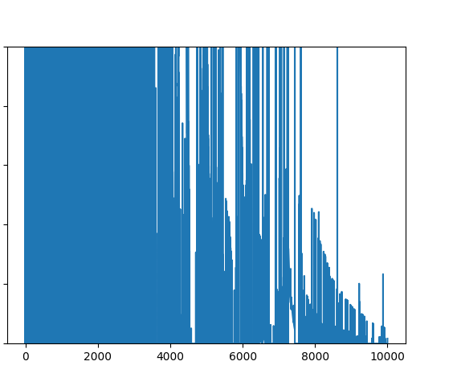
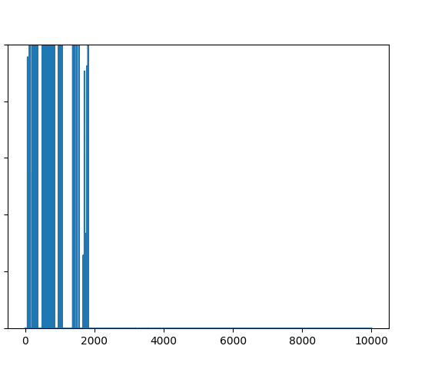
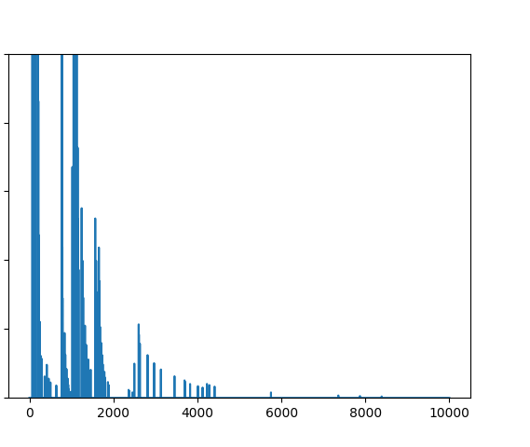
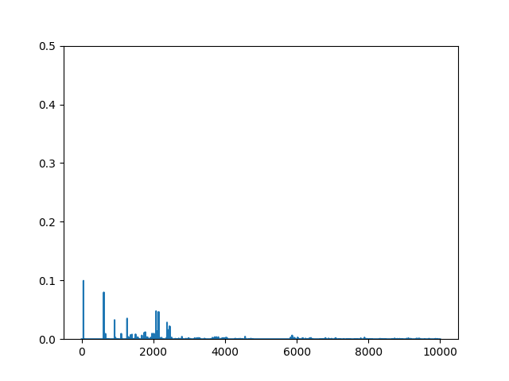
a
b
0.5
0.5
Figure 1. Q-value difference for each simulation iteration. (a) Using SARSA, represent player A’s Q-values, corresponding to state s and action S. (b-d) Using friend-Q, foe-Q, and CE-Q, respectively, represent player A’s Q-values, corresponding to state s, when player A takes action S and player B sticking. Initial alpha = 0.5, minimum alpha = 0.001, initial epsilon = 0.5, minimum epsilon = 0, gamma = 0.9, alpha decay = 0.9995, epsilon decay = 0.9995, random seed = 1.
0.4
0.4
0.3
0.3
Q-value difference
Q-value difference
0.2
0.2
0.1
0.1
0.0
0.0
0.2
0.4
0.6
0.8
1.0
0.0
0.0
0.2
0.4
0.6
0.8
1.0
Simulation Iteration
$$×$$
Simulation Iteration
$$×$$
10⁴
10⁴
c
d
0.5
0.5
0.4
0.4
0.3
0.3
Q-value difference
Q-value difference
0.2
0.2
0.1
0.1
0.0
0.0
0.2
0.4
0.6
0.8
1.0
0.0
0.0
0.2
0.4
0.6
0.8
1.0
Simulation Iteration
$$×$$
Simulation Iteration
$$×$$
10⁴
10⁴

Slide 2
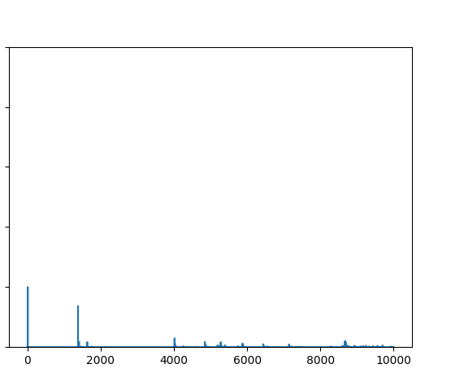
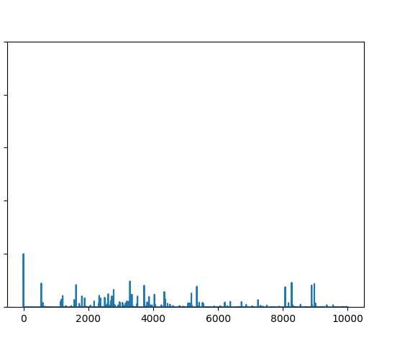
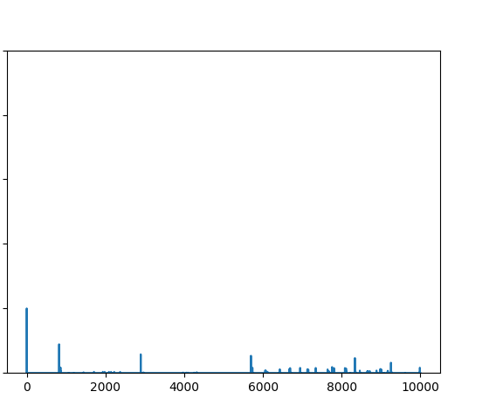
a
b
0.5
0.5
Figure 2. Q-value difference for each simulation iteration using CE-Q, represent player A’s Q-values, corresponding to state s, when player A takes action S and player B sticking. Initial alpha = 0.5, minimum alpha = 0.001, initial epsilon = 0.5, minimum epsilon = 0, gamma = 0.9, random seed = 1. (a) alpha decay = 0.9995, epsilon decay = 0.9995. (b) alpha decay = 0.9995, epsilon decay = 0.9999. (c) alpha decay = 0.9999, epsilon decay = 0.9995. (d) alpha decay = 0.9999, epsilon decay = 0.9999.
0.4
0.4
0.3
0.3
Q-value difference
Q-value difference
0.2
0.2
0.1
0.1
0.0
0.0
0.2
0.4
0.6
0.8
1.0
0.0
0.0
0.2
0.4
0.6
0.8
1.0
Simulation Iteration
$$×$$
Simulation Iteration
$$×$$
c
10⁴
d
10⁴
0.5
0.5
0.4
0.4
0.3
0.3
Q-value difference
Q-value difference
0.2
0.2
0.1
0.1
0.0
0.0
0.2
0.4
0.6
0.8
1.0
0.0
0.0
0.2
0.4
0.6
0.8
1.0
Simulation Iteration
$$×$$
Simulation Iteration
$$×$$
10⁴
10⁴

Slide 3
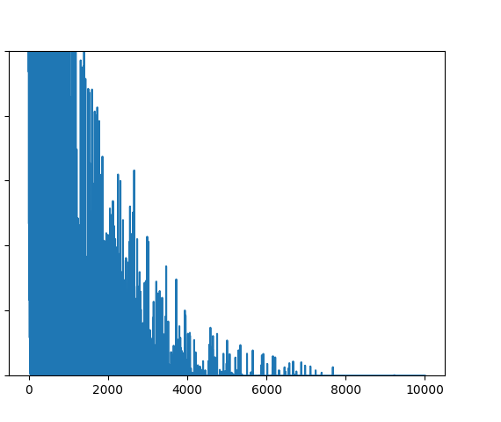
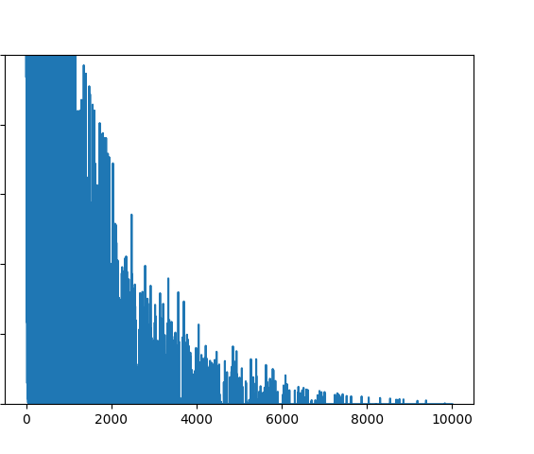
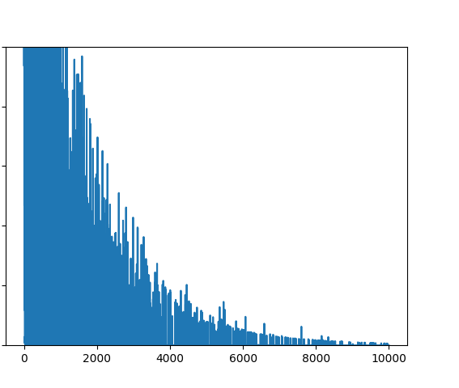
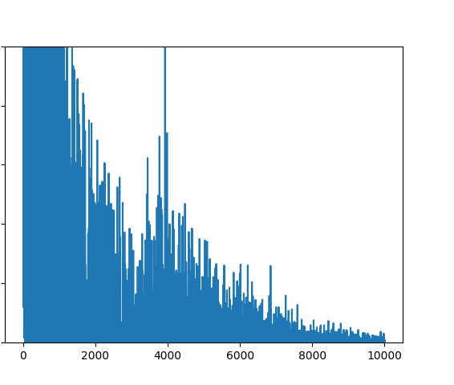
a
b
0.5
0.5
Figure 3. Overall RMS difference for each simulation iteration using CE-Q, represent player A’s Q-values, corresponding to state s, when player A takes action S and player B sticking. Initial alpha = 0.5, minimum alpha = 0.001, initial epsilon = 0.5, minimum epsilon = 0, gamma = 0.9, random seed = 1. (a) alpha decay = 0.9995, epsilon decay = 0.9995. (b) alpha decay = 0.9995, epsilon decay = 0.9999. (c) alpha decay = 0.9999, epsilon decay = 0.9995. (d) alpha decay = 0.9999, epsilon decay = 0.9999.
0.4
0.4
0.3
0.3
RMS error
RMS error
0.2
0.2
0.1
0.1
0.0
0.0
0.2
0.4
0.6
0.8
1.0
0.0
0.0
0.2
0.4
0.6
0.8
1.0
Simulation Iteration
$$×$$
Simulation Iteration
$$×$$
c
10⁴
d
10⁴
0.5
0.5
0.4
0.4
0.3
0.3
RMS error
RMS error
0.2
0.2
0.1
0.1
0.0
0.0
0.2
0.4
0.6
0.8
1.0
0.0
0.0
0.2
0.4
0.6
0.8
1.0
Simulation Iteration
$$×$$
Simulation Iteration
$$×$$
10⁴
10⁴

Slide 4
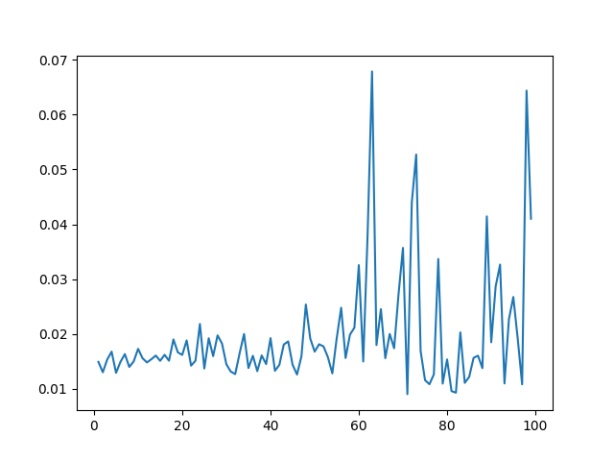
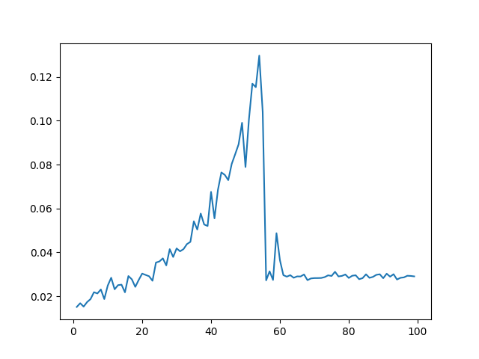
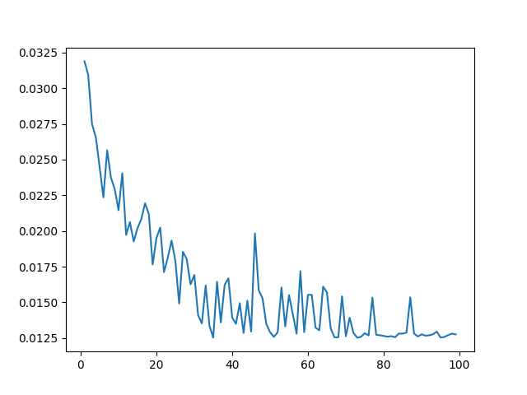
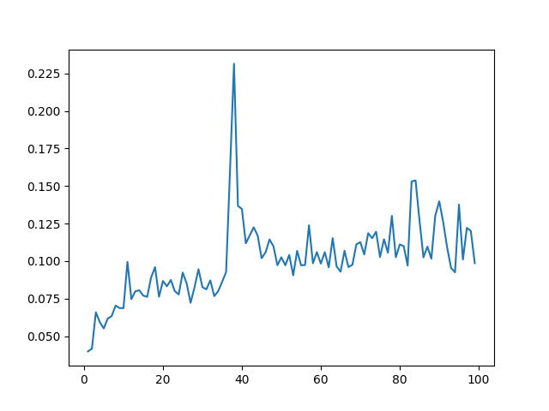
a
b
Figure 4. Average time consumption per 100 simulation iterations.(a) Using SARSA, represent player A’s Q-values, corresponding to state s and action S. (b-d) Using friend-Q, foe-Q, and CE-Q, respectively, represent player A’s Q-values, corresponding to state s, when player A takes action S and player B sticking. Initial alpha = 0.5, minimum alpha = 0.001, initial epsilon = 0.5, minimum epsilon = 0, gamma = 0.9, alpha decay = 0.9995, epsilon decay = 0.9995, random seed = 1.
Time per iteration (s)
Time per iteration (s)
0.0
0.2
0.4
0.6
0.8
1.0
0.0
0.2
0.4
0.6
0.8
1.0
Simulation Iteration
$$×$$
Simulation Iteration
$$×$$
10⁴
10⁴
c
d
Time per iteration (s)
Time per iteration (s)
0.0
0.2
0.4
0.6
0.8
1.0
0.0
0.2
0.4
0.6
0.8
1.0
Simulation Iteration
$$×$$
Simulation Iteration
$$×$$
10⁴
10⁴

