Slide 1

Stock Trading Database (CS-4347)
Jack Zumalt, Po-Yu Liu, Johnny Jiang, Olumayowa Labinjo

Slide 2

Overall Goal
Creating a database for stock exchange
Broker-client relationship
Client has money to invest
Stocks exist to be bought
Broker manages transaction
In order to accomplish this, we took the following approach.

Slide 3
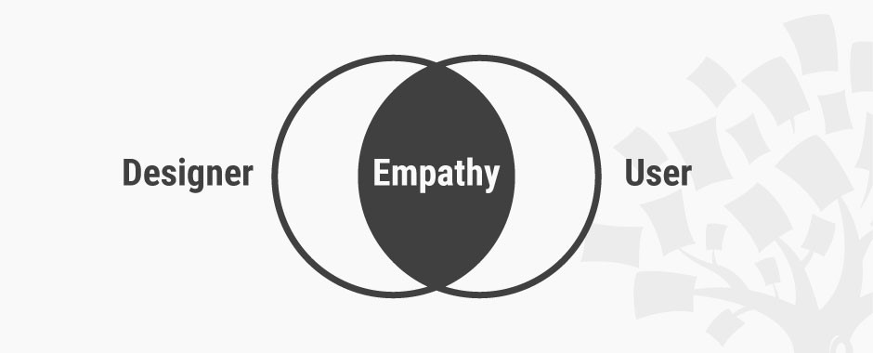
Design Approach
General approach
Identify the entities
Identify relationships
Describe the relationship
Add attributes
Actual Implementation
Come up with initial idea
Simplified our initial idea
Created entities & relationships
Refined and revised

Slide 4
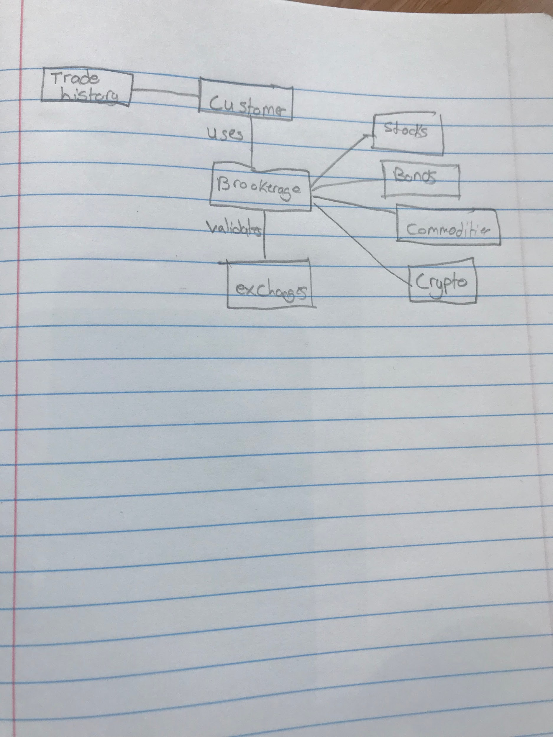
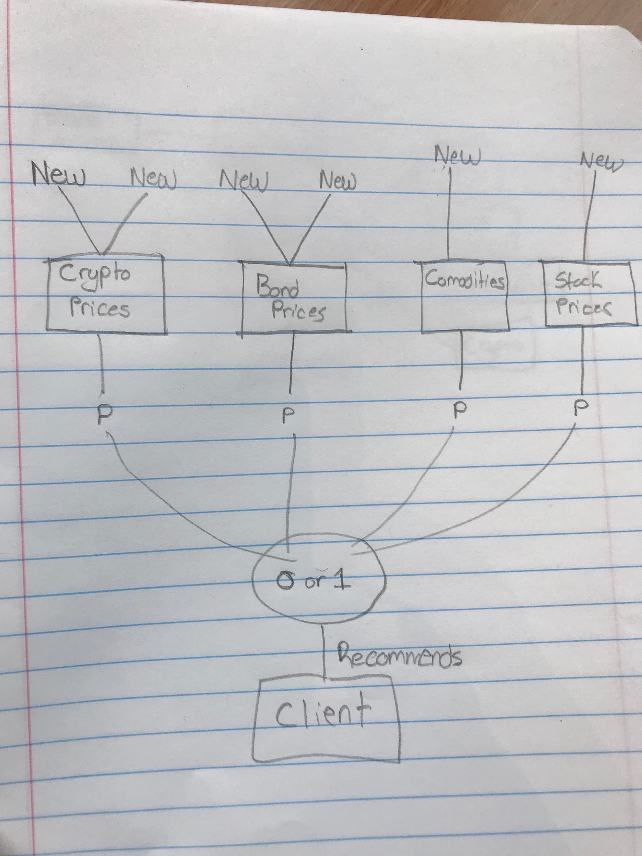
Conceptual Design Model

Slide 5
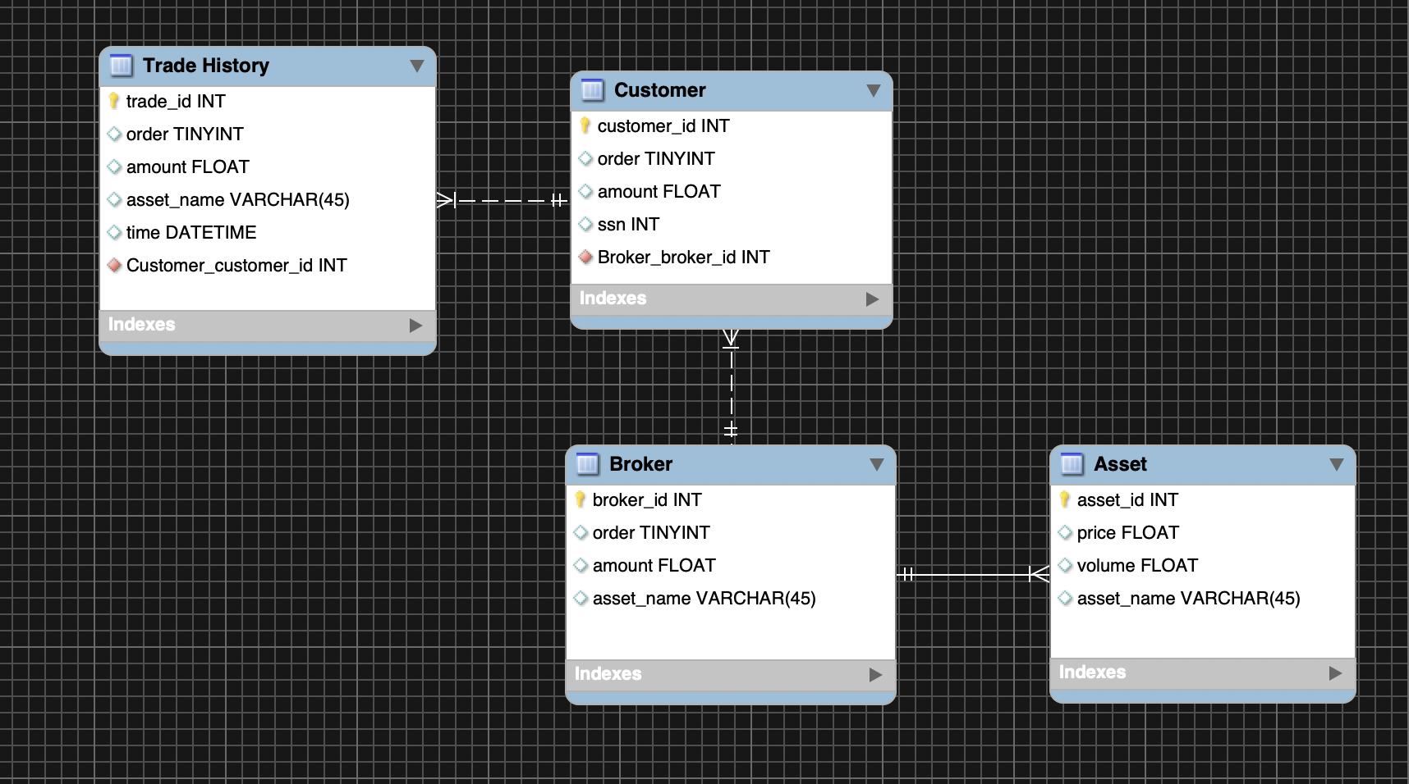
Entity Relationship Diagram

Slide 6
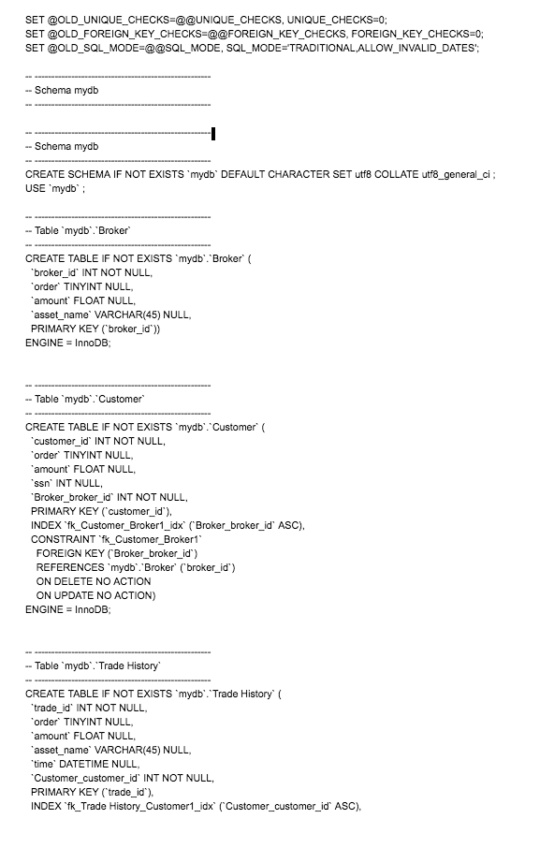
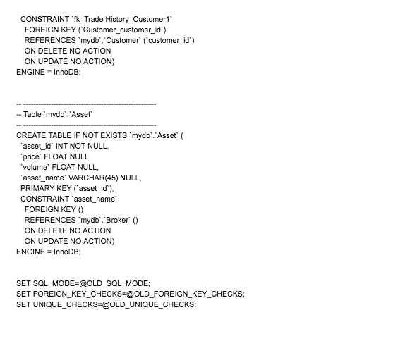
Forward Engineered DDL

Slide 7
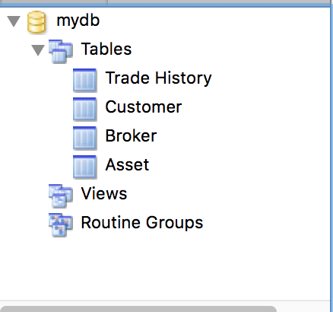
Schema

Slide 8
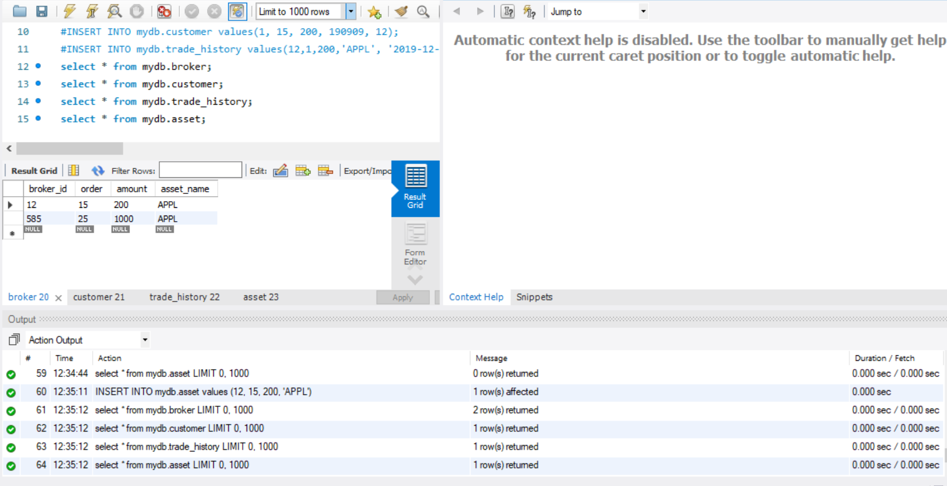
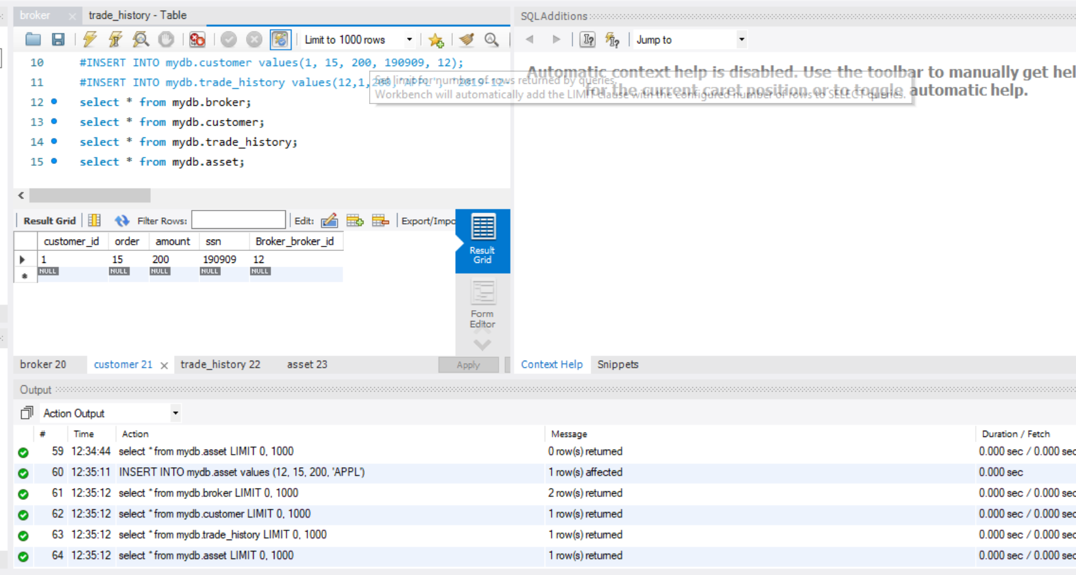
Sample Screenshots

Slide 9
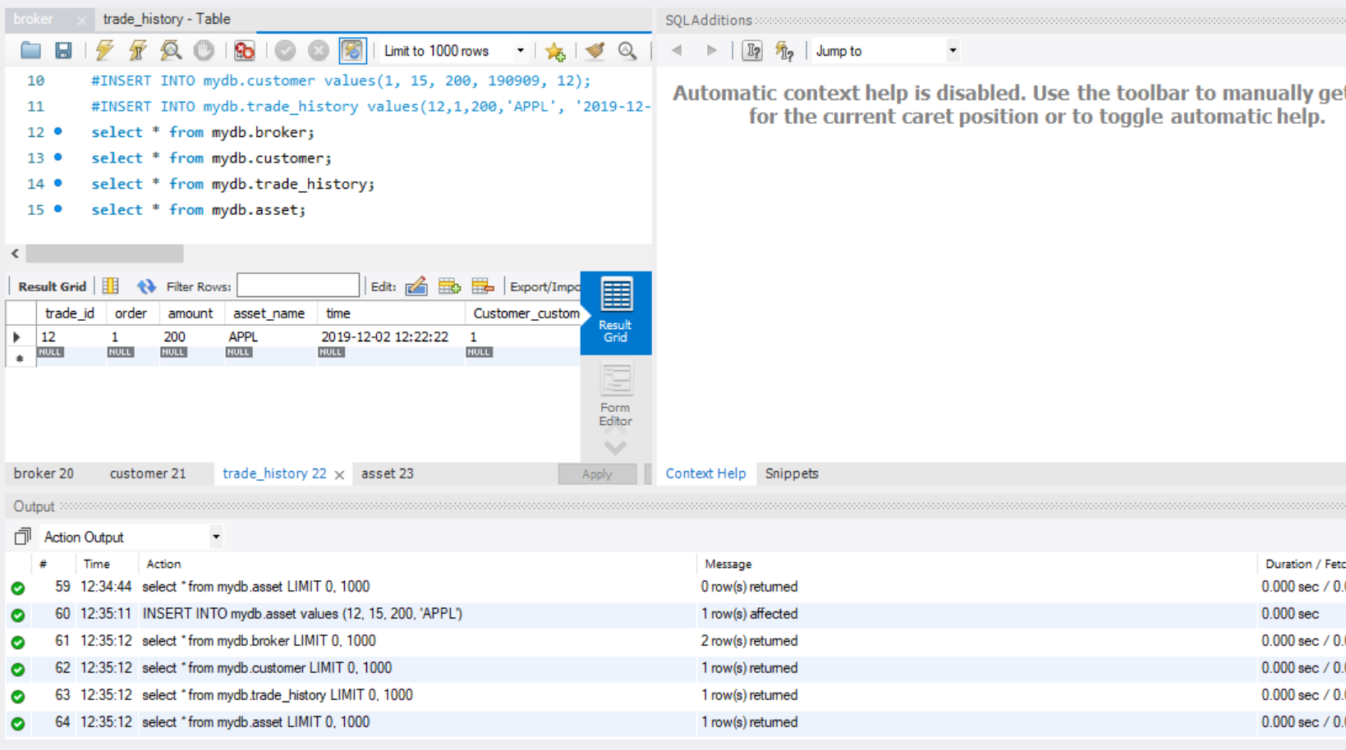
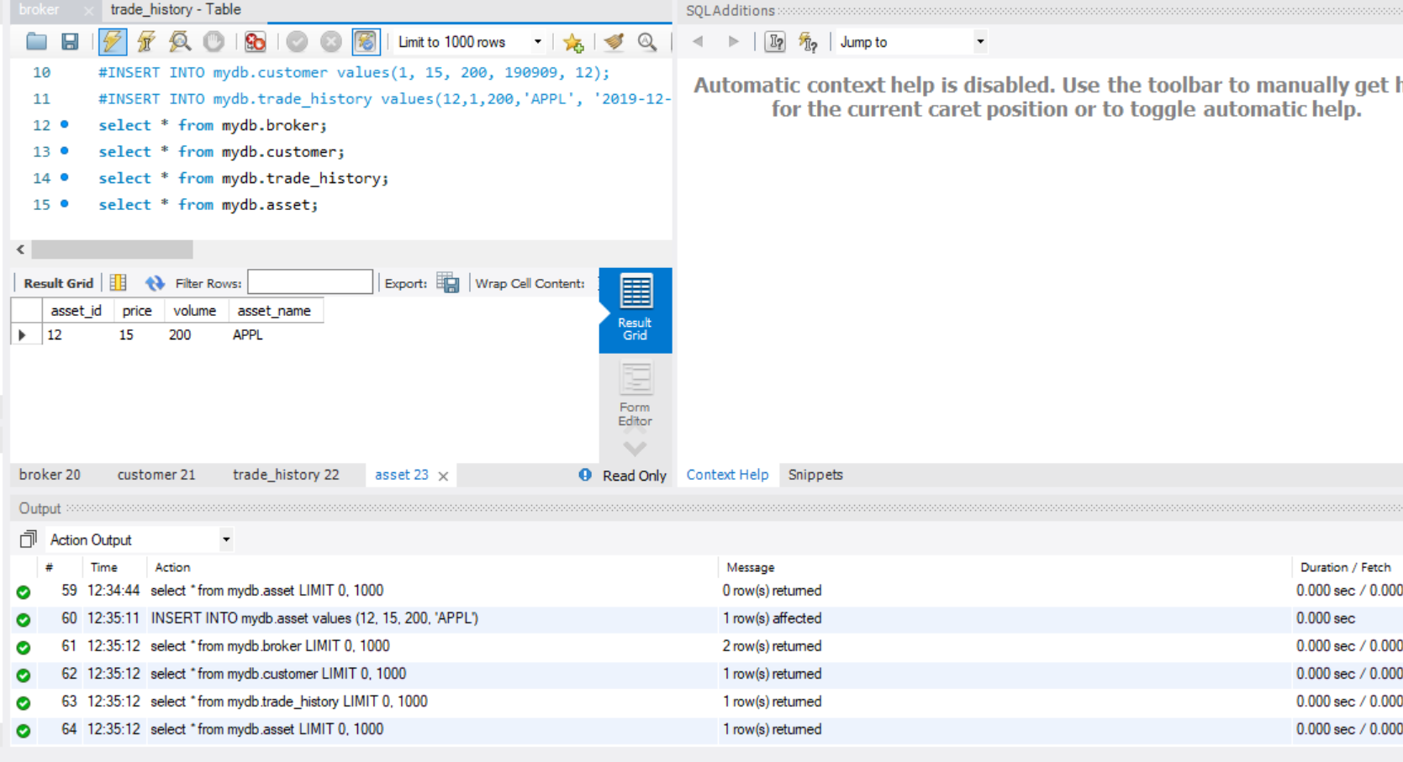
Sample Screenshots

Slide 10
Reverse Engineered ER Diagram
No changes were made to the schema

Slide 11

Lessons Learned
Working as a team to propose solution to Database project
Deciding candidate entities for our business domain.
Creating Entity Relationship Diagram.
Creating schema with given UML entity classes.
Delivering an SQL script that will create DB schema.

