Slide 1
Implementation
and
Applications
of Main-memory Hash-join
Xing Wei
simba_wei@stu.ecnu.edu.cn

Slide 2
01
Main-Memory Hash Joins on Multi-Core CPUs:
Tuning to the Underlying Hardware (ICDE 2013)
02
Design and Evaluation of Main Memory Hash Join Algorithm for Multi-core CPUs (SIGMOD 2011)
References
03
Optimizing Main-Memory Join on Modern Hardware (TKDE 2002)
04
Revisiting Reuse in Main Memory Database Systems (SIGMOD 2016)

Slide 3
Chapter Ⅰ
Introduction of Different Hash-join Algorithms

Slide 4
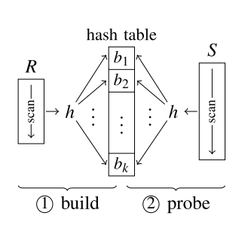
Canonical Hash Join Algorithm
“Application of hash to data base machine and its architecture,” New Generation Comput., vol. 1, no. 1, pp. 63–74, 1983.
Two Phases(Sequential):
Phase 1 Build:
Retrieving a tuple from the smaller relation R;
Hashing the join value from the selected tuple;
Populating a Hash Table with the tuple;
Phase 2 Probe:
Retrieving a tuple from the relation S;
Hashing the join value from the selected tuple;
Probing the Hash Table to find matching tuple;
Low Parallelism!

Slide 5
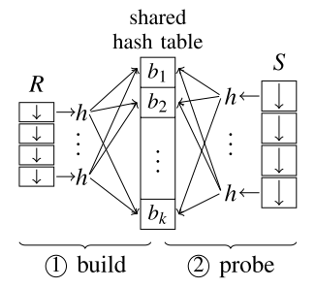
No-Partitioning Hash Join Algorithm
“Design and evaluation of main mem- ory hash join algorithms for multi-core CPUs,” in SIGMOD Conference, 2011, pp. 37–48.
Two Phases(Sequential):
Latch
Phase 1 Build:
Assigning equal-size portions to working threads(R);
Hashing the join value from the selected tuple in parallel;
Populating a shared Hash Table in parallel;
Phase 2 Probe:
Assigning equal-size portions to working threads(S);
Hashing the join value from the selected tuple in parallel;
Probing the Hash Table to find matching tuple in parallel;
Concurrency conflict!

Slide 6
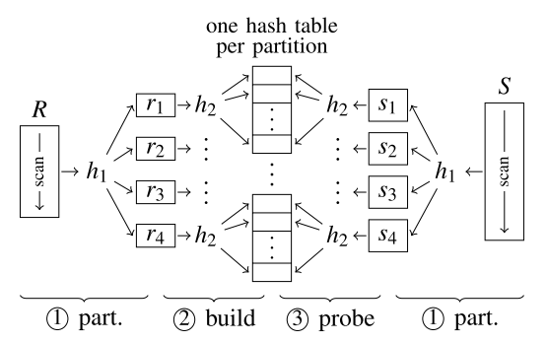
Partitioned Hash Join Algorithm
“Design and evaluation of main memory hash join algorithms for multi-core CPUs,” in SIGMOD Conference, 2011, pp. 37–48.
Three Phases(Non-Blocking):
?
Phase 1 Hash Partitionin:
R → r1, r2,……; S → s1, s2, ……；
Phase 2 Build:
Build the tuple from ri into HTi in parallel;
HTi should fit the CPU Cache
Phase 3 Probe
Hardware Concious!

Slide 7
Partitioned Hash Join Algorithm
“Design and evaluation of main memory hash join algorithms for multi-core CPUs,” in SIGMOD Conference, 2011, pp. 37–48.
How to divide the input relation into multiple clusters?
Cluster on Lower B bits Hash
57
01
20
00
17
01
92
03
11
57
01
06
10
2^{B} = 4
17
20
00
06
10
92
00
66
47
11
03
11
66
10
47

Slide 8
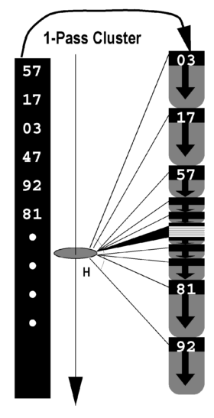
Is Partitioned Hash Join Good Enough?
“Optimizing Main-Memory Join on Modern Hardware” in TKDE 2002
Retrieve Tuple
Partitioning
Hashing
Clustering
Build
Optimized by parallel execution
Optimized by cache-sensitive
&
parallel execution
Probe
Clustering on the lower B bits of the hash value
# of tuple from each forming chunk is C/2^{B}

Slide 9
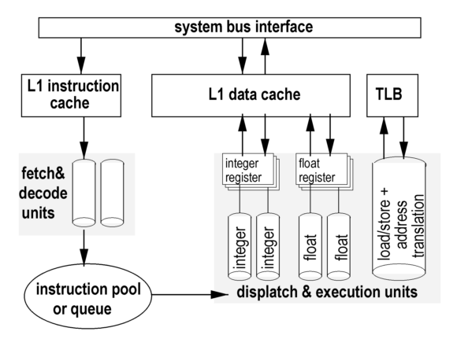
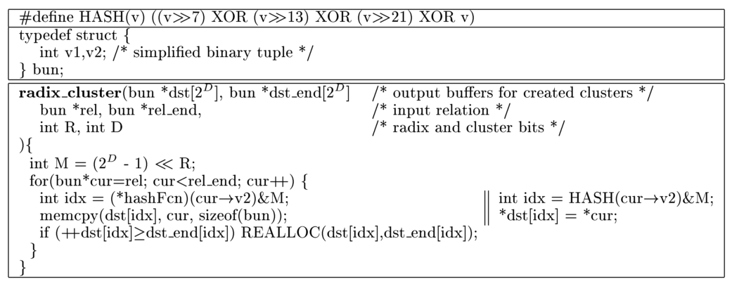
Is Partitioned Hash Join Good Enough?
“Optimizing Main-Memory Join on Modern Hardware” in TKDE 2002
Read a cacheline about the corresponding address
Translate the logical address into physical address in memory
Write the tuple into hash table
Modify the logical address
Write the logical address into cache

Slide 10
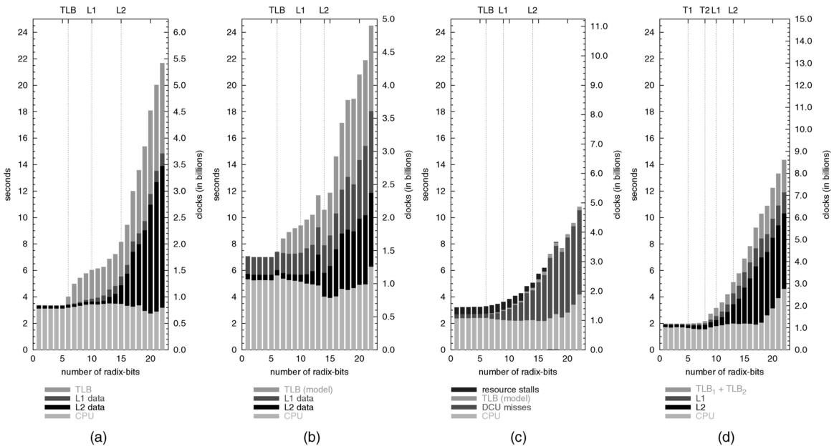
Is Partitioned Hash Join Good Enough?
NO！
“Optimizing Main-Memory Join on Modern Hardware” in TKDE 2002
What if the cardinality(C) of input relation is a great value?
Exceed the # of cachelines in CPU Cache?
Exceed the # of entries in TLB Cache?
When C↑
Keep the size of cluster(C/2^{B}) fitting CPU cache
# of clusters(2^{B})↑
B↑
Cardinality：~8M
a：Origin2000
b：Sun Ultra
c：Intel PC
d：AMD PC

Slide 11
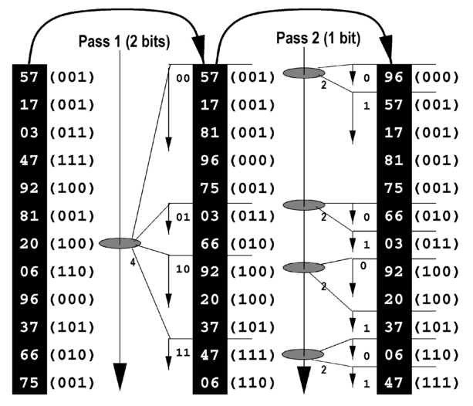



Solution: Radix-Cluster Algorithm
“Optimizing Main-Memory Join on Modern Hardware” in TKDE 2002
The radix-cluster algorithm divides a relation into H clusters using multiple passes.(Blocking)
Multiple clustering passes
Limit number of clusters per pass
Avoid cache/TLB trashing
Trade memory cost for CPU cost
Any data type (hashing)
Each pass keeps the # of clusters less than the # of cachelines and # of TLB entries.

Slide 12
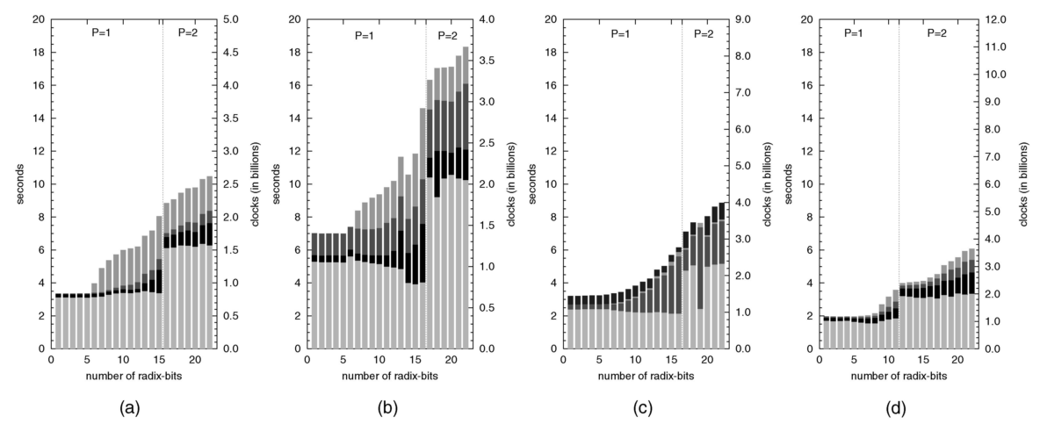
Solution: Radix-Cluster Algorithm
“Optimizing Main-Memory Join on Modern Hardware” in TKDE 2002
How to decide the # of passes during the execution of clustering?
Take CPU to overlap the costs of cache latencies！
B_{i} = B/P

Slide 13
Radix Hash Join Algorithm
“Sort vs. hash revisited: Fast join implementation on modern multi-core CPUs,” PVLDB, vol. 2, no. 2, pp. 1378–1389, 2009.
Radix join can be parallelized by subdividing both input relations into sub-relations that are assigned to individual threads.
230
11100110
CPU₀
17
10001
High Contention! (be different from the low-contention assumption of non-partitioning hash join)
00…
52
110100
128
10000000
CPU₁
174
10101110
384
110000000

Slide 14
Parallel Radix Hash Join Algorithm
“Sort vs. hash revisited: Fast join implementation on modern multi-core CPUs,” PVLDB, vol. 2, no. 2, pp. 1378–1389, 2009.
Solution: Take histogram to parallelize subdivision
00-CPU₀
230
11100110
00-CPU₁
CPU₀
17
10001
52
110100
01-CPU₀
Scan twice
128
10000000
CPU₁
174
10101110
10-CPU₀
384
110000000
10-CPU₁
00
1
00
01
10
Histogram for CPU₀
01
1
1
2
1
1
1
10
1
+
+
+
+
Scan once
00
2
Histogram for CPU₁
Prefix sum
1
3
4
5
6
10
1

Slide 15
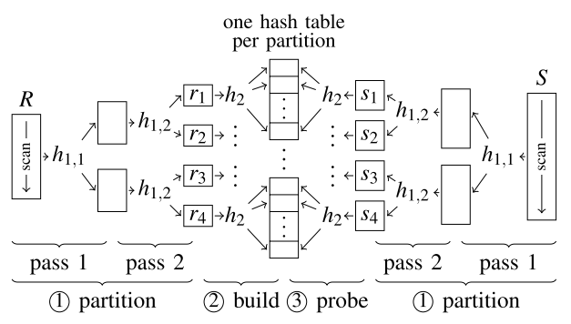
Parallel Radix Hash Join Algorithm
“Optimizing Main-Memory Join on Modern Hardware” in TKDE 2002
We learned that join is one of most expensive database operators → joins are one of the most tuned pieces of code in databases
Radix Hash Join:
allow for improved cache locality during clustering
allow for improved parallelism
Optimal choice on your aspects?

Slide 16
Chapter Ⅱ
Evaluations of Different Types
of
Hash-Join Algorithms

Slide 17
Evaluation of Different Hash-Join Algorithms
Is PHJ Good Enough in Real World？

Slide 18
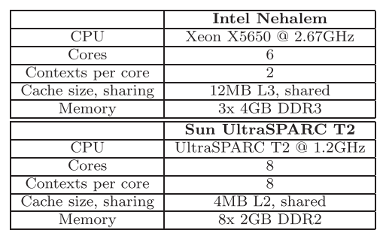
Evaluation of Different Hash-Join Algorithms
Hash Join variants:
No Partitioning Join
Shared Partitioning Join
Independent Partitioning Join
Radix Partitioning Join
Dataset:
Uniform, low skew, high skew
R → 16M
S → 256M

Slide 19
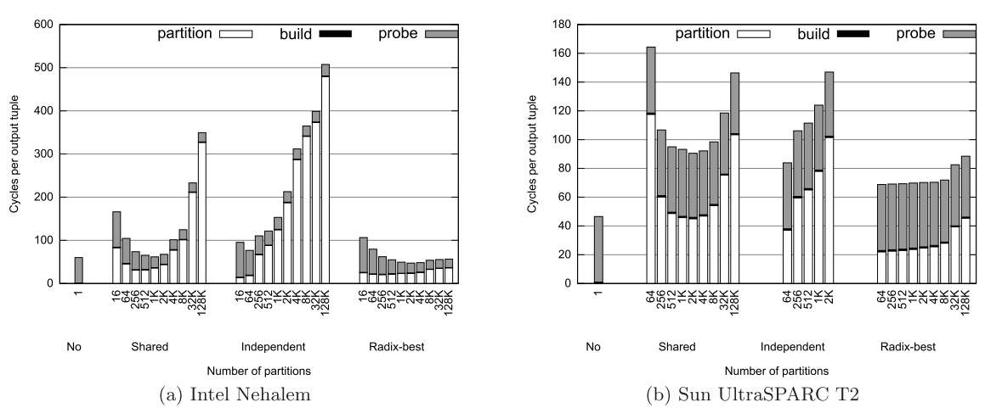
Evaluation of Different Hash-Join Algorithms
Uniform Dataset

Slide 20
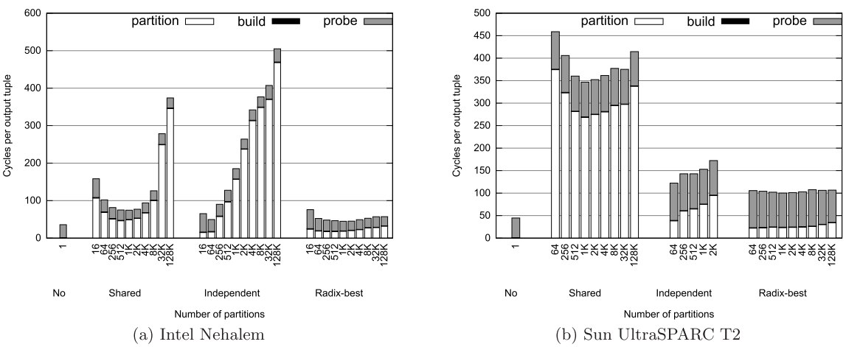
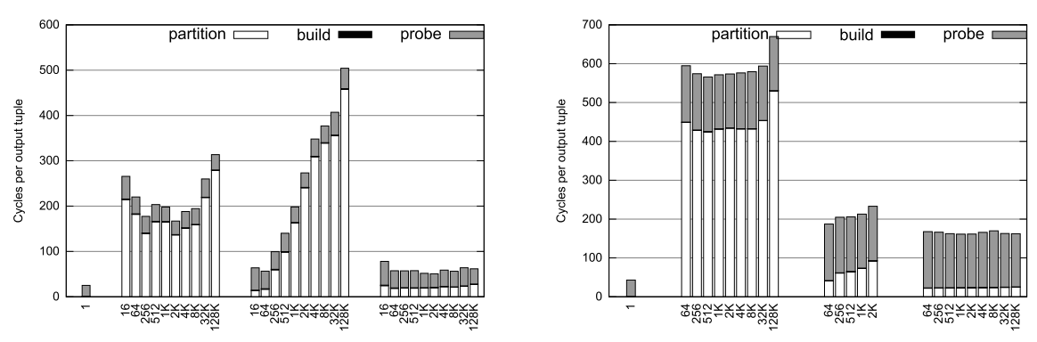
Evaluation of Different Hash-Join Algorithms
Skew Dataset

Slide 21
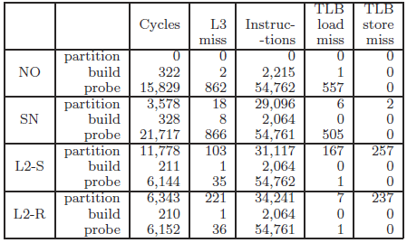
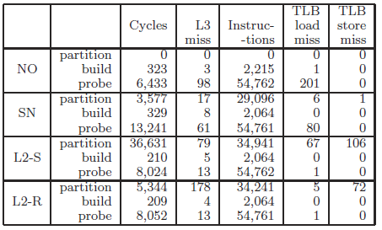
Evaluation of Different Hash-Join Algorithms
Analysis of Each Phase
Uniform Dataset
Skew Dataset

Slide 22
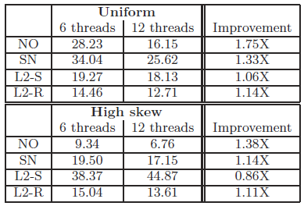
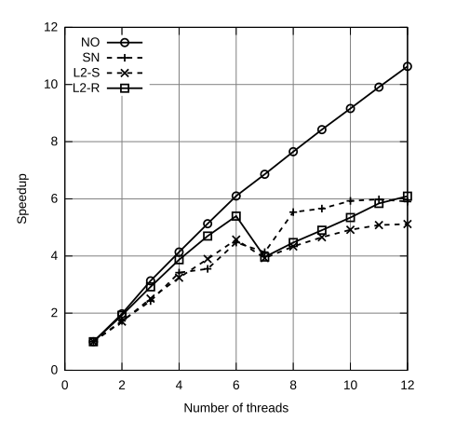
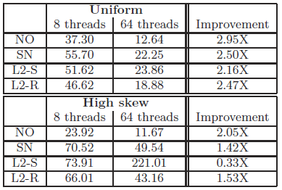
Evaluation of Different Hash-Join Algorithms
Speedup

Slide 23
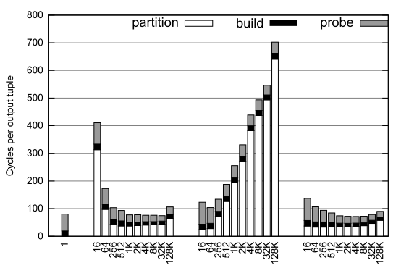
Evaluation of Different Hash-Join Algorithms
|R| = |S|

Slide 24
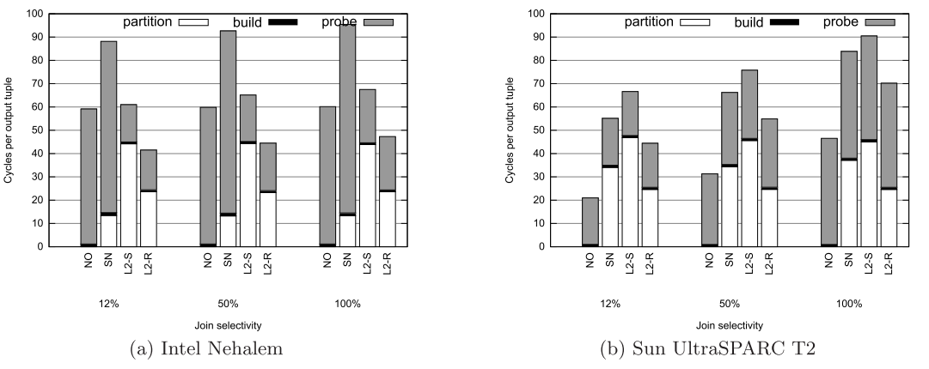
Evaluation of Different Hash-Join Algorithms

Slide 25
Evaluation of Different Hash-Join Algorithms
Minimizing cache misses requires additional computation
Skew has an impact on synchronization and load balancing
High performance main memory designs have to consider how to minimize computation and synchronization costs
No-Partitioning Hash Join is often an optimal choice! (in current multi-core environments)

Slide 26
Evaluation of Different Hash-Join Algorithms
But，Is That Really So?
http://web.cse.ohio-state.edu/~blanas.2/files/multijoin.tar.bz2

Slide 27
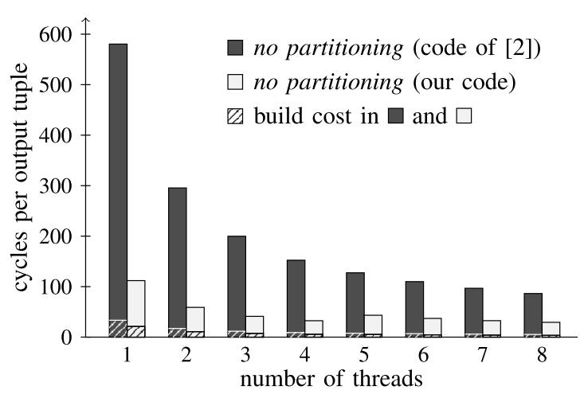
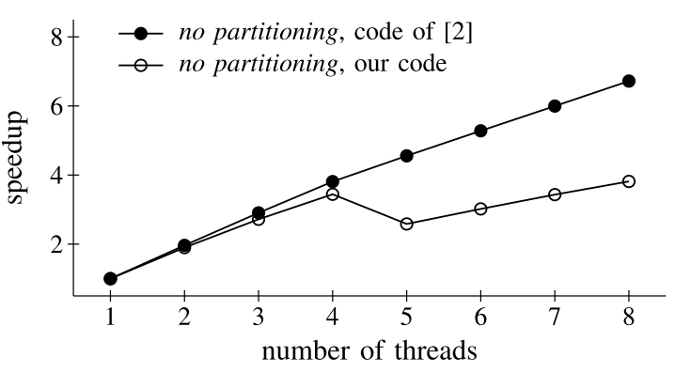
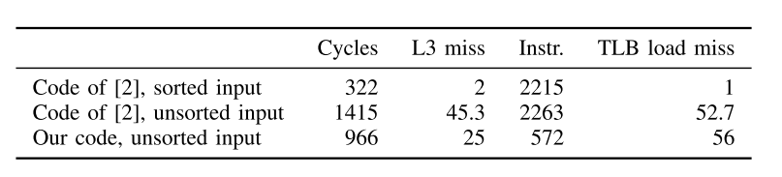
Evaluation of Different Hash-Join Algorithms
Chained Hash Table (code of [2])
Open Addressing Hash Table
Analysis of this code reveals that their results are based on experiments where R is pre-sorted. As a result, as data items are hashed using a modulo hash function, they map to consecutive hash buckets, leading to strictly sequential memory accesses. The sorted input also removes any contention for the bucket latch

Slide 28
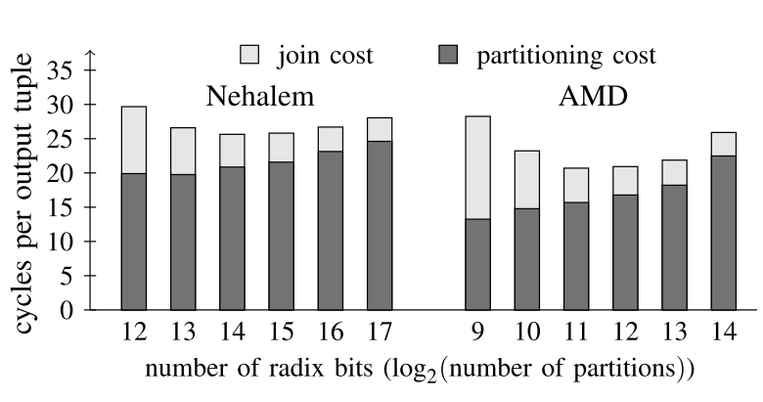
Evaluation of Different Hash-Join Algorithms
Robust！
Notes:
分的越是细，并行起来cache-locality越是好啊
14和11是明显更好的一个trade Off。明显在不同的bits数量下，整体的cost的代价的变化并不是特别的大

Slide 29
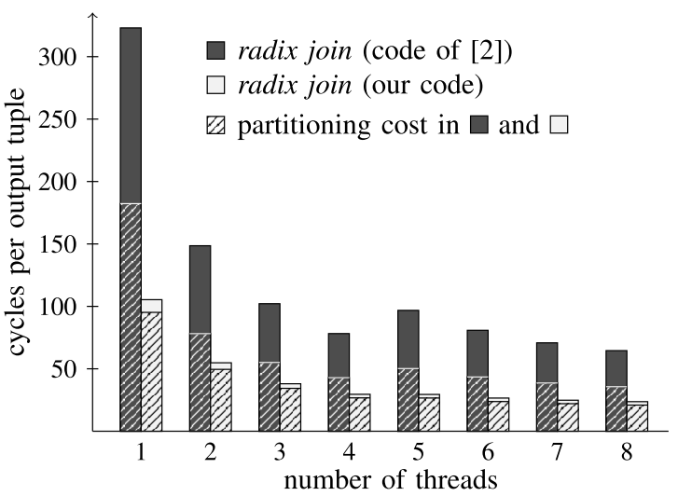
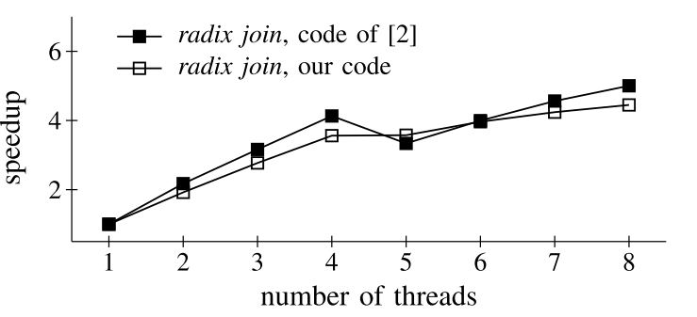
Evaluation of Different Hash-Join Algorithms
Implementation is a critical factor！
Different implementations lead to significant differences！
Notes:
里面有太多的函数调用（虚函数）和指针引用

Slide 30
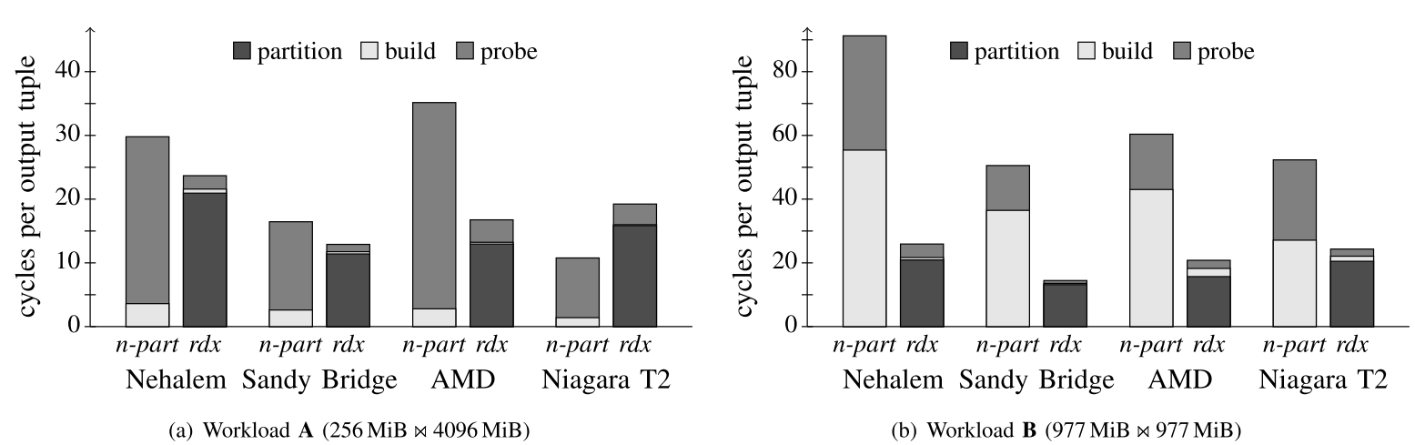
Evaluation of Different Hash-Join Algorithms
Hardware-Conscious OR Not ？
Effect of Workloads

Slide 31
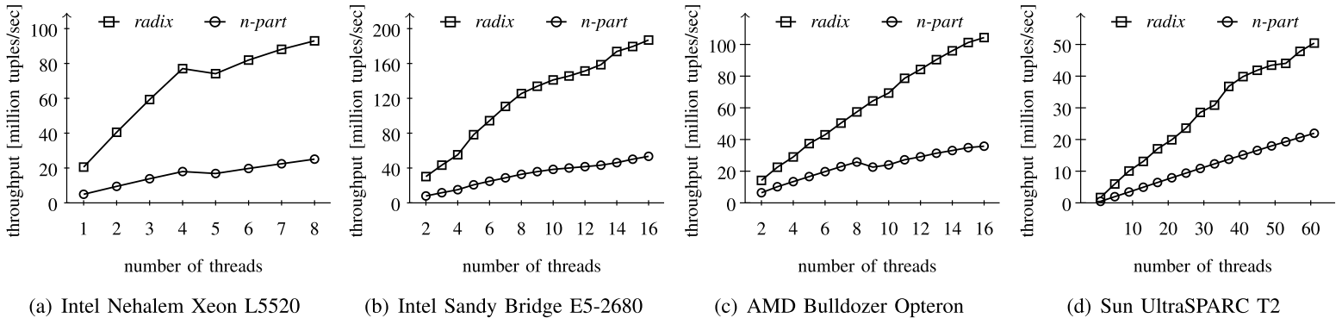
Evaluation of Different Hash-Join Algorithms
Hardware-Conscious OR Not ？
Scalability

Slide 32
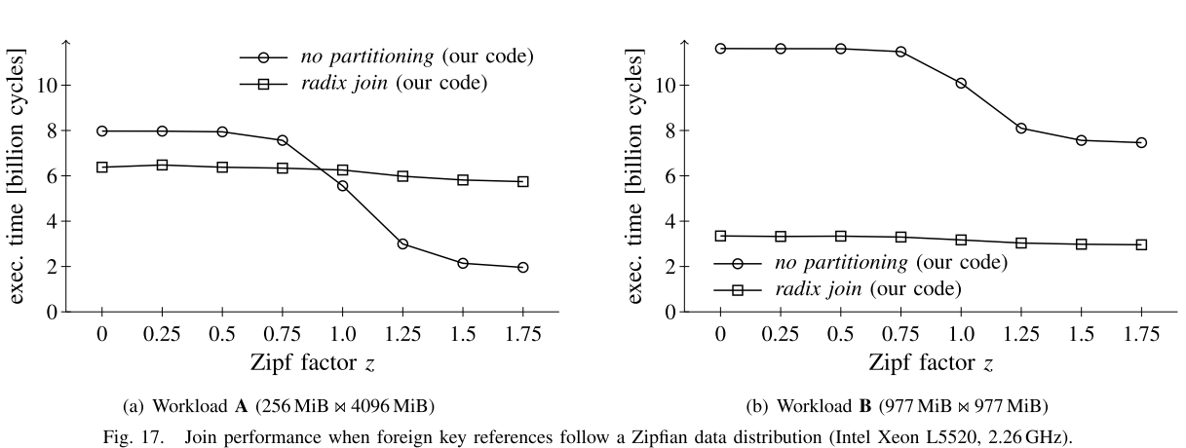
Evaluation of Different Hash-Join Algorithms
Hardware-Conscious OR Not ？
Data Skew

Slide 33
Evaluation of Different Hash-Join Algorithms
Conclusion:
Hardware-oblivious algorithms only work well under a narrow parameter window (when the table sizes significantly differ) and on one particular hardware platform.
Hardware-conscious algorithms can be made significantly faster than what has been published so far and more robust to a wider set of parameters.

Slide 34
Chapter III
Revisiting Reuse Hash Tables in Main-Memory DBs

Slide 35

Revisiting Reuse in Main-Memory Databases
“Revisiting Reuse in Main-Memory Database Systems”SIGMOD 2016.
REUSE IN THE REAL WORLD …
emmm………
MIGHT HELP!

Slide 36
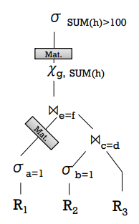

Revisiting Reuse in Main-Memory Databases
“Revisiting Reuse in Main-Memory Database Systems”SIGMOD 2016.
REUSE IN DATABASES MIGHT HURT …
Limit the memory bandwidth.
Suffer from the low cache- and register-locality.
Benefits of materialization depends on the characteristics of the workload.

Slide 37
Revisiting Reuse in Main-Memory Databases
“Revisiting Reuse in Main-Memory Database Systems”SIGMOD 2016.
REUSE WITHOUT REGRET!
Main idea: Reuse internal structures
Keep internal data structure
Reuse for subsequent queries
Savings are two-fold
No additional materialization costs
No need to re-create internal structures
More robust towards different reuse-potentials
This talk: reuse hash tables for joins + aggregations

Slide 38
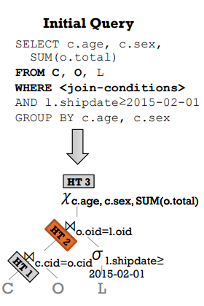
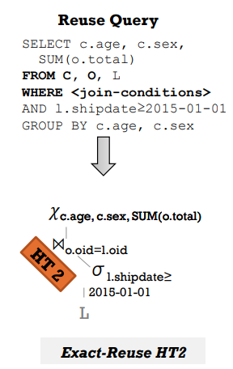
Revisiting Reuse in Main-Memory Databases
“Revisiting Reuse in Main-Memory Database Systems”SIGMOD 2016.
CASE 1: Exact Reuse

Slide 39
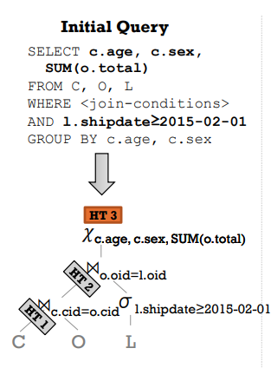
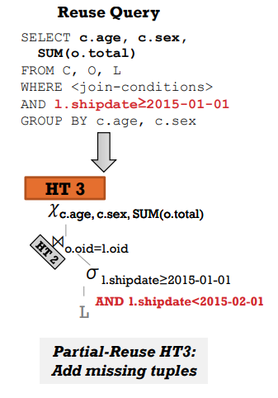
Revisiting Reuse in Main-Memory Databases
“Revisiting Reuse in Main-Memory Database Systems”SIGMOD 2016.
CASE 2: Partial Reuse

Slide 40
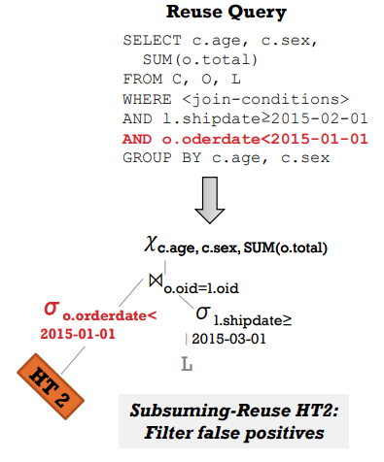
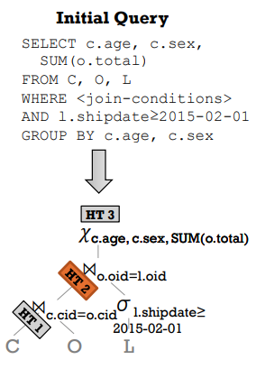
Revisiting Reuse in Main-Memory Databases
“Revisiting Reuse in Main-Memory Database Systems”SIGMOD 2016.
CASE 3: Subsuming Reuse

Slide 41
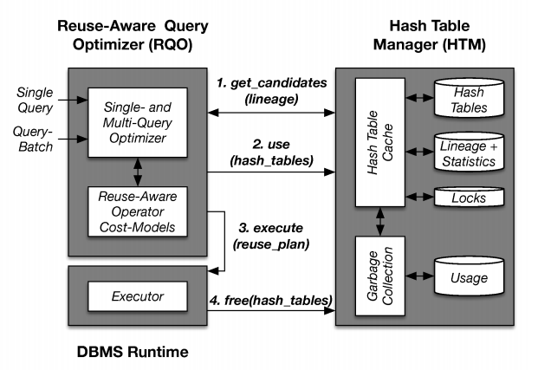
Revisiting Reuse in Main-Memory Databases
“Revisiting Reuse in Main-Memory Database Systems”SIGMOD 2016.
Hash-Stash Architecture

Slide 42

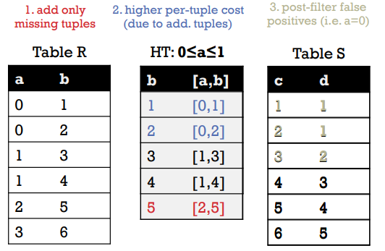
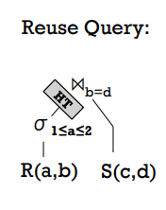
Revisiting Reuse in Main-Memory Databases
“Revisiting Reuse in Main-Memory Database Systems”SIGMOD 2016.
Cost Model

Slide 43
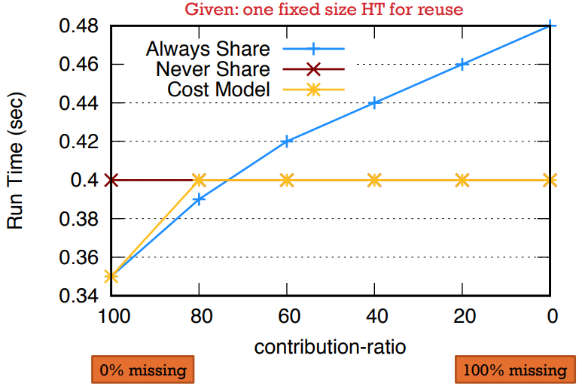
Revisiting Reuse in Main-Memory Databases
“Revisiting Reuse in Main-Memory Database Systems”SIGMOD 2016.
Join：Reuse or Not Reuse?

Slide 44
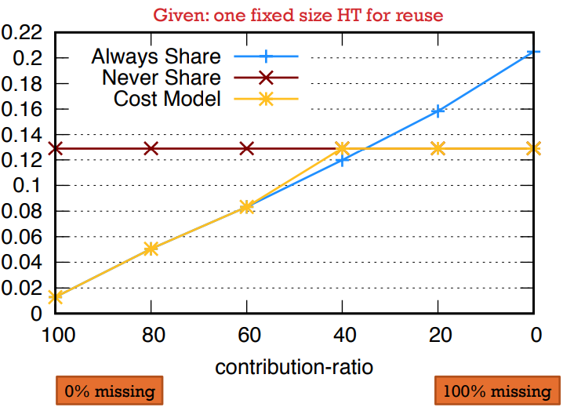
Revisiting Reuse in Main-Memory Databases
“Revisiting Reuse in Main-Memory Database Systems”SIGMOD 2016.
Aggregation：Reuse or Not Reuse?

Slide 45
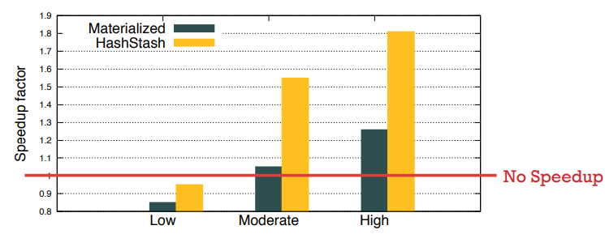
Revisiting Reuse in Main-Memory Databases
“Revisiting Reuse in Main-Memory Database Systems”SIGMOD 2016.
Results: Reuse Efficiency
Workloads: 64 queries with different reuse potentials:
Low: 1% of the cached data is reused on average
Medium: 10% of the cached data is reused on average
High: 50% of the cached data is reused on average

Slide 46
Thanks

