Slide 1
Ames House Price Prediction
Regression Project

Slide 2
01
Introduction
Introduces the project and loads the datasets for analysis.

Slide 3
Introduction
Imagine you’re a real estate detective! Our mission: predict house prices using clues hidden in the data. First step grab our case files: the training and test datasets.
https://github.com/hamnasz

Slide 4
Dataset
This dataset appears to be a housing price prediction dataset typically used for regression tasks.
https://github.com/hamnasz

Slide 5
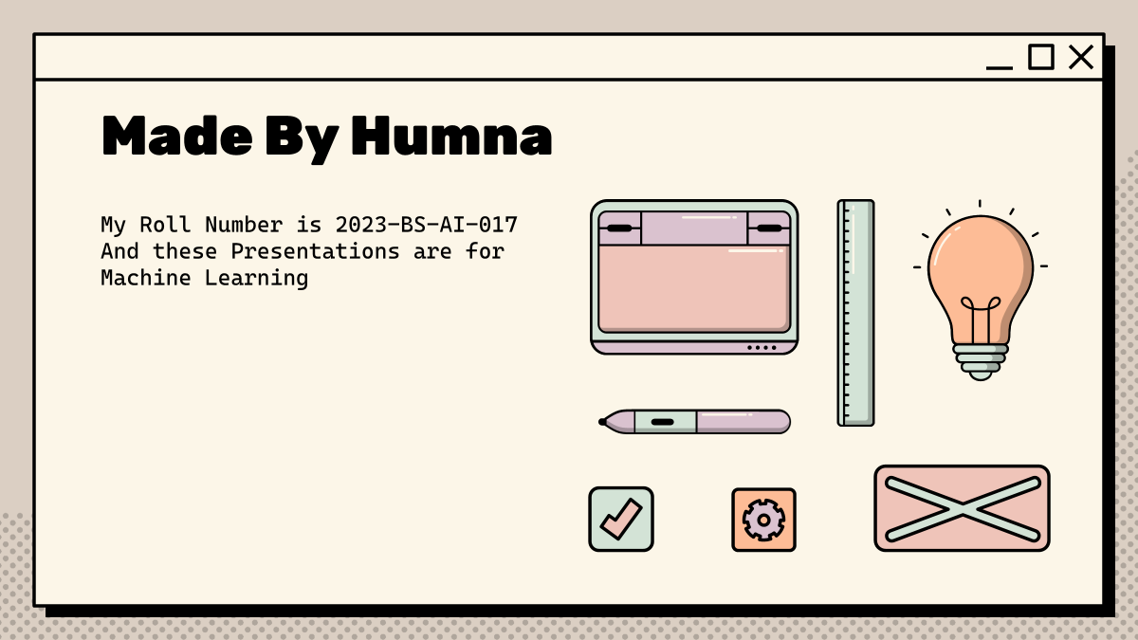
Why this dataset?
Assumes linear relationship between features and target
Fast, interpretable, but less flexible for non-linearities

Slide 6
Target Variable
SalePrice (last column) is the target variable for prediction. This represents the actual sale price of houses in the dataset.
https://github.com/hamnasz

Slide 7
Introduction
import pandas as pd
train_data = pd.read_csv('Data/train.csv', index_col='Id')
test_data = pd.read_csv('Data/test.csv', index_col='Id')
https://github.com/hamnasz

Slide 8
02
Features
Identifies and categorizes the dataset features for focused processing.

Slide 9
Features (Predictors)
80+ housing characteristics including:
Physical attributes: LotArea, OverallQual, YearBuilt, BedroomAbvGr
Location factors: Neighborhood, Condition1
Economic indicators: MoSold, YrSold
https://github.com/hamnasz

Slide 10
Features
Every detective needs to know their suspects. Here, we sort our features into two groups: numbers (like square footage) and categories (like neighborhood). Knowing who’s who is key to cracking the case.
https://github.com/hamnasz

Slide 11
Features
numCols = train_data.select_dtypes(exclude='object').columns
catCols = train_data.select_dtypes(include='object').columns
print(numCols, catCols)
https://github.com/hamnasz

Slide 12
03
Handling Missing Values
Handles missing data to ensure a complete and reliable dataset.

Slide 13
Handling Missing Values
LotFrontage
Alley
General approach
Impute with median or mean value grouped by Neighborhood (since frontage can depend on location)
Most values are NA, which likely means "No alley access." Fill missing with a new category like "None" or "NoAlley"
Use df.isnull().sum() to check missing values
Impute or drop based on feature importance and missing percentage

Slide 14
Handling Missing Values
Code:
Story:
Some clues are missing! We fill in the blanks with the average value for each feature. This ensures our investigation isn’t derailed by missing evidence.
train_data.fillna(train_data.mean(), inplace=True)
https://github.com/hamnasz

Slide 15
04
Feature Engineering
Creates new, meaningful features to enhance model performance.

Slide 16
Feature Engineering
train_data['totalSqFeet'] = train_data['TotalBsmtSF'] + train_data['1stFlrSF'] + train_data['2ndFlrSF']
We combine clues to create a new one: total square footage. Bigger homes usually mean higher prices—this new feature gives our model a sharper eye for value.

Slide 17
05
Data Transformation
Scales and encodes data to prepare it for machine learning algorithms.

Slide 18
Data Transformation
Not all clues are created equal—some numbers are huge, some tiny. We scale them to the same range, and translate categories into numbers so our model can understand every detail.
https://github.com/hamnasz

Slide 19
Data Transformation
from sklearn.preprocessing import RobustScaler
scaler = RobustScaler()
train_data[numCols] = scaler.fit_transform(train_data[numCols])
train_data = pd.get_dummies(train_data)
https://github.com/hamnasz

Slide 20
06
Training the Model
Trains a Ridge Regression model to learn relationships in the data.

Slide 21
Training the Model
Time to put our detective to work! We train a Ridge Regression model, teaching it how different clues relate to house prices. The smarter the detective, the better the predictions.
https://github.com/hamnasz

Slide 22
Training the Model
from sklearn.linear_model import Ridge
ridge = Ridge(alpha=22.9)
ridge.fit(X_train, y)
https://github.com/hamnasz

Slide 23
07
Model Evaluation
Evaluates the model’s performance using cross-validation techniques.

Slide 24
Model Evaluation
How good is our detective? We test its skills using cross-validation—making sure it can solve new cases, not just the ones it’s seen before.
https://github.com/hamnasz

Slide 25
Model Evaluation
from sklearn.model_selection import cross_val_score
score = cross_val_score(ridge, X_train, y, scoring="neg_mean_squared_error").mean()
https://github.com/hamnasz

Slide 26
08
Predicting House Prices
Generates and exports final predictions for unseen test data.

Slide 27
Predicting House Prices
The investigation is complete! Our detective predicts prices for unseen houses. We package up the results, ready to impress the real estate world.
https://github.com/hamnasz

Slide 28
Predicting House Prices
predictions = ridge.predict(X_test)
output = pd.DataFrame({'Id': test_data.index, 'SalePrice': predictions})
output.to_csv('submission.csv', index=False)
https://github.com/hamnasz

Slide 29
Thanks!
Does anyone have any questions?
devhamnah@gmail.com
www.linkedin.com/in/devhamna
https://github.com/hamnasz
We’ve followed the clues, cleaned the scene, engineered new features, and trained a sharp model—all to solve the mystery of house prices.
This Presentation was created and designed By Humna Imran

