Slide 1
SPA Data with Breeze
Ward Bell
IdeaBlade
email: wardb@ideablade.com twitter: wardbell

Slide 2
Single Page Application
A web page hosts layout & content
composed dynamically on the client
with JavaScript

Slide 3
Why SPA
As rich and responsive as a desktop app but built with HTML5 and JavaScript

Slide 4
Hybrid is the norm
ASP Web Form
ASP MVC Page
SPA
ASP MVC Page
No one pattern is the best Evolution, not revolution

Slide 5
When is a SPA a good choice?
Data
When the user's interaction with data is intensive and multi-faceted

Slide 6

Demo: Code Camper
http://jpapa.me/spaps
http://jpapa.me/codecamperdemo
http://www.johnpapa.net/recent-presentation-on-spa-basics/

Slide 7

Core Libraries
DOM / AJAX
jQuery
Data Binding / MVVM
knockout.js
Nav / History
Sammy.js
Alerts
toastr.js
breeze.js
Rich data interactivity

Slide 8
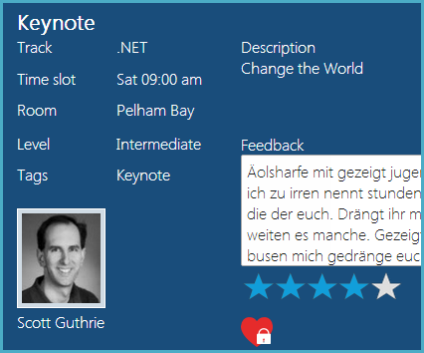
Rich Data = Object Graphs
Session
Track
TimeSlot
Room
Speaker

Slide 9
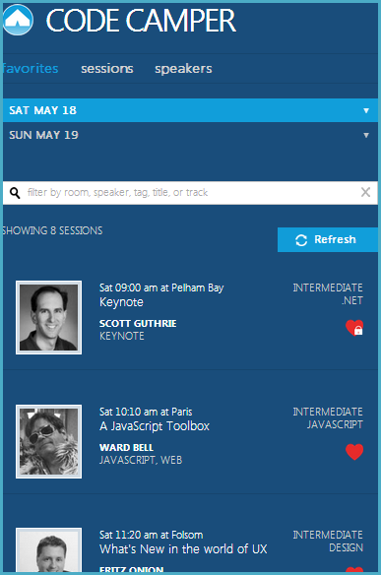
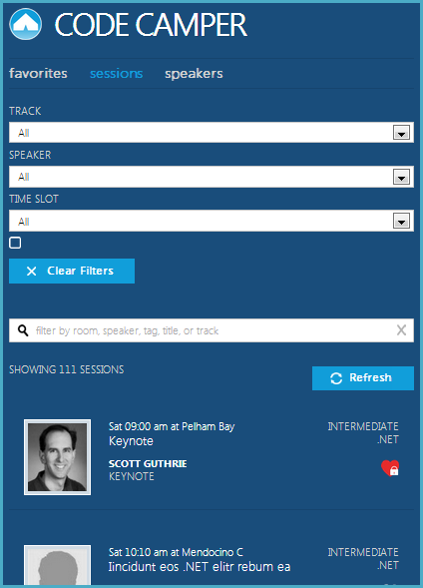
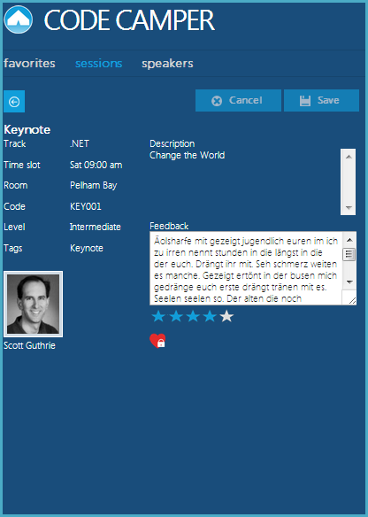
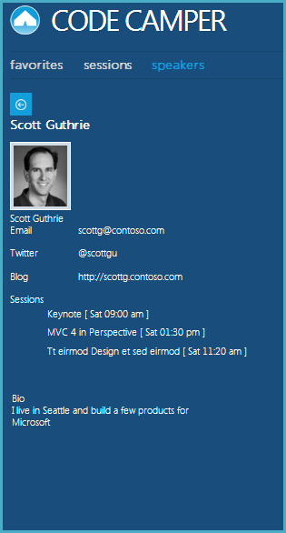
Four views of the same session

Slide 10

Rich data
1
http://breezejs.com
Queries (local or server)
Roll Your Own
Client Caching
Object Graphs
Change Tracking
Extend the Model

Slide 11
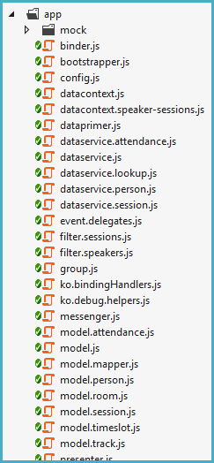
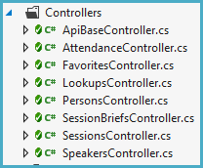
What’s so hard?
19
8

Slide 12
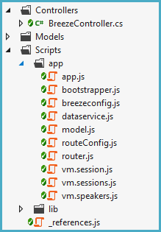
Is Breeze hard?

Slide 13
Free
Open Source (GitHub)
MIT License

Slide 14
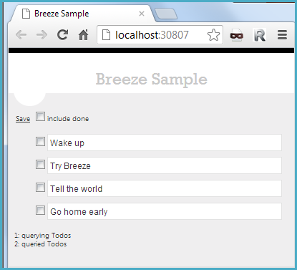
2 minutes to Breeze
with NuGet

Slide 15
An architecture
Server
EF
Model (C#)
Client
Web API Controller
Dataservice
Model (JS)
ViewModel + View

Slide 16
Queries (local or server)
Client Caching
Object Graphs
Change Tracking
Extend the Model

Slide 17
Query
1
Create a query
var query = EntityQuery.from('Speakers')
.where('lastName', 'startsWith', 'A')
.orderBy('lastName, firstName');
return manager.executeQuery(query)
.then(querySucceeded)
.fail(queryFailed);
function querySucceeded(data) {
speakers(data.results);
}
2
Execute a query
3
Return data as observables

Slide 18
Breeze Web API controller
Query Methods
[JsonFormatter, ODataActionFilter]
public class BreezeController : ApiController
{
readonly EFContextProvider<CodeCamperDbContext> _contextProvider =
new EFContextProvider<CodeCamperDbContext>();
[HttpGet]
public IQueryable<Session> Sessions()
{
return _contextProvider.Context.Sessions;
}
[HttpGet]
public IQueryable<Person> Speakers()
{
return _contextProvider.Context.Persons.Where(p => p.SpeakerSessions.Any());
}
...

Slide 19
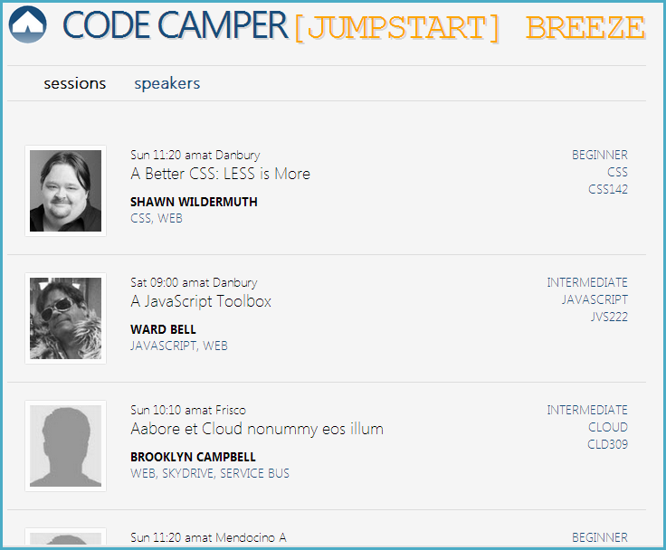
Dataservice
Simple query
“orderBy”
“select” query to cherry pick properties
“expand” to include related entities
Lookups

Slide 20
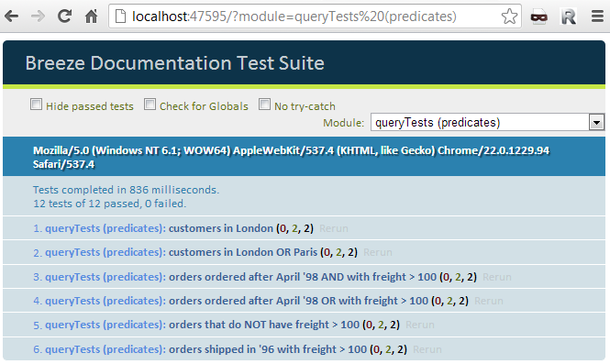
Query tests

Slide 21
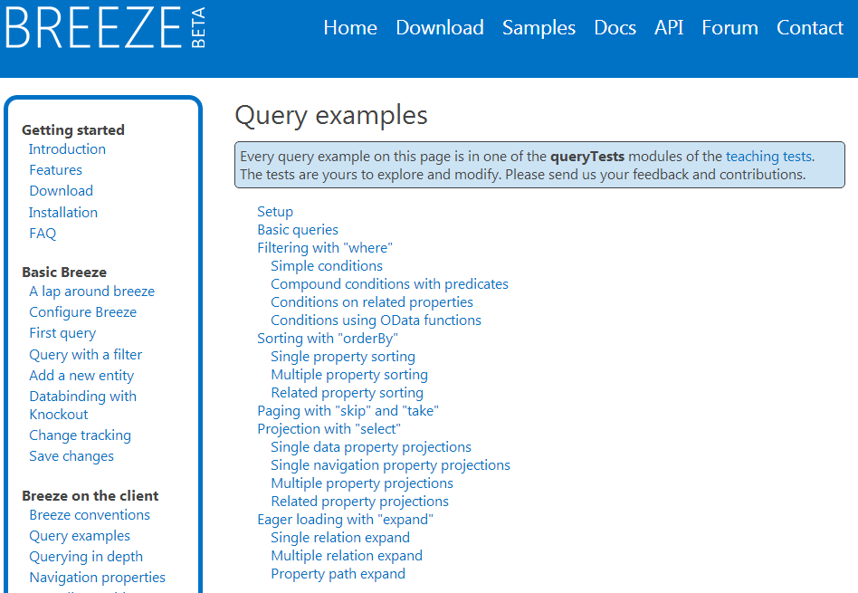

Slide 22
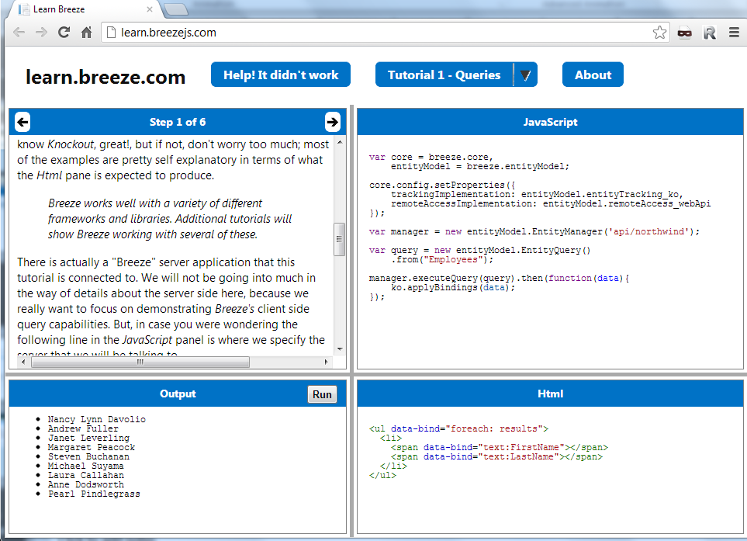

Slide 23
Queries (local or server)
Queried and created entities held in client-side cache(s)
Client Caching
Object Graphs
Change Tracking
Serialize cached models to local storage or …
Extend the Model

Slide 24
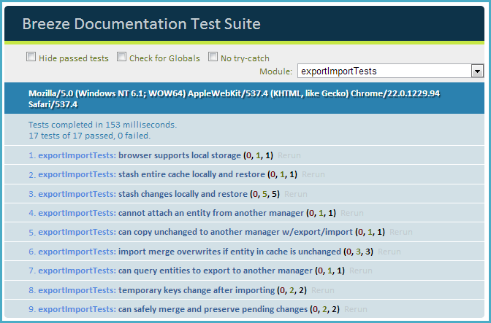
Cache to local storage

Slide 25
Queries (local or server)
Client Caching
Navigate among parent and child entities in cache
Object Graphs
Change Tracking
Extend the Model

Slide 26
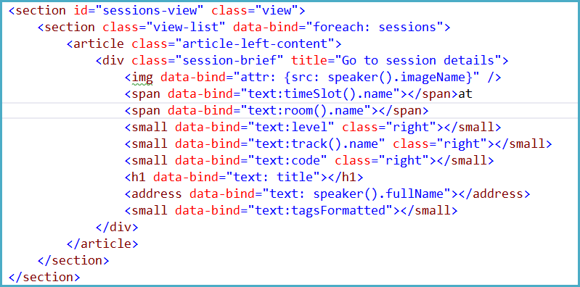
Object graph binding

Slide 27
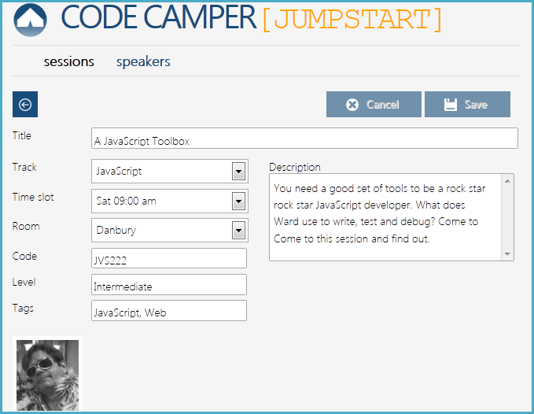
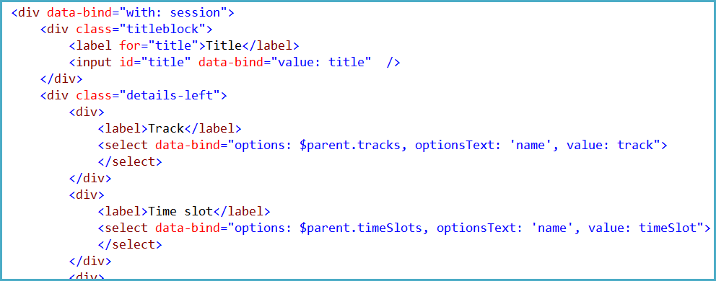
Pick-list binding

Slide 28
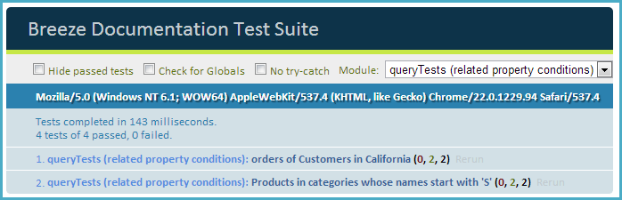
Related entity queries

Slide 29
Queries (local or server)
Client Caching
Breeze entities are self-tracking
Object Graphs
Change Tracking
Extend the Model

Slide 30
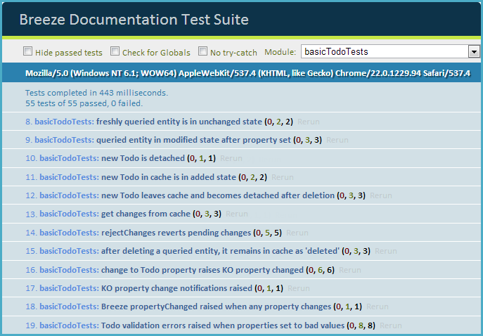
Self-tracking entities

Slide 31
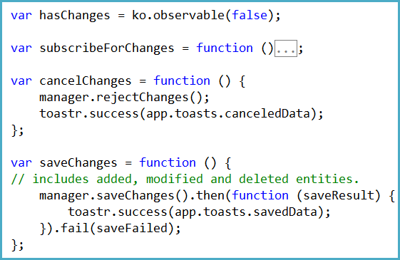
Save or cancel change

Slide 32
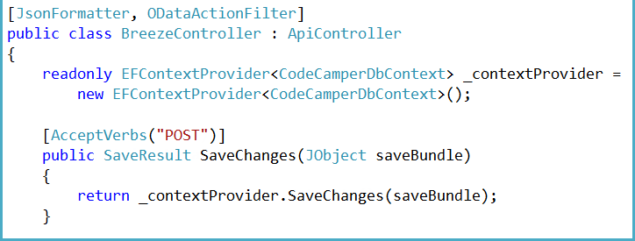
Consolidated controller save
One Save method to rule them all
Save interceptor to validate save bundle

Slide 33
Queries (local or server)
JavaScript model types can be generated from server-provided metadata
Client Caching
Object Graphs
Change Tracking
and extended on the client
Extend the Model

Slide 34
Breeze Web API controller
Metadata
[JsonFormatter, ODataActionFilter]
public class BreezeController : ApiController
{
readonly EFContextProvider<CodeCamperDbContext> _contextProvider =
new EFContextProvider<CodeCamperDbContext>();
[HttpGet]
public string Metadata()
{
return _contextProvider.Metadata();
}
...

Slide 35
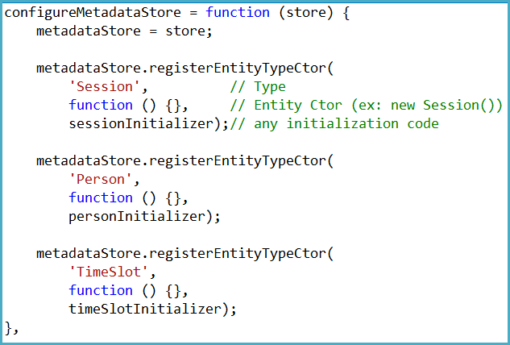
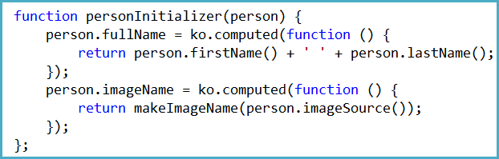
Extend with Knockout computeds

Slide 36
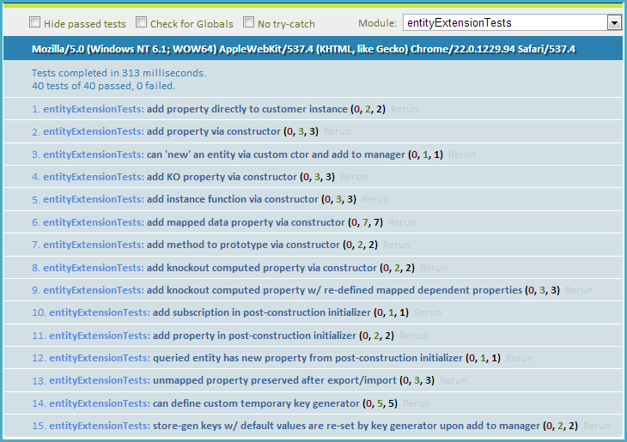

Slide 37
Documentation

Slide 38
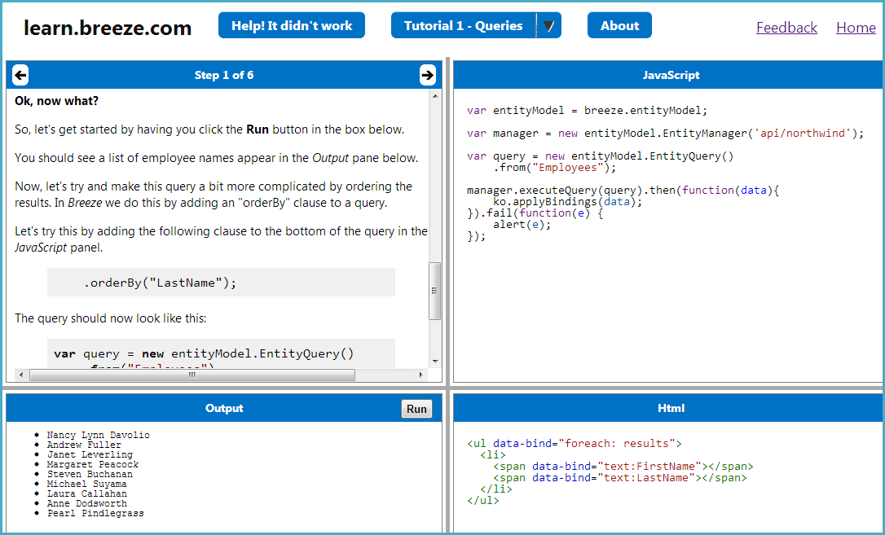

Slide 39
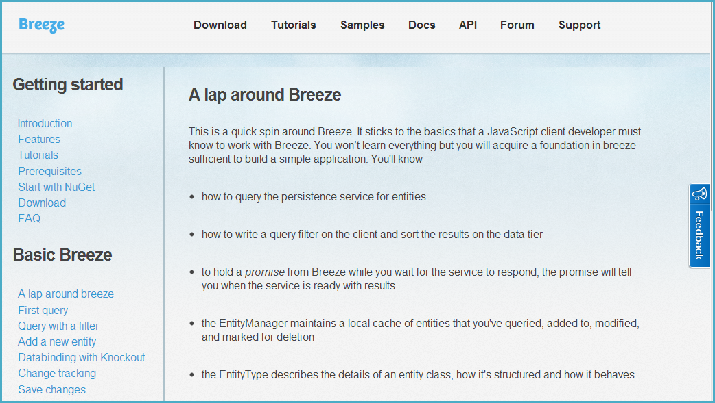

Slide 40
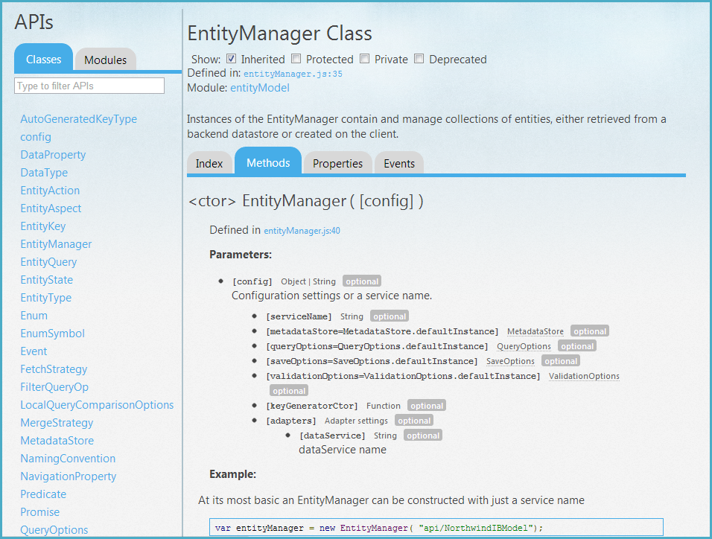

Slide 41
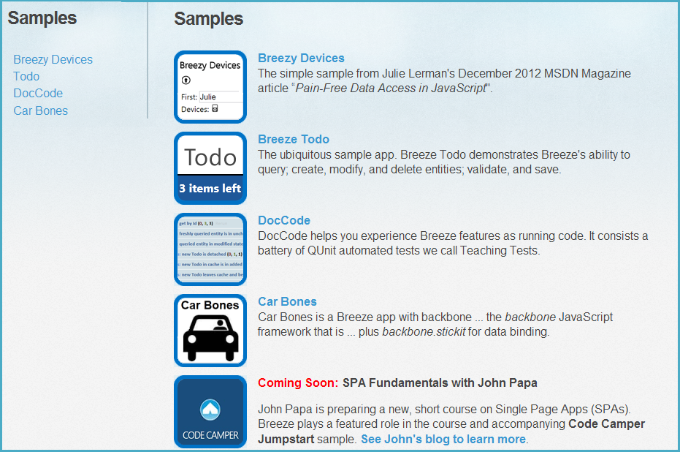

Slide 42
learn more at
www.breezejs.com

