Slide 1
TypeScript in 30 minutes
Ward Bell
IdeaBlade
email: wardb@ideablade.com twitter: wardbell

Slide 2
Why
“Meet the needs of the JavaScript programming teams that build and maintain large JavaScript programs”

Slide 3
How
Tooling for productivity
Type checking
Symbol-based navigation
Re-factoring
Dynamically loadable modules
Interfaces for JS components

Slide 4
What
“Every JavaScript program is a TypeScript program”
Syntactic sugar
Superset of ES5
Some ES6 proposed features (classes, modules)
Optional type annotations + type inference

Slide 5
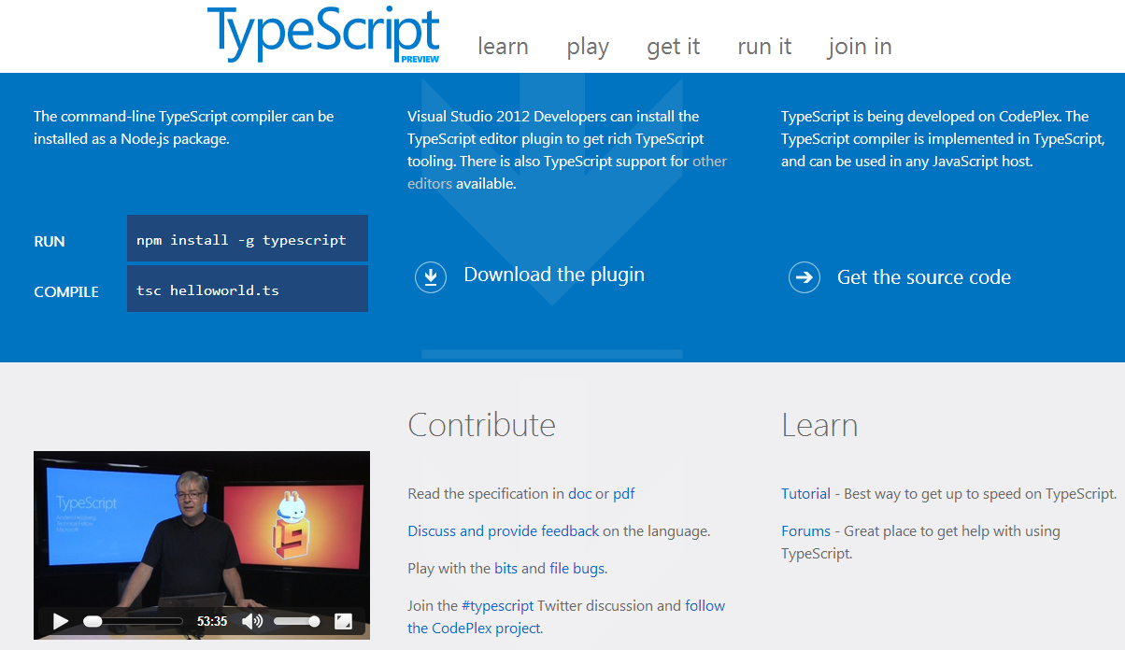

Slide 6
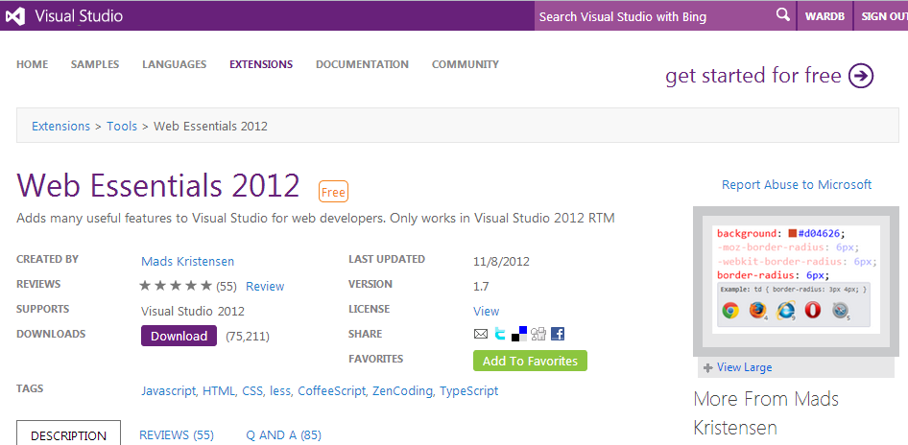

Slide 7
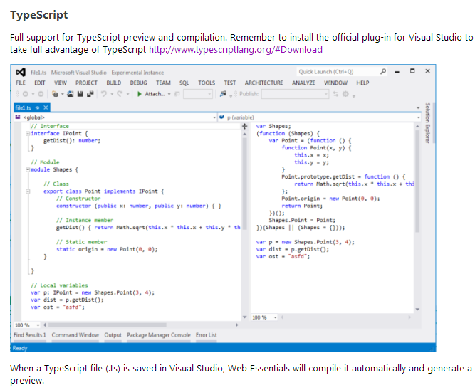

Slide 8
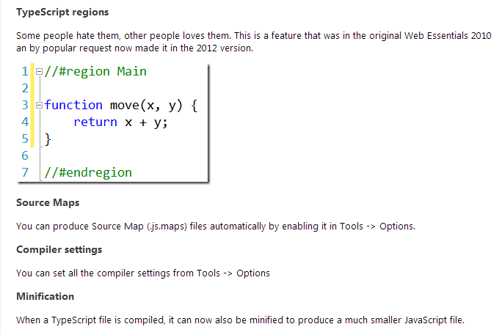

Slide 9
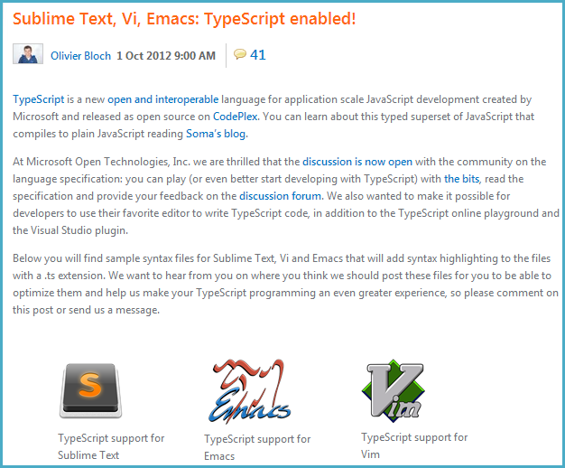

Slide 10
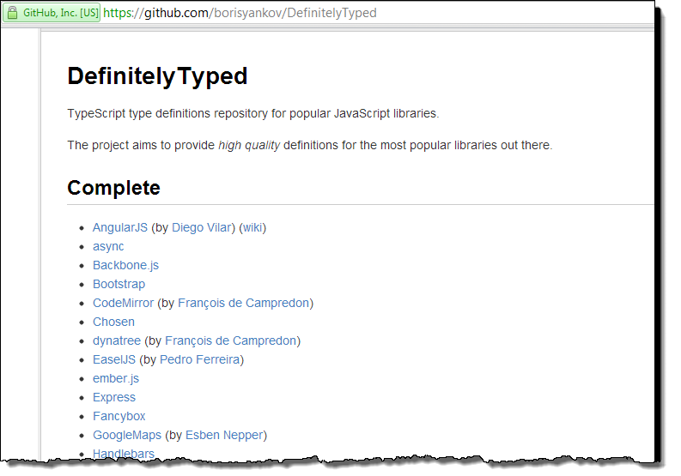

Slide 11
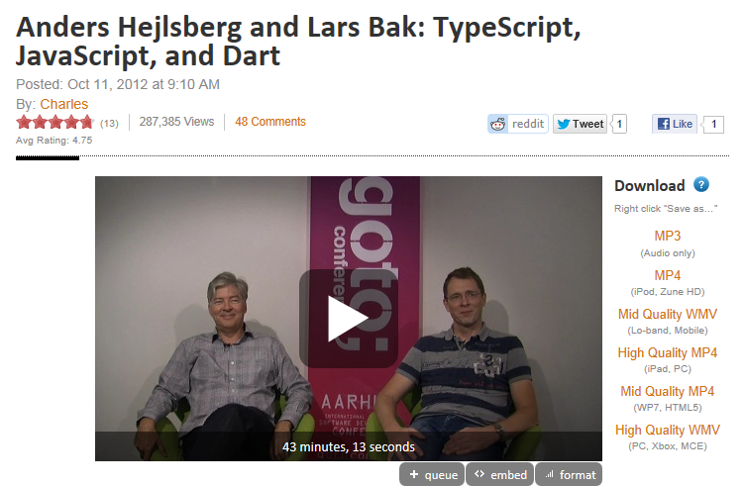
TypeScript vs. Dart vs. CoffeeScript

