Slide 1
A JavaScript developer’s toolbox
AJS321
One
Ward Bell
IdeaBlade
email: wardb@ideablade.com twitter: wardbell

Slide 2
Tools & Libraries

Slide 3
Tools
Visual Studio 2012
R#
Browser developer tools
jsFiddle
Fiddler

Slide 4
jsFiddle
Great for exploration
Great for demos
Can include external libraries
Free
Warning: use Chrome or Firefox; fails in IE9 too often

Slide 5
Libraries
Knockout
BreezeJS
QUnit
Q.js (promises)
RequireJS

Slide 6
What? No jQuery?
Don’t be silly … everyone knows about jQuery

Slide 7
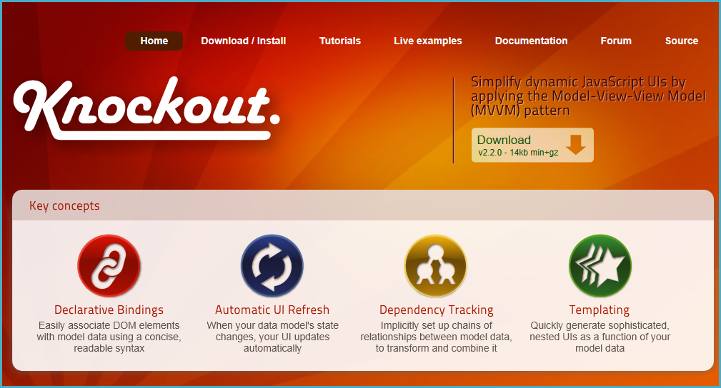

Slide 8
Data Binding via Knockout
Declarative Binding
<input data-bind="value: firstName" />
Create an Observable
var myViewModel = {
firstName: ko.observable('John')
};
Connect the ViewModel to the View
ko.applyBindings(myViewModel);
Notes:
http://jsfiddle.net/johnpapa/BEzJc/

Slide 9
Knockout
Client UI data binding (free)
Amazing documentation
Live tutorial
Ryan Niemeyer’s jsFiddles
Endorsed by MS … and non-MS
Basic KO binding
Basic KO computed binding
Checkout Backbone, Angular, Can, Ember …

Slide 10
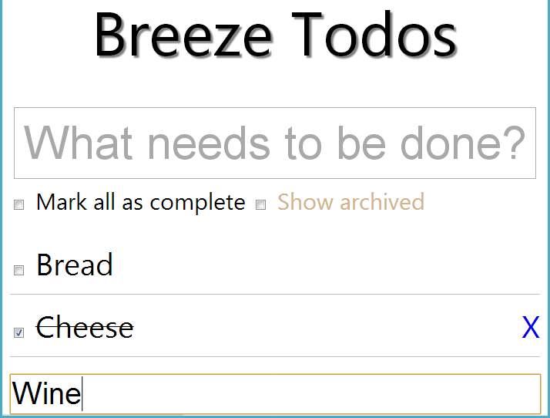

Slide 11
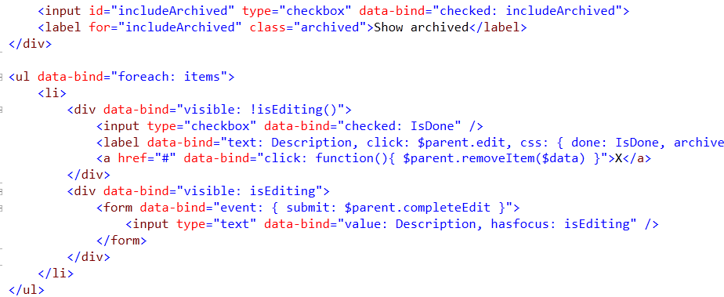
View

Slide 12
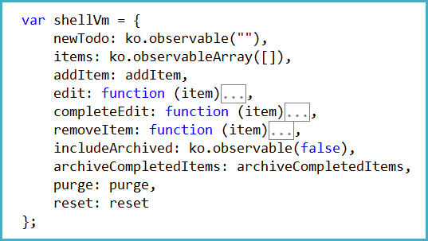
ViewModel

Slide 13
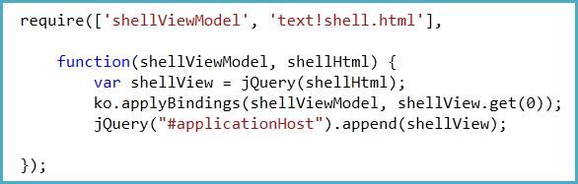
View meets ViewModel
1
2
Require ViewModel
Require View template
3
View as DOM elem.
4
5
View meets VM
Stick it on screen

Slide 14

Rich data
1
http://breezejs.com
Client Caching
Roll Your Own
Change Tracking
Queries (local or server)
Extend the Model
Object Graphs

Slide 15
LINQ-style query
1
Create a query
var query = EntityQuery.from('Speakers')
.orderBy('lastName, firstName');
return manager.executeQuery(query)
.then(querySucceeded)
.fail(queryFailed);
function querySucceeded(data) {
speakers(data.results);
}
2
Execute a query
3
Return data as observables

Slide 16
Rich data
Demo
Notes:
CCJS 101 Demo
Session/Speakers lists
Custom data service with jquery ajax
Router/nav
Viewmodels and knockout
Breeze 101 Demo
Same as above plus …
Priming the data
Breeze replaces dataservice
Simplifying the data service (queries)
Simplifying the models (init code for computeds)
Breeze Demo
Same as above plus …
Getting briefs/partials
Priming the data with briefs only
Querying the local cache
Saving / rejecting changes
Change tracking

Slide 17
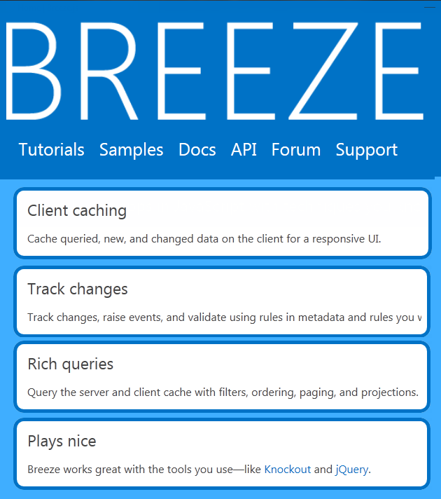
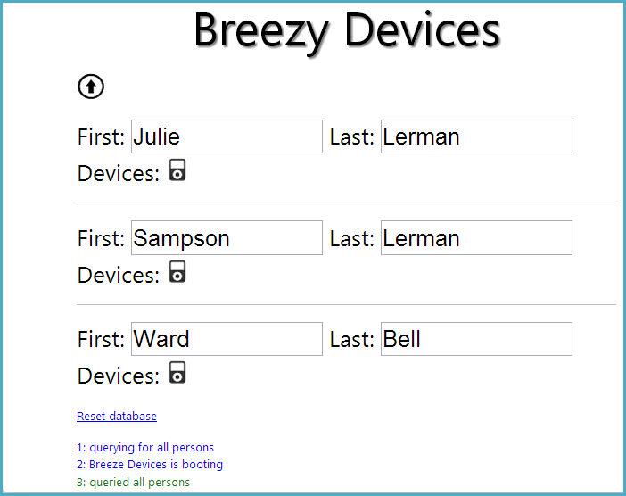
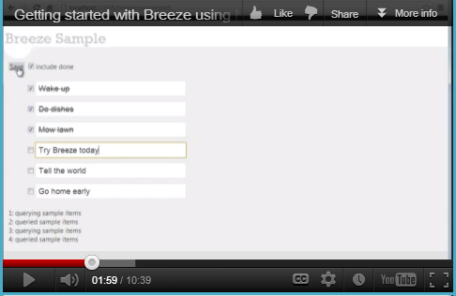
BreezeJS
Julie Lerman on Breeze
MSDN Magazine, Dec 2012
“Zero to Breeze in 2 minutes”

Slide 18
QUnit
The Bad: automated testing is mandatory
JavaScript === tons of stupid bugs!
Weak IDE support
No compiler help
Slow, painful debugging
Browser madness
The Good: usually easier than in C#
Checkout Jasmine, Mocha, Phantom (headless)…

Slide 19
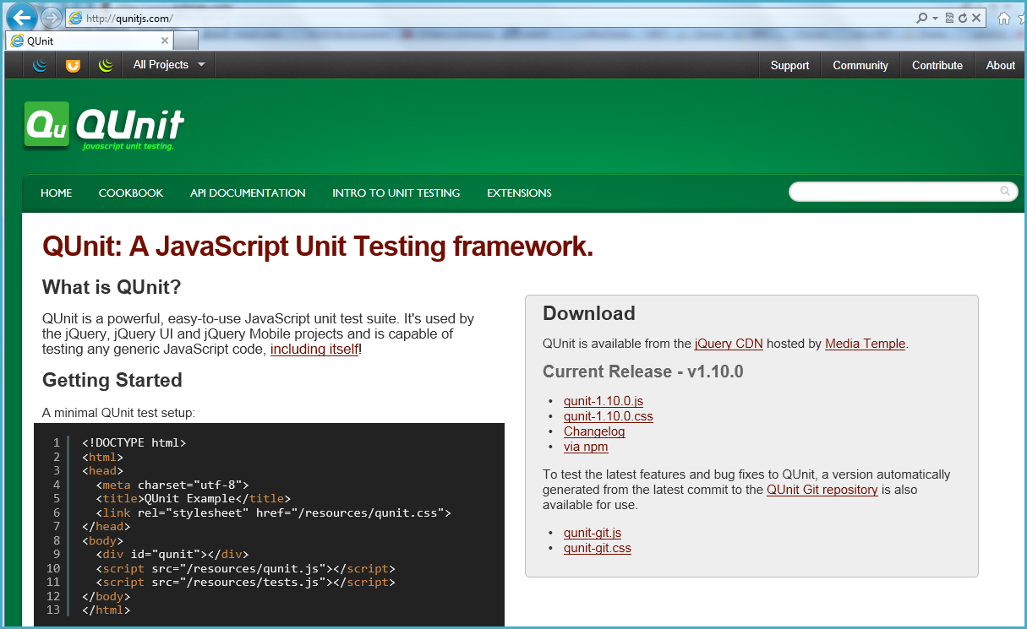
http://qunitjs.com/

Slide 20
Promises
Q.js
manager.executeQuery(query)
.then(assertGotCustomers) // success callback
.fail(handleFail) // failure callback
.fin(start); // "fin" always called.
jQuery deferred is also popular

Slide 21
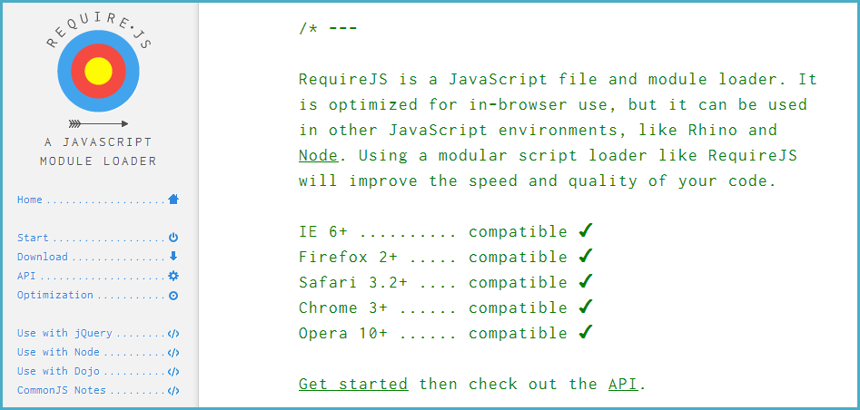
RequireJS – for modularity

Slide 22
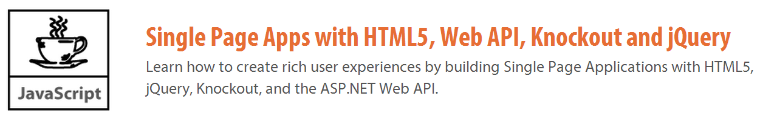
http://johnpapa.net http://jpapa.me/spaps http://jpapa.me/codecamperdemo

Slide 23

Your Feedback is Important
Please fill out a session evaluation form
drop it off at the conference registration desk.
Thank you!
AJS321: a JavaScript dev’s toolbelt

