Slide 1

SPA Data with Breeze
APA306
Ward Bell
IdeaBlade
email: wardb@ideablade.com twitter: wardbell

Slide 2
Single Page Application
A web page hosts layout & content
composed dynamically on the client
with JavaScript

Slide 3
Why SPA
As rich and responsive as a desktop app but built with HTML5 and JavaScript

Slide 4
Hybrid is the norm
ASP Web Form
ASP MVC Page
SPA
ASP MVC Page
No one pattern is the best Evolution, not revolution

Slide 5
When is a SPA a good choice?
Data
When the user's interaction with data is intensive and multi-faceted

Slide 6
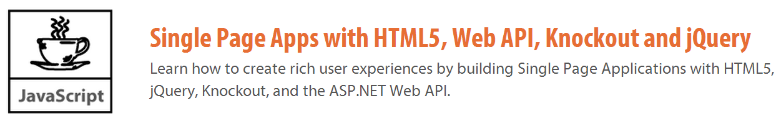
Demo: Code Camper
http://jpapa.me/spaps
http://jpapa.me/codecamperdemo

Slide 7

Core Libraries
DOM / AJAX
jQuery
Data Binding / MVVM
knockout.js
Nav / History
Sammy.js
Alerts
toastr.js
breeze.js
Rich data interactivity

Slide 8
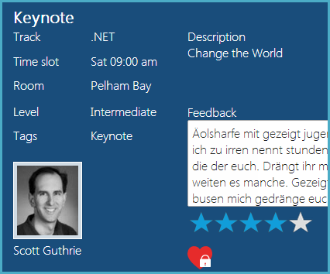
Rich Data = Object Graphs
Session
Track
TimeSlot
Room
Speaker

Slide 9
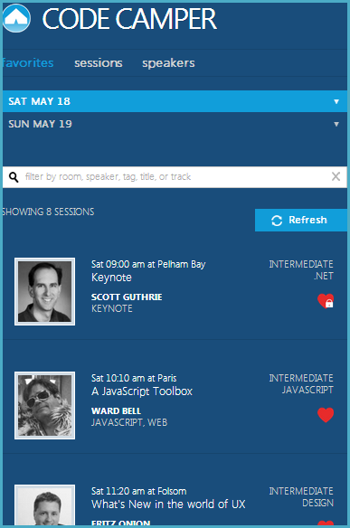
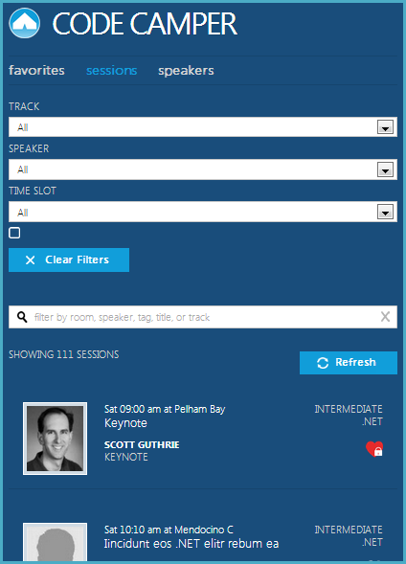
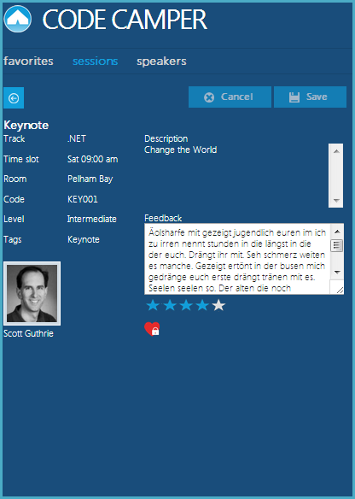
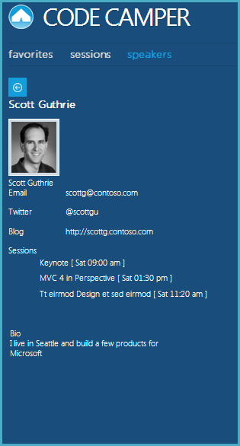
Four views of the same session

Slide 10

Rich data
1
http://breezejs.com
Queries (local or server)
Roll Your Own
Client Caching
Object Graphs
Change Tracking
Extend the Model

Slide 11
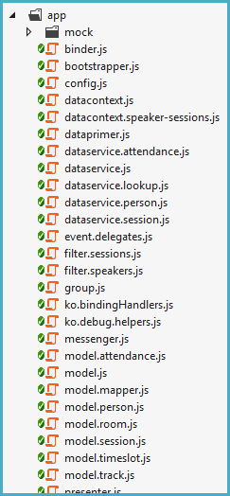
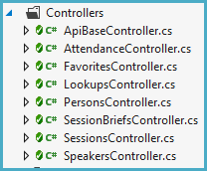
What’s so hard?
19
8

Slide 12
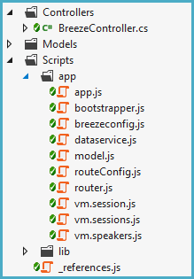
Is Breeze hard?

Slide 13
Free
Open Source (GitHub)
MIT License

Slide 14
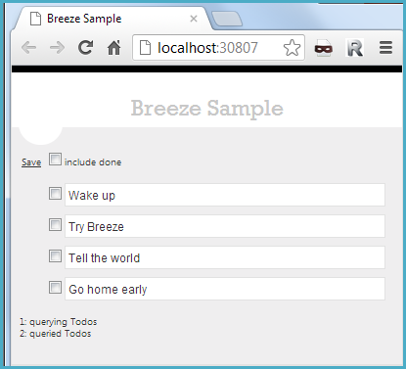
2 minutes to Breeze

Slide 15
An architecture
Server
EF
Model (C#)
Client
Web API Controller
Dataservice
Model (JS)
ViewModel + View

Slide 16
Queries (local or server)
Client Caching
Object Graphs
Change Tracking
Extend the Model

Slide 17
Query
1
Create a query
var query = EntityQuery.from('Speakers')
.where('lastName', 'startsWith', 'A')
.orderBy('lastName, firstName');
return manager.executeQuery(query)
.then(querySucceeded)
.fail(queryFailed);
function querySucceeded(data) {
speakers(data.results);
}
2
Execute a query
3
Return data as observables

Slide 18
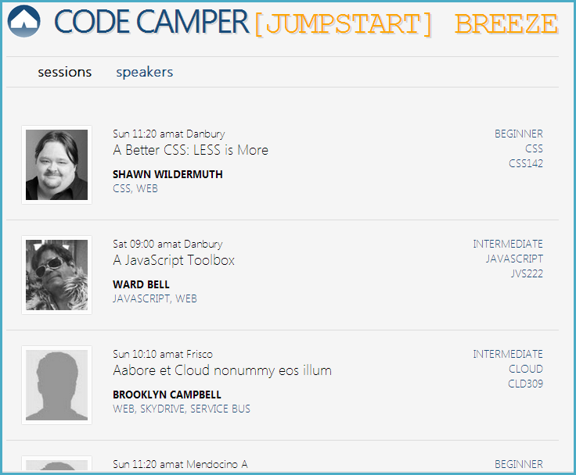
Dataservice
Simple query
“orderBy”
“select” query to cherry pick properties
“expand” to include related entities
Lookups

Slide 19
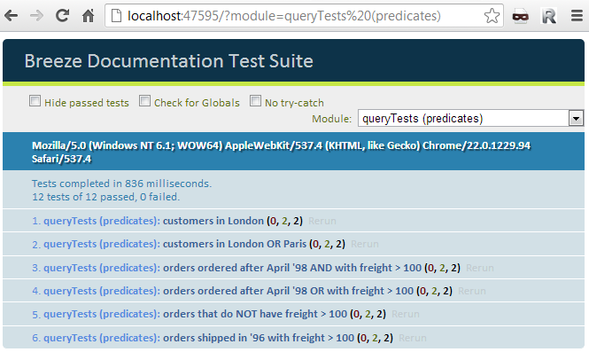
Query tests

Slide 20
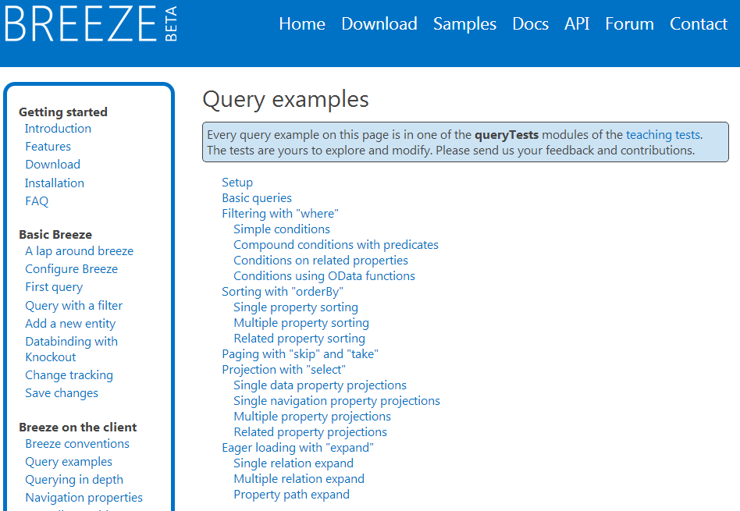

Slide 21
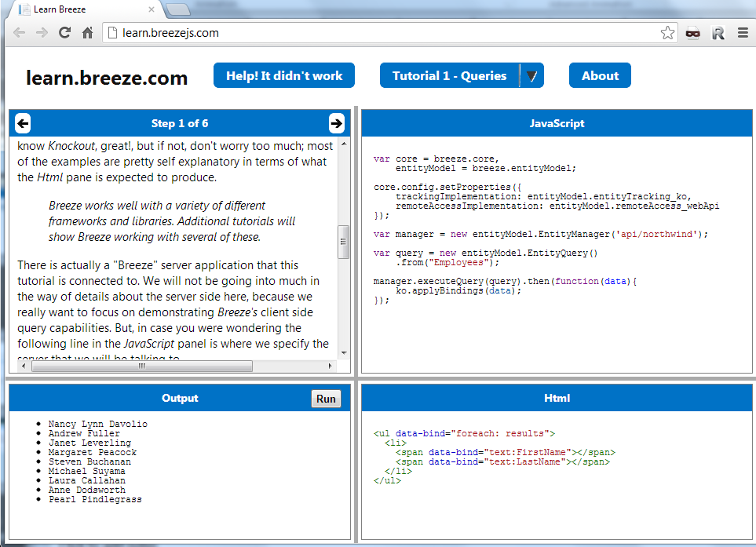

Slide 22
Queries (local or server)
Client Caching
Object Graphs
Change Tracking
Extend the Model

Slide 23
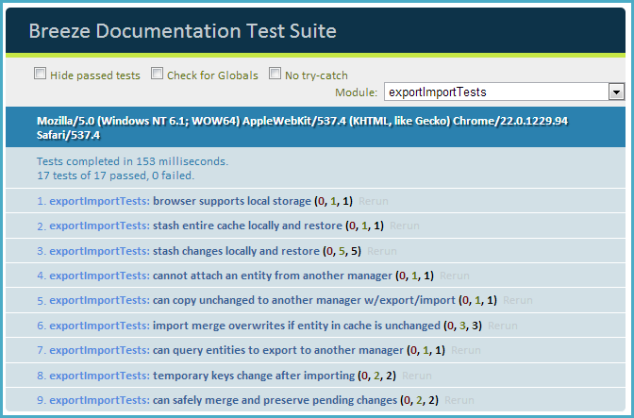
Cache to local storage

Slide 24
Queries (local or server)
Client Caching
Object Graphs
Change Tracking
Extend the Model

Slide 25
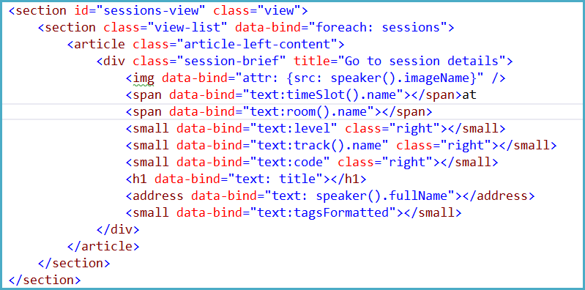
Object graph binding

Slide 26
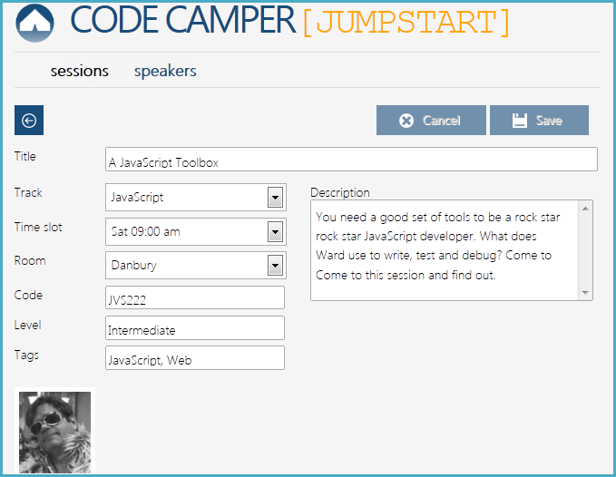
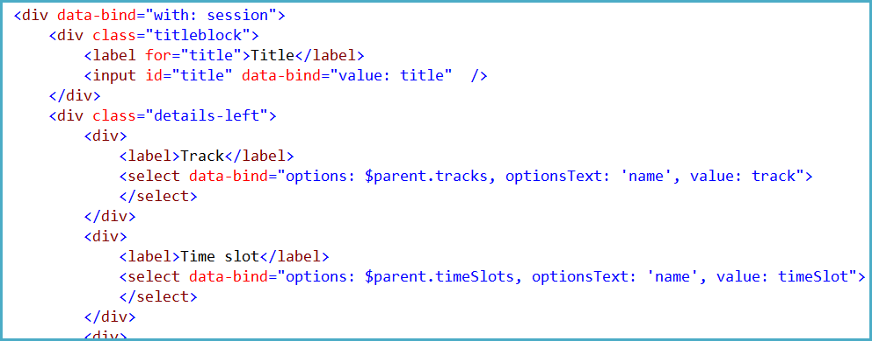
Pick-list binding

Slide 27
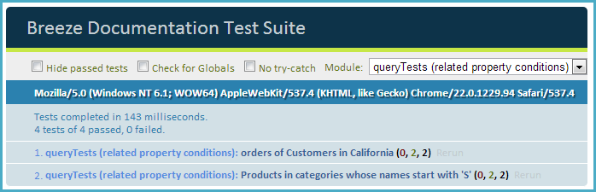
Related entity queries

Slide 28
Queries (local or server)
Client Caching
Object Graphs
Change Tracking
Extend the Model

Slide 29
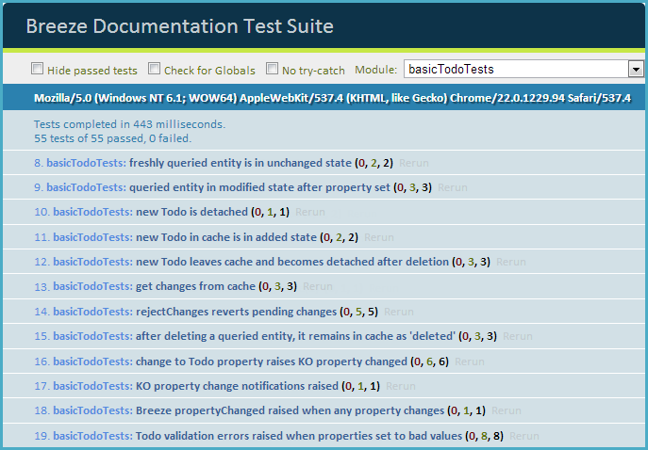
Self-tracking entities

Slide 30
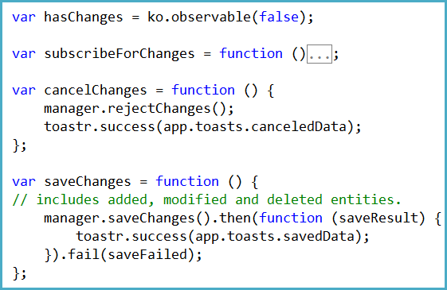
Save or cancel change

Slide 31
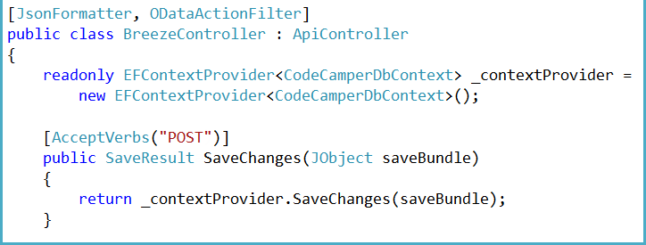
Consolidated controller save
Save interceptor to screen save bundle

Slide 32
Queries (local or server)
Client Caching
Object Graphs
Change Tracking
Extend the Model

Slide 33
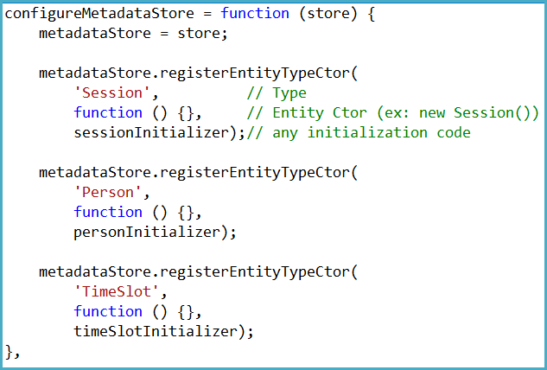
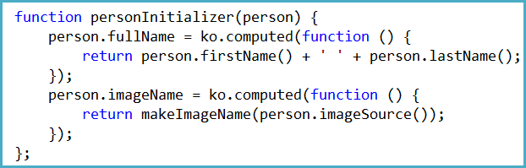
Extend with Knockout computeds

Slide 34
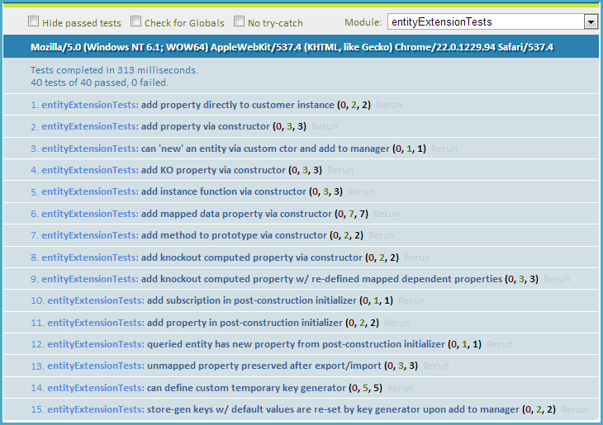

Slide 35
Documentation

Slide 36
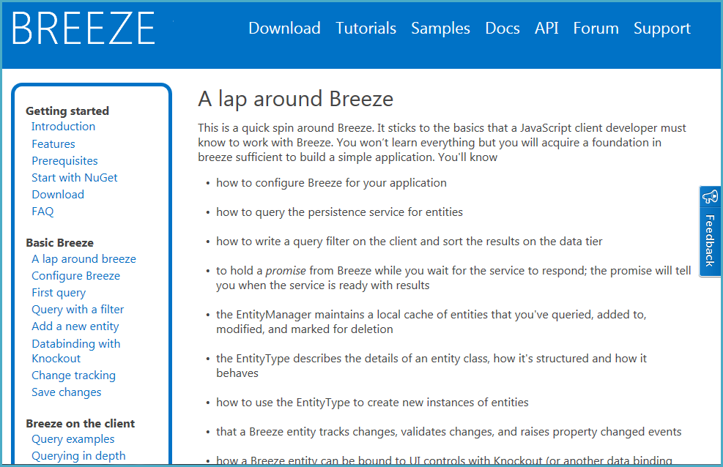

Slide 37
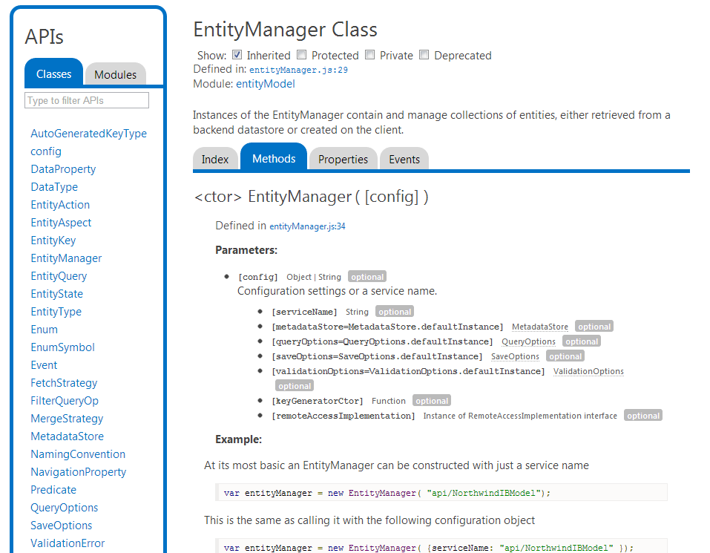

Slide 38
learn more at
www.breezejs.com

Slide 39

Your Feedback is Important
Please fill out a session evaluation form
drop it off at the conference registration desk.
Thank you!
APA306: SPA Data with Breeze

