Slide 1


for

Slide 2

{Welcome to Progress Virtual Classroom}

Slide 3
Date | Time | Course
February 28, 2018 | 9am - 1pm EST | Kendo UI & Angular
March 7, 2018 | 9am - 1pm EST | Telerik UI for ASP.NET MVC and ASP.NET Core
March 8, 2018 | 9am - 1pm EST | Kendo UI & React
March 14, 2018 | 9am - 1pm EST | Kendo UI & jQuery
March 22, 2018 | 9am - 1pm EST | Kendo UI & Vue
March 27, 2018 | 9am - 1pm EST | Telerik UI for Xamarin
March 30, 2018 | 9am - 1pm EST | Telerik UI for WPF
April 5, 2018 | 9am - 1pm EST | Telerik Reporting & Telerik Report Server
April 10, 2018 | 9am - 1pm EST | Telerik UI for WinForms
April 12, 2018 | 9am - 1pm EST | Telerik UI for ASP.NET AJAX
April 13, 2018 | 9am - 1pm EST | Telerik UI for UWP

Slide 4









Vladimir Milev
Chief Software Architect @
vladi@newventuresoftware.com
github.com/vmilev
vmilev

Slide 5
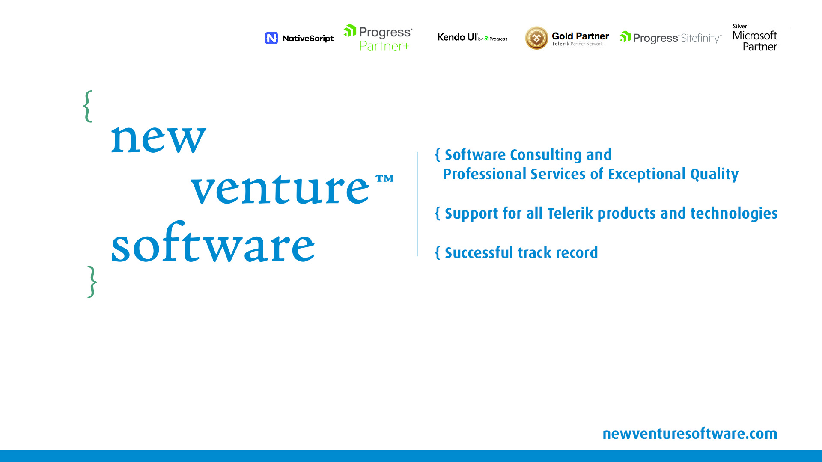

Slide 6
{Agenda}
Part 1: Vue.js
Part 2: Kendo UI for Vue
Part 3: Live coding/demo

Slide 7

Wait, wait! Aren’t there already….

Slide 8

Why Vue.js ?
Easy to learn
Easy to develop
Easy to maintain
Fast!

Slide 9



Tools we will need
Node.js
https://nodejs.org/en/download/current/
VSCode
https://code.visualstudio.com/
GitHub
https://github.com/newventuresoftware/<project>

Slide 10
{Vue.js is fast}
Library size
74.8kb
Runtime performance
Virtual DOM
Compared to other frameworks
* http://www.stefankrause.net/js-frameworks-benchmark5/webdriver-ts/table.html

Slide 11
{What is a Vue Component}
Mechanism for reusing code

Slide 12
{Advanced Tooling}

Slide 13
Vue-CLI

