Slide 1
Google File System
CSE 454
From paper by Ghemawat, Gobioff & Leung

Slide 2
The Need
Component failures normal
  Due to clustered computing
Files are huge
  By traditional standards (many TB)
Most mutations are mutations
  Not random access overwrite
Co-Designing apps & file system
Typical: 1000 nodes & 300 TB

Slide 3
Desiderata
Must monitor & recover from comp failures
Modest number of large files
Workload
  Large streaming reads + small random reads
  Many large sequential writes
    Random access overwrites don’t need to be efficient
Need semantics for concurrent appends
High sustained bandwidth
  More important than low latency

Slide 4
Interface
Familiar
  Create, delete, open, close, read, write
Novel
  Snapshot
    Low cost
  Record append
    Atomicity with multiple concurrent writes

Slide 5
Architecture
metadata only
Master
Client
Chunk
Server
}
{
Client
Many
Many
Chunk
Server
Client
data only
Client
Chunk
Server

Slide 6
Architecture
Store all files
  In fixed-size chucks
    64 MB
    64 bit unique handle
Triple redundancy
Chunk
Server
Chunk
Server
Chunk
Server

Slide 7
Architecture
Master
Stores all metadata
  Namespace
  Access-control information
  Chunk locations
  ‘Lease’ management
Heartbeats
Having one master ➔ global knowledge
  Allows better placement / replication
  Simplifies design

Slide 8
Architecture
Client
GFS code implements API
Cache only metadata
Client
Client
Client

Slide 9
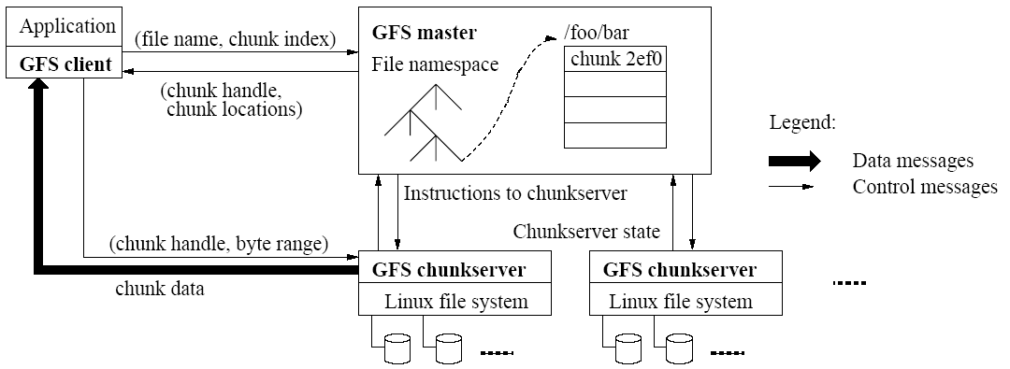
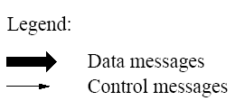
Using fixed chunk size, translate filename & byte offset to chunk index.
Send request to master

Slide 10
Replies with chunk handle & location of chunkserver replicas (including which is ‘primary’)

Slide 11
Cache info
using filename & chunk index as key

Slide 12
Request data from nearest chunkserver
“chunkhandle & index into chunk”

Slide 13
No need to talk more
About this 64MB chunk
Until cached info expires or file reopened

Slide 14
Often initial request asks about
Sequence of chunks

Slide 15
Metadata
Master stores three types
  File & chunk namespaces
  Mapping from files → chunks
  Location of chunk replicas
Stored in memory
Kept persistent thru logging

Slide 16
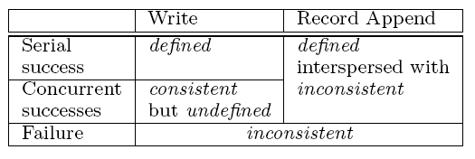
Consistency Model
Consistent = all clients see same data

Slide 17
Consistency Model
Defined = consistent + clients see full effect of mutation
Key: all replicas must process chunk-mutation requests in same order

Slide 18
Consistency Model
Different clients may see different data

Slide 19
Implications
Apps must rely on appends, not overwrites
Must write records that
  Self-validate
  Self-identify
Typical uses
  Single writer writes file from beginning to end, then renames file (or checkpoints along way)
  Many writers concurrently append
    At-least-once semantics ok
    Reader deal with padding & duplicates

Slide 20
Leases & Mutation Order
Objective
  Ensure data consistent & defined
  Minimize load on master
Master grants ‘lease’ to one replica
  Called ‘primary’ chunkserver
Primary serializes all mutation requests
  Communicates order to replicas

Slide 21
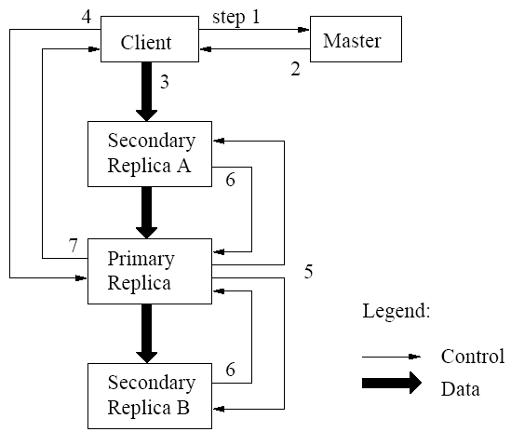
Write Control & Dataflow

Slide 22
Atomic Appends
As in last slide, but…
Primary also checks to see if append spills over into new chunk
  If so, pads old chunk to full extent
  Tells secondary chunk-servers to do the same
  Tells client to try append again on next chunk
Usually works because
  max(append-size) < ¼ chunk-size [API rule]
  (meanwhile other clients may be appending)

Slide 23
Other Issues
Fast snapshot
Master operation
  Namespace management & locking
  Replica placement & rebalancing
  Garbage collection (deleted / stale files)
  Detecting stale replicas

Slide 24
Master Replication
Master log & checkpoints replicated
Outside monitor watches master livelihood
  Starts new master process as needed
Shadow masters
  Provide read-access when primary is down
  Lag state of true master

Slide 25
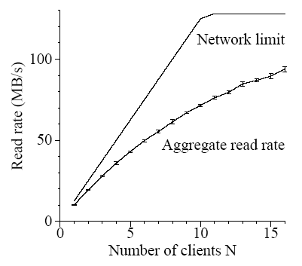
Read Performance

Slide 26
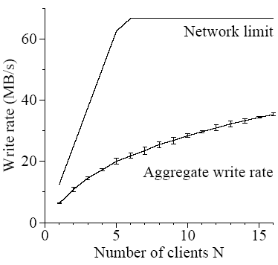
Write Performance

Slide 27
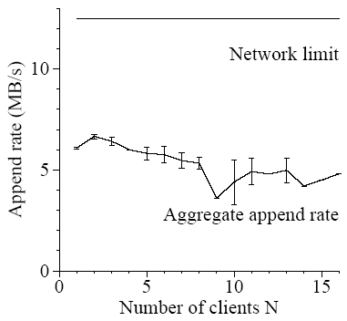
Record-Append Performance

