Slide 1
A recap of congestion control in TCP
Based upon slides from:
D. Choffnes, P. Gill, S. Katti, and N. Carlsson (Linköping University, Sweden)
Bob Kinicki (Worcester Polytechnic Institute)
Bob Briscoe et al. (IETF 96 meeting)

Slide 2
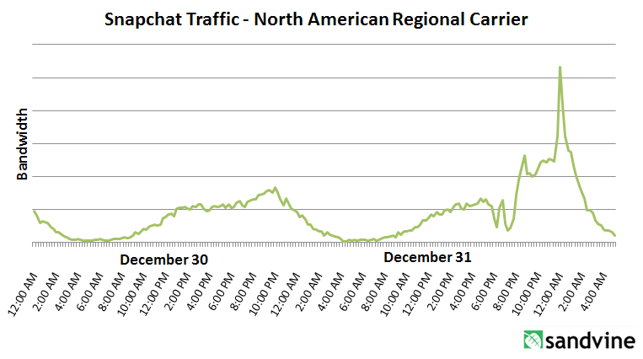
What is Congestion?
Load on the network is higher than capacity
Capacity is not uniform across networks
Modem vs. Cellular vs. Cable vs. Fiber Optics
There are multiple flows competing for bandwidth
Residential cable modem vs. corporate datacenter
Load is not uniform over time
10pm, Sunday night = Bittorrent Game of Thrones

Slide 3
Why is Congestion Bad?
Results in packet loss
Routers have finite buffers
Internet traffic is bursty, no buffer can prevent all drops
When routers get overloaded, packets will be dropped
Practical consequences
Router queues build up, delay increases
Wasted bandwidth from retransmissions
Low network “goodput”

Slide 4
Congestion Avoidance and Control Van Jacobson ‘88

Slide 5
The Danger of Increasing Load
Congestion Collapse
Knee – point after which
Throughput increases very slow
Delay increases fast
Cliff – point after which
Throughput → 0
Delay → ∞
Knee
Cliff
Goodput
Ideal point
Load
Delay
Load

Slide 6
Cong. Control vs. Cong. Avoidance
Congestion Avoidance:
Stay left of the knee
Congestion Control:
Stay left of the cliff
Knee
Cliff
Congestion Collapse
Goodput
Load

Slide 7
Advertised Window, Revisited
Does TCP’s advertised window solve congestion?
NO
The advertised window only protects the receiver
A sufficiently fast receiver can max the window
What if the network is slower than the receiver?
What if there are other concurrent flows?
Key points
Window size determines send rate
Window must be adjusted to prevent congestion collapse

Slide 8
Goals of Congestion Control
Adjusting to the bottleneck bandwidth
Adjusting to variations in bandwidth
Sharing bandwidth between flows
Maximizing throughput

Slide 9
General Approaches
Do nothing, send packets indiscriminately
Many packets will drop, totally unpredictable performance
May lead to congestion collapse
Reservations
Pre-arrange bandwidth allocations for flows
Requires negotiation before sending packets
Must be supported by the network
Dynamic adjustment
Use probes to estimate level of congestion
Speed up when congestion is low
Slow down when congestion increases
Messy dynamics, requires distributed coordination

Slide 10
TCP Congestion Control
Each TCP connection has a window
Controls the number of unACKed packets
Sending rate is ~ window/RTT
Idea: vary the window size to control the send rate
Introduce a congestion window at the sender
Congestion control is sender-side problem

Slide 11
Congestion Window (cwnd)
Limits how much data is in transit
Denominated in bytes
wnd = min(cwnd, adv_wnd);
effective_wnd = wnd –
(last_byte_sent – last_byte_acked);
last_byte_acked
last_byte_sent
effective_wnd
wnd

Slide 12
Two Basic Components
Detect congestion
Packet dropping is most reliably signal
Delay-based methods are hard and risky
How do you detect packet drops? ACKs
Timeout after not receiving an ACK
Several duplicate ACKs in a row
Rate adjustment algorithm
Modify cwnd
Probe for bandwidth
Responding to congestion

Slide 13
Detection
Sequence numbers catch sequence problems
Duplicates are ignored
Out-of-order packets are reordered or dropped
Missing sequence numbers indicate lost packets
Lost segments detected by sender
Use timeout to detect missing ACKs
Need to estimate RTT to calibrate the timeout
Sender must keep copies of all data until ACK

Slide 14
Implementing Congestion Control
Maintains three variables:
cwnd: congestion window
adv_wnd: receiver advertised window
ssthresh: threshold size (used to update cwnd)
For sending, use: wnd = min(cwnd, adv_wnd)
Two phases of congestion control
Slow start (cwnd < ssthresh)
Probe for bottleneck bandwidth
Congestion avoidance (cwnd >= ssthresh)
AIMD
Notes:
Got to here.

Slide 15
Slow Start
Upon starting (or restarting) a connection
cwnd =1
ssthresh = adv_wnd
Each time a segment is ACKed, cwnd++
Continues until…
ssthresh is reached
Or a packet is lost
Slow Start is not actually slow
cwnd increases exponentially

Slide 16
Slow Start Example
cwnd = 1
cwnd grows rapidly
Slows down when…
cwnd >= ssthresh
Or a packet drops
1
cwnd = 2
2
3
cwnd = 4
4
5
6
7
cwnd = 8

Slide 17
Congestion Avoidance
AIMD mode
If cwnd >= ssthresh then each time a segment is ACKed increment cwnd by 1/cwnd (cwnd += 1/cwnd).
So cwnd is increased by one only if all segments have been acknowledged

Slide 18
Congestion Avoidance Example
cwnd = 1
cwnd = 2
cwnd >= ssthresh
cwnd = 4
ssthresh = 8
cwnd (in segments)
Slow Start
cwnd = 8
cwnd = 9
Round Trip Times

Slide 19
The Big Picture
ssthresh
Timeout
Congestion
Avoidance
cwnd
Slow Start
Time

Slide 20
The Evolution of TCP
Thus far, we have discussed TCP Tahoe
Original version of TCP
However, TCP was invented in 1974!
Today, there are many variants of TCP
Early, popular variant: TCP Reno
Tahoe features, plus…
Fast retransmit
Fast recovery

Slide 21
TCP Reno: Fast Retransmit
Problem: in Tahoe, if segment is lost, there is a long wait until the RTO
Reno: retransmit after 3 duplicate ACKs
cwnd = 1
1
2
cwnd = 2
2
3
3
4
cwnd = 4
4
5
6
7
4
3 Duplicate ACKs
4
4

Slide 22
TCP Reno: Fast Recovery
After a fast-retransmit set cwnd to ssthresh/2
i.e. don’t reset cwnd to 1
Avoid unnecessary return to slow start
Prevents expensive timeouts
But when RTO expires still do cwnd = 1
Return to slow start, same as Tahoe
Indicates packets aren’t being delivered at all
i.e. congestion must be really bad

Slide 23
Fast Retransmit and Fast Recovery
ssthresh
Timeout
Congestion Avoidance
Fast Retransmit/Recovery
Timeout
cwnd
Slow Start
Time
At steady state, cwnd oscillates around the optimal window size
TCP always forces packet drops

Slide 24
Many TCP Variants…
Tahoe: the original
Slow start with AIMD
Dynamic RTO based on RTT estimate
Reno: fast retransmit and fast recovery
NewReno: improved fast retransmit
Reduce number of retransmissions
Window inflation
Vegas: delay-based congestion avoidance
And many, many, many more…

Slide 25
TCP in the Real World
What are the most popular variants today?
Key problem: TCP performs poorly on high bandwidth-delay product networks (like the modern Internet)
Compound TCP (Windows)
Based on Reno
Uses two congestion windows: delay based and loss based
Thus, it uses a compound congestion controller
TCP CUBIC (Linux)
Enhancement of BIC (Binary Increase Congestion Control)
Window size controlled by cubic function
Parameterized by the time T since the last dropped packet

Slide 26
High Bandwidth-Delay Product
Key Problem: TCP performs poorly when
The capacity of the network (bandwidth) is large
The delay (RTT) of the network is large
Or, when bandwidth * delay is large
b * d = maximum amount of in-flight data in the network
a.k.a. the bandwidth-delay product
Why does TCP perform poorly?
Slow start and additive increase are slow to converge
TCP is ACK clocked
i.e. TCP can only react as quickly as ACKs are received
Large RTT → ACKs are delayed → TCP is slow to react

Slide 27
Reno
Low window size resilience to packet loss in High-Speed Network
1.4 hours
1.4 hours
1.4 hours
Packet loss
Packet loss
Packet loss
Packet loss
TCP
cwnd
100,000
10Gbps
50,000
Slow Increase
cwnd = cwnd + 1
Fast Decrease
cwnd = cwnd * 0.5
5Gbps
Slow start
Congestion avoidance
Time (RTT)
Presentation: "Congestion Control on High-Speed Networks”, Injong Rhee, Lisong Xu, Slide 7

Slide 28
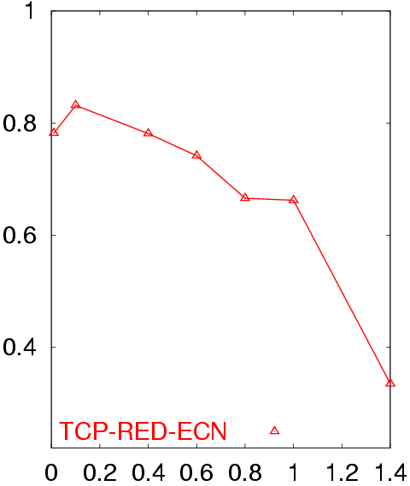
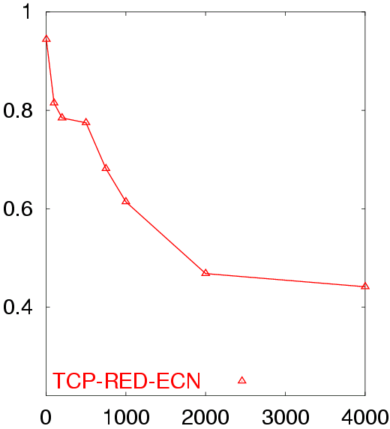
Poor Performance of TCP Reno CC
50 flows in both directions
Buffer = BW x Delay
RTT = 80 ms
50 flows in both directions
Buffer = BW x Delay
BW = 155 Mb/s
Avg. TCP Utilization
Avg. TCP Utilization
Bottleneck Bandwidth (Mb/s)
Round Trip Delay (sec)

Slide 29
Goals
Fast window growth
Slow start and additive increase are too slow when bandwidth is large
Want to converge more quickly
Maintain fairness with other TCP variants
Window growth cannot be too aggressive
Improve RTT fairness
TCP Tahoe/Reno flows are not fair when RTTs vary widely
Simple implementation

Slide 30
Compound TCP Implementation
Default TCP implementation in Windows
Key idea: split cwnd into two separate windows
Traditional, loss-based window
New, delay-based window
wnd = min(cwnd + dwnd, adv_wnd)
cwnd is controlled by AIMD
dwnd is the delay window
Rules for adjusting dwnd:
If RTT is increasing, decrease dwnd (dwnd >= 0)
If RTT is decreasing, increase dwnd
Increase/decrease are proportional to the rate of change

Slide 31
Compound TCP Example
Faster cwnd growth
High
RTT
Low
RTT
Slower cwnd growth
Timeout
Timeout
cwnd
Slow Start
Time
Aggressiveness corresponds to changes in RTT
Advantages: fast ramp up, more fair to flows with different RTTs
Disadvantage: must estimate RTT, which is very challenging

Slide 32
TCP CUBIC Implementation
Default TCP implementation in Linux
Replace AIMD with cubic function
Solve RTT un-fairness
B → a constant fraction for multiplicative increase
T → time since last packet drop
W_max ➔ cwnd when last packet dropped

Slide 33
CUBIC Algorithm
ACK received
C is a scaling factor
t is the elapsed time from the last window reduction
Wmax is the window size just before the last window reduction
K is updated at the time of last lost event
Recovery
Update K with:
Update Wmax with:
β is a constant multiplication decrease factor
cwnd cannot be less than
as to keep the growth rate the same as standard TCP in short RTT networks.

Slide 34
TCP CUBIC Example
Slowly accelerate to probe for bandwidth
CUBIC Function
Timeout
cwnd_{max}
cwnd
Stable
Region
Slow Start
Fast ramp up
Time
Less wasted bandwidth due to fast ramp up
Stable region and slow acceleration help maintain fairness
Fast ramp up is more aggressive than additive increase
To be fair to Tahoe/Reno, CUBIC needs to be less aggressive

Slide 35
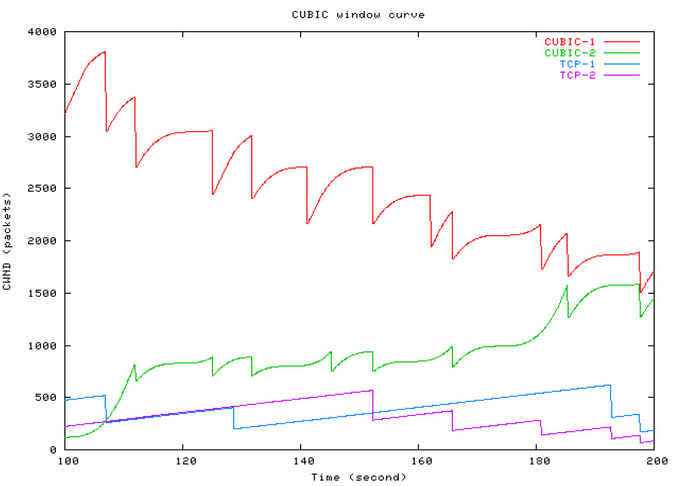
Simulations of CUBIC Flows
CUBIC
CUBIC
Reno
Reno

Slide 36
Deploying TCP Variants
TCP assumes all flows employ TCP-like congestion control
TCP-friendly or TCP-compatible
Violated by UDP :(
If new congestion control algorithms are developed, they must be TCP-friendly
Be wary of unforeseen interactions
Variants work well with others like themselves
Different variants competing for resources may trigger unfair, pathological behavior

Slide 37
Issues with TCP
The vast majority of Internet traffic is TCP
However, many issues with the protocol
Lack of fairness
Synchronization of flows
Poor performance with small flows
Really poor performance on wireless networks

Slide 38


Fairness
Problem: TCP throughput depends on RTT
100 ms
1 Mbps
1 Mbps
1 Mbps
1 Mbps
1 Mbps
1000 ms
ACK clocking makes TCP inherently unfair
Possible solution: maintain a separate delay window
Implemented by Microsoft’s Compound TCP

Slide 39
Synchronization of Flows
Oscillating, but high overall utilization
Ideal bandwidth sharing
cwnd
cwnd
In reality, flows synchronize
One flow causes all flows to drop packets
Periodic lulls of low utilization
cwnd

Slide 40
Small Flows
Problem: TCP is biased against short flows
1 RTT wasted for connection setup (SYN, SYN/ACK)
cwnd always starts at 1
Vast majority of Internet traffic is short flows
Mostly HTTP transfers, <200KB
Most TCP flows never leave slow start!
Proposed solutions (driven by Google):
Increase initial cwnd to 10
TCP Fast Open: use cryptographic hashes to identify receivers, eliminate the need for three-way handshake

Slide 41
Wireless Networks
Problem: Tahoe and Reno assume loss = congestion
True on the WAN, bit errors are very rare
False on wireless, interference is very common
TCP throughput ~ 1/sqrt(drop rate)
Even a few interference drops can kill performance
Possible solutions:
Break layering, push data link info up to TCP
Use delay-based congestion detection (TCP Vegas)
Explicit congestion notification (ECN)

Slide 42
TCP Perspectives
Cerf/Kahn
Provide flow control
Congestion handled by retransmission
Jacobson / Karels
Need to avoid congestion
RTT estimates critical
Queuing theory can help
Winstein/Balakrishnan
TCP is maximizing an objective function
Fairness/efficiency
Throughput/delay
Let a learning program pick the best fit for your environment

