Slide 1
Digital signature
-Sunny Nipun Dasu

Slide 2
What is Digital Signature?
A Digital signature is a mathematical scheme for demonstrating the authenticity of a digital message or documents. A valid digital signature gives a recipient reason to believe that the message was created by a known sender. Digital signatures are commonly used for software distribution, financial transactions, and in other cases where it is important to detect forgery or tampering.

Slide 3
Authenticity
Integrity
Non-Repudiation
Non repudiation refers to the ability to ensure that a party to a contract or a communication cannot deny the authenticity of their signature on a document or the sending of a message that they originated.
The Digital Signature helps to assure that the signer is who he/she claims to be.
The Digital Signature helps to assure that the content has not been changed or tampered with since it was digitally signed

Slide 4
Digital Signature has three main blocks
1.Key Generation Algorithm(symmetric or asymmetric)
2.Signing Algorithm
3.Signature Verification

Slide 5
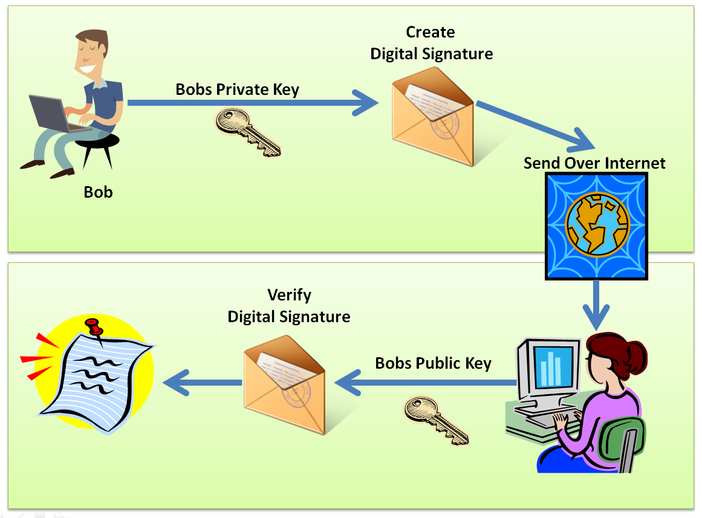

Slide 6
RSA(Ron Rivest, Adi Shamir, and Leonard Adleman)
Key Generation:
The keys for the RSA algorithm are generated the following way:
Choose two distinct prime numbers p and q.
For security purposes, the integers p and q should be chosen at random, and should be similar in magnitude but 'differ in length by a few digits to make factoring harder.
Compute n = pq.
n is used as the modulus for both the public and private keys.
Compute φ(n) = φ(p)φ(q) = (p − 1)(q − 1), where φ is Euler's totient function. This value is kept private.
Choose an integer e such that 1 < e < φ(n) and gcd(e, φ(n)) = 1; i.e., e and φ(n) are coprime.
Determine d as d ≡ e⁻¹ (mod φ(n)); i.e., d is the modular multiplicative inverse of e (modulo φ(n)).
This is more clearly stated as: solve for d given d⋅e ≡ 1 (mod φ(n))
d is kept as the private key exponent.

Slide 7
Encryption Algorithm :
In this phase using the parameters generated in the first phase we sign the message as shown below
c=m^{d} mod n
Signature Verification Algorithm:
The signature can be verified by extracting the message.
m=c^{e} mod n

Slide 8
Example:
Choose two distinct prime numbers, such as
p = 61 and q = 53
Compute n = pq giving
n = 61* 53 = 3233
Compute the totient of the product as φ(n) = (p − 1)(q − 1) giving
φ(3233) = (61 - 1)(53 - 1) = 3120
Choose any number 1 < e < 3120 that is coprime to 3120.
Let e = 17
Compute d, the modular multiplicative inverse of e (mod φ(n)) yielding,
d = 2753
Worked example for the modular multiplicative inverse:
e *d mod φ (n) = 1
17 *2753 mod φ ( 3120) = 1

Slide 9
The public key is (n = 3233, e = 17). For a padded plaintext message m, the encryption function is
c(m) = m¹⁷mod( 3233)
The private key is (d = 2753). For an encrypted cipher text c, the decryption function is
m(c) = c²⁷⁵³mod(3233)
For instance, in order to encrypt m = 65, we calculate
c = 65¹⁷mod(3233) = 2790
To decrypt c = 2790, we calculate
m = 2790²⁷⁵³mod(3233) = 65

Slide 10
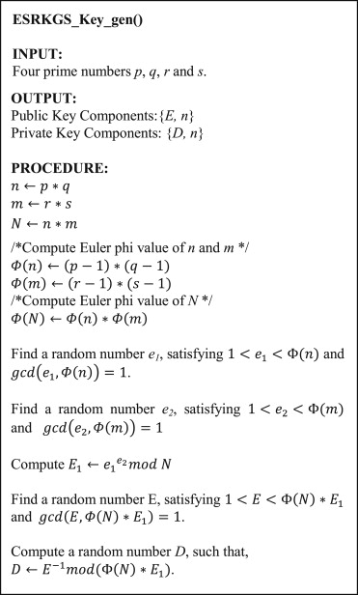
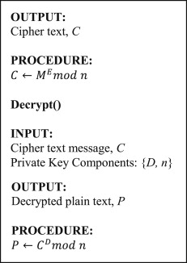
Enhanced and Secure RSA key generation scheme[1]

Slide 11
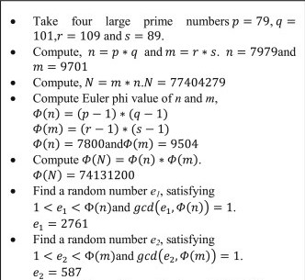
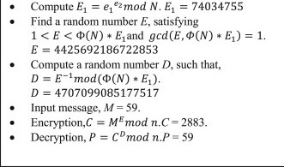
Example

Slide 12
Performance of ESRKGS.
Length of p,q, r and s (in bits) | Key generation time (in ms) | Encryption time (in ms) | Decryption time (in ms) | Total execution time (in ms)
100 | 113 | 1.5 | 1.3 | 115.8
128 | 165 | 2 | 2 | 169
256 | 237 | 3 | 2 | 242
512 | 389 | 16 | 16 | 421
1024 | 1168 | 105 | 106 | 1379
2048 | 11,164 | 784 | 745 | 12,693
4096 | 181,811 | 6620 | 6647 | 195,078
Performance of RSA.
Length of p,q(in bits) | Key generation time (in ms) | Encryption time (in ms) | Decryption time (in ms) | Total execution time (in ms)
100 | 72 | 1 | 1 | 74
128 | 92 | 1.1 | 1.1 | 94.2
256 | 133 | 1 | 1.1 | 135.1
512 | 352 | 3 | 3 | 358
1024 | 889 | 21 | 22 | 932
2048 | 4315 | 183 | 169 | 4667
4096 | 91,542 | 1380 | 1381 | 94,303

Slide 13
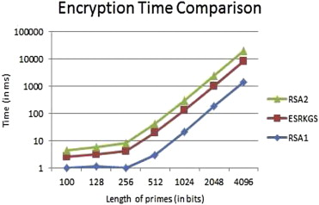
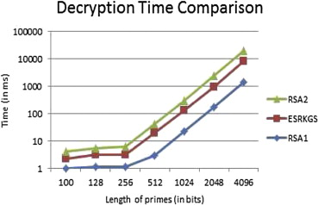

Slide 14
Proposed RSA Algorithm[2]
Choose two distinct prime numbers p&q.
Compute n = p.q
Compute φ(n) = φ(p). φ(q) =(p-1).(q-1)
Choose e1,e2,e4,e4…en such that 1<(e1,e2,e3…en)< φ(n), gcd((e1,e2,e3…en), φ(n)) = 1,where (e1,e2,e3…en) & φ(n) are co-prime; here (e1,e2,e3…en) used as public key exponent.
Determine
d=e⁻¹ (mod φ(n))
For e1: d1.e1 = mod(φ(n))
For e2: d2.e2 = mod(φ(n))
.
.
.
For en: dn.en = mod(φ(n))

Slide 15
Here d1 ,d2 ,d3 ….. dn is kept as the private key exponents.
So, public key(e1,n),(e2,n),(e3,n)…..(en,n) and private key(d1,n) (d2,n),(d3,n)…..(dn,n)
For Encryption: Cipher text, c = m^{e}(mod n)
Similarly calculate the value of other cipher text (c1,c2,c3…..cn) using value of public key(e1,n),(e2,n),(e3,n)…..(en,n) and private key(d1,n) (d2,n),(d3,n)…..(dn,n)
For Decryption: Message, m = c^{d}(mod n)
Similarly calculate the value of other received messages (m1,m2,m3…..mn) using value of public key(e1,n),(e2,n),(e3,n)…..(en,n) and private key(d1,n) (d2,n),(d3,n)…..(dn,n)

Slide 16
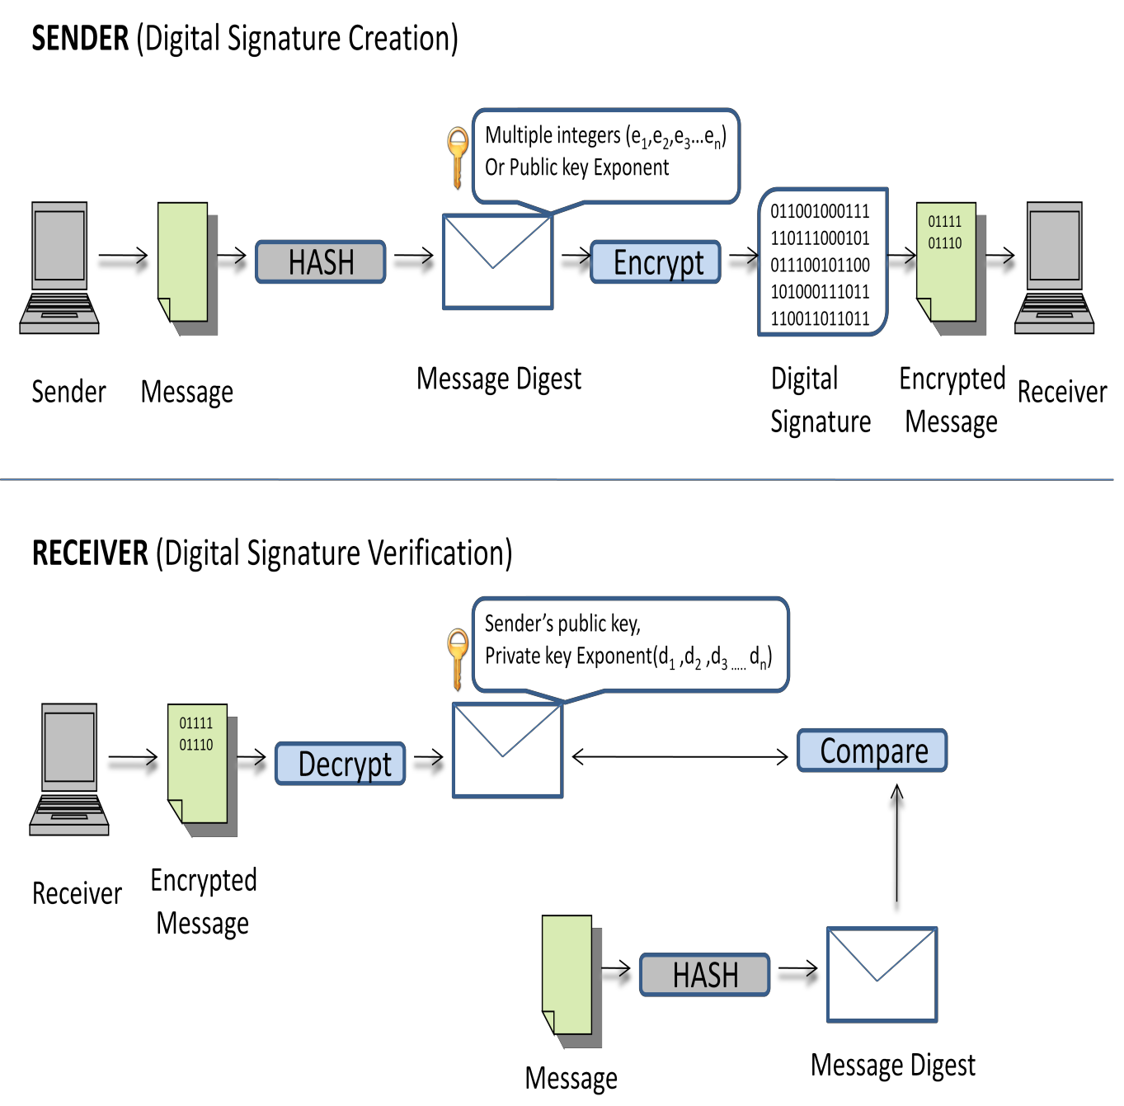
Proposed RSA Algorithm Design:

Slide 17
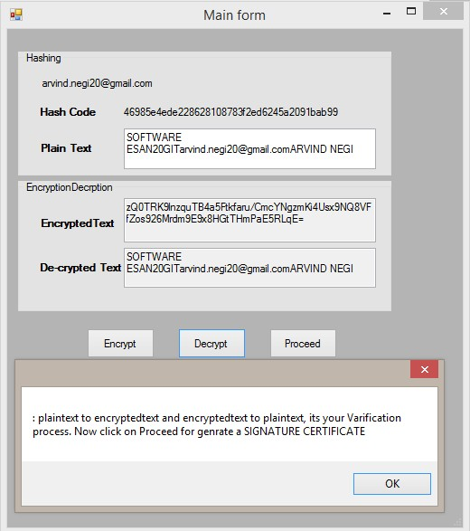
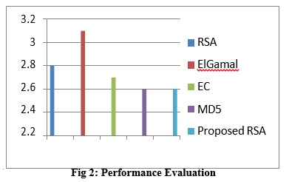
Result Analysis:
The algorithm has been executed on CPU Intel CORE i3, Processor
2.20 GHz. The project of digital signature certificate Implemented using Microsoft Visual Studio 2010, (Fig 3). It is tested with messages with length 50

Slide 18
Conclusion:
According to the survey using Enhanced and Secure RSA key generation scheme is advantageous than using the above proposed RSA.
Even though the ESRKGS takes little more time for encryption and decryption , it will be hard to find the prime numbers based on the e and n as it has much complex implementation.

Slide 19
References:
Thangavel, M. , Varalakshmi, P. , Murrali, M. , & Nithya, K. (2015). An enhanced and secured rsa key generation scheme (esrkgs). Journal of Information Security and Applications, 20, 3-10
Negi, A. , Sharma, P. , Chaudhary, P. , & Gupta, H. (2015). New method for obtaining digital signature certificate using proposed rsa algorithm. International Journal of Computer Applications, 121(23),
Xiao, Z. , Wang, Y. , & Jiang, Z. (2015). Research and implementation of four-prime rsa digital signature algorithm. 2015 IEEE/ACIS 14th International Conference on Computer and Information Science (ICIS), 545-549
https://en.wikipedia.org/wiki/RSA_(cryptosystem)

Slide 20
Thank You

