Slide 1







1 PROBLEM · 2 USERS
Welfare Navigator · PS-07 · Team SleepDeprived
The rules exist. Families cannot reach them.
A bilingual Malayalam–English screener that tells Kerala's fishing and plantation families which welfare schemes they may potentially be eligible for, why, what to bring, and where to go.
THE PROBLEM
WHO IT'S FOR
37 official sources, many unreadable
Conditions sit across PDFs, pages, Acts and orders, many in legacy-font Malayalam that cannot be searched.
Fisher and allied fish-worker families
Easy Mode, recorded Malayalam audio, big buttons
Small plantation and estate families
Mixed livelihoods, so work is multi-select
Five bodies, five sets of offices
Two welfare boards, Fisheries, Matsyafed and the Labour Commissionerate each own different benefits.
Akshaya operators and field workers
Assisted mode clears answers after 3 idle minutes
One fixable gap blocks a benefit
Unpaid Welfare Fund contributions quietly rule a family out, and nobody tells them why.
Department officers
Rules maintained as workbook data, checked in CI
32
106
37
66
0
schemes encoded
conditions, each quoted
official sources
offices, 14 districts
names or ID numbers asked
Notes:
Problem: the rules are public but scattered and partly unreadable, and one fixable gap blocks a benefit with no explanation. Users: fisher and allied families, plantation families, Akshaya operators and field workers, and the department officers who keep the rules current.

Slide 2




3 APPROACH · SYSTEM AND DATA FLOW
Welfare Navigator · PS-07 · Team SleepDeprived
Rules decide. The browser does the work.
Rules as data
all / any / not trees; every condition carries its exact source quote and page.
BUILD TIME
IN THE BROWSER · OFFLINE
ONLINE · OPTIONAL
37 official sources
Acts · GOs · guidelines
Questions · Easy Mode
tap or voice
Speech service
opt-in, confirmed
Three-valued engine
True, false or unknown. Unknown never rejects on its own.
Workbook (xlsx)
quote + page per rule
Engine T / F / U
picks next question
/api/screen
stateless, reviewers
Adaptive questions
Only what can still change a result, in bands cut at the rules' thresholds.
npm run data
validate · convert
Results · why · documents
offices · one step away
Model API
only if key is set
On-device and offline
Answers never reach our server. Only voice and the AI rewrite need internet.
dataset.json
+ rule audit in CI
Official quotes
per scheme question
/api/assist
scheme + question only
Part | Stored where | Kept? | Offline
Rules, documents, offices, strings | dataset.json bundled in the page | Build artefact | Works
Household answers | Tab memory only; never the URL or browser storage | No: Clear, close or idle | Works
Recorded audio, fonts | Static files, self-hosted | Static | Works
/api/screen · /api/assist · /api/health | Stateless server, no-store, no logging | No | Assist hides
Voice input | Browser speech service | Not by us | Hides itself
Notes:
Build time: sources to workbook to validated dataset.json, gated by the rule audit in CI. In the browser: the engine evaluates true, false or unknown and picks the next question; results and quotes render locally. Online and optional: voice, the reviewer API, and the assist API, which receives only scheme id, question type and language.

Slide 3



3 APPROACH · DATA
Welfare Navigator · PS-07 · Team SleepDeprived
Every rule carries its source sentence.
37
Sources
KFWFB welfare schemes guideline 2025 · Fisheries Department scheme pages and district officers · Small Plantation Workers' Welfare Fund Act 2008, board pages and forms · G.O.(P) 81/2024/LBR · Matsyafed and Akshaya directories.
Each has authority, URL or stored copy, and access date.
Fields
conditions fact · operator · value · OR-group · changeable · how-to · source · exact quote · page · reviewer
facts type · EN/ML question · unit · sensitivity
schemes name · authority · summary · 3 verification levels
also documents · offices · terms · disclaimer · 32 test profiles
official sources
6 tier 1 · 31 tier 2
TRANSFORMATIONS
1
2
3
4
5
6
Quote copied from the source with its page
Workbook validated; build fails on errors
OR-groups become all / any / not trees
Numbers become bands at rule thresholds
Districts and offices normalised to 14
Rule audit checks thresholds and wording
Limitations
Privacy controls
106 conditions quoted; second review still pending
Legacy-font Malayalam PDFs read and typed by hand
FISH-07 has no published route; 6 schemes lack a document list (shown on screen)
No verified office coordinates, so no distances
A snapshot as of each access date; not an official service
No name, phone, Aadhaar, address or free-text field
Income, age, years asked as bands; Prefer not to say offered
Answers in tab memory only; Clear, close or idle erases them
Printed checklist carries documents and offices, never answers
APIs no-store, no logs; AI helper rejects answers; voice disclosed
Notes:
Sources, fields, transformations, limitations and privacy controls, as in the README. The limitations come from our own rule audit and reviewer page.

Slide 4
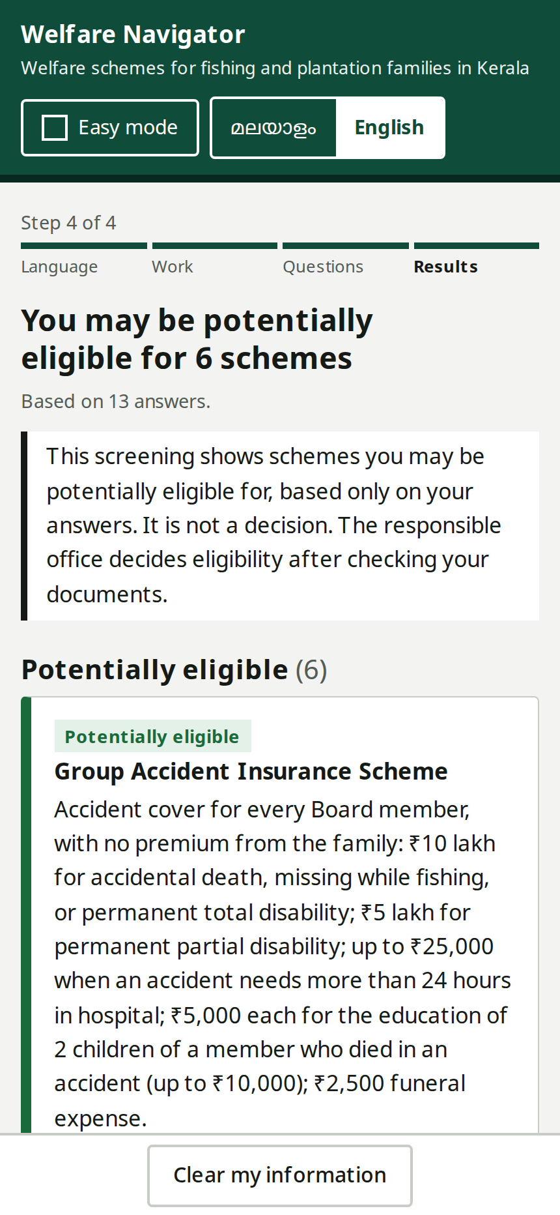
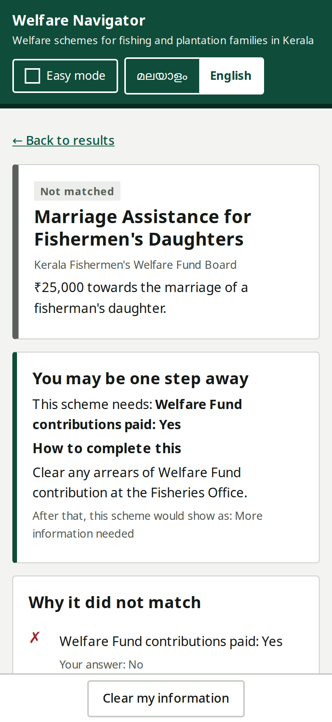

4 DEMO
Welfare Navigator · PS-07 · Team SleepDeprived
13 answers. 6 schemes worth asking about.
1
Language and mode
Malayalam or English; Easy Mode reads everything aloud
2
Livelihood
Fishing, plantation, allied work, or more than one
3
About 12 questions
Only ones that can still change a result; I don't know is always there
4
Results
6 potentially eligible, 1 one step away, under the approved disclaimer
5
Why
Each condition shows your answer, the rule, the official quote and page
6
Checklist and office
15 documents merged across 6 schemes, the right office, Clear
Edge case: contributions in arrears
Answering No to “contributions fully paid” makes Marriage Assistance Not matched, but it stays visible as one step away: clear the arrears at the Fisheries Office. The engine re-runs with that one fixable condition flipped. Nothing is promised.
Failure case: no internet
Voice and the AI rewrite hide themselves; screening, audio, quotes and results keep working.
Results
Edge case: one step away
Notes:
Live path. Then invite the judges to give us any household from their sheet and run it on /review against the same engine. Screenshots are from the current build.

Slide 5




5 IMPACT · 6 LIMITATIONS
Welfare Navigator · PS-07 · Team SleepDeprived
Fewer wasted trips, and a reason for every result.
Impact
Limitations
Which of 32 schemes to ask about, in one sitting instead of several office visits
One step away turns a silent rejection into an action
One answer-free checklist and the right office cut failed trips
One Akshaya operator screens family after family
A threshold change is a workbook edit, checked by tests and the audit
A screening, not a decision; the office verifies documents
Conditions await second review; Malayalam UI awaits native review
Voice needs Chrome and internet; weak on spoken numbers
Not yet tested with families; impact is what the design enables, not a measured result
AI use declaration
Feedback and our response
Claude Opus 5.5 coding, review, tests, docs; optional runtime model for the plain-language helper
ChatGPT GPT-6 Sol coding, Malayalam and English text drafts, source cross-checks
ElevenLabs v3 recorded question clips Browser speech optional voice
No AI decides eligibility, writes rules, or sees a family's answers.
Round 1 “Add an AI component.”
A plain-language helper grounded in official quotes: every sentence cited, any number not in the source rejected, no answers sent. Plus an automated rule audit in CI. Commit ba4e8d9.
Pre-coding review rule trees, unknown ≠ rejection, income bands, multi-select livelihood, offline build, reviewer runner. Log in FEEDBACK.md.
Notes:
Impact is what the design enables; we have not measured outcomes with families yet. AI declaration matches the README. Later rounds are logged in FEEDBACK.md.

