Slide 1


Smart Part Verification in Automotive Manufacturing Plants

Slide 2

Project Overview
Introduction:
In modern automotive assembly plants, ensuring the correct installation of parts is crucial for maintaining high product quality and minimizing production defects.
This project leverages sensor-based detection systems, including Passive Infrared (PIR), Infrared (IR), and Color Sort sensors, to monitor part presence, type, and color in real time during the assembly process.
Sensor data is transmitted to cloud platforms via MQTT for further analysis.
By integrating Machine Learning (ML) models, the system can automatically detect part mismatches, missing components, and incorrect installations, and predict the future, such as how many alert signals will be generated and the trend analysis.
Dashboards provide visual insights into defect trends, while real-time alerts are generated to prompt immediate corrective action by human operators or robotic arms. This intelligent system enhances production efficiency, reduces rework, and minimizes the risk of delivering defective products.

Slide 3
Project Overview
Domain Relevance:
Domain: Industrial Automation, Internet of Things (IoT), Embedded Systems , Machine Learning
Industry Applications: Automotive Assembly, Electronics Manufacturing, Quality Control Systems, Industrial IoT (IIoT)
Purpose of combining Embedded system with Machine Learning:
Intelligent Decision-Making: Machine Learning models analyze sensor data to detect defects, part mismatches, or missing installations with high accuracy and also predict the future for trend analysis.
Data-Driven Insights: ML-powered dashboards(Power BI) help supervisors monitor defect trends and identify root causes quickly.

Slide 4
Problem Statement
In automotive assembly plants, verifying correct part installation is vital to maintain quality and reduce rework. PIR, IR, and Color Sort sensors detect part presence, type, and color along the assembly line. This sensor data is transmitted to the cloud via MQTT. Machine learning models and data analytics pipelines process the data to detect mismatches, missing parts, or improper installations. Dashboards visualize defect trends and enable root cause analysis. The system generates real-time alerts for human or robotic intervention, enhancing efficiency and minimizing production defects.
Real-World Problem:
In Automotive assembly plants, ensuring that the correct parts are installed in the correct sequence is critical to maintaining product quality, safety, and production efficiency. However, in fast-paced manufacturing environments:
Parts may be missing.
Incorrect parts may be installed.
Wrong colors or materials may be used.
Human errors may go unnoticed until late in the process.

Slide 5
Problem Statement
Why Is It Important?
For the Automotive Industry:
Reduces defective product rates.
Increases production line efficiency.
Ensures customer safety by preventing faulty assemblies.
Saves costs by reducing rework and material waste.

Slide 6
Project Goal & Objectives
Main project goal:
To develop a smart, real-time part verification system for automotive assembly lines using embedded sensors and machine learning to minimize production defects, reduce rework costs, and improve overall manufacturing quality and efficiency.
Measurable objectives :
1. High Accuracy :
Our Machine learning model accuracy is around 92% for predicting future alerts
2. Fast Data Transmission Efficiency: Ensure sensor data transmission to the cloud via MQTT and HTTP with a latency of less than 1 second per transaction to support real-time decision-making.
3. Reduction in Manual Rework: Aim for reduction in manual rework within the first 2 months of system deployment.

Slide 7
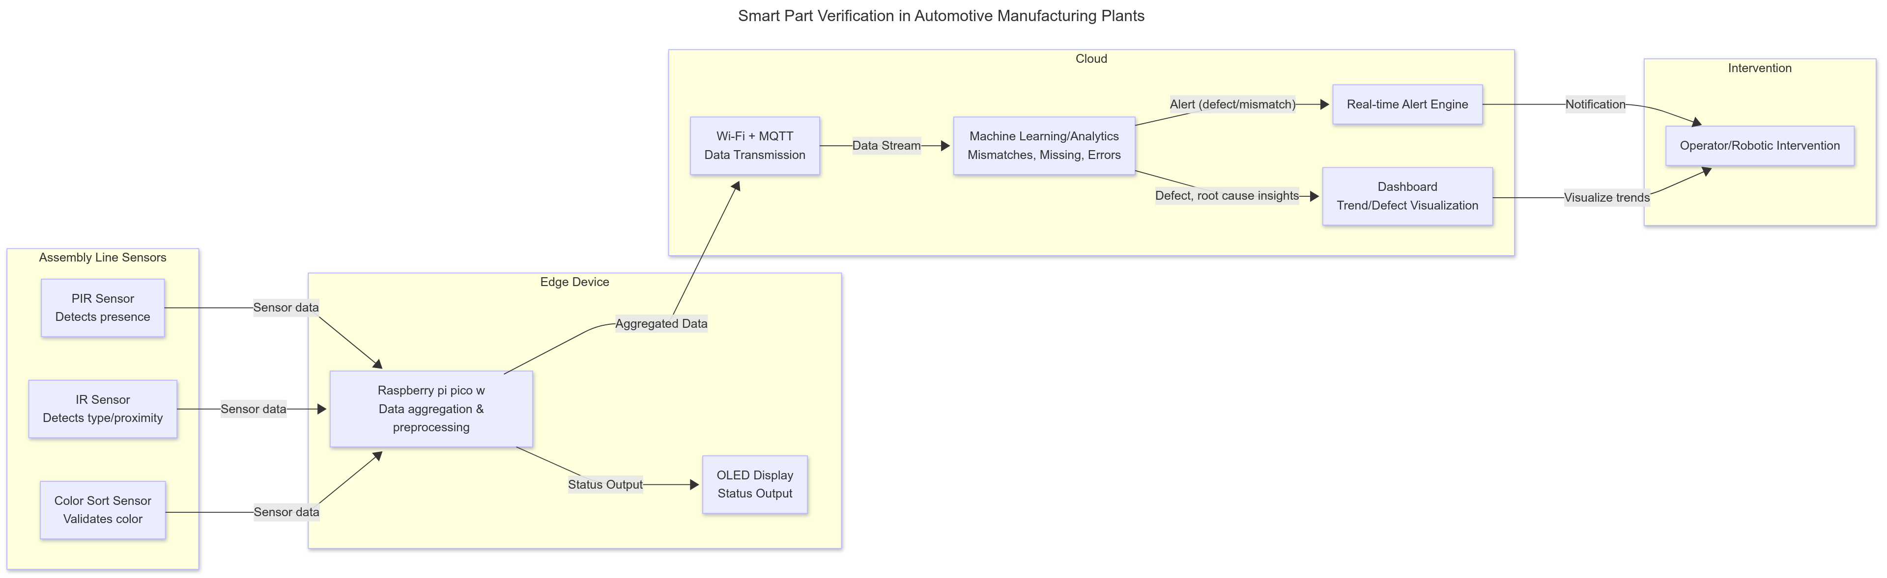
Proposed Solution
System Architecture diagram

Slide 8
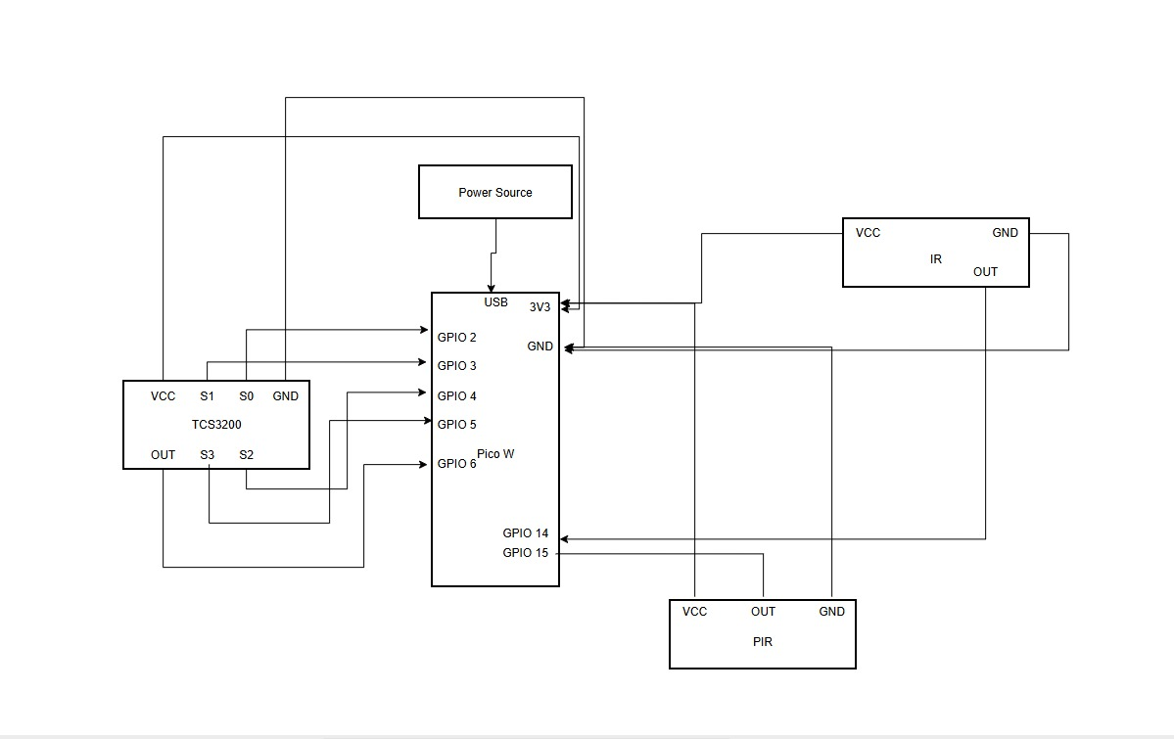
Circuit Diagram

Slide 9
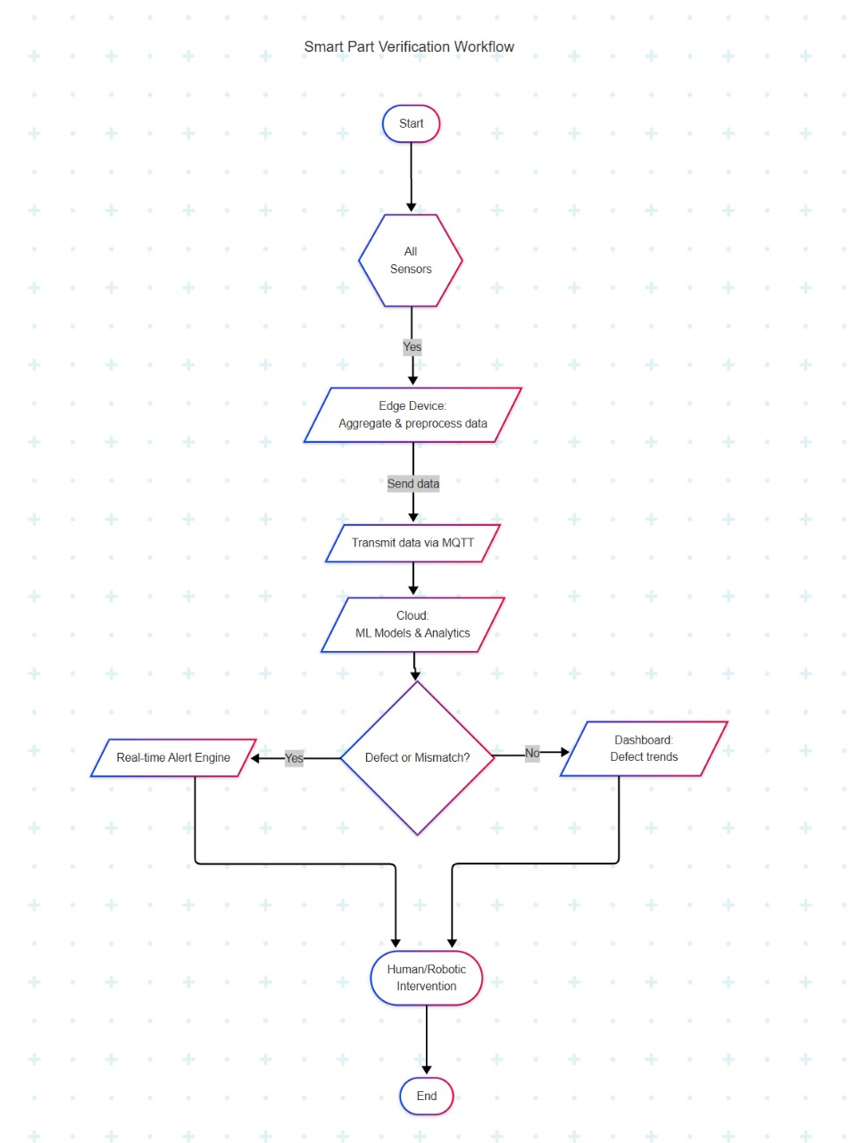
System Design
Flow chart:

Slide 10
Proposed Solution
Integration of ML and Embedded:
1. Sensor Data Collection (Embedded System Role)
Embedded Devices: Raspberry Pi used to interface with sensors (PIR, IR, and Color sensors) on the automotive assembly line.
Sensor Functions:
PIR Sensor: Detects the presence of a part.
IR Sensor: Measures distance to confirm part placement.
Color Sensor: Identifies the part’s color to verify if the correct part is being installed.
2. Data Transmission :
The embedded system processes raw sensor signals and sends this data to a cloud server or edge device using lightweight communication protocols like MQTT (Message Queuing Telemetry Transport) for fast, real-time updates.

Slide 11
3. Machine Learning Model Processing
A pre-trained Machine Learning model:
Analyzes the incoming sensor data.
Detects future alerts
Predict Future for trend analysis.
Possible ML Model: Random Forest
4. Real-Time Alerts and Dashboard Visualization
When the model detects a Defect, real-time alerts are sent back to the embedded system for immediate intervention like Buzzer.
The processed data is also displayed on a dashboard that:.
Shows Trend analysis.

Slide 12
Resources Utilized
Hardware: The Hardware components are Raspberry Pi Pico W, PIR sensor(HC-SR501) , IR sensor, and color sensor (TCS3200)
Software & Tools:
ThingSpeak - Acts as a cloud-based IoT platform to receive, store, and visualize sensor data (from PIR, IR, and Color Sort sensors).
Google Collab – Used to develop, train, and test machine learning models for detecting mismatches, missing parts, or improper installations using the sensor data.
Wokwi - Allows you to simulate the entire sensor setup (PIR, IR, Color Sort) with microcontrollers like Raspberry pi
Power BI - Builds professional dashboards to display real-time sensor data, defect trends, and system performance metrics.

Slide 13
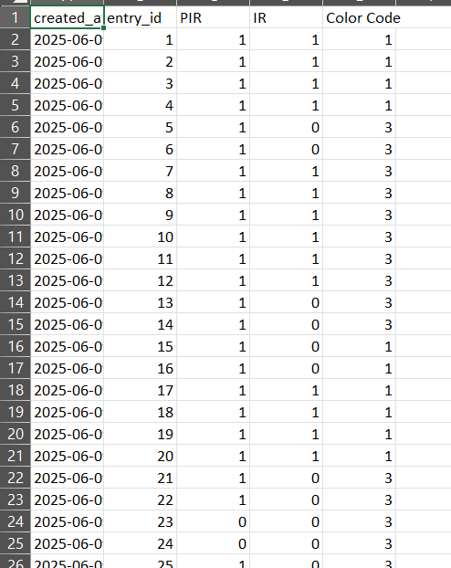
Dataset:
Initial Dataset

Slide 14
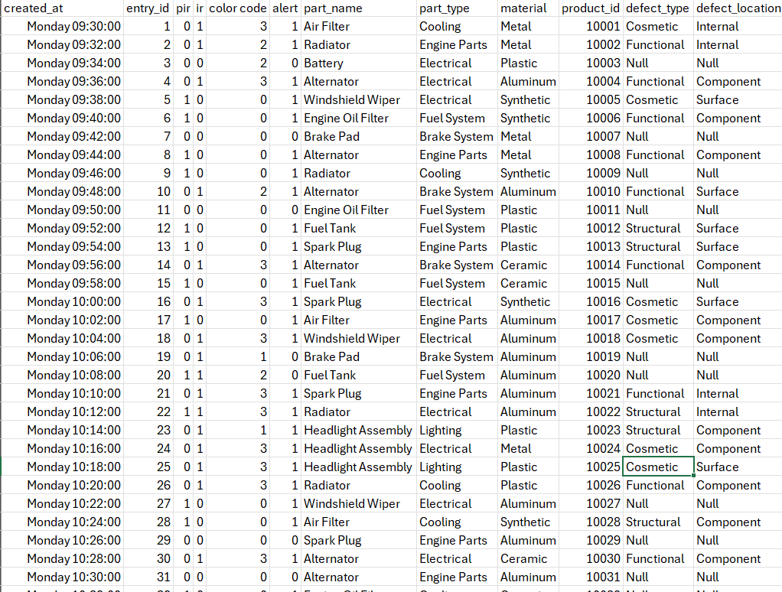
Resources Utilized
Dataset:
Synthesized Dataset

Slide 15
System Design
ML workflow:
Data Collection and Loading
Data Preprocessing
Data Splitting
Model Training
Model Evaluation
Future Predictions (7 Days)
Visualization

Slide 16
Implementation Details
Steps in project development:
Problem Understanding & Requirement Gathering
Hardware & Sensor Setup
Embedded Programming & Data Collection
Cloud Integration
Machine Learning Model Development
Real-Time Data Processing & Alerts
Dashboard Development
Deployment & Monitoring
Screenshots/code snippets if relevant

Slide 17
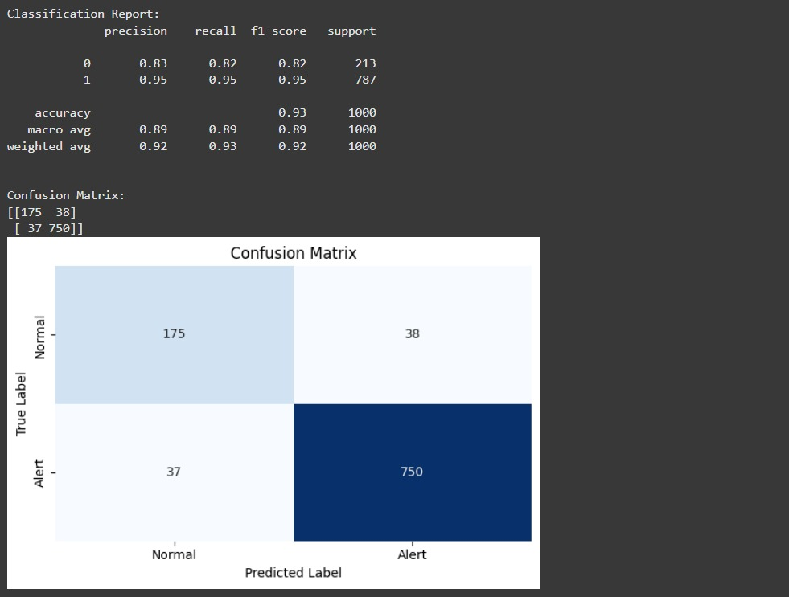
Results & Observations
Accuracy of the model

Slide 18
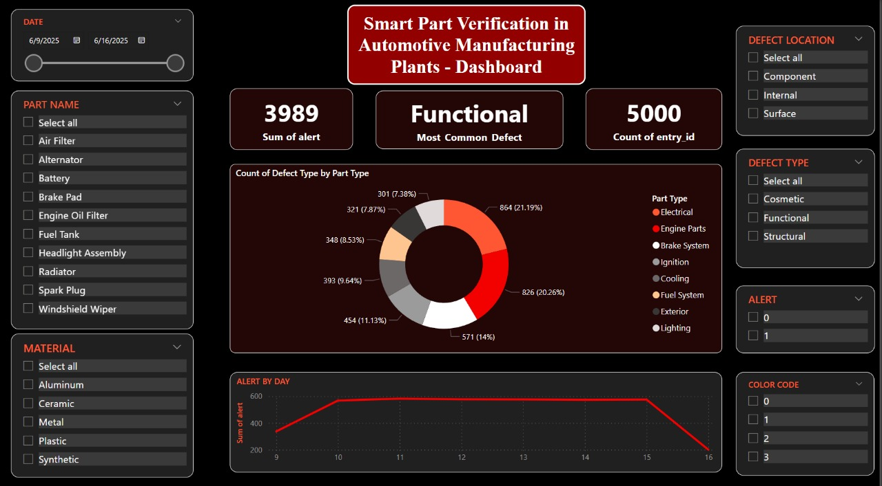
Data visualization

Slide 19
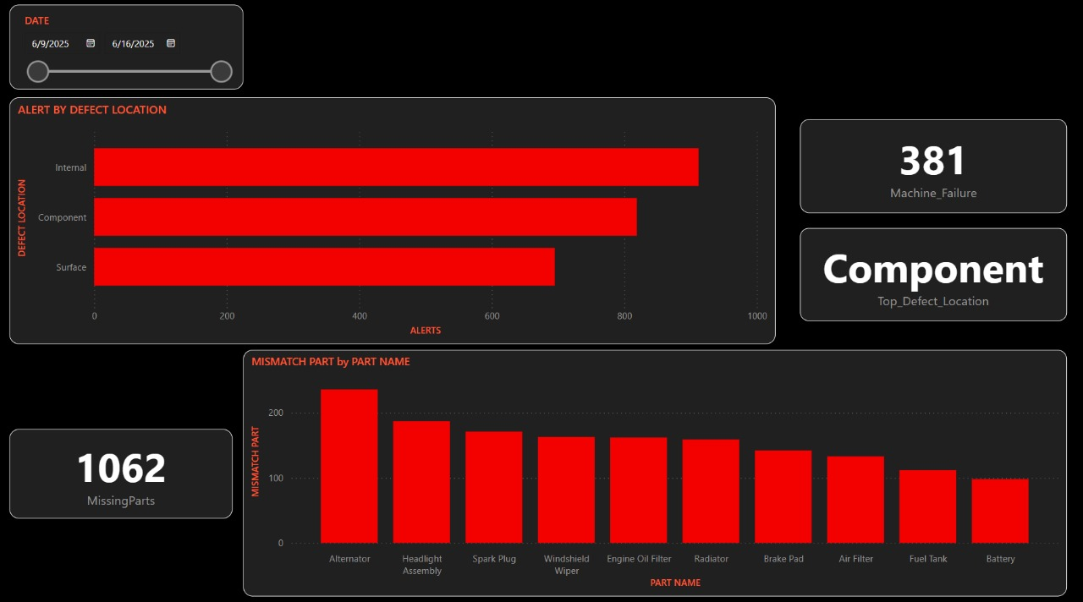
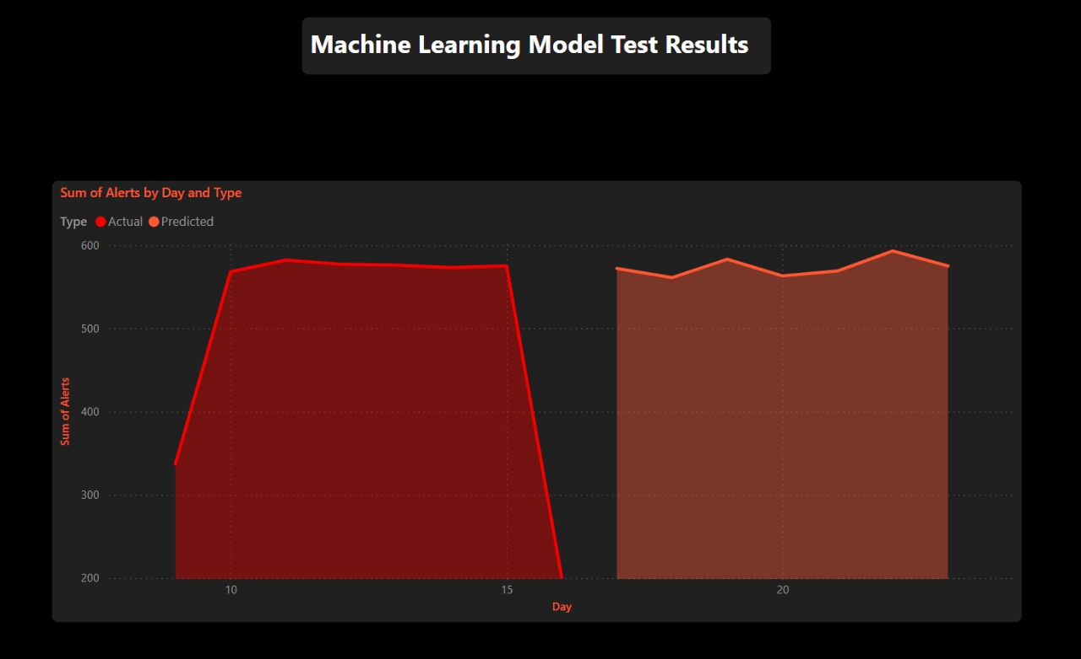

Slide 20
Advantages & Limitations
Improved Quality Control Real-time part verification ensures fewer defects, missing parts, and mismatches.
⚡Real-Time Monitoring and Alerts Instant detection and automatic alerts enable faster human or robotic intervention.
📊 Data-Driven Insights Sensor data and machine learning models provide actionable trends and root cause analysis.
🌐 Cloud-Based Accessibility Sensor data can be accessed remotely via ThingSpeak and dashboards, improving plant-wide visibility.
💰 Reduced Rework and Costs Early defect detection leads to lower rework time, reduced scrap, and cost savings.
🛠️ Scalable and Flexible The system can easily integrate additional sensors or assembly lines as the plant expands.
⚙️ Easy Simulation and Testing Hardware logic and sensor communication can be simulated virtually using Wokwi, saving time and resources.

Slide 21
Future Scope
Real-Time Data Integration
Expanded Dataset
Cloud and IoT Integration
Dashboard & Reporting

Slide 22
Conclusion
Conclusion:
The Smart Part Verification System successfully leverages sensor data (PIR, IR, color), part metadata, and time features to detect anomalies in an automotive assembly line. Using a Random Forest classifier, the system achieves reliable classification performance by predicting whether a part is defective or normal.
Key outcomes:
High accuracy in identifying defects using historical data.
Integration of time-of-day and day-of-week helped model operational patterns.
Daily alert forecasts provide insights for proactive maintenance and resource planning.

Slide 23
Thank you

