Slide 1
Project Life Expectancy
Fall 20171 Week 12
CSCI-141
Scott C. Johnson

Slide 2

Outline
Description
Getting Started
Data Files
The Five Tasks
Testing
Submission
Grading

Slide 3
First Step!
READ THE ENTIRE ASSIGNMENT!

Slide 4
Description
World Bank
Provided free open source access to global dev data
You will analyze some of this data
Life Expectancy at Birth
There is a link in the writeup for more info

Slide 5
Description
Summary:
Utilities:
Tools for reading / processing data
Struct_types will be defined here
Other task use and import this
Ranking:
Process and rank data for given year
Growth:
Rank the growth for a given interval of years
Drop:
Compute the largest drops across any portion of the timeline
Factors
Compare how region and income affect life exprectancies
Use turtle to make graphs

Slide 6
Getting Started
Data
Two files:
worldbank_life_expectancy_data.txt
Worldbank_life_expectancy_metadata.txt
More on this later
Provided Code (DO NOT CHANGE)
rit_lib.py: must be used if you make your own data types
test_overall.py: tester for your program

Slide 7
Getting Started
Code to Write:
utils.py: Task 0, supporting utils
ranking.py: Task 1
growth.py: Task 2
drop.py: Task 3
factors.py: Task 4
More details later

Slide 8
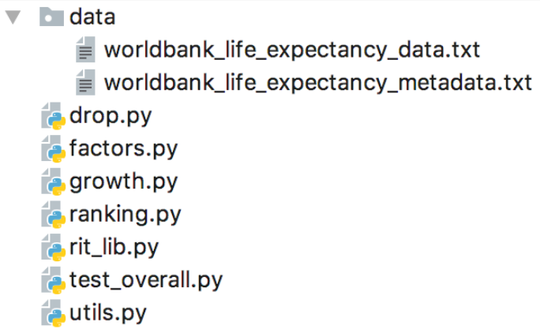
Getting Started
Project Structure

Slide 9
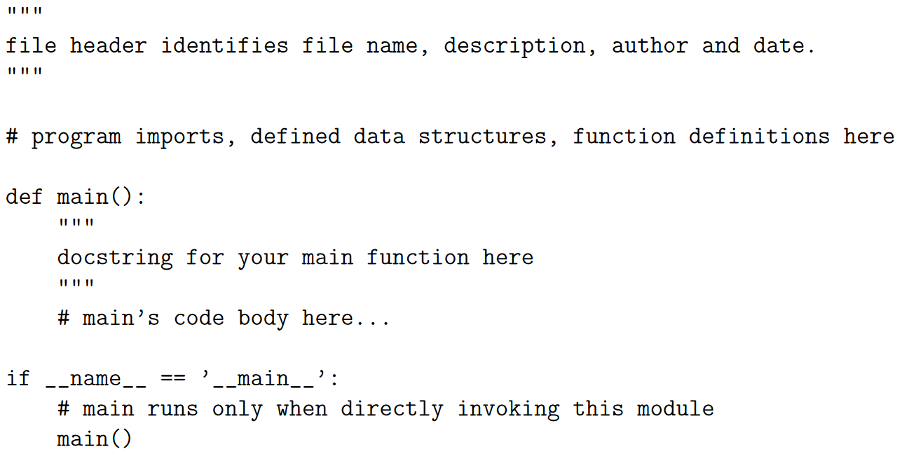
Getting Started
Stand-alone vs Imported Execution

Slide 10
Data Files
worldbank_life_expectancy_data.txt
Details:
First line: header info that can be discarded
Each line after:
Comma separated
Comma after last field as well
Contains in this order:
Country name
Three character country code
Rest are floating point numbers
Life expectancies for years 1960 to 2015
In that order
Some lines are groupings and not countries
IE Least developed countries: UN classification

Slide 11
Data Files
worldbank_life_expectancy_metadata.txt
Details:
First line is a header; discard
Each line after:
Comma separated
Contains in this order:
Three character country code
A region
Income classification
Possible special notes
We are only interested in the first 3
Lines that are not countries do not have a region or classification

Slide 12
The Tasks
For all tasks:
You must name the files exactly
Testers will not work
Will result in a low grade
Any specifically stated user defined data types must be names and defined exactly as described
Testers will not work
Will result in a low grade
Functions must be named and defined as described
Testers will not work
Will result in a low grade
You can make any additional help functions or data types beyond the ones described

Slide 13
Task 0: utils.py
Utilities to help with other tasks
User-defined data types defined here
Must have a stand alone piece
Used to test your functionality
Must work as defined

Slide 14
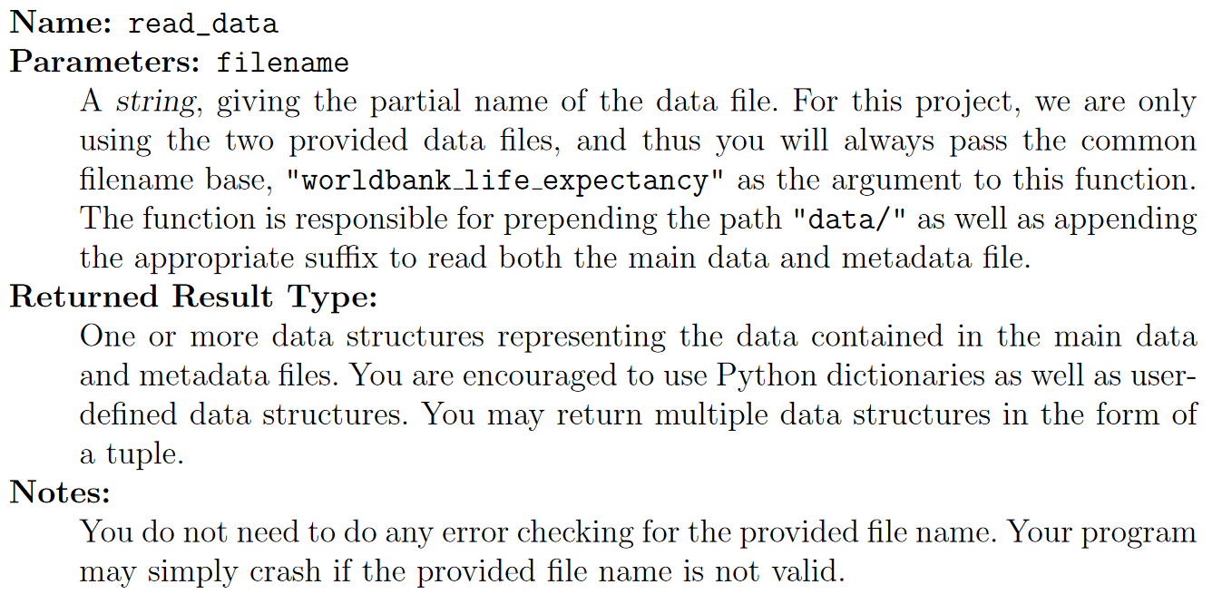
Task 0: utils.py
Required functions:

Slide 15
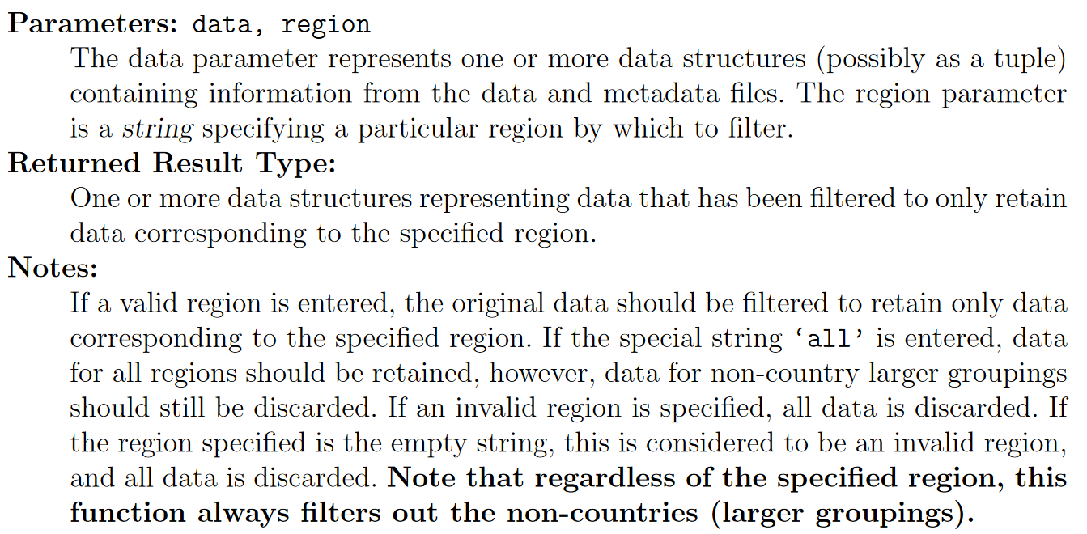
Task 0: utils.py
Required functions:

Slide 16
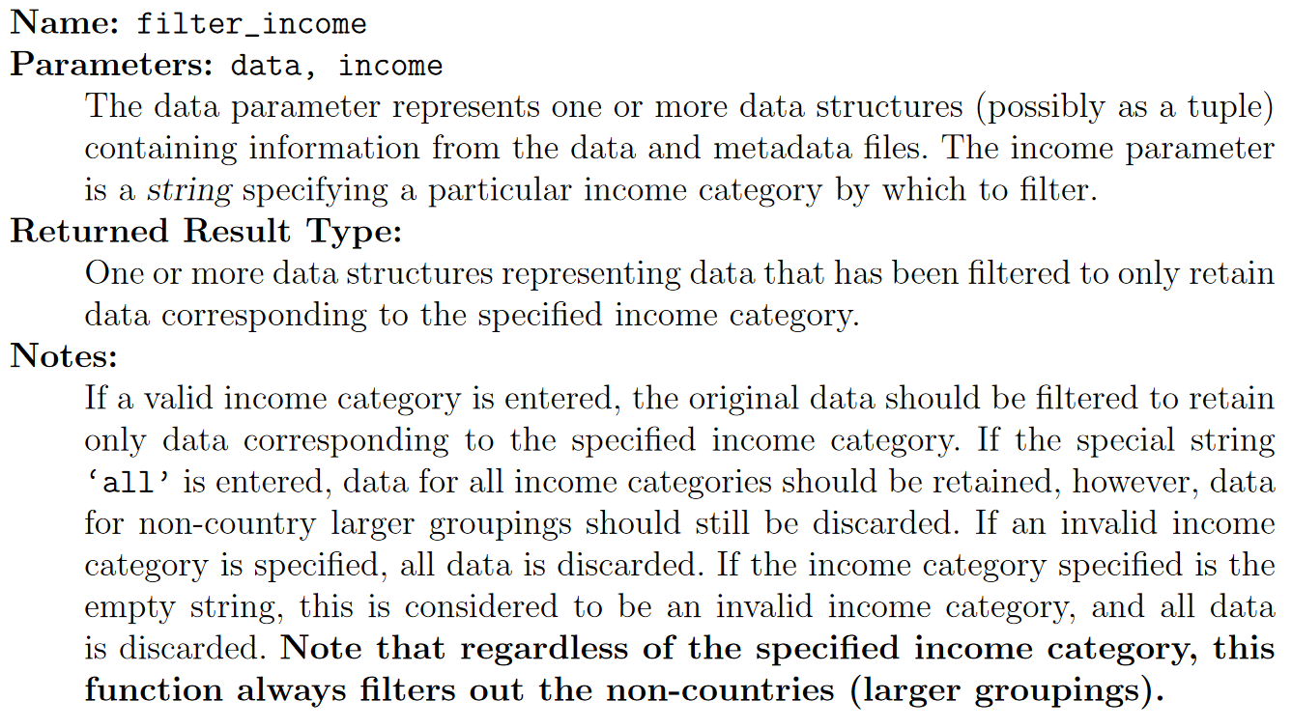
Task 0: utils.py
Required functions:

Slide 17
Task 0: utils.py
Things to note:
You have freedom on how you store the data
Dictionaries are encouraged
You can return multiple items from you functions
Your read_data return must be acceptable input to:
filter_region
filter_income
Filtering functions must allow chaining
Output from one as input to another
Example:
filter_region( filter_income( read_data(file), “low income”) “Asia”)

Slide 18
Task 0: utils.py
Tips:
Take time to review the write-up
Determine what you need and how to store it
Review others task and the stand-alone output
Design data structures to hold the data
Design functions in order:
read_data → filter_region → filter_income
Test each one as you make it
Create the stand-alone to verify our output matches yours…
There is no tester for this, make sure it works.
Dictionaries, dictionaries, dictionaries
Do not be afraid to make multiples
Store the same data in many possibly

Slide 19
Task 1: ranking.py
Ranks countries based on their life expectancy
For a given year
Data may be filtered
You will use utils.py
Will have a stand-alone version
Tester will test this directly

Slide 20
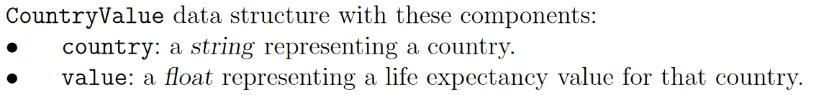
Task 1: ranking.py
Required Structs and Functions

Slide 21
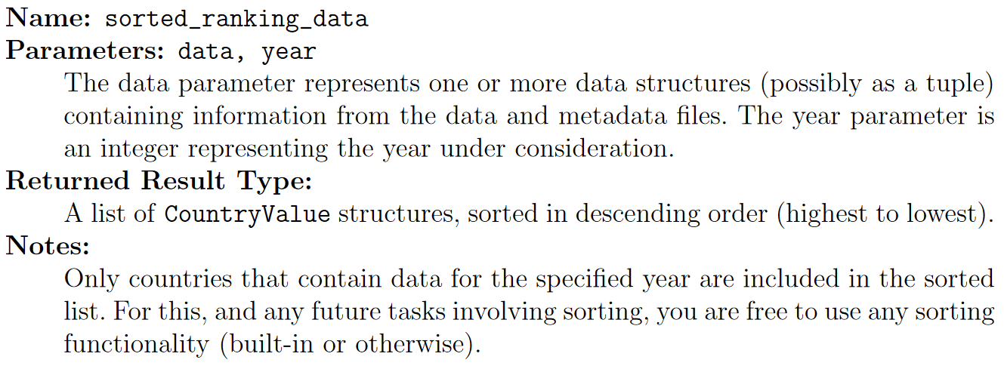
Task 1: ranking.py
Required Structs and Functions

Slide 22
Task 2: growth.py
Ranks countries by growth over range of years
Data may be filtered by region or income
You will use utils.py
Will have a stand-alone version
Tester will test directly

Slide 23
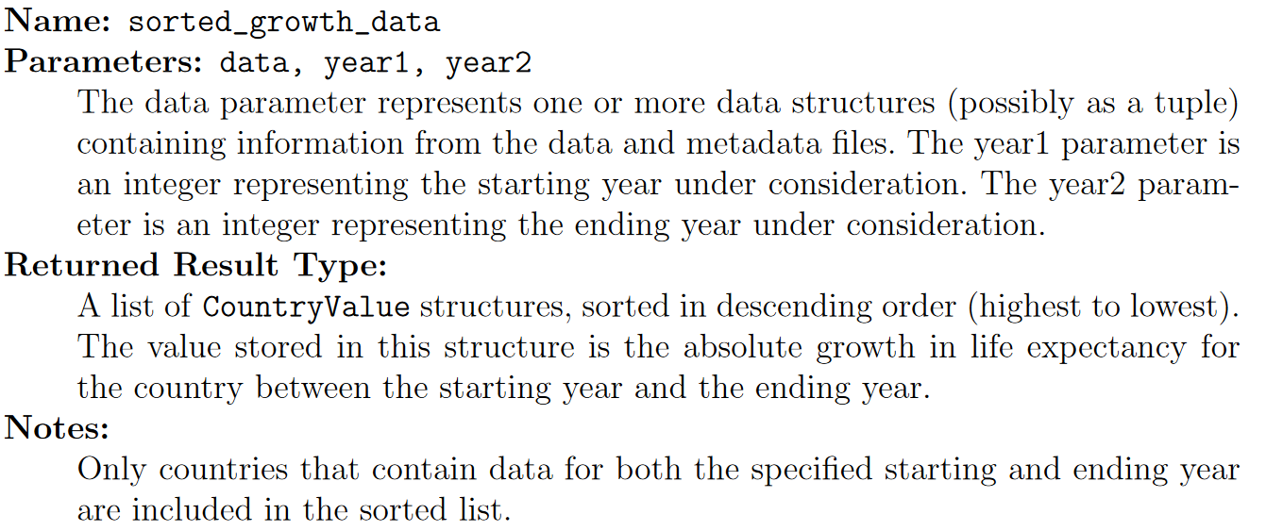
Task 2: growth.py
Required Functions

Slide 24
Task 3: drop.py
Identify 10 worst drops in life expectancy
Range 1960 to 2015
Filtered to nly remove non-countries
You will use utils.py
Will have stand-alone version
Tester will test directly

Slide 25
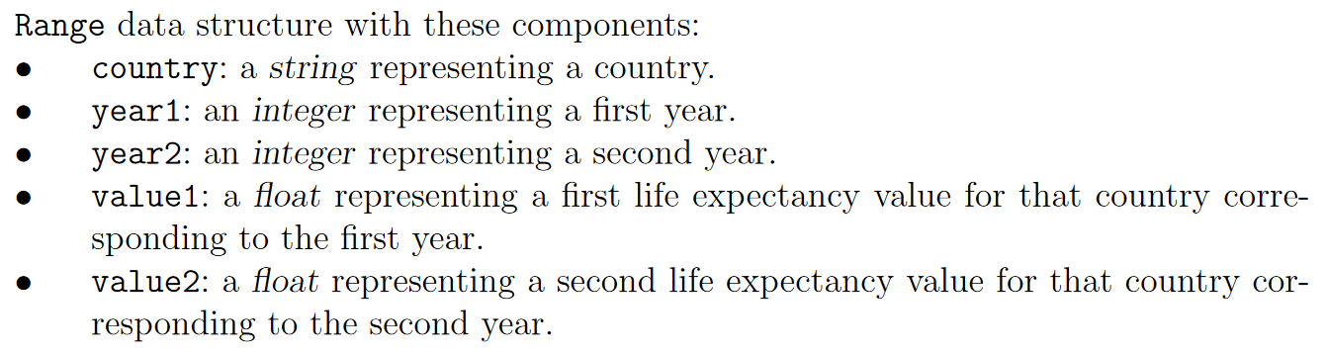
Task 3: drop.py
Required Functions and Data Structures

Slide 26
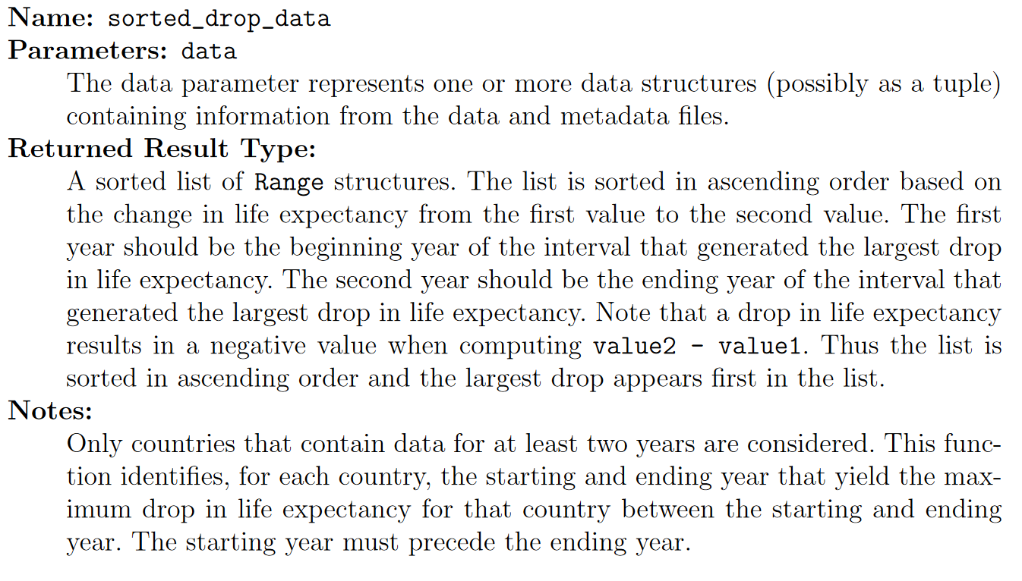
Task 3: drop.py
Required Functions and Data Structures

Slide 27
Task 4: factors.py
Measure of Effect that income and region have
Will use turtle to draw graphs
You will use utils.py
Will have stand-alone version
Tester will test directly

Slide 28
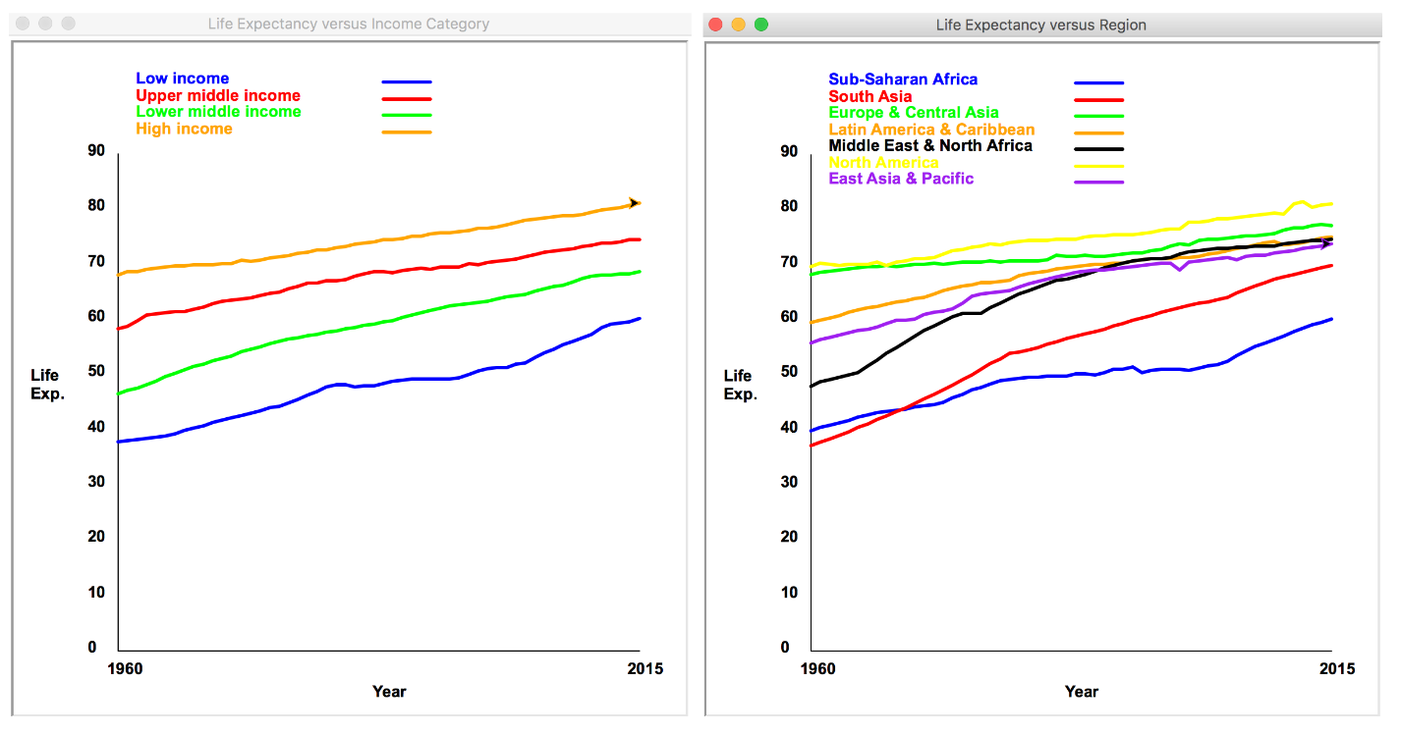
Task 4: factors.py
No required functions
But…
Read the section on this for additional help

Slide 29
Testing
Use test_overall.py
Do not change.
Must work with this file.
Typically you will be good if you pass these tests
We will test with other cases
No I will not tell you what they are

Slide 30
Submission
File name: abc1234.zip
Abc1234 is your RIT user name
Only contain the 5 files for tasks 0-4
No rar, 7zip, etc
No folders inside the zip
No MACOSX, .idea, _Dstore_ etc.
Not following this will result in penalities

Slide 31
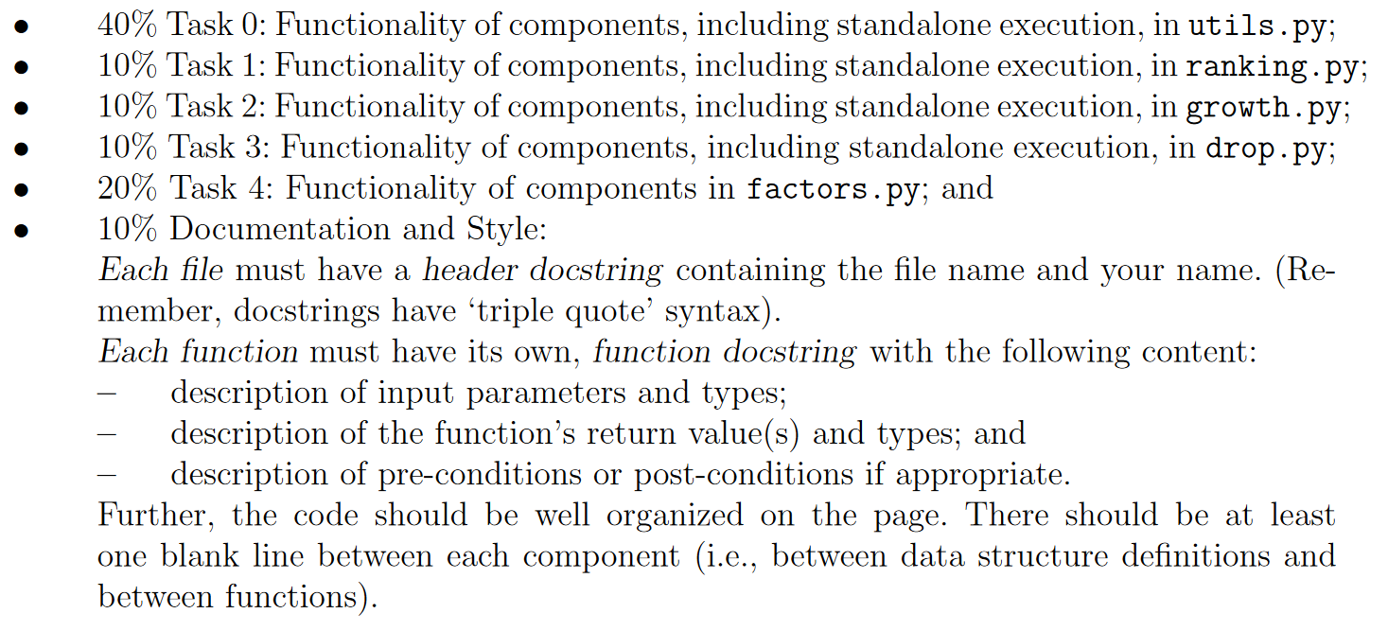
Grading

Slide 32
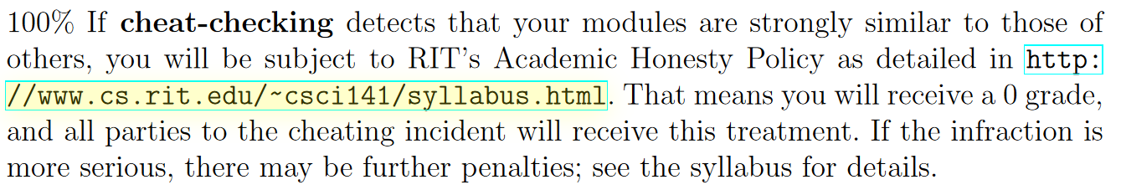
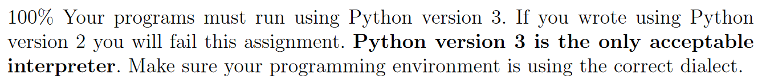
Grading Penalities

Slide 33
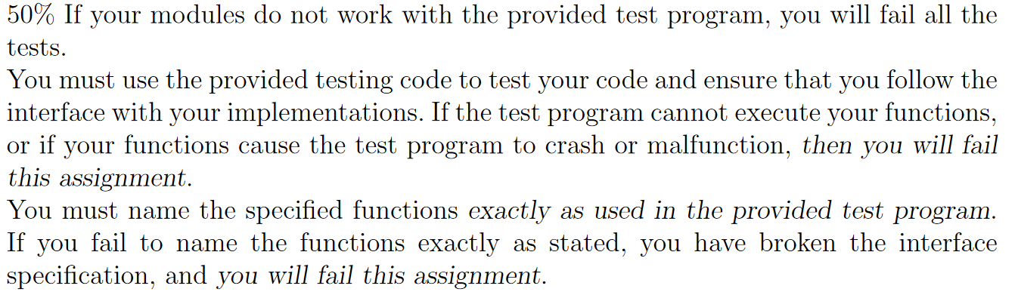
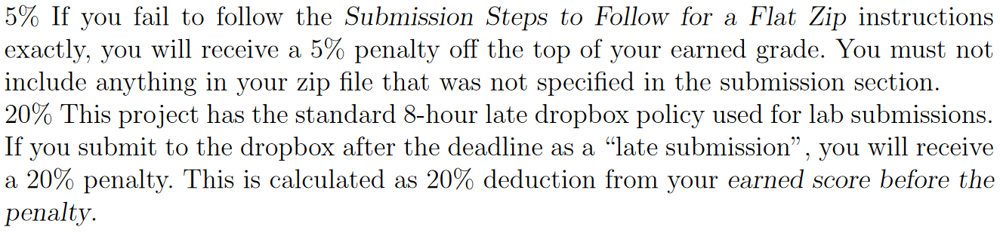
Grading Penalities

Slide 34
Individual Work
This is not a team project
All work is your own
You can discuss ideas, but code alone
Do not share any code!
It will be cheat checked!
Do not make me talk to you about cheating…
I hate to do it!

Slide 35
Help!
Help is here!
Email me…
What the hell… come see me in my office!
I am here to help
myCourses Discussion
Read them all before you post…
Mentoring Center

Slide 36

Questions…

