Slide 1
MirChecker: Detecting Bugs in Rust Programs via Static Analysis
Zhuohua Li, Jincheng Wang, Mingshen Sun, John C.S. Lui
Presenter: 任灏贇
21210240303

Slide 2
Rust Bugs Overview (Runtime Panics)
fn encoded_size(bytes_len: usize, config: Config) -> usize {
let rem = bytes_len % 3;
let complete_input_chunks = bytes_len / 3;
let complete_output_chars = complete_input_chunks * 4;
let printing_output_chars = if rem == 0 {
complete_output_chars
} else {
complete_output_chars + 4
};
...
}
Integer Overflow

Slide 3
Rust Bugs Overview (Lifetime Corruption)
fn from(buffer: Buffer) -> Vec<u8> {
let mut slice = Buffer::allocate(buffer.len);
let len = buffer.copy_to(&mut slice);
unsafe {
Vec::from_raw_parts(
slice.as_mut_ptr(), len, slice.len())
}
}
Use-After-Free

Slide 4
Challenges
Runtime Panics: The range of integer variable?
Numerical static analysis
Lifetime Corruption: The ownership of each allocation?
Analyze the CFG & symbolically keep track of the ownership

Slide 5
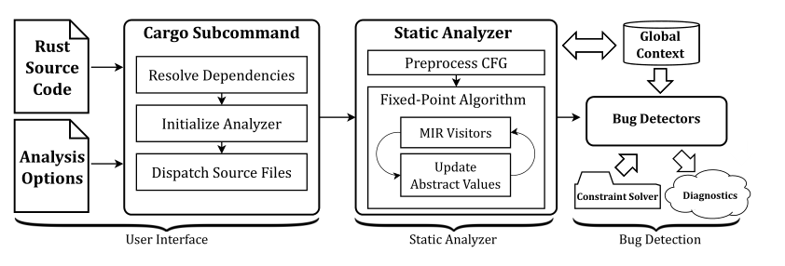
Design of MirChecker
Model program semantics
Combine numerical static analysis and symbolic execution
Perform analysis on top of Rust MIR (Why not LLVM IR?)

Slide 6
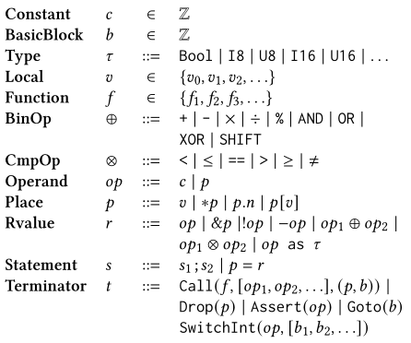
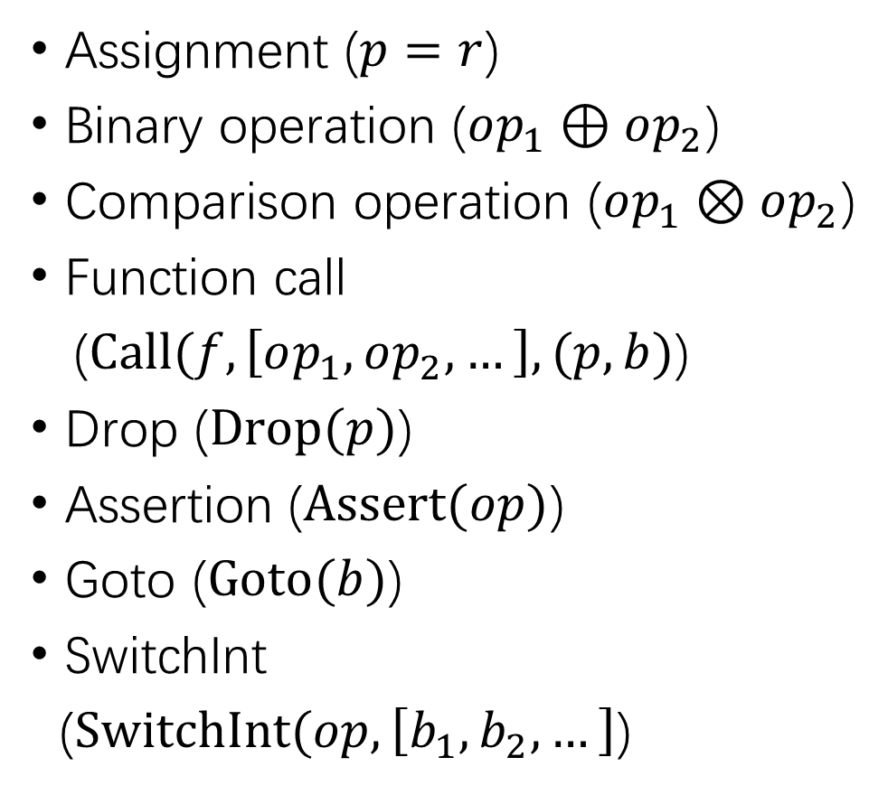
Language Model
Assignment ($p=r$)
Binary operation ($op_{1}⊕op_{2}$)
Comparison operation ($op_{1}⊗op_{2}$)
Function call
($Call(f,\left[op_{1},op_{2},…\right],(p,b)$)
Drop ($Drop(p)$)
Assertion ($Assert(op)$)
Goto ($Goto(b)$)
SwitchInt
($SwitchInt(op,\left[b_{1},b_{2},…\right]$)

Slide 7
Memory Model
a[0] = *p;
How to decide which memory cell is accessed during static analysis?
Points-to analysis?
Symbolic expression as an abstract memory address!

Slide 8

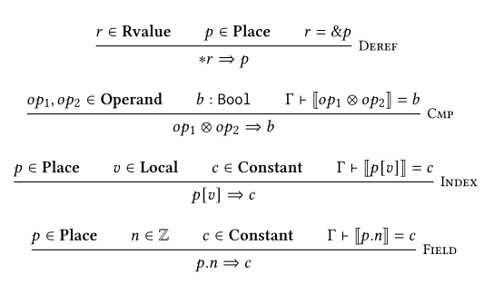
Numerical Analysis & Symbolic Analysis

Slide 9
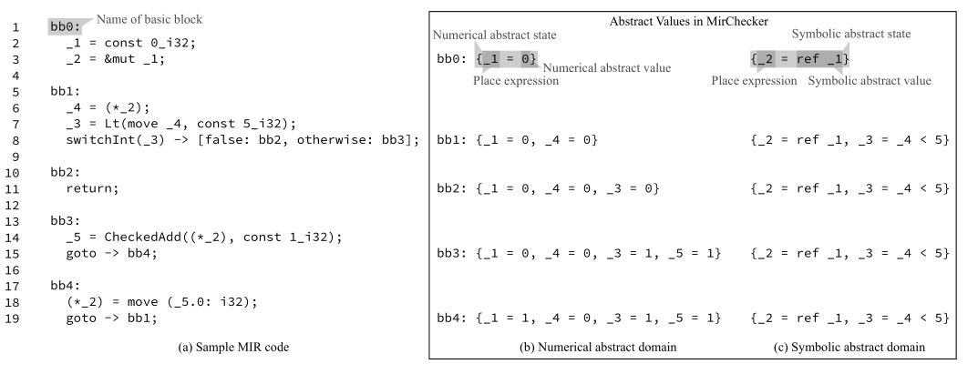
Numerical Analysis & Symbolic Analysis

Slide 10
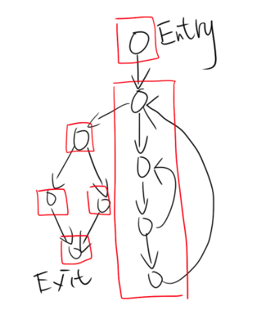
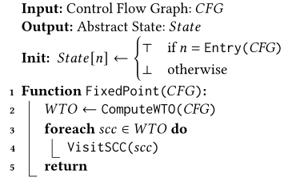
CFG Traversal

Slide 11
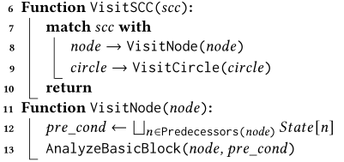
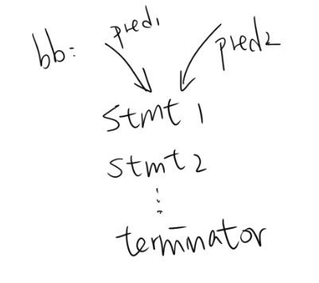
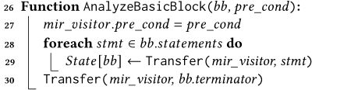
CFG Traversal

Slide 12
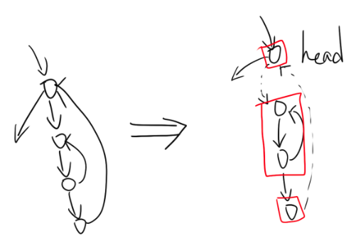
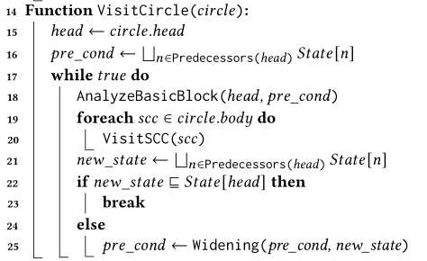
CFG Traversal

Slide 13
Interprocedural Analysis
Only analyze if it is within the current crate that is being analyzed and its location can be statically determined.
Provide some special handlers for some functions that are commonly used but hard to be analyzed (e.g., as_mut_ptr).
Avoid recursive functions.

Slide 14
Verification Conditions for Bug Detectors
Runtime Panics
Get all the conditions from the Assert(cond) terminators
Use SMT solver to verify the satisfiability of !cond
Lifetime Corruptions
Maintains a list of unsafe functions such as Vec::from_raw_parts
Verify whether the original owner is used after the ownership has been transferred

Slide 15
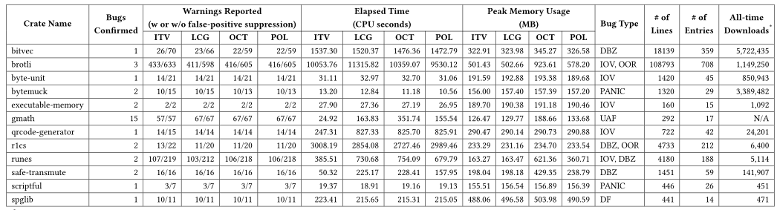
Evaluation
Found 33 bugs in 12 crates.
(17 runtime panics and 16 memory-safety issues)

Slide 16
Conclusion
Find runtime panics & lifetime corruptions bugs in Rust
Combine numerical analysis & symbolic analysis
High false-positive rate

