Slide 1
Stacked Borrows: An Aliasing Model for Rust
RALF JUNG, Mozilla, USA and MPI-SWS, Germany HOANG-HAI DANG, MPI-SWS, Germany JEEHOON KANG, KAIST, Korea DEREK DREYER, MPI-SWS, Germany
吴钟立 21210240362

Slide 2
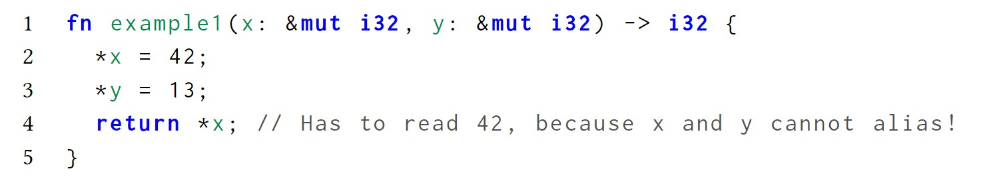
motivation
alias information is essential in justifying reorderings and other program transformations for optimization like this code fragment:

Slide 3
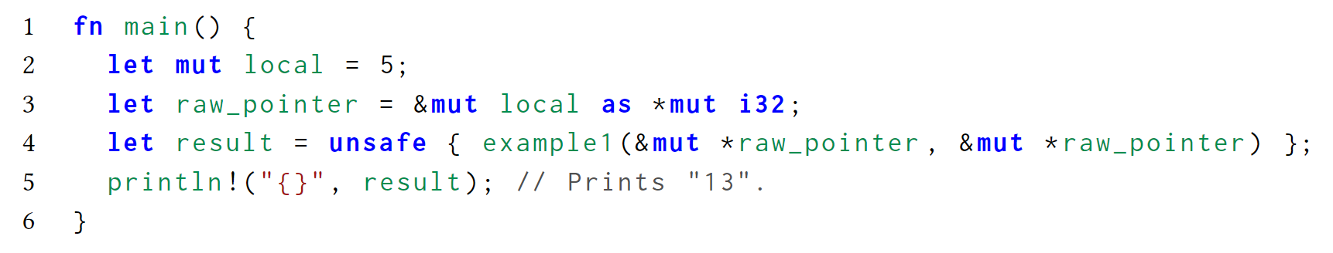
motivation
Rust supports unsafe code, which widely used in some important libraries and data structures
unsafe code could make exception of optimization like this:

Slide 4
motivation
to enable optimization, a definition of dynamic semantics is necessary
we have to define the behavior of our source program in a way that actually, it is allowed for the program to output 42.
more precisely, we will define the operational semantics in such a way that our example program has undefined behavior, which means the compiler is allowed to compile it in any way it chooses.

Slide 5
features involved
data can either be mutated through one reference, or it can be immutably shared amongst many parties, but not both at the same time(exception exists)
data always has a unique owner, ownership can be borrowed
lifetime: (1) the reference can only be used while its lifetime is ongoing, and (2) the original referent does not get used until the lifetime of the loan has expired

Slide 6
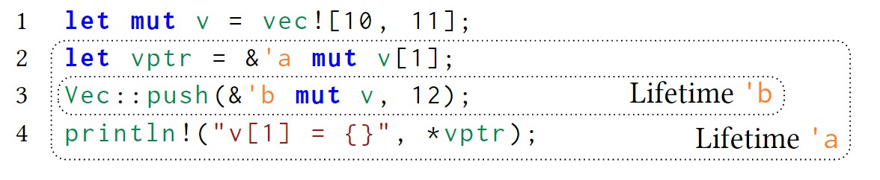
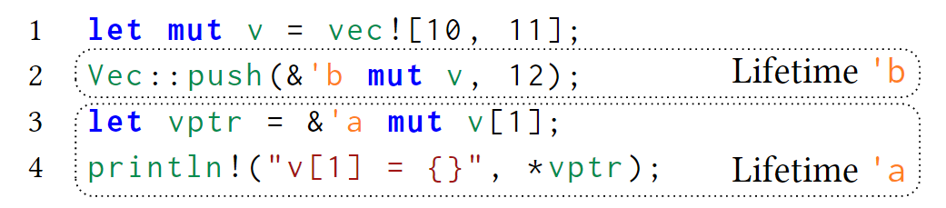
features involved
lifetime:
rejected for violates condition (2)
accepted

Slide 7
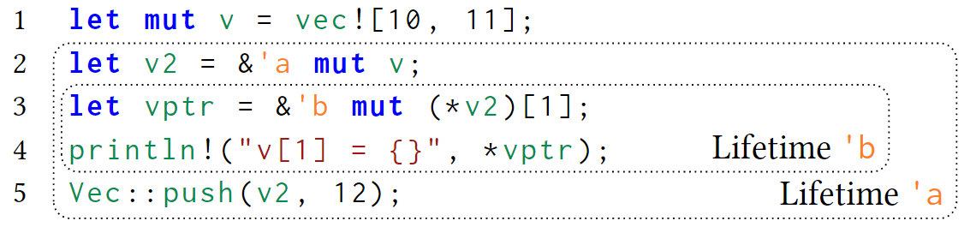
features involved
reborrowing:

Slide 8
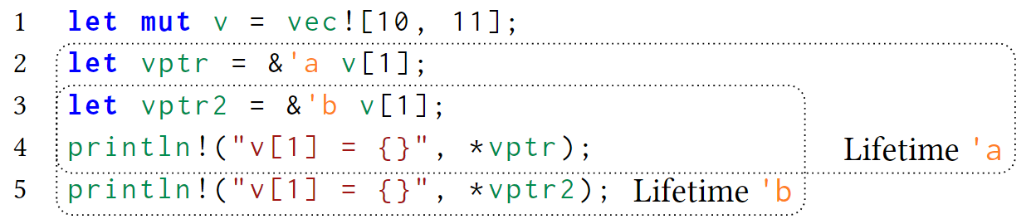
features involved
shared references: aliasing but no mutation, could co-exist with overlapping lifetimes
only once both loans have expired may v[1] be mutated again

Slide 9
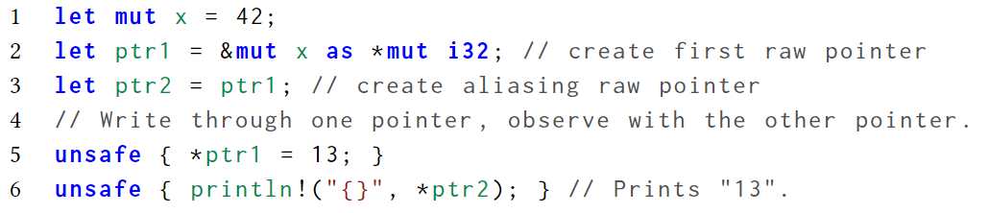
features involved
raw pointers: neither checked by compiler nor aliasing restricted

Slide 10
Stacked Borrows — for mutable references
borrow checker insures (1) that a reference and all references derived from it can only be used during its lifetime, and (2) that the referent does not get used until the lifetime of the loan has expired
re-phrase this property without referring to lifetimes, by saying that every use of the reference (and everything derived from it) must occur before the next use of the referent (after the reference got created), which can be abstracted to stack discipline
Stacked Borrows tracks a stack of references that are allowed to access variable

Slide 11
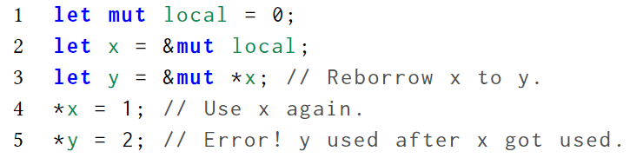
Stacked Borrows — for mutable references
example:
stack principle enforces a well-nested usage of references: the use of the derived reference y must be well-nested between other uses of x and cannot be arbitrarily interleaved. The XYXY sequence of usages violates this idea of nesting

Slide 12
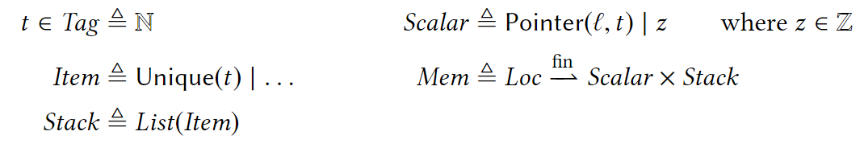
Stacked Borrows — for mutable references
operational model
every reference gets tagged by some unique pointer ID t
a pointer value Pointer(l, t) consists of a location l in memory that the pointer points to, and a tag t identifying the pointer/reference
for every location l, store a borrow stack of tags identifying the references that are allowed to access this location
elements of the stack called items, Unique(t) holding a tag t is a type of items

Slide 13
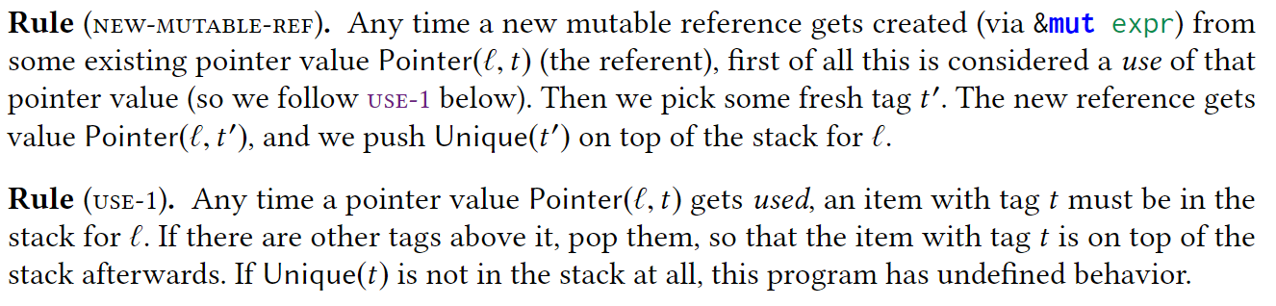
Stacked Borrows — for mutable references
operational semantics

Slide 14
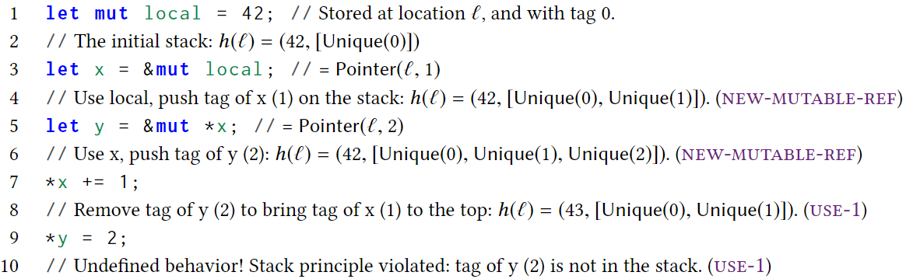
Stacked Borrows — for mutable references
example

Slide 15
Stacked Borrows — for raw pointers
add a second kind of items that can live in the stack: SharedRW
the idea is that an XYXY is allowed when both X and Y are raw pointers, but if either one of them is a mutable reference, we want that to still be a violation of the stack principle

Slide 16
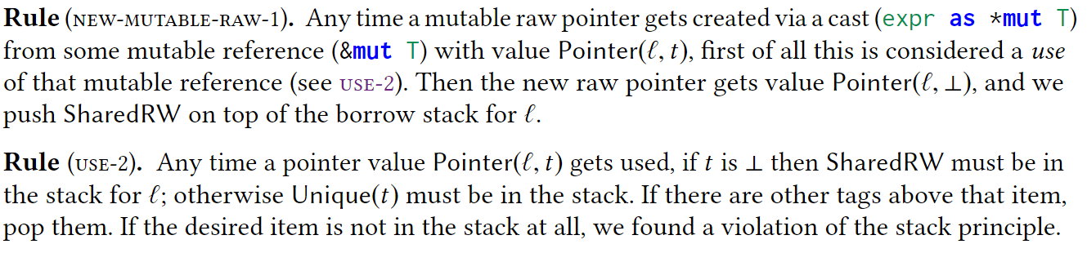
Stacked Borrows — for raw pointers
operational semantics
use-2 replaces ues-1

Slide 17
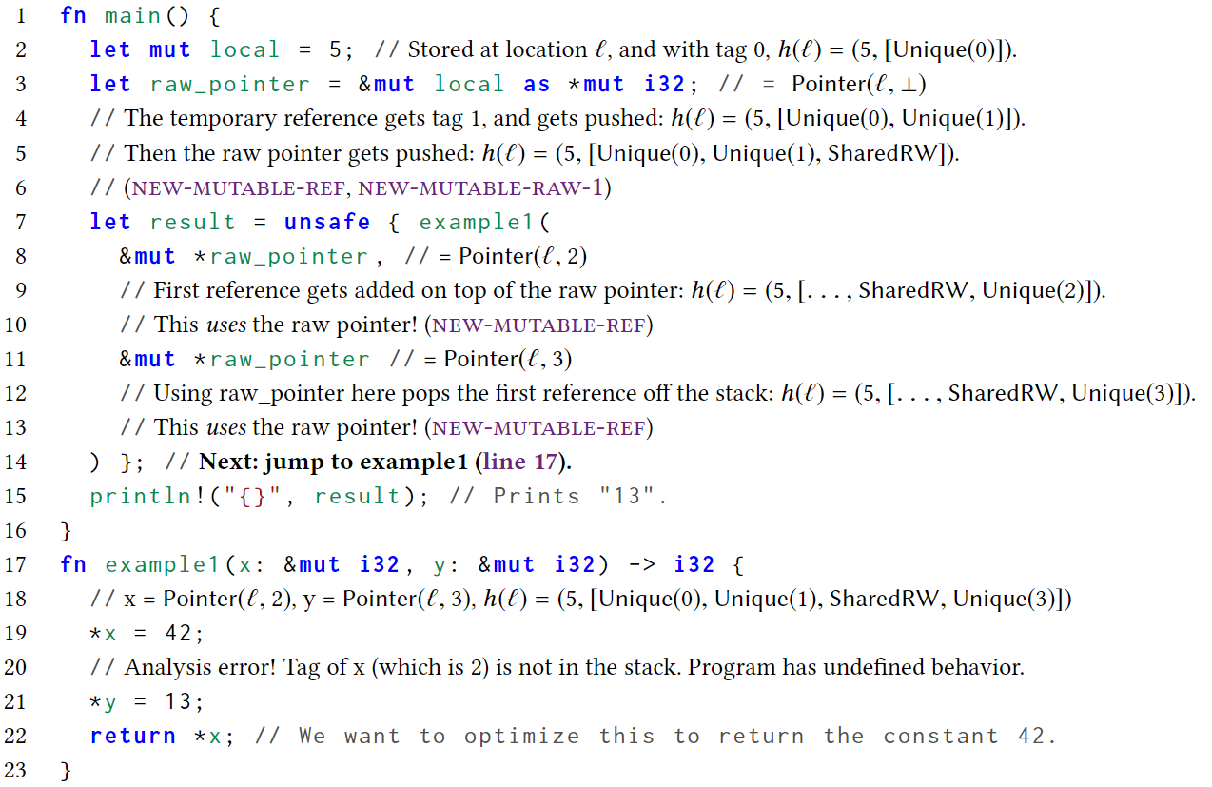
Stacked Borrows — for raw pointers
example

Slide 18
Stacked Borrows — retagging
if example1 gets called with two pointer values carrying the same tag, stacked borrows cannot differentiate two references with the same tag yet
Such duplicate tags are possible because unsafe code can make copies of any data (e.g., using transmute_copy), including mutable references
we need to be sure that both references have unique tags that are not used by any other pointer value

Slide 19
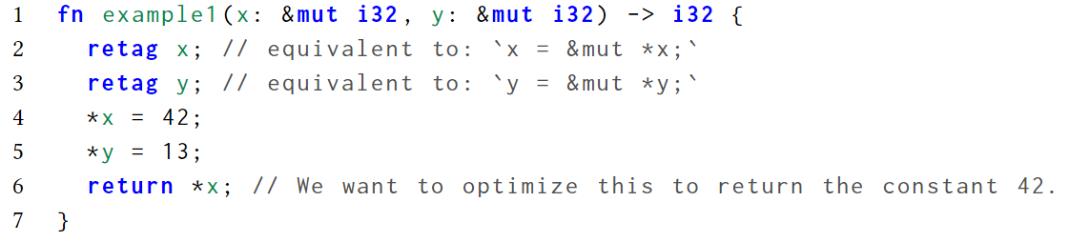
Stacked Borrows — retagging
retag is an administrative instruction that makes sure that references have a fresh tag. It is automatically inserted by the compile (no language operation for unsafe code to forge tags)

Slide 20
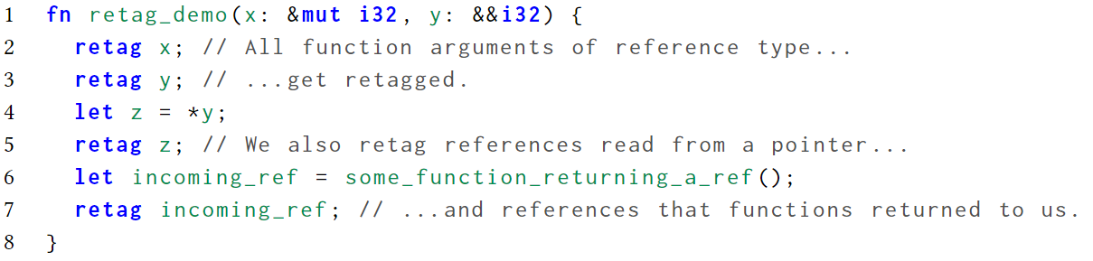
Stacked Borrows — retagging
Where is retag inserted?
we expect retagging to happen any time a reference gets passed in as an argument, returned from a function, or read from a pointer
Basically, any time a reference enters our scope, it should get retagged

Slide 21
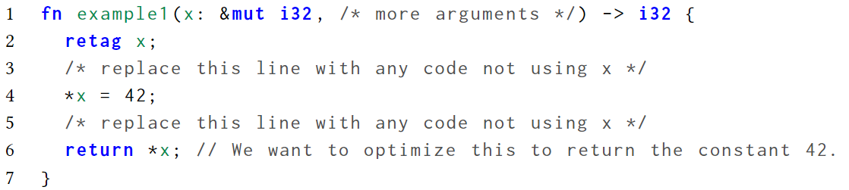
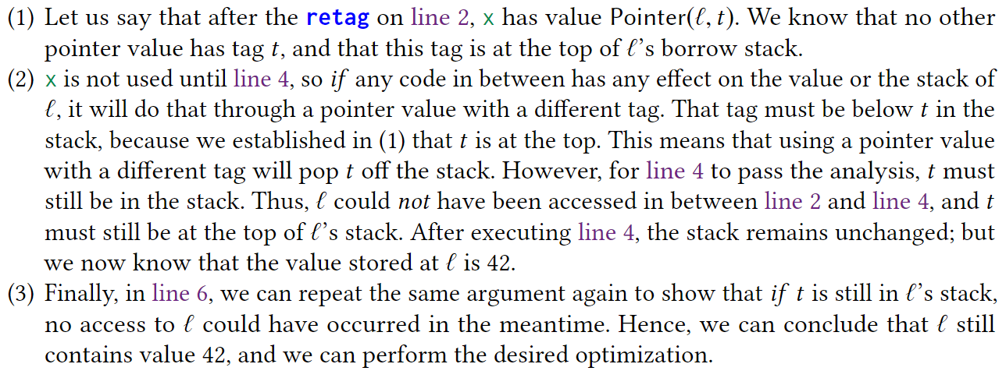
Stacked Borrows — a proof sketch for the optimization on mutable references

Slide 22
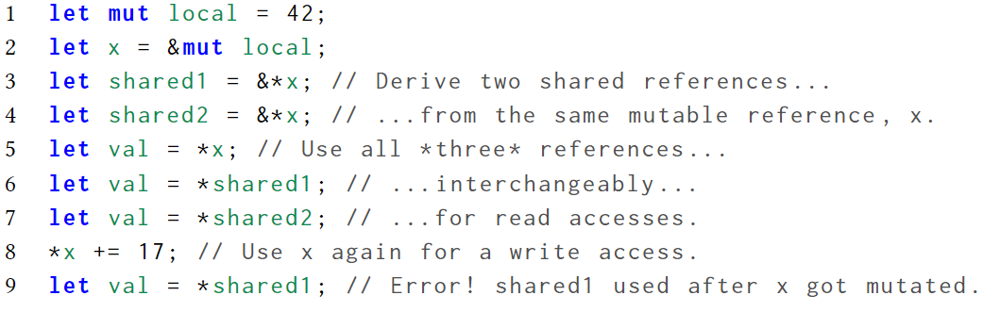
Stacked Borrows — shared references
shared references: every use of the reference (and everything derived from it) must occur before the next mutating use of the referent (after the reference got created), and moreover the reference must not be used for mutation

Slide 23
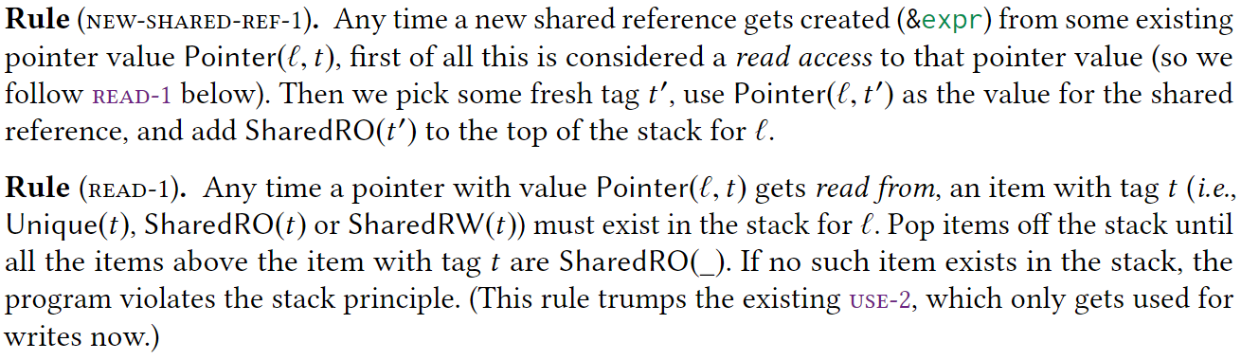
Stacked Borrows — shared references
introduce another kind of item that can exist in the borrow stack:
operational semantics

Slide 24
Stacked Borrows — shared references
note that we leave the rules for writing unchanged

Slide 25
Stacked Borrows — shared references
two shared references can be used for reading without disturbing each other: they do not pop the other reference’s item off the stack (in contrast to write accesses)
a key invariant: if there are any SharedRO’s in the stack, they are all adjacent at the top
creating a mutable reference or a raw pointer would first make some Unique(_) or SharedRW(_) the top of the stack by popping off all SharedRO’s above them
Never is a Unique(_) or SharedRW(_) pushed on top of a SharedRO(_)

Slide 26
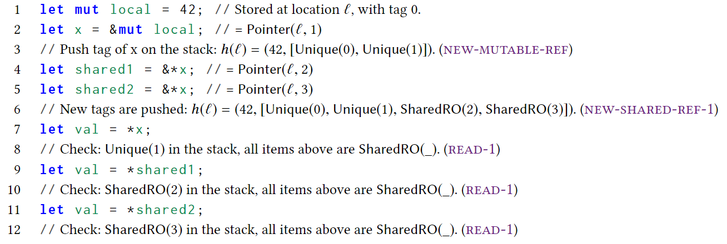
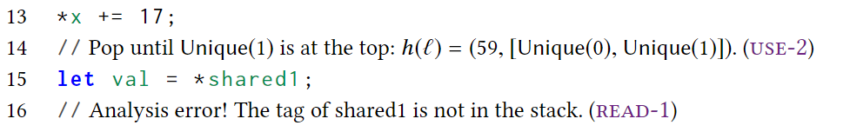
Stacked Borrows — shared references
example

Slide 27
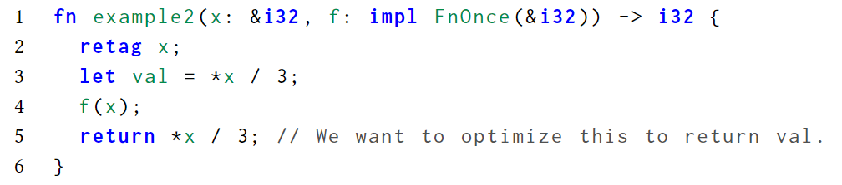
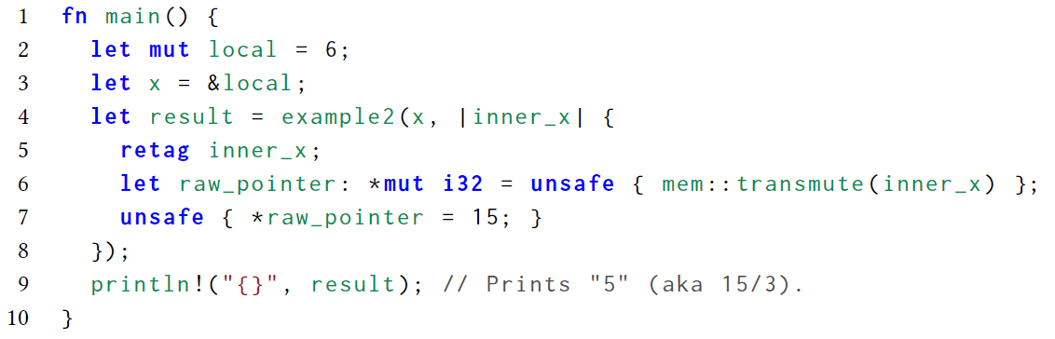
Stacked Borrows — shared references
optimization example
counterexample that prohibits this optimization

Slide 28
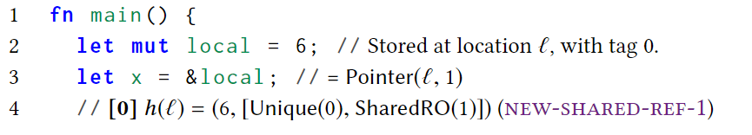
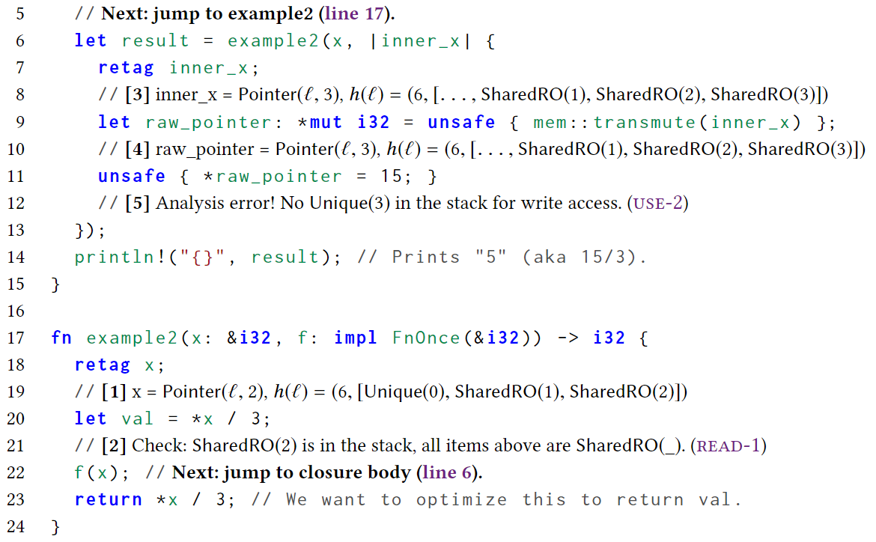
Stacked Borrows — shared references
how stack borrows reject the counterexample

Slide 29
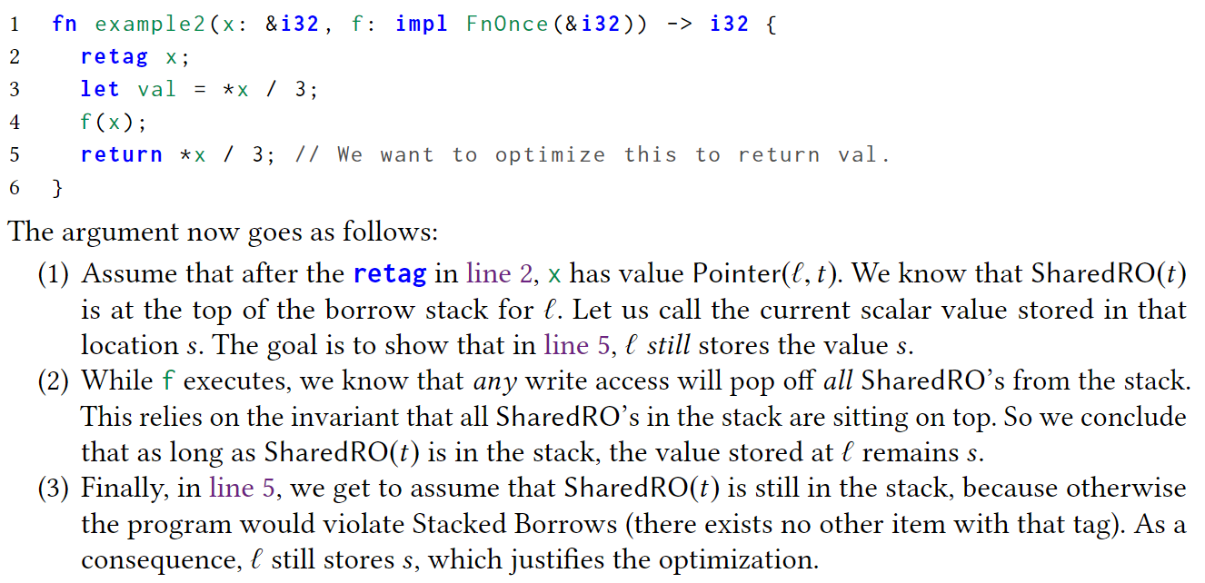
Stacked Borrows — a proof sketch for the optimization on shared references

Slide 30
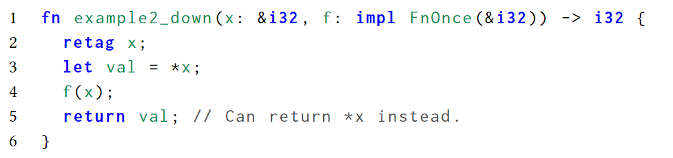
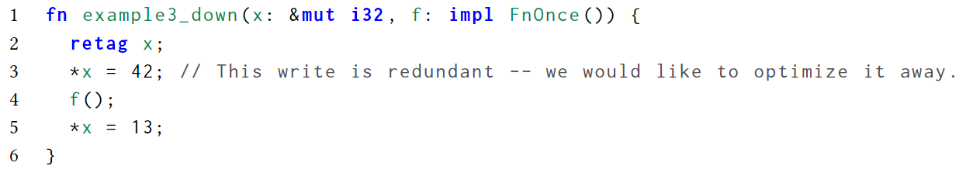
Stacked Borrows — more advanced transformations
move a memory access down across unknown code is harder, for extending the liveness range of a reference

Slide 31
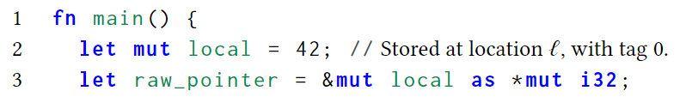
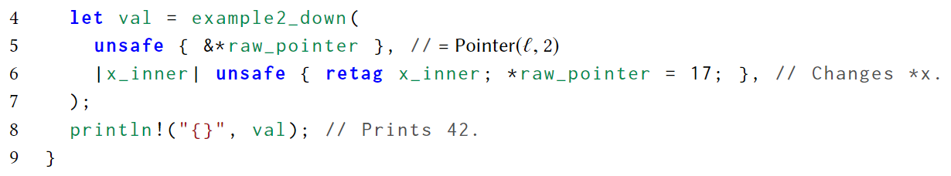
Stacked Borrows — more advanced transformations
so far, Stacked Borrows rejects these optimizations that move operations down. Counterexample:

Slide 32
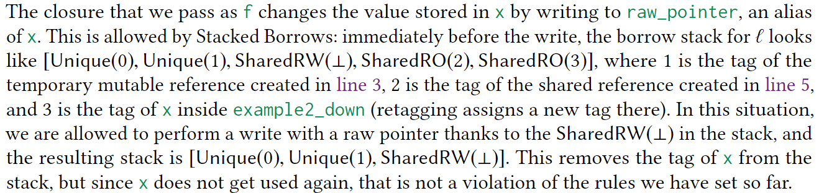
Stacked Borrows — more advanced transformations

Slide 33
Stacked Borrows — more advanced transformations
however, lifetime of x ends while example2_down is still running, when SharedRO(2) gets popped off the stack
in Rust, a reference passed to a function must outlive the function call, i.e., its lifetime must last at least for the duration of the call

Slide 34
Stacked Borrows — more advanced transformations
to prevent SharedRO(2) from being popped off while example2_down still runs, we introduce the notion of a protector
an item in the stack can be protected by a function call, which means that while that function call is still ongoing, if the item gets popped off the stack, that is a Stacked Borrows violation and hence undefined behavior
the semantics keeps track of the set of call IDs that correspond to function calls that have not returned yet
change retag to retag[fn] to add call ID

Slide 35
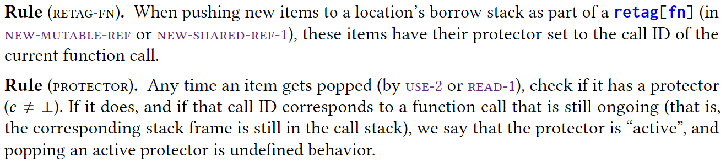
Stacked Borrows — more advanced transformations
add following rules to Stacked Borrows:

Slide 36
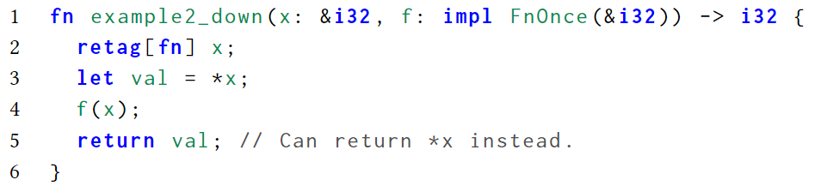
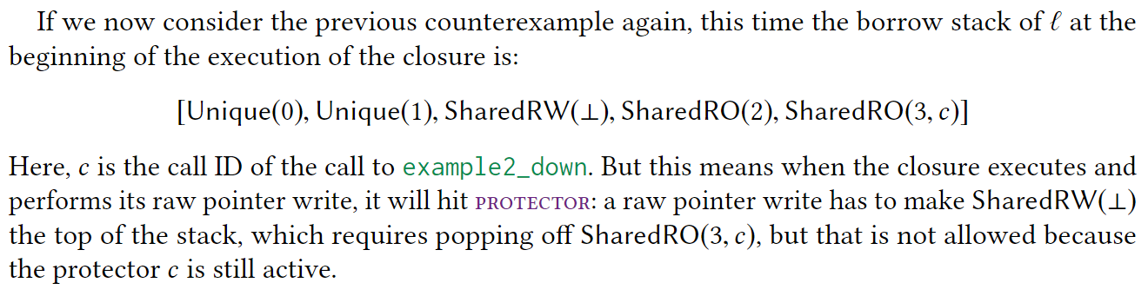
Stacked Borrows — more advanced transformations

Slide 37
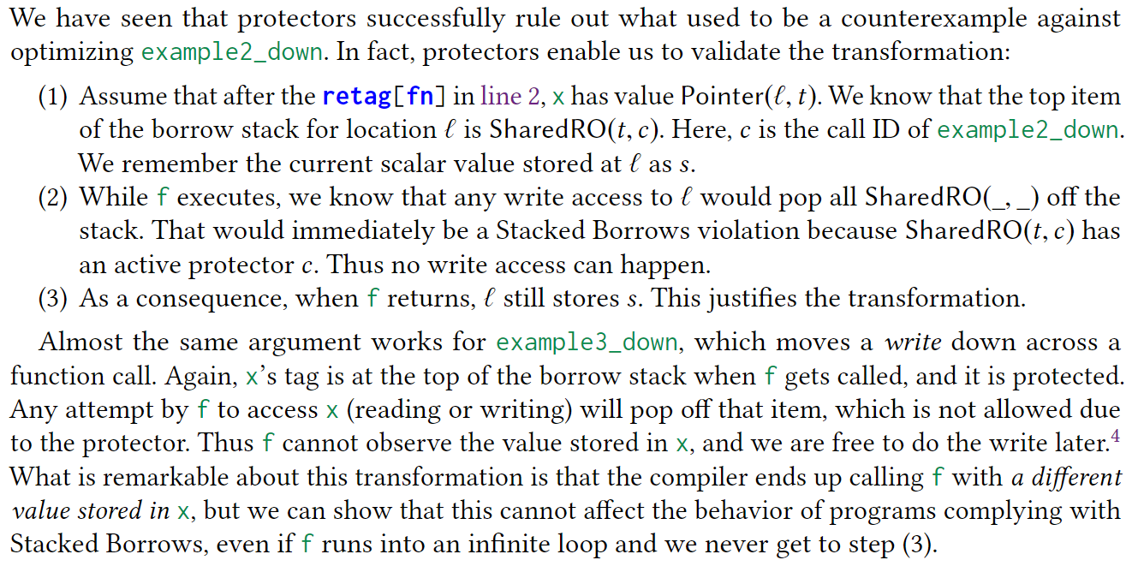
Stacked Borrows — proof sketches for the optimizations

Slide 38
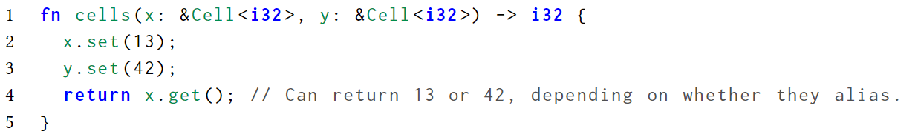
Stacked Borrows — supporting interior mutability
Rust provides Cell that permits mutation with shared reference:
Cell only allows copying data into and out of the Cell, no obtaining a reference into a Cell

Slide 39
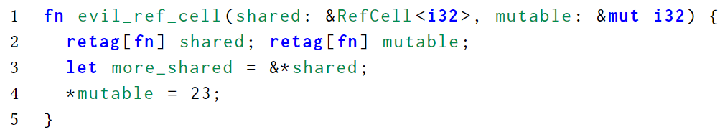
Stacked Borrows — supporting interior mutability
what makes things complicated:
partial interior mutability: with &(i32, Cell<i32>), the first 4 bytes are not inside an UnsafeCell but the second 4 bytes are inside an UnsafeCell, so we cannot perform the same actions for all locations that the reference covers
a type-based traversal of the memory the reference covers is needed
creating a reference is not always an access:
if more_shared created with popping mutable(read-1), line 4 will raise a error;
If just push more_shared directly, the invariant will be broken, which breaks the proof sketch

Slide 40
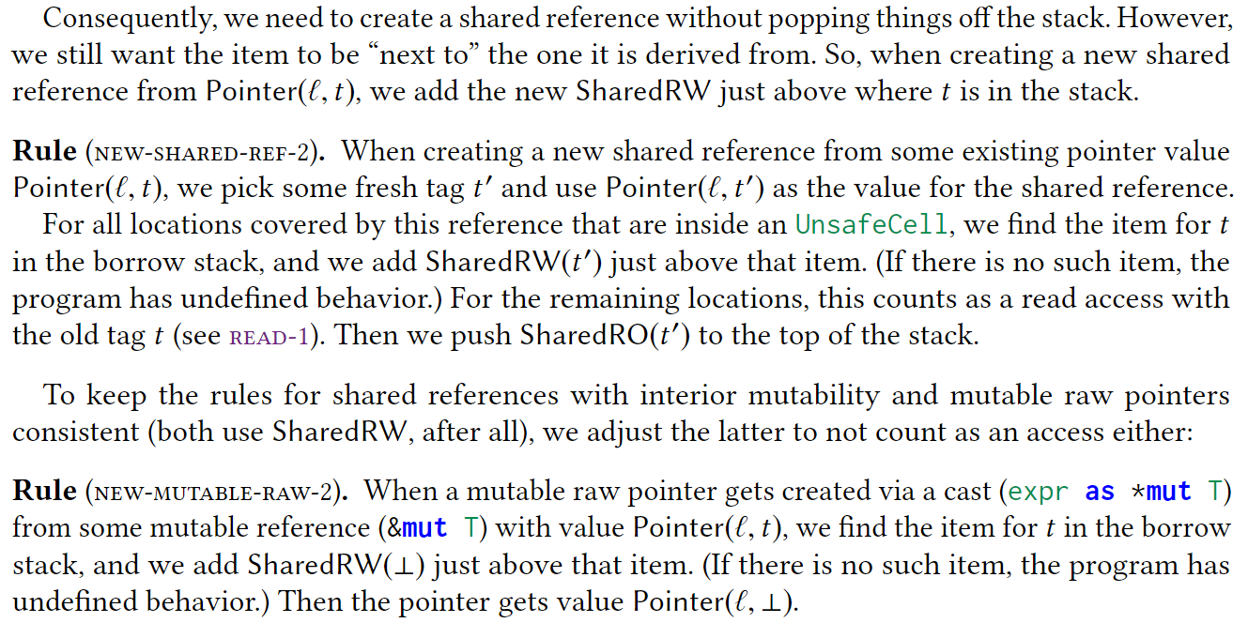
Stacked Borrows — supporting interior mutability

Slide 41
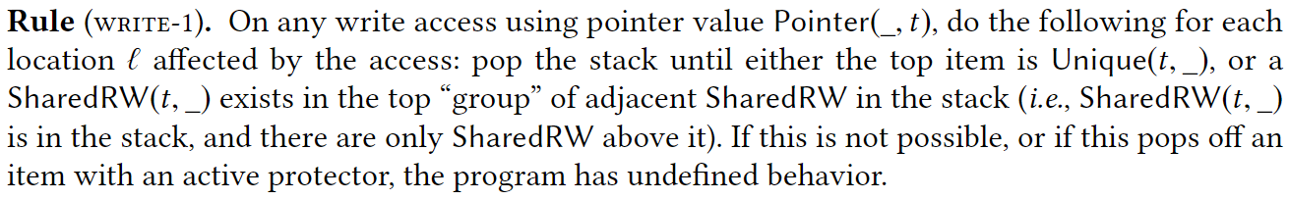
Stacked Borrows — supporting interior mutability
new rules leads that there could be many SharedRW next to each other in the stack
just as SharedRO, we want to let the group of SharedRW items be used without removing each other

Slide 42
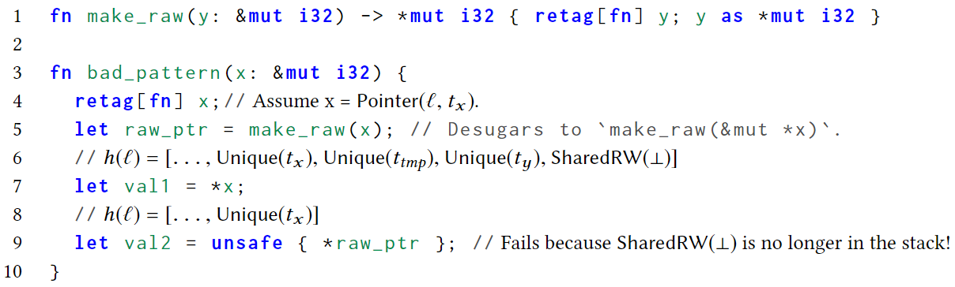
Stacked Borrows — supporting interior mutability
read access: we want to be able to read from a SharedRW item without invalidating the other SharedRW or SharedRO items that may be adjacent to it
however, we still need to make sure that there are never any Unique items left above the item that justifies the access
there is a slight twist to how we do this:

Slide 43
Stacked Borrows — supporting interior mutability
this pattern is widely used and thus should not induce undefined behavior
to fix this, instead of popping items off the stack until there are no more Unique above the accessed item, we just disable the Unique that are above the accessed item while leaving the SharedRW items alone

Slide 44
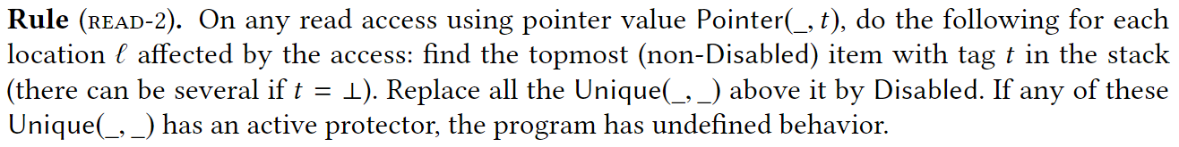
Stacked Borrows — supporting interior mutability
introduce a new kind of item:

Slide 45
Stacked Borrows — formal definition and evaluation
ellipsis

Slide 46
Stacked Borrows — conclusion
the goal is to exploit the rich alias information encoded in types in order to enable intraprocedural optimizations
the core idea of Stacked Borrows is to implement a dynamic version of the borrow checker
this allows us to extend the scope of the analysis to also cover unsafe code manipulating raw pointers
the validity has been proved formally in Coq

Slide 47
thank you for listening

