Slide 1

Basic Details of the Team and Problem Statement
HackToFuture-2024
In Association with
The Institution of Engineers (India)
IEI Local Centre, Belagavi
Domain : Web Application
PS Code: WD-01
Problem Statement Title: Run Chart
Team Name: Byte System
Team Leader Name: Yallappa Dalawai
Table Code Assigned: 1..1(lab 1-b)
Institute Name: Jain college of Engineering, Belagavi

Slide 2
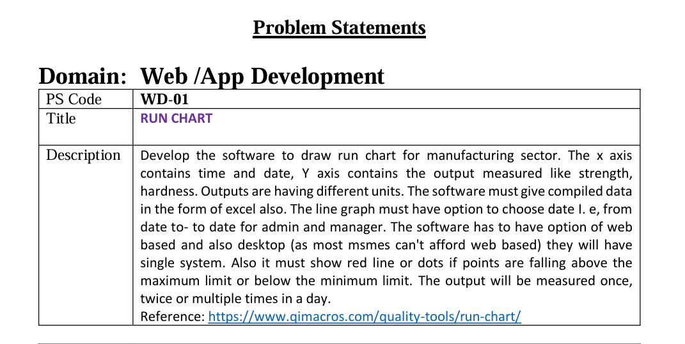

Slide 3
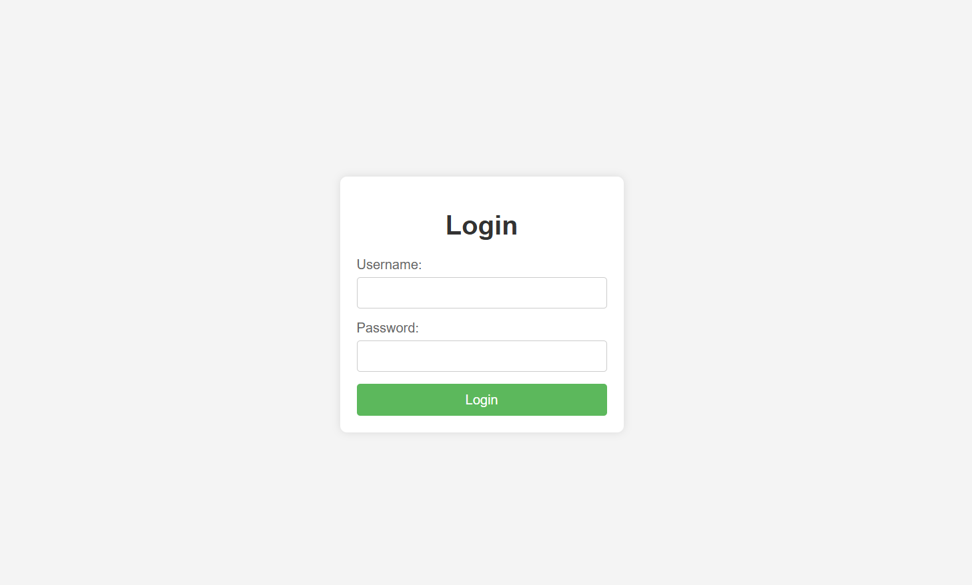
Login page in order to View the Chart.

Slide 4
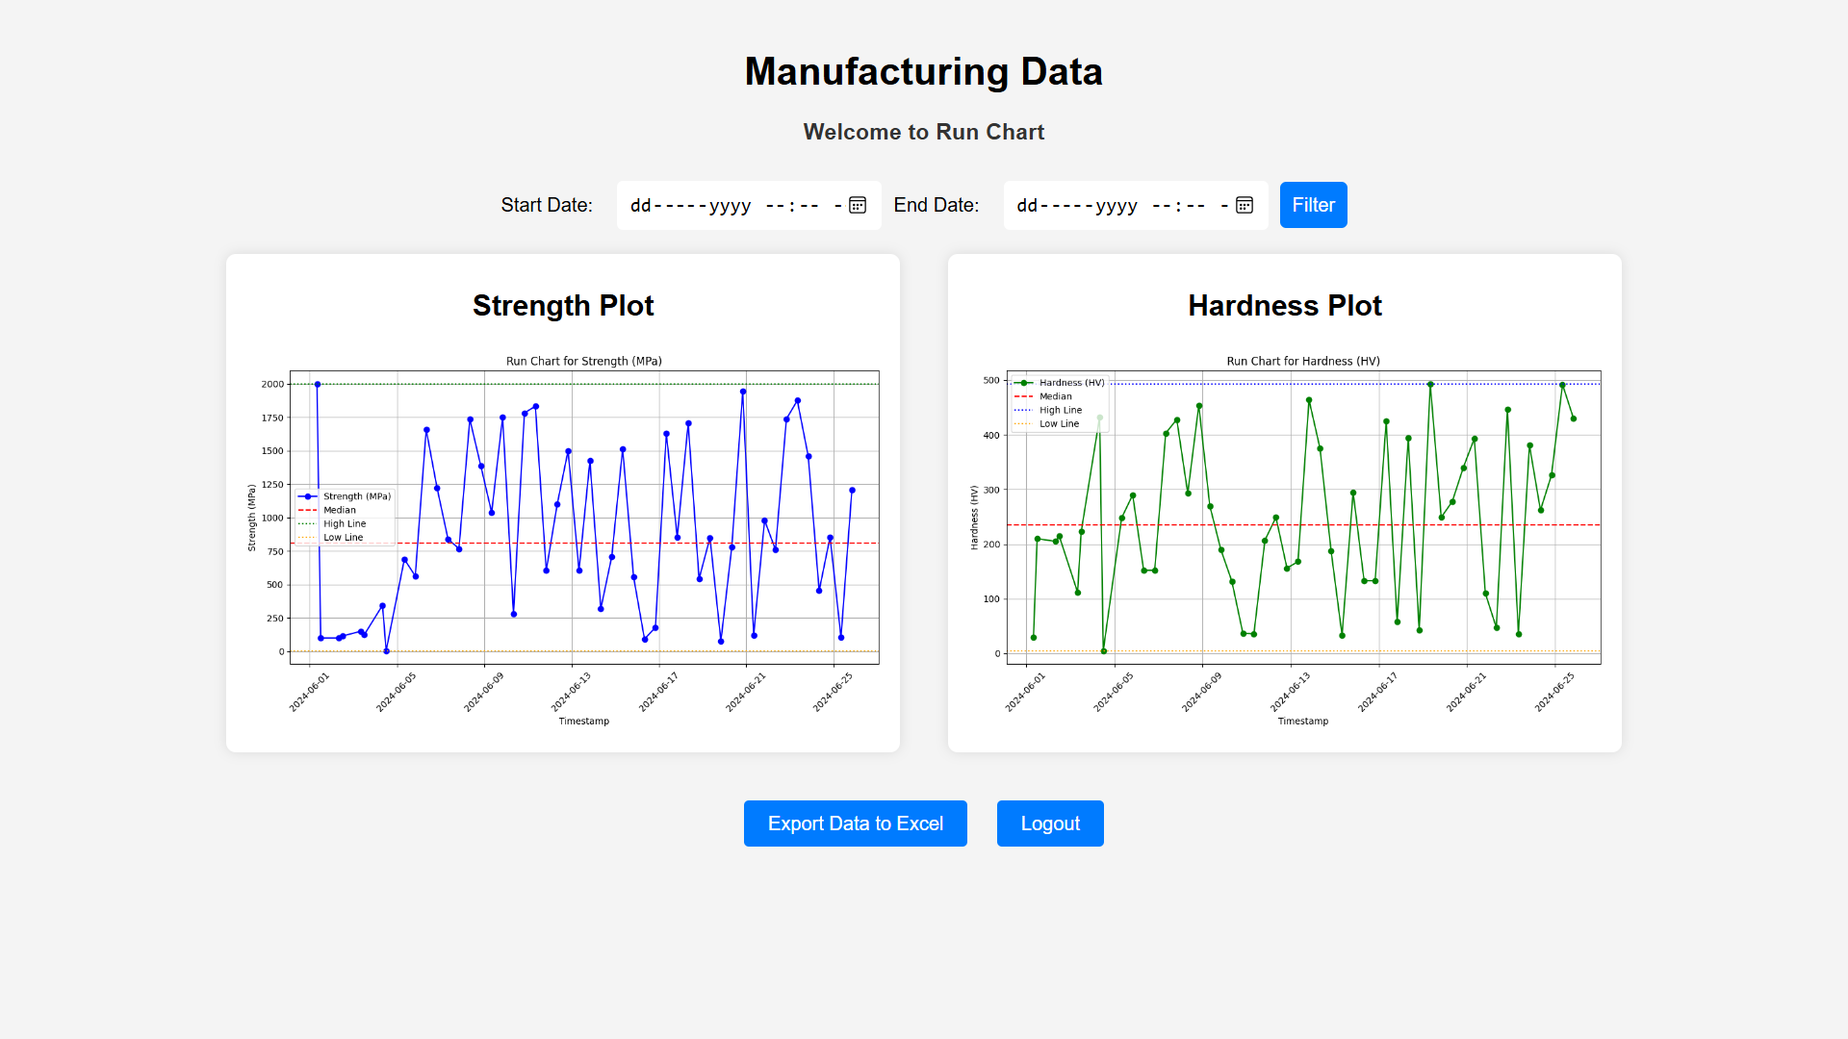
View page for Run Chart After successful login

Slide 5
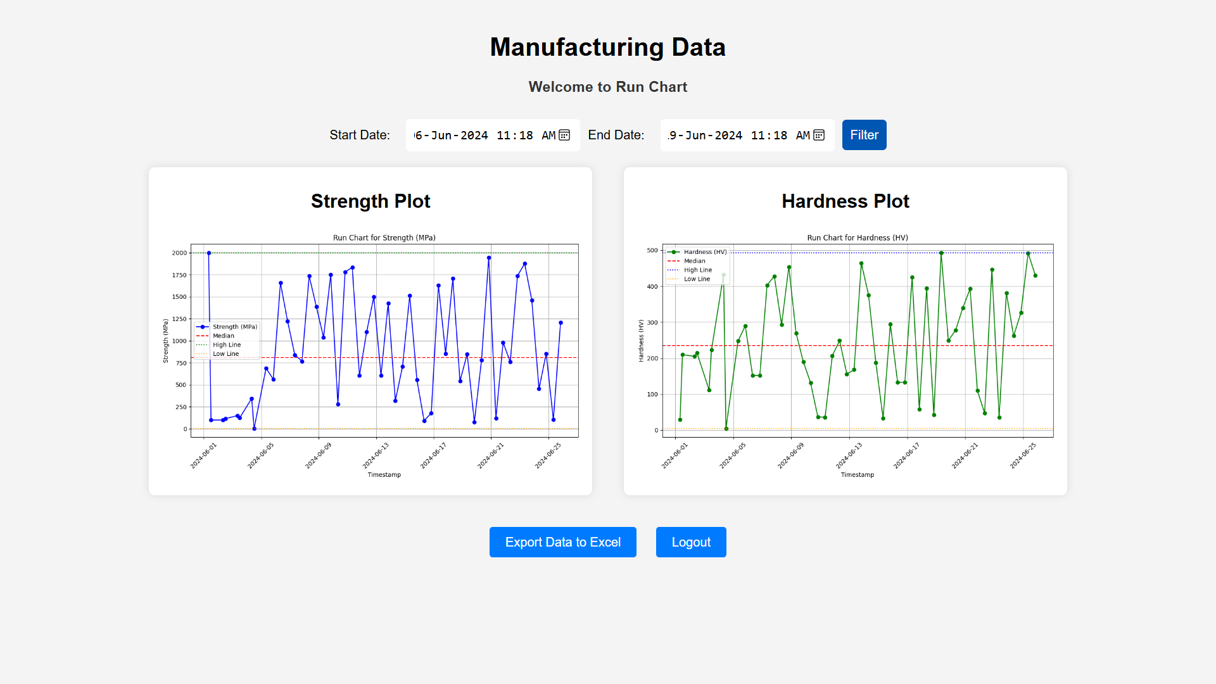
Filtered Data for a given period.

Slide 6
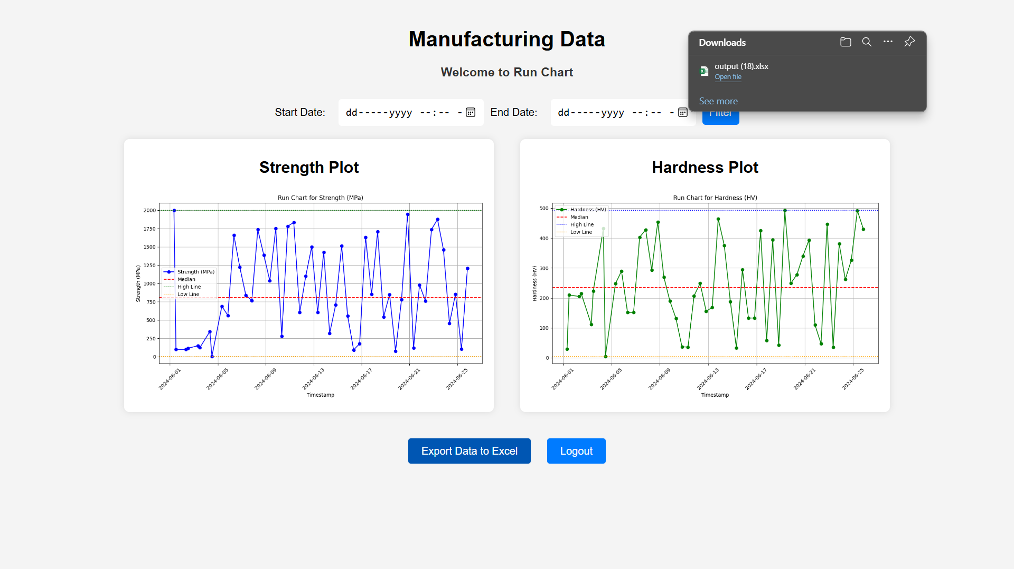
Downloading the Run Chart Data into Excel(.xlsx) format

Slide 7
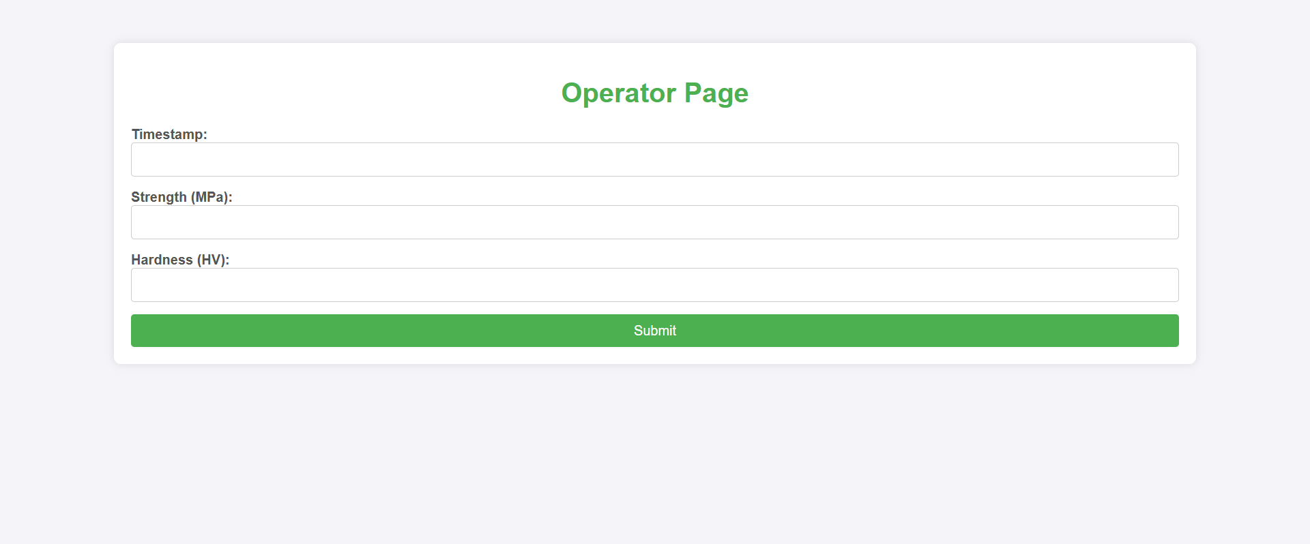
Operator page to update the graph real-time.

Slide 8
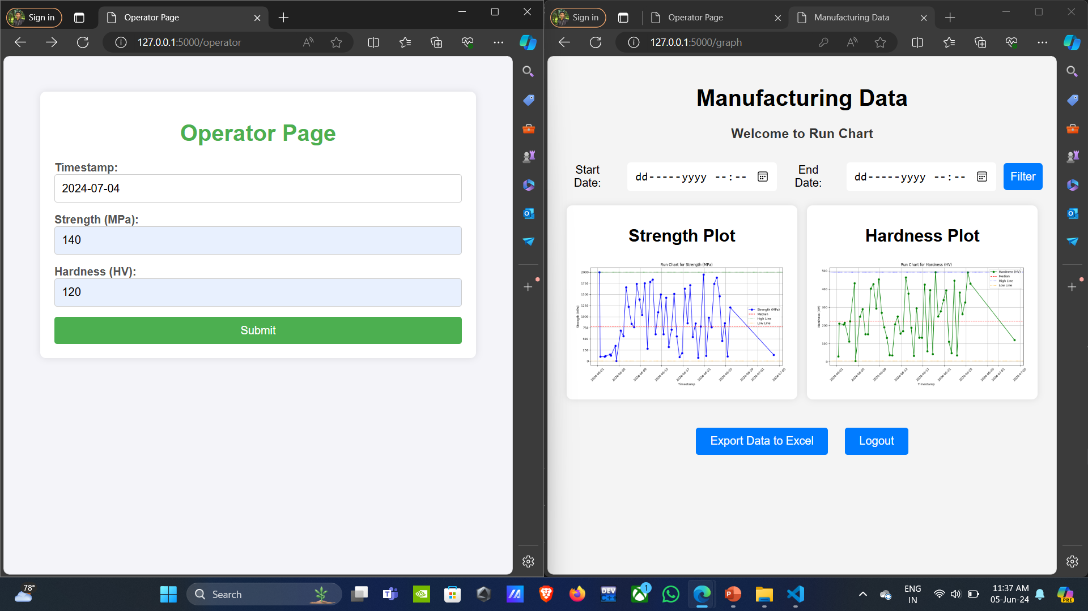
Real time updation of RunChart by the operator

Slide 9
THANK YOU

