Slide 1
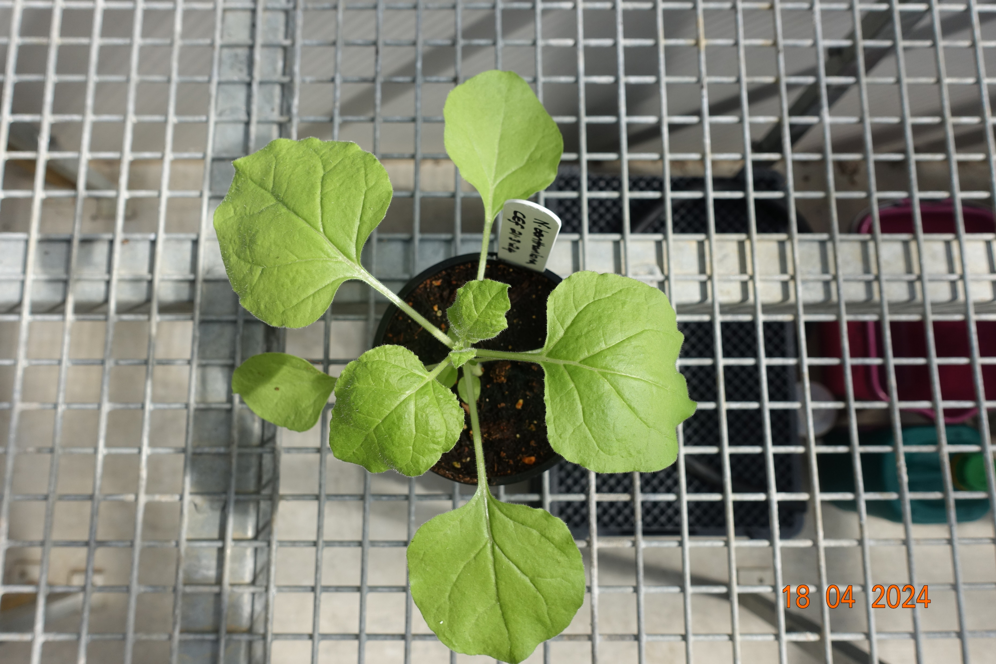
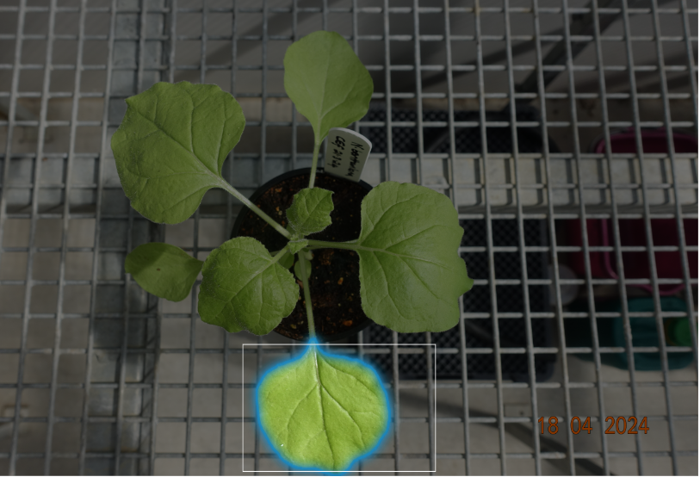

Using SAM tflite model for
mobile
Classified disease
Using Disease
detection tflite
model

