Slide 1
Student Performance
& Attendance Analysis
Cleaning, merging, and visualizing five linked classroom datasets
Dataset: Student Performance and Attendance Dataset — Marvy Ayman Halim (Kaggle)

Slide 2
Problem Statement
?
Schools collect attendance, homework, and exam data in separate systems. That makes it hard to see, at a glance, how attendance and homework habits relate to exam performance — or to spot patterns by grade level and subject.
5
linked datasets
This project cleans and merges five related datasets into one analysis-ready table, then visualizes subject-level performance, attendance patterns, and the relationship between attendance/homework and exam scores.
12,157
✓
students covered
6
subjects tracked
2

Slide 3
The Dataset
Student Performance and Attendance Dataset — Marvy Ayman Halim, via Kaggle
students.csv
12,157
Roster: ID, name, grade level, date of birth
attendance.csv
~365,000
Daily attendance status by subject
homework.csv
~61,000
Homework assignment status
performance.csv
~36,000
Exam scores & homework completion %
teacher_parent_communication.csv
~24,000
Communication log entries
3

Slide 4
Methods
1
2
3
4
5
Load
>
Clean
>
Merge
>
Analyze
>
Visualize
Read all five raw CSVs
Normalize status text, dates, and percent fields
Join into one row per student × subject
Mean, variance, and correlations per subject
Charts in matplotlib and Plotly
Full cleaning decisions documented in DATA_CLEANING_BRIEF.md and notebook section 3–4.
4

Slide 5
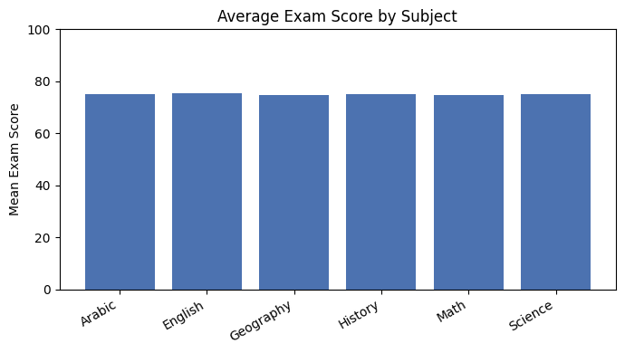
Results: Score by Subject
Average exam scores are consistent across all six subjects, sitting in the mid-70s with no subject standing out as substantially harder or easier.
~75
average score
across all subjects
5

Slide 6
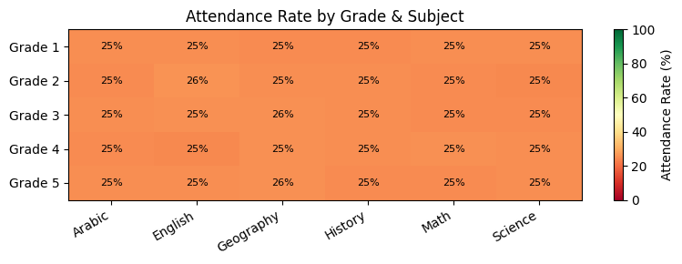
Results: Attendance Patterns
Attendance rate by grade level and subject shows no systematic pattern — no grade or subject sees meaningfully higher or lower attendance than any other.
6

Slide 7
Key Insights
≈
Scores are consistent
Mid-70s average across every subject, no outliers.
0
No correlation found
Attendance and homework completion show ~0 correlation with exam score, in every subject.
─
Flat attendance trend
Monthly attendance rate stays roughly flat over the full period covered.
◆
Likely synthetic data
The absence of any attendance/homework → performance relationship is consistent with randomly generated data, not real classroom outcomes.
7

Slide 8
Conclusion & Next Steps
This project delivered a clean, merged, analysis-ready dataset and a full set of subject and attendance visualizations — the descriptive foundation for deeper analysis.
Suggested next steps
• Predictive modeling (regression on exam score, or classification of at-risk students) — out of scope for this submission
• Validate findings against real (non-synthetic) classroom data
• Extend the attendance/homework analysis with time-of-year or subject-difficulty controls
8

