Slide 1

An Empirical Framework for IBR Short Circuit Modelling
September 16, 2026
Hao Xiang Yang
Supervisor: Prof. Joseph Euzebe Tate
MASC Thesis, University of Toronto, Engineering
Notes:
Good morning => thank everyone for skipping work to join => name, title, under the supervision of Prof Zeb Tate
Focus => Estimate SC response of GFL IBR while capturing important controller dependent behavior
Schedule of Today
Why this matters
Setup and data collection
Model
Verification method
Limitations

Slide 2
Motivation
The growing usage of inverter-based resources (IBRs) introduces challenges for conventional short-circuit analysis because their fault-current response is governed by converter controls instead of machine impedance.
Conventional voltage source behind an impedance has its limitations when trying to represent IBRs
  GFL tends to behave more like a controlled current source during normal operations and many fault conditions.
  Lack certain pre-fault conditions and current limiter behavior
Manufacturer-specific lookup tables
  May not be accessible for utilities to do short-circuit studies
  Proprietary => Require NDAs
  Not generalizable to other IBRs
EMT Models
  Need very large computation resources for large networks.
  May not know the detailed vendor-specific EMT models
Notes:
IBR behave very differently from SG during faults
SGs use voltage source behind an impedance whereas GFL inverters behaves more like controlled current source
Lookup tables => accessibility and generalization issues
EMT => accurate, but computationally heavy especially for large networks
Trying to find something in between
- Computationally simple, but can still capture the important fault-current behavior

Slide 3
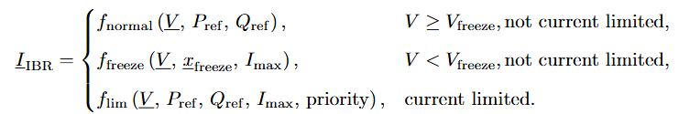
Research Gap and Objectives
Voltage Phase
  A fault can produce a positive-sequence phase shift.
  Changes current angle and apparent impedance
Simplification of PLL Dynamics
  PLL has much weaker voltage reference at low voltage => less reliable
  Fault current can depend on the pre-fault controller state.
Current Limiting Behavior
  Current control priority for Id and Iq
  IBR current limits are very low compared to SGs
Nonlinear and Piecewise Fault Behavior
Objective:
Modelling of the post-fault current.
Identify dominant variables and control mechanisms affecting IBR fault current.
Notes:
Develop a reduced model of fault current of a GFL inverter => identifying main variables and controller mechanisms that shape its response
Not straighforward
Voltage magnitude and phase affects fault current magnitude and phase
Inverter relies on PLL => phase becomes more controller state dependent for big voltage drops
Strict current limit (Iq is +90 degrees out of phase with voltage)
Is it possible to identify what contributes to the behavior seen from the EMT simulations and represent them with a much simpler model?
If we treat the inverter as a black box, is it possible to model its fault response with only measurable quantities?

Slide 4
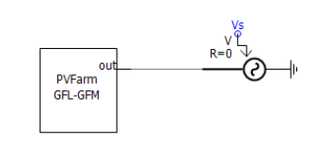
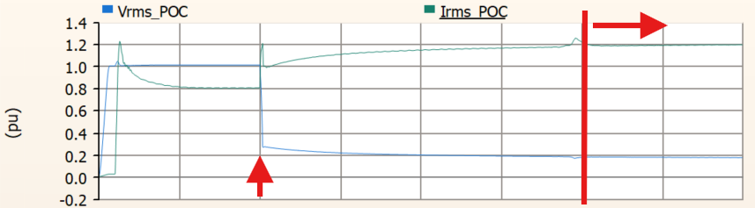
Benchmark Inverter and Test System
Operating Mode
  GFL with SRF-PLL: Standard Q injection GFL configuration
Base Values and Inverter References
Inverter Response to Fault
Notes:
EPRI GFL model in PSCAD => following base values for pu calculations
Inverter in GFL config => SRF-PLL for synchronization => P/omega, Q/V control
Interested in transient fault current
Subtransient fault current is caused partially by the inner control loop acting faster than the outer control loop => hard to model without reproducing internal switching and controller state

Slide 5
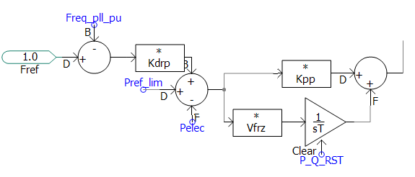
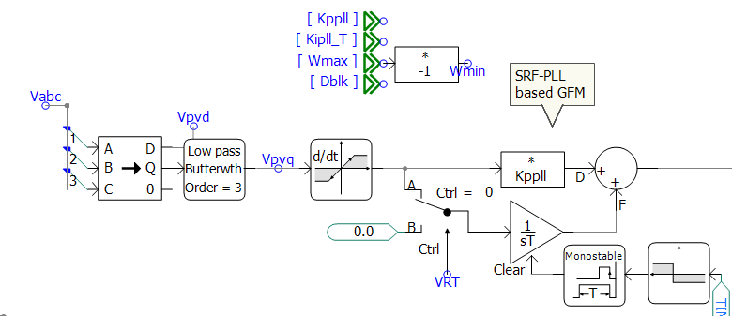
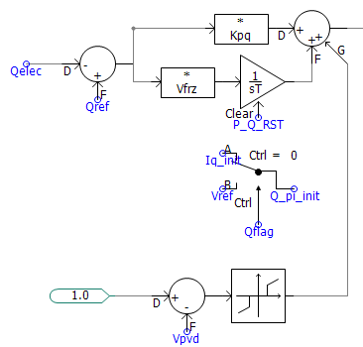
Controller Mechanisms that Matter During Faults
Inverter VSC Reference Current PI Controller
SRF-PLL Control Loop
Notes:
Before looking at the simulation results => highlight main controller mechanisms responsible for the inverter fault current
- PLL determines the rotating dq reference frame => attempts to align d-axis with positive sequence voltage
P/omega control and Q/V control
Voltage drop => current increase to maintain Pref and Qref
Low-voltage state-freeze logic => protects the inverter controller from low voltage drops
PI integrator states stop updating => previous error value is retained => dependence on pre-fault controller state
(I suspect from the literature review that IBRs have the same kind of control behavior)
(Using a PI controller because when inverter is stable => dq frame => the values the controller try to regulate becomes DC values => integrator forces the error to 0)

Slide 6
Simulation and Data Generation
One Inverter Sweep
Varying
  Pref, Qref
  Terminal Voltage Magnitude and Phase
  Prefault Terminal Voltage Magnitude
Recording current magnitude and phase
Notes:
To generate the dataset => controlled single-inverter PSCAD tb
Vary Pref and Qref and pre-fault voltage magnitude Apply voltage disturbance and vary both post-fault voltage magnitude and phase
For each case => allow inverter to reach prefault steady state => apply fault => record sustained fault response
Sweep V, voltage phase, Pref, Qref, Vprefault; allow pre-fault steady state; apply voltage disturbance; extract sustained post-fault response
(assume the PLL is locked onto grid voltage during normal operations)
(Varied the fault-inception time => for balanced fault this turns out not to matter because control sync to dq-frame => fault sees the same on Phase A, B and C)

Slide 7
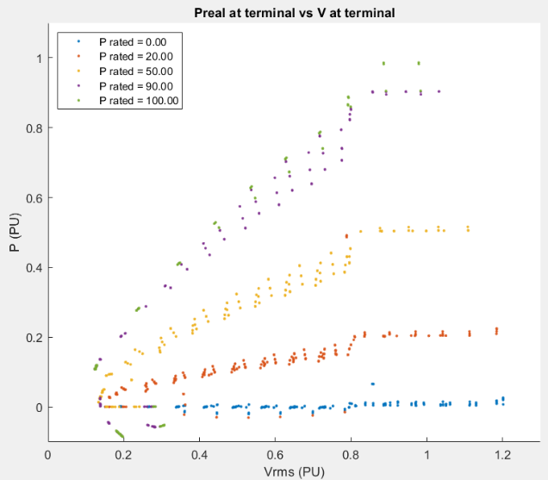
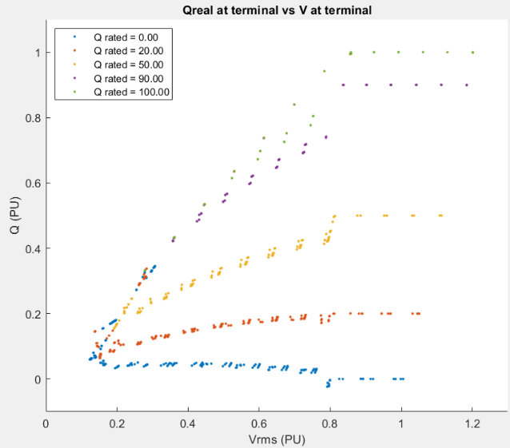
Key Physical Results: Voltage and Current
Notes:
P and Q vs the post-fault voltage
Show that $P,Q$ follow references normally, then depart below the control boundary
Note when P and Q follow a trajectory from commanded P and Q under Vfreeze.
Note the effect of prefault Voltage if voltage decrease below Vfreeze.
Note the undetermined behavior when voltage is low => IBR forces voltage to be not 0 => PLL can’t find phase if voltage is small
- Voltage never drops to 0 even when the voltage at the terminal -> 0

Slide 8
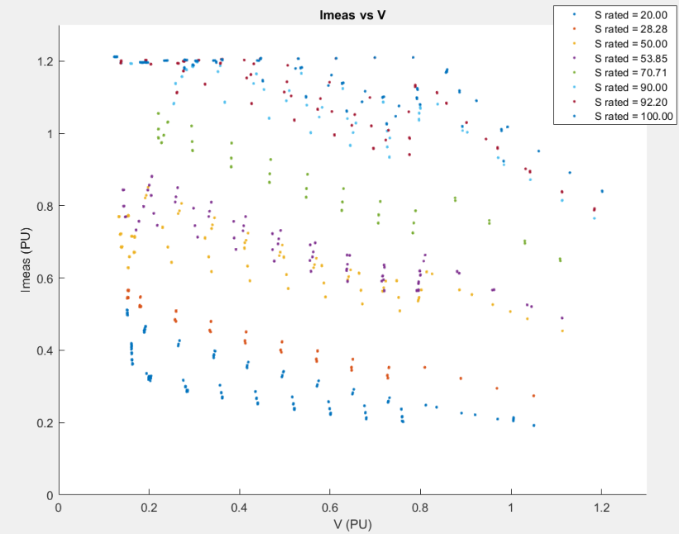
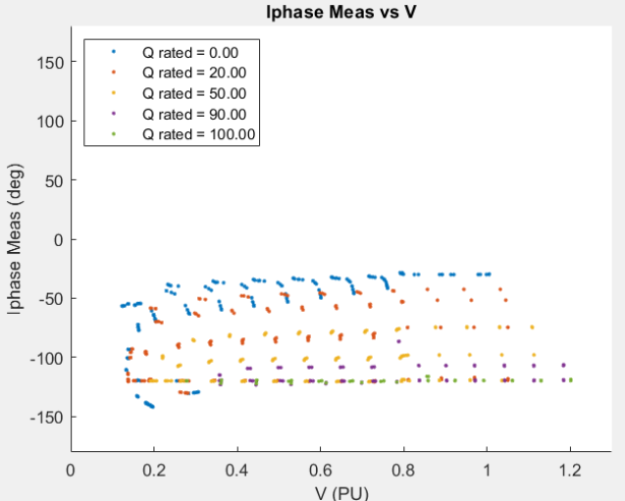
Key Physical Results: Pre-fault State and Phase
Notes:
Reiterate current phase error at low voltage.
Current limiting and state freezing are distinct boundaries.
Note Imax.
Note the effect of prefault Voltage if voltage decrease below Vfreeze.
Note that the inverter does not have to drop below Vfreeze to meet Imax
(Note the undetermined behavior when voltage is low => more drastic as apparent power increases)
Explain history dependence and the $−{30}^{∘}$to $−{120}^{∘}$ phase bands
Highlight increased nonlinear behavior at low voltage.
Note that voltage never drops to 0 => that’s why phase looks undeterministic => poor voltage reference

Slide 9







Modeling Philosophy
1. Start from main assumptions
2. Use predefined relationships
3. Add empirical terms only when necessary
Pre-fault conditions are met
  Vq = 0
V < Vfreeze
V < Vfreeze
Notes:
Keep the model as physics-base and simple as possible => use empirical param when basic relationships are no longer sufficient
Start with normal operations => expected connections
Observe PSCAD data as terminal voltage is reduced => above Vfreeze conventional relationships work well
Below Vfreeze => behavior begins to depend on prefault voltage and controller states => empirical corrections
(Note that I’m modelling the prefault state as a virtual source behind a dynamic impedance that I use an empirical term to estimate)

Slide 10
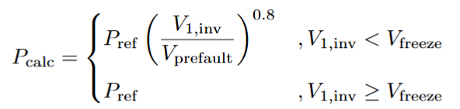
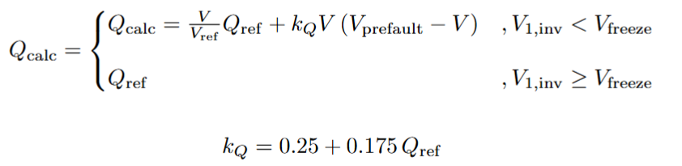
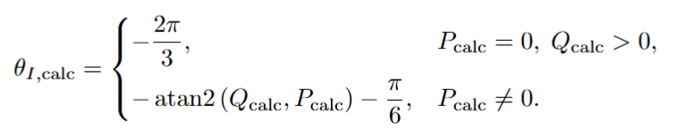
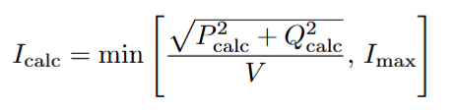
Proposed Empirical Model
Active-Power Model
Reactive-Power Model
Current Model
Notes:
Using modeling philosophy from previous slide => empirical model obtained
Note active power => power law
Note reactive power => voltage dependent correction term
Once Pcalc and Qcalc are known => recover current using complex-power relationship and enforce I < Imax
Similarly, use Pcalc and Qcalc to model I phase
(Fmincon => explain the optimization (MSE with error cap to prevent large errors skewing the model))
Phase offset pi/6 might be caused by how I use PSCAD to calculate the phase (I is positive sequence but V is line to line?)
3 modes of operation is not an universal number, but within the space I investigated, the simulations only showed three modes of operation associated with identifiable controller mechanisms
I selected the minimum number of breakpoints needed to capture those transitions.
Introducing further break points did not reveal another consistent physical regime or provide a meaningful improvement in validation accuracy

Slide 11
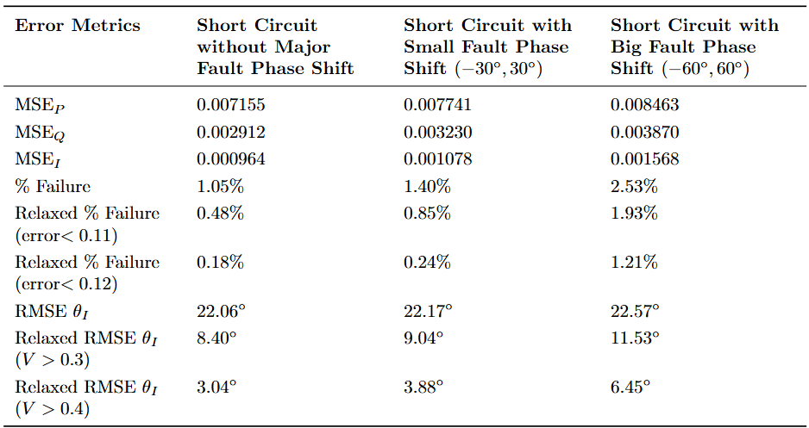
Single-Inverter Validation
Notes:
Current magnitude => agreement is quite strong => 98.95% within 0.1 pu current error => errors high Ps and high Qs
Phase prediction less accurate at low terminal voltage => consistent with weaker voltage reference for the PLL => dependent on controller state and dynamics
Observation => even in some cases where Pcalc and Qcalc are misallocated => current magnitude is still accurate
Away from very-low-voltage regions => phase prediction also improves significantly
Say: 98.95% within 0.1 pu current error, $MSE_{I}=0.000964$, phase RMSE $≈{22.06}^{∘}$, with phase much better away from the very-low-voltage region.
Explain that even though the the phase error is large at low V, the error on the current magnitude is not large => misallocation of the model to P and Q
Highlights the effect of phase
The empirical relationships were developed using the single-inverter sweep data, and the finalized model was evaluated across the broader set of operating conditions.
- The reported single-inverter error statistics should be interpreted as good-of-fit across the simulated operating space.
- The separate multi-inverter network study provides an additional test of whether the model remains useful when embedded in a network.

Slide 12
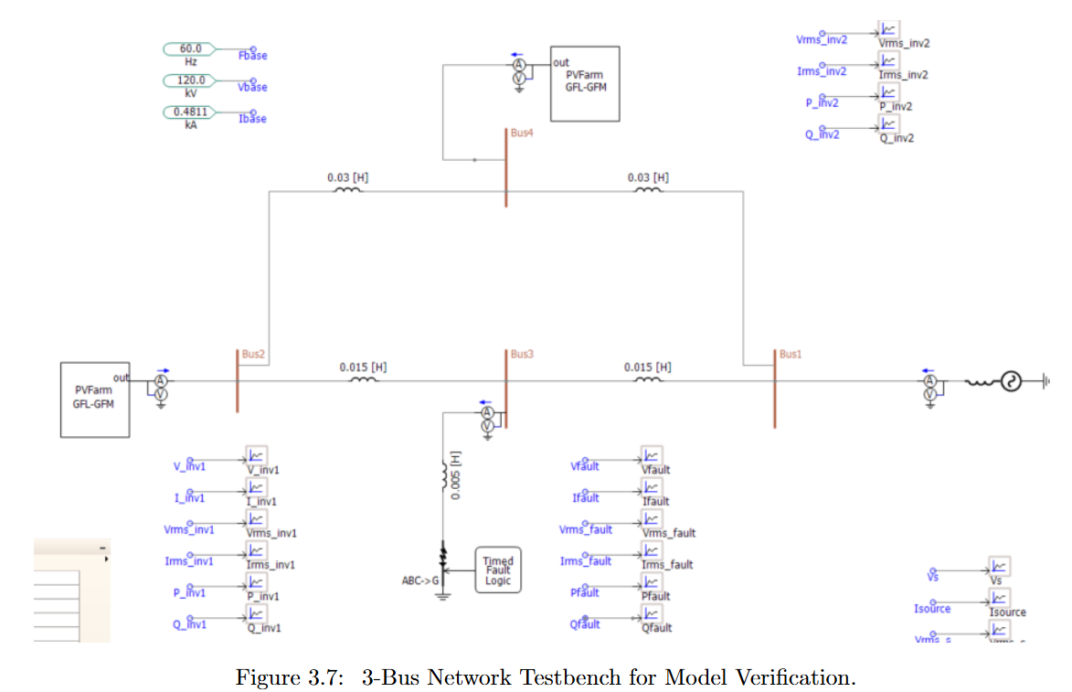
Network-Level Validation
Notes:
Two inverter and one SG
Can vary the position of the inverter and their prefault conditions
Can vary Pref and Qref and fault impedance.
Terminal voltage determined by the network itself
Match pre-fault current injection with EMT simulation then calculate corresponding post-fault P,Q
These injections affects network voltages => network and inverter have to be solved consistently
Determine if model is reliable when multiple devices interact through network

Slide 13
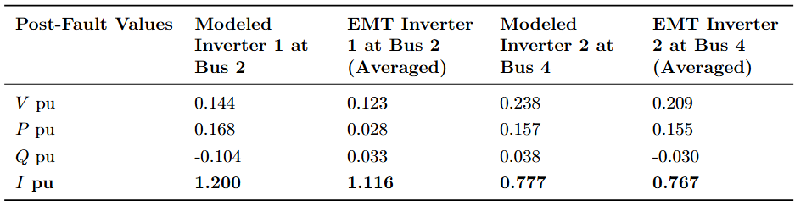
Network-Level Validation
The framework is also easily integrated in a large power flow calculation (4000 buses convergence test)
  EMT results takes 1-2 minutes to compute 3 seconds of the network fault response with only 2 inverters
  Simple power flow calculations can be done almost instantly on MATLAB
Notes:
These results show why constant current injection model can be misleading
Two IBRs, different prefault loading conditions experiencing different terminal voltages during fault
Model predicts different post-fault currents for each inverter
Heavy loaded inverter who is closer to the fault => Imax
Other inverter, farther from the fault => 0.77 pu
Other advantage is the model is faster computationally => algebraic equations embedded in power-flow network calculations
EMT => generating a few seconds of data uses several minutes and it’s only 2 inverters => imagine a network of 1000 synchronous machines and inverters together
Take away => model can preserve device-specific fault behavior without requiring full EMT representation

Slide 14
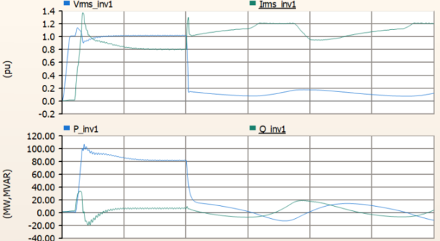
Limitations
Unable to capture instantaneous initial fault current and individual PLL logic in weaker grid
Identified coefficients and operating regions are inverter specific
Need to apply this framework to any inverter used in the network
The takeaway is that it is possible using only measurable data obtained from the inverter to model its transient fault current in function of its terminal voltage.
Framework is only developed for balanced 3-phase faults
Notes:
Model represent sustained fault response => capturing initial subtransient response require additional dynamic states => explicit PLL or control dynamics => inverter no longer a black box
Problem in weak grid when current injection itself changes the voltage at the terminal significantly
Identifies params and boundaries are inverter specific => framework is transferable but the params and boundaries need to be reidentified using measurements
A lot of simplification can be done with balanced fault => unbalanced fault would require negative-sequence current and potentially zero-sequence current
(Unbalanced fault modeling
- Sequence-domain empirical model => V and I
Establish P1, Q1 => V1, I2 => V2 )
(Even if the inverters are tuned correctly, their network level interactions are still hard to model and can generate low frequency behavior)

Slide 15
Conclusion
Contributions and Takeaways
Future Work
Physics-informed empirical framework for rapid short-circuit response for GFL IBRs
Demonstration that this reduced representation is able to accurately represent the fault current while remaining suitable for network-level calculations
Provide a practical bridge between oversimplified conventional short-circuit models and detailed EMT simulations
No need to access proprietary internal controller state to obtain useful estimate of the IBR short-circuit fault current
Extend framework to GFM
Extend framework to unsymmetrical faults
Examine different PLL and controller implementations with more advanced parameter identification
Validate using real inverter hardware and field measurements
Notes:
Physics-based framework for rapid short circuit calculations of GFL IBRS
Sustained fault current can be modeled with relatively small # of params while still capturing some controller dependent effects
Rely on externally measurable quantities => no need to access proprietary information
Future work
Thank you for listening! I’m happy to take any questions.

Slide 16
Contributions
Development of an empirical framework for rapid calculation of short-circuit responses.
Detailed investigation of the variables and controller mechanisms that govern IBR fault behavior
Separate empirical formulas for inverter’s active power, reactive power, current magnitude, and current phase.
Demonstrate results based on an open-source EPRI GFL inverter model
Design a framework to bridge highly simplified constant models to intensely computational EMT models
Keep number of empirical parameters small
Distinguish normal, current-limited, and low-voltage frozen operating regions.
Demonstrate why a linear or constant current relationship does not work
Demonstrate the importance of current phase.
Notes:
Characterization of the fault behavior of GFL inverter
Low-order empirical framework with separate relationship between active power, reactive power, current magnitude, and current phase
Keep # of empirical param low
Evaluate the framework with open-source EPRI GFL inverter model => demonstrate how it can be used for network-level calculations

Slide 17
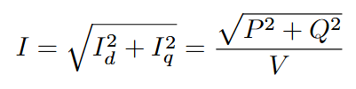
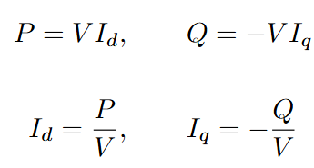




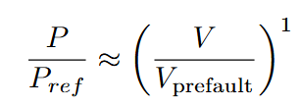
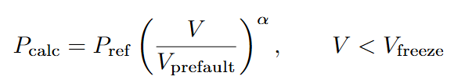
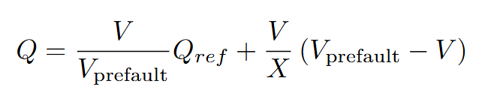
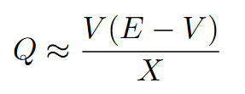
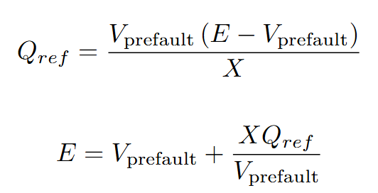
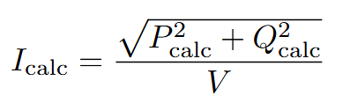
Full dq derivation of P, Q, I
If θPLL ≈ θV:

Slide 18



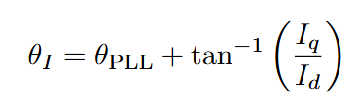
Definition and Physical Meaning of ∆θ
∆θ is the instantaneous synchronization error
Under normal synchronized operation, ∆θ = 0
But during fault, the PLL may not be able to recover that angle.
Notes:
Vab = Vph,ang 0 - Vph,ang -120 = sqrt(3) Vph, ang 30
If Q = 0 => I1 // V1 => relative VLL = -30
a = exp(1j*2*pi/3); I1 = (Ia + a*Ib + a^2*Ic)/3; I1_mag = abs(I1); I1_ang_deg = angle(I1)*180/pi;

Slide 19

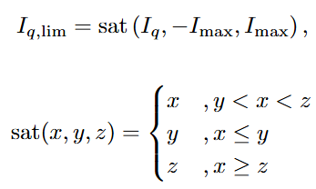
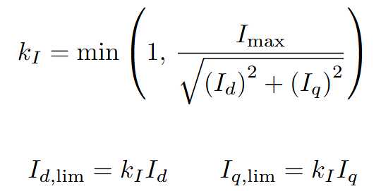
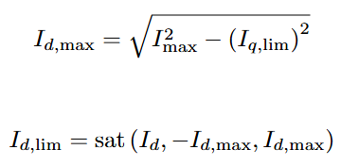
Q-Priority Current-Limiting Equations
Scaling Coefficient Method
Q-Priority Current-Limiting Equations

Slide 20
Difference Between Imax and Vfreeze
Imax
Vfreeze
Inverter cannot increase its current indefinitely
Limit on how much current the inverter can output
Diminish the power output of the inverter to match the current limit.
Effect can be seen on the current vs voltage graph.
  When the current reaches Imax it plateaus
Threshold at which the inverter stops following its reference values.
The PI-integrator states stop updating normally and is stuck on its previous value.
The post-fault response depends on the values of V, P, Q, and controller state before the threshold was crossed.
Effect can be seen on P, Q and I graph
  When V drops below Vfreeze, different pre-fault voltage produce different post-fault current at the same terminal voltage.

Slide 21
Why α = 0.8 and Interpretation of kQ
α and kQ should be interpreted as identified empirical coefficients used to modify the shape of the low voltage response
α => Modeling on the effect of the pre-fault Pref and Vprefault on the post-fault P
  It tries to empirically represent a dynamic reactance between a virtual source and the inverter terminal
kQ => Modeling of the effect of the pre-fault Qref and Vprefault on the post-fault Q
  Act like a virtual source as well

Slide 22
Why the phase RMSE is much worse near low voltage
At low voltage a small change of Vq => big angle change
  When V = 0, inverter PLL still has to reference an angle => Problem
Small voltage phasor = poor reference for PLL
  PLL start to depend on the current synchronization step or controller states to determine the
Evidence in the results because in low voltage
  Pcalc, Qcalc are inaccurate.
  Icalc magnitude is accurate.
  Icalc phase is inaccurate.

Slide 23
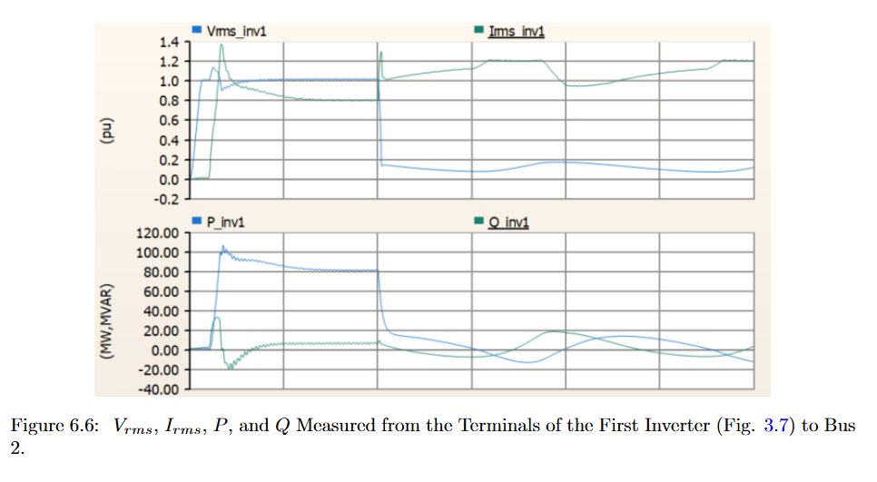
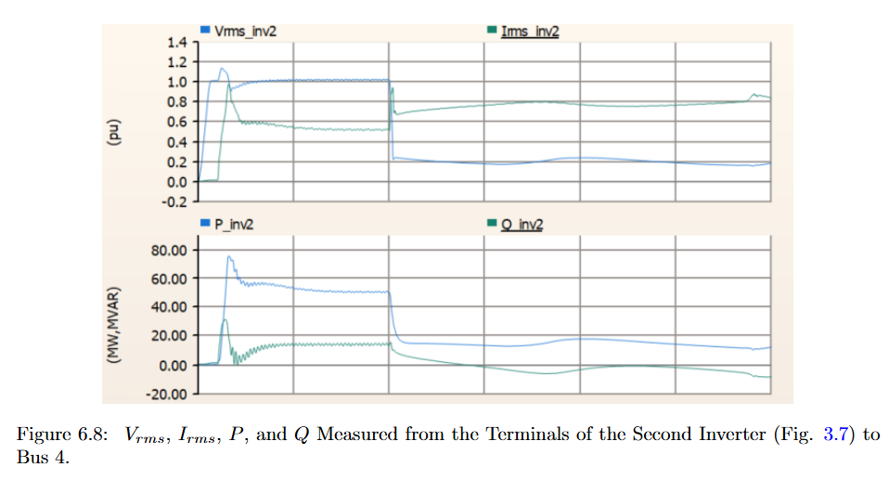
3-bus pre- and post-fault graphical comparison

Slide 24
4000-bus Solver and Iteration Flow
Running a 4000-bus power flow solver with my thesis model => Algorithm Convergence test
Create 4000 bus network (80% IBR, 20% SGs, 1 slack)
Construct sparse Ybus
Solve Pre-fault AC power flow
  Store pre-fault voltages
Apply fault to Ybus
Initialize faulted solution to prefault solutions
Loop to update IBR bus P/Q injections using present IBR P/Q
  Inner loop: Calculate V, P, Q => Form P/Q mismatch => enforce SG Q limits => Build Jacobian => Solve J(delta x) = mismatch => update voltage angle and magnitude => terminate if mismatch < 10^-8
  Evaluate empirical IBR model using solved terminal voltage => enforce Imax
  Apply relaxation => Look is the delta P and Q < 10^-4
Calculate device currents => Check SG limits
Notes:
Talk a bit about the Newton-Raphson method using admittance matrix Ybus
Guess of V and theta, then calculate P and Q, get mismatch from initial IBR results, build Jacobian and find the correction on V and theta

Slide 25
Balanced-fault and Positive Sequence Limitations
With balanced-fault, since Ia, Ib, and Ic have the same magnitude, we can simplify the problem down to just the positive sequence
Unbalanced fault require modeling of the negative and zero sequences
  Ia, Ib, Ic may not be equal.
IEEE standards require negative sequence injection during faults
Protection equipment may require negative sequence information to function properly
For IBRs, negative-sequence current is determined by the implemented control strategy

Slide 26
Why the model uses sustained rather than instantaneous fault current
Different mechanisms dominate different portions of the fault response
  The initial transient is determined by the filters and the severity of the voltage disturbance
  The current limited and controller states determine the sustained fault current
IEEE standard specifies that the IBR current limiter can only kick in 0.2 s after the voltage drop.
To capture the instantaneous fault current
  Require explicit dynamic PLL state
  Reproduce all the history-dependent rotations that occur when PLL tracking becomes weak
Instantaneous fault current behavior can be obtained more precisely through EMT simulation

Slide 27
How to re-identify the model for another inverter
Apply controlled fault sweeps
  Modify Pref and Qref, Prefault voltage, fault voltage magnitude and phase
Record External Measurements
  V, P, Q, I magnitude and phase
Identify control boundaries
  Imax, Vfreeze/low-voltage transition, current-priority behavior
Fit low-voltage P model
Fit low-voltage Q model
Reconstruct current from P, Q and enforce Imax
Identify Current-phase model
Validate on unseen fault cases
Deploy in network calculations

Slide 28
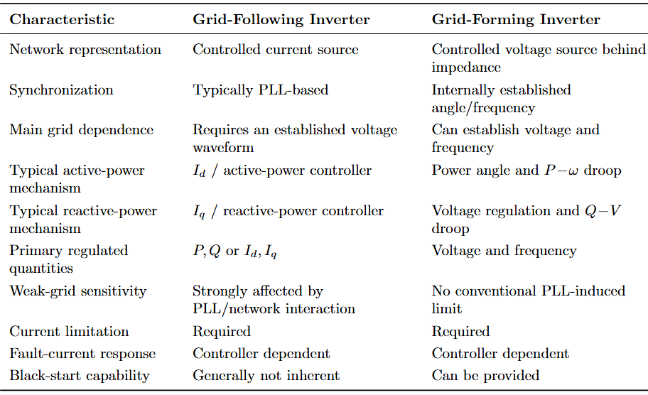

GFL vs GFM, why the current model is specifically GFL
Specifically GFL because its physical foundation is the PLL-oriented $dq$-current-control structure.
  Empirical equations capture how those current-control states change under current limiting and low-voltage state freezing.
GFM inverter forms an internal voltage and frequency => its fault response is governed by voltage regulation, power angle, droop or virtual impedance, and different current-limiting transitions.
  For GFM, the underlying low-order equations would need to be re-derived

