Slide 1
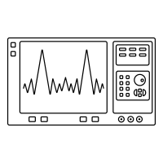
VNA
300K
-20dB
50K
-10dB
4K
-10dB
800mK
-3dB
60mK
-3dB
7mK
-1dB

Slide 2








Port 1
DUT
Port 2
$$V_{1}^{+}$$
$$S_{21}$$
$$V_{2}^{+}$$
$$S_{11}$$
$$S_{22}$$
$$V_{1}^{−}$$
$$S_{12}$$
$$V_{2}^{−}$$

